Slide 1
Hurricane Sandy: Before and After Photo Exhibit
In response to the many requests to know what happened at Gateway as a result of the storm we have created this web-exhibit that shows before and after pictures, many taken just a few days following the storm’s landfall on October 29. These images were taken by members of the special Incident Command Team (ICT), set up in response to Sandy. The aerial photos are courtesy of National Aeronautics and Space Administration (NASA); of National Oceanic and Atmospheric Administration (NOAA), New York City Department of Information Technology and Telecommunications (NYCDoITT) and New Jersey Geographic Information Network (NJGIN).
Many people are now referring to hurricane Sandy as a super-storm, the truly “perfect” storm. The confluence of elements—a tropical depression developing into a hurricane coupled with a different storm from the west—all driven by the jet stream at the peak of an astronomical high tide created a super-storm event that has never been known in recorded weather history. The storm drove head-on into the Jersey shore and New York harbor delivering blows and creating damage that could not have been imagined.
The Incident Command Team (“disaster management team” in previous times) was organized just a few days after the storm to assess the damage and begin to provide stabilization and remediation. In addition to assessing the damage to Gateway, the team members travelled to all the National Parks of New York Harbor, and Long Island to create a report for the National Park Service senior management and Director Jon Jarvis.
While these pictures demonstrate damage and the aftermath of one of the most destructive natural disasters the country has known, the take-away message should not be one of doom and gloom, but rather one of resilience. There is already recovery, there will be remediation, there is a lot of work to do, and there will be some things that are changed forever. But, the park is reopening, the natural areas will rebound, and park visitors will be welcomed back.
Special thanks to my gifted colleagues, Mark Christiano, Natalya Apostolou, Jason Wickersty and Angelo Maci for help in assembling and preparing this exhibit. -- Charles Markis, Exhibit Curator, January 2013

Slide 2
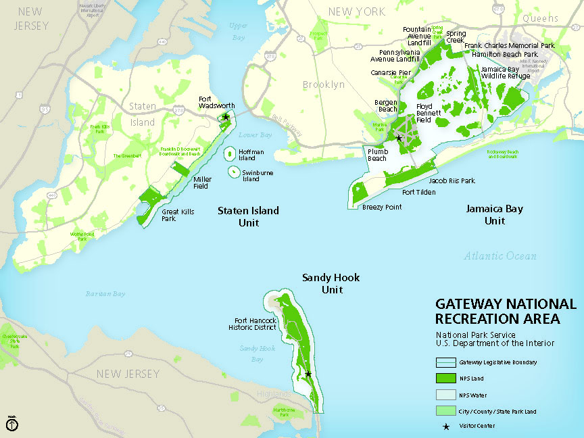

Slide 3
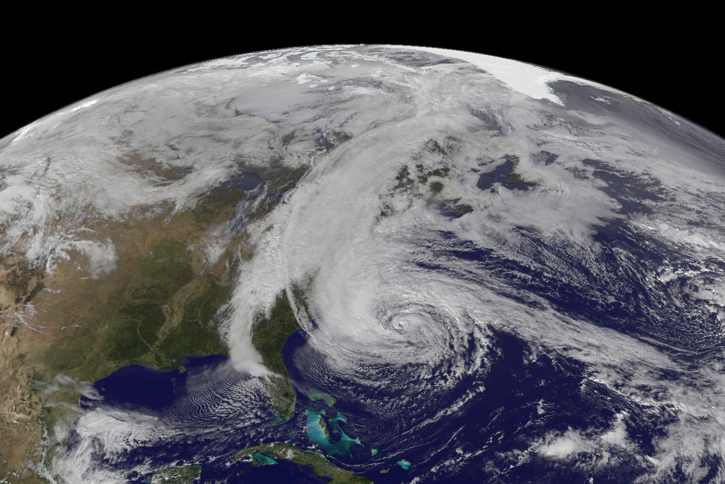
Hurricane Sandy Oct. 29, 7:33 p. m., one hour before landfall in New York City. NASA photo.
Notes:
Hurricane Sandy Oct. 29, 7:33pm, one hour before landfall in New York City. NASA photo.

Slide 4
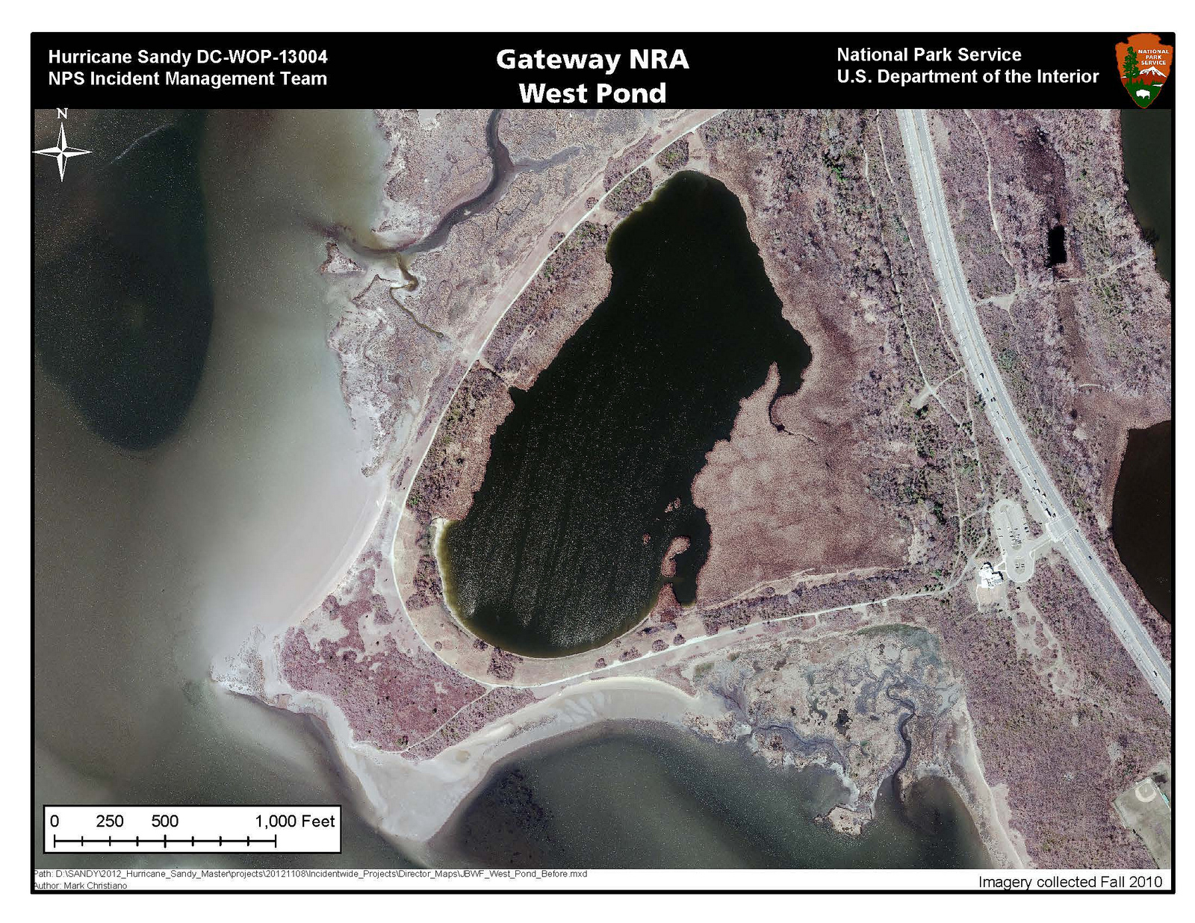
Fall 2010; NYCDoITT photo.
Notes:
Jamaica Bay Wildlife Refuge: West Pond. Before, Fall 2010.

Slide 5
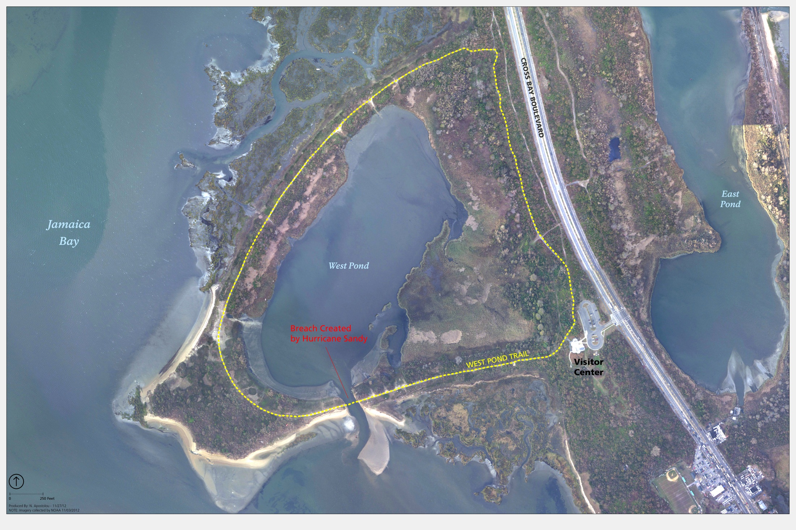
November 1; NOAA photo.
Notes:
Jamaica Bay Wildlife Refuge: West Pond. Before, Fall 2010; after, Nov. 1.

Slide 6
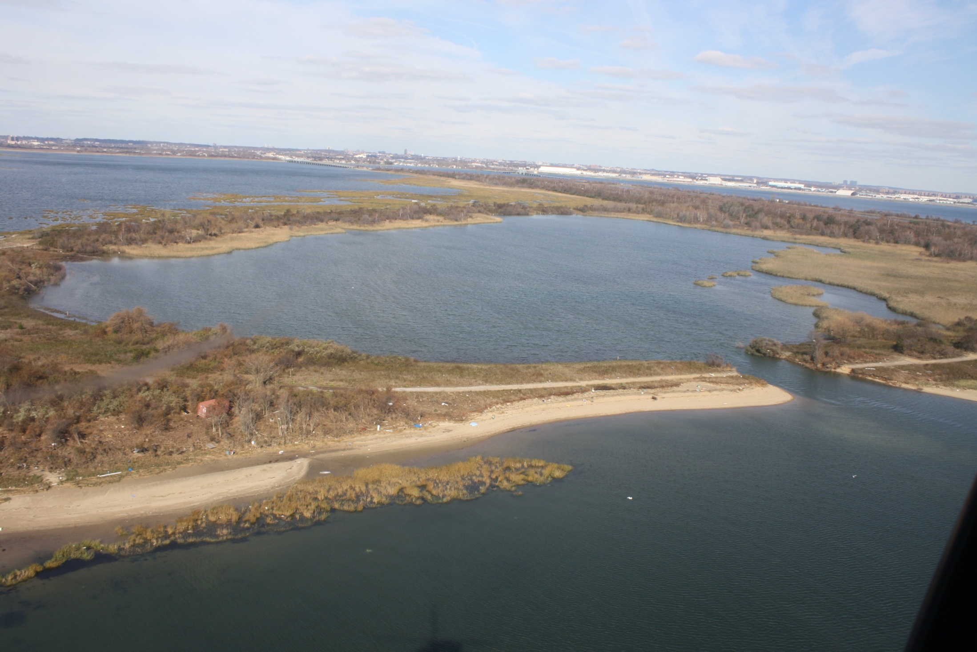
Jamaica Bay: West Pond. Nov. 5; NPS photo, Colyer.
Notes:
Jamaica Bay: West Pond. Nov. 5; NPS photo Colyer.

Slide 7
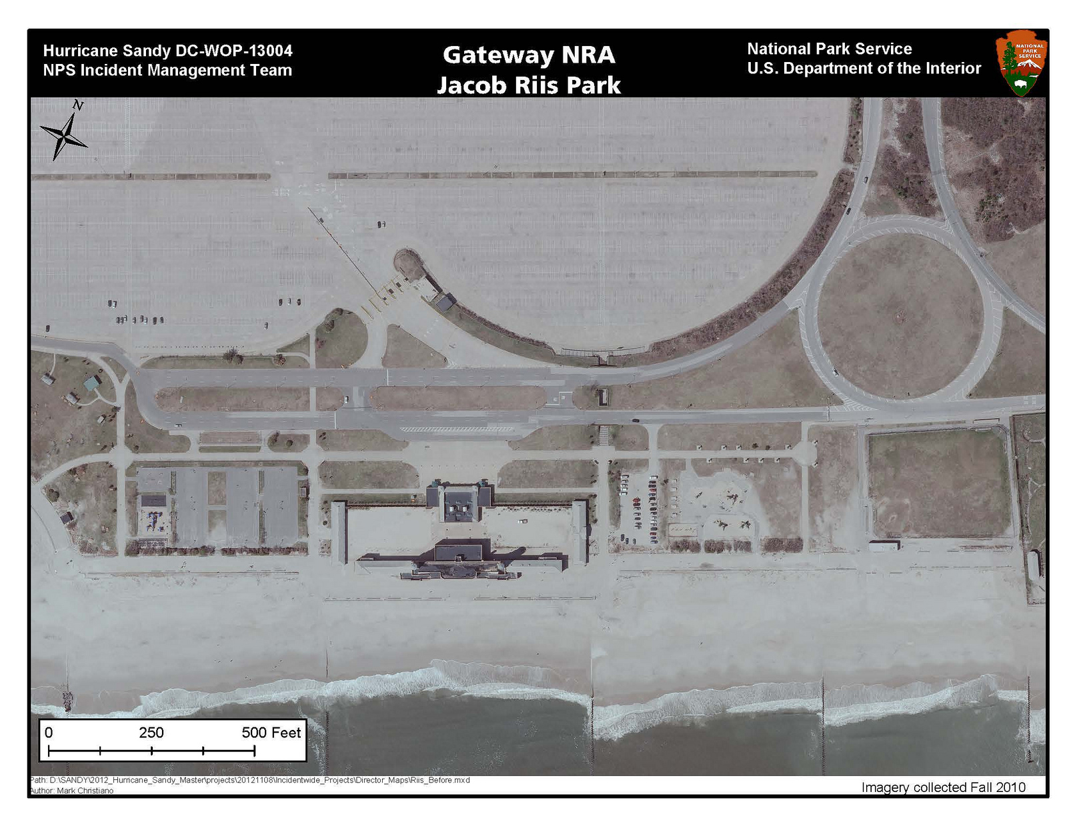
Fall 2010; NYCDoITT photo.
Notes:
Jacob Riis Park, before, Fall 2010.

Slide 8
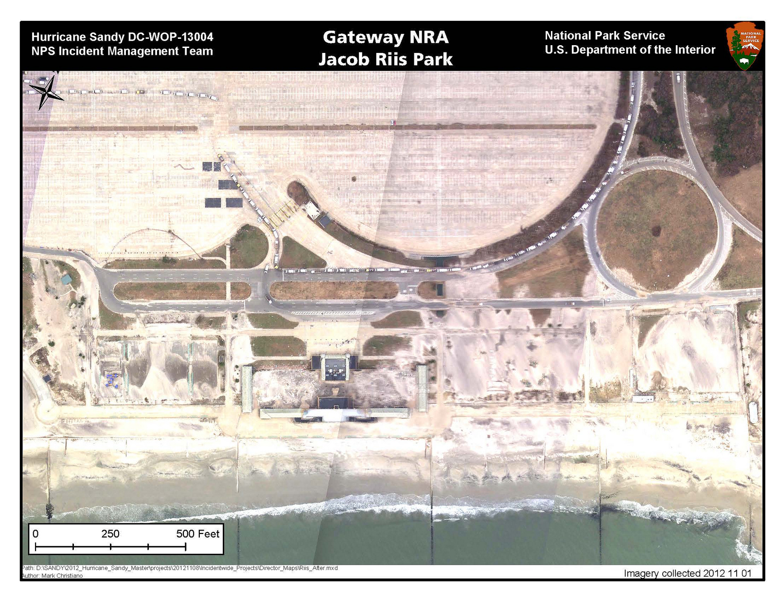
November 1; NOAA photo.
Notes:
Jacob Riis Park, after, Nov. 1; satellite photo.

Slide 9
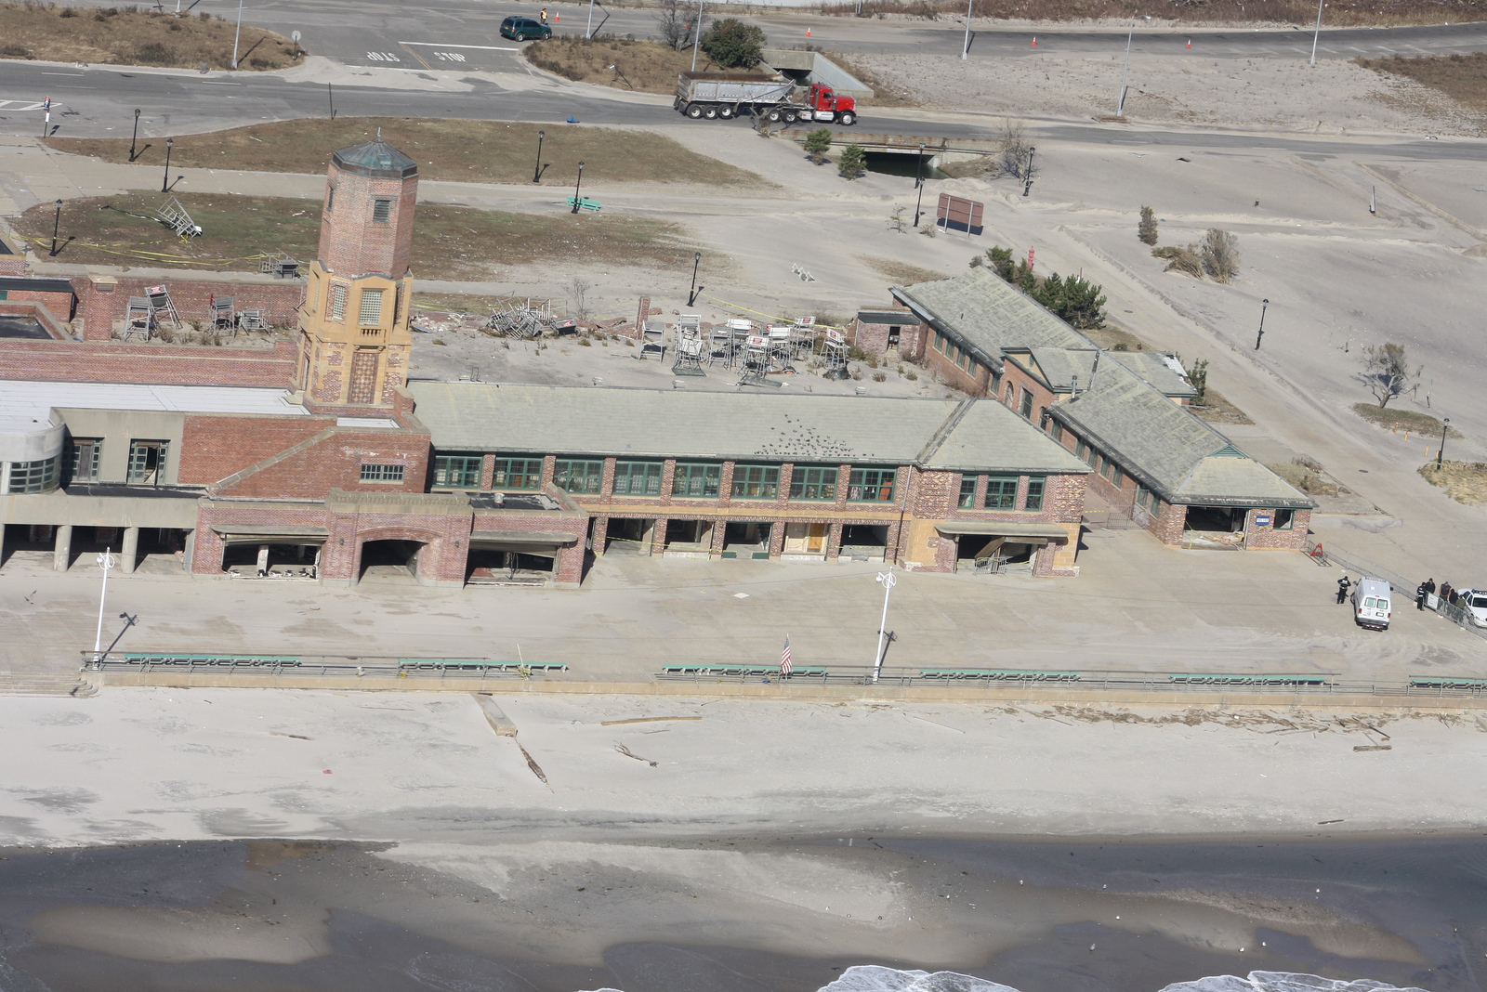
Jacob Riis Park Bathhouse, Nov. 5; NPS photo, Colyer.
Notes:
Jacob Riis Park Bathhouse, Nov. 5, NPS photo Colyer.

Slide 10
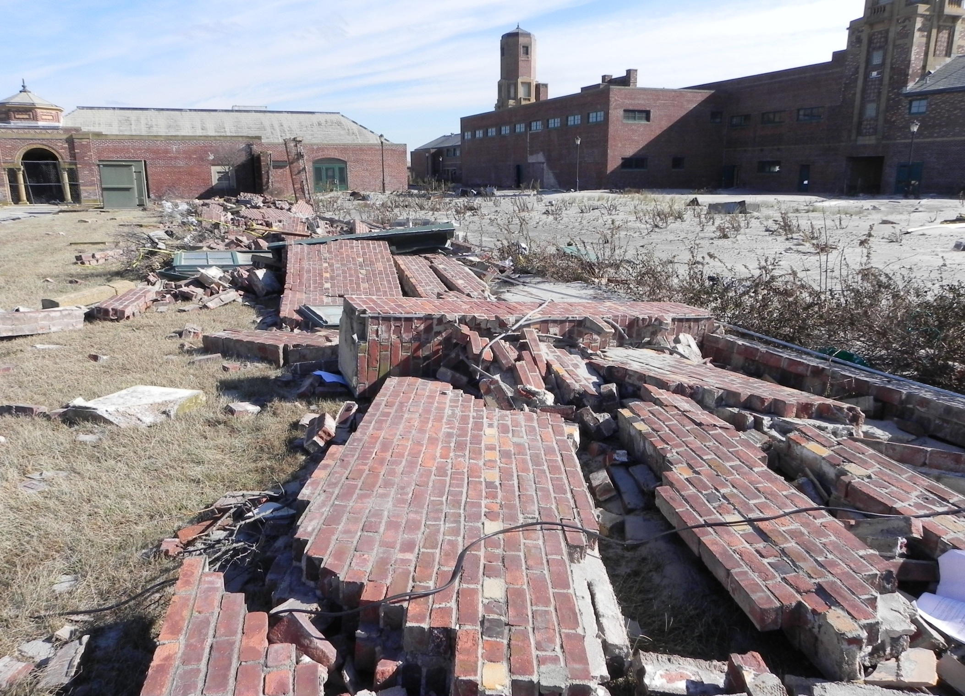
Jacob Riis Bathhouse Yard. Nov. 6; NPS photo, Pisani.
Notes:
Jacob Riis Bathhouse, Yard detail. Nov. 6; NPS photo, Pisani.

Slide 11
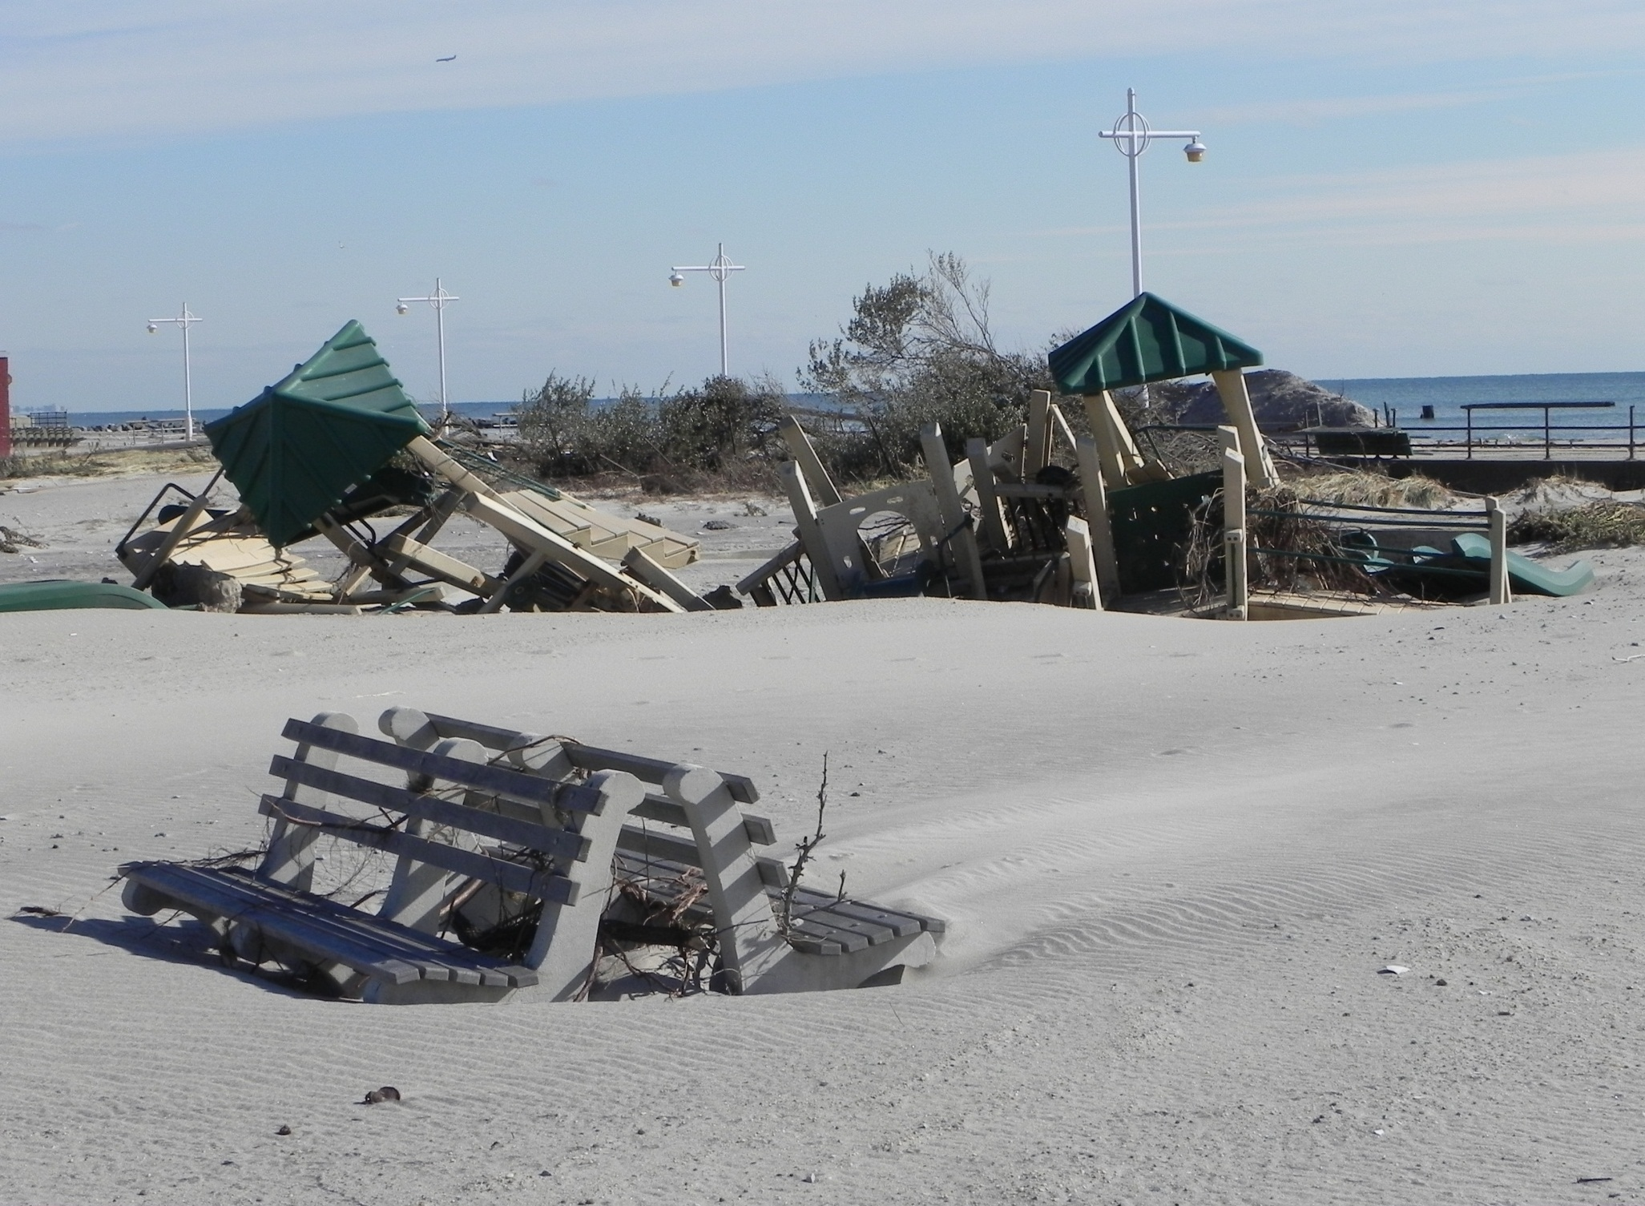
Jacob Riis Park. Nov. 5; NPS photo.

Slide 12
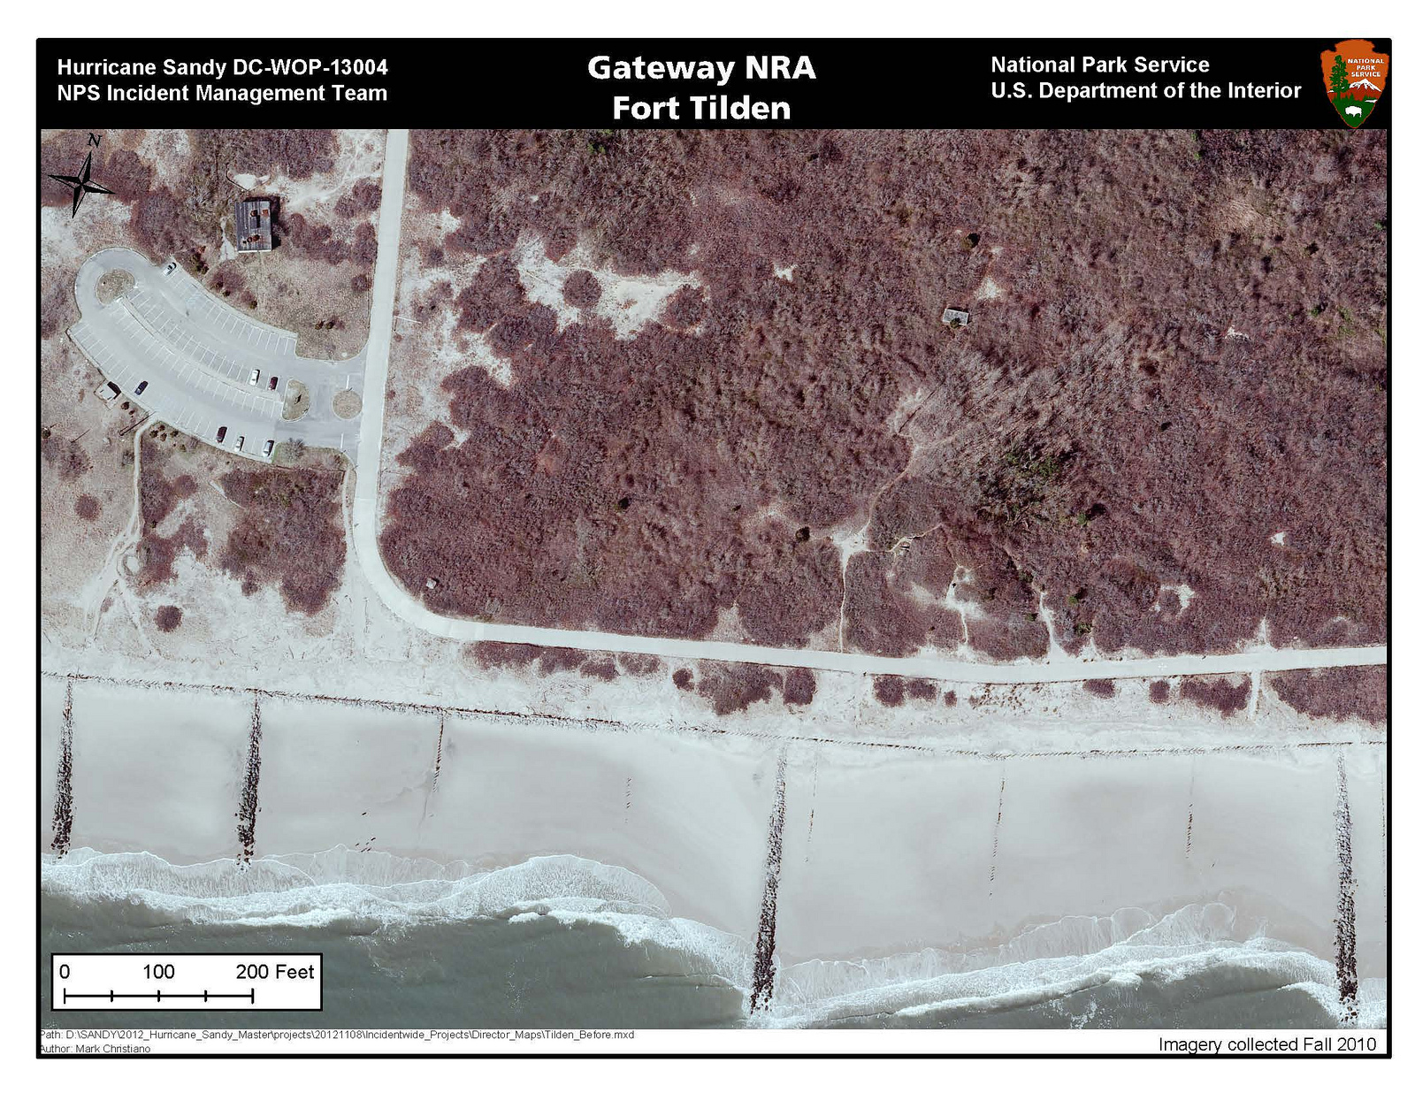
Fall, 2010; NYCDoITT photo.

Slide 13
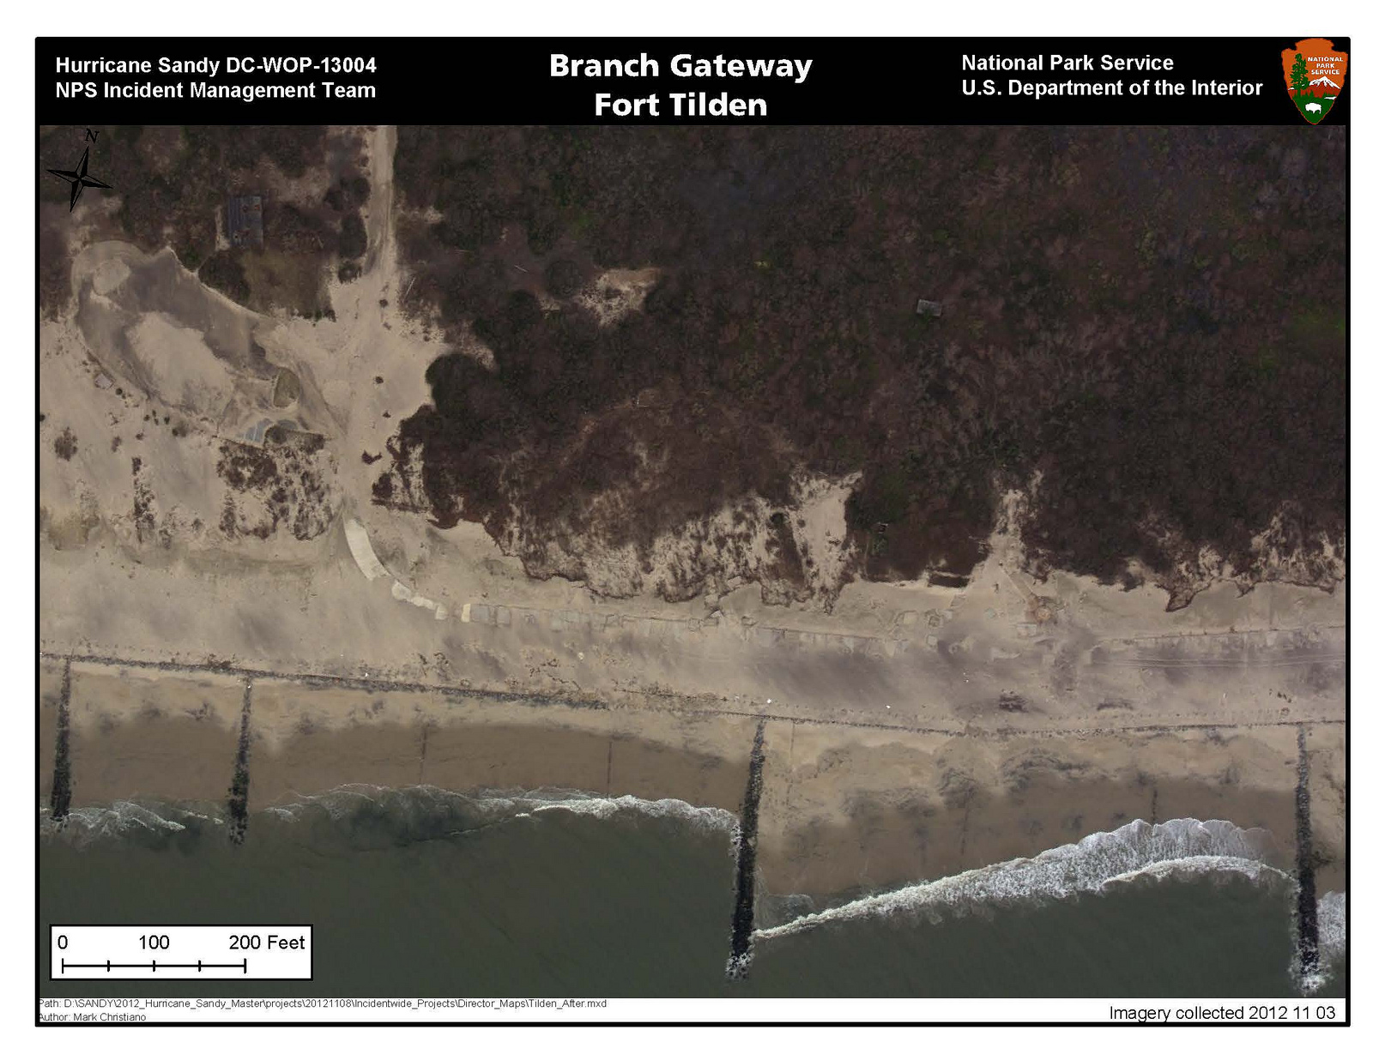
Nov. 3; NOAA photo.
Notes:
Fort Tilden; before Fall 2010; after Nov. 3; NPS photo.

Slide 14
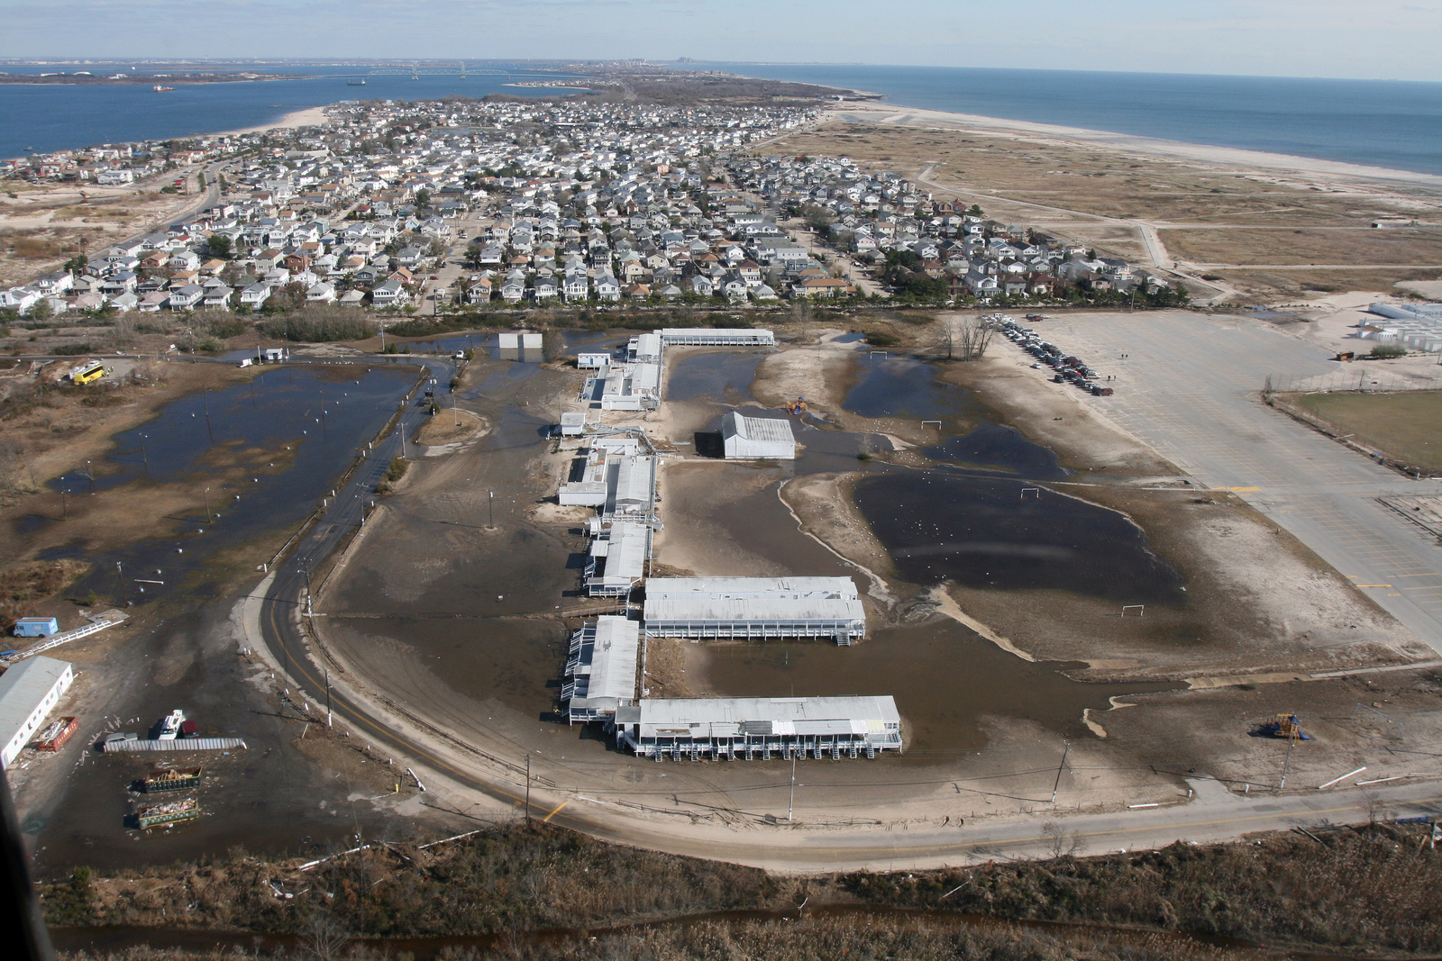
Breezy Point Surf Club; Nov. 5; NPS photo, West.
Notes:
Breezy Point Surf Club NPS photo West Nov. 5

Slide 15
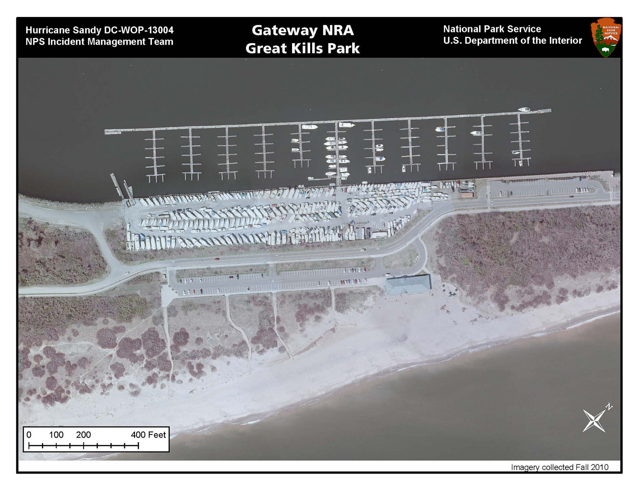
Fall, 2010; NYCDoITT photo.

Slide 16
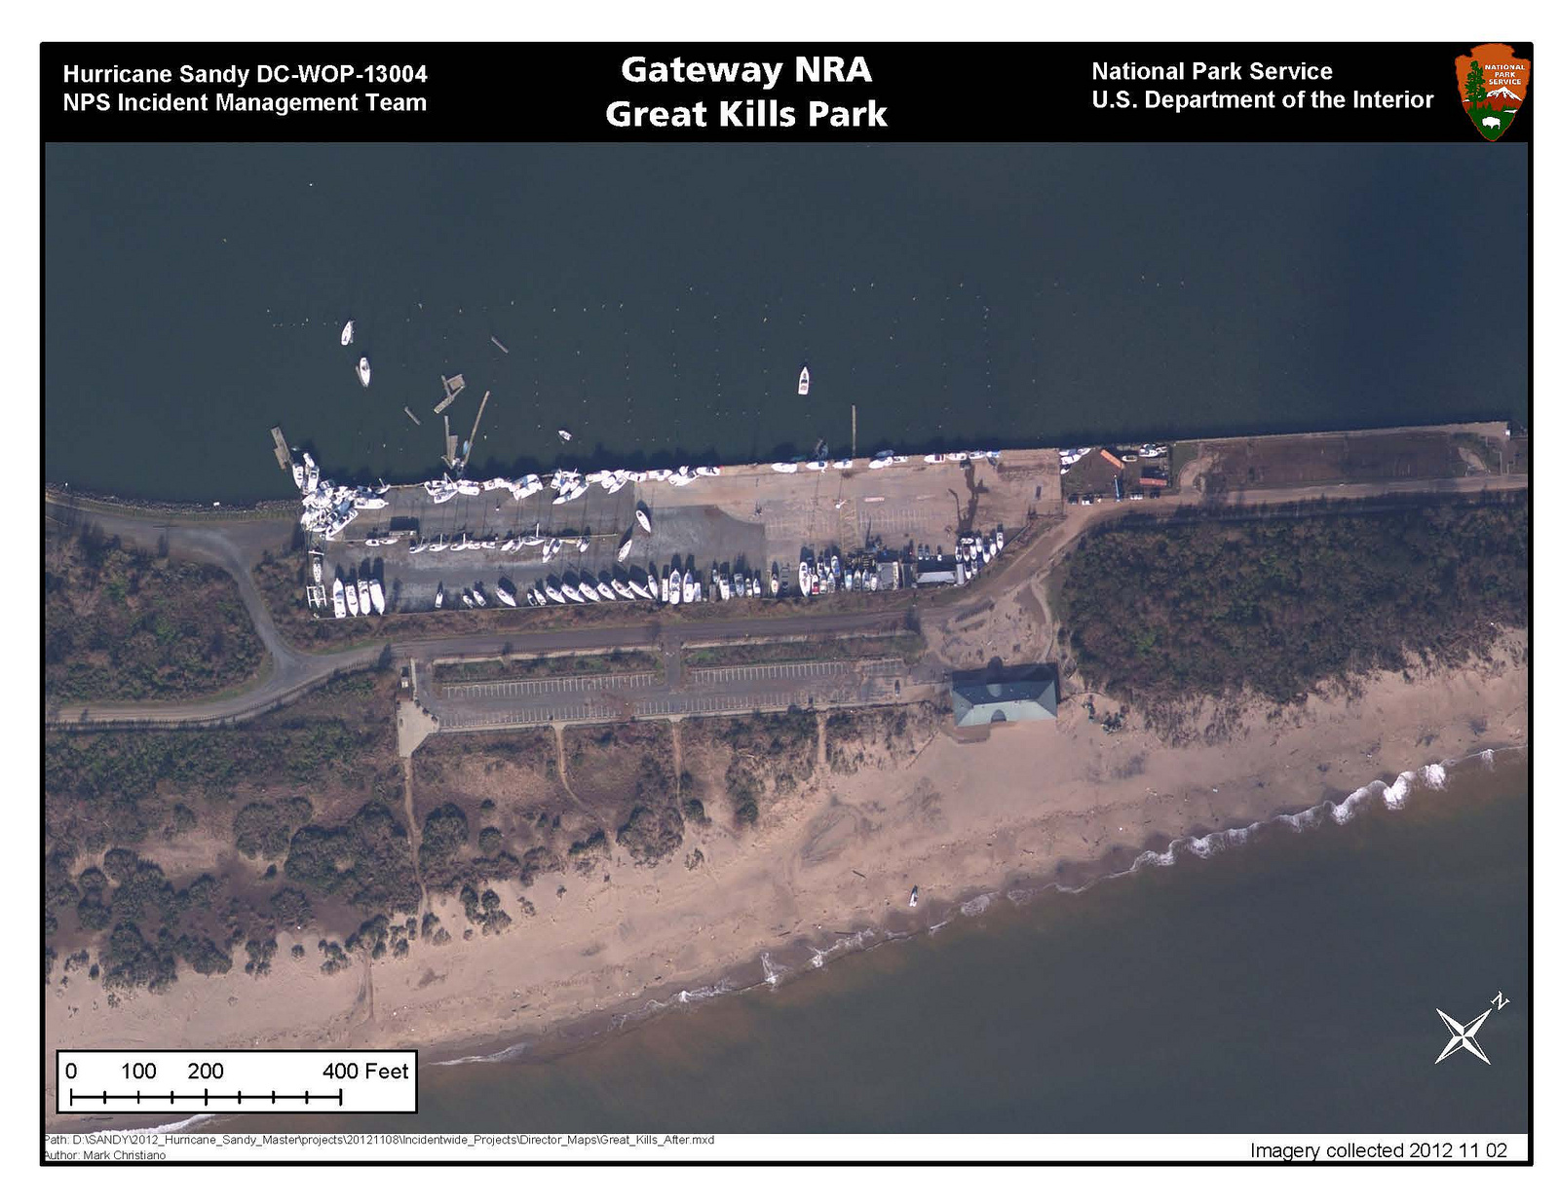
Fall, 2010; NOAA photo.
Notes:
Great Kills Park, Marina, before: Fall 2010; after, Nov. 2 NPS photo.

Slide 17
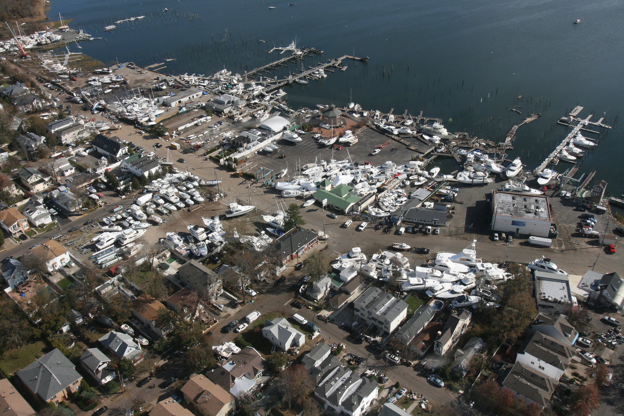
West side Great Kills Harbor; NPS photo West; Nov. 2.
Notes:
West side Great Kills Harbor; NPS photo West; Nov. 2

Slide 18
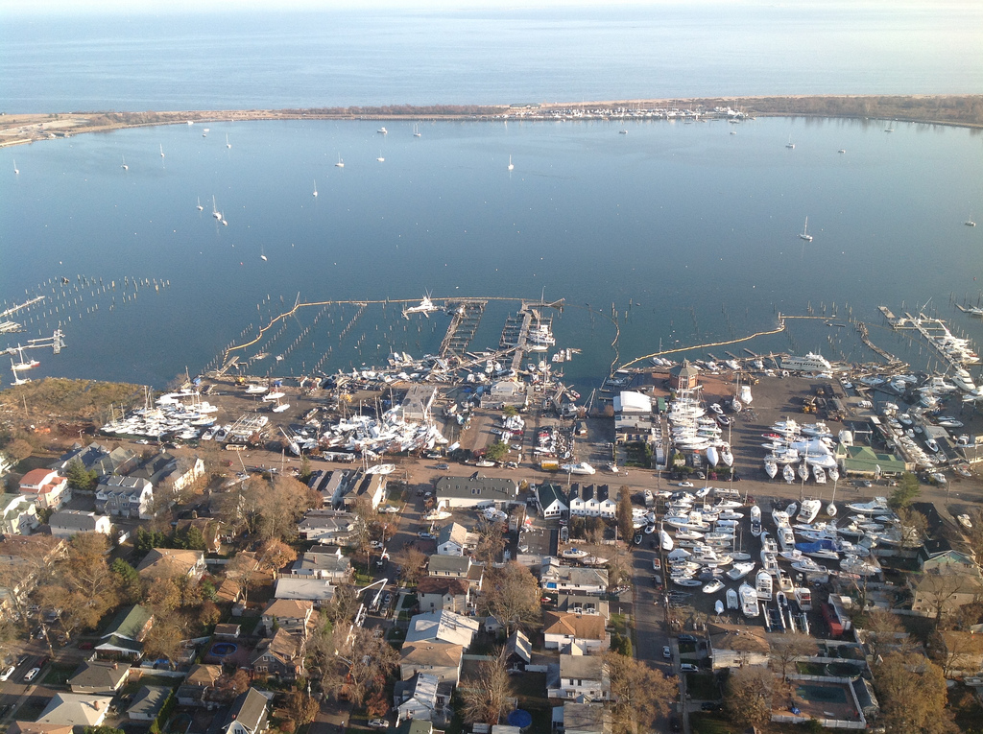
West side of Great Kills Harbor; Nov. 7; NPS photo, West.
Notes:
West side of Great Kills Harbor; NPS photo West Nov. 7, 2012

Slide 19
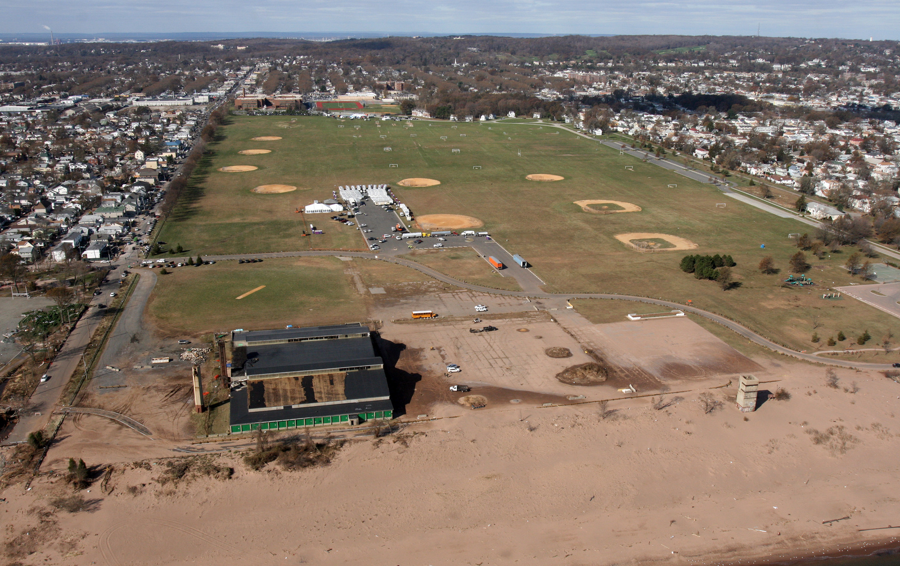
Miller Field, used as staging area for the US Army and FEMA; Nov. 7; NPS photo, West.
Notes:
Miller Field, used as staging area for the US Army and FEMA photo: NPS photo West 11-7-12

Slide 20
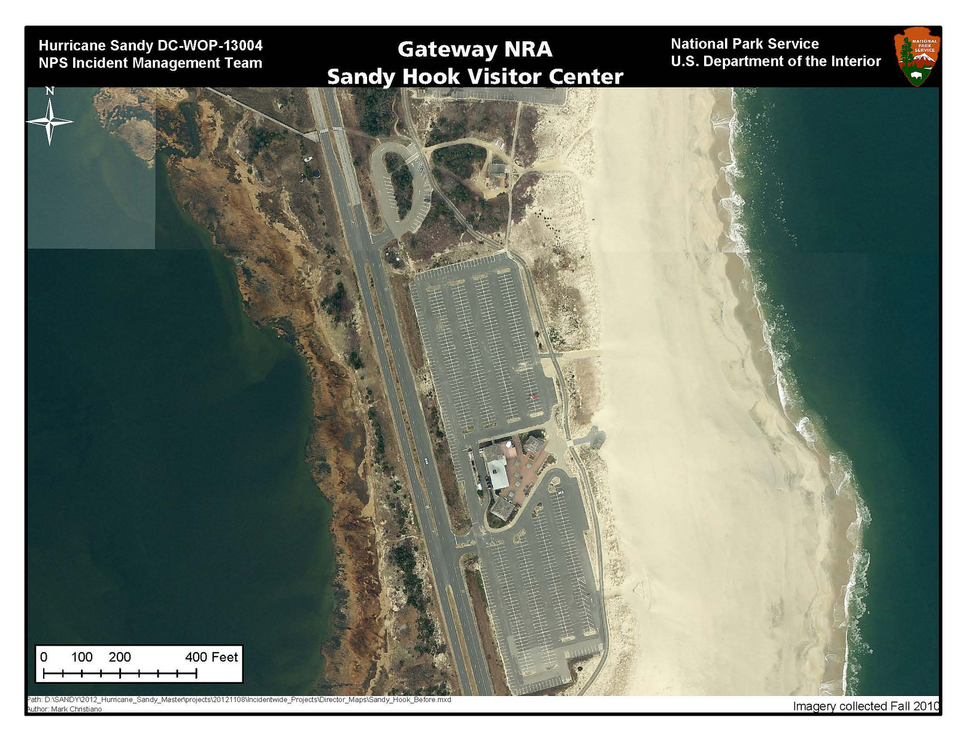
Fall, 2008; NJGIN photo.

Slide 21
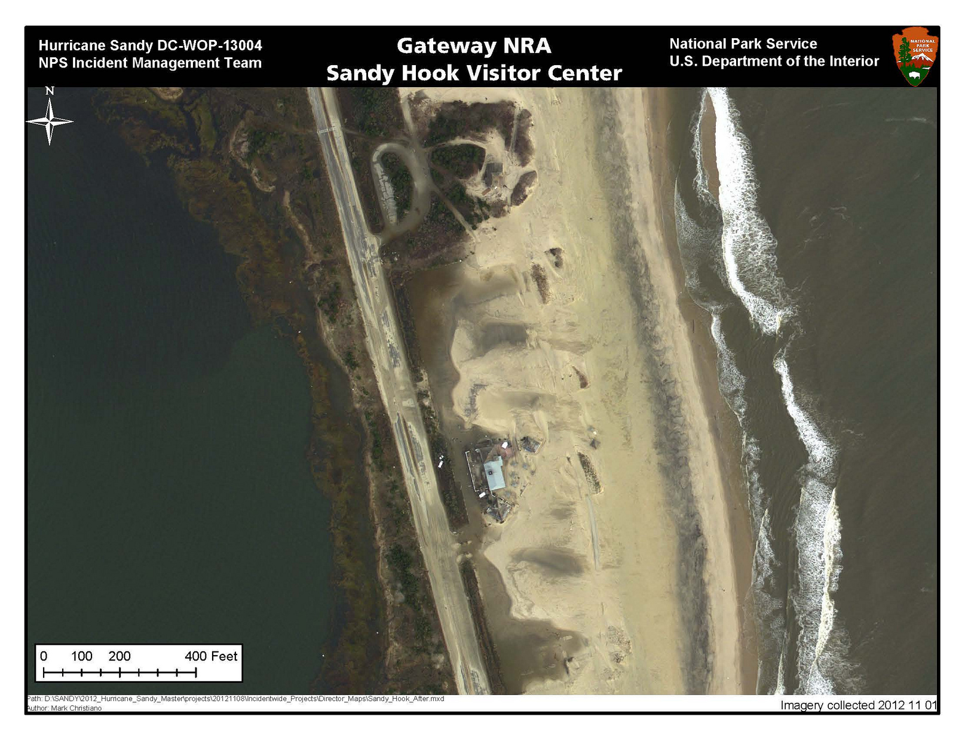
Nov. 1; NJGIN photo.
Notes:
Sandy Hook Visitor Center area: before, Fall 2010; after Nov. 1; NPS photo.

Slide 22
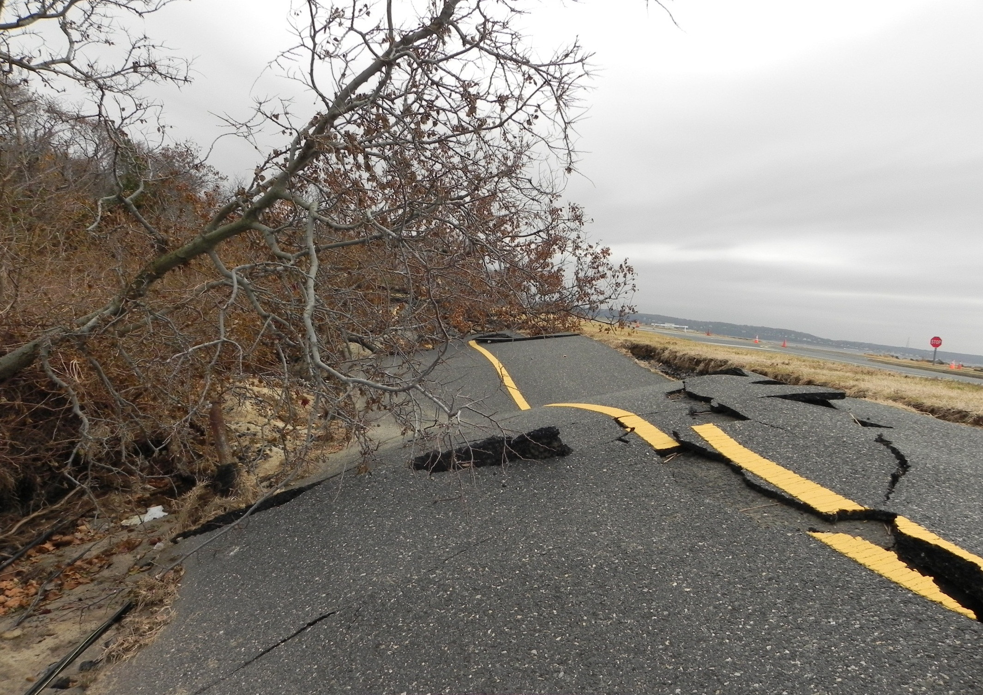
Sandy Hook, Multi-use Path. Nov. 11; NPS photo, Hoeksema.
Notes:
Sandy Hook, Multi-use Path. Nov. 11; NPS photo, Hoeksema.

Slide 23
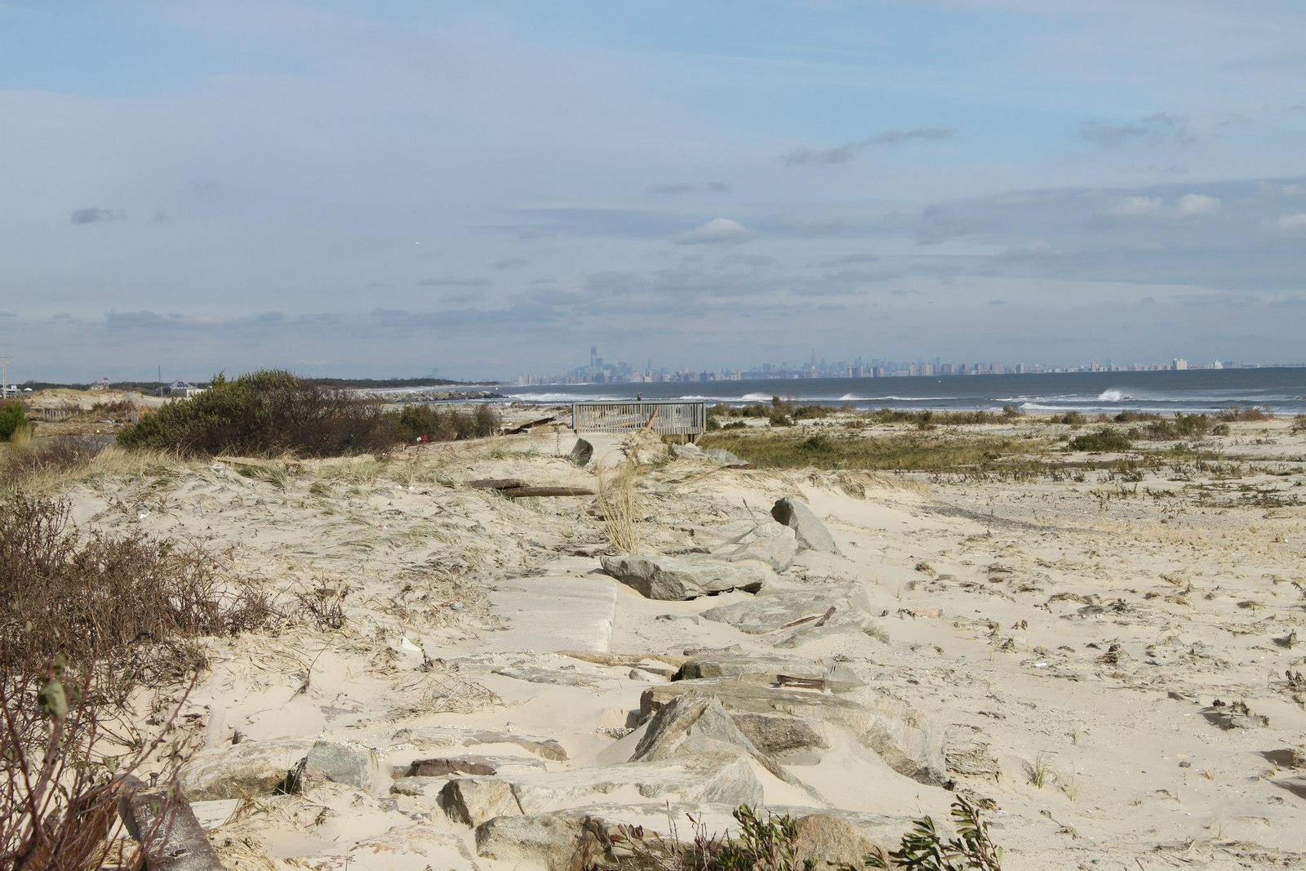
Sandy Hook north towards Rockaways and Queens, Manhattan afar; Nov. 16; NPS photo.
Notes:
Sandy Hook looking north towards Rockaways and Queens, Manhattan in far distance; NPS photo Nov. 16

Slide 24
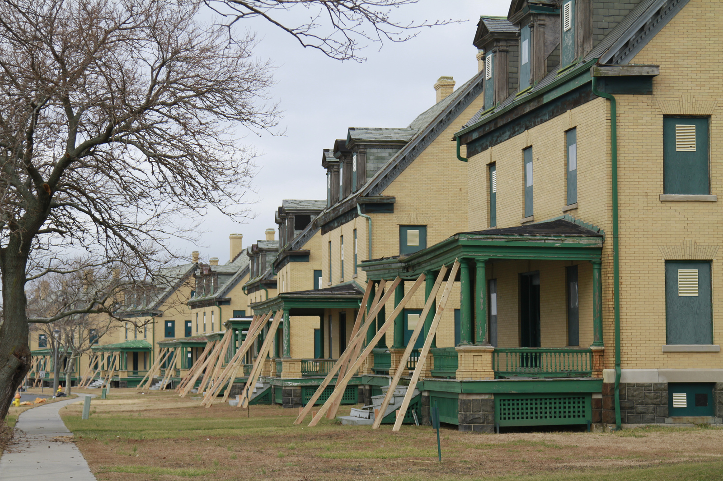
Sandy Hook; Fort Hancock: Officer’s Row; Nov. 19; NPS photo, Wickersty.
Notes:
Sandy Hook; Fort Hancock: Officer’s Row; NPS photo Wickersty Nov. 19

Slide 25
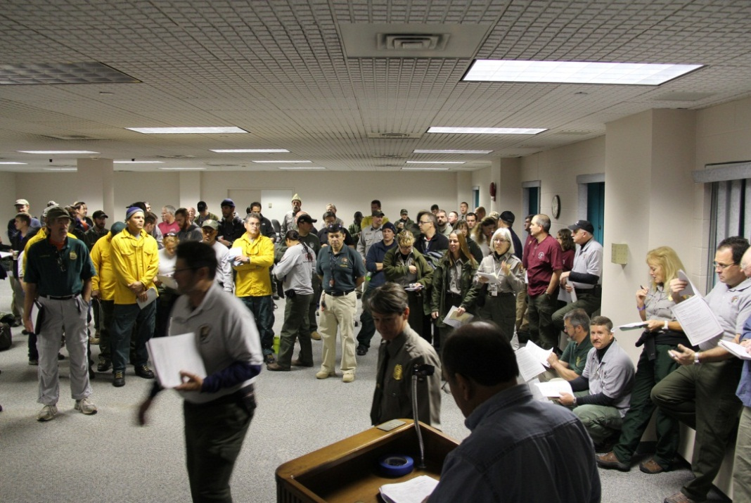
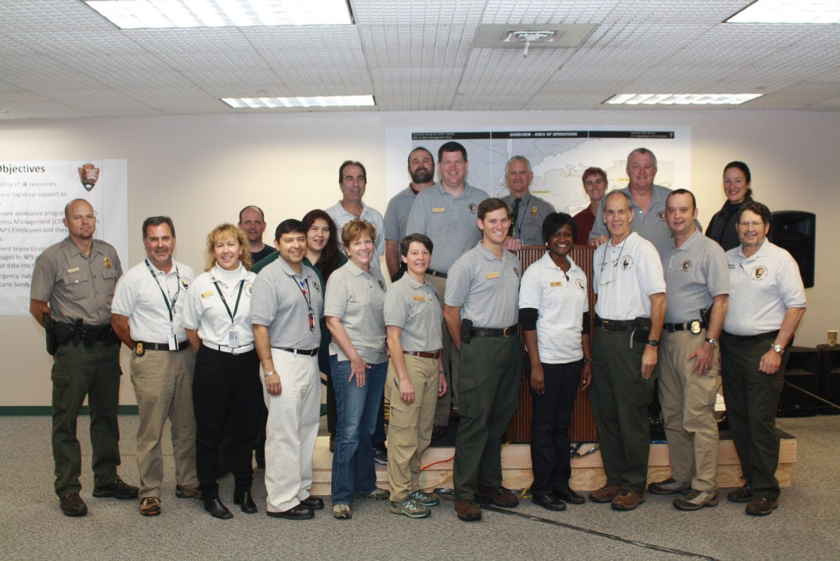
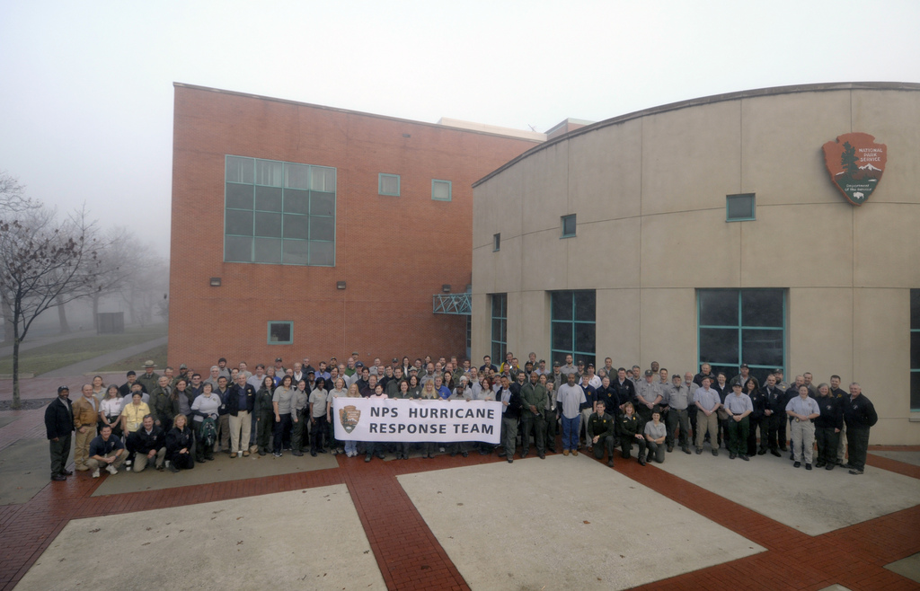
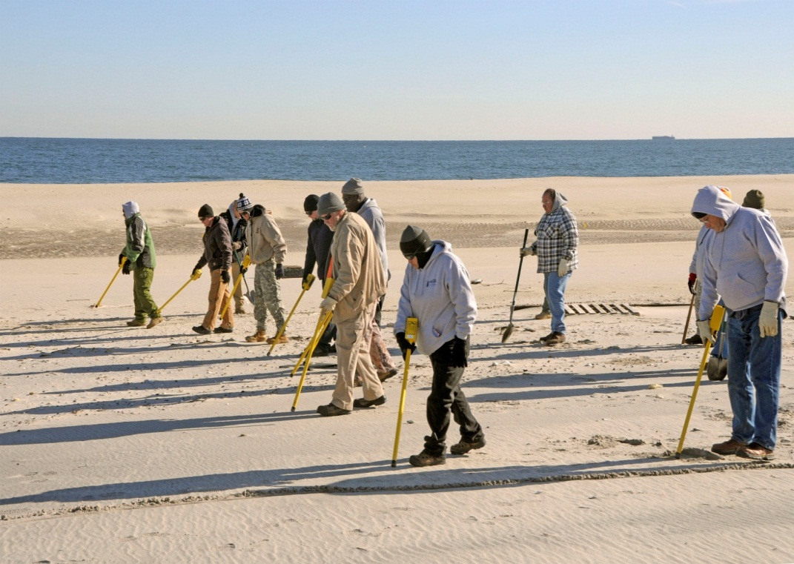
The Incident Management Team assembled was one of the largest teams in NPS history.
Upper left; lower right, NPS photo Daley. Nov. 12.
Notes:
The eastern and Midwestern Incident mgt teams joined forces in one of the largest incidents in NPS history
Upper left; lower rt NPS photo Daley. .Nov. 12

Slide 26
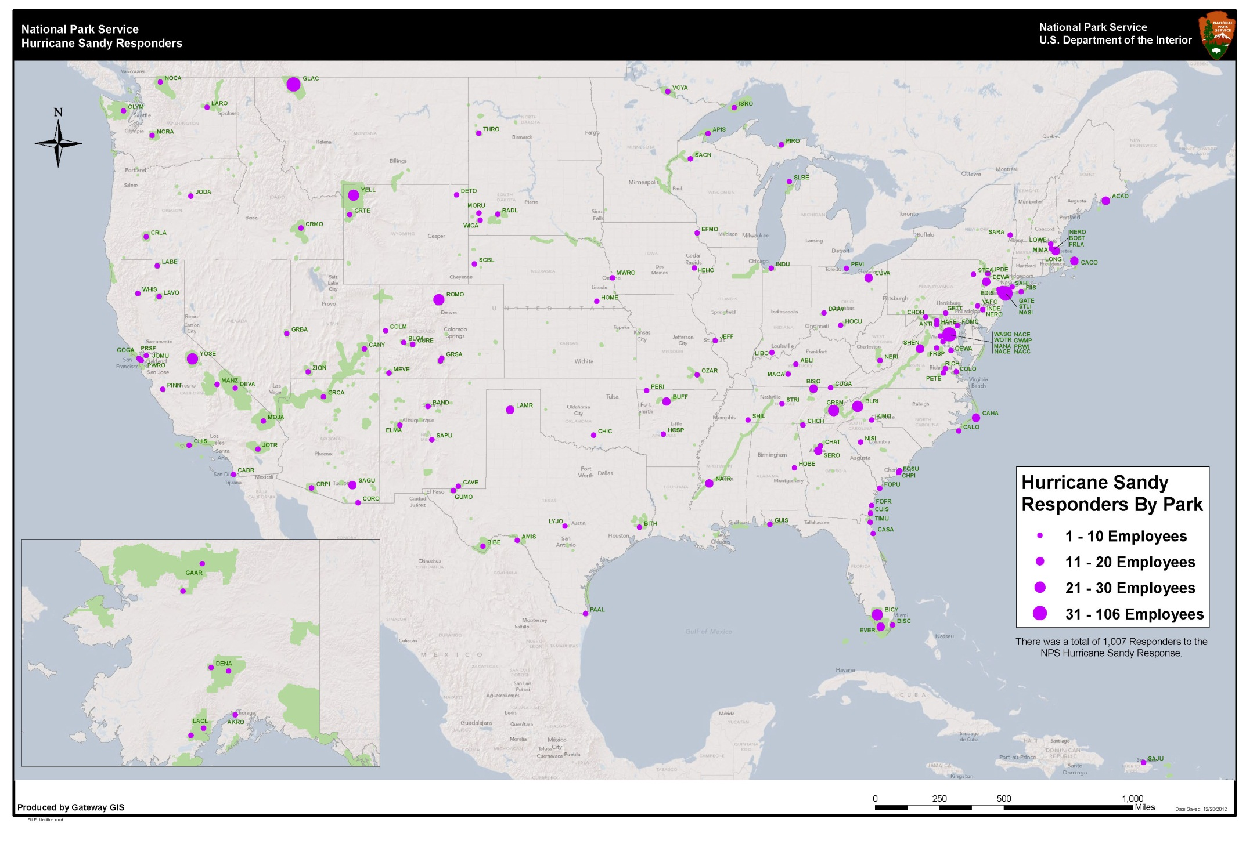

Slide 27
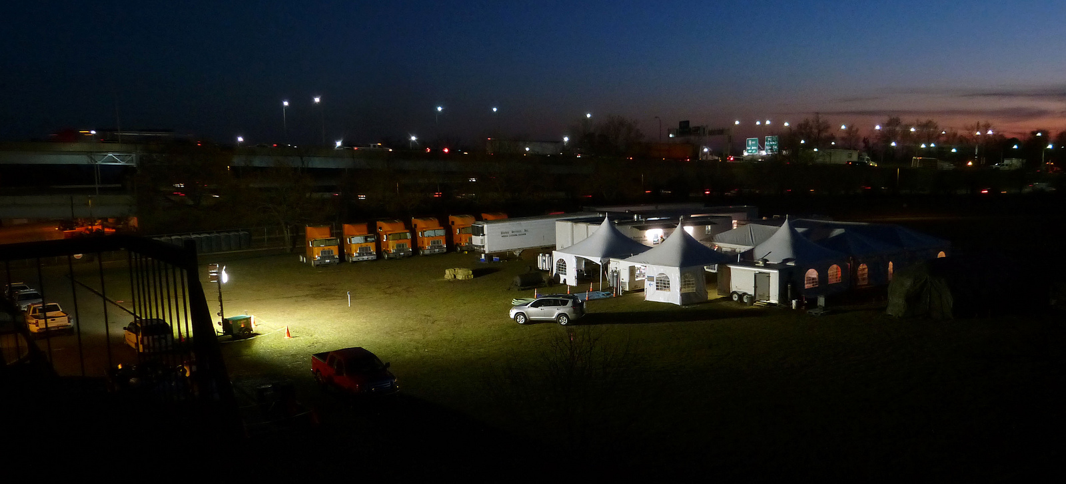
Fort Wadsworth, a staging area for an some 400 NPS employees; food service tents at dusk. Nov. 14; NPS photo.
Notes:
Fort Wadsworth, a staging area for an some 400 NPS employees; food service tents at dusk. NPS photo; Nov. 14

Slide 28
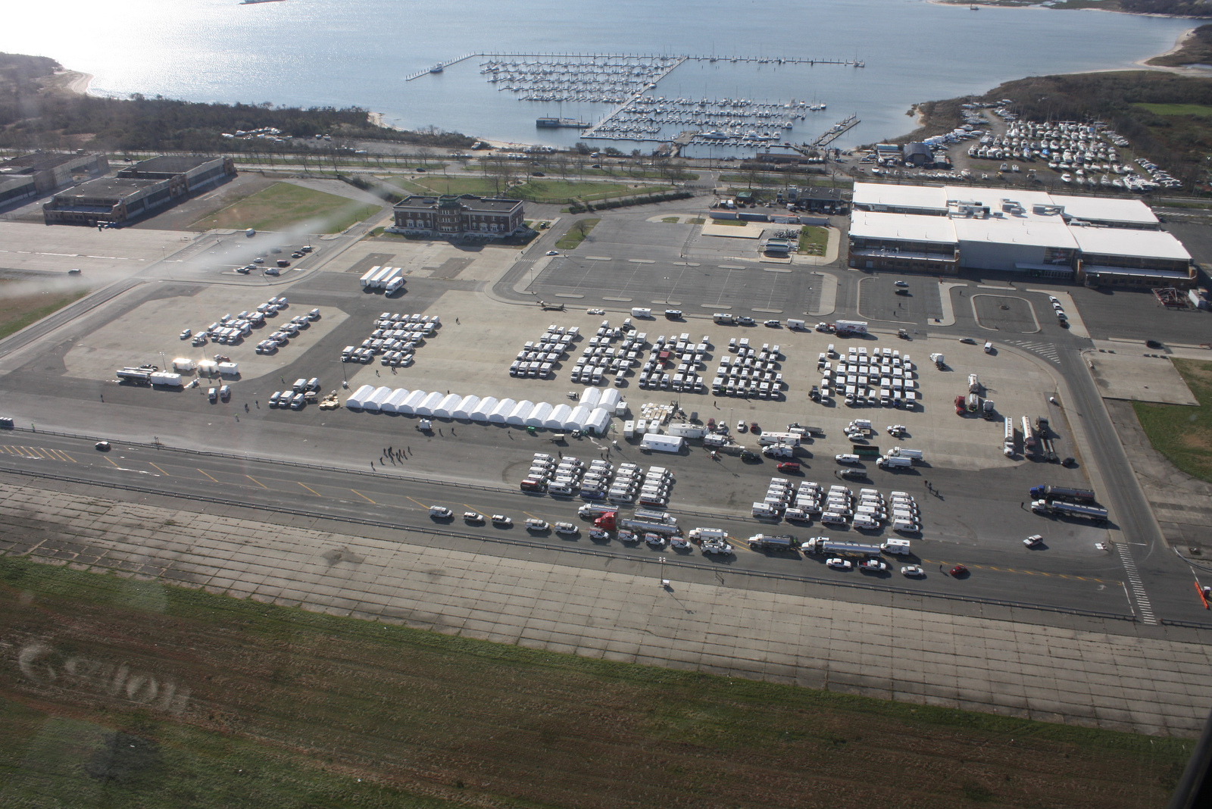
Floyd Bennett Field used by emergency response agencies including FEMA. Nov. 5; NPS photo, Stinnet.
Notes:
Floyd Bennett Field is used by emergency response agencies including FEMA. NPS photo Stinnet, Nov. 5.

Slide 29
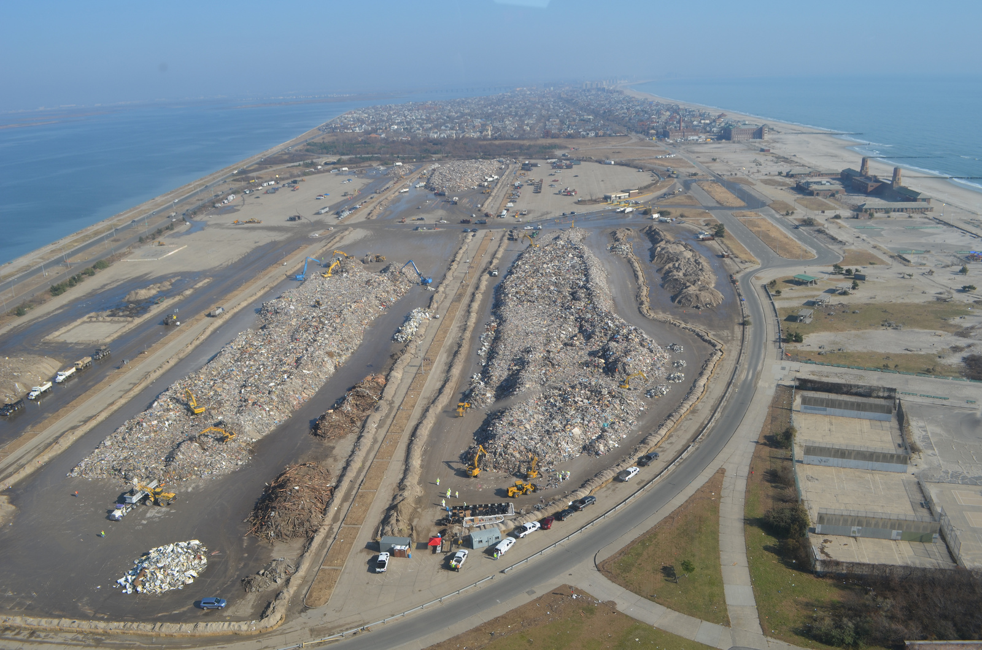
Jacob Riis Park, looking eastward are the communities of Neponsit, Belle Harbor and Rockaway Park ; Nov. 11; NPS photo.
Notes:
Jacob Riis Park, looking eastward are the communities of Neponsit, Belle Harbor and Rockaway Park NPS photo, Nov. 11.

Slide 30
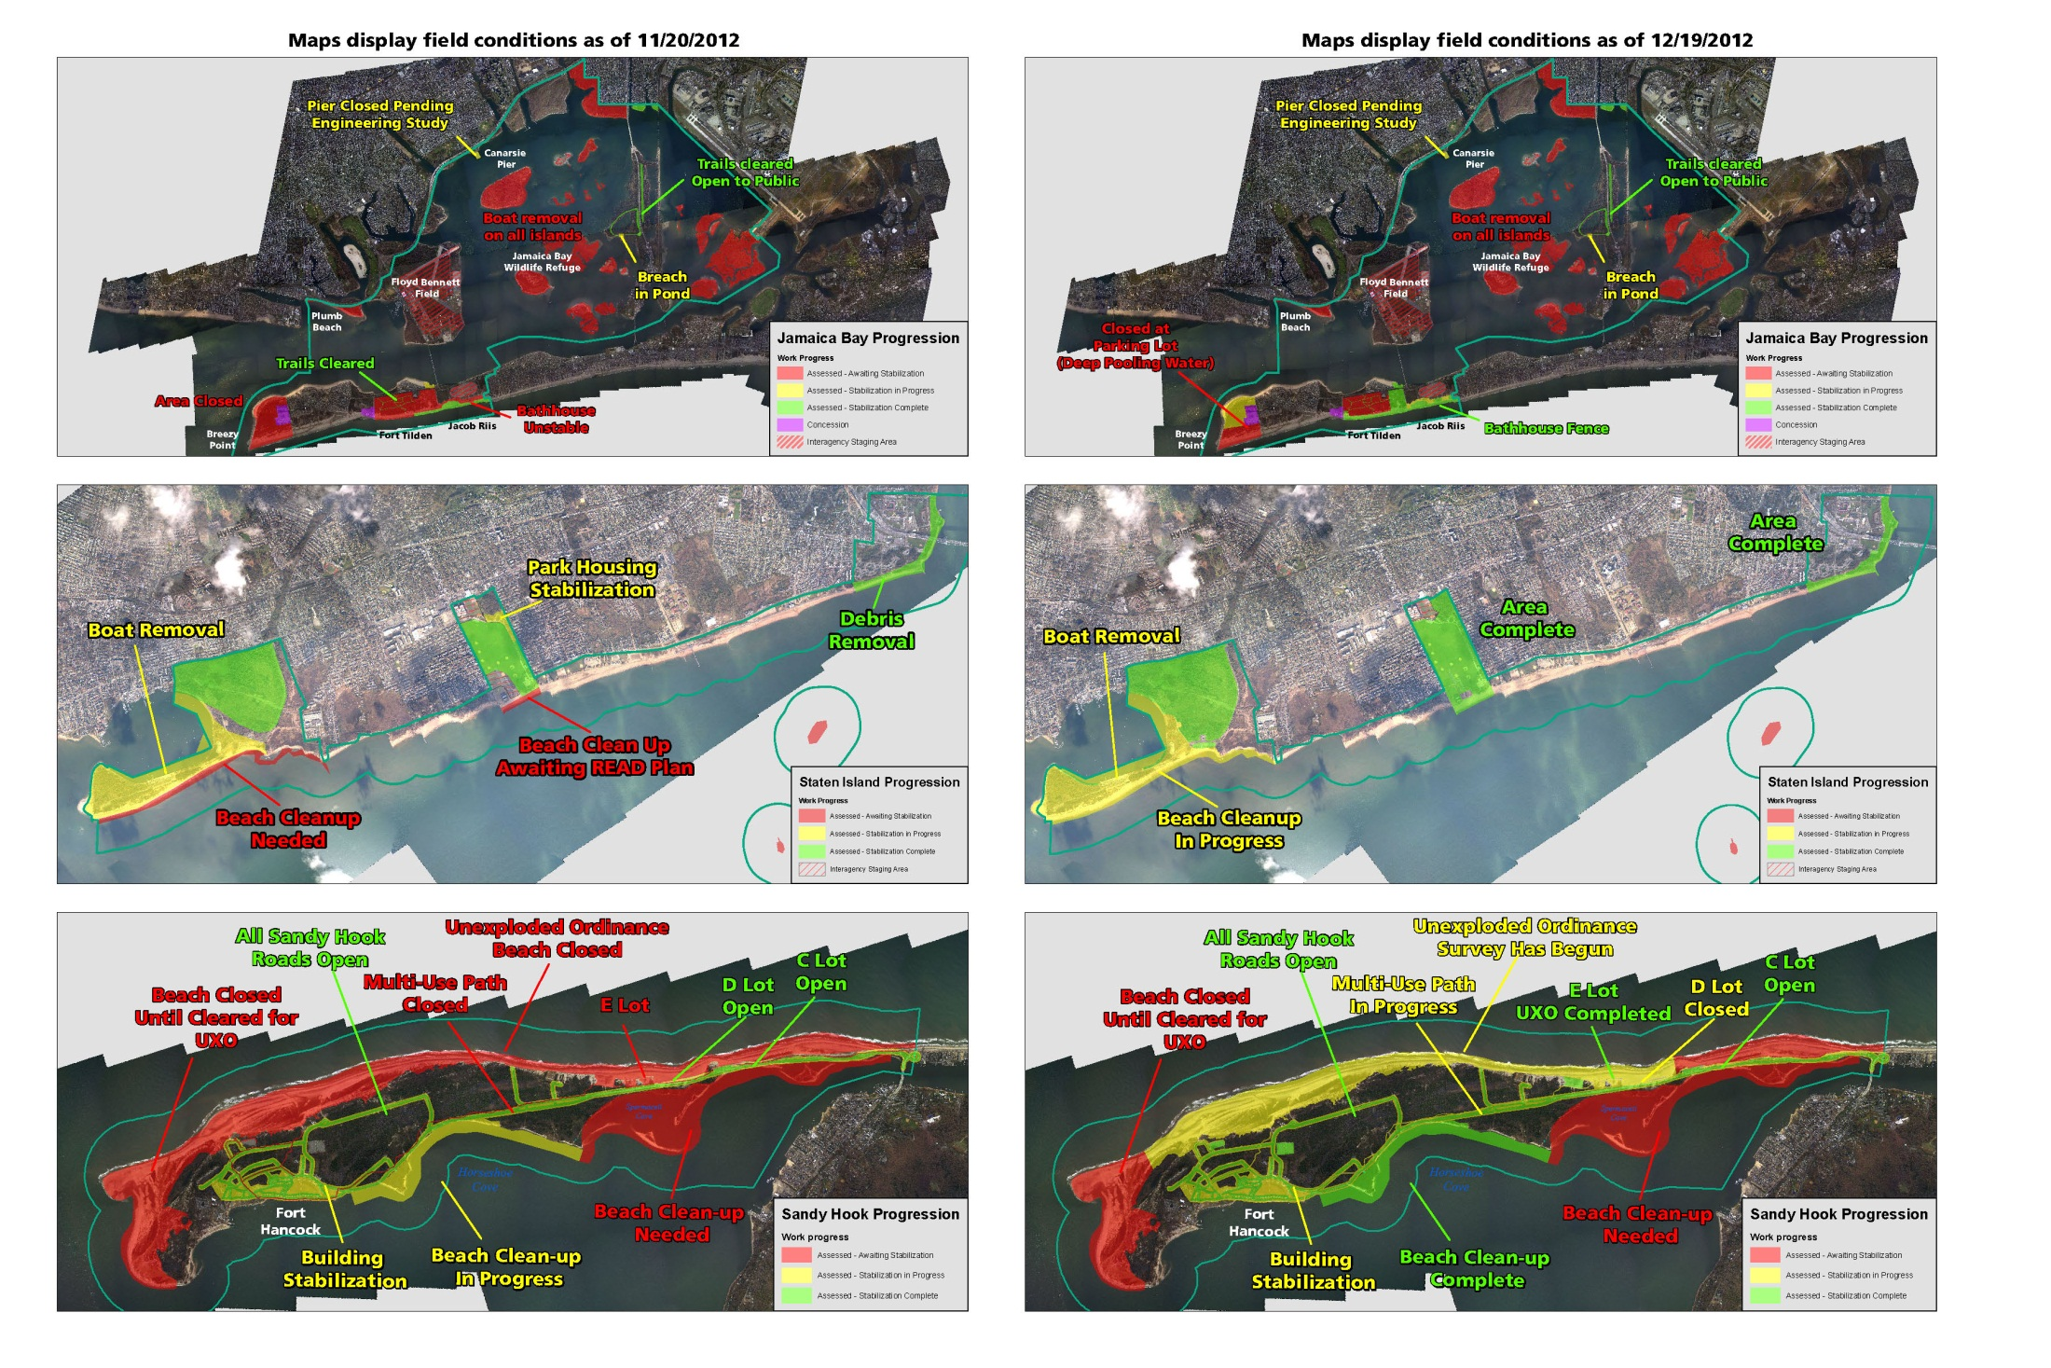
Progression Maps were used to provide daily snapshots of the recovery operations. This panel shows progress achieved in thirty days. NPS image.

Slide 31
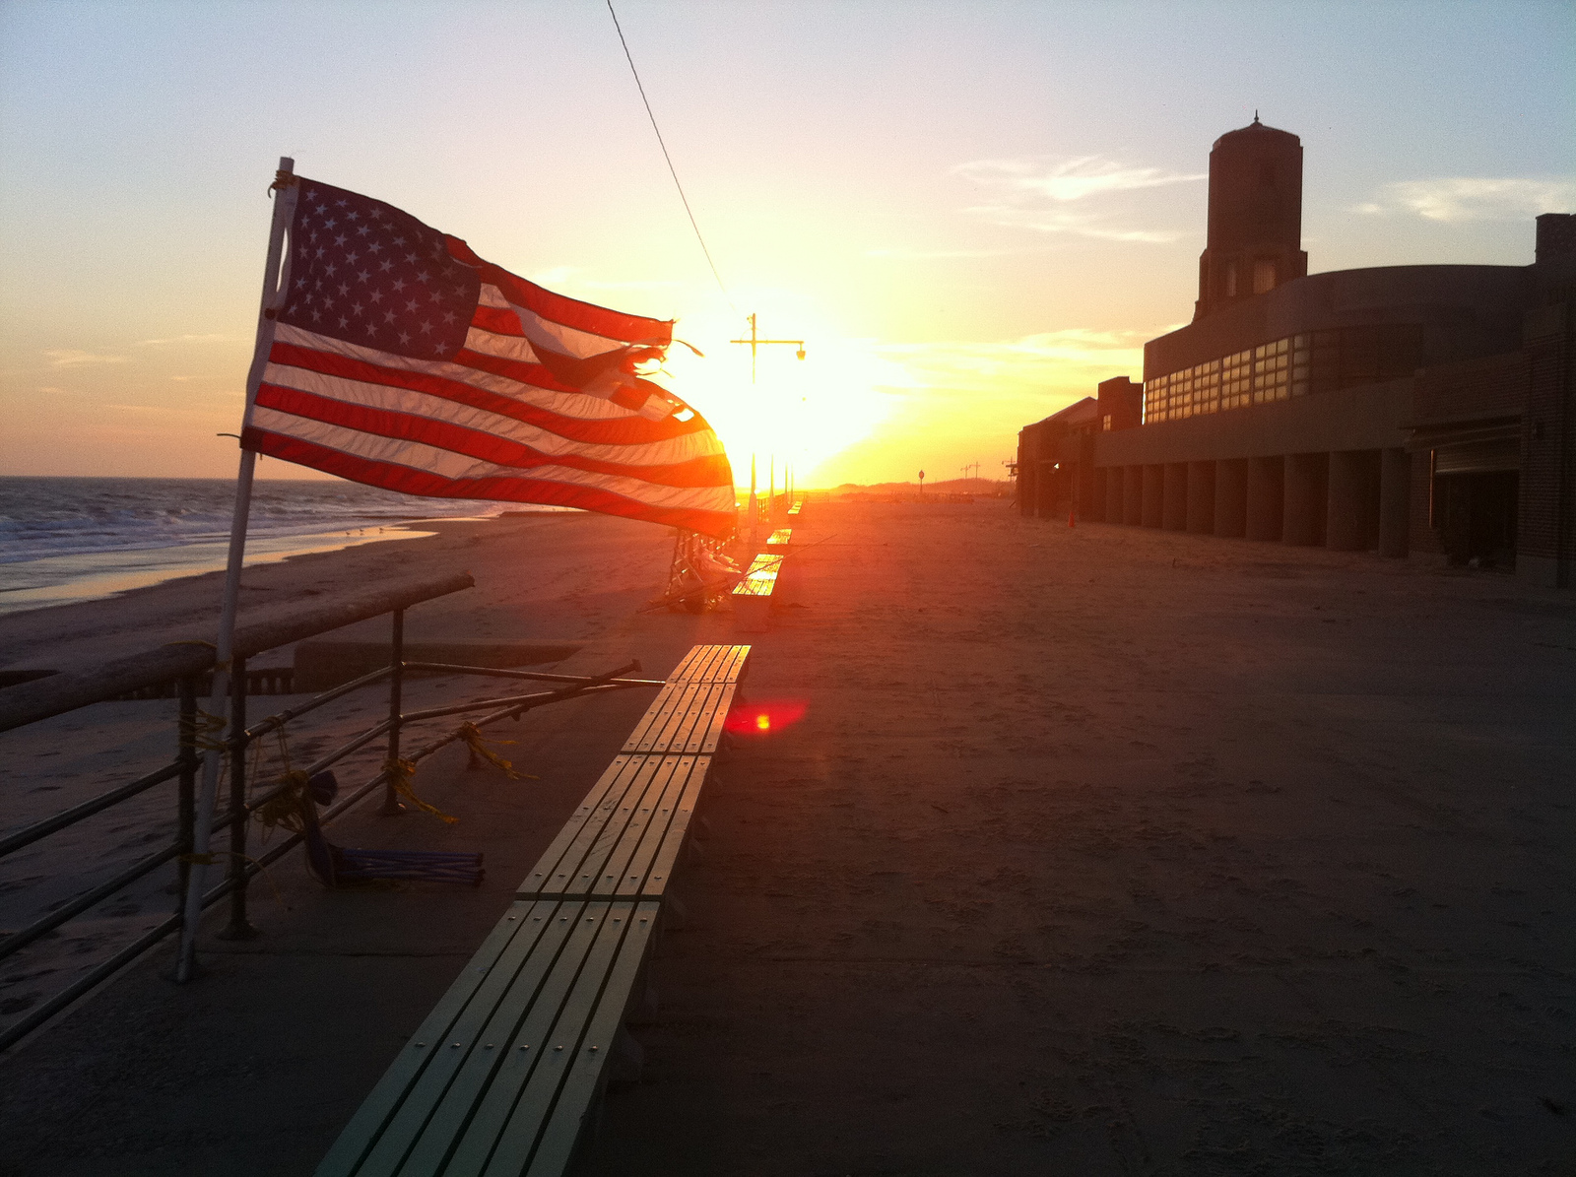
Jacob Riis Park, Veteran’s Day, Nov. 11 ; NPS photo, Noble.
Notes:
Jacob Riis Park, Veteran’s Day, NPS photo Noble, Nov. 11.

