Slide 1
A Banding Study of Common Terns on Pettit Island, NJ: Preliminary Results
Brian G. Palestis
Kaitlin E. Eppinger
Wagner College

Slide 2
Introduction
Nearly 1600 chicks banded at Pettit Island since 1996
Recaptures/recoveries have been reported during migration and winter
Trapped breeding adults in 2010
Previous studies at other sites (Great Lakes, New England, Germany):
Both natal and breeding site fidelity is usually high
But variability among sites, abandonment of unsuccessful sites (predation, flooding)

Slide 3
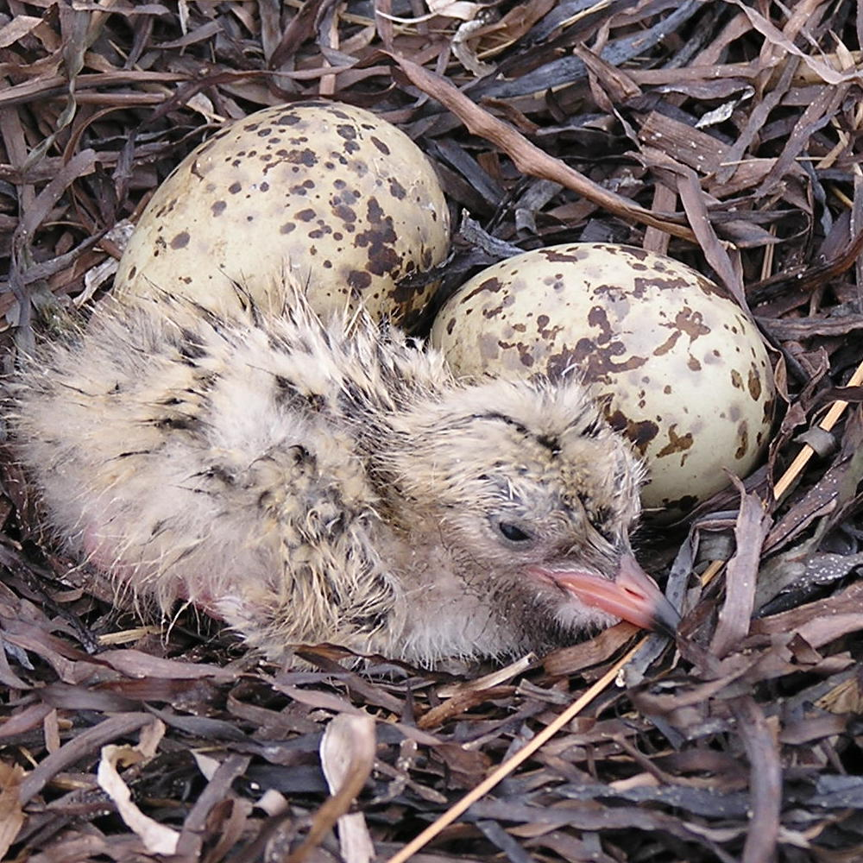
Common Tern (Sterna hirundo)
At Pettit Island, Ocean County, NJ

Slide 4
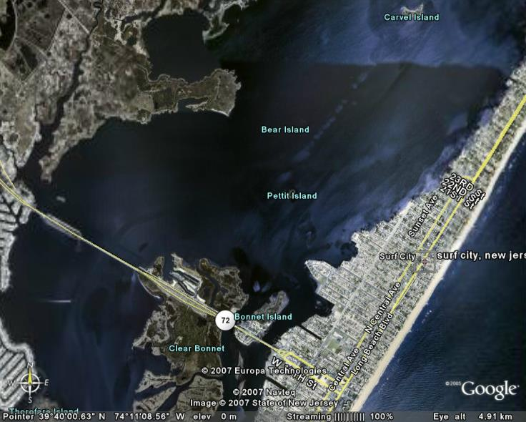

Slide 5
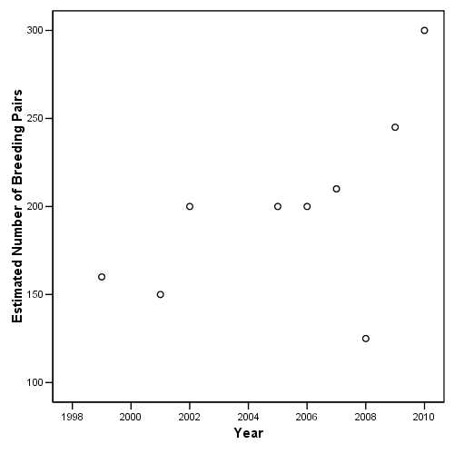
Colony Size

Slide 6
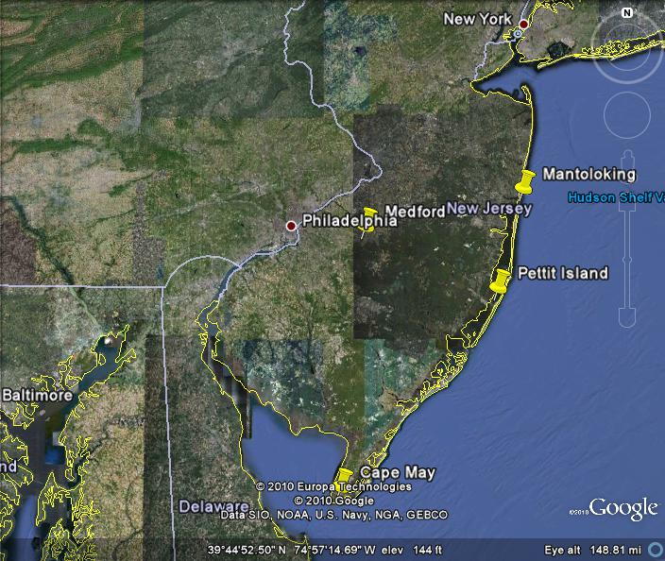
Recoveries of Fledglings: Fall Migration

Slide 7
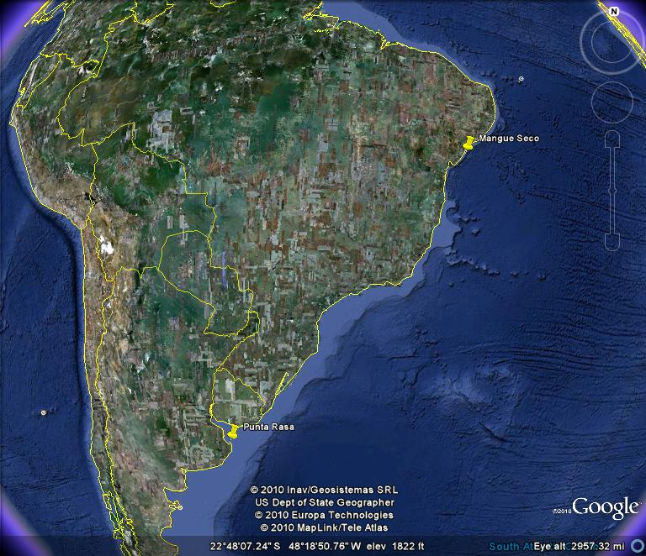
Wintering Adults

Slide 8
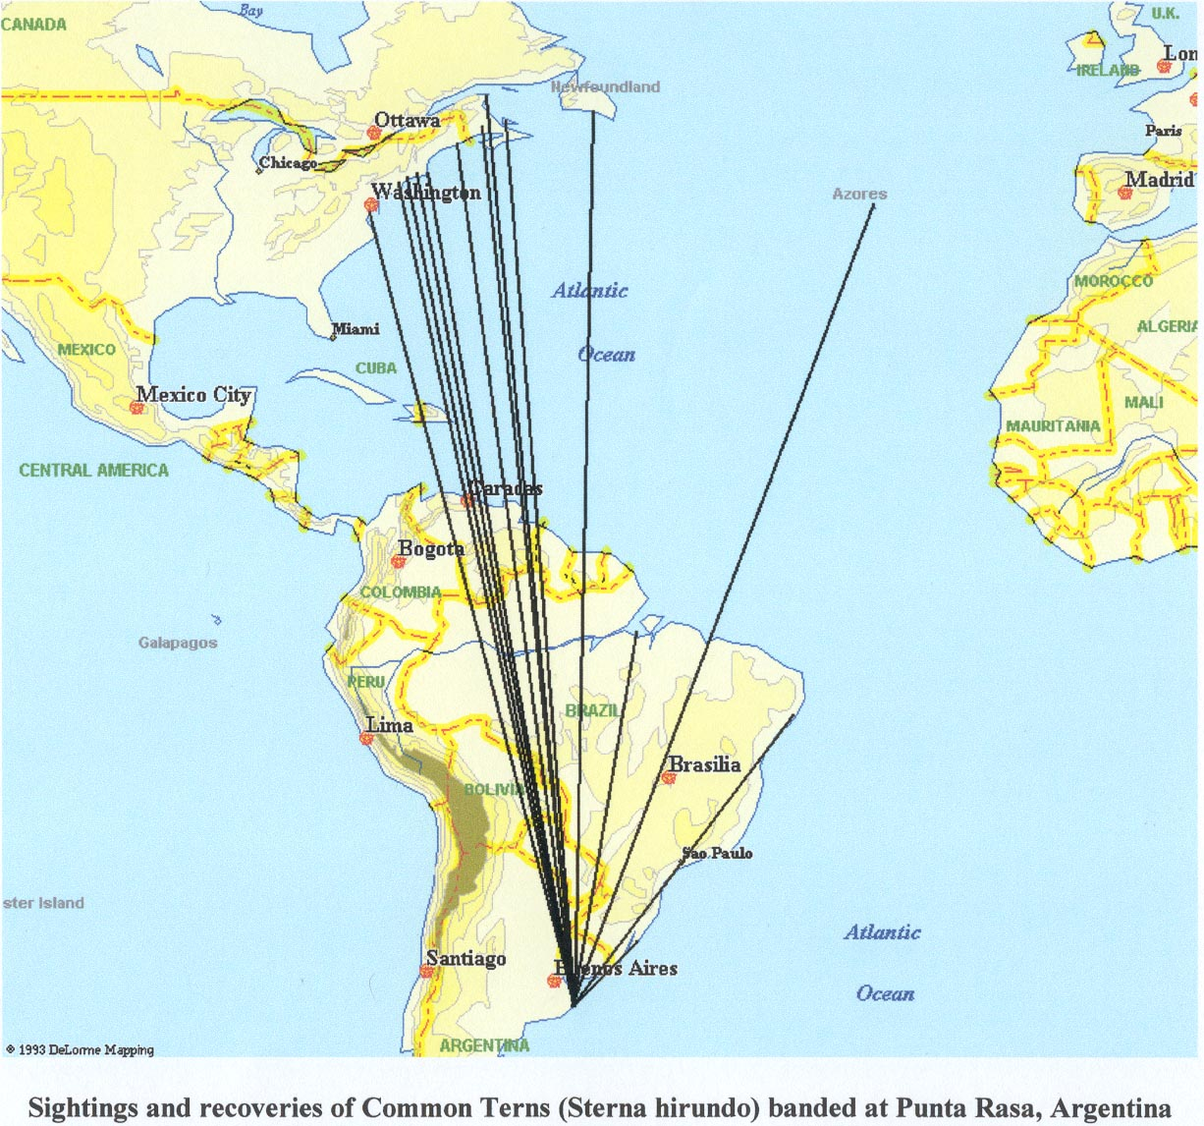
Esteban Bremer

Slide 9
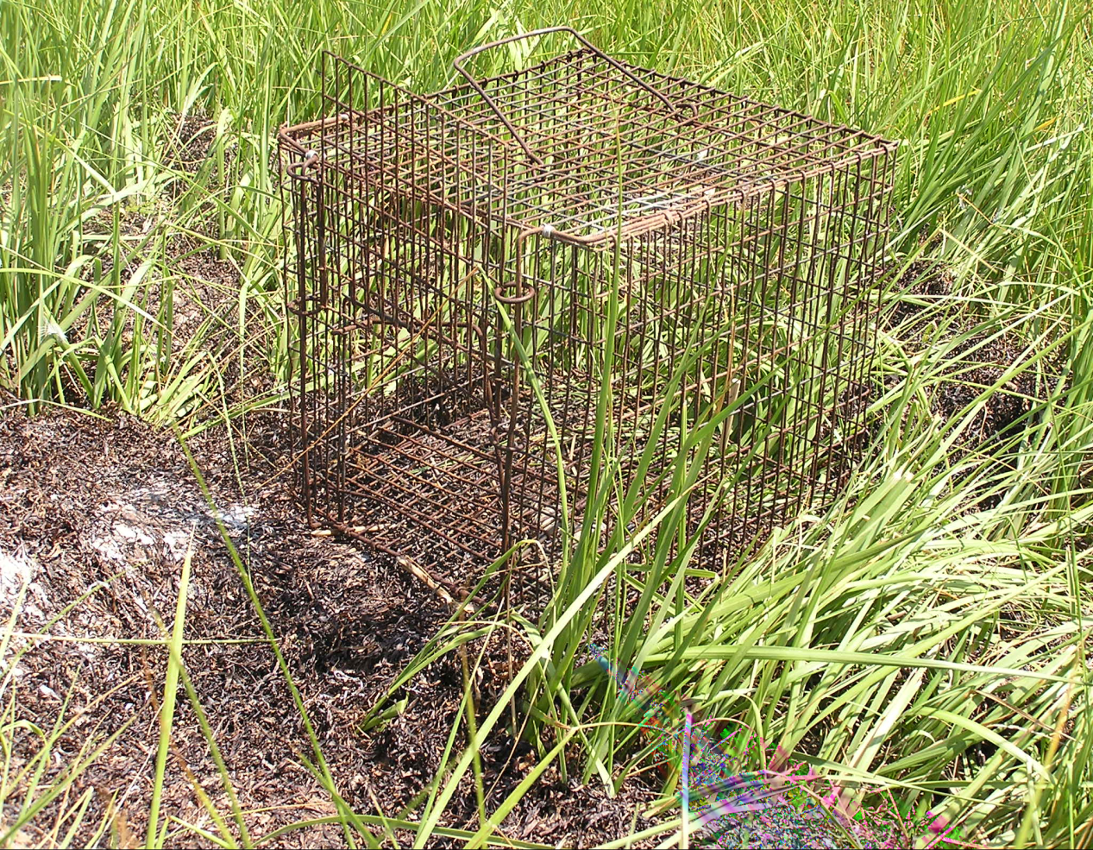
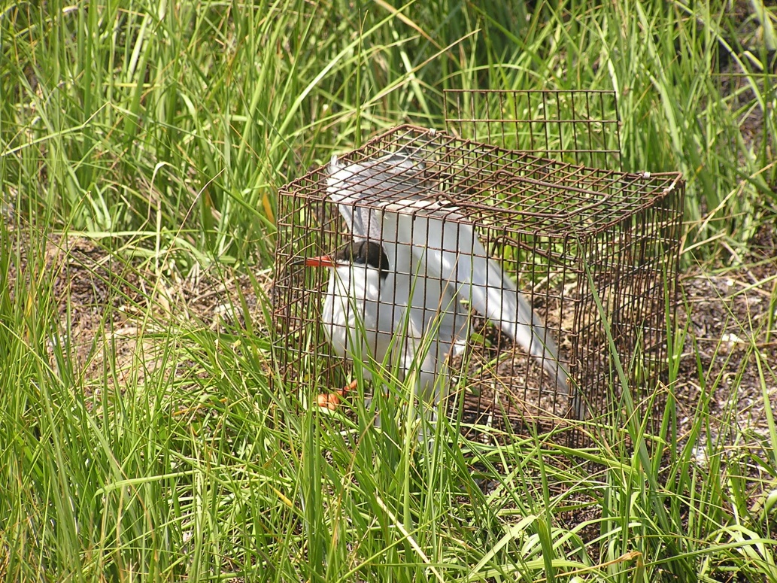
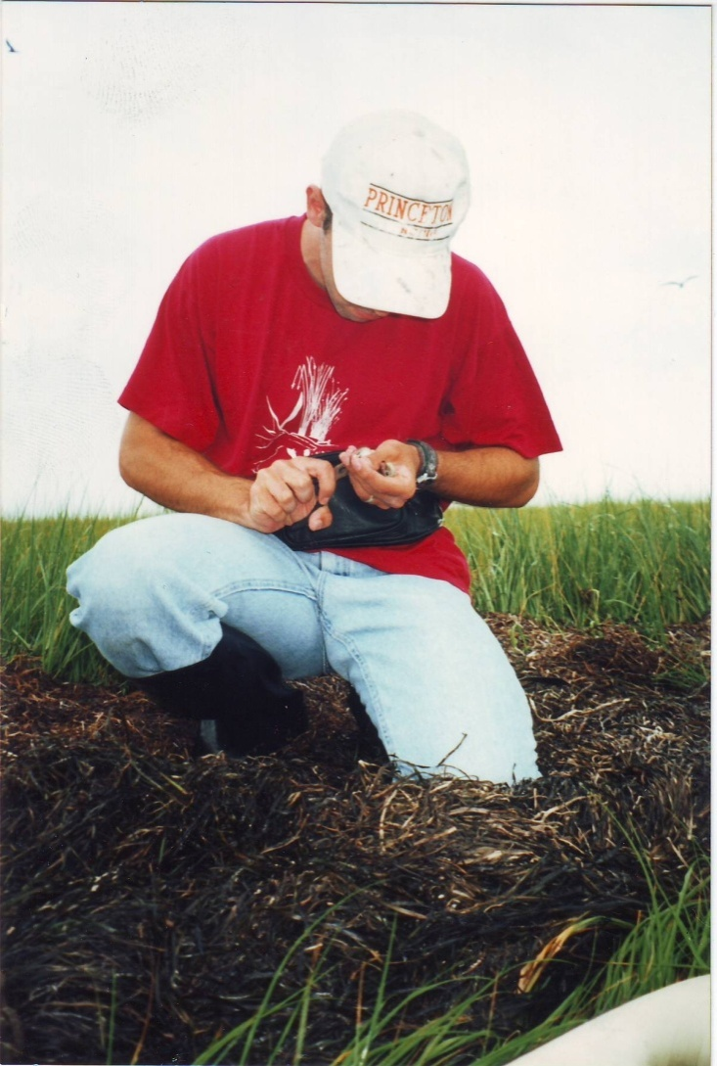

Slide 10
Banding at Pettit Island
Years | Chicks Banded | Adults Banded | Adults Trapped
1996-1999 | 275 | 27 | 28*
2000-2004 | 283 | 17 | 17
2005-2009 | 799 | 0 | 0
2010 | 219 | 50 | 51#
Totals | 1576 | 94 | 96
*One bird previously banded at Pettit
#One bird previously banded in Argentina

Slide 11
Why have there been so few recaptures at Pettit?
Other colonies also present in Barnegat Bay – may be movement among them
Recent fluctuations in colony size also suggest Pettit is part of metapopulation
Chick banding effort variable among years
Recently banded chicks not yet old enough to breed (most breed at age 3)
51 adults trapped in 2010 represents only ~8.5% of breeding adults
Plan to trap at other islands in addition to Pettit

Slide 12
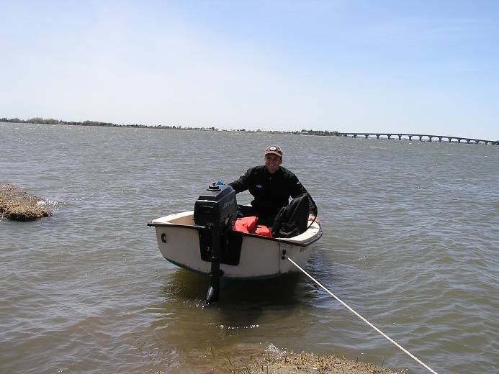
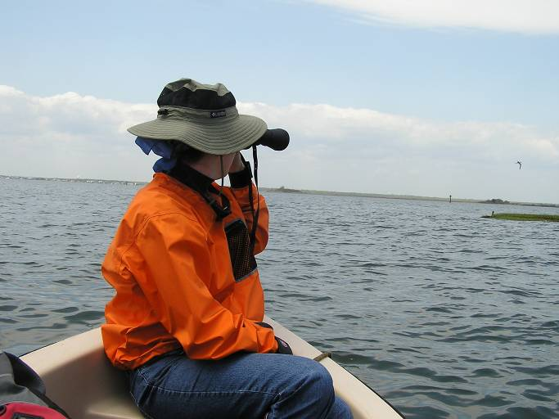
Acknowledgments
Joanna Burger
Chomee Yoon, Robert Liberto, Jusuf Husic, Shannon O’Neill, Michael Stanton
Wagner College, Anonymous Donor, Mollica Family Fund, Foundation for Biosocial Research, CRESP
Larry Kusar, Richard Buzby, NJ Div Fish & Wildlife, Borough of Surf City

