Slide 1
A Harbor Herons Habitat Pilot Project?
Photo: Don Riepe

Slide 2
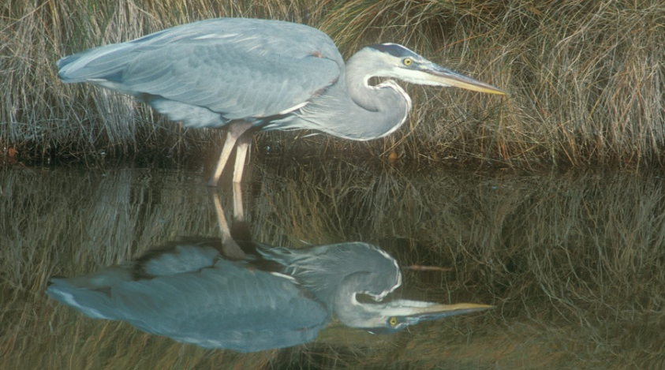
Harbor Herons and the NY-NJ Harbor Estuary Program
NY/NJ Harbor Estuary Program’s Harbor Herons Subcommittee has been monitoring populations since 1980?
Recently published a Conservation Plan.
An emphasized unknown: we do not know enough about why herons nest where they nest.
Don Riepe
Notes:
1. HH Subcommittee is an offshoot of HEP’s habitat work group, and has been part of HEP for__years
2. Recently published conservation plan is part of the implementation plan of HEP’s CCMP.

Slide 3
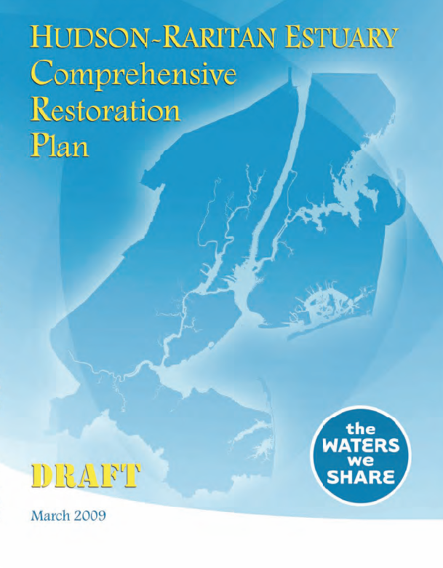
Harbor Herons and the Comprehensive Restoration Plan
In line with the Comprehensive Restoration Plan, further investigation is needed push forward the Harbor Herons TEC.
Restoration Working Group
is interested in pursuing pilot
projects.
Launching a dual restoration/
feasibility study may prevent
us from restoring blindly.

Slide 4
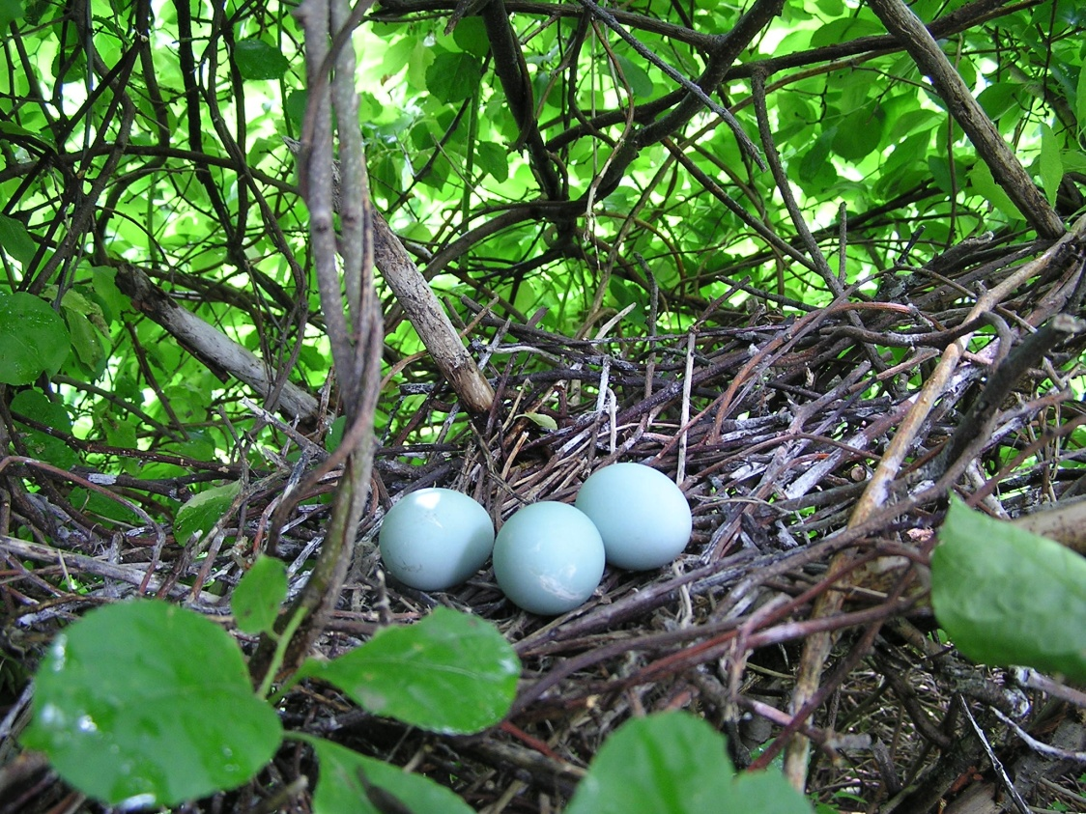
Goals of the pilot project
Improve our understanding of what non-social factors influence nesting site selection, and what restoration strategies may lead to successful, multi-year nesting.
Improve nesting on at least
one island and potentially
associated forage habitat.
Take a low-risk approach
by not disturbing current
nesting areas.

Slide 5
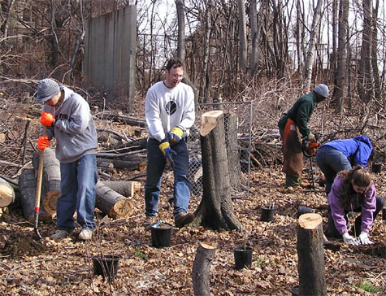
Potential paired restoration and monitoring projects
Re-vegetation with native species and potential elevation manipulation
Predator removal
Improved adjacent
forage habitat
Notes:
Re-vegetation/elevation change: to reduce susceptibility to storm damage
Improved adjacent forage habitat - could include restored tidal flushing, salt marsh or shoreline restoration,
sediment remediation…

Slide 6
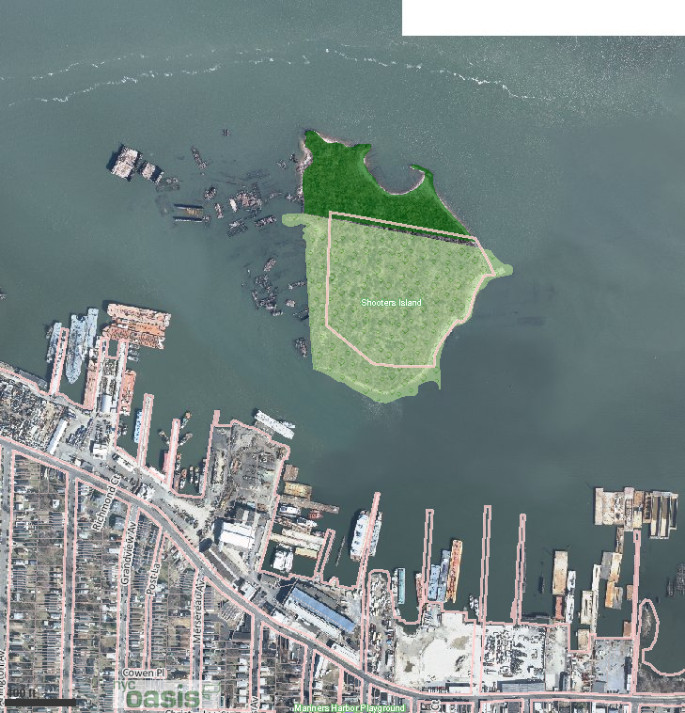
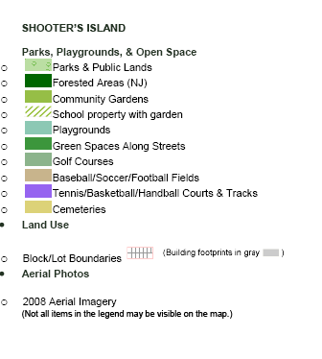
Initial site possibilities: nesting habitat on Shooter’s Isl.
Notes:
Owned by both NY and NJ – both benefits and drawbacks with this
Smaller – this may be a good thing, as Herons are less likely to be concerned about predators
Low risk of disturbance (little to no nesting at the moment)

Slide 7
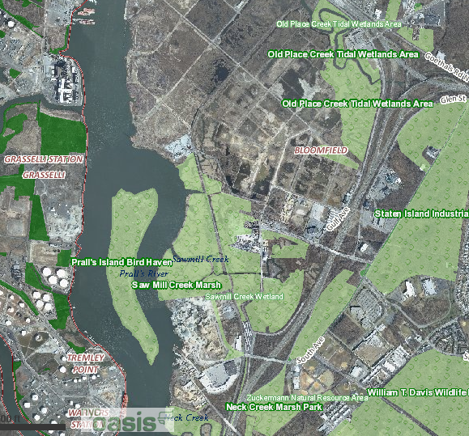
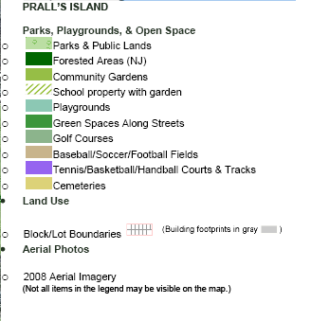
Initial possibilities: nesting habitat and predators on Pralls Isl.
Notes:
1991 oil spill demolished much of the previous Grey Birch habitat (herons used to nest here in abundance prior to this)
Low risk of disturbance (little to no nesting at the moment)
There was also a dramatic change in water level of Goethal’s Bridge Pond and surrounding development (formerly a nearby
forage habitat)
Lower elevation/more susceptible to storm surge
Predators: raccoon, boat-tailed grackle, crows

Slide 8
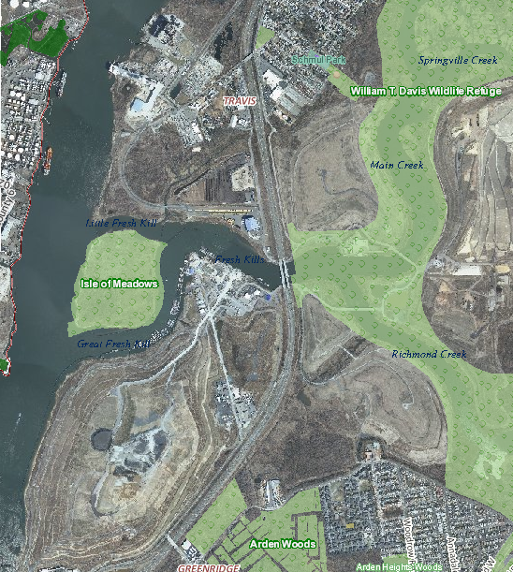
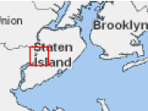
Initial site possibilities: Isle of Meadows

Slide 9
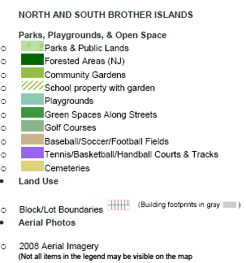
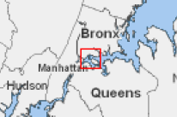
Initial site possibilities: forage near North and South Brother Islands
Notes:
Currently are used as nesting habitat (higher restoration risk)
North: predominantly Black-Crowned Night Herons; well-forested; bulkheaded/built to be above 100-yr flood; Norway Maple
South: multiple species, and is mostly sandy beach and rocky outcroppings with some black locust
Carter – 800 ft. shoreline restoration on nearby Randall’s Island is being investigated…could be paired with these sites as a
potential study of the influence of adjacent forage habitat restoration on nesting.

Slide 10
Next steps
Work with Harbor Herons subcommittee and potential partners to create a restoration and experimental design plan.
Define partners, available funding, and create a funding timeline for pieces of the project.
Consider the launching of the Harbor Herons Pilot project for the next large grant funding cycle.
We need input!! boicourt.kate@epa.gov
Notes:
Using the Conservation Plan as an initial resource, but keeping in mind the potential sites, expected resource availability, and possibility of integrating research into existing, longer-term programs.
Create a short and long-term timeline, with a feasible short-term project that involves both restoration and research.

