Slide 1
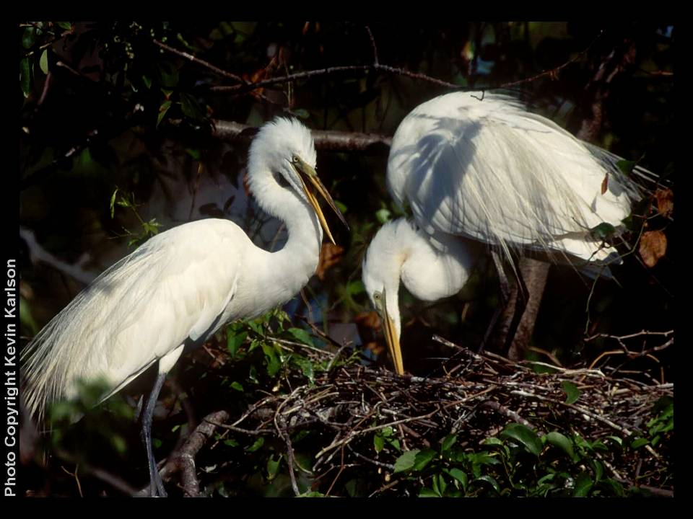
Harbor Heron – Citizen Science Update
2008-2010
Kristin Munafo, Elizabeth Ng, Tom Smith, Kate Ruskin, Kim Mendillo, and Nellie Tsipoura, New Jersey Audubon;
Susan Elbin, John Rowden, and Joe O’ Sullivan, New York City Audubon

Slide 2
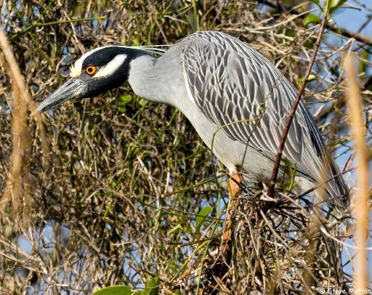
Harbor Heron Citizen Science Surveys
Collaborative effort of NJAS, NYCA and NJ Meadowlands Commission
Fill gaps in knowledge in the New Jersey Wildlife Action Plan for coastal areas in the Hackensack Meadowlands and the Raritan Bay
Collect information needed for the Harbor Heron Conservation Plan

Slide 3
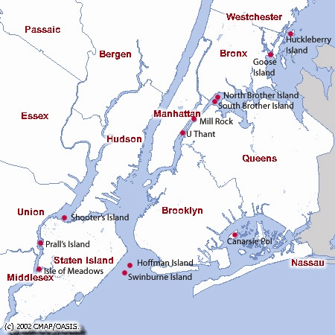
Harbor Heron Breeding Colonies

Slide 4
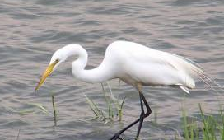
Harbor Heron Feeding Areas
Birds fly from island nesting colonies to other areas where they forage
Much more is known about breeding colonies than
foraging sites
  Surveys of herons away
  from breeding colony
  are more challenging

Slide 5
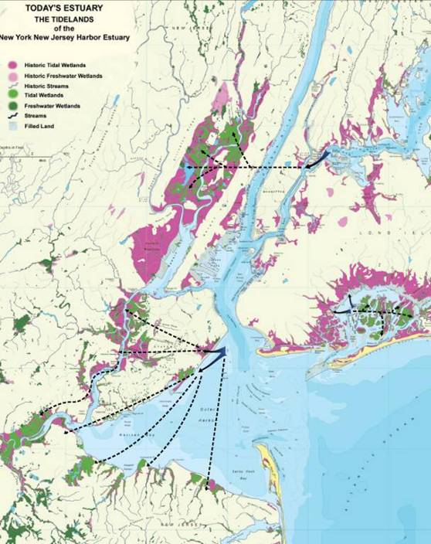
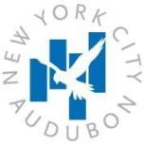
Where do birds from each island go to forage and loaf?
  Flight direction information
  Tagging and telemetry

Slide 6
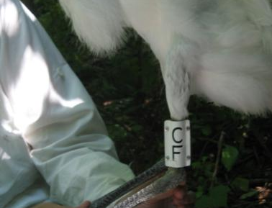
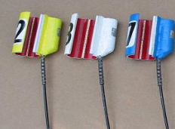
Where do birds from each island go to forage and loaf?
  Flight direction information
  Tagging and telemetry

Slide 7
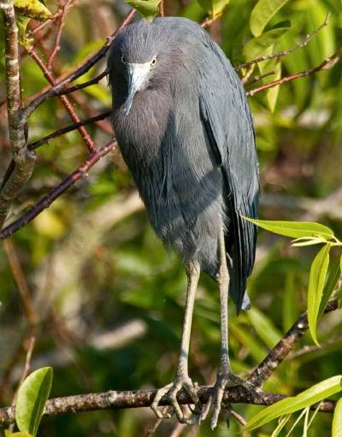
Citizen Science Survey Objectives
Determine the abundance and distribution of ‘Harbor Herons’ at foraging sites
  Tide, time of day
  Habitat, site factors
  Seasonal patterns
Explore foraging behaviors
  Foraging success
  Time/activity budgets
  Aggressive interactions
Mobilize, train, and coordinate citizen scientists

Slide 8
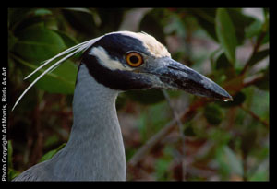
Citizen Science Methodology

Slide 9
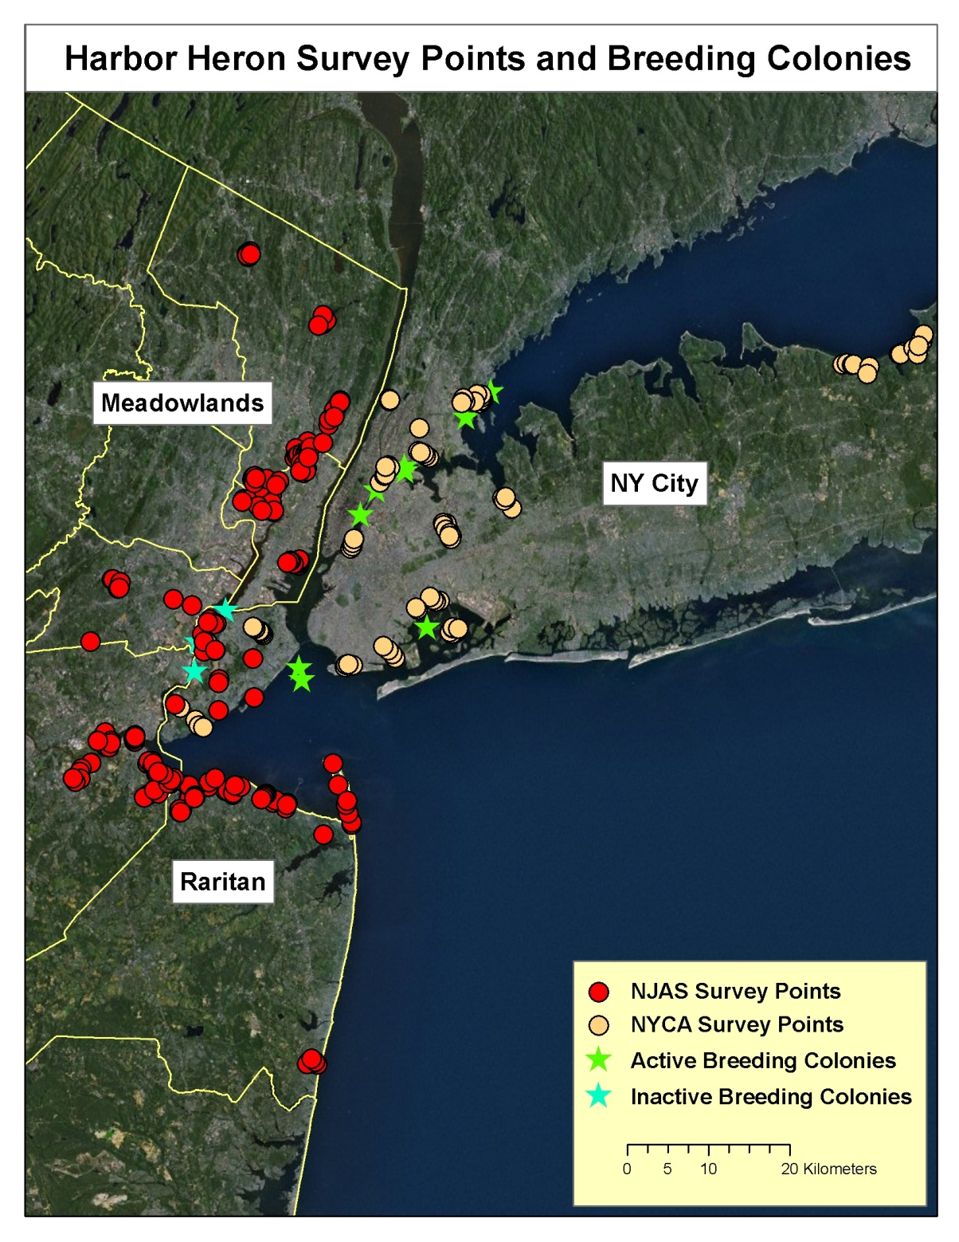
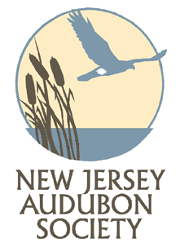
Survey Sites
NJA (2008-2010)
43 Sites
217 Points
NYCA (2009-2010)
20 Sites
> 110 Points

Slide 10
Survey Methodology
Sites are visited ~ 10 times between May and October
During each survey, and at each point the observer records:
    Point information: tide level, time of day, habitat and weather
    The total count of each heron and egret species
    Behavioral observations for selected birds

Slide 11
Target Species
Great Egret (GREG)
Snowy Egret (SNEG)
Black-crowned Night Heron (BCNH)
Yellow-crowned Night-Heron (YCNH)
Great Blue Heron (GBHE)
Glossy Ibis (GLIB)
Green Heron (GRHE)
Little Blue Heron (LBHE)
Tricolored Heron (TRHE)

Slide 12
Habitat Assessment
Habitat is characterized at each survey location as the percentage of each habitat type:
Un-vegetated Habitats
  MF – Mudflat
  OW – Open water
    OWA – Open Water above the (bird’s) knee
    OWB – Open Water below the knee
Vegetated Habitats
  Low Marsh (LM), High Marsh (HM) or Phragmites (PH)
  FO – Forest
  SC – Scrub/shrub

Slide 13
Recording Tide Information
Tide is recorded for every point visit:
Observers select whether the point is tidal or non-tidal
Using site specific tide tables, observers record the time of the nearest low tide. We use this to categorize visits into:
      Low tide
      High tide
      Mid-outgoing
      Mid-incoming

Slide 14
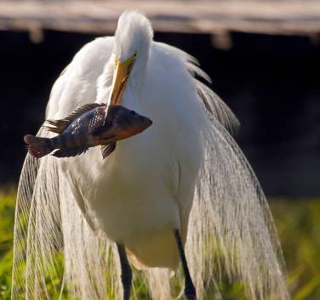
Behavioral Observations
Observe each individual for 3 minutes and record:
Species and age (if known)
Habitat
Behavior
Number of strikes
Number of successes
Neighbors
Aggressive behavior

Slide 15
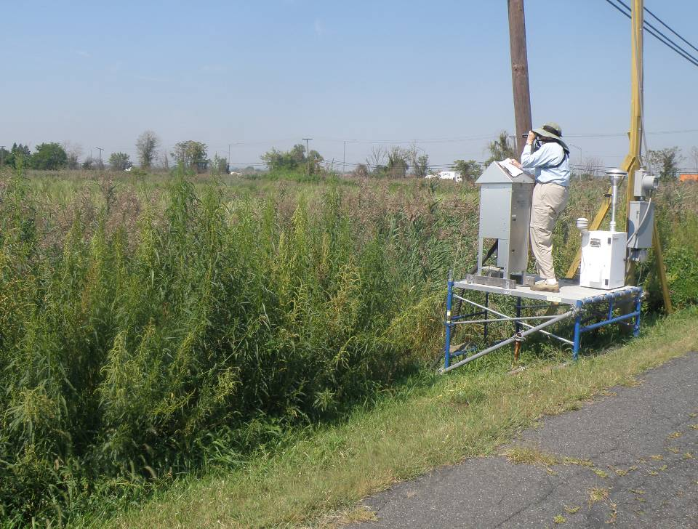
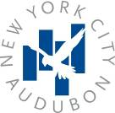
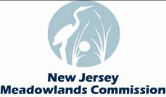

2008 - 2010: RESULTS

Slide 16
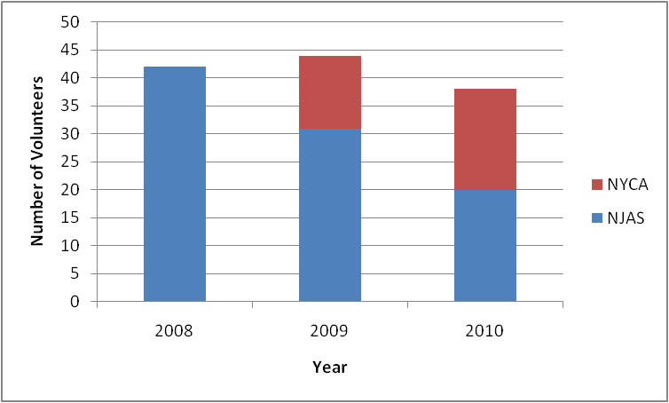
Volunteer Participation
Notes:
Recruited and trained new volunteers in 2009
In 2010, continued with some training, but didn’t have the dedicated staff to expand the project.

Slide 17
2008: Pilot Study
42 Volunteers surveyed 30 sites
Conducted 279 site visits
Made 1,567 point surveys
Over 3,340 herons and egrets observed

Slide 18
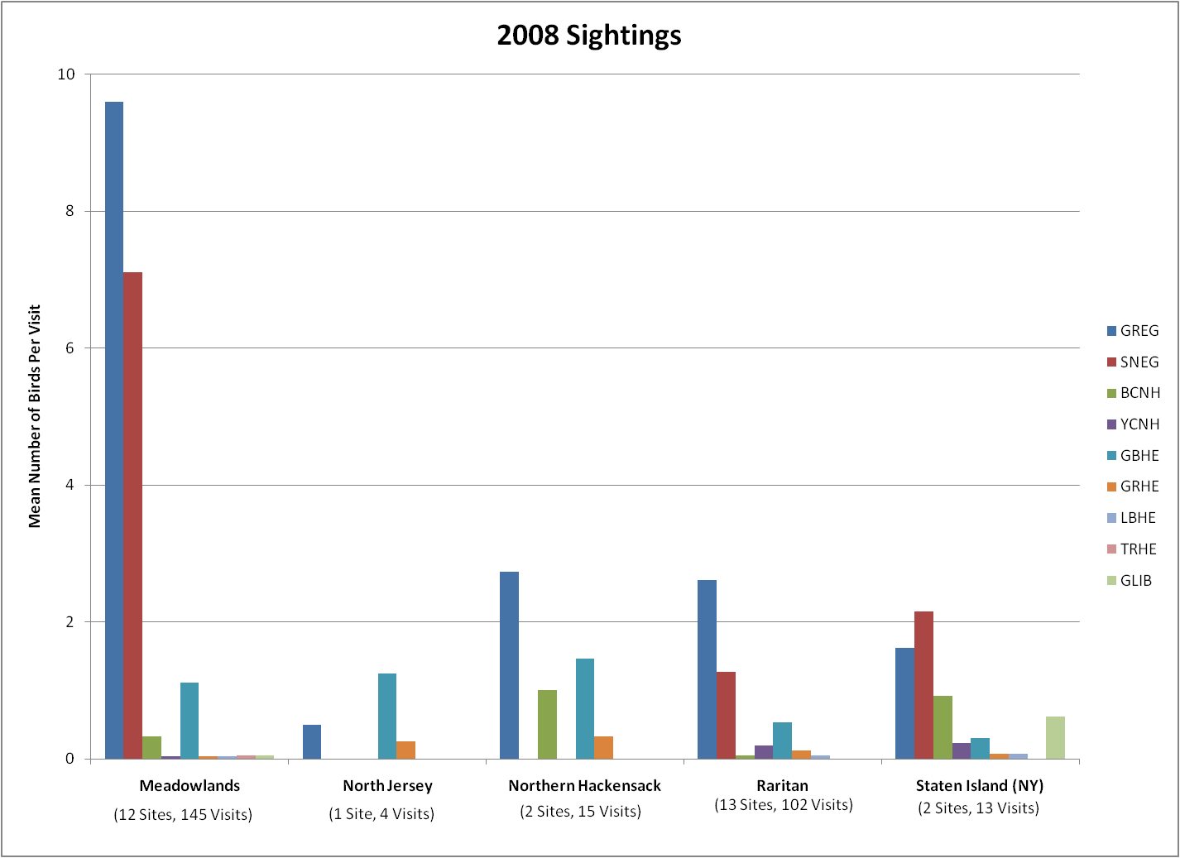
Notes:
-Great Egrets (GREG) were the most common in at all sites, except for North Jersey, where Great Blue Herons were more common, and Staten Island, where Snowy Egrets (SNEGs) were most common.
-More colonial wading birds were observed at the Meadowlands per visit than any other site:
- Average of 9.6 Great Egrets per visit
-Average of 7.1 Snowy Egrets per visit
-Small sample size at North Jersey, but Great Blue Herons were common there
-Great Blue Herons were also, on average, the second most frequent Harbor Heron observed at N. Hackensack

Slide 19
2009: Study expands
31 NJAS and 13 NYCA volunteers surveyed 39 sites
Conducted 566 site visits
Made 2,491 point surveys
Observed 3,442 herons and egrets
Notes:
Increased the number of sites surveyed and nearly doubled the number of site visits made.

Slide 20
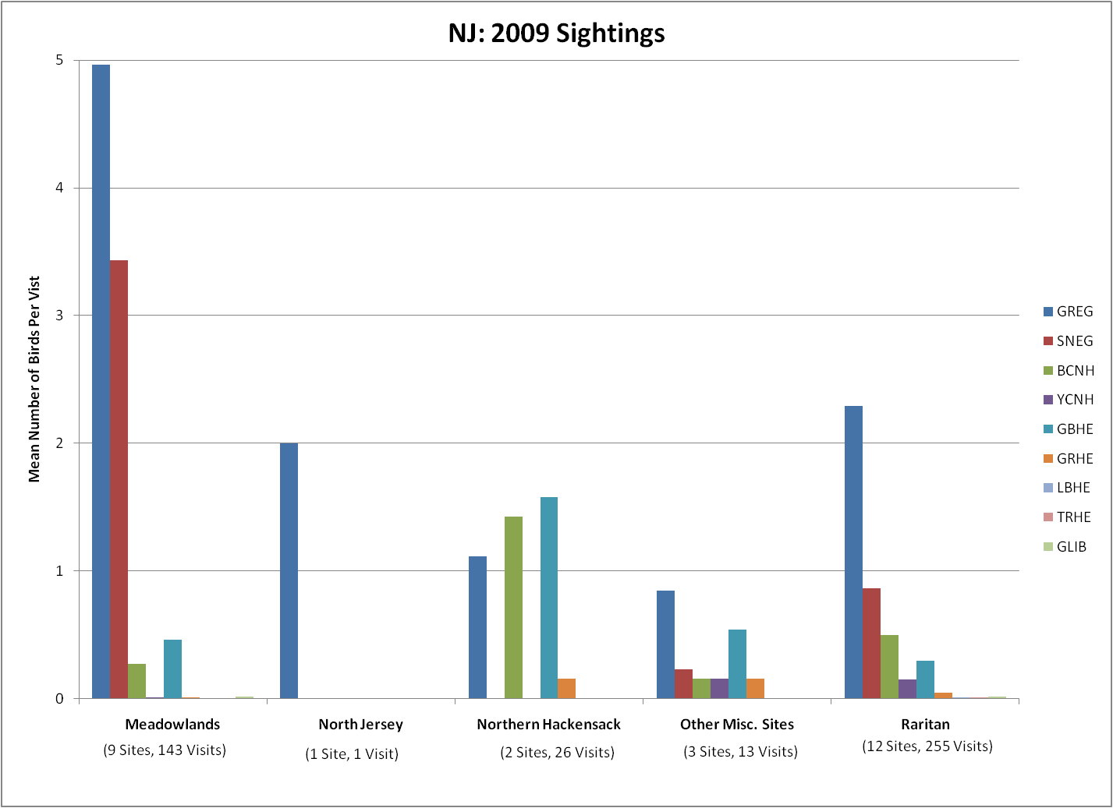
Notes:
-In 2009 as in 2008, there was a high occurrence of Great Egrets and Snowy Egrets in the Meadowlands:
-Average of 5.0 GREGs per visit
-Average of 3.4 SNEGs per visit
-lower average this year (vs 9.6 GREGs/visit and 7.1 SNEGs/visit)
-N Hackensack Great Blue Herons, Black-crowned, and Great Egrets were once again the most commonly observed species.
-Other Misc. Sites (Elizabeth River, Liberty State Park, and Wreck Pond)
-In Raritan, as in 2008, GREG was common, with 2.3 birds sighted on average survey

Slide 21
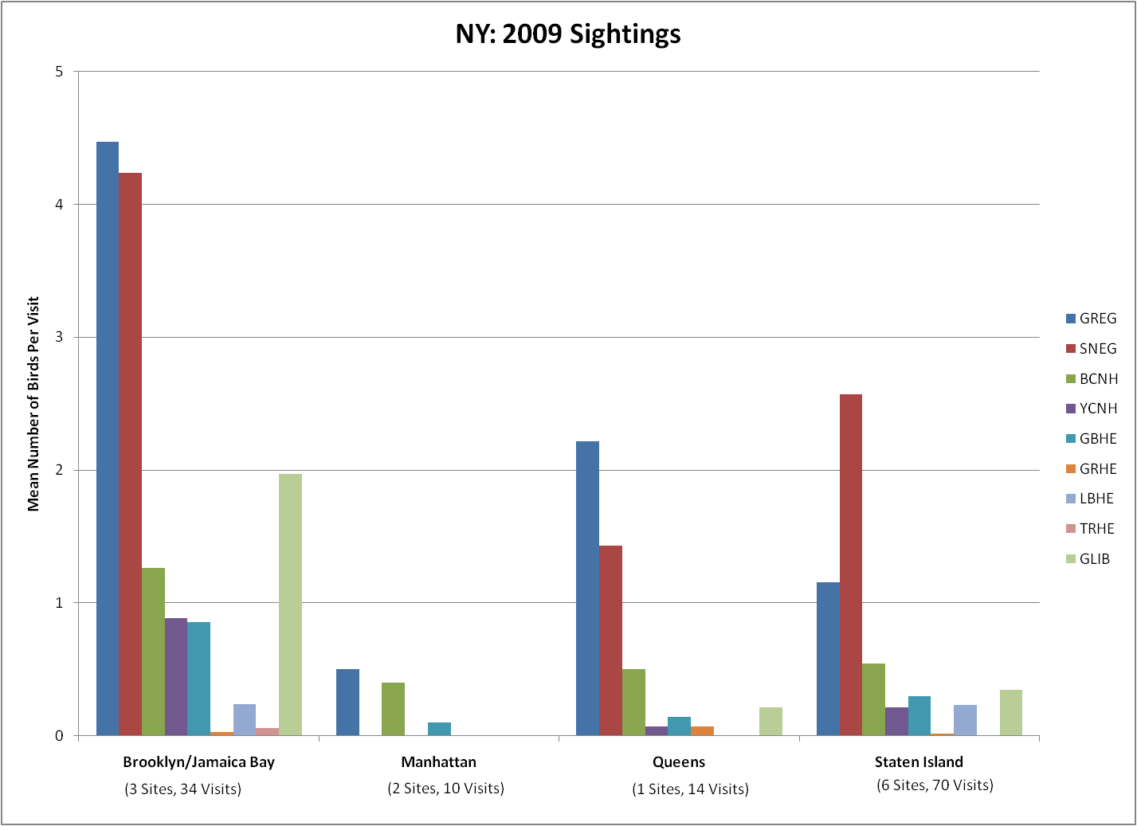
Notes:
-GREGs were once again observed at every site, and, on average, was the most common species at Brooklyn/Jamaica sites, and Queens
-The Brooklyn/Jamaica Bay area more diverse, including an average of ~2 Glossy Ibis per site visit.
-As in 2008, SNEGs are the more common species at Staten Island (2.6 SNEGs on average, vs. 1.2 GREGs)

Slide 22
2010: Study maintained
20 NJAS and 18 NYCA volunteers surveyed 34 sites
Conducted 487 site surveys
Made 2,303 point visits
Observed 2,851 herons and egrets
Notes:
-No dedicated staff to organize or run programs, so the study was not expanded this year.
-Slightly reduced the number of sites and number of surveys conducted (by over 10%)

Slide 23
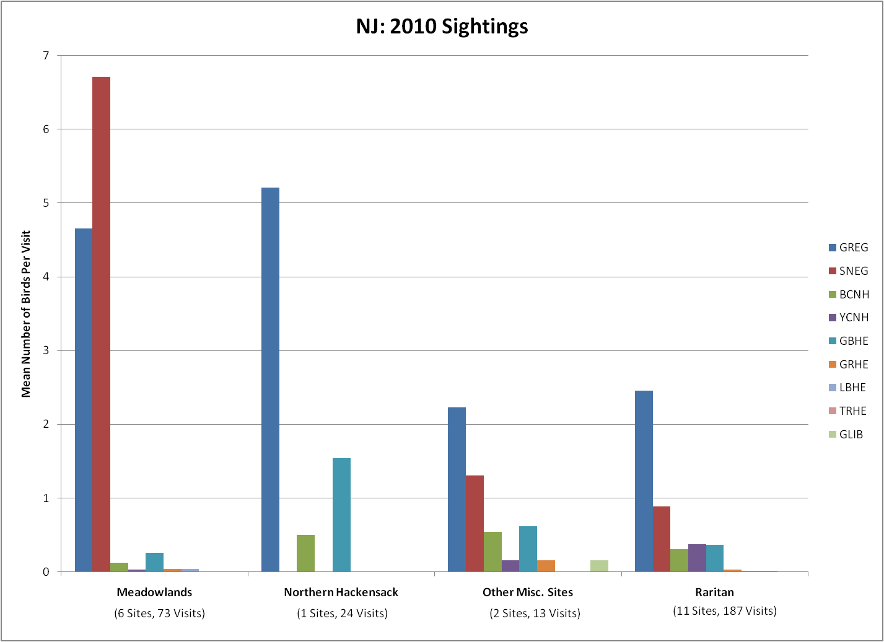
Notes:
-GREGs once again observed at all sites
-BUT in 2010 at Meadowlands, SNEGs were observed, on average, more frequently than GREGs (different from past 2 years)
-Average of 6.7 SNEGs / visit
-Average of 4.7 GREGs / visit
-As in 2008, GREGs most common in North Hackensack (average 1.5 Great Blue Herons / site visit) though Great Blue herons were also observed, on average, at a higher rate than other sites.
-Raritan, GREGs still the most common species at rate consistent with past years.

Slide 24
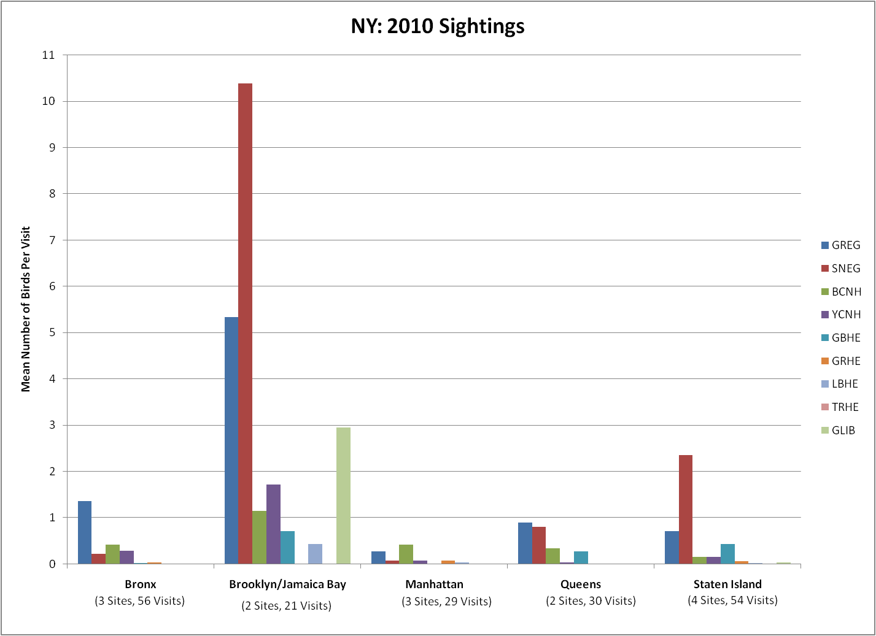
Notes:
-(First thing to notice is) Big increase in average observed SNEGs at Brooklyn/Jamaica Bay sites (like Meadowlands)
-In 2009, site averaged 4.5 GREGs and 4.2 SNEGs per site visit
-In 2010, average jumped to 5.3 GREGs and 10.4 SNEGs per site visit
-Also saw again presence of Glossy Ibis, averaging 3 sightings per site visit
-Staten Island again with SNEG as most common species
-Average 2.4 SNEGs per site visit

Slide 25
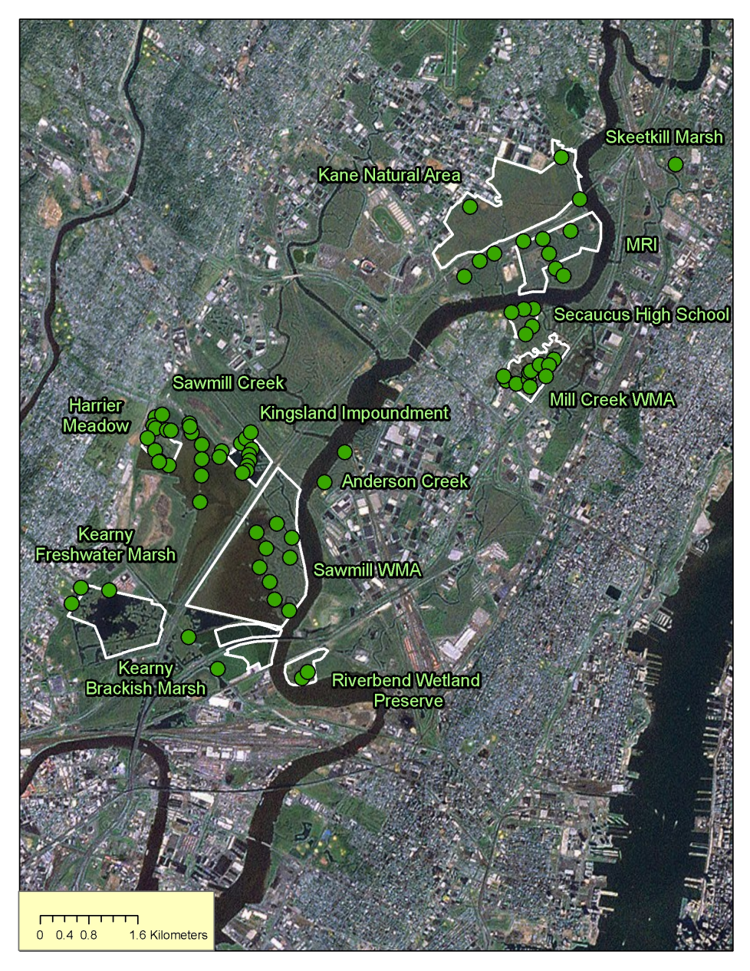
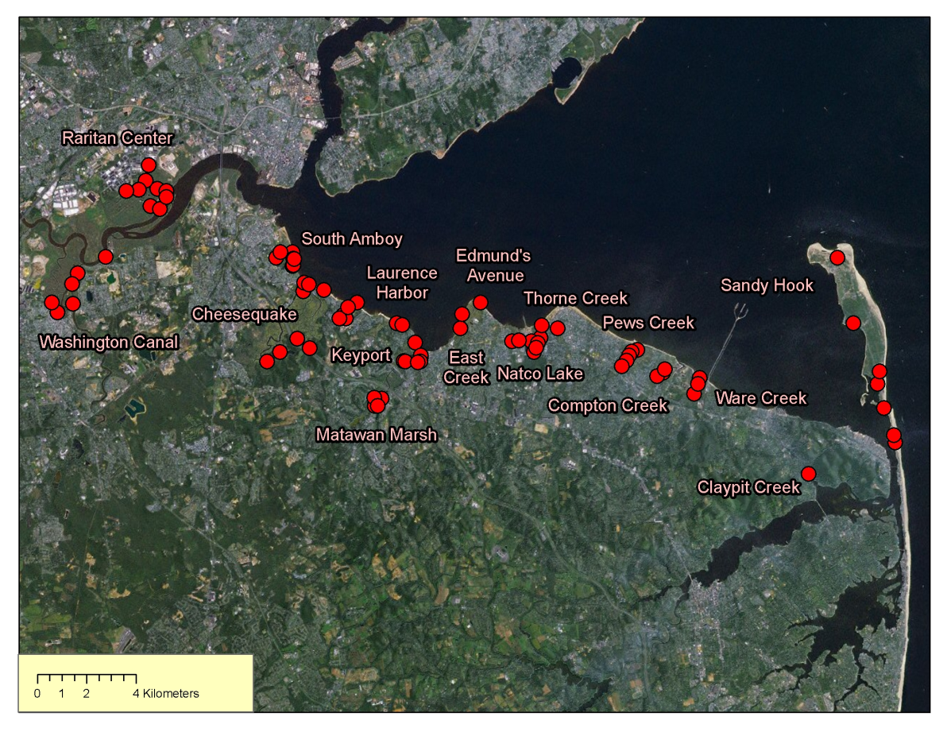
NJ Primary Focal Areas
Raritan
Meadowlands
Notes:
-Site-level look at the Meadowlands and Raritan
-Most comprehensively observed areas

Slide 26
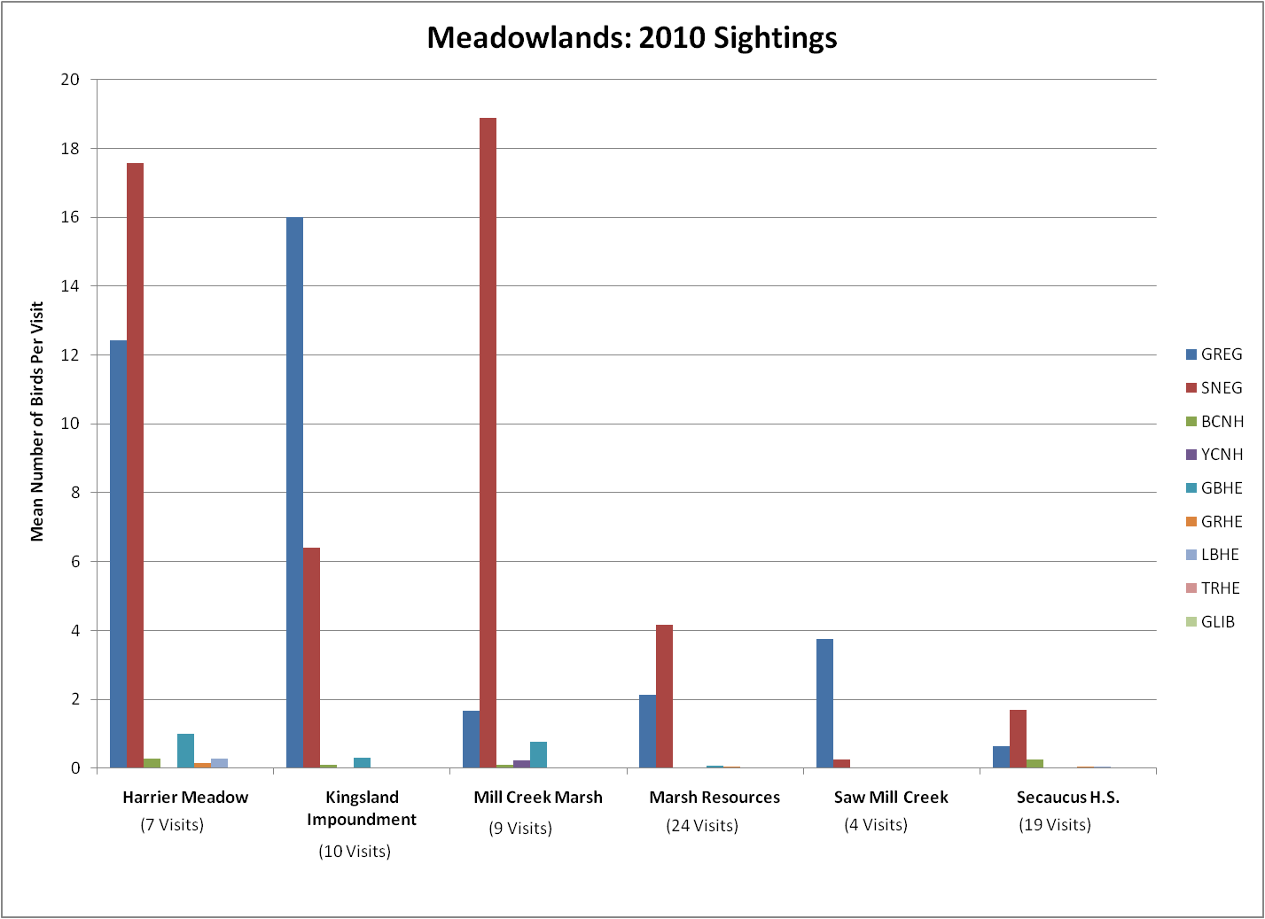
Notes:
-2010 was different from 2008 and 2009 overall, because SNEGs appeared more frequently on average than GREGs (Average of 6.7 SNEGs / visit)
-Seems to be due to the high rate of observation at Harrier meadow and Mill Creek Marsh

Slide 27
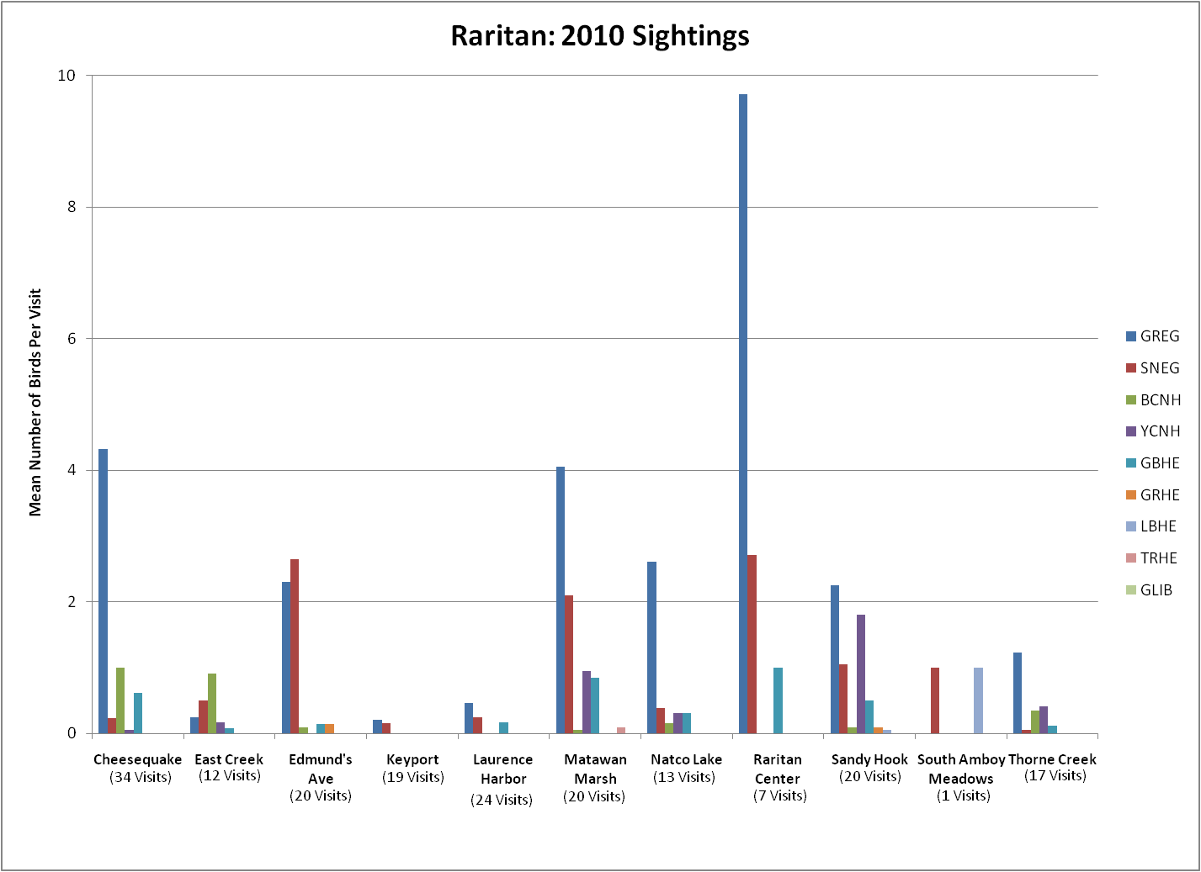
Notes:
-Overall at Raritan in 2010, GREGs were most common, as in 2008 and 2009
-Raritan Center common place for GREGs (average 10 GREGs per visit)
-Cheesequake and Matawan Marsh were also important areas for sighting GREGs

Slide 28
Conclusions
Great Egrets observed in all areas
Snowy Egrets second most common
Great Blue Heron commonly observed at North Hackensack
2010 Increase in average number Snowy Egrets observed
Notes:
-GREGs observed in all of the study areas, and were often the dominant species (especially at Meadowlands, Raritan)
-SNEGs were the second most common (and were consistently the most frequently observed species at Staten Island)
-GBHE, and to a lesser extent BCNH, were also important species at North Hackensack (inland-nesting GBHE may prefer this area)
-Smaller (but consistently observed) contingent (~2/visit) of GLIB at Brooklyn/Jamaica Bay, where they may breed.
-Interesting note from 2010, an apparent increase in the mean number of Snowy Egrets observed
-Increase in Meadowlands moved SNEGs above GREGs as most common species
-In Brooklyn/Jamaica Bay, more than doubled the average number of SNEGs sighted per visit

Slide 29
Future Work
Continue entering and proofing data
Explore relationship between foraging, tide, and habitat use

Slide 30
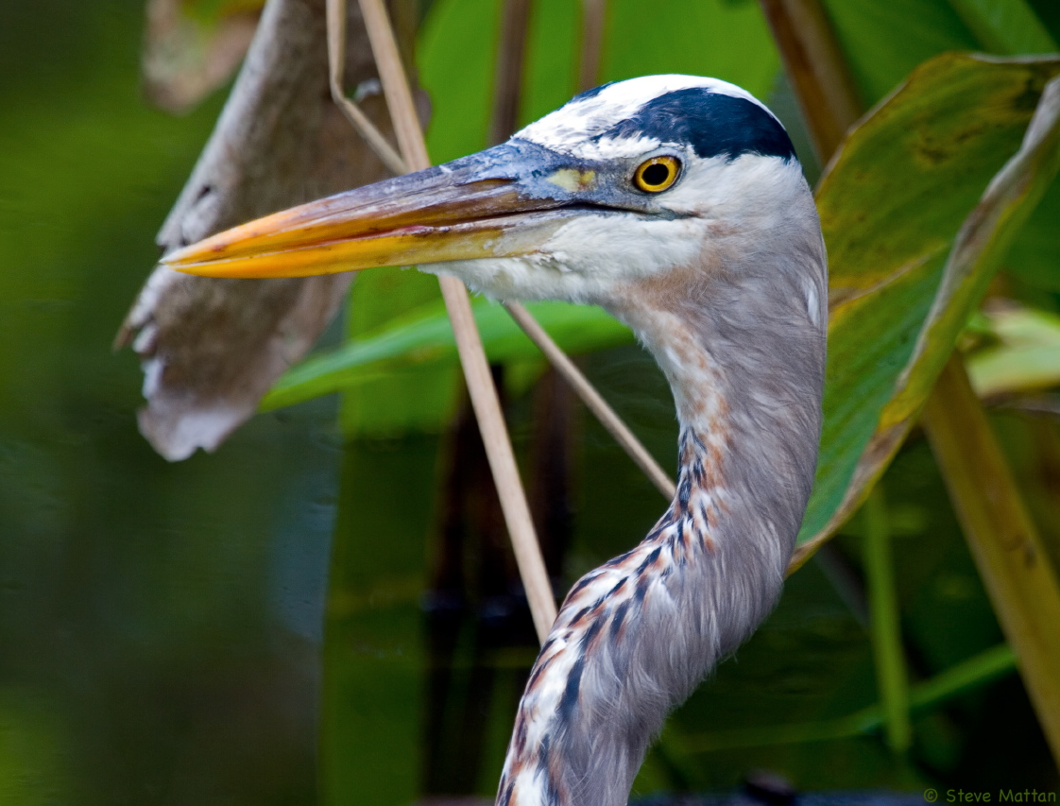
Acknowledgments
Thanks to all our dedicated volunteers!
Andy Ackerman
Laura and Sara Alderson Catharine Barron
Susan Beck
Jennifer Beirne
Lisa Boulanger
Tim Bourne
Claudia Brumbaugh
Andrew Burmester
Karen Carlough
Margaret Casagrande
Leonor Chavez
Judy Chen
Heidi Cleven
Yoryi De La Rosa
Lisa DeFancesco
Donna Evans
Mike Fedosh
Allen Field
Ann Fridlind
Dave Gamache
Joel Geib
Jerry Golub
Camille Gutmore
Kiera Hepford
Wendi Harrison
Sandi Hemmerlein
Barbara Hendrickson
Tom and Judy Honohan
Jean Hummel
John Jegla
John Kandybowicz
Lena Kelly
Cheryl Kern
Ann Klepner
Joanne Kornoelje
Joe Kulhanek
Erica Linnell
Emily Loffredo
Ernie Lowenfels
Mary Jo Marino
Joe Martin
Janene Matragrano
Scott McCoy
Dennis McNamara
Pat Meko
Kim Mendillo
Jackie Milander
Terry Milligan
Dan Morley
Lucy Betti Nash
Peggy Nitka
Lorraine Novinski
Tom Ostrand
Nancy O’Keefe
Joseph O’Sullivan
Elke Passarge
George Pitcher
Irving Robbins
David Rosenblatt
Ed Rumain
Pam Salkeld
John and Sue Schmerler
Bette Scott
Ken Sieben
Tom Smith
Liz Sorg
Debra and Dan Sweet
Chris Takacs
Lydia Thomas
Don Torino
Andrew Turk
John Tyler
Elizabeth Vreeland
Rei-Hua Wang
Mary Watkins
Dana Weber
Jessica White
Jay Wiggins
Tod Winston
Darren Zap
Naomi Zurcher
Funding was provided by:
New Jersey Meadowlands Commission, Conserve Wildlife Foundation of NJ, Educational Foundation of America, NOAA,ConocoPhillips Bayway Refinery, Leon Levy Foundation

