Slide 1
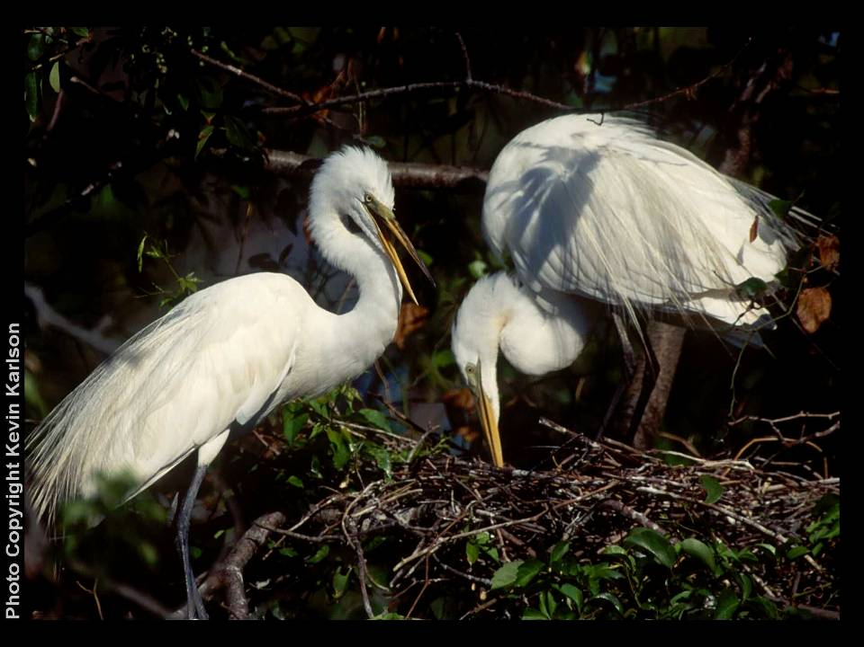
Harbor Herons Citizen Science Surveys: Issues, Constraints, and Future Directions.
Nellie Tsipoura, Kristin Munafo, Tom Smith, Kate Ruskin, Kim Mendillo, New Jersey Audubon;
Susan Elbin, New York City Audubon

Slide 2
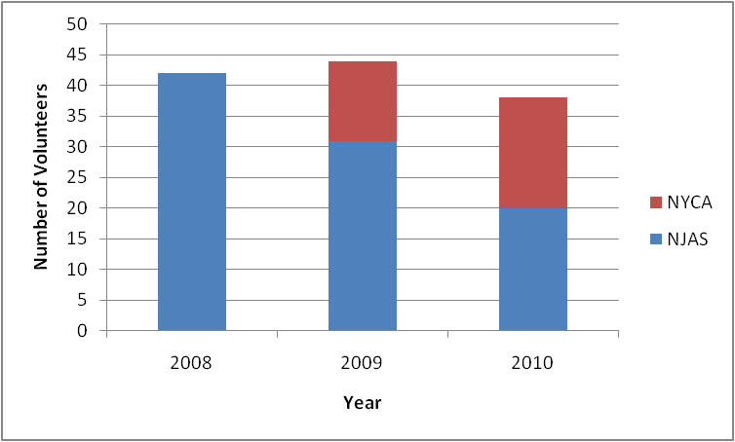
Why do these Citizen Science surveys work?
Dedicated citizen scientists
Trainings
Volunteer input welcome
“Participatory” project
Online data entry
Carefully crafted protocols
Maintaining contact with volunteers

Slide 3
What are the issues
Habitat Assessment
Effects of Tides
Distance
Data entry and program administration

Slide 4
Habitat Issues
Reported percentages may change drastically from one survey to the next.
  In some cases, this may represent actual habitat changes that occurred at the site. In other cases, it may be due to variation in visual estimates from one visit to the next.

Slide 5
Habitat Issues
Volunteers may have different approaches for estimating habitat percentages.
  Some volunteers have done this by deciding on percentages during the first survey, and then change only those percentages that really change (e.g. mudflat vs. open water).
  Other volunteers estimate percentages independently during every survey.

Slide 6
Habitat Issues
Possible solutions:
Use only the dominant habitat class for analysis.

Slide 7
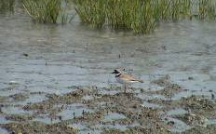
Habitat – NJ and NY Data
Average total counts per point visit, for each dominant habitat type (as selected by volunteer)

Slide 8
Habitat Issues
There are discrepancies within the same survey, between the overall site habitat percentages recorded and the individual bird habitat entered under the behavioral observations.

Slide 9
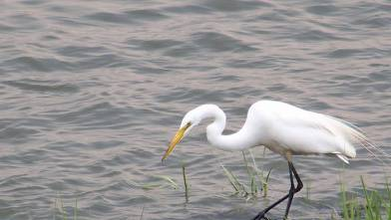
Habitat – Preliminary Data
Specific habitats used by birds volunteers selected for behavioral observations

Slide 10
Habitat – What does it mean?
Bird distribution may be related to dominant habitat type even if when they selectively use a different habitat type within the site
  Mudflat/open water changes with tide
Volunteers are selecting birds in a biased way for their behavioral observations.
  Volunteers may be selecting open water habitat preferentially over other habitats
Sampling bias?
  More data from open water sites
More information is needed!

Slide 11
Habitat Issues
Possible solutions:
Explore habitat characteristics of sites where no birds were seen?

Slide 12
Habitat – NY and NJ Data
Dominant Habitat for Points with no birds observed (on any survey)

Slide 13
Habitat – NY and NJ Data
Dominant habitat for points with no birds observed was open water
Not different from the predominant habitat for the individual bird observations.
However,
Is open water without associated mudflat a reflection of hardened shorelines and water levels that may be too deep for egrets?
More information is needed!

Slide 14
Habitat Issues
Possible solutions:
Can we analyze a subset of the data to look at habitat use patterns?

Slide 15

Habitat – NJ Data
Water depth for Great Egrets and Snowy Egrets

Slide 16
Habitat – NY Data
Water depth for Great Egrets and Snowy Egrets

Slide 17
Habitat Issues
Can we make management recommendations for specific habitats based on these data?
??? Maybe not
We can analyze a subset of the data to look at habitat use patterns.
More complex data becomes more difficult to interpret.

Slide 18
Habitat Issues
Solutions:
Standardize collection of habitat information
  estimate percentages at the beginning of the season and then change only the ones that vary, while keeping the others constant.
Give volunteers aerial photos to ground truth
  Problematic.
Use staff to record habitat and other relevant site information
  Funding constraints

Slide 19
Tide Issues
Tide information is crucial; however, the data collection and entry can be confusing.
Many sites (in both the Meadowlands and Raritan) have a tide delay, relative to the available tide tables.
  Some volunteers have adjusted tides using the appropriate delay, while others do not. Therefore, tide information needs to be proofed and adjusted before data analysis.

Slide 20
Tide Issues
Management changes at some sites can cause unexpected tide fluctuations
  Sites controlled by tide gates, sites subject to restoration that alters tidal regimes
At some sites it may not be tidal cycle, but the proportion of mudflat and open water that determines use by waterbirds.
  This may also relate to rainfall, site management and lunar cycles.

Slide 21
Tide Issues
Possible solutions:
Collect tide information carefully
  In 2010 we used time of survey and the time of the low to and calculated the stage in the tidal cycle.
Proof tide information carefully
  Incorporate the time needed to enter and correct tidal information before the data can be analyzed in project budgets.

Slide 22
Tide – Preliminary Data
A subset of sites were selected for analysis
Focus on sites that we know have no tidal delay, or for which delay corrections were made.
Meadowlands | Raritan
Mill Creek | Sandy Hook
Marsh Resources | Edmund’s Avenue
Secaucus HS Marsh | Raritan Center

Slide 23
Tide – Preliminary Data
Chi-Square = 7.96; P = 0.04

Slide 24
Tide – Preliminary Data
Chi-Square = 38.1; P < 0.001

Slide 25
Tide – What does it mean?
There is a slight effect of tide for GREGs, with lower numbers at low relative to all other tides.
There is a large effect of tide for SNEGs, with preferences for low and incoming over high and outgoing.
This is in agreement to the results of the habitat/water depth data for SNEGs.
Our Citizen Science data are reasonably good or can be edited and corrected to give us the information we need.

Slide 26
Distance Issues
There are no distance categories for the bird observations.
It would be useful to know which birds are seen relatively close to the point and which are seen at a great distance (e.g. 500m or more).
  This might eliminate biases in the habitat data
  Distance categories may also allow us to undertake some type of detection probability analysis

Slide 27
Distance Issues
Possible solutions:
Have volunteers record birds in distance classes (less than 100m, 100-500m, >500m).
  There may be problems related to distance estimation in the field.
Have volunteers record bird locations on a site map during every survey. This would allow us to identify which portions/habitat within the site the birds are using.
  However this would result in very time intensive data entry and proofing post-data collection.

Slide 28
Program Administration Issues
Decline in volunteer participation without a staff coordinator.
Data are useful, but a certain amount of post-data collection data proofing and manipulation is essential before any meaningful analysis.
Unpredictable site changes (e.g. habitat, tide) need to be tracked through communication with site managers.

Slide 29
Conclusions
Where do we go from here?
Citizen Science data can be used in at least some types of analyses after being corrected and processed
Continue volunteer effort – this allows us to survey many more sites and much more often that we would be able to do with staff.
Develop and obtain funding for a hybrid volunteer/staff program to address specific concerns such as habitat use.

