Slide 1

NYC Parks & Recreation
Natural Resources Group
Secretive Marshbirds on
New York City Parklands
Ellen Pehek, Susan Stanley, Alex Summers, Nate McVay, Evelyn Fetridge, Charles Hofer

Slide 2
NYC Parks & Recreation
Natural Resources Group
What Are Secretive Marshbirds?
  Breed in fresh, brackish or salt marsh
  Not easily detectable using traditional methods of surveying for breeding birds
  Includes Rails, Bitterns, American Coot, Moorhen, Pied-billed Grebe

Slide 3
NYC Parks & Recreation
Natural Resources Group
Two Types of Surveys:
  Breeding bird surveys in Brooklyn, the Bronx and Staten Island
  Call-response surveys in Queens and Staten Island

Slide 4
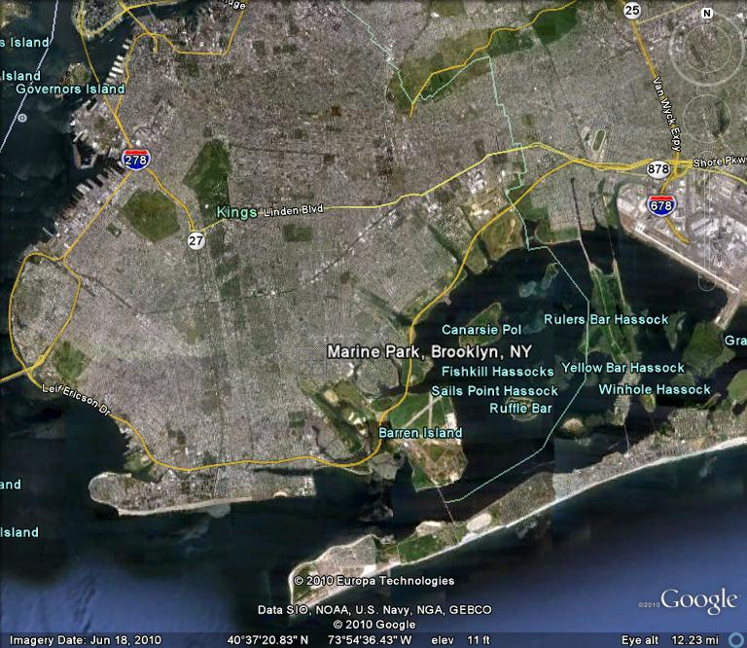
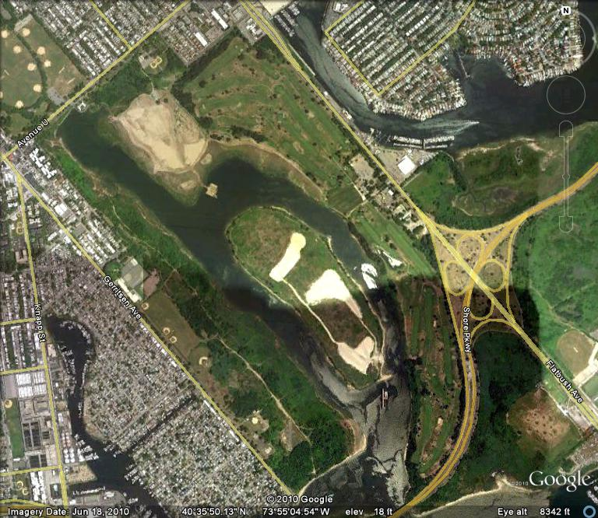
NYC Parks & Recreation
Natural Resources Group
Breeding Bird Surveys: Brooklyn - 2000 & 2002
Marine Park
Clapper Rail - Confirmed
Four Sparrow Marsh Preserve
Clapper Rail - Possible

Slide 5
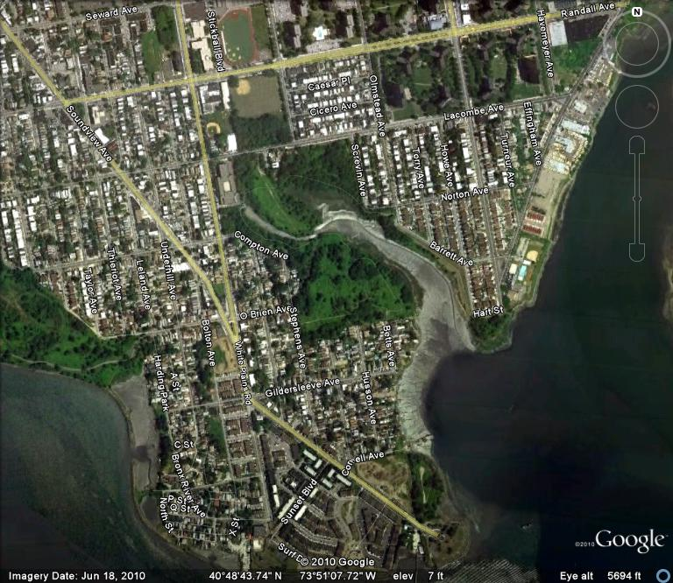
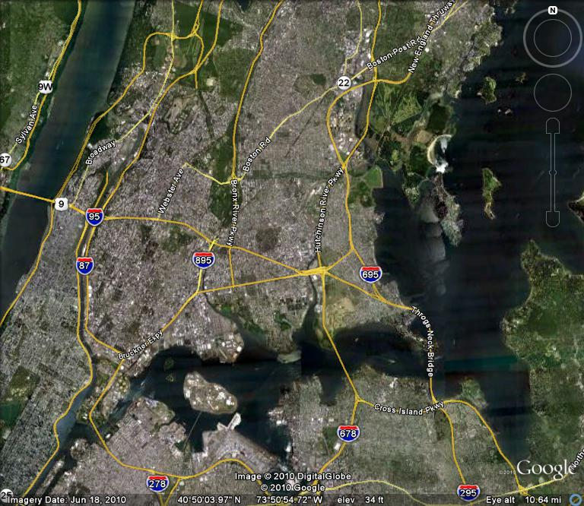
NYC Parks & Recreation
Natural Resources Group
Breeding Bird Surveys: Bronx- 2006
Pugsley Creek
No Marshbirds Observed

Slide 6
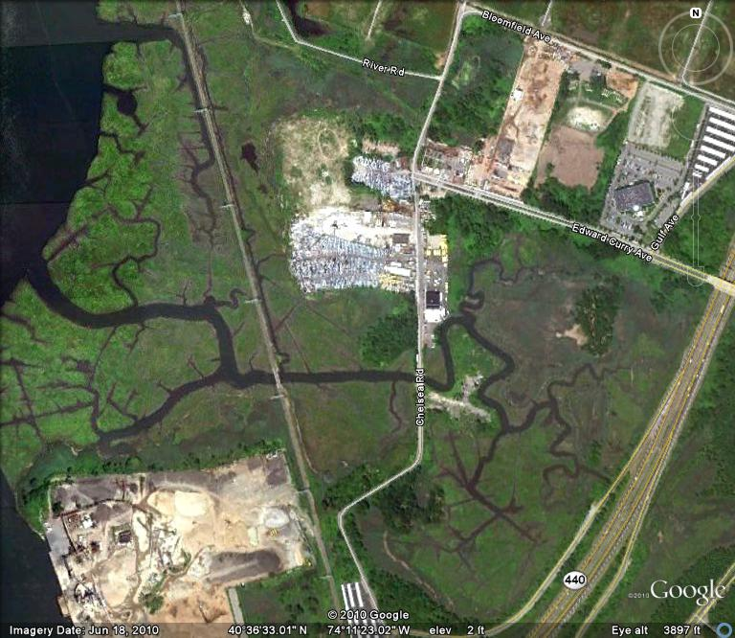
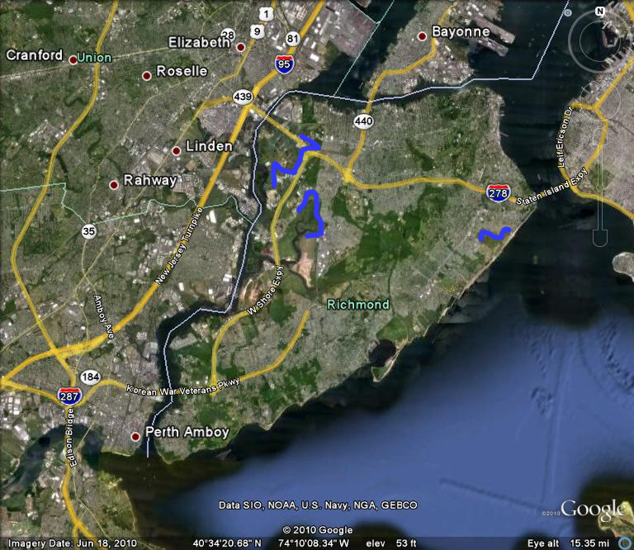
NYC Parks & Recreation
Natural Resources Group
Breeding Bird Surveys: Staten Island -2005 & 2006
Sawmill Creek
Clapper Rail - Confirmed

Slide 7
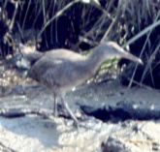
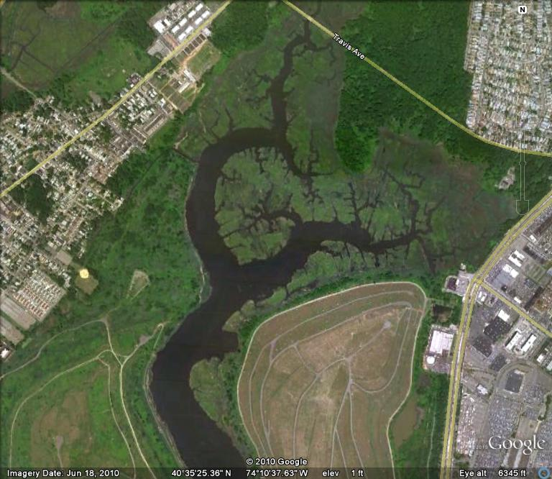

NYC Parks & Recreation
Natural Resources Group
Breeding Bird Surveys: Staten Island - 2006
William T Davis Refuge
Clapper Rail - Confirmed
Alex Summers

Slide 8
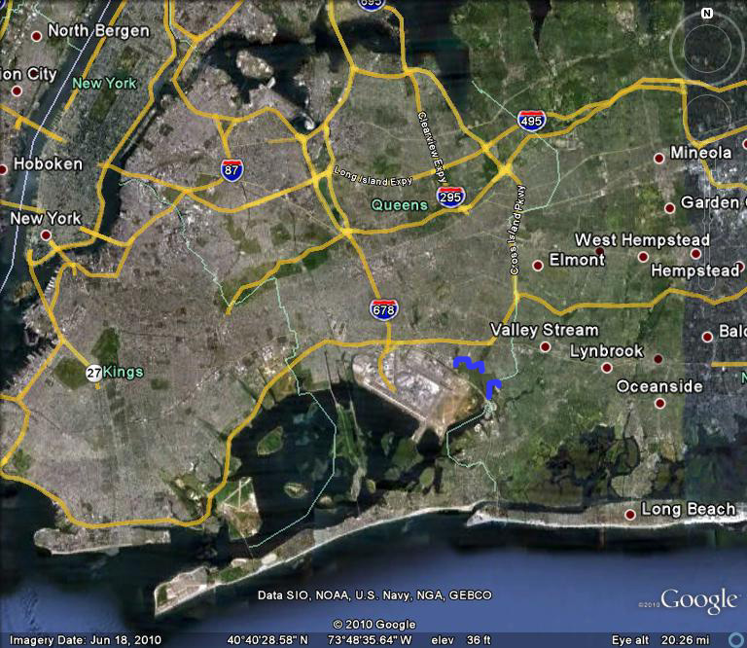
NYC Parks & Recreation
Natural Resources Group
Call-Response Surveys: Queens- 2008
Idlewild
Public Place

Slide 9
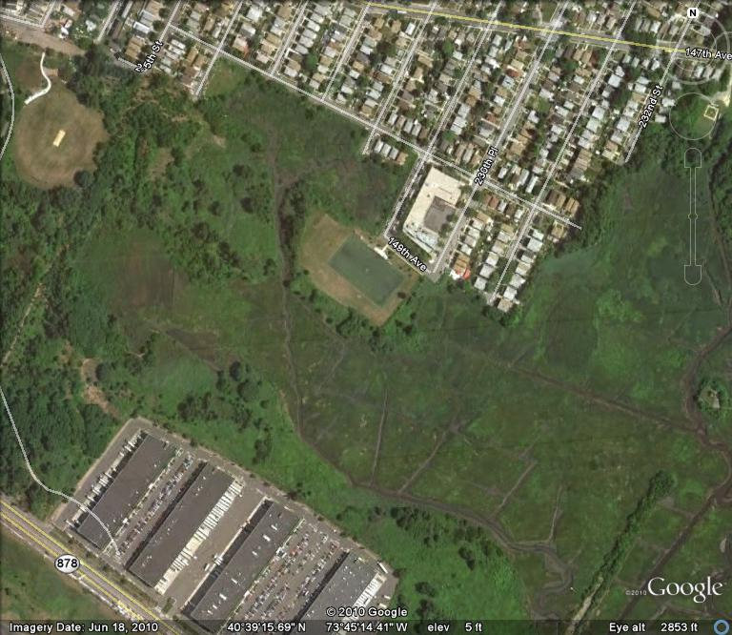
NYC Parks & Recreation
Natural Resources Group
Call-Response Surveys: Idlewild- 2008
Soccer Field 1
Clapper Rail
Idlewild Preserve
Clapper Rail
Soccer Field 2
Clapper Rail

Slide 10
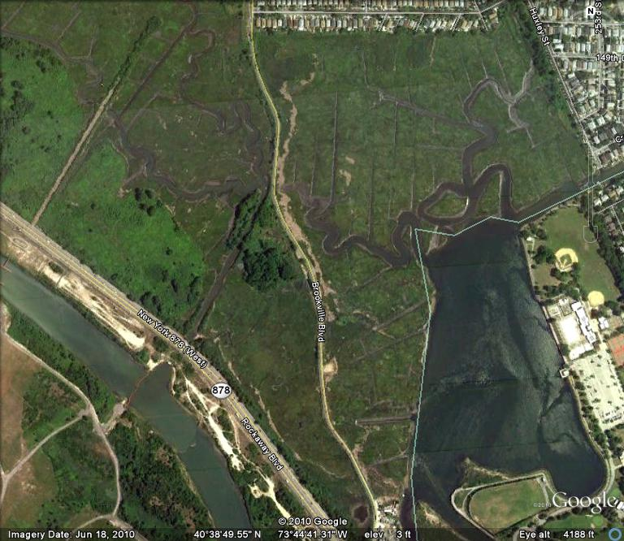
NYC Parks & Recreation
Natural Resources Group
Call-Response Surveys: Public Place- 2008
Huxley
Clapper Rail
Brookeville Blvd
Clapper Rail

Slide 11
NYC Parks & Recreation
Natural Resources Group
Call-Response Surveys: Staten Island - 2008
Northwest SI
South Beach
Wm T Davis

Slide 12
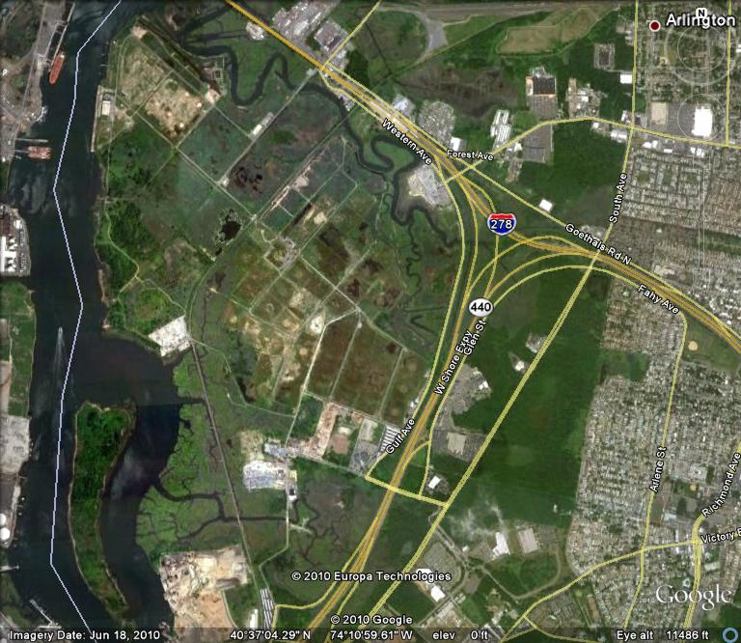
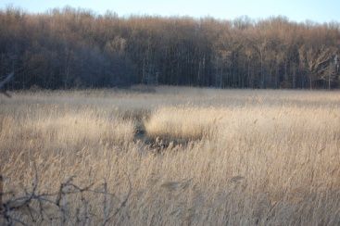
NYC Parks & Recreation
Natural Resources Group
Call-Response Surveys: Northwest Staten Island- 2008
River Road Hibiscus
Virginia Rail
Graniteville
Virginia Rail
Old Place Creek
Virginia Rail
Great Blue Heron
River Road Bend
Clapper Rail

Slide 13
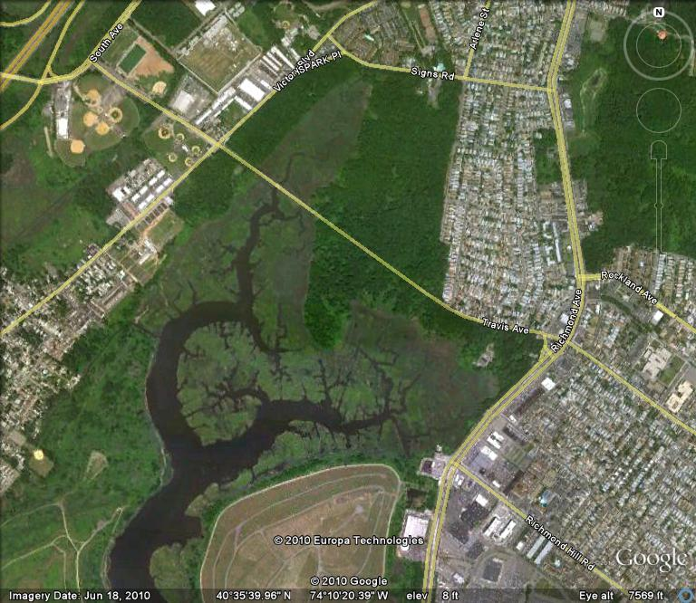
NYC Parks & Recreation
Natural Resources Group
Call-Response Surveys: William T. Davis Refuge- 2008
Wm T Davis 2
Clapper Rail
Wm T Davis 1
Clapper Rail
Wm T Davis 6
Clapper Rail
Wm T Davis 7
Clapper Rail
Wm T Davis 8
Clapper Rail

Slide 14
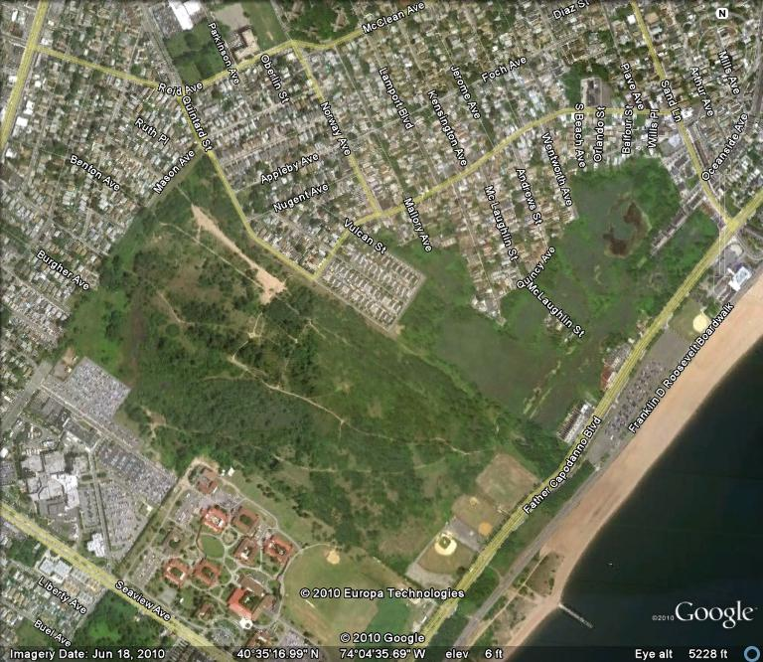
NYC Parks & Recreation
Natural Resources Group
Call-Response Surveys: Northwest Staten Island- 2008
South Pond
Black-crowned Night Heron
Quintard Marsh
Black-crowned Night Heron

Slide 15
NYC Parks & Recreation
Natural Resources Group
Future Surveys:
  Coordination with regional saltmarsh breeding bird surveys
  Call-response surveys in Brooklyn (Marine Park & Four Sparrow Marsh)

