Slide 1

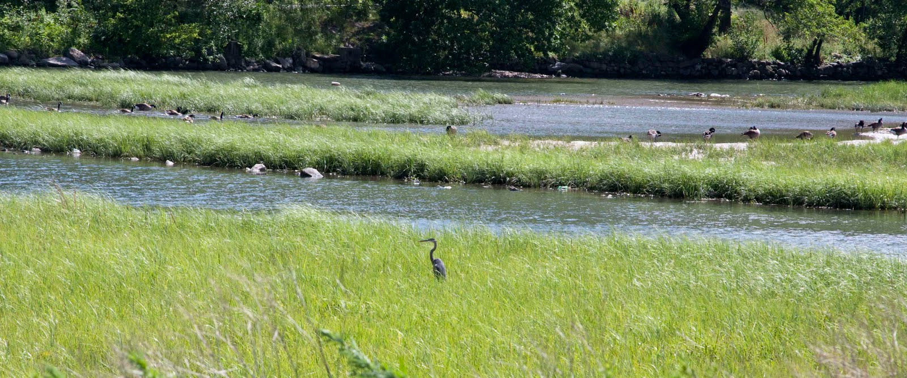
Natural Areas Department
photo by Fernand Brunschwig
Natural Areas Manager
Victoria Ruzicka

Slide 2
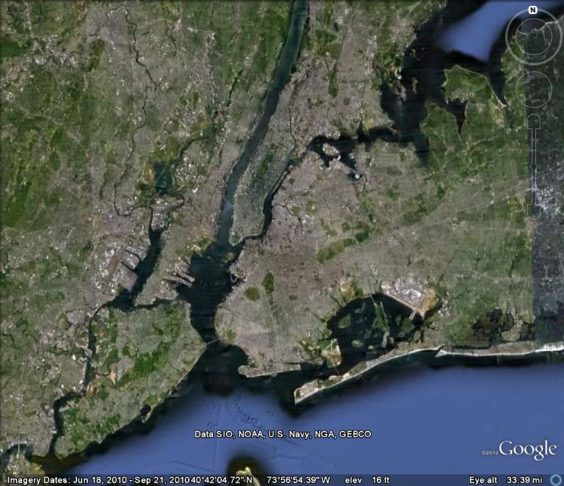

Slide 4
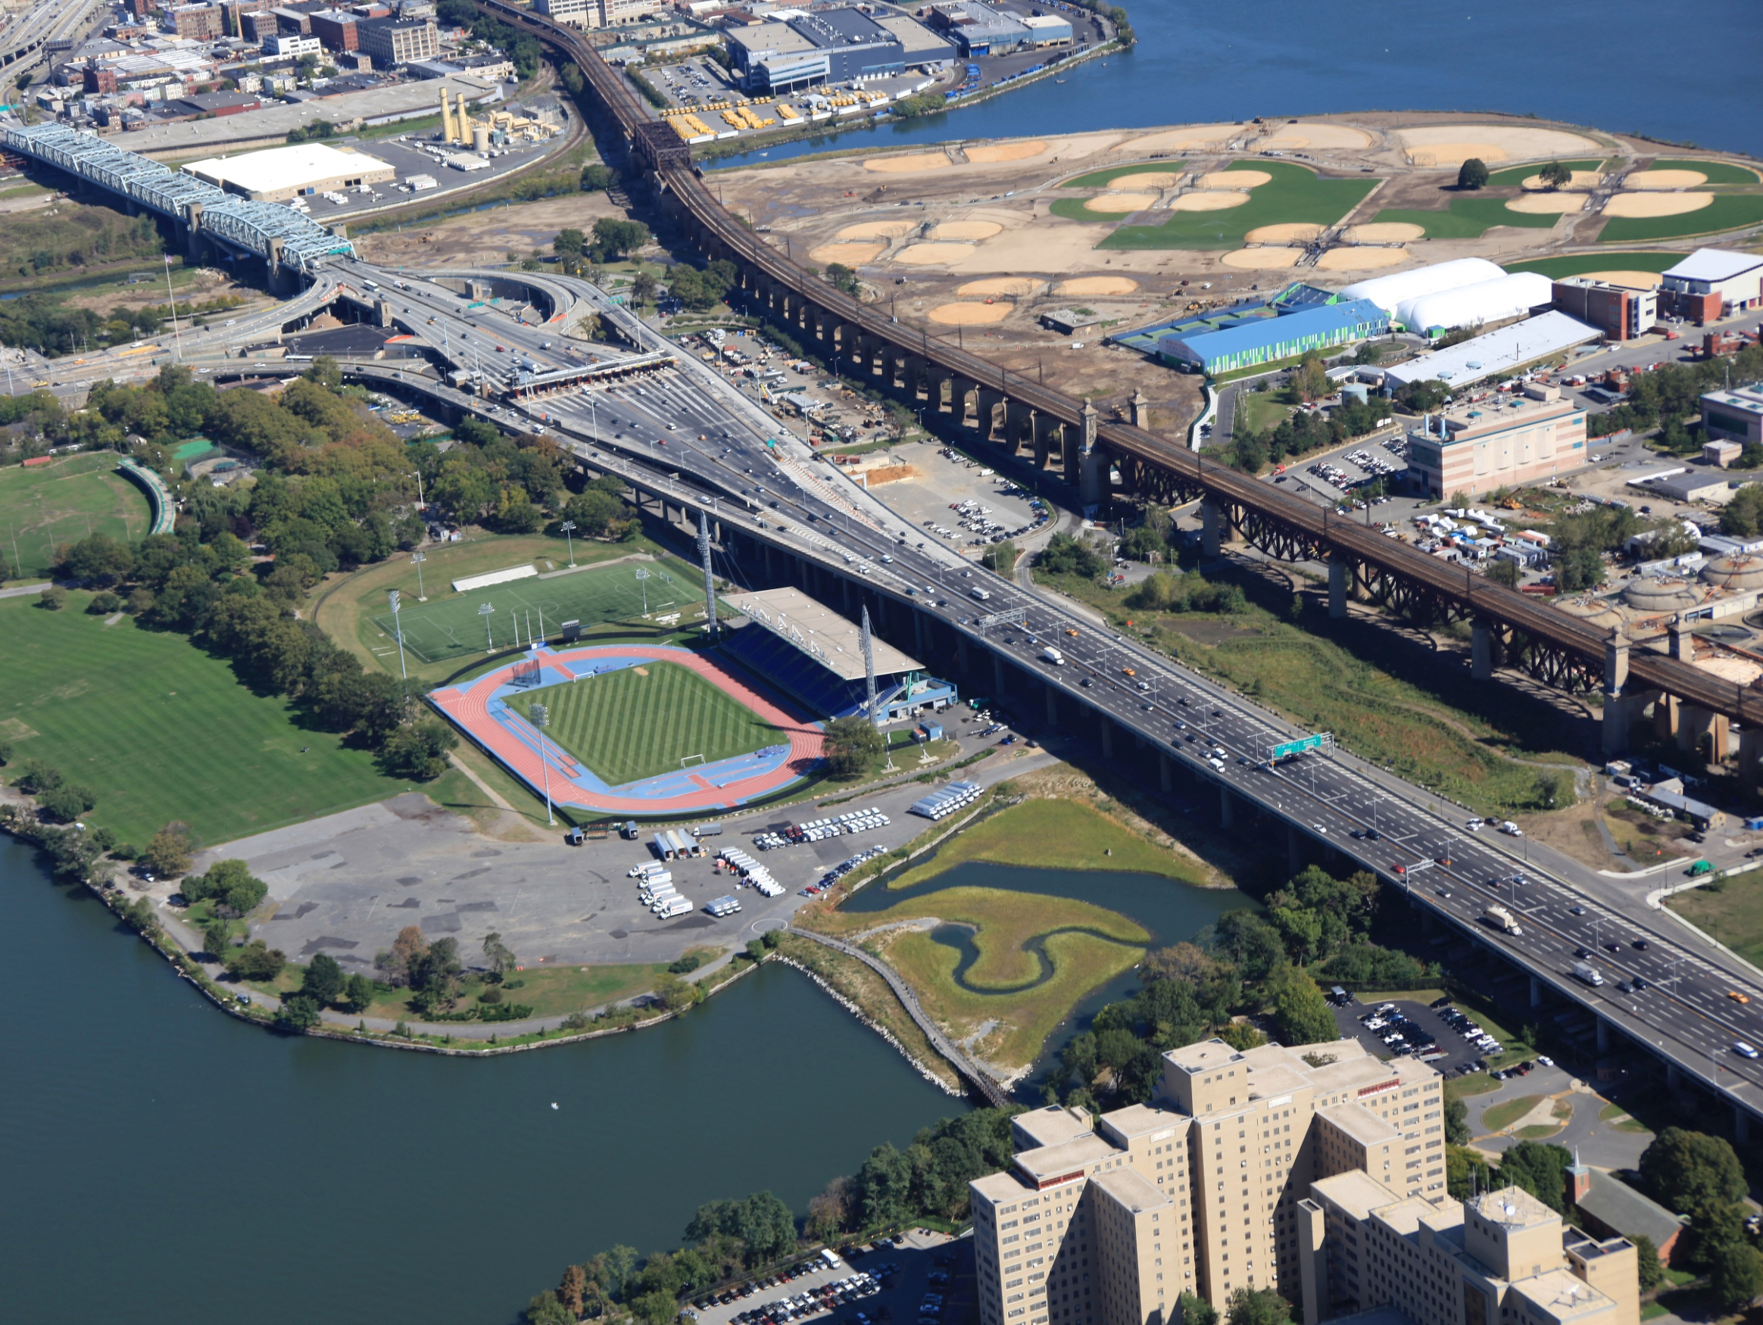
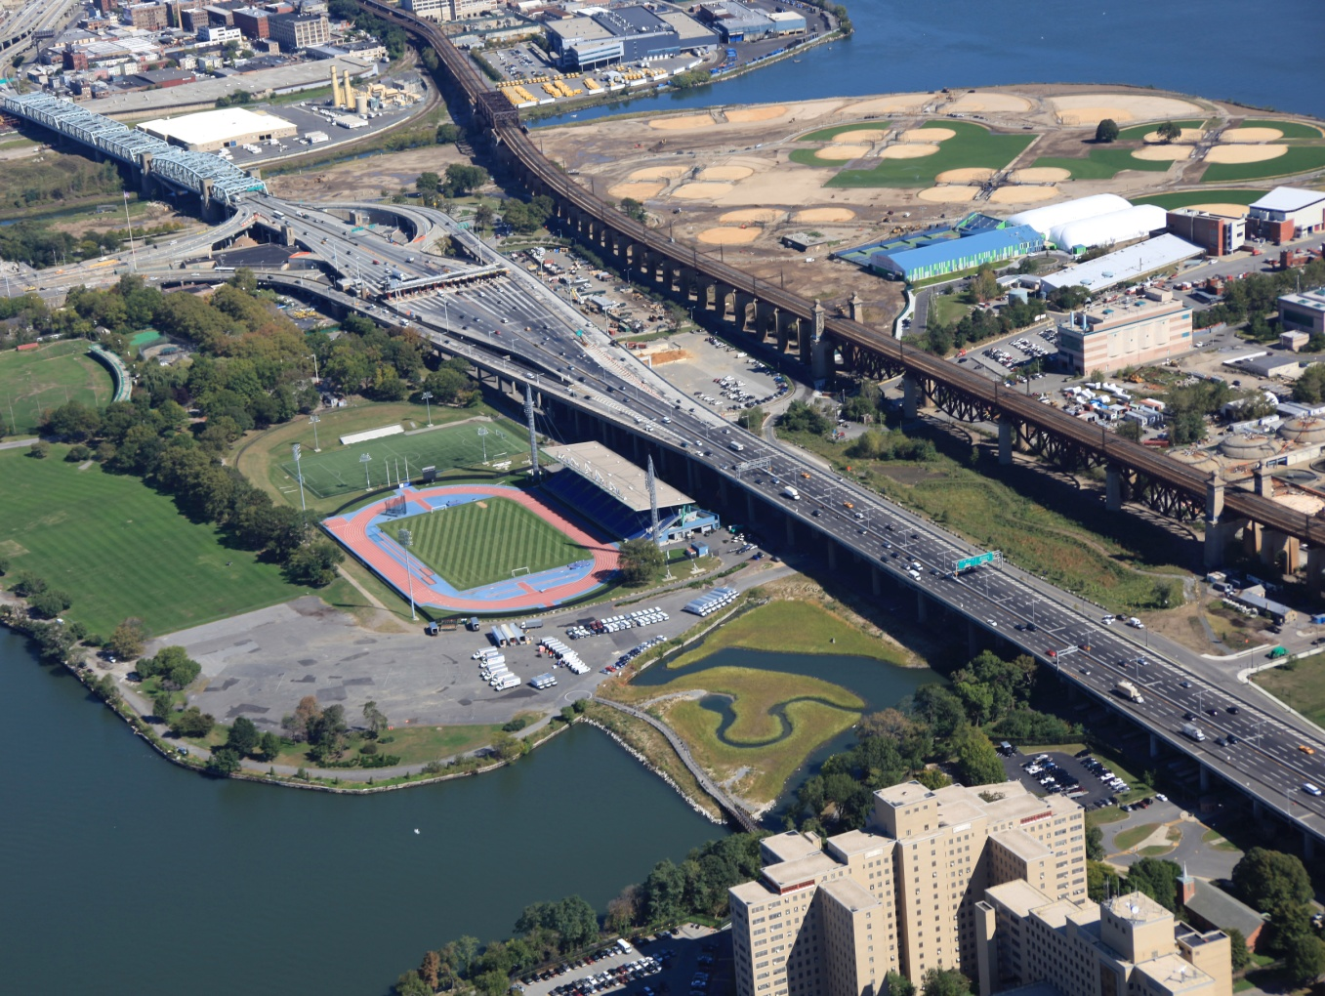

Slide 5
Bronx Kill Salt Marsh
1 acre
Freshwater Emergent Wetland
4 acres
Little Hell Gate Salt Marsh
4 acres

Slide 6
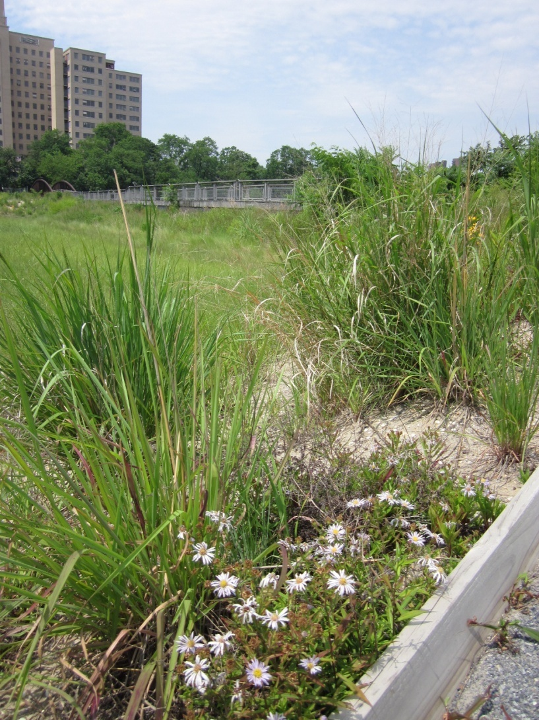
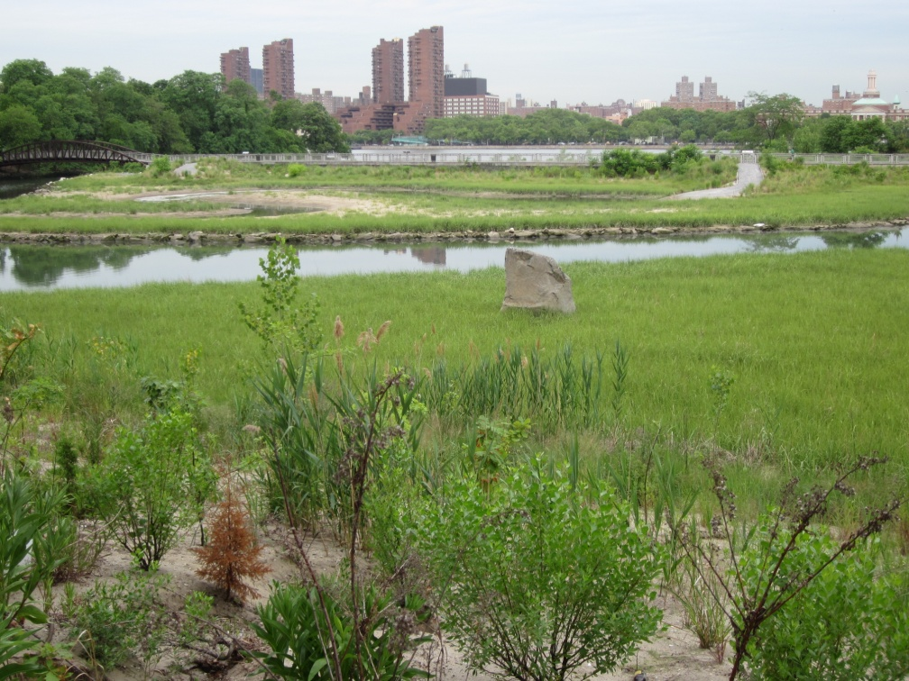
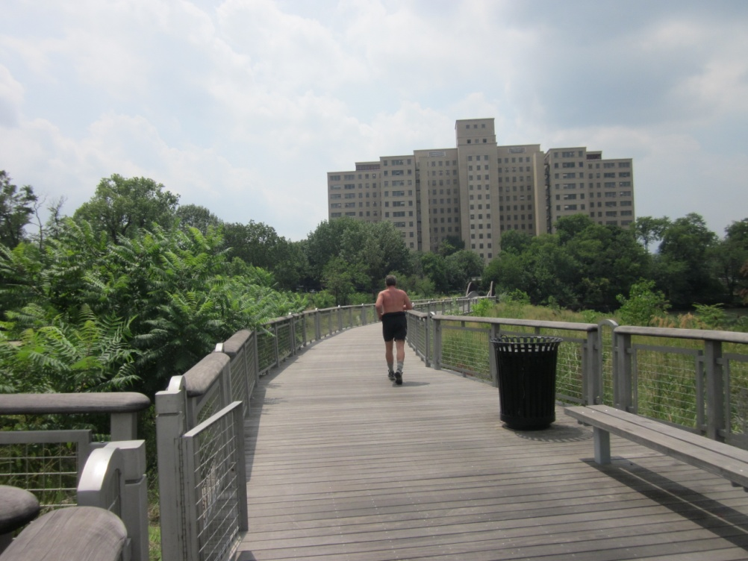
Little Hell Gate Inlet Salt Marsh
Notes:
New England Asters (ASTER NOVI-BELGII), Switchgrass (Panicum), Groundsel tree (Baccharis halimifolia), roughstemmed goldenrods (Solidago rugosa), Staghorn Sumac (Rhus typhina)

Slide 7
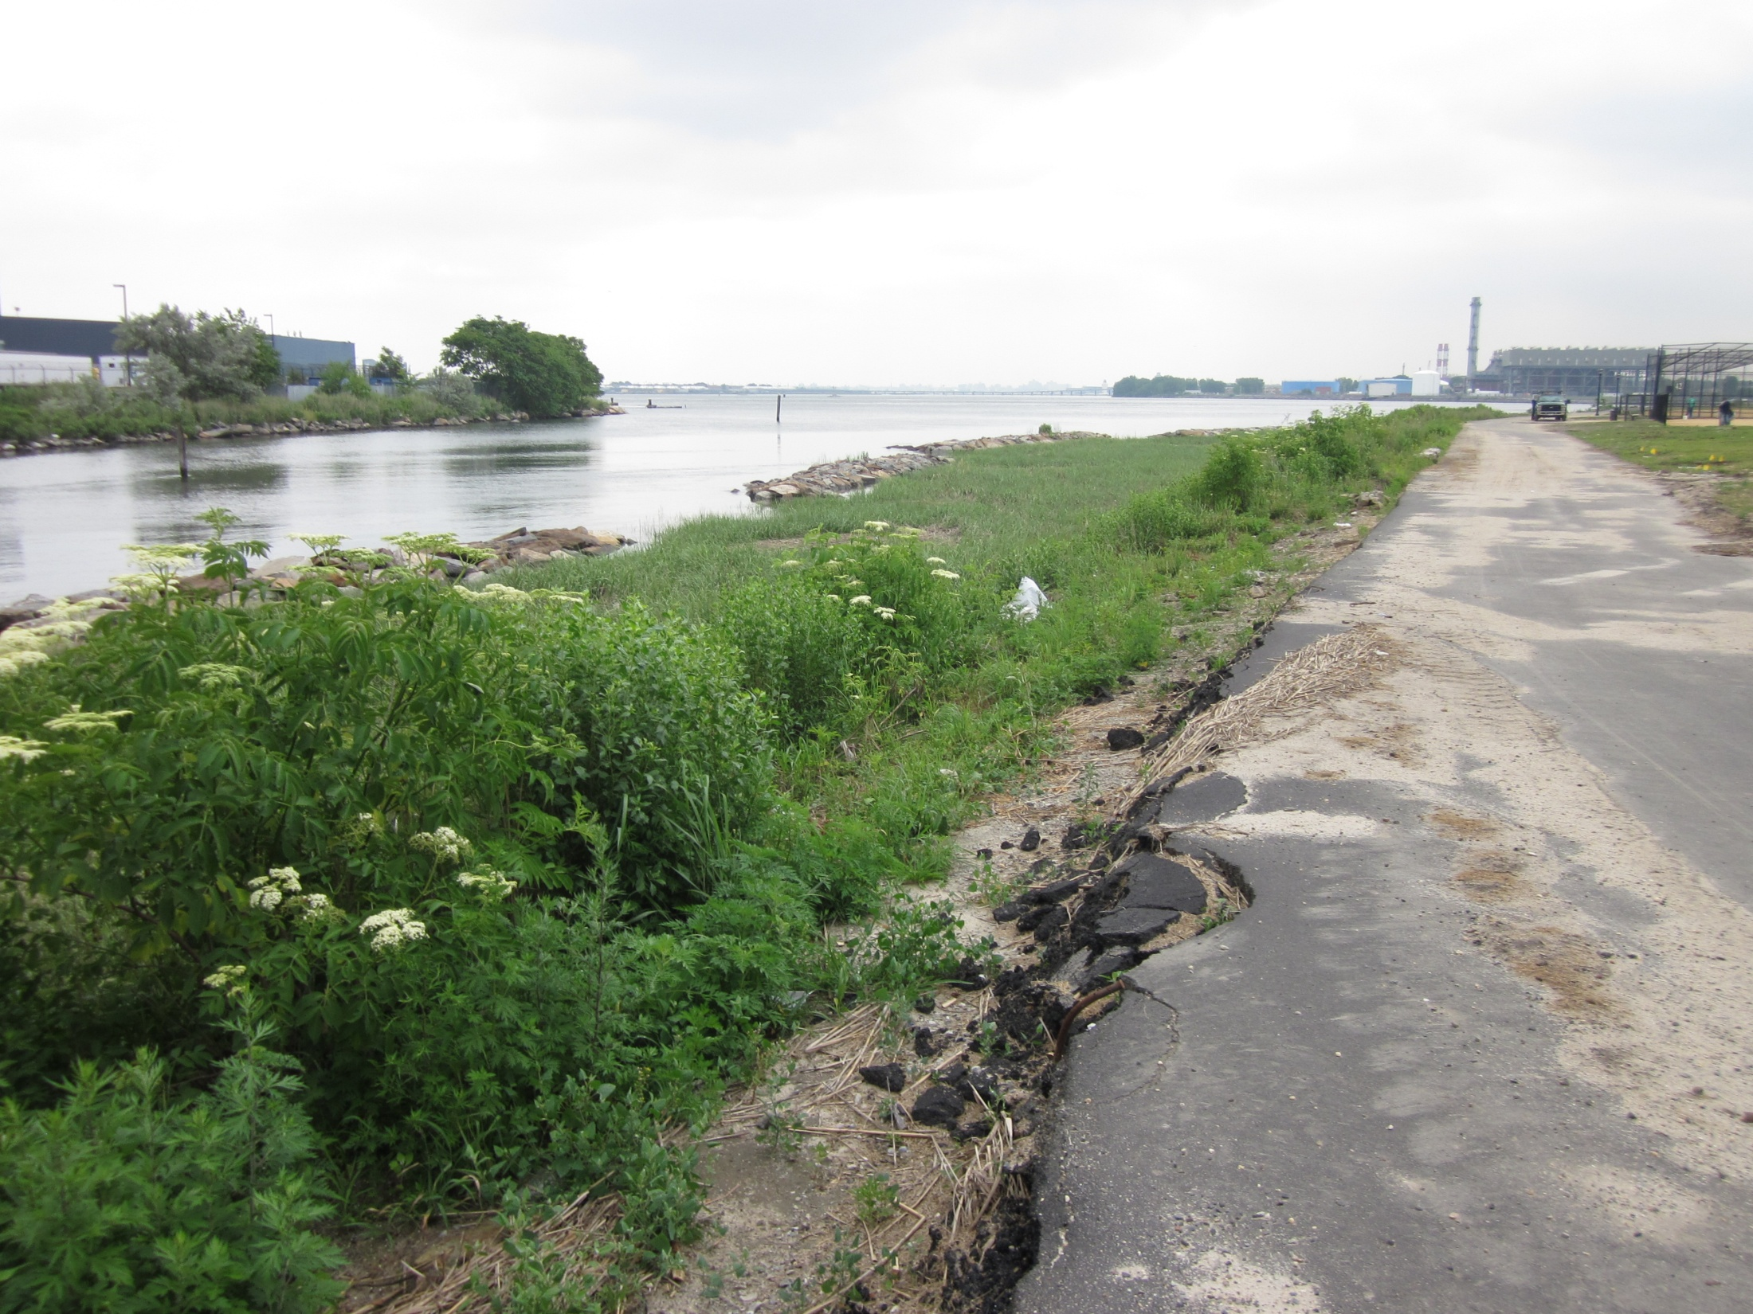
Bronx Kill
Salt Marsh

Slide 8
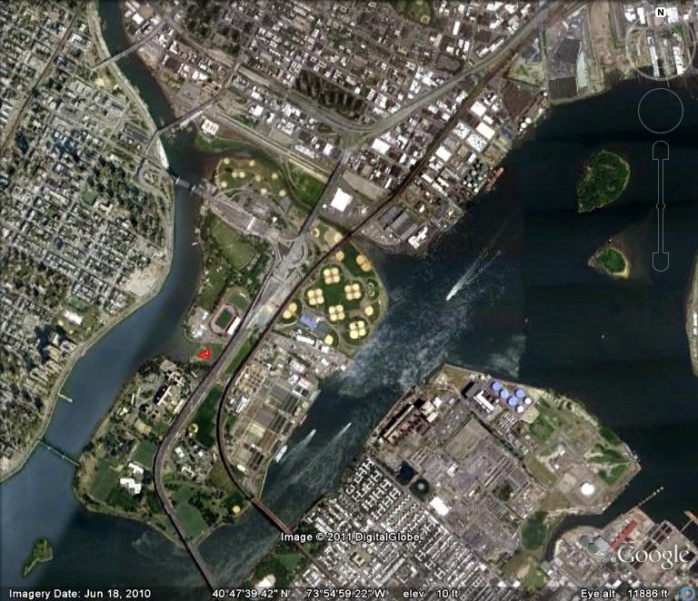
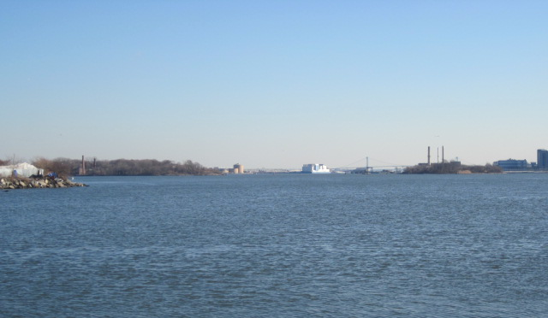
North Brother
South Brother
Bronx Kill
Salt Marsh
North Brother
South Brother

Slide 9
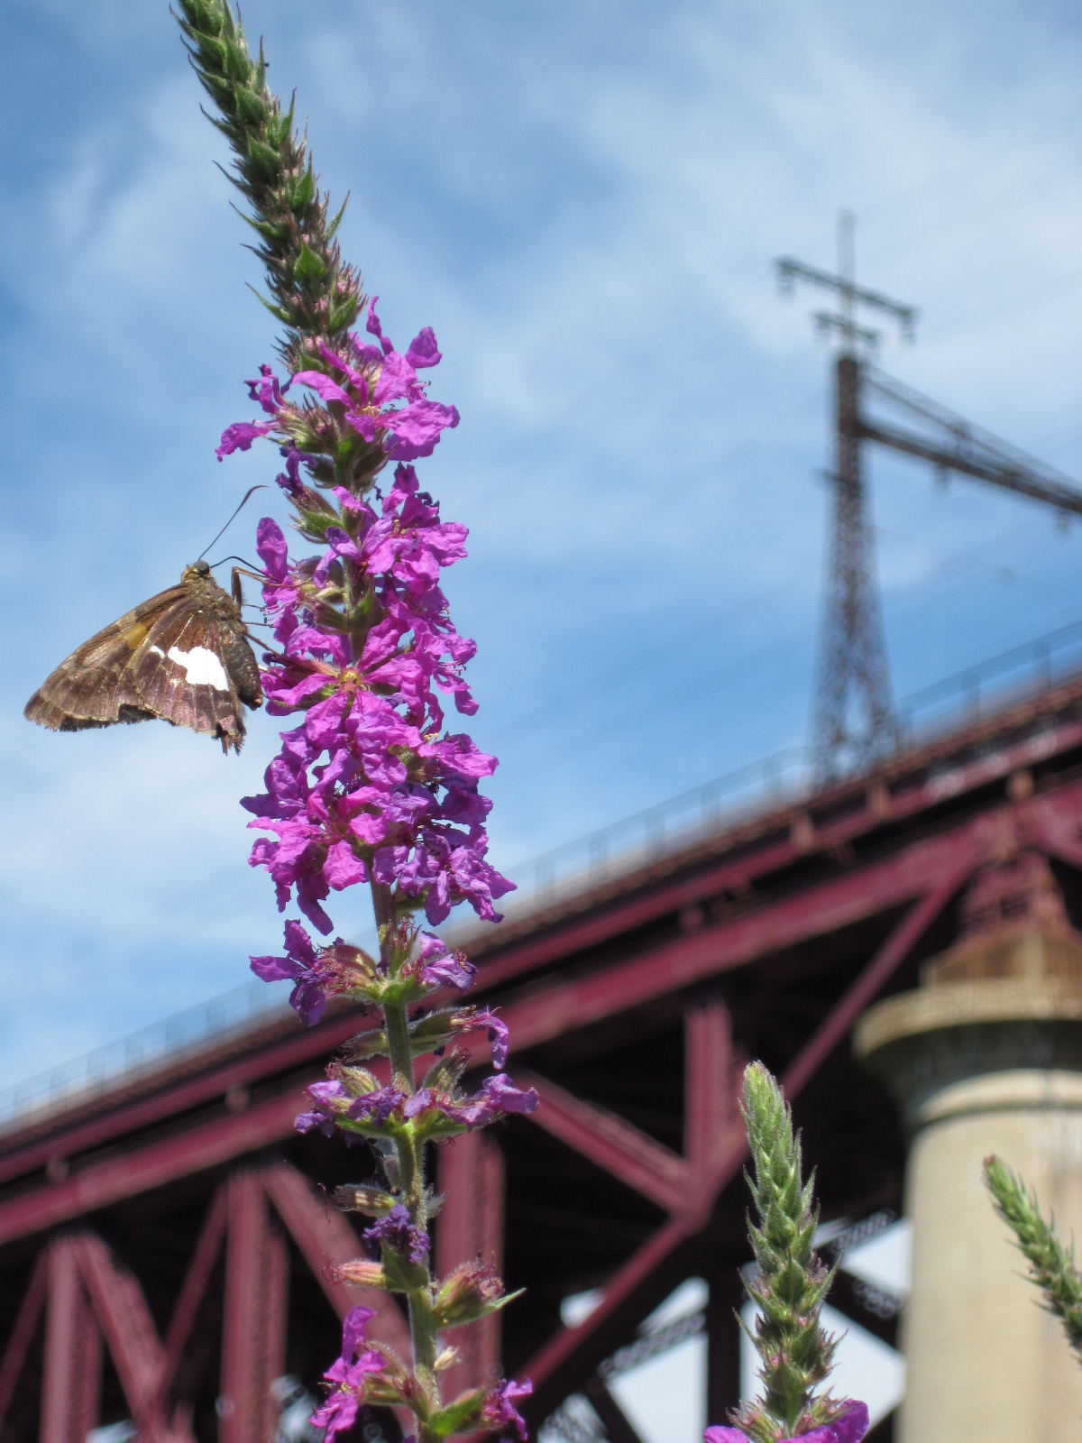
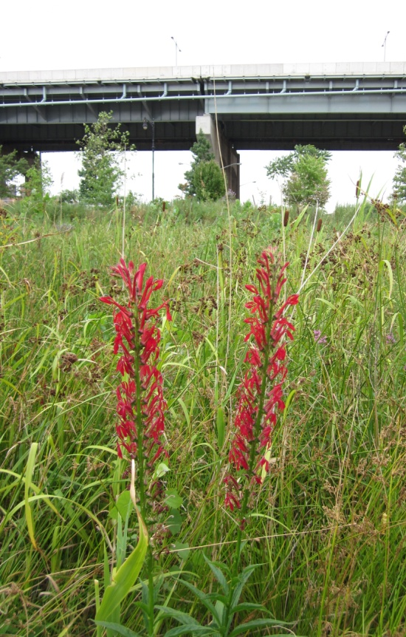
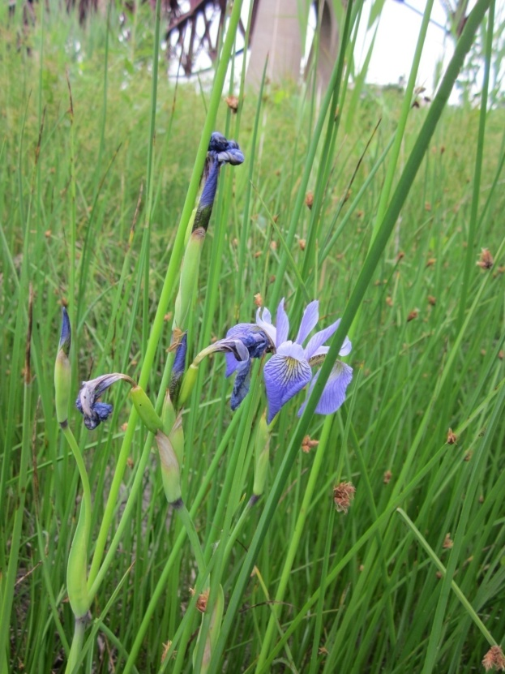
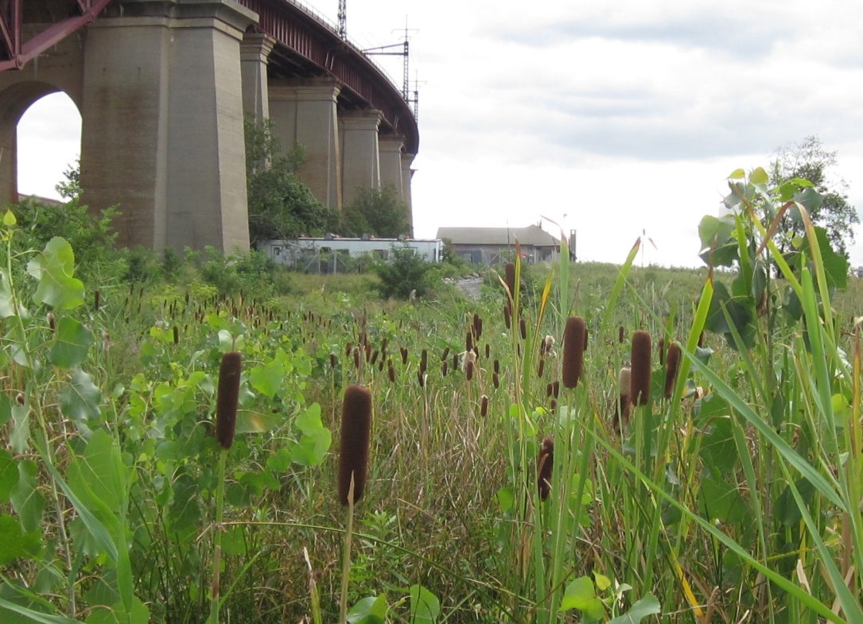
Freshwater Emergent Wetland
Notes:
Silver Spotted Skipper on Purple Loosestrife, Common Three Square (Scirpus pungens), blueflag iris (iris versicolor), Cardinal Flower(Lobelia cardinalis), Typha (Cattails), Cottonwoods, Phragmites

Slide 10
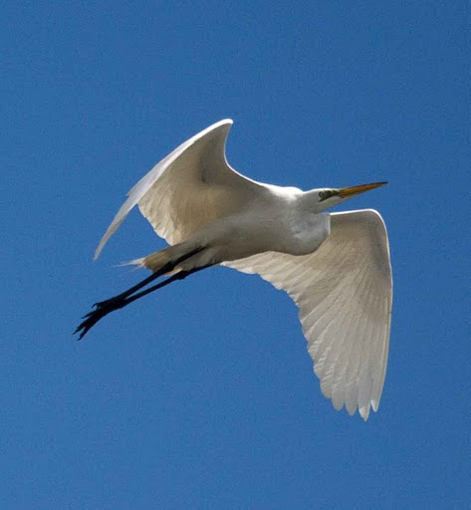
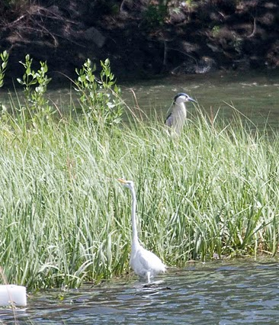
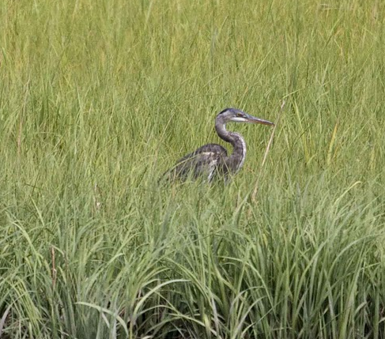
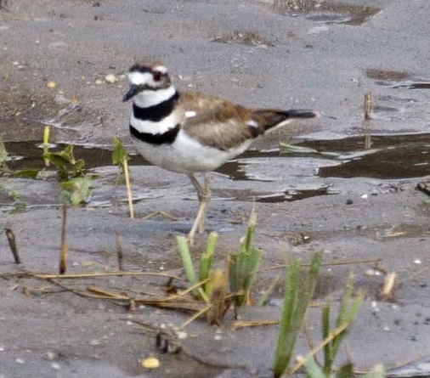
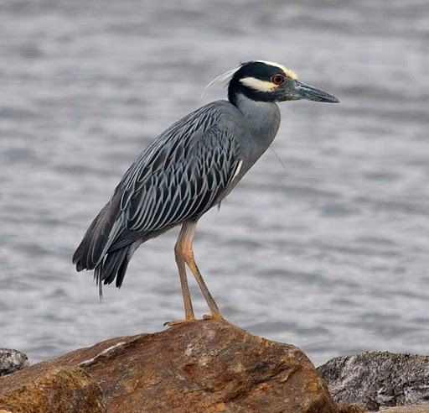
Wildlife
photos by Fernand Brunschwig

Slide 11
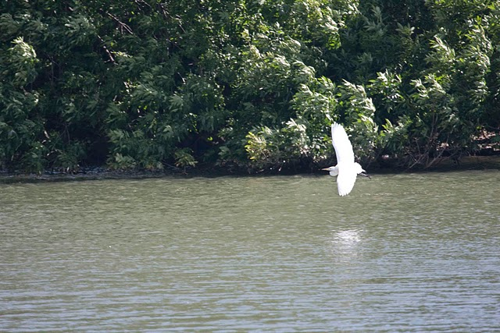
Future Avian Monitoring
Wading Bird Surveys
Wading Bird Strike Surveys
Winter Waterfowl
Shorebird Surveys

Slide 12
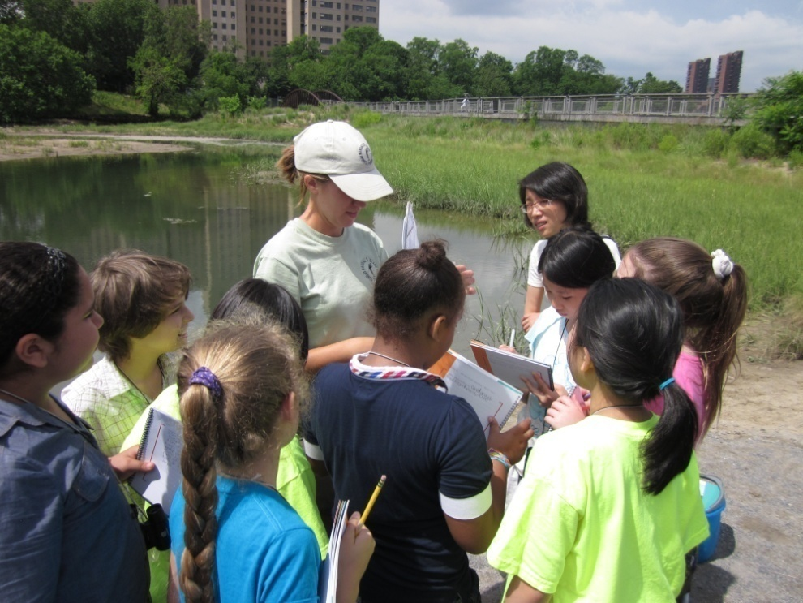
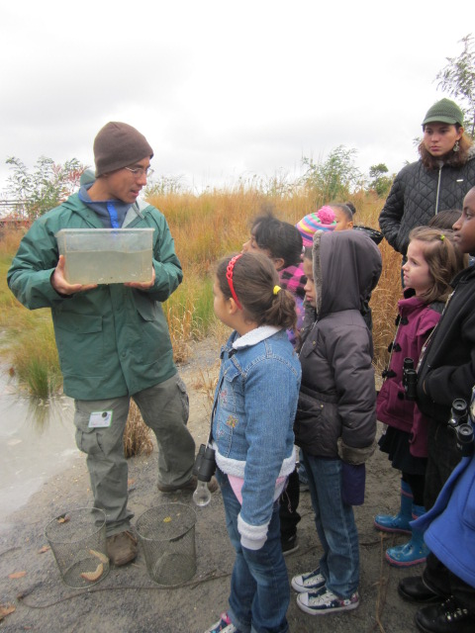
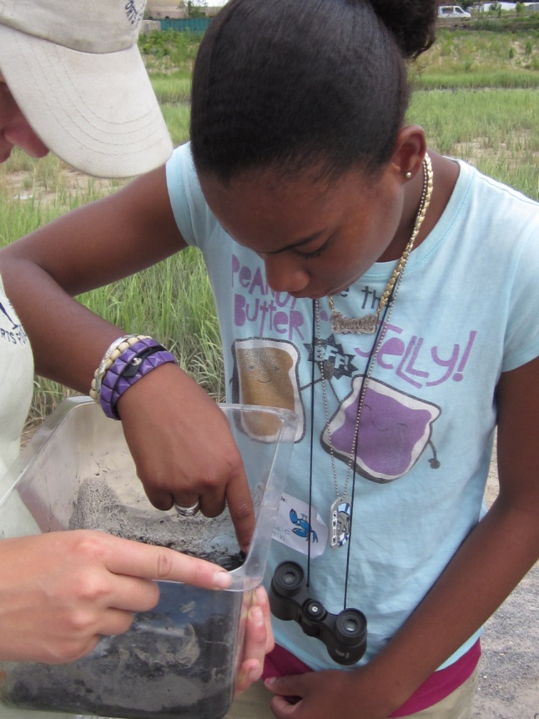
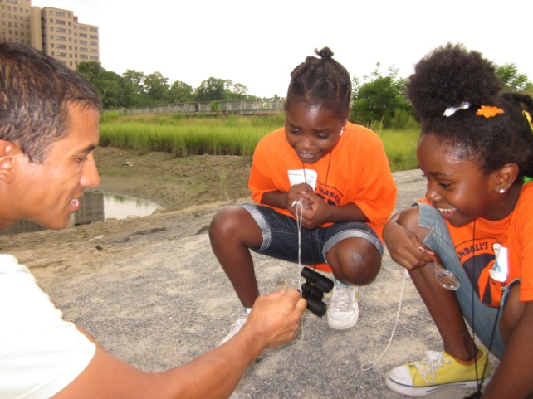
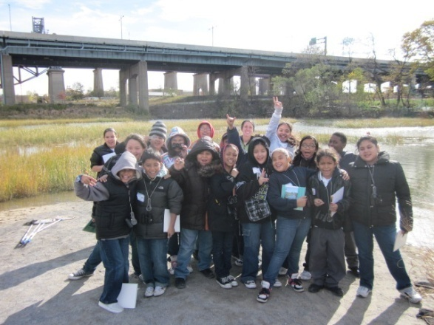
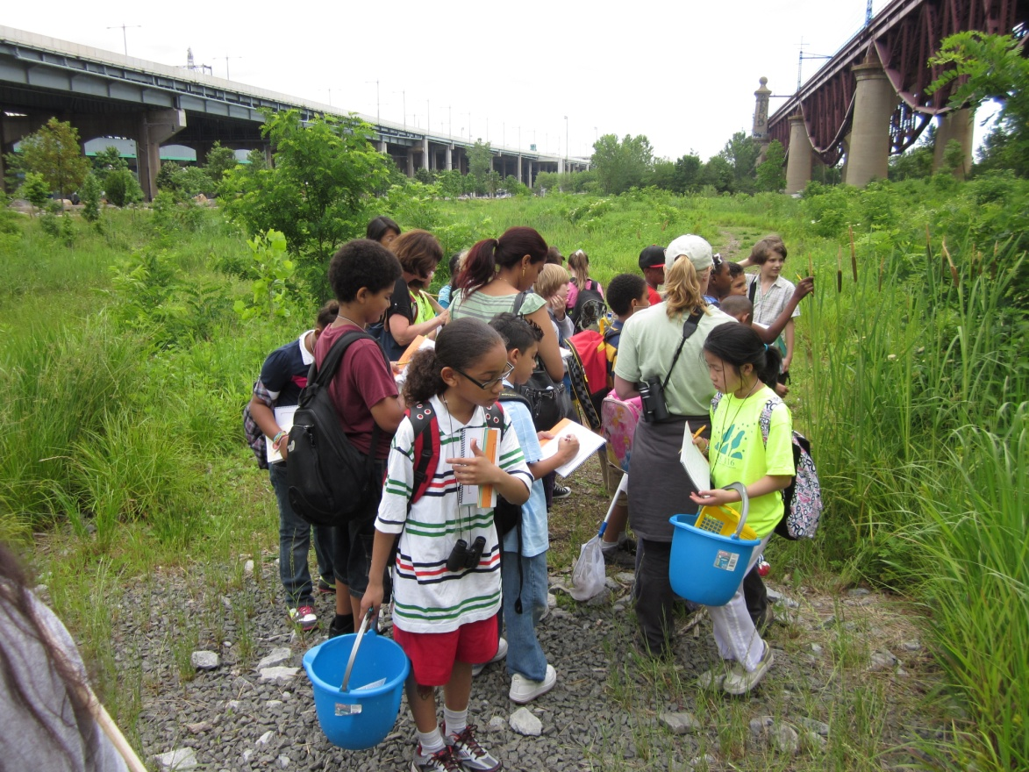
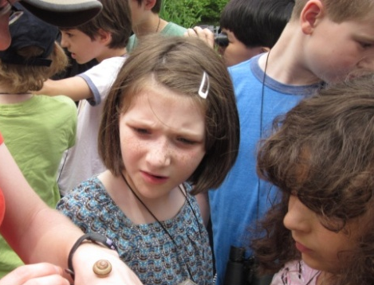
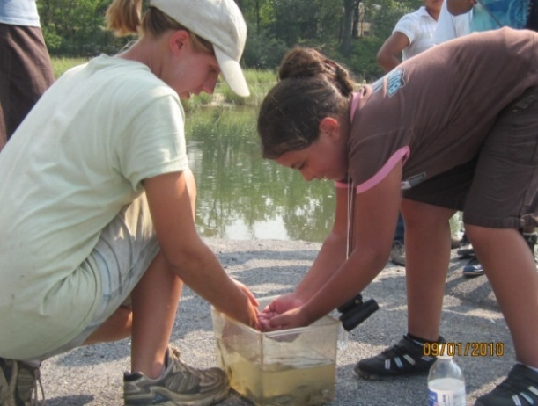
Wetlands Stewardship Program 2010
Notes:
Served 946 kids in 2010 and we plan to expand program for 2011.

Slide 16
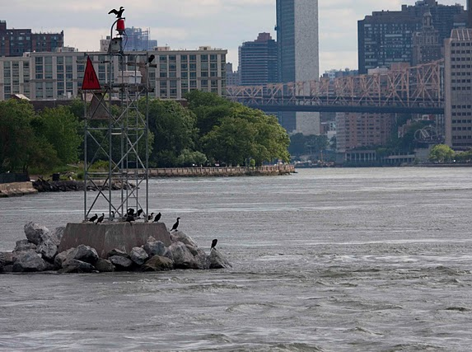
Questions?
photo by Fernand Brunschwig

