Slide 1




Avian Radar – Experience at
John F. Kennedy Intl. Airport
Notes:
Joint project with FAA William J Hughes Technical Center, Univ of IL CEAT, and PANYNJ.
Accipiter radars provided by Sicom for test.
I will provide a briefing of some of the radar work we’ve done so far at JFK and the limitations of the technology. There is more technical detail to these analyses than I am providing, but that’s better presented by one of our CEAT partners and perhaps we will do that after we have more data and more complete analyses of some of our objectives.

Slide 2
Introduction
FAA avian radar performance assessment program at several US airports
The Center of Excellence for Airport Technology (CEAT) cooperated with JFK to define objectives for radar analysis & analyze radar data
Avian radar was deployed to JFK and was operational in January 2010
After an initial period of tuning and calibration, the radars have been operating continuously since March 2010
2 radar systems deployed
  AR1 (single sensor)
    Located between runways 22L and 22R by Rockaway Blvd.
  AR2 (dual sensors)
    On Jamaica Bay at the midpoint of 13L/31R
    Parabolic dish antennas - beam

Slide 3
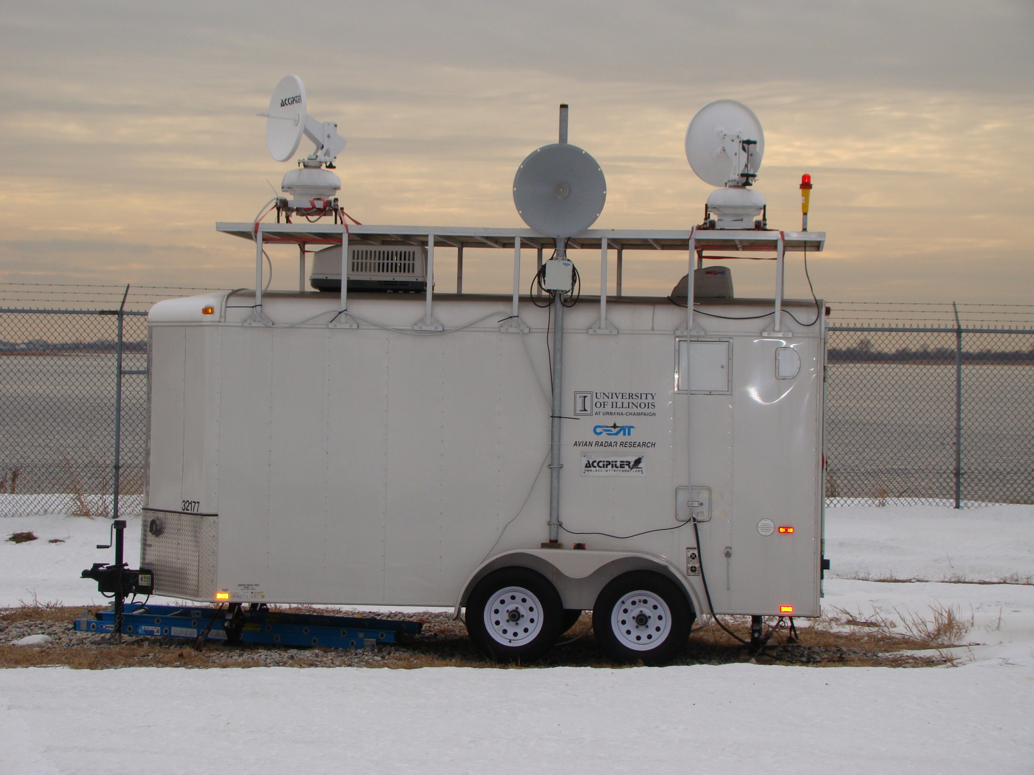

Slide 4
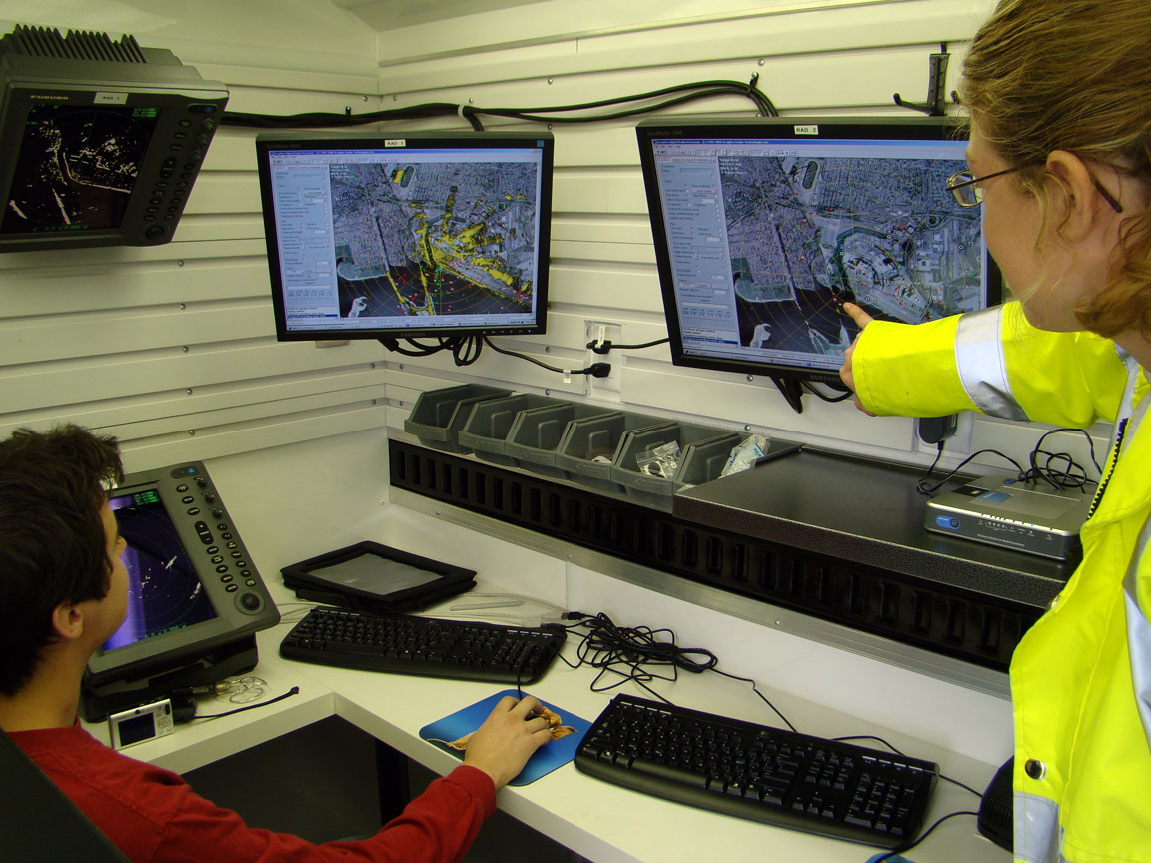
Notes:
Inside trailer – two monitors for AR-2 Low and AR-3 High

Slide 5
Objectives
General Activity
  Observe both low and high elevation targets with the AR2
  Concentrations of detections shows where groups of birds are staging and what areas can be attractants to large numbers of birds
  Timing related to sunrise/sunset & tides
Night Movement
  Frequency, timing, and direction
Migration
  migration periods and patterns of bird dynamics related to migration
Local Bird Movements
  Radar can provide information on local bird movements
  Information on long and short distance commuters
Notes:
Radar can be used to assess activity dynamics
First we need to understand the basics of radar physics to correctly interpret the data analysis

Slide 6
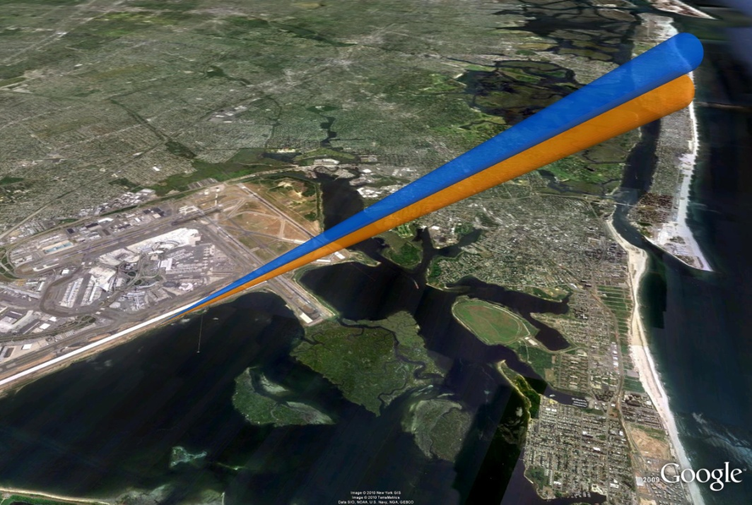
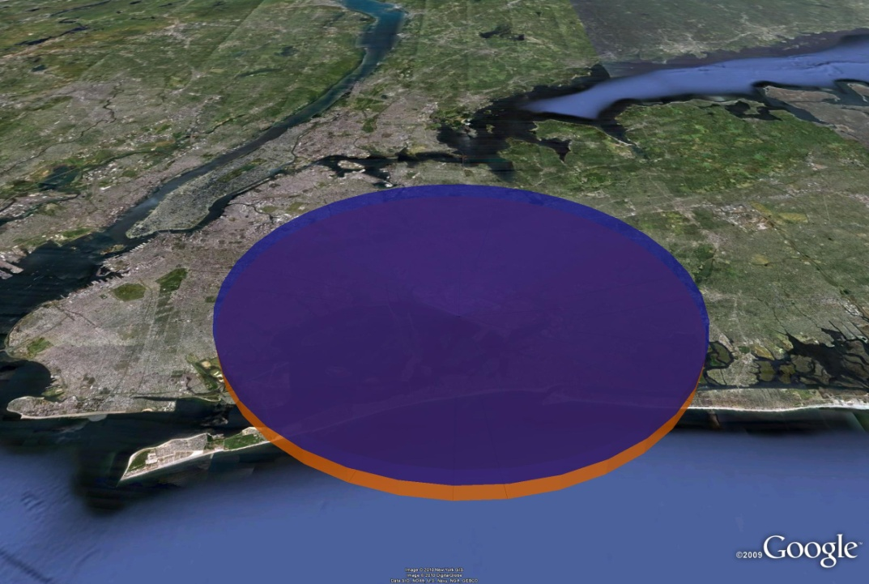
Understanding Radar Physics
The radar with a parabolic dish antenna produces a cone of energy which is directed in a beam.
AR2 at JFK has 2 dishes set at different uptilt angles
Hence 2 cones of energy emitted from the sensor
Then antennas rotate 360 degrees for a complete zone of coverage.
Notes:
PL – I think they language here could be more concise.

Slide 7
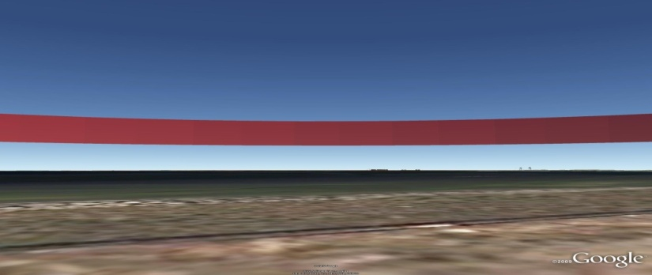
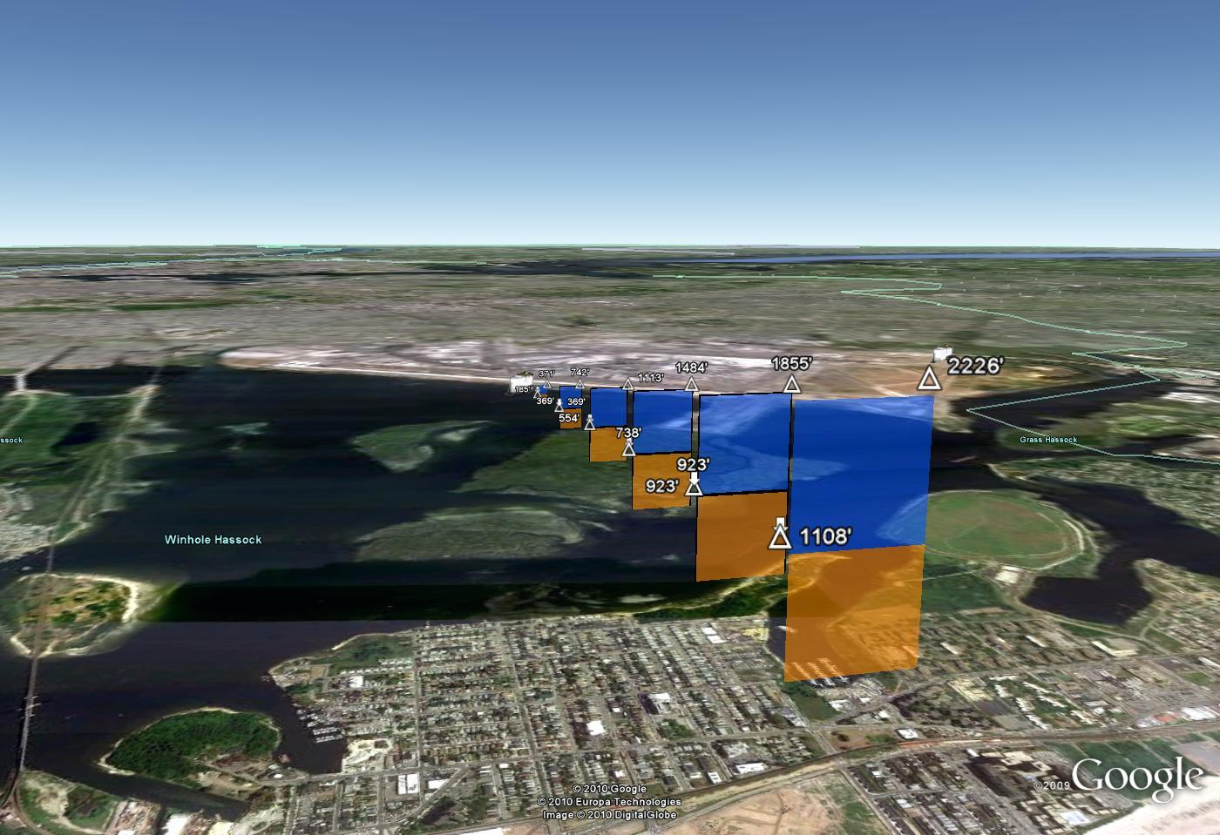
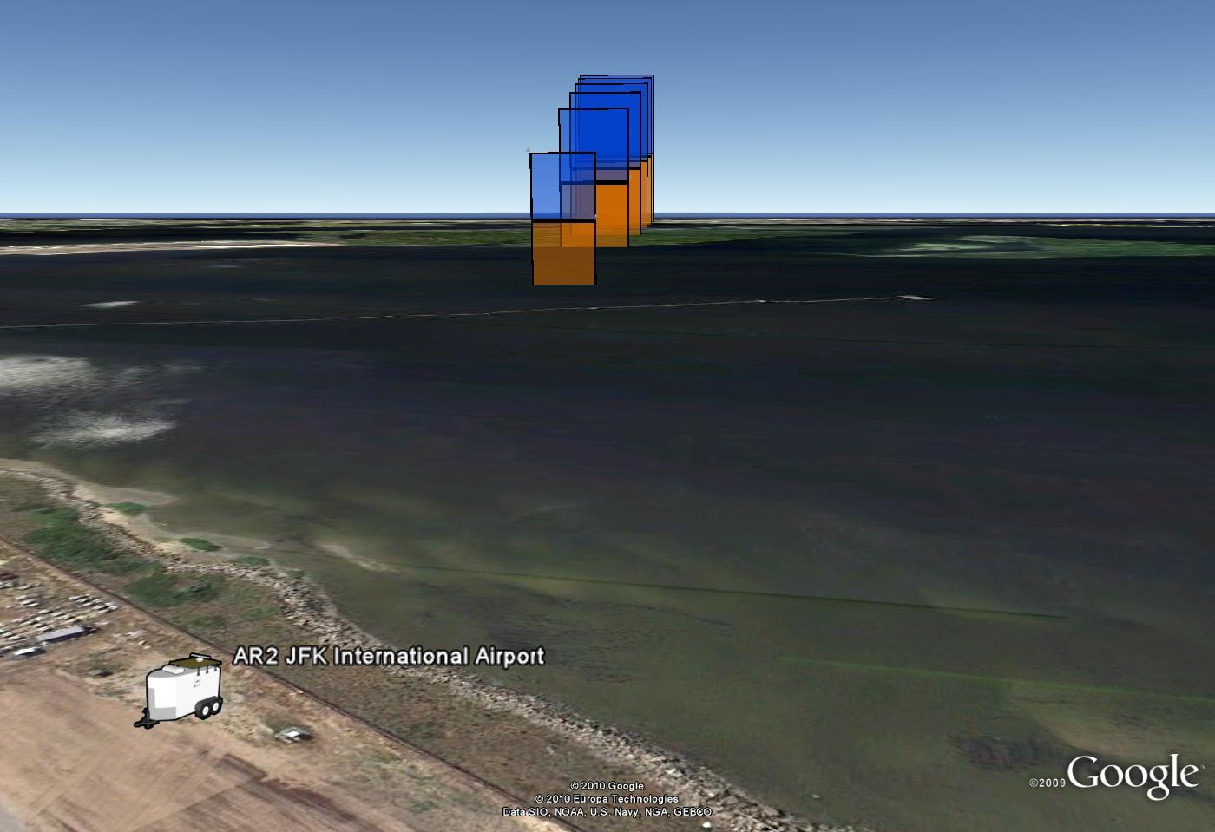
Radar Physics
The AR2-L (low) is a 4 degree beam tilted to center at 2 degrees above horizontal. Hence this sensor covers from horizontal to 4 degrees.
The AR2-H (high) is a 4 degree beam tilted to center at 6 degrees above horizontal . Hence the AR2H covers from 4 to 8 degrees
This a zone of coverage with altitude specific information.
Notes:
PL – width for the dishes is 2 degrees to either side. Range resolution is 20m.

Slide 8
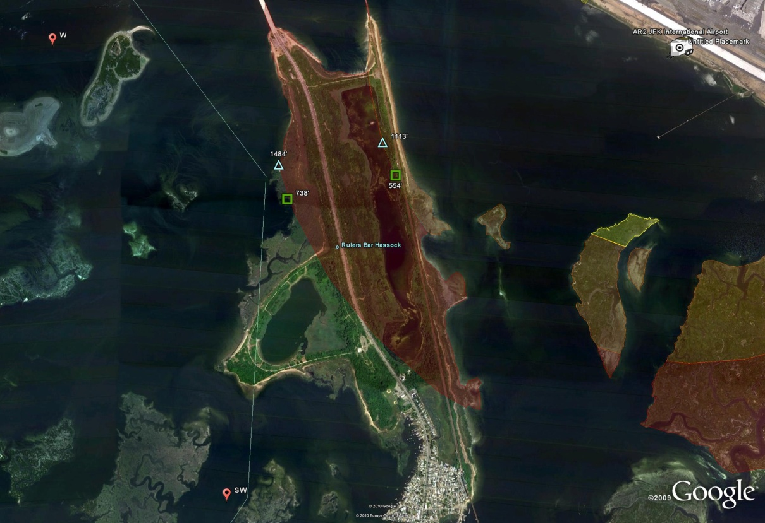
Understanding Radar Physics
The volume of airspace coverage increases with range from the radar.
For example, the eastern shore of Broad Channel is closer to the radar and at this range the beam detects birds at lower altitudes than on the SW side of the island.
1113’-1484’-radar beam of the AR2-H
554’ -738 radar beam of the AR2-H
Notes:
Range resolution at the eastern shore of subway island is 20m.

Slide 9
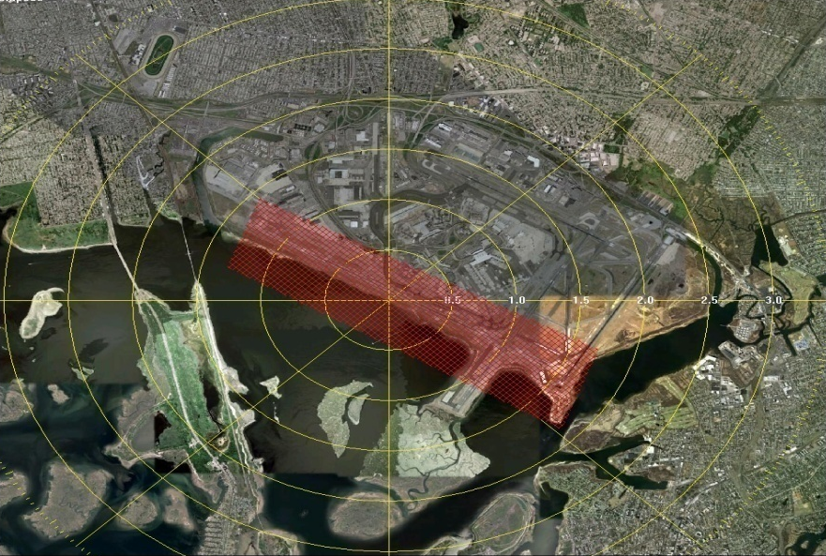
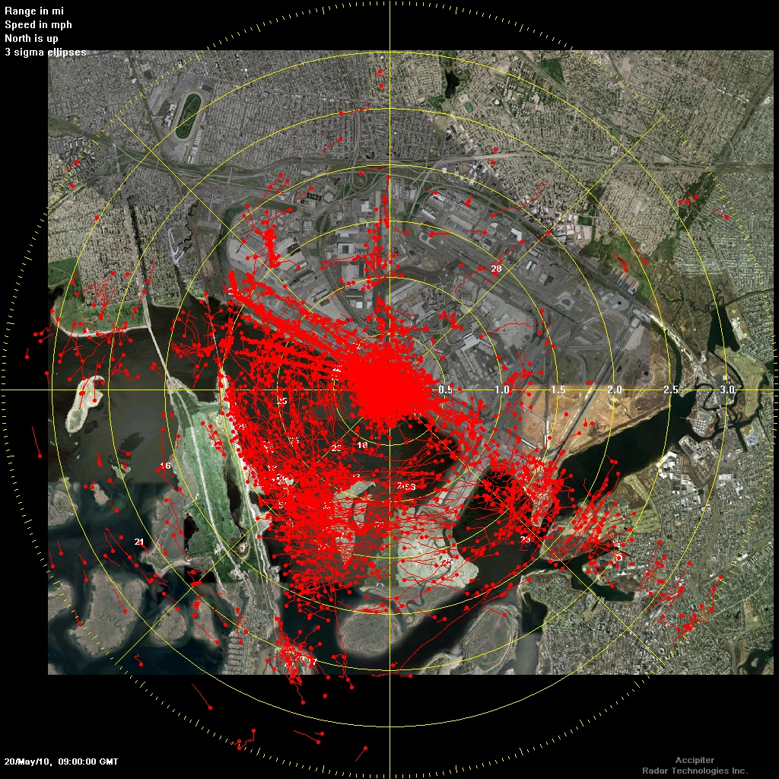
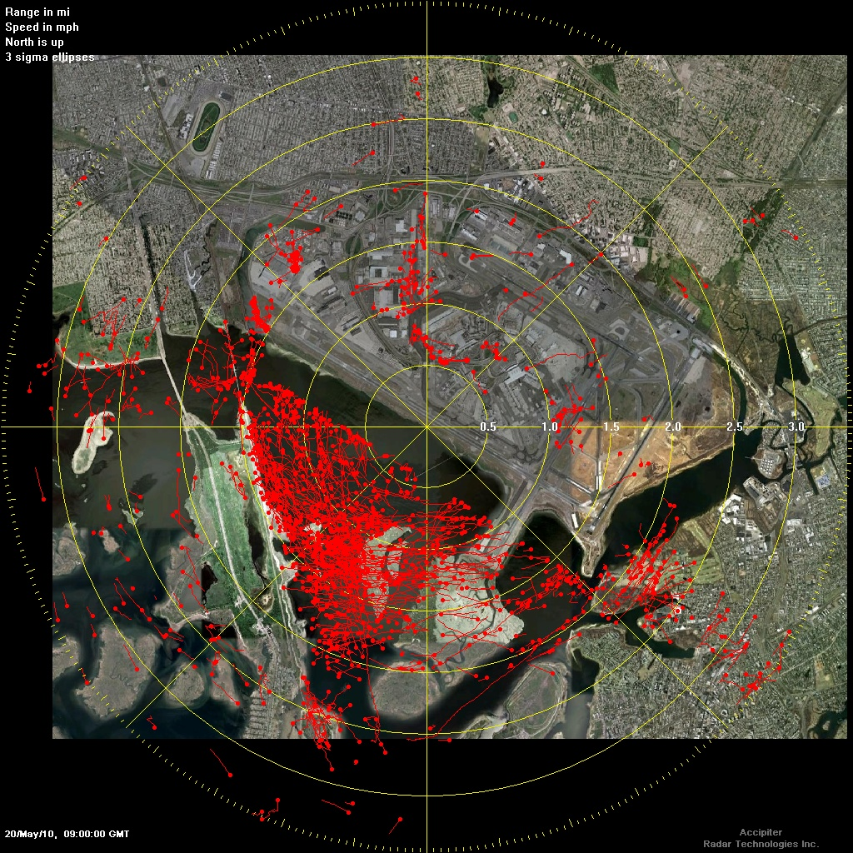
ANALYTICAL METHODS – MASKING on the AR2-L
Because the beam of the AR2-L covers low elevations over the airport, a mask was created to assist in our analysis. (Note: it was not necessary to mask the AR2-H)
May 20 2010; 04:30:00a.m.-5:00:01a.m.(Local Time),
without the use of a mask
May 20 2010; 04:30:00a.m.-5:00:01a.m.(Local Time),
With the use of a mask
Notes:
Track
- target = single bird or group of birds detected as a single target due to radar resolution.
- Each track is assigned an identifying number
- Each track has associated information like speed
MASKING
- we mask some areas on AR2-L to eliminate influence of non-bird target detection in our analysis.
Other sources of tracks
Multipath reflection = interference from aircraft produces that produce multiple false tracks.
Surface Vehicles - Radar detection algorithms based on speed may also include surface vehicles in tracks.
Data replayed faster than real time
Detections are at different altitudes
Not all tracks are birds
9

Slide 10
AR2-L
ITO
ITO results indicate both the variability that can be expected from day to day, and the general timing of ITO type movements during the day.
Note: it is possible to have many single tracks and no ITOs
Notes:
Reinforce that we have detections at different altitudes
Radar only sees one area and we are looking at several variables: timing (sunrise/sunset, tides), location of ITOs (altitude, distance from radar, location), direction of movement
Initial Track Observation (ITO) –
ITO is a group of tracks that were first observed together at a particular location and moving in the same direction.
Track History –
Since radar data is produced continuously need to separate data into manageable chunks
TH = the accumulation of tracks recorded by the radar for a given time period.
Automated process producing 30 minute time periods at JFK
Replaying data at faster than real time
Not all Tracks are birds

Slide 11
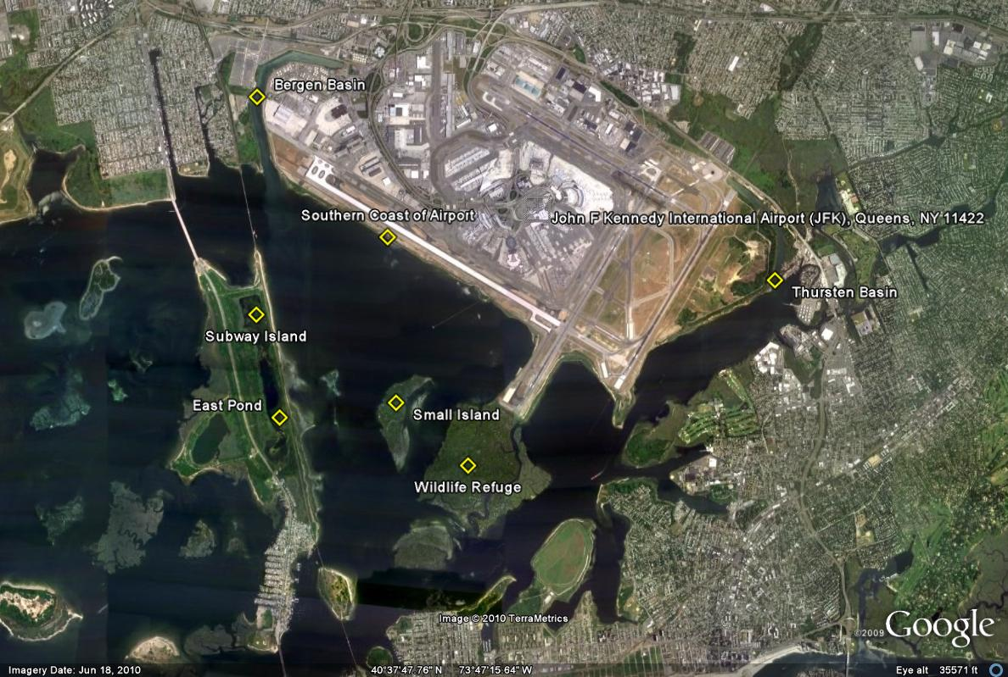
Common Movements on AR2 in May
Yellow = AR2-H movements
Red = AR2-L movements
Notes:
AR-2 L - 3 main locations of ITOs (5% of ITOS not in one of these locations):
JOCO Marsh (38%)
East High Meadow (30%)
Subway Island (27%)
AR-2H - highest numbers of ITOs began to be tracked at the following locations
Subway Island - 27% - moved north or northeast towards shore, or east towards Thurston Basin
Bergen Basin -18% - moved towards the center of Jamaica Bay, Joco Marsh, or Subway Island
Southern Coast of the Airport. – 16% - same as Bergen Basin

Slide 12
Summary of Movements for September 2010 - Night
Yellow – AR2-L Red – AR2-H
Notes:
Most of activity close to radar. There is very little out past the small island.
Long tracks indicative of migration, or long distance commuters on the AR2H.
The AR2-H beam coverage is at high elevation (greater than 700 feet).

Slide 13
Summary of Initial Radar Analysis
Timing
  peak of activity in the 15 minutes surrounding sunrise.
  higher levels of activity in the afternoon and near sunset.
  least amount of activity at night
Location Analysis
  high levels of bird activity in Jamaica Bay
  Subway Island may play significant role in activity at JFK
Upcoming Studies
  comparison of amount of tracks in Jamaica Bay v. JFK
  analysis of ITOs and movements for other months
  validation studies
  and more !!!
Notes:
New methodologies in historical radar analysis were developed
Activities include movement related to time of day.
Eastbound and westbound movements dominate morning and evening.
Short range activity at night in both radars.
Long range detections may be migration or commuters at night in AR2-H.
VALIDATION - Observation of birds from known areas at known times.
CEAT will use observational information from several sources:
Regular wildlife monitoring (point counts)
Observations at the radar by CEAT personnel using techniques developed by CEAT at other radar installations.

Slide 14

Radar Limitations
Not practical for real time warnings
Very technical tool requires dedicated personnel
Expensive
Cannot discriminate between single birds and flocks or between species of birds
Need several radar units to cover large areas
May sacrifice distant detection for near detection
?
or
Notes:
The radar is not practical for real-time warnings
radar takes about 1.5-2 seconds to complete a pass
radar software must obtain 3 observations of a target to produce a track
by the time a track is produced, about 7 seconds have passed and the target may no longer be a hazard
Very technical tool that requires dedicated personnel to monitor and analyze
can’t tell between 2 large birds or a flock of 50 small birds
can’t distinguish species
requires multiple units to cover large areas and may sacrifice distance for near detections or vice versa

Slide 15
