Slide 1
THE DIAMOND ALKALI NRDAR CASE
HARBOR HERONS MEETING UPDATE
JANUARY 13, 2011
Tim Kubiak
New Jersey Field Office
U.S. Fish & Wildlife Service
Pleasantville, New Jersey
tim_kubiak@fws.gov

Slide 2
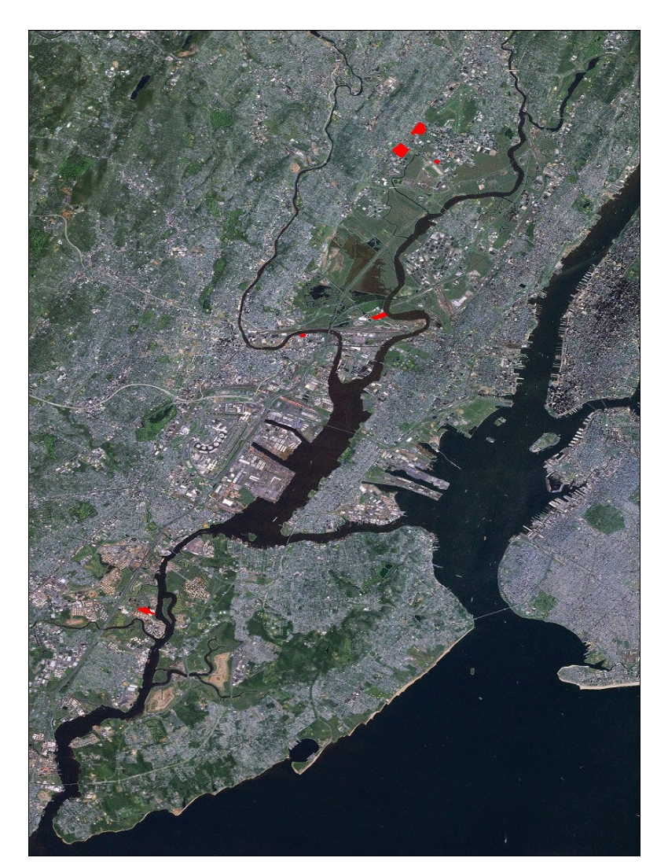
Current Berrys Creek Watershed
Study Area
Current Diamond Alkali
Study Area
Hackensack River
Passaic River
Meadowlands
Current
Hudson River
Study Area
Standard
Chlorine
Site
Diamond Alkali
Plant Site
Newark Bay
Liberty and Ellis
Islands
Kill Van Kull
Arthur Kill
Shooter’s Island
LCP/GAF
Site
Prall’s Island
Isle of Meadows
Hoffman / Swinburne
Islands
Gateway NRA

Slide 3
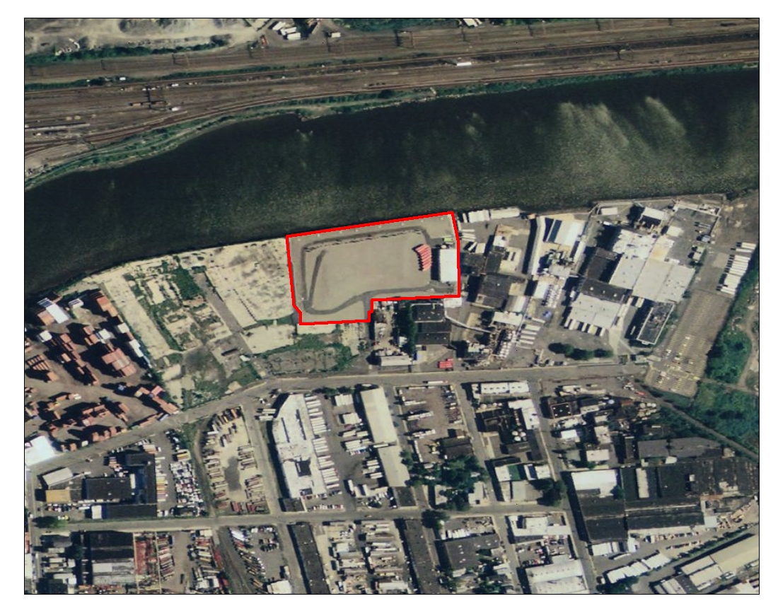
Diamond Alkali Plant Site

