Slide 1
Gateway National Recreation Area’s role in monitoring and management of airport bird hazards in Jamaica Bay, NY
Presentation to the Harbor Herons Conference, 12-13 Jan. 2011,
by the Natural Resources Management
Division at Gateway NRA

Slide 2
History of bird strikes at JFK International Airport
Pre-Shooting
During 1988-1990, 86% of bird strikes were gulls:
Laughing Gulls = 52% of strikes,
Herring & GBB & Ring-billed Gulls = 34% of strikes.
Post-Shooting
In 3 years, Laughing Gull strikes reduced by >90%.
Source: Dec. 2010 Supplement to the 1994 FEIS (USDA/APHIS/Wildlife Services)

Slide 3
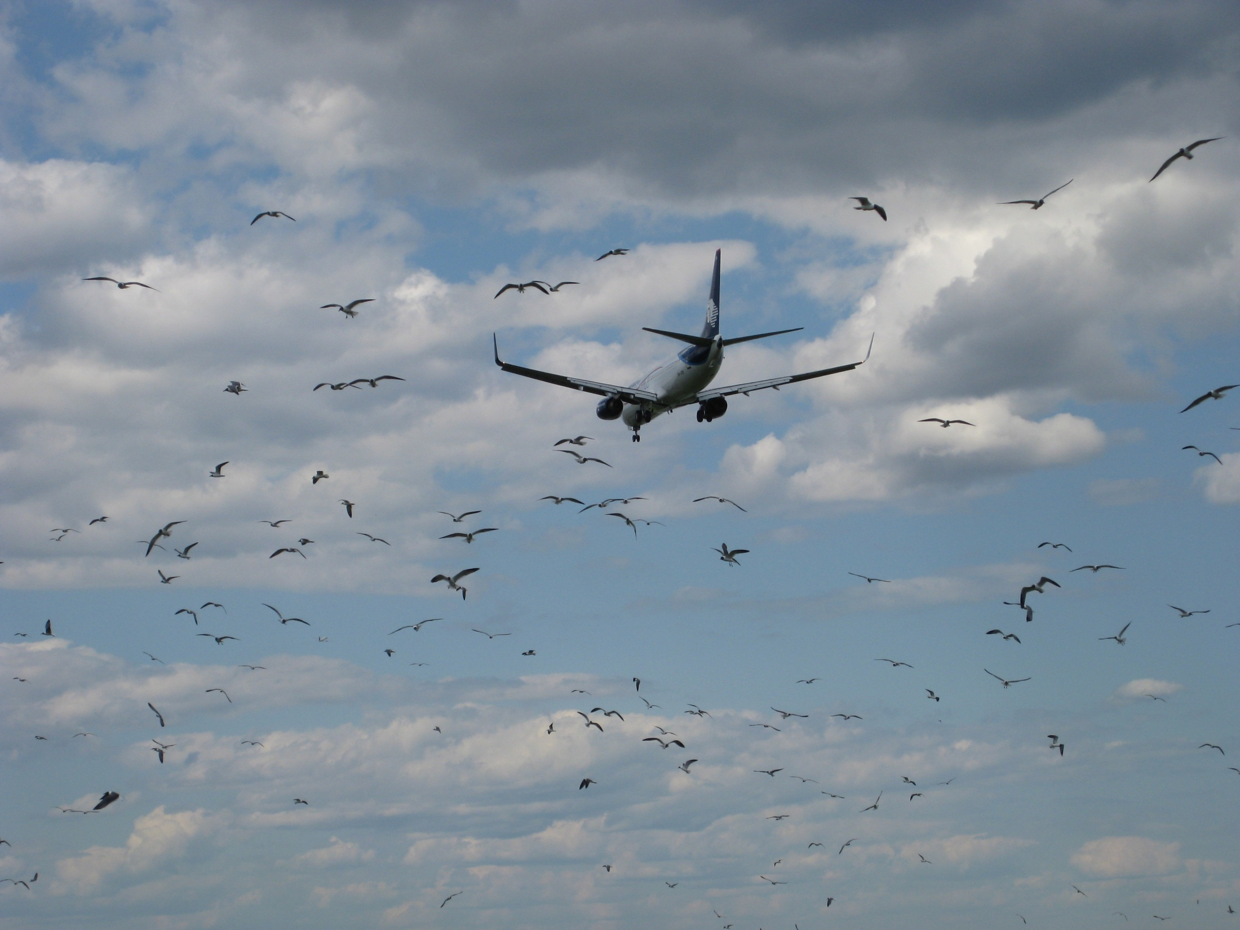
Airport runway at JoCo Marsh

Slide 4
Bird-strike rate at JFK International Airport:
1979-2008 = 1.82 bird-strike incidents/
10,000 aircraft movements at JFK.
Averaged about 77 strikes/year.
Source: Dec. 2010 Supplement to the 1994 FEIS (USDA/APHIS/Wildlife Services)

Slide 5
Changing emphasis on the bird hazards at JFK airport
The on-airport shooting program successfully reduced gull strikes.
New focus is on heavy birds and flocks of small birds, which always had low strike rates, but which can be catastrophic.
Management is expanding to off-airport sites.
Source: Dec. 2010 Supplement to the 1994 FEIS (USDA/APHIS/Wildlife Services)

Slide 6
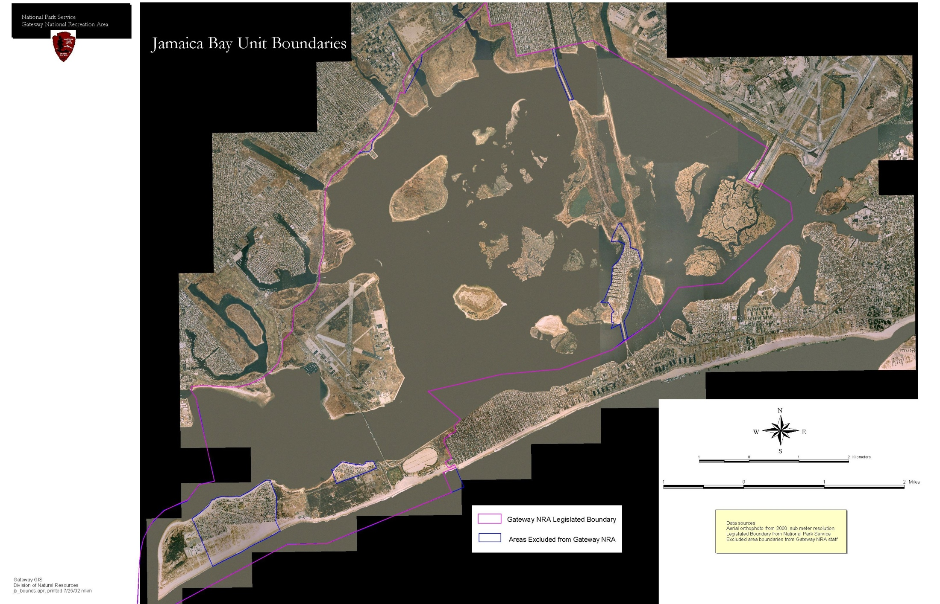

Slide 7
Species proposed for management in Jamaica Bay Wildlife Refuge
Lethal control—Resident Can Goose (molt), Mute Swan (eggs).
Non-lethal control—gulls, Brant, Osprey,
D-c Cormorant, Snow Goose, ducks, crows, blackbirds, Rock Dove, European Starling.
Source: Dec. 2010 Supplement to 1994 FEIS
(USDA/APHIS/Wildlife Services)

Slide 8
11 actions by Gateway NRA to reduce bird hazards at JFK airport
(1) NPS 5-yr study of Laughing Gull Colony, resulting in management recommendations to JFK airport.
(2) Cooperating Agency in 1994 Final EIS (gulls).
(3) Participant in Bird Hazard Task Force and the new Bird Hazard Steering Committee.
(4) Assist in annual monitoring of L. Gull colony.
(5) Addle Mute Swan eggs to stop pop. growth.
(continued)

Slide 9
11 actions by Gateway NRA to reduce bird hazards at JFK airport
(continued)
(6) Keep saltmarsh restoration beyond 2 miles of airport.
(7) Monitor geese & gulls weekly, year-round.
(8) Resident Canada Goose roundup on landfill.
(9) Plan to re-distribute Osprey nest platforms.
(10) Proposal to create alternative L. Gull colony.
(11) Cooperating Agency in new EIS supplement to further reduce bird hazards in FAA 5-mi radius.
(end)

Slide 10
Action 1: NPS-funded 5-year study of Laughing Gull nest colony at JoCo Marsh
National Park Service funded a 5-year multi-agency study of the L. Gull nesting colony in and around JoCo Marsh, to evaluate the hazards and recommend management options (on airport) to improve safety for air travellers.
Now that the on-airport management of bird hazards is comprehensive, further reduction of hazards will come increasingly from off-airport management.

Slide 11
Action 2: Record of Decision based on Enabling Legislation & NPS Policies
Protect islands and waters of Jamaica Bay.
Conserve natural resources, fish, & wildlife.
No incompatible developments or uses.
Protect ecosystems & landscapes.
Preserve native local genetic populations.
Manage or eliminate non-native populations.

Slide 12
Action 3: Participate in the Bird Hazard Task Force
The BHTF holds semi-annual meetings (past 2 decades) to share information among agencies on wildlife hazards and management.
A new Steering Committee was formed to discuss policies for bird-hazard management.
Gateway NRA participates in both.

Slide 13
Action 4: Assist in annual monitoring of Laughing Gull nest colony at JoCo
1979—15 nests (first new colony in NY State)
1990—7629 nests
1991—shooting began on JFK airport
1992—6875 nests
1997—3872 nests (E. High Meadow flooded)
2000—2718 nests (Silver Hole flooded)
2008—1280 nests (lowest pop., all sites flood)
2010—2932 nests
Source: USDA/APHIS/Wildlife Services

Slide 14
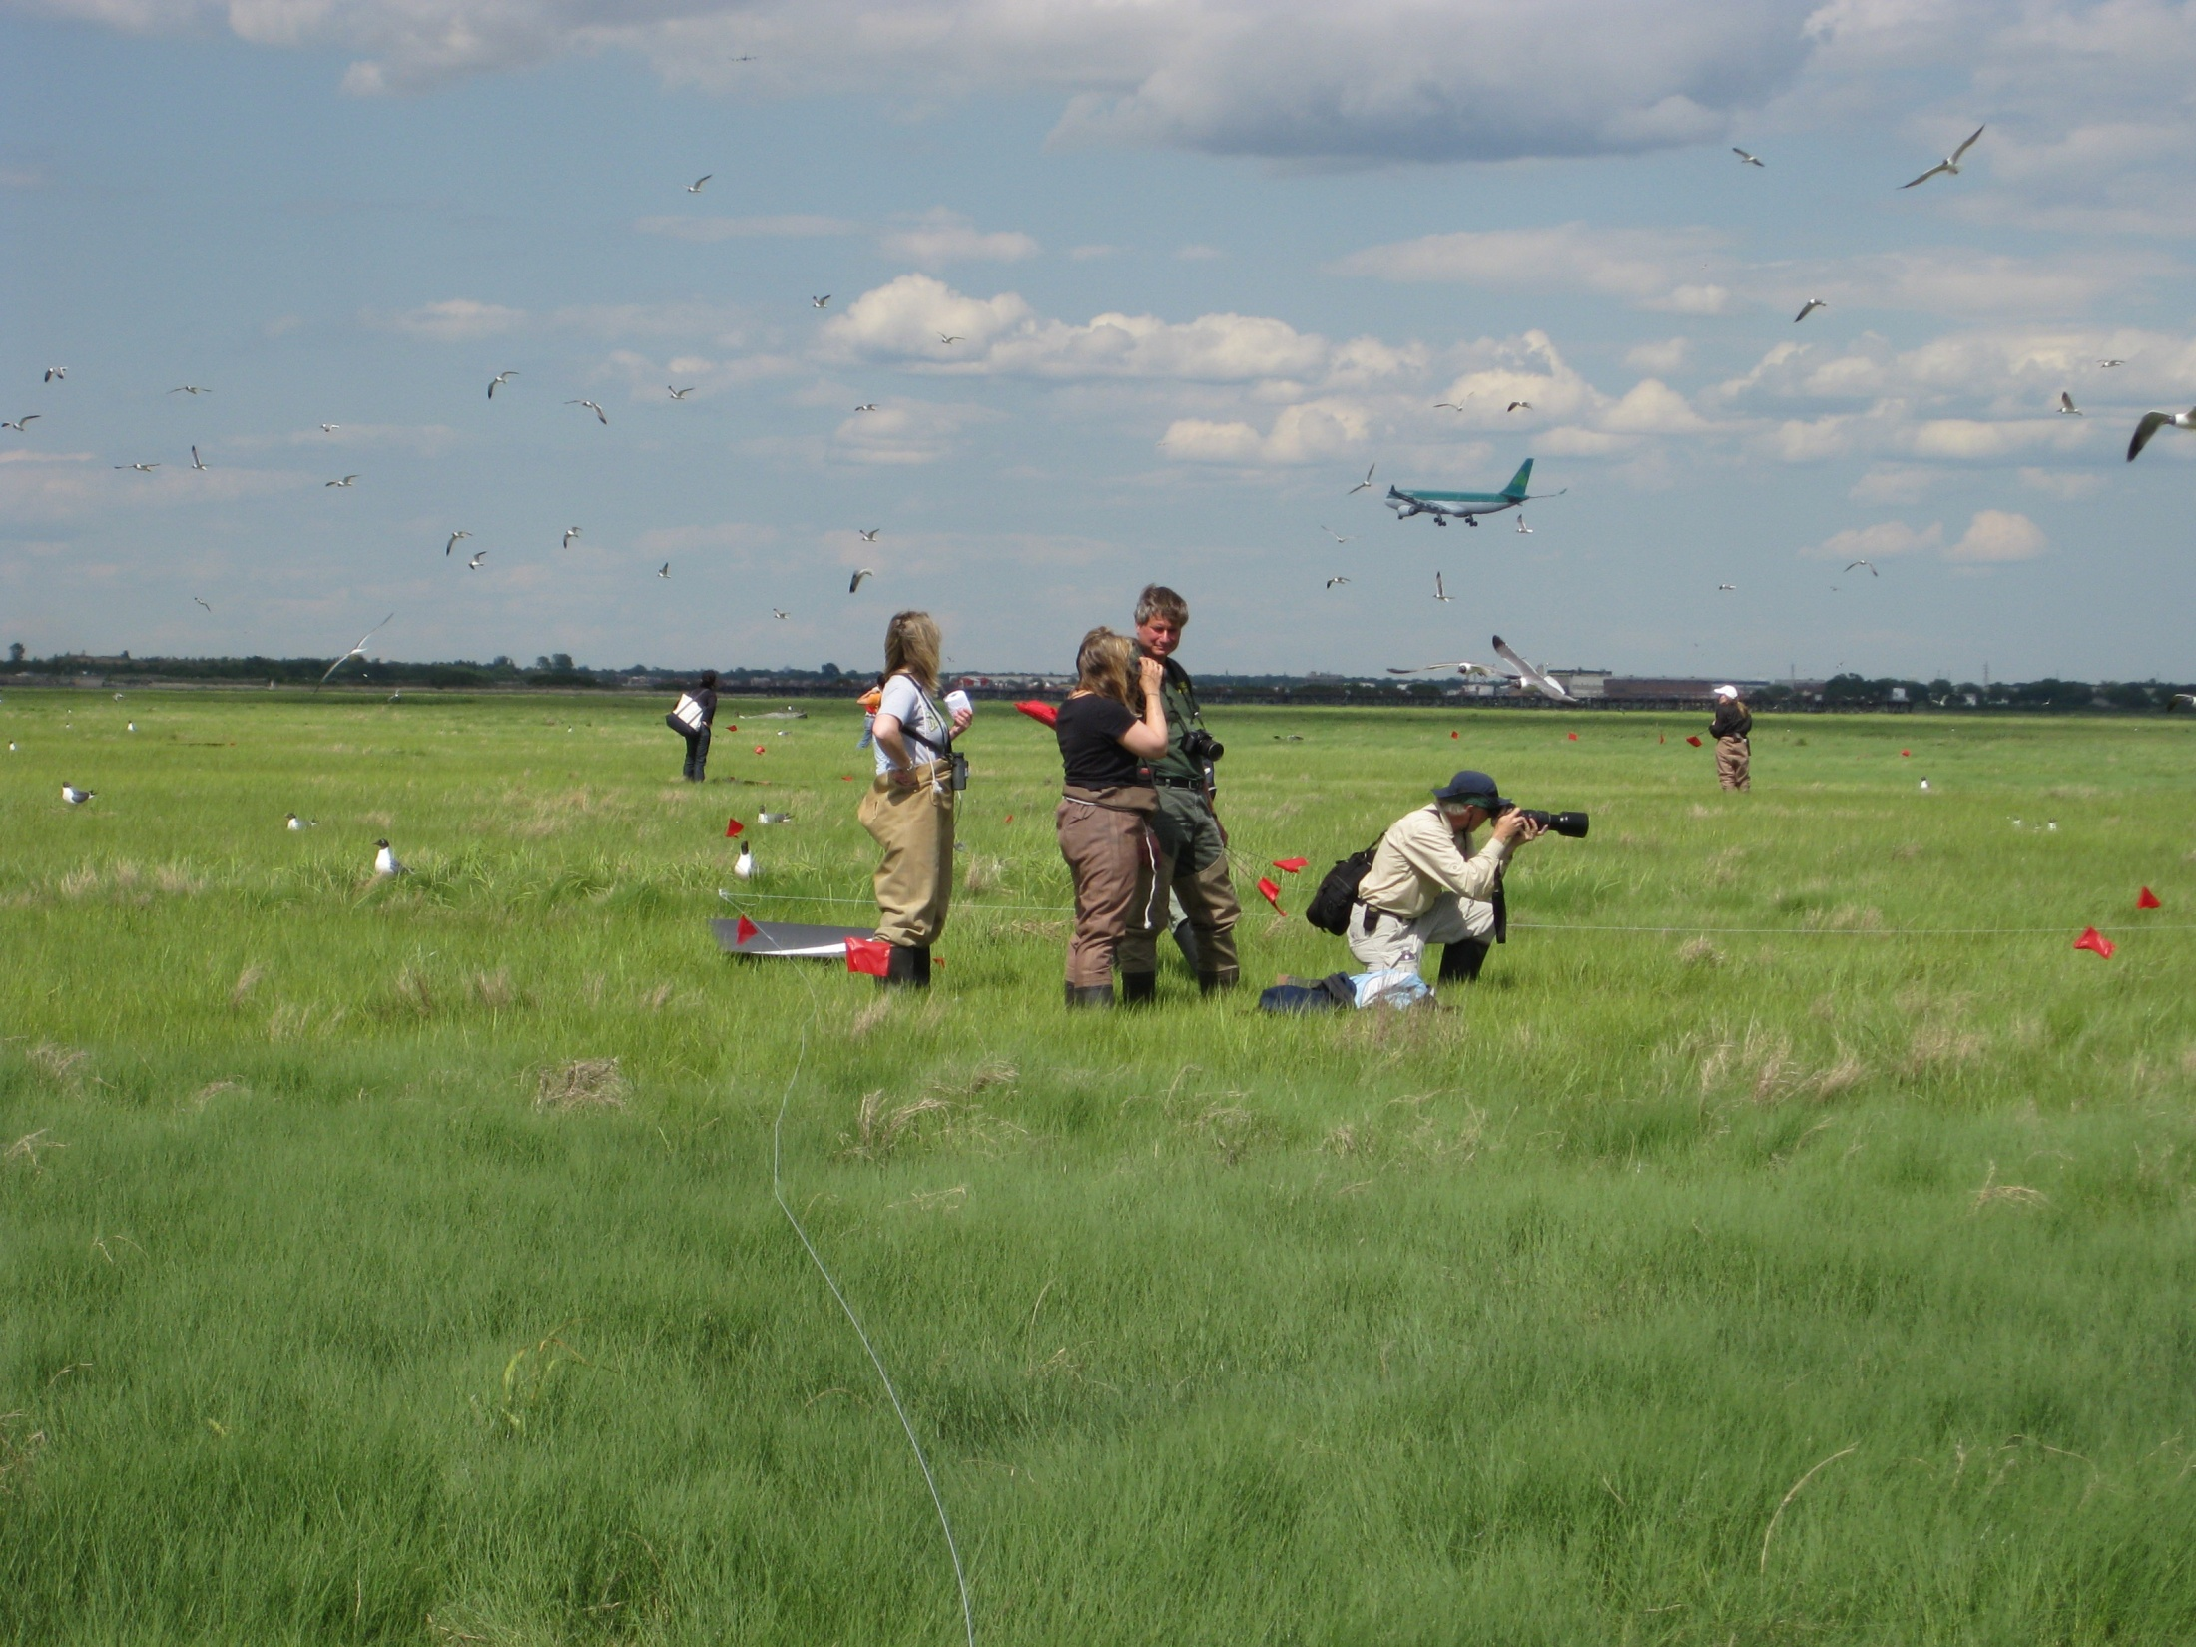

Slide 15
Action 5: Mute Swan egg addling
Since 1993, swan monitoring in Jamaica Bay.
Highest count was 388 swans in 2008.
There are 17 known nests in Jamaica Bay, plus several undiscovered nests.
Egg addling since 1994, because non-native.
Addling done in 9 of past 17 years; suspended in 2004-08 due to review of non-native status.
Addled 108 eggs in July 2009.

Slide 16
Action 6: Habitat restoration away from JFK airport
Since 2002, planning for saltmarsh restoration in Jamaica Bay is confined to sites > 2 miles from airport:
2003 Big Egg Marsh
2007 Elders Point (West Island)
2009 Elders Point (East Island)
2011 Yellow Bar (and maybe Black Wall & Rulers Bar)

Slide 17
Action 7: Monitor geese, gulls, and other large birds in JBWR
Weekly, year-round, total counts of Canada Goose, Brant, Snow Goose, Herring Gull, Great Black-backed Gull, Ring-billed Gull, Laughing Gull, and ducks are being done by NPS since 2005, at a dozen places in Jamaica Bay: e.g., counted 1228 Can Goose at Rulers Bar Hassock during molt, 24 June 2010.
Multi-agency & NGO collaborators do total counts of heron and gull nests in Jamaica Bay.

Slide 18
Action 8: Goose round-up on the landfills.
NPS allowed an emergency roundup of 100 Resident Canada Goose in July 2010 (during the molt) on Pennsylvania Avenue Landfill.
Possible future roundups of flightless Resident Canada Goose (a non-native population) in JBWR are discussed in the Supplemental EIS, released in Jan 2011 for public comment.

Slide 19
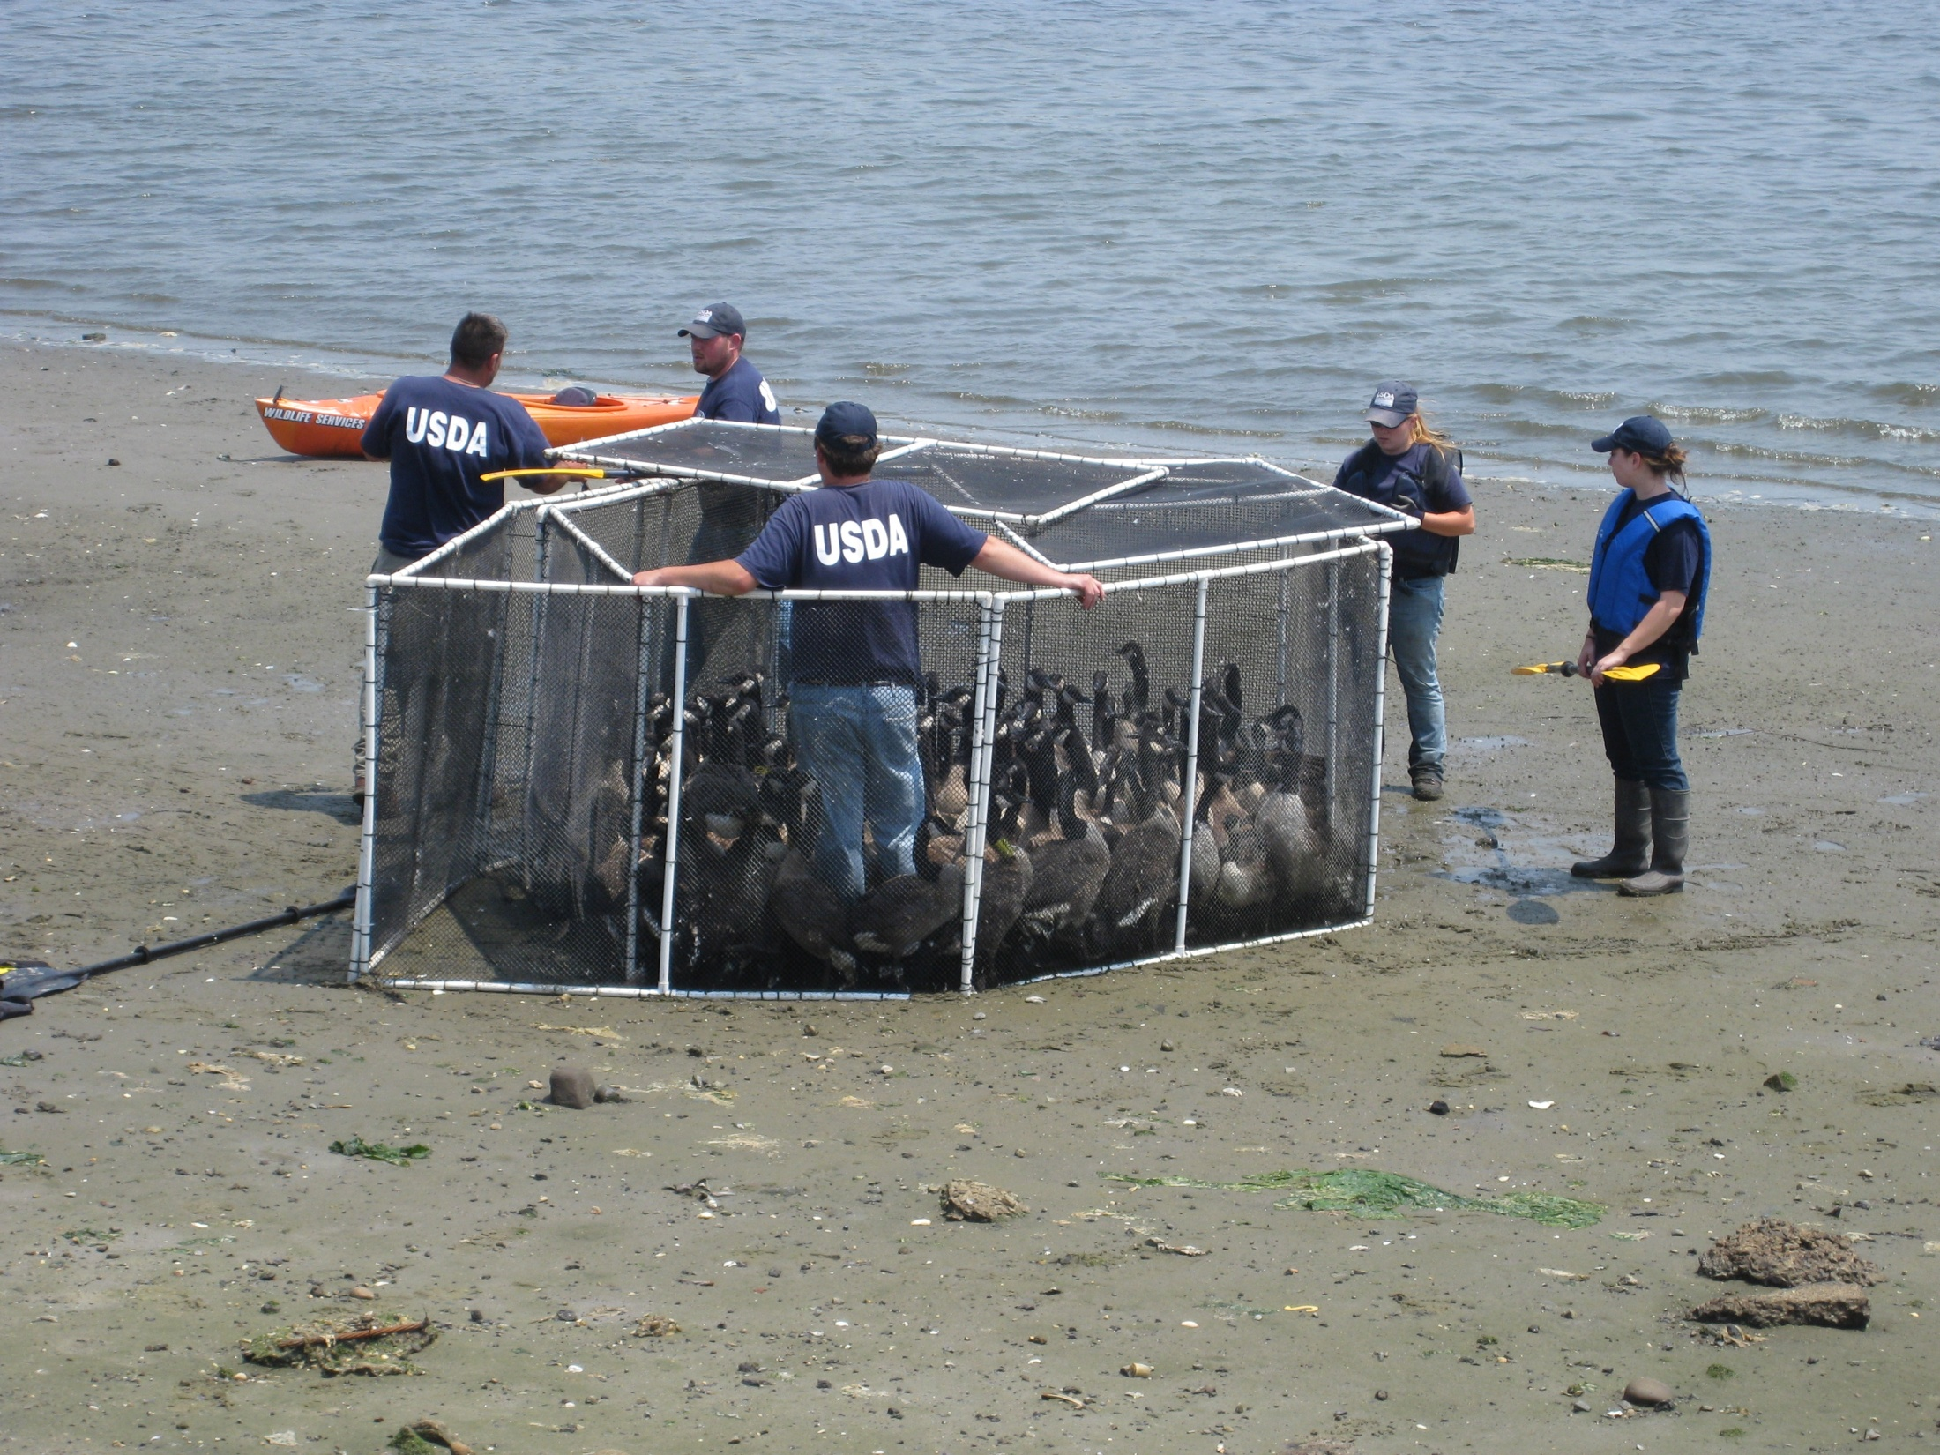

Slide 20
Action 9: Plan to move Osprey nest platforms farther from airport
A plan is being drafted to remove the Osprey nest platform from JoCo Marsh, because of its nearness to the runway.
Derelict boats will be removed from JoCo each spring, to prevent them being used as Osprey of Peregrine Falcon nest sites.
Plans are to install new Osprey nest platforms at the west side of Jamaica Bay, outside the FAA 5-mile radius.

Slide 21
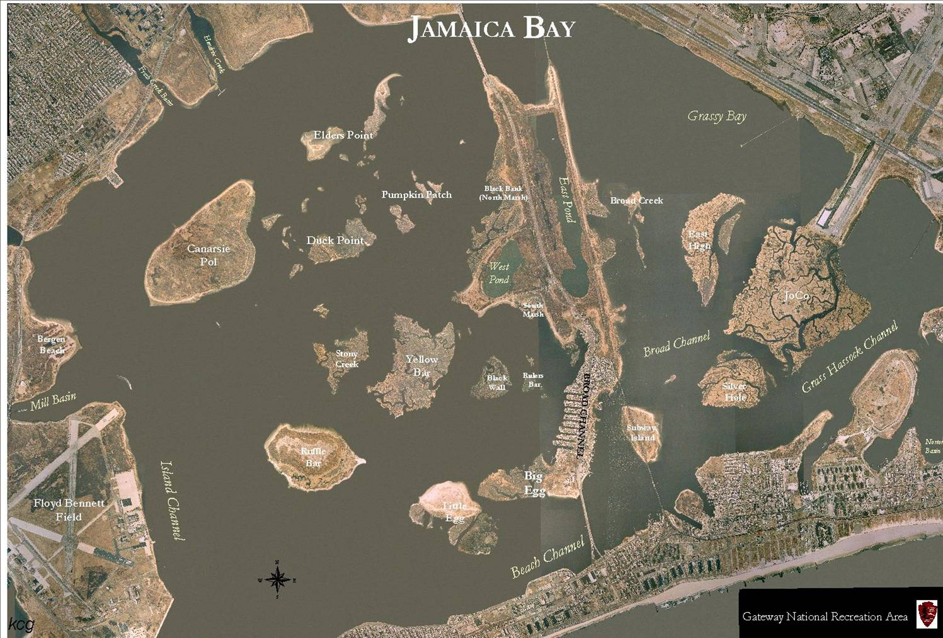

Slide 22
Action 10: Propose a substitute Laughing Gull nesting-colony site in western Jamaica Bay
As part of the saltmarsh restoration program, a large area of high marsh in southwestern Jamaica Bay will be suggested as an alternative site where Laughing Gulls can nest.
The location will need to be free of raccoons, and with few loafing gulls.
Active management will be prescribed in Spring to entice Laughing Gulls to nest there.

Slide 23
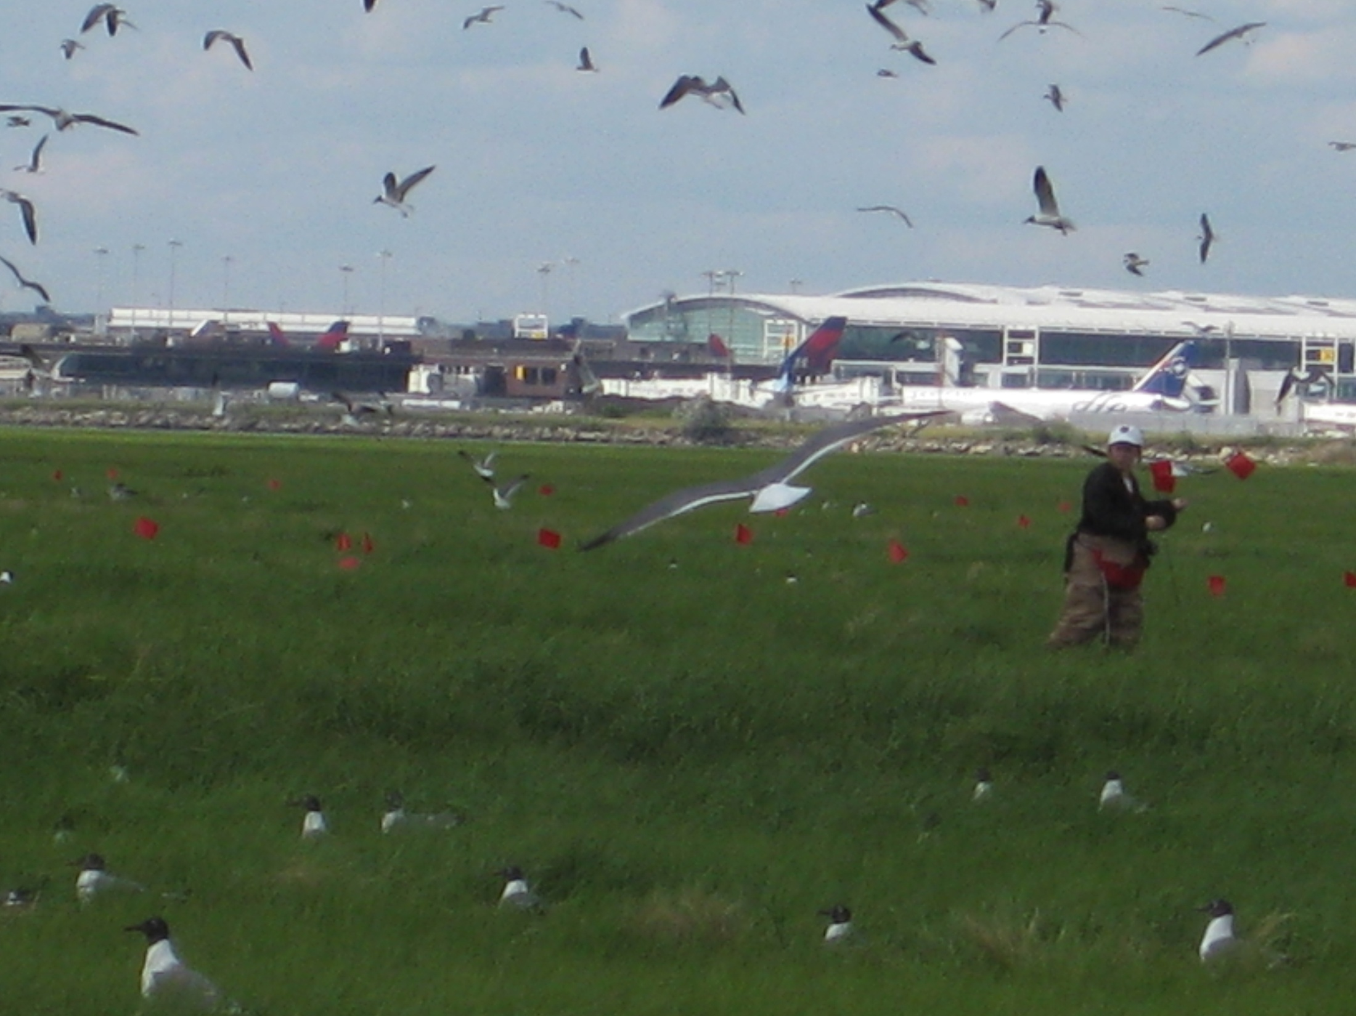

Slide 24
Action 11: Collaborate in new Supplementary EIS to further reduce bird hazards
Within the framework of federal laws and policies, Gateway NRA is trying to find ways to reduce bird hazards near JFK airport.
Removal of non-native bird species is one possibility; the reduced competition will favor native bird populations.
Elimination of artificial attractants near the airport, for both the native and non-native species, could reduce gulls and geese.

Slide 25
Conclusions by Gateway NRA
The national park continues monitoring birds and sharing information.
Bird mgmt in JBWR is based foremost on the park’s Enabling Legislation & and NPS policies.
Reducing non-native bird populations could aid air safety as well as help native birds and salt marshes.
11 ways were described in which the park is addressing the bird-hazard issue at JFK airport.

