Slide 1
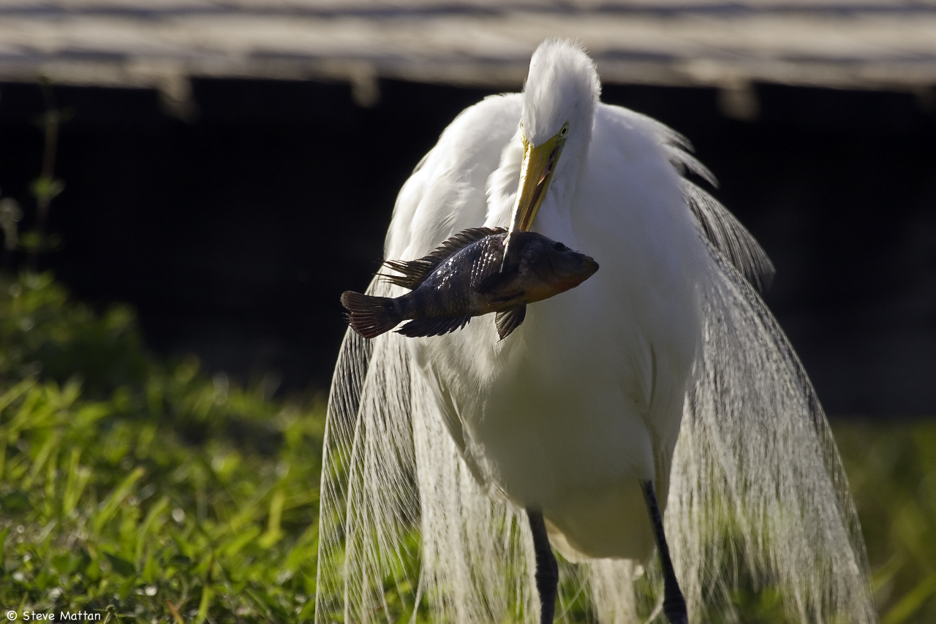
The Harbor Herons Conservation Plan
New York/New Jersey Harbor Region
Written by: The Harbor Herons Subcommittee Habitat Workgroup NY/NJ HEP
edited by Susan B. Elbin and Nellie K. Tsipoura*

Slide 2
First rough draft available for review
Google groups Colonial Waterbirds Harbor Heron Subcommittee site: http://groups.google.com/group/cwb2/files?hl=en
File Name:
HHjan52010_submitted.docx

Slide 3
Executive Summary will be revised
Sections I and II – completed
FEEDBACK REQUESTED
Section III - Status Of Habitat Conservation For Harbor Herons; Management, Acquisition, Restoration, And Enforcement
Review recommended Acquisition and Restoration Priority Sites
Update status of sites
Recommend other sites
Update/edit site descriptions

Slide 4
FEEDBACK REQUESTED
Section IV - Conservation Threats
Review for content
Section V - Plan Of Action: Addressing Threats And Setting Priorities
Review recommendations
Review and update habitat sub-section
Suggest and add content for additional priorities and actions
Fill in gaps relating to other existing plans in the region (CRP, state wildlife action plans etc)

Slide 5
NEXT STEPS
Prioritize actions through stakeholder meetings
Add $$ to priority actions

Slide 6
NEXT STEPS
Create subgroups to implement different aspects of the Conservation Plan

Slide 7
NEXT STEPS
Work with HEP and EPA to develop a business plan to pursue these steps, including fundraising

