Slide 1
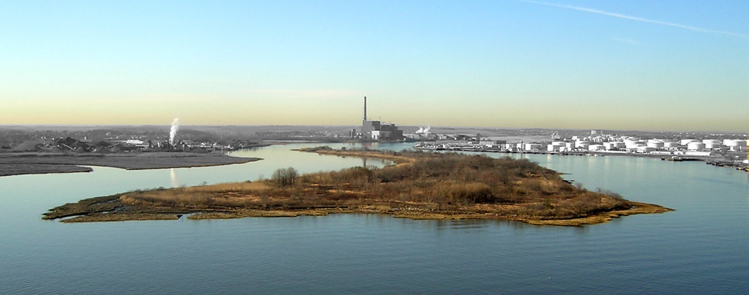
PRALL’S ISLAND COLONIAL WATERBIRD
NESTING HABITAT RESTORATION
City of New York Parks & Recreation
Natural Resources Group (NRG)
Alexander Summers

Slide 2
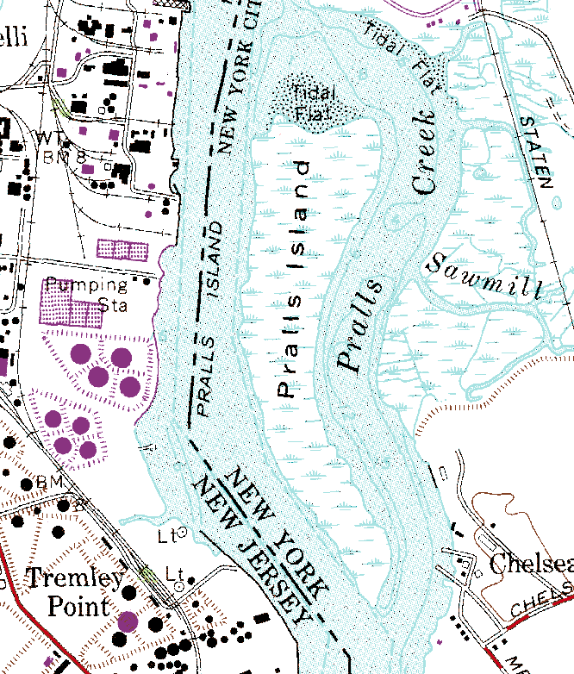
LOCATION OF PRALL’S ISLAND
Location: In the Arthur Kill,
west of Prall’s Creek;
One mile south of the Goethals Bridge;
Borough of
Staten Island

Slide 3
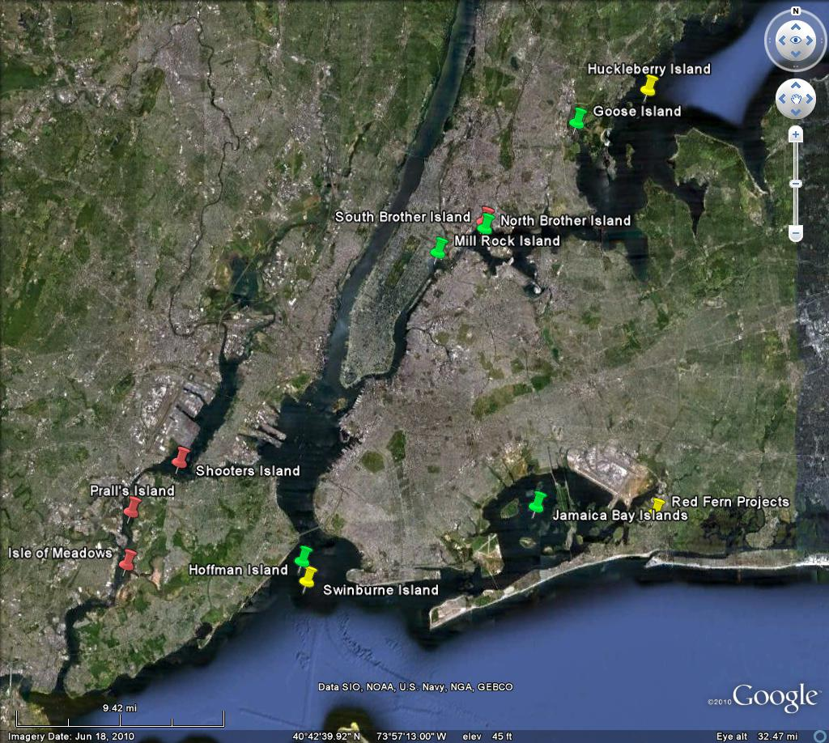
NYC Metro Area Nesting Habitats

Slide 4
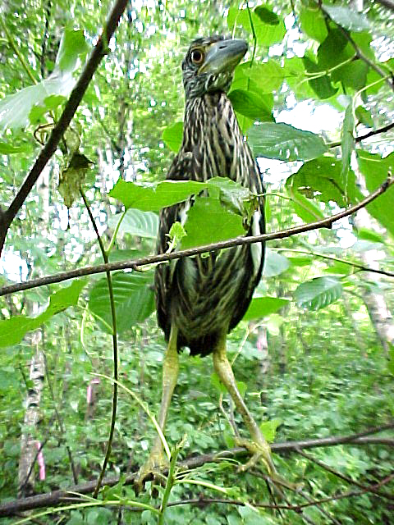
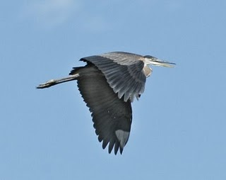
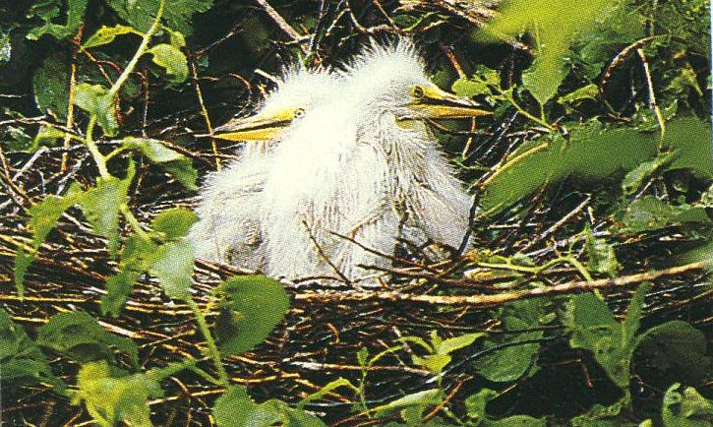
PURPOSE To allow colonial wading bird populations to recover from a decline in breeding success by increasing nesting habitat at Prall’s Island.
Great Egret chicks
Great Blue Heron
Juvenile
Black-crowned Night Heron

Slide 5
QUESTIONS
What is the cause of decline in Heron colonies or why are some colonies abandoned?
Predators?
Pollution?
Habitat?
Human interference?
Exotic Invasives?
Food Supply?
Natural Movement?
Disasters? (oil spills, ALB, etc…)
What dynamics are required for habitat selection?
What attributes help sustain a healthy colony?
What attributes contribute to the demise of a colony?

Slide 6
BRIEF HISTORY
Low and High Saltmarsh (Spartina alterniflora, Spartina patens)
Breeding Herons peak in 1989
Stable population through a decade, declined rapidly in mid-1990’s,
late1980’s: 800 adult pairs
1996: 200 adult pairs
2000: ~24 nests found on North end of island, 3 nests found mid island
2005: Colony ceases to exist
2007 Harbor Herons Project Nesting Survey, no wading bird nesting activity reported in the Arthur Kill/ Kill van Kull Areas (NYC Audubon Society 2007)

Slide 7
DATA COLLECTION
2000/01 and 2010 GPS Surveys
TREE SPECIES: caliper/ height/ spread/ architecture(dense twiggy vs. loose not dense)/health/ pests
NESTS: species/ quantity/caliper/ height in tree/ distance to center/ location (crotch, inner branch, outer branch)/nest materials
VEGETATION COMMUNITIES (entitation):
dominant species/ formation/topography/soil condition/historical indicators/ exotic/native/non-native/stability index
TERRAIN MAPPING: mudflats/debris/low marsh/high marsh/uplands/tides *2001
SOILS: USDA NRCS survey *2002
21 soil pits (4ft. Depth) profiled and classified

Slide 8
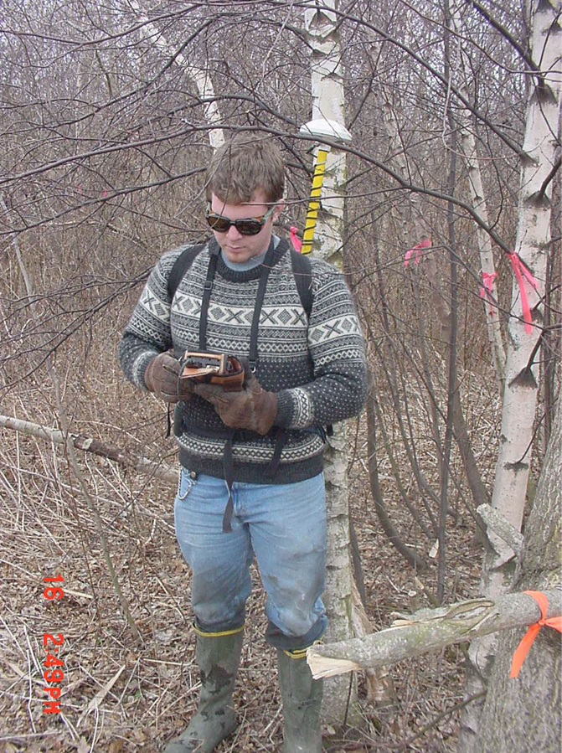
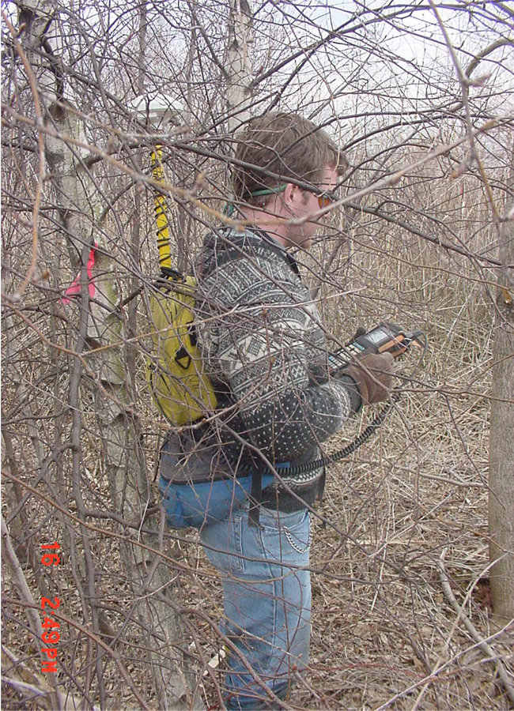
GPS BACKPACK UNIT

Slide 9
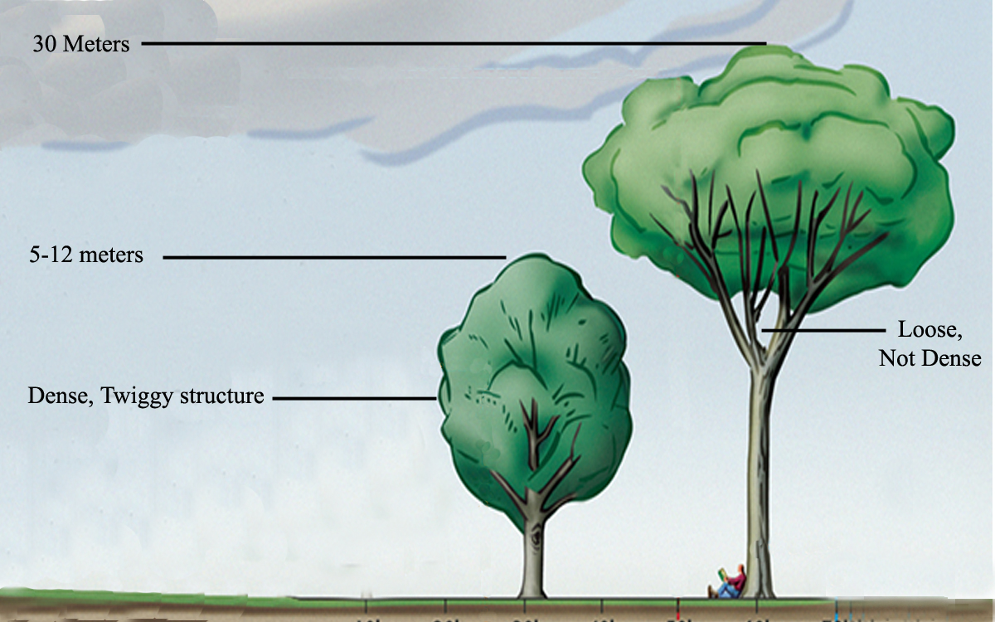
HERON NESTING HABITAT DYNAMICS
TREES

Slide 10
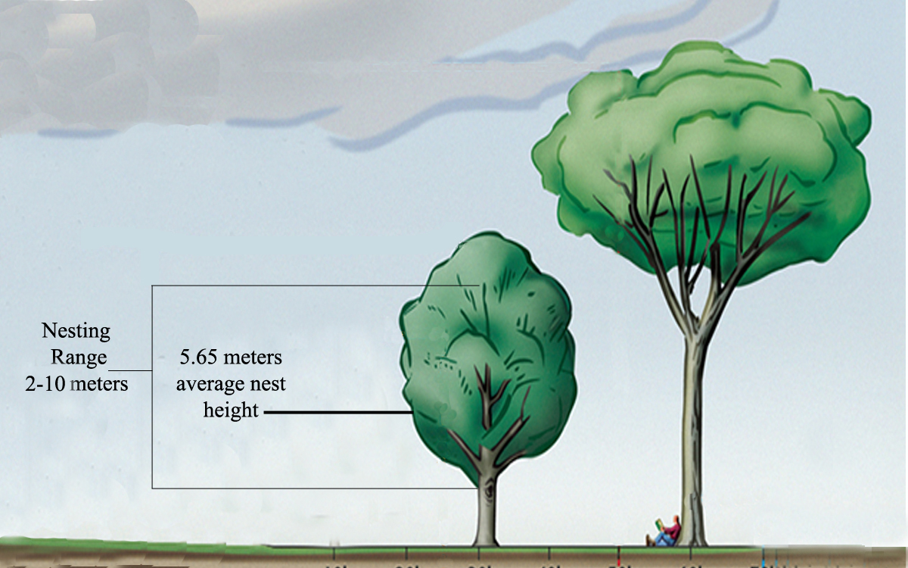
NESTS

Slide 11
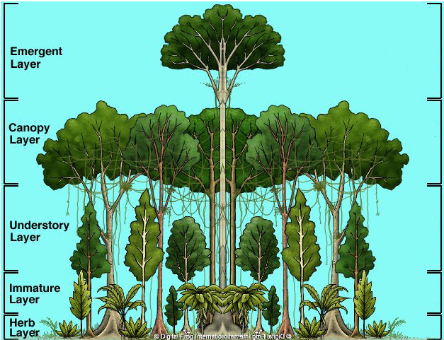
STRUCTURE

Slide 12
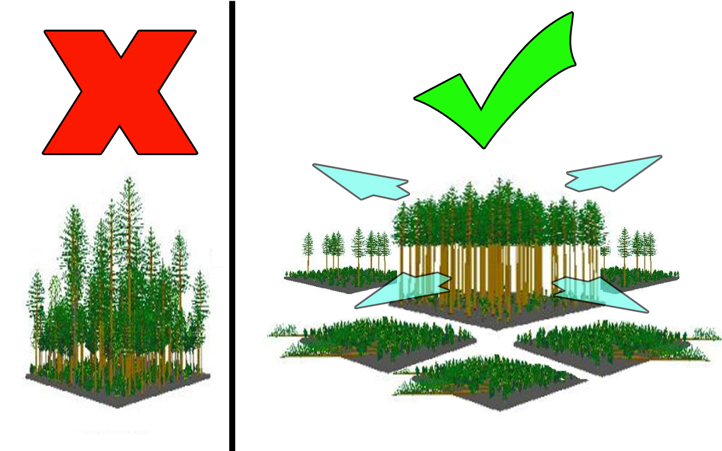
STRUCTURE

Slide 13
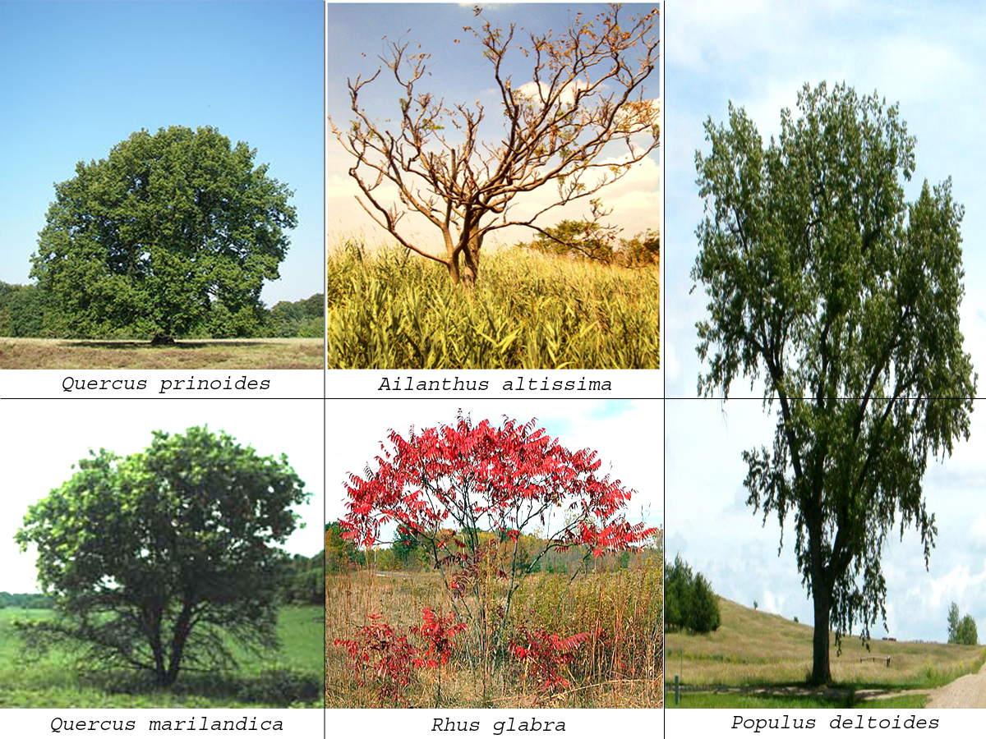
THE VARIATION

Slide 14
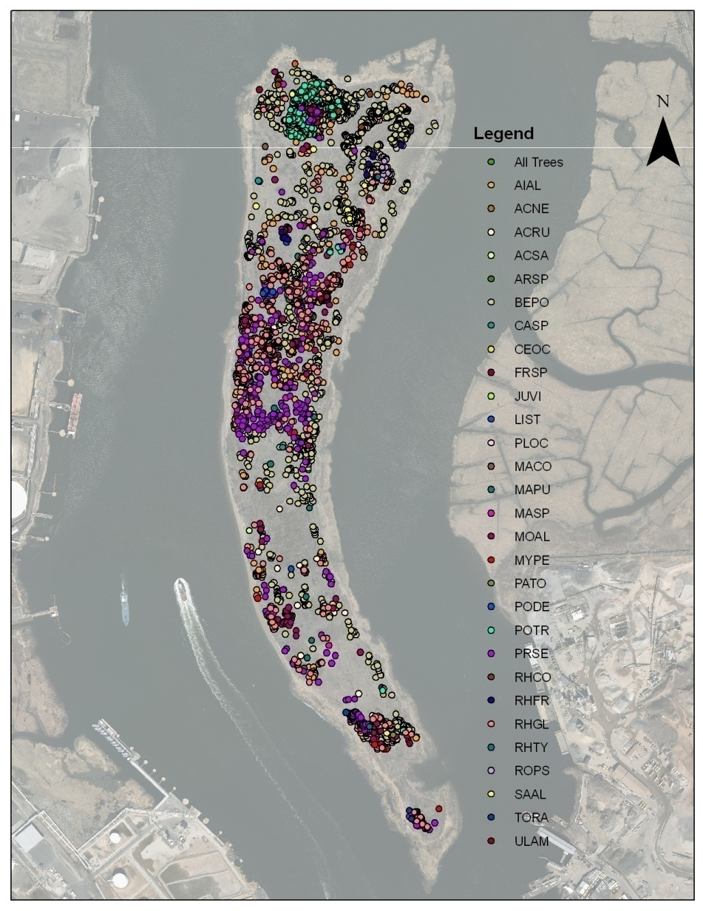
2001 TREES on PRALL’S ISLAND

Slide 15
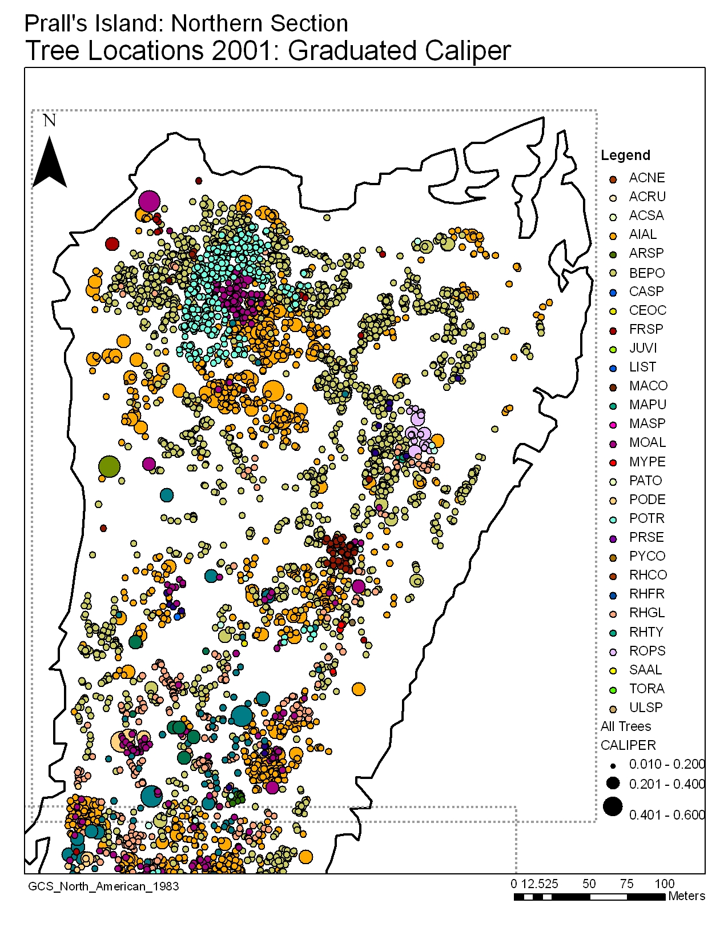

Slide 16
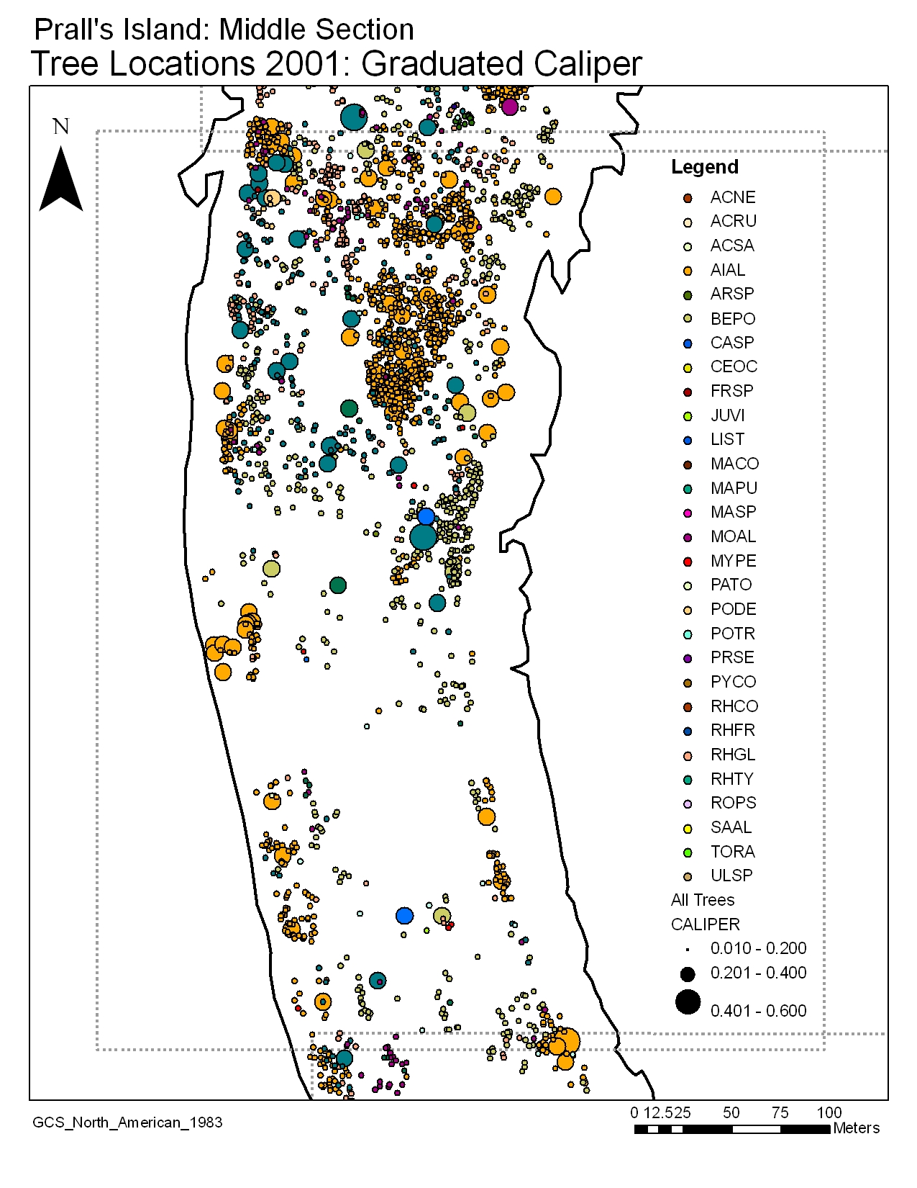

Slide 17
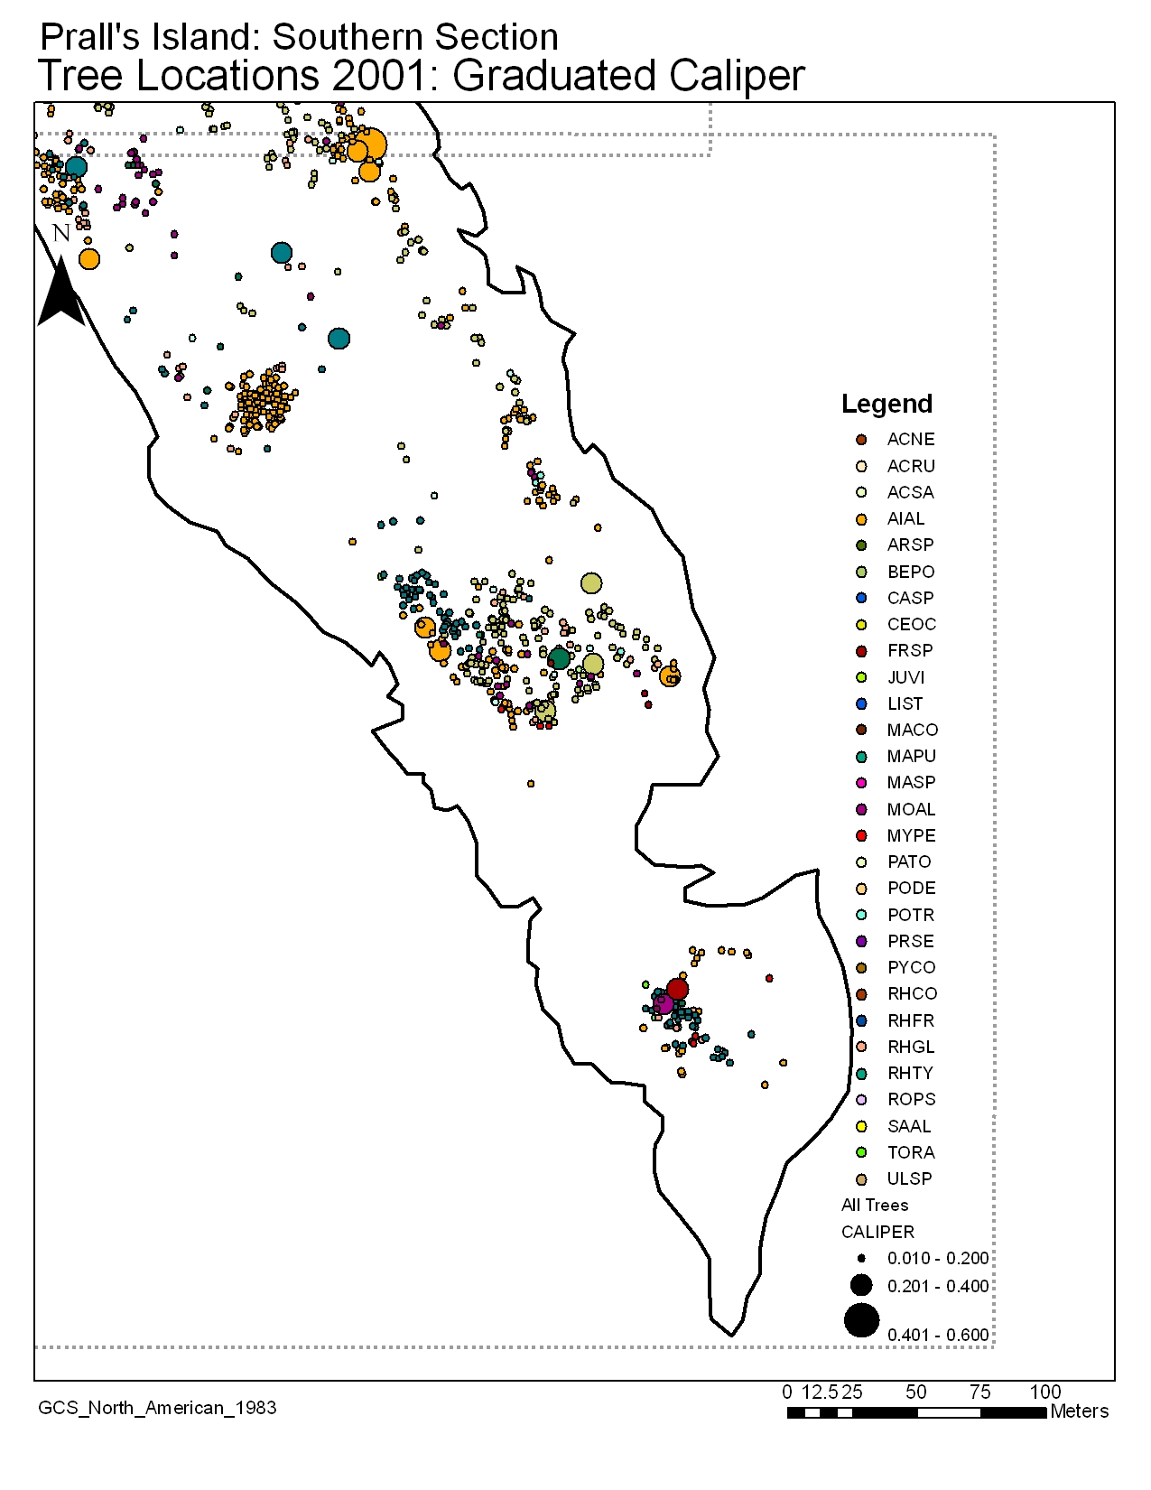

Slide 18
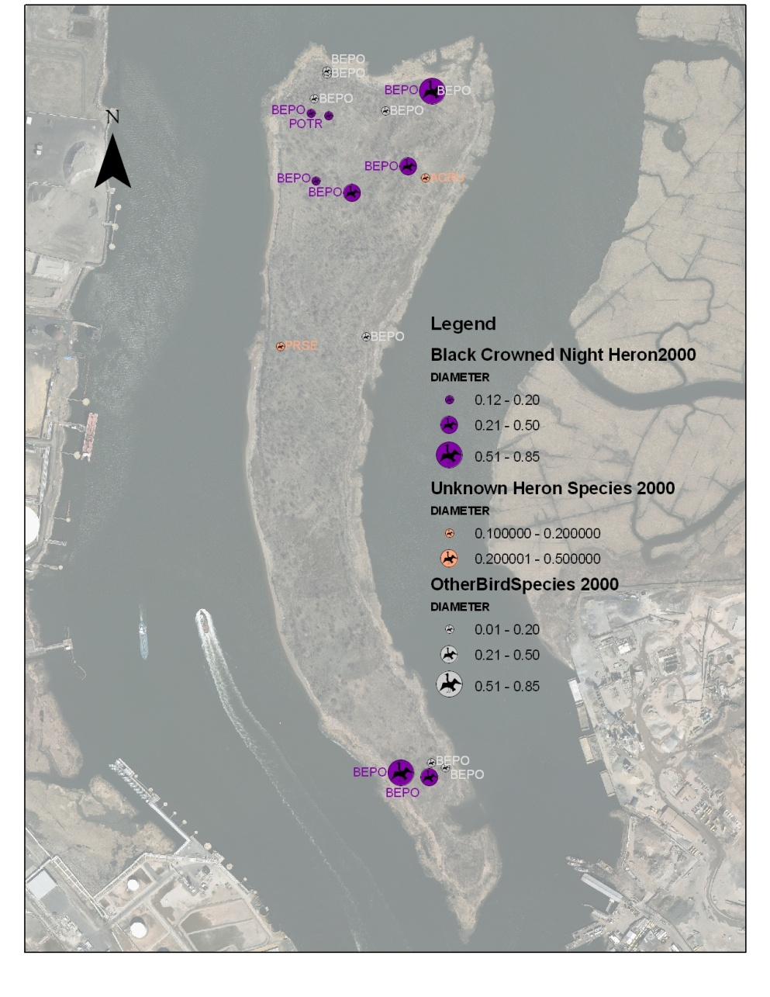
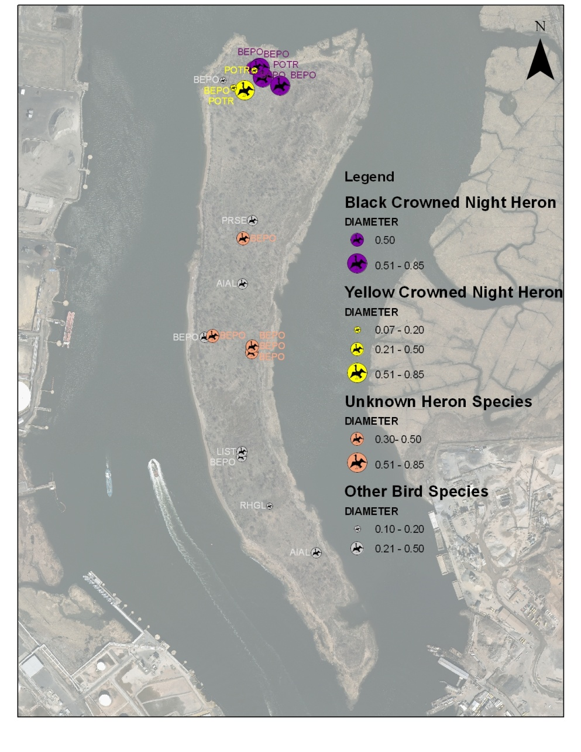
2000 Nest Data
2001 Nest Data
GPS Nest Counts
BCNH: 13
Unknown Heron: 7
YCNH: 3

Slide 19
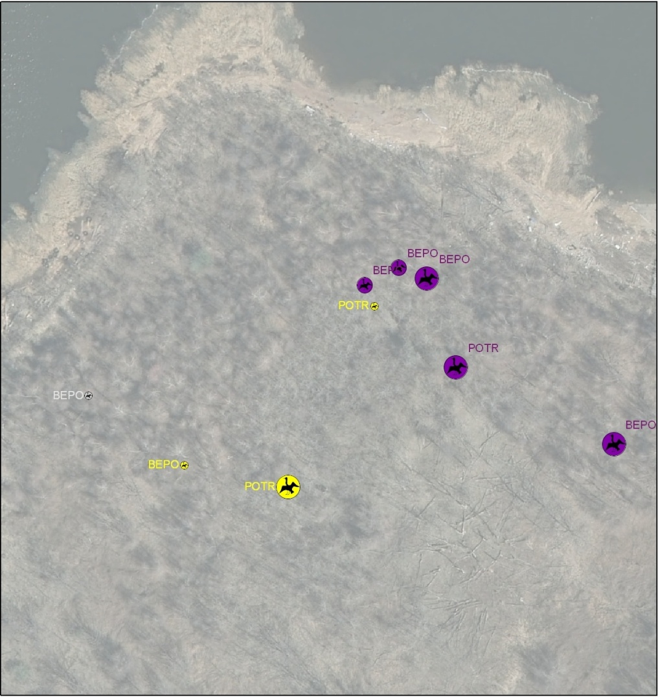
2001 Concentration of Heron nests at Northwest corner of the island in dense stand of Betula populifolia trees
Notes:
Concentration of Heron nests at NW corner of the island in dense stand of bepo trees
Pic of Prall’s NW Section from 10 years ago?

Slide 20
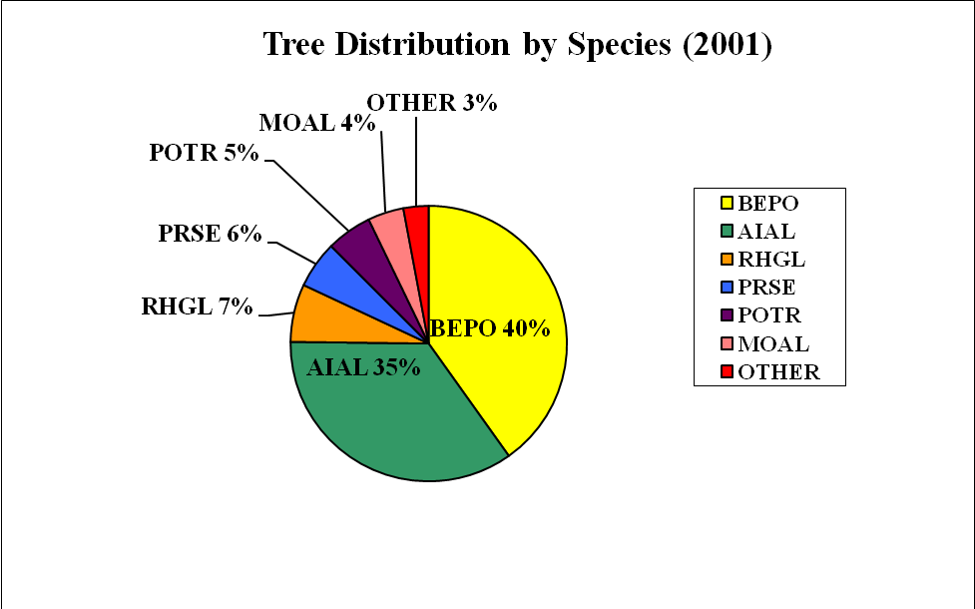
CHARTS and GRAPHS

Slide 21
Betula populifolia and Populous tremuloides most selected

Slide 22
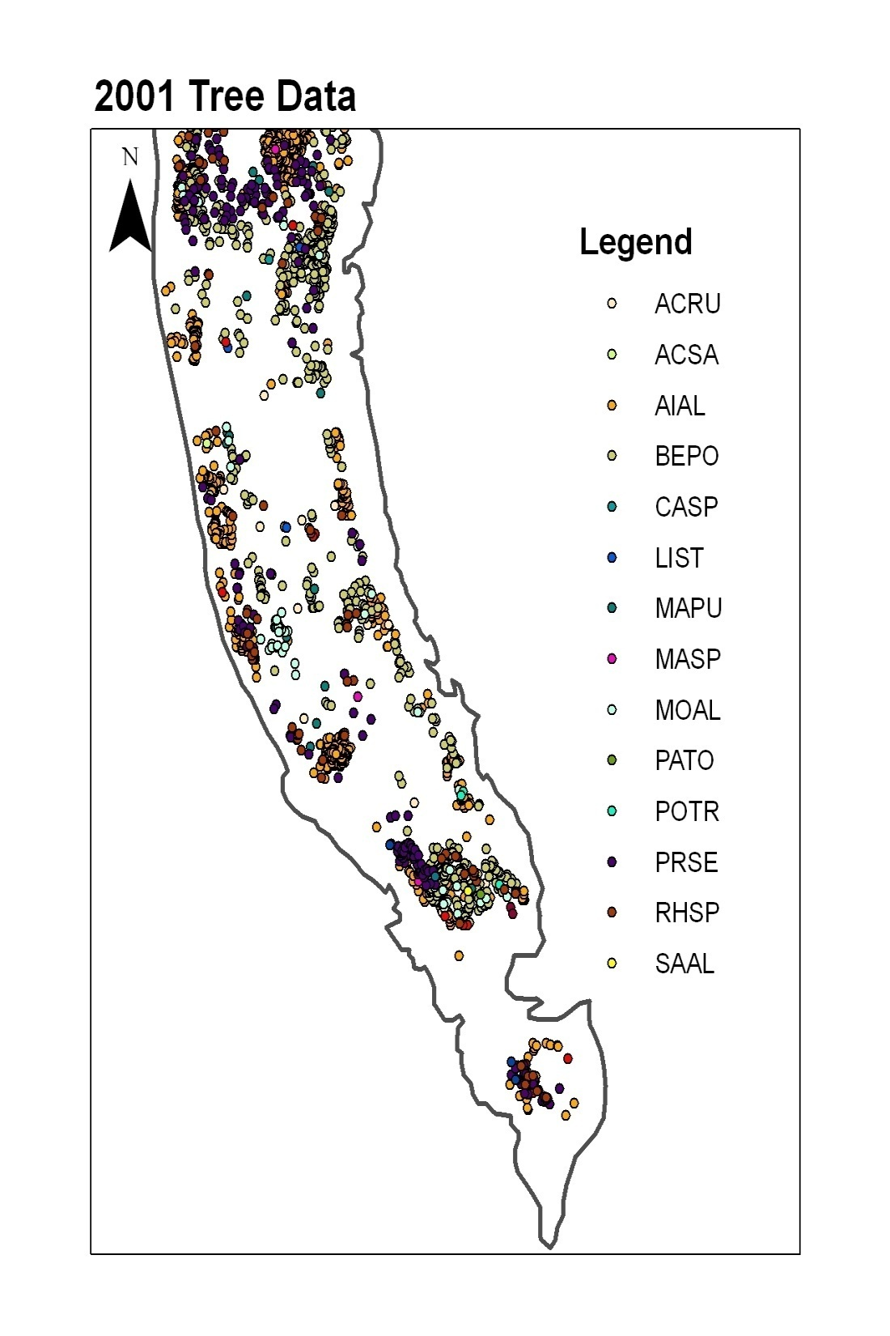
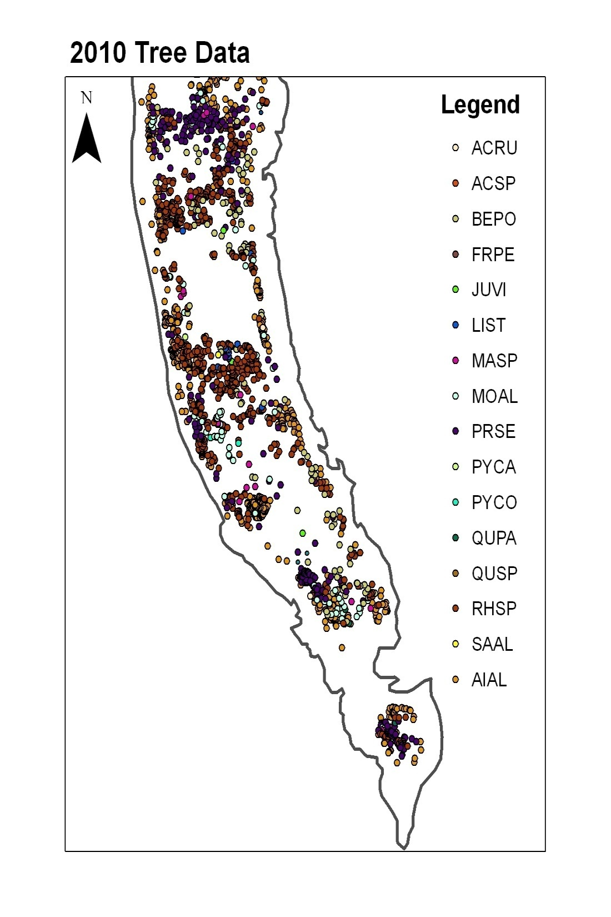

Slide 23
 | # Trees |  | Avg. Caliper (m)
Species | 2001 | 2010 | 2001 | 2010
ACSA | 1 | 0 | 0.08
ACRU | 17 | 2 | 0.08941176 | 0.06
ACSP | 0 | 1 |  | 0.07
AIAL | 718 | 675 | 0.09196379 | 0.10050445
BEPO | 558 | 106 | 0.08360215 | 0.05575472
CASP | 1 | 0 | 0.06
FRPE | 0 | 1 |  | 0.06
JUVI | 1 | 3 | 0.1 | 0.13333333
LIST | 3 | 14 | 0.23333333 | 0.16285714
MAPU | 18 | 0 | 0.14555556 | 0
MOAL | 54 | 86 | 0.08648148 | 0.1251
MASP | 4 | 20 | 0.06 | .2145
PATO | 1 | 0 | 0.15
POTR | 3 | 0 | 0.09666667
PRSE | 213 | 258 | 0.1071831 | 0.1343
PYCA | 0 | 1 |  | 0.14
PYCO | 0 | 2 |  | 0.095
QUPA | 0 | 5 |  | 0.092
RHSP | 81 | 642 | 0.05876543 | 0.05899908
SAAL | 1 | 3 | 0.05 | 0.12

Slide 24
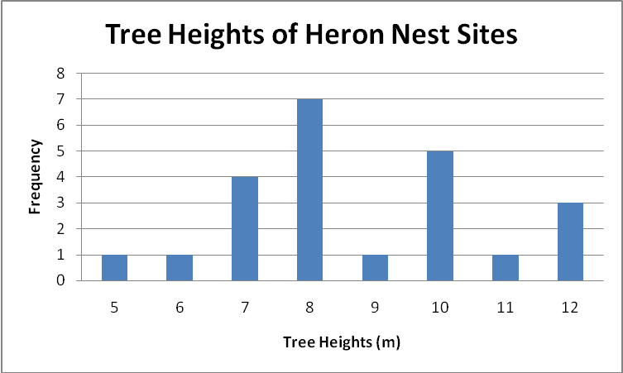
While the most common heights for all Prall’s Island trees ranged from 4-6m, the heron nests were mostly found in trees with heights ranging from 7-10m
Avg. tree height for preferred species: 8.73913 m
Avg height for total tree population: 6.509269 m
Avg nest height= 5.65 m
2000/2001

Slide 25
Range nest height: 2 to 10
Avg: 5.652174

Slide 26
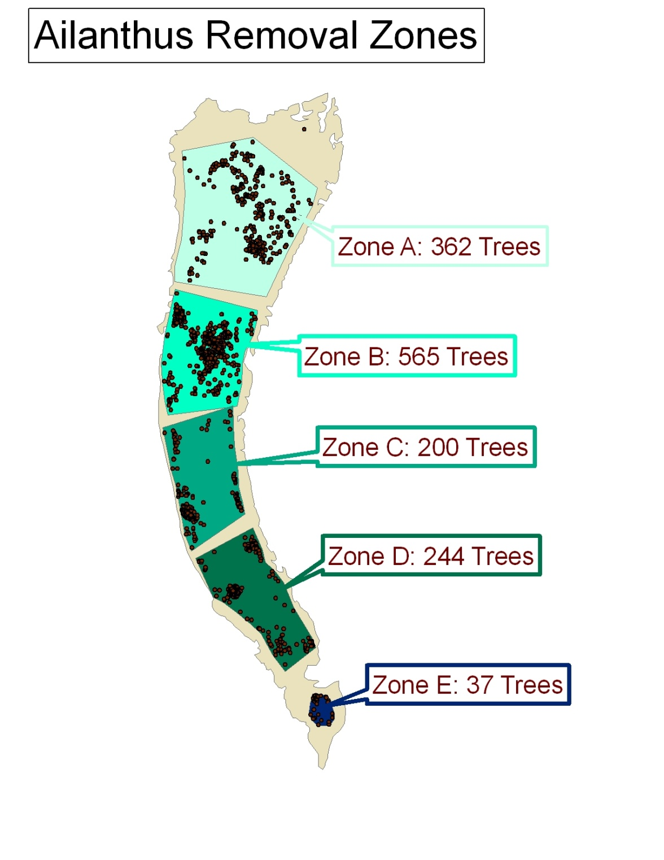
ZONES
The island is divided into 5 zones:
A, B, C, D, E
Trees for removal are located and flagged and/or marked within these zones.

Slide 27
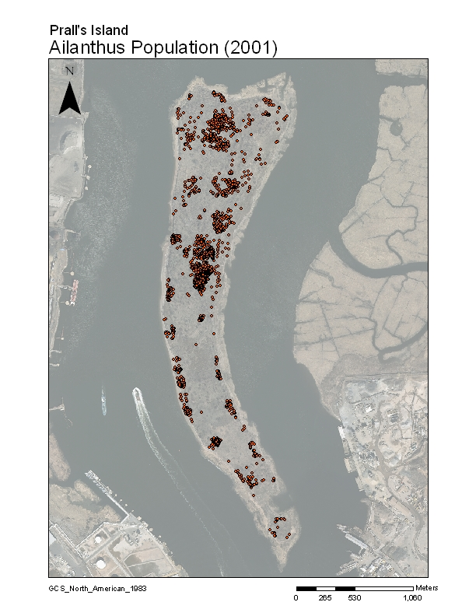
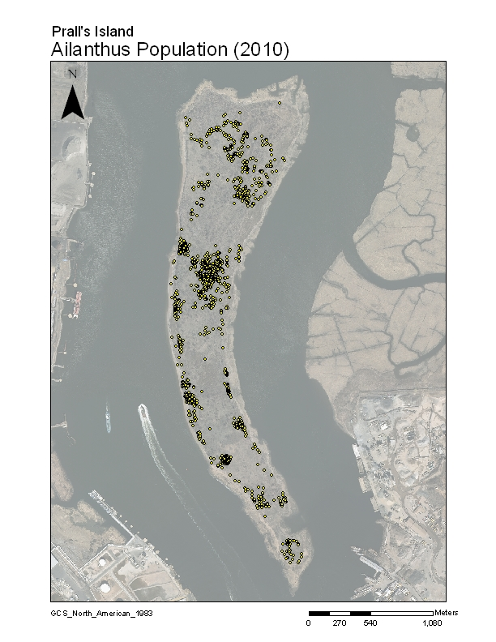

Slide 28
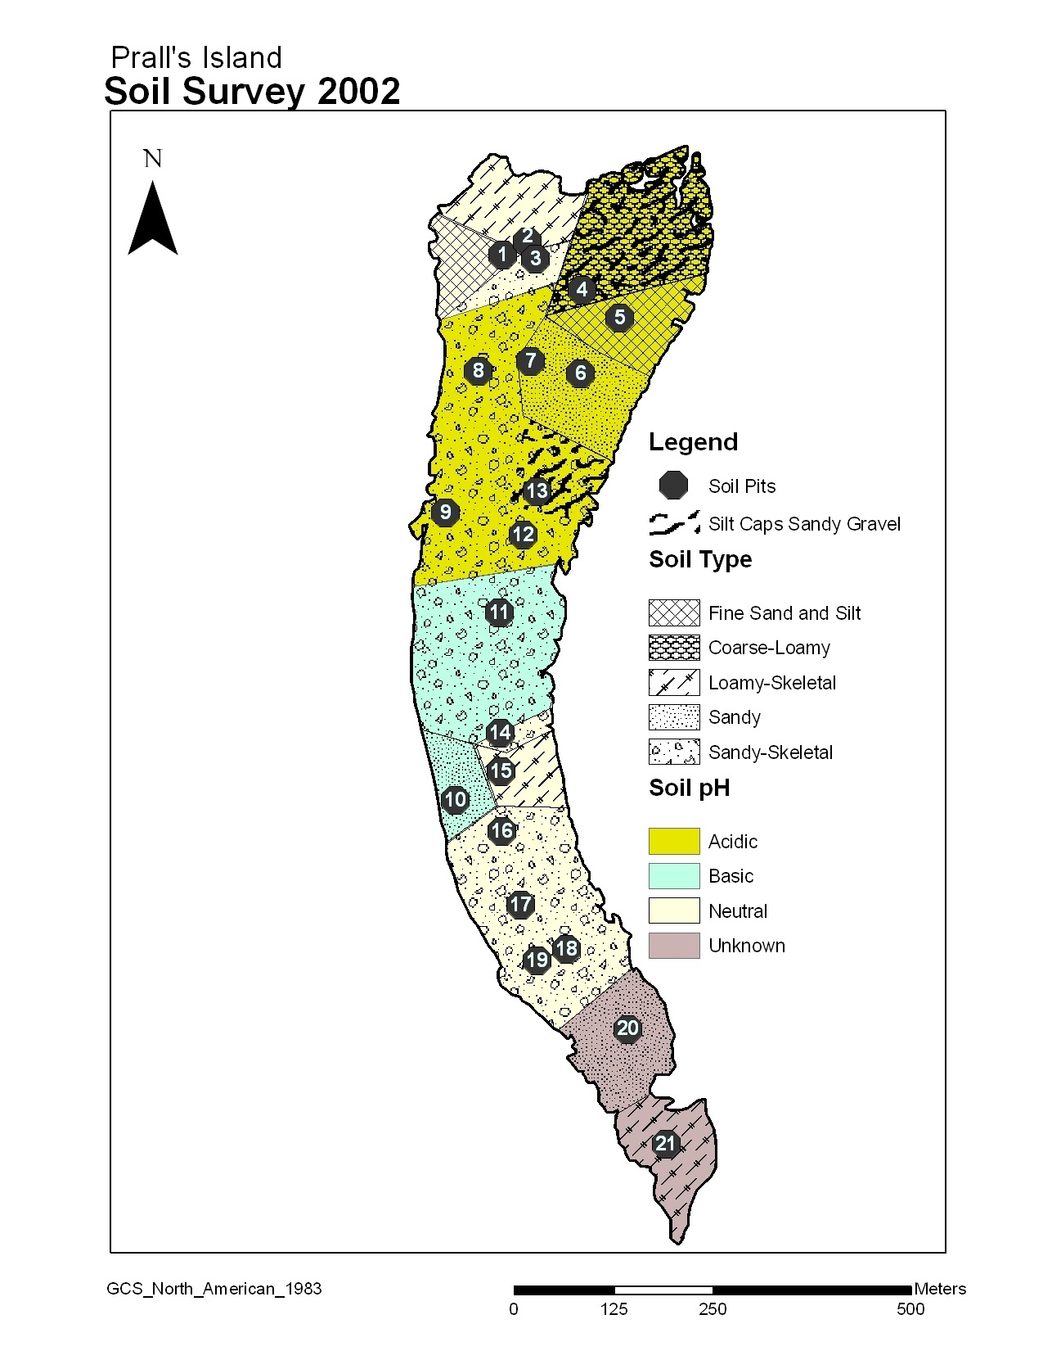
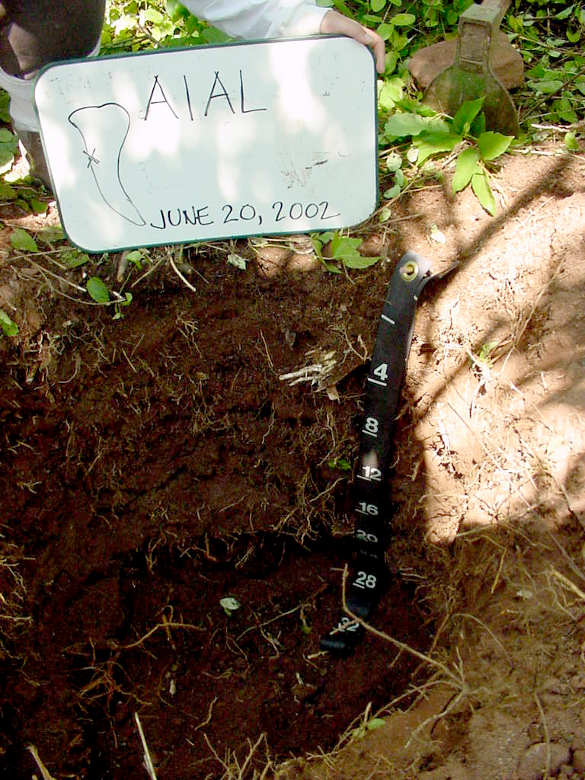

Slide 29
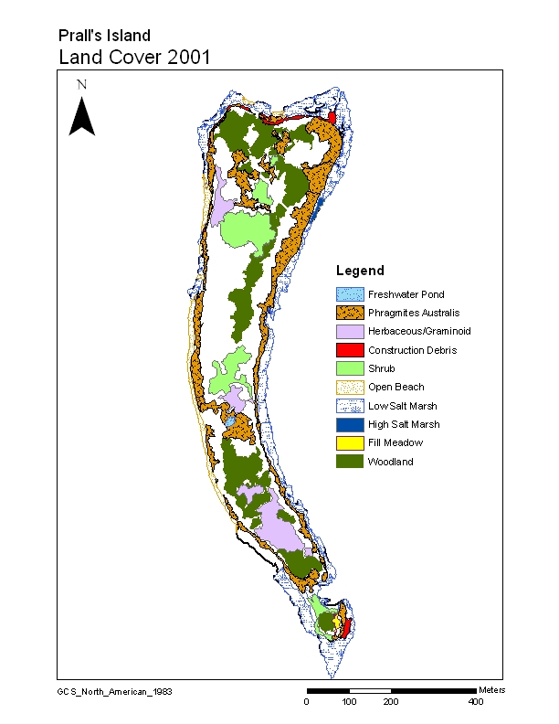
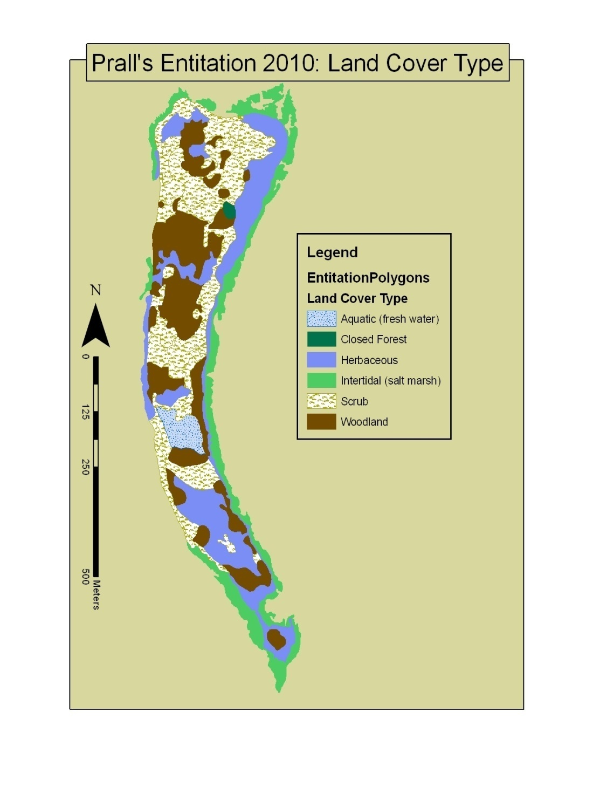

Slide 30
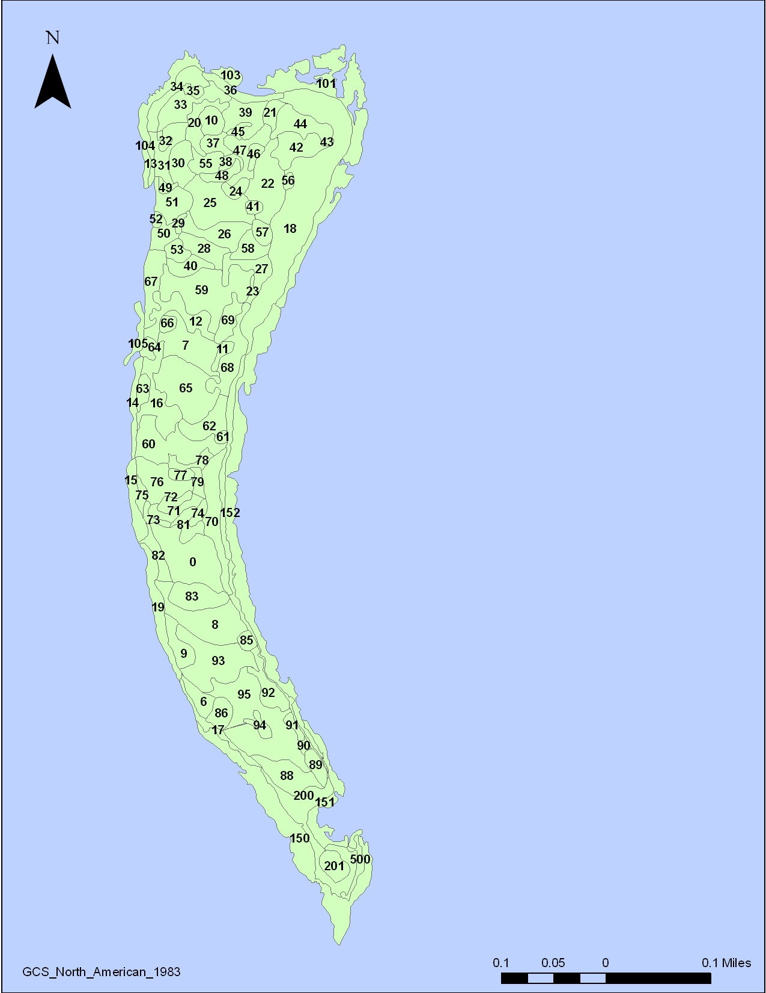
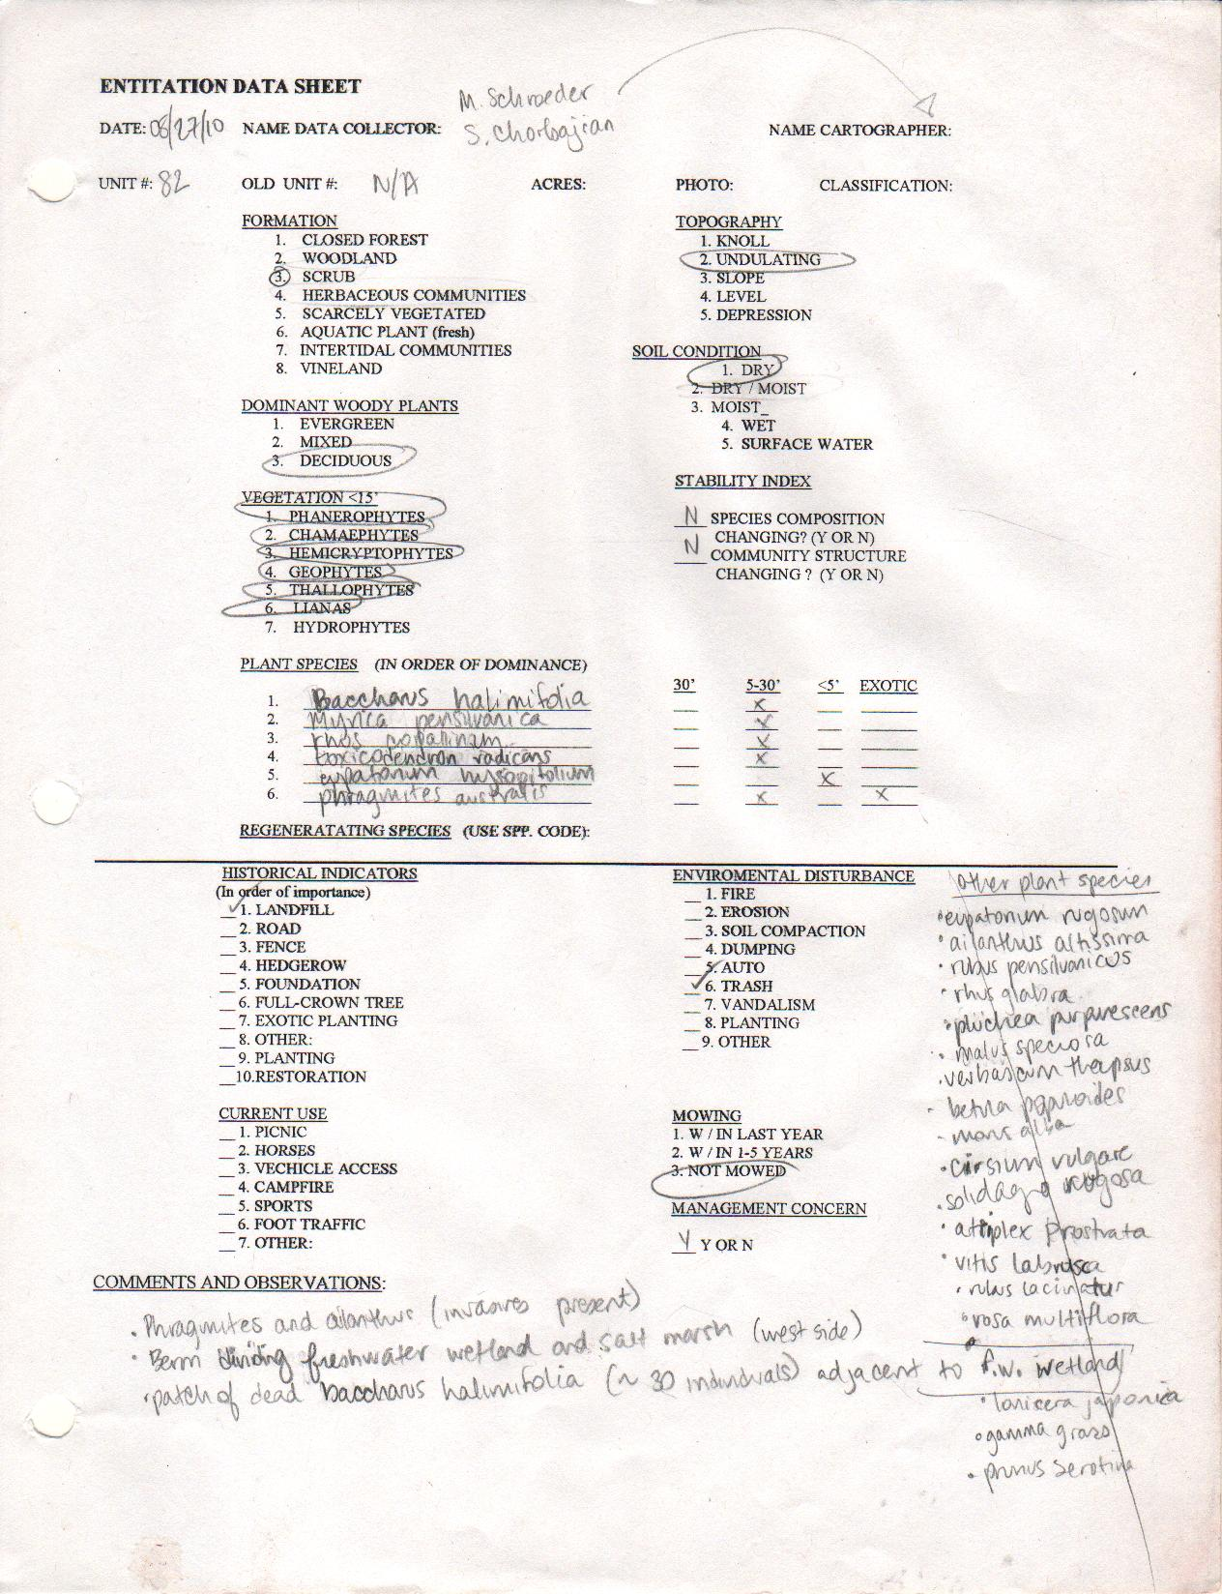

Slide 31
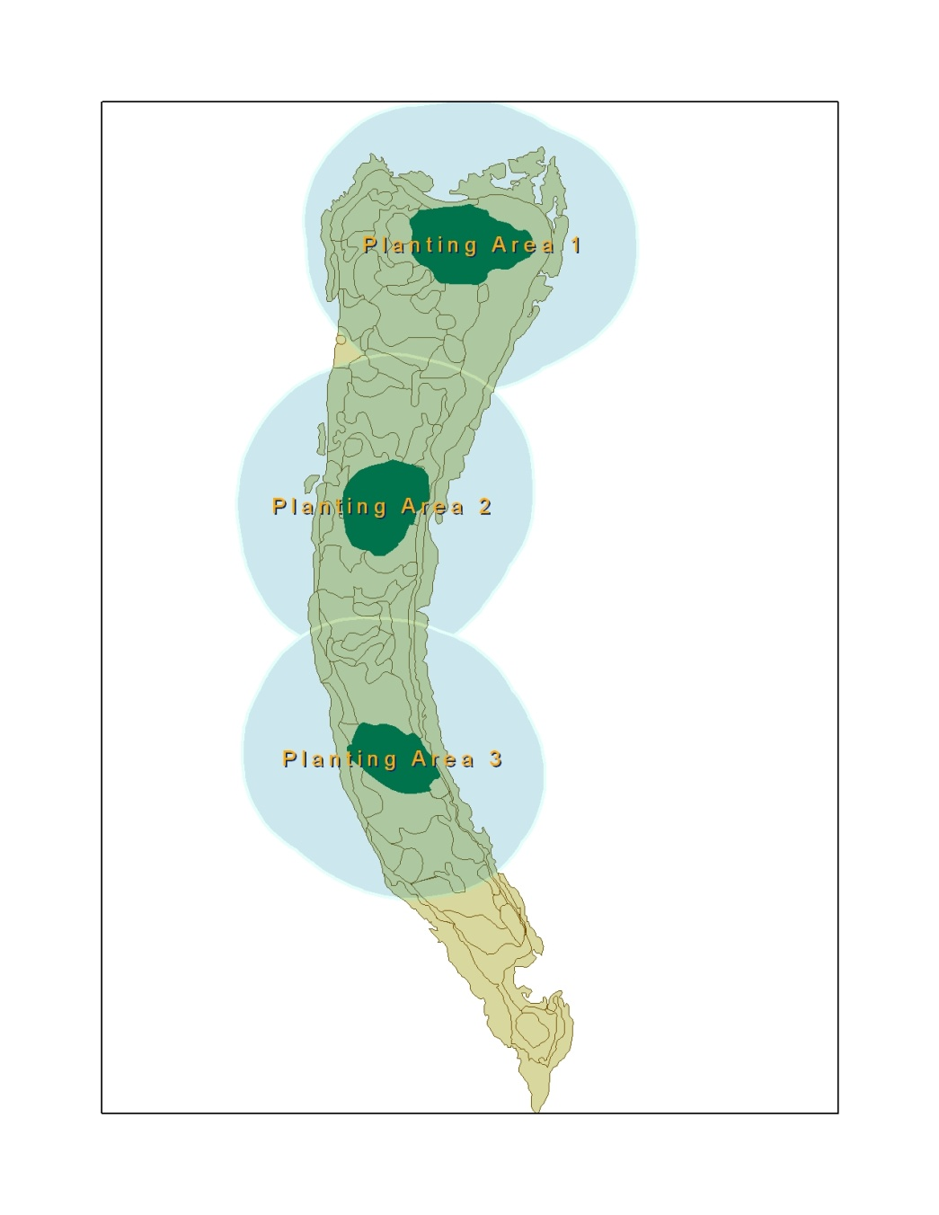
HABITAT DESIGN
Smaller Trees, Shrubs, Herbaceous, Grasslands
Dense Tree Groves
~Height: 15m-20m

Slide 32
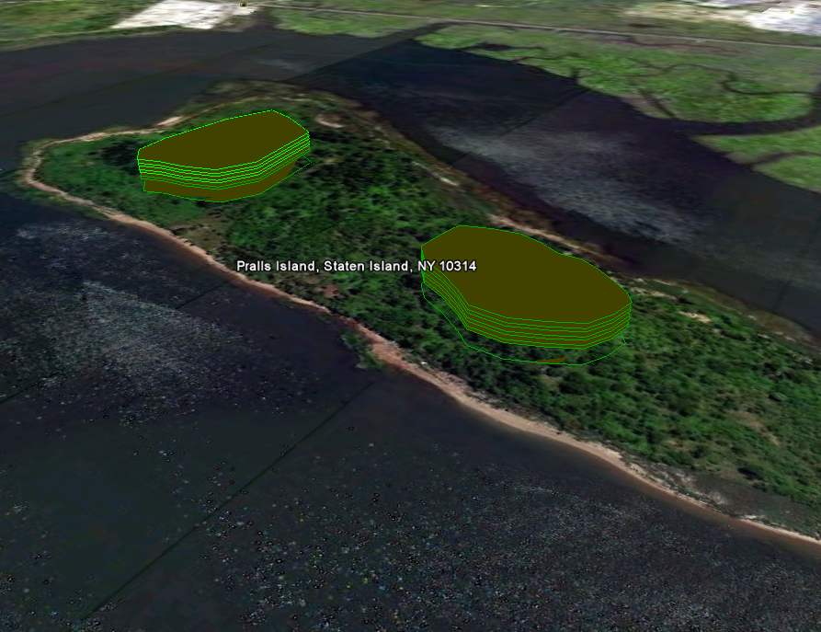
~15-20 meters
1
2

Slide 33
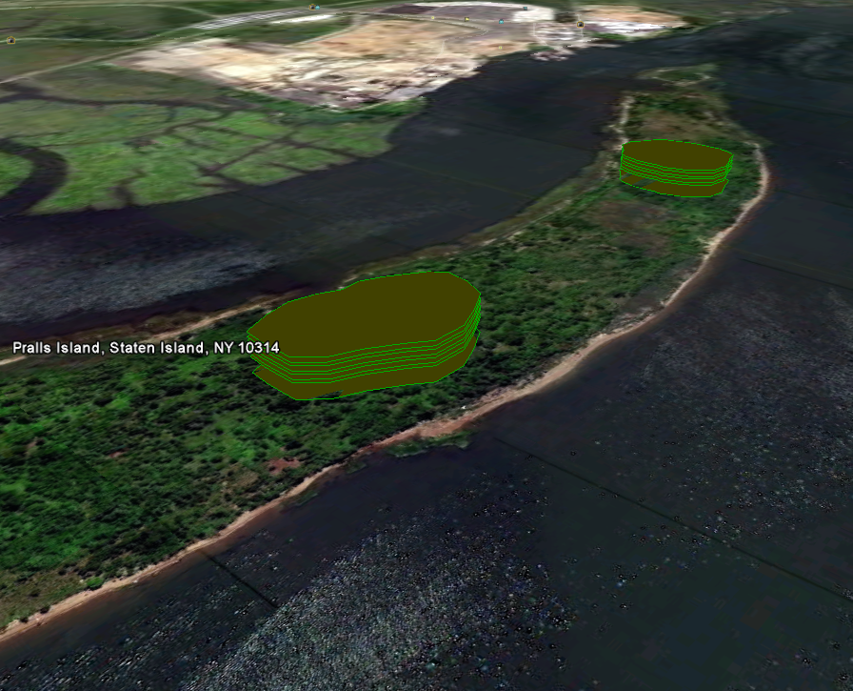
3
2

Slide 34
TREE SPECIES

Slide 35
SUMMARY
“Wisdom is knowing what to do with what you know.” -- J. Winter Smith
“Think globally, Act locally”
-- David Brower, Rene Dubos?
"A process cannot be understood by stopping it.
Understanding must move with the flow of the process,
must join it and flow with it."
-- Frank Herbert
Where do we find heron species currently nesting and why?
What are the conditions of their environment?
What is their tolerance level?
How is growth sustained?

Slide 36
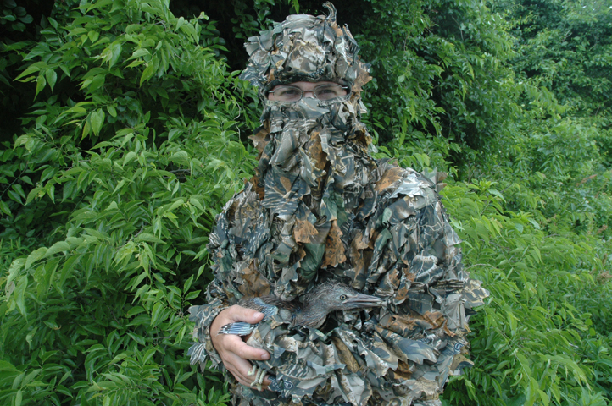
Identify clear goals and
performance standards
Identify and measure existing
conditions and available resources
Compare to reference sites
Assess historical conditions
and actions
Plan according to best case scenario,
but prepare for the unexpected
Put yourself in their feathers

Slide 37
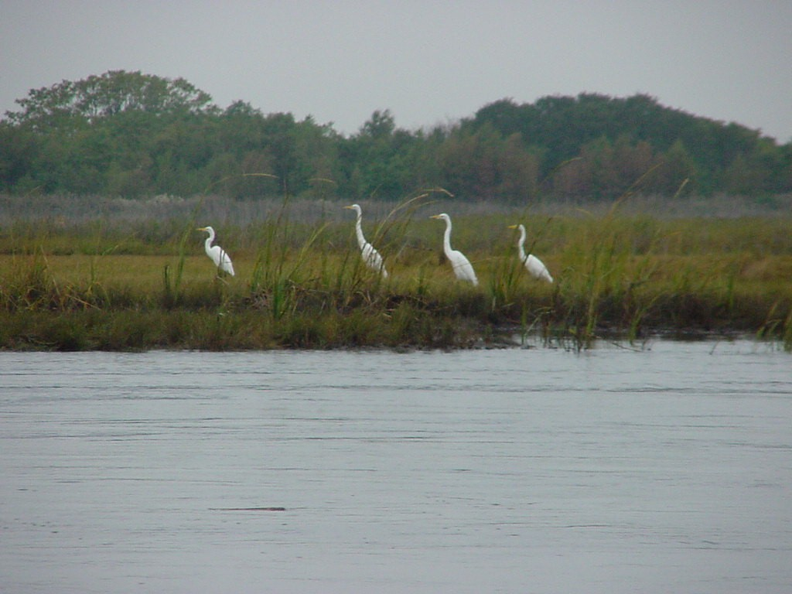
Special Thanks and Acknowledgements
Susan Elbin, Liz Craig, Carl Alderson, Nate McVay, Scott Newman, Andy Bernick,
Rich Shaw, Tim Chambers, Paul Kerlinger, Mike Feller, Dave Kunstler
Seta Chorbajian, Mary Schroeder

