Slide 1
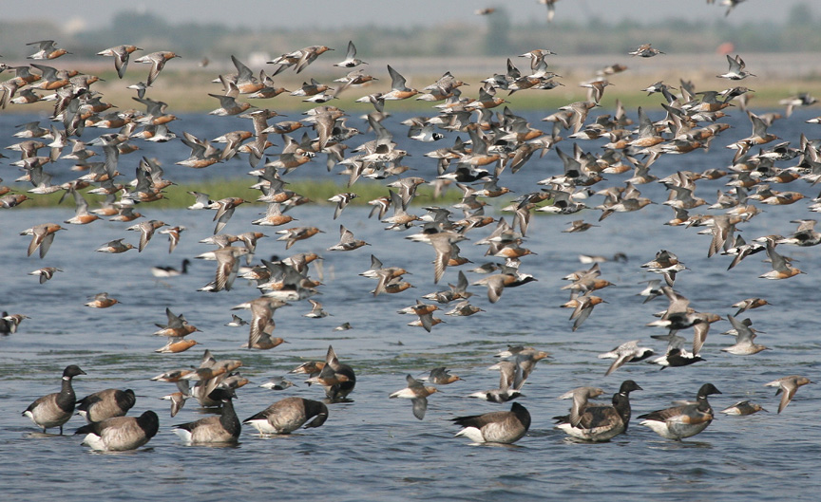
Improving Wetland Accessibility for Shorebirds and
Horseshoe Crabs:
NYC Audubon’s Citizen Science Program in Jamaica Bay
Jamaica Bay
credit: Don Riepe

Slide 2
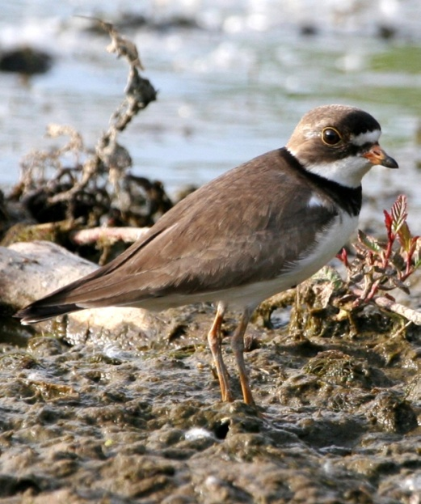
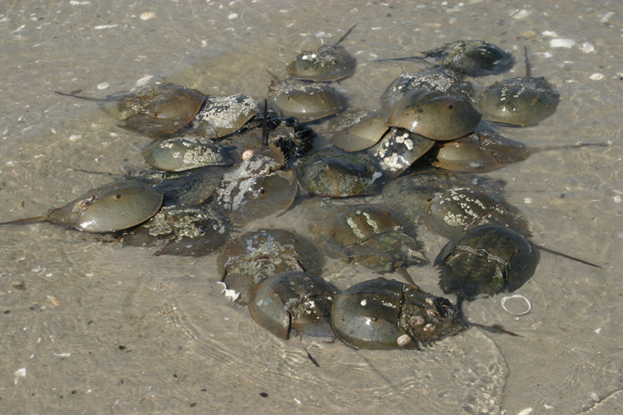
IWASH
2010
credit: Don Riepe
credit: Donna Dewhurst/USFWS
Clean-ups targeting horseshoe crab spawning beaches
in Jamaica Bay
- Education program with schools in the area
- Monitoring of horseshoe crabs and migratory shorebirds
- Outreach to the Deaf and Hard of Hearing Community

Slide 3
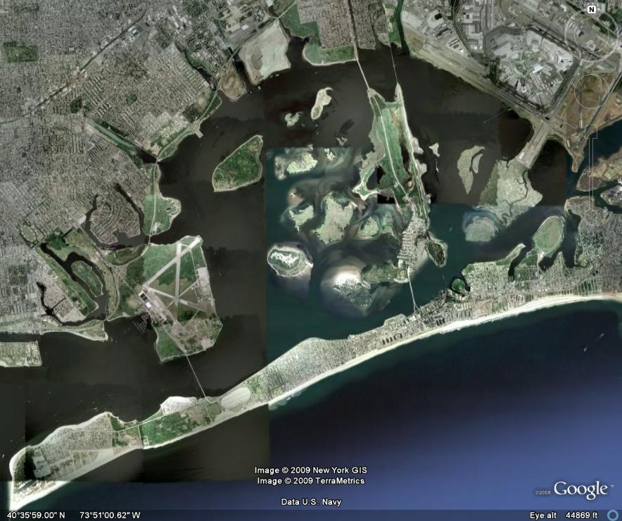
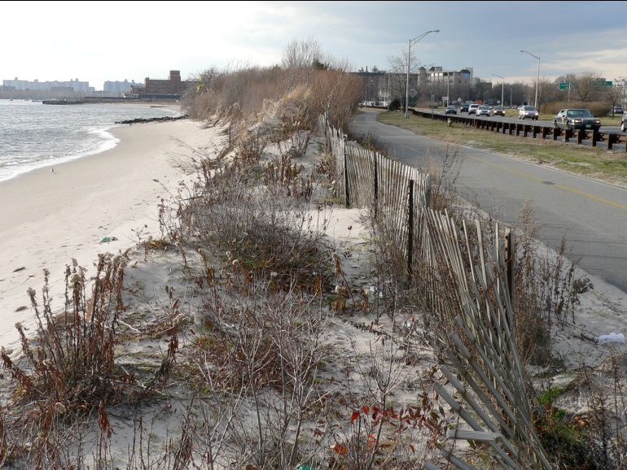
Jamaica Bay
credit: Ron Bourque

Slide 4
2010:
Sample visits: 45
Dates covered: April 4th – June 20th
Total shorebirds counted: 11,441
Birds counted per sample visit: 254
Most abundant species: Semi-palmated sandpiper (6,305; 55% of total seen)
2009:
Sample visits: 35
Dates covered: April 18th – June 19t
Total shorebirds counted: 28,942
Birds counted per sample visit: 1,196
Most abundant species: Semi-palmated sandpiper (10,243; 35% of total seen)
Notes:
There are a few things to note from these data. First, there was a large decrease in the number of birds seen this year from last, particularly when you look at how many birds were counted per sample visit. These are only two years' worth of data and I would hesitate to draw large conclusions from the change from 2009 to 2010, but it certainly is interesting. Second, I've included a list of the species that declined or increased in numbers between the two years. The number of species is relatively similar (10

Slide 5
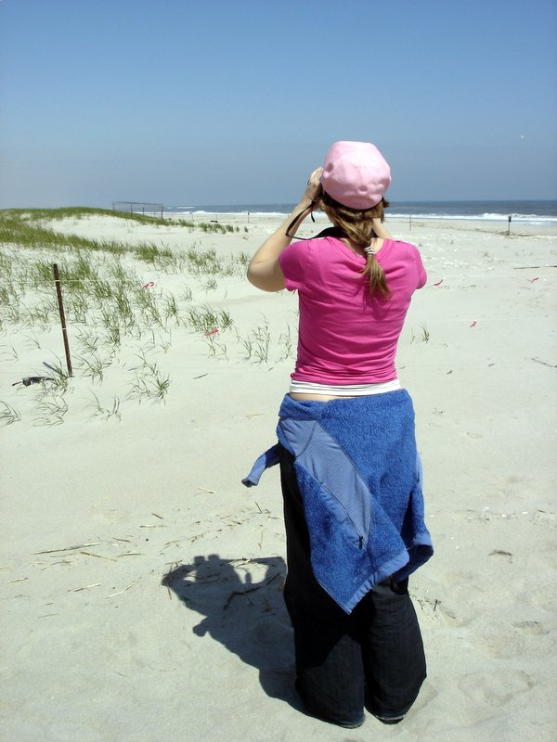
Monitoring
credit: Yigal Gelb

Slide 6
Horseshoe Crabs
Total site visits
2009: 14
2010: 11
Span of sample dates:
2009: 7 May – 9 July
2010: 11 May – 28 June
Total crabs counted
2009: 2091
2010: 1493
Individuals counted 2010: 651per sample night:
2009: 149
2010: 135
High number counted in the quadrats
2009: 362
2010: 651

Slide 7
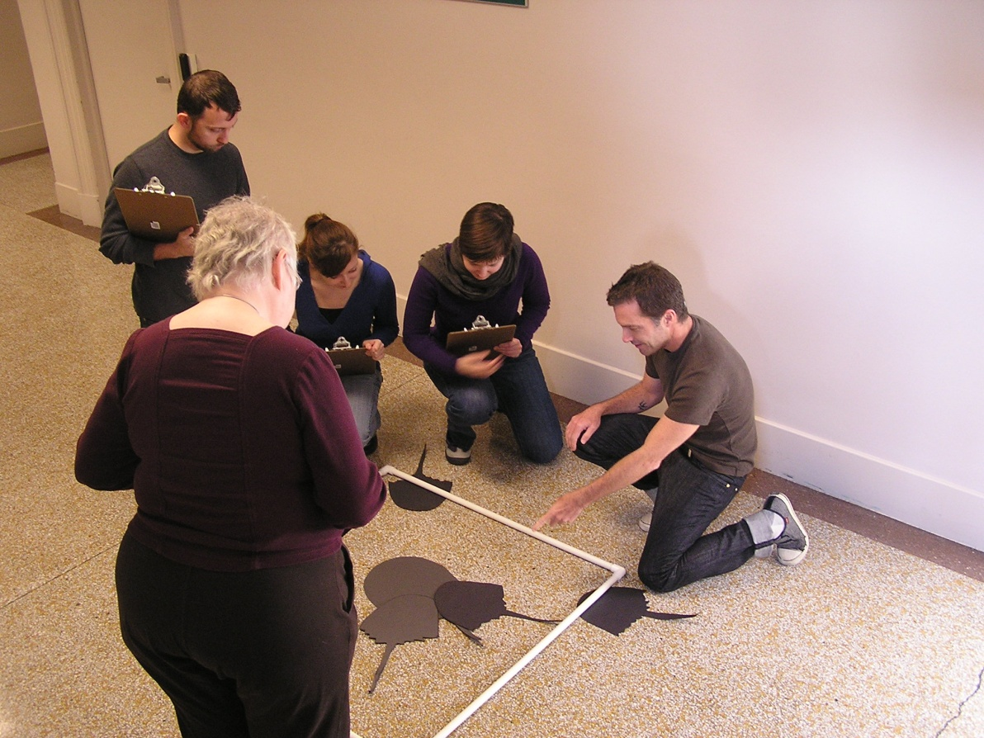
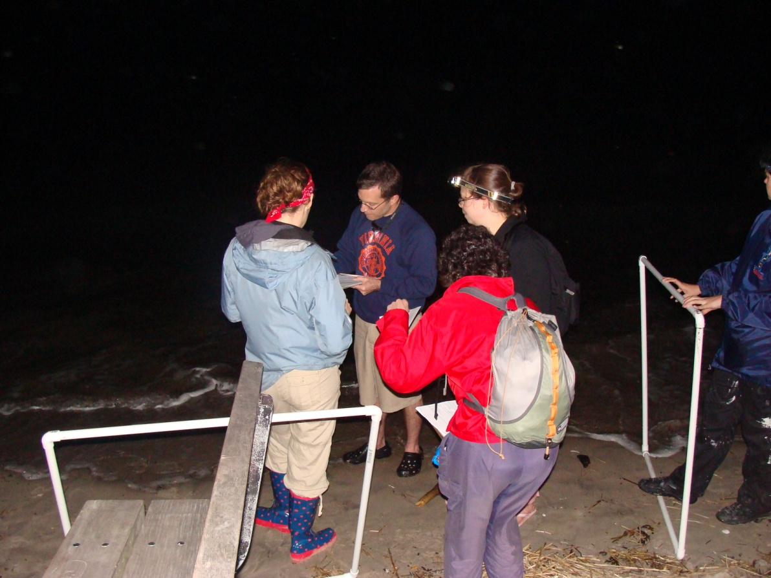
credit: Susan Elbin
credit: Candace Khaokham

Slide 8
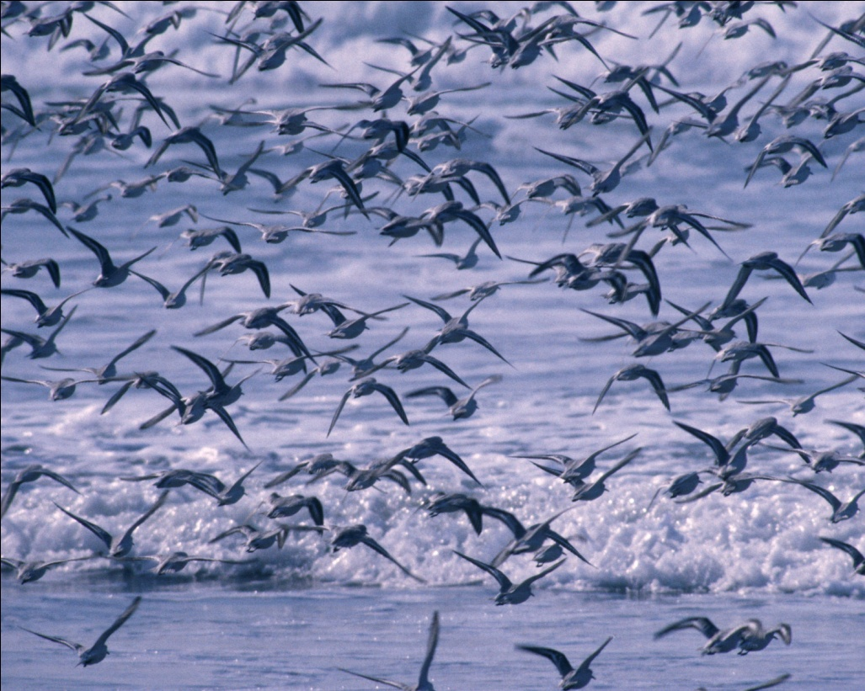
Partners
National Park Service
New York State Department
of Environmental Conservation
New York City Department
of Parks and Recreation
Wallerstein Collaborative for
Urban Environmental Education
credit: Lee Karney/USFWS
American Littoral Society
American Sign Language Inc.
New Jersey Audubon
Cornell Cooperative Extension

