Slide 1
Water Quality in Jamaica Bay NPS - PEC
Deborah Sarria
Andries Hudde JHS
IS 240K

Slide 2
Pre-Trip Lessons
Formative Assessment –Name as many bodies of water as you can
Review vocabulary:
Ocean, river, bay, estuary, brackish, marsh
Map activity: using a map of the NY/NJ Estuary, students will identify the fresh and salt-water sources.

Slide 3
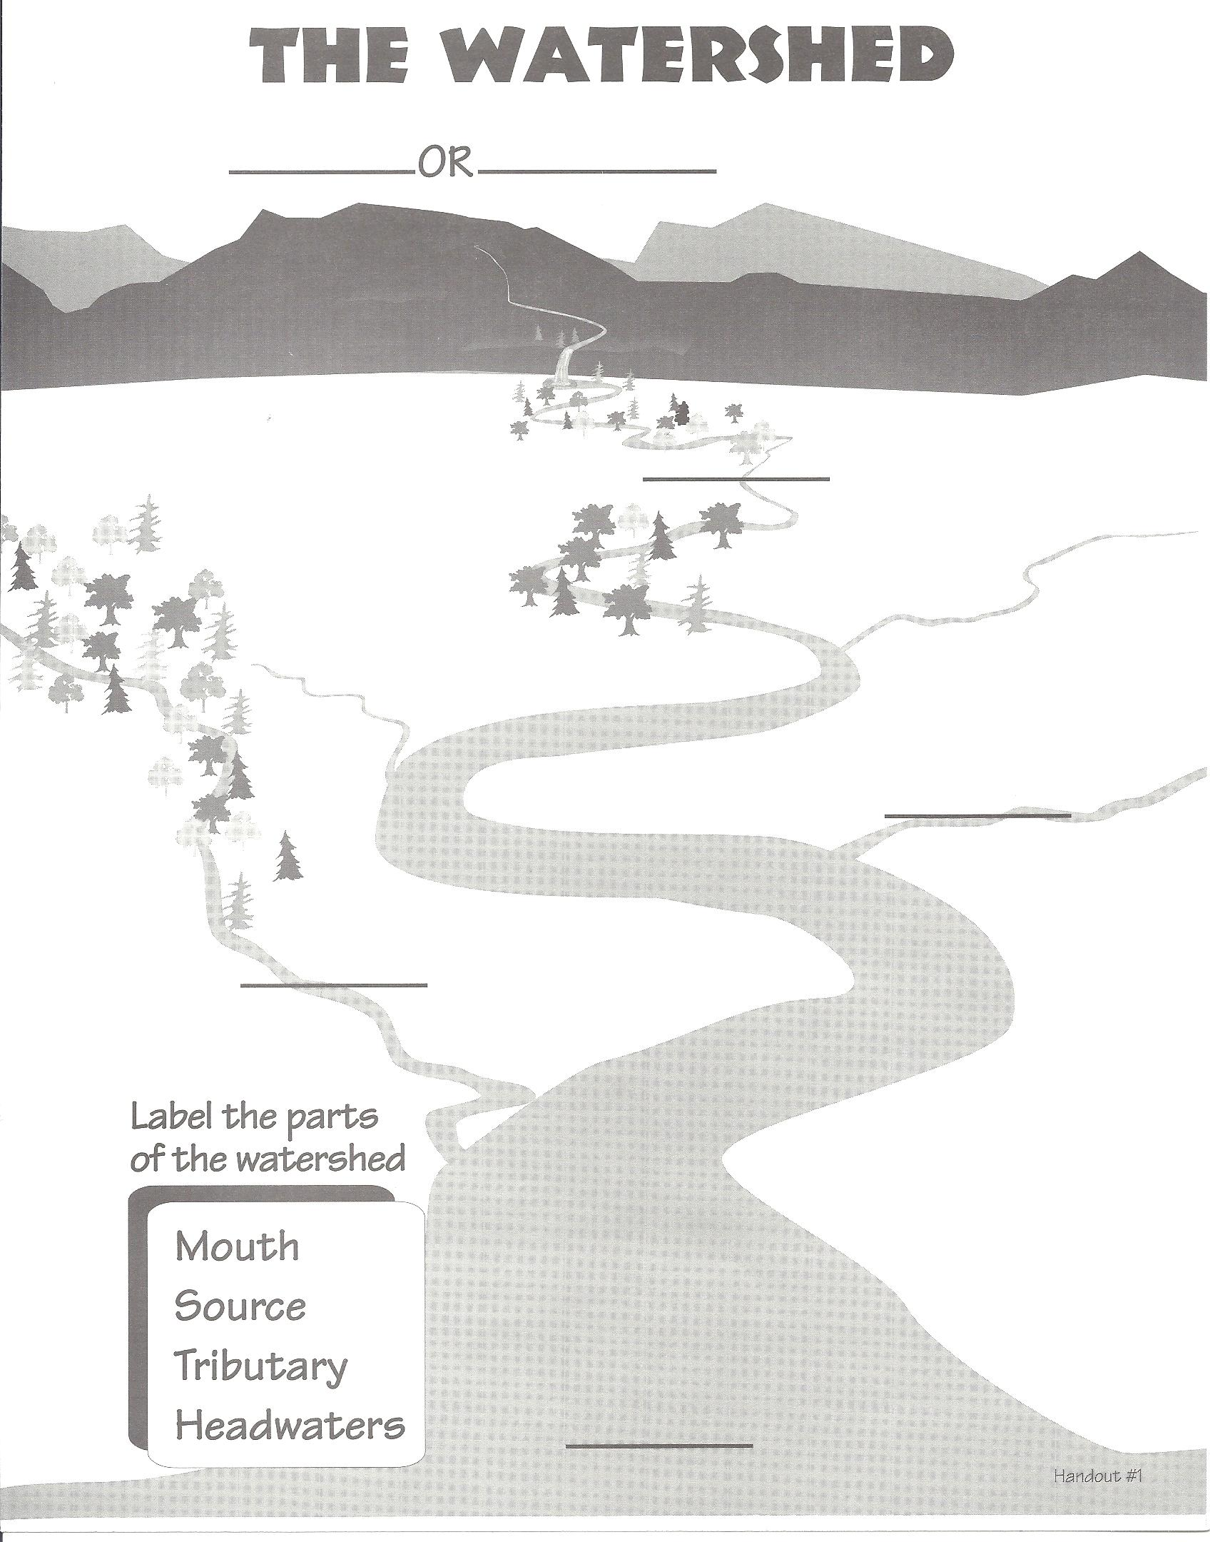
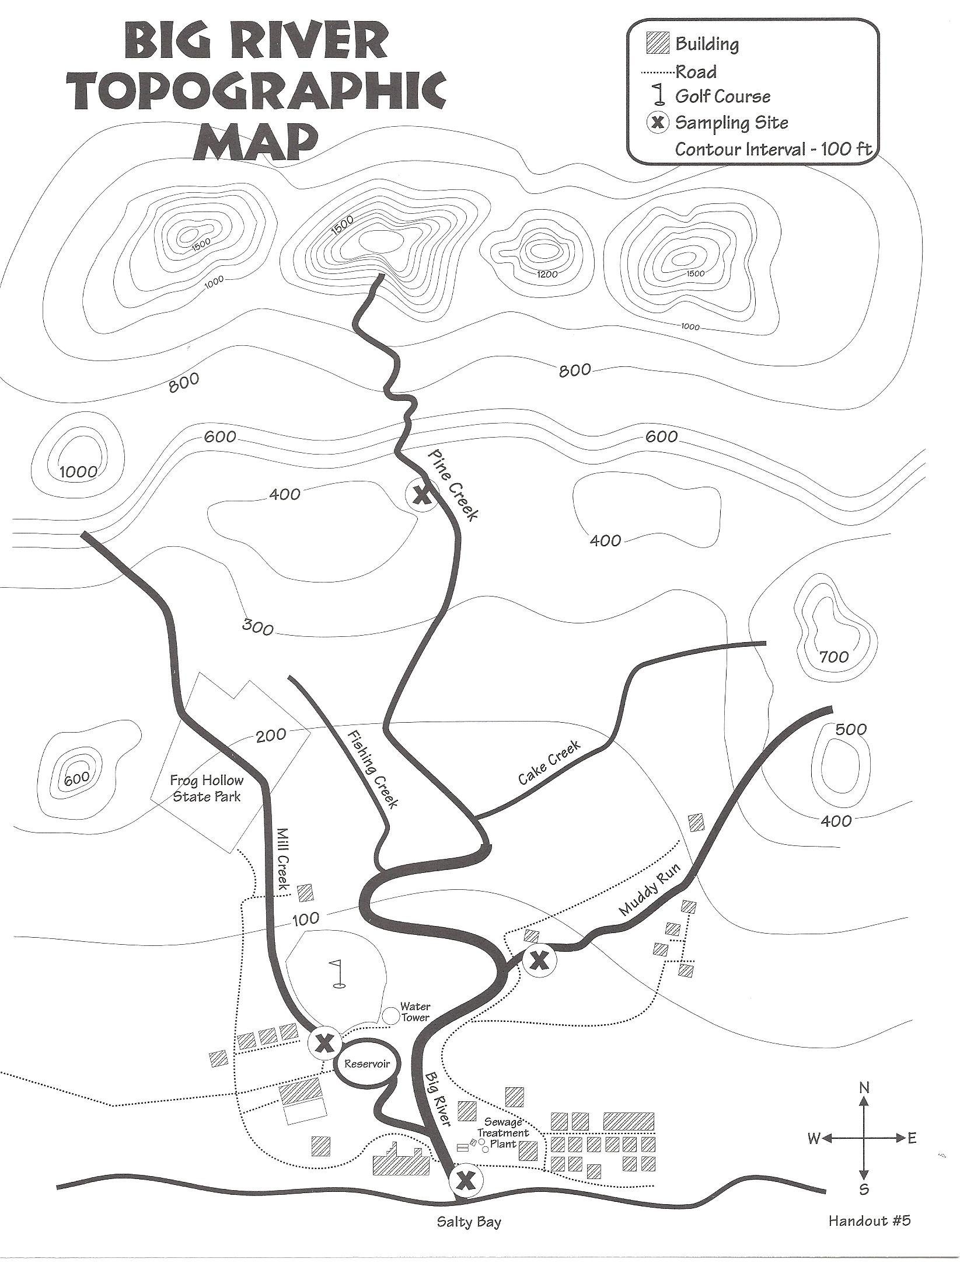
What is a watershed?
Discuss the definition of a water shed.
Big River Topo Map Activity
LaMotte/Stroud Watershed Tour Kit
Crumpled paper watershed model
http://www.omsi.edu/sites/all/FTP/files/expeditionnw/4.E.1.Crumple.pdf

Slide 4
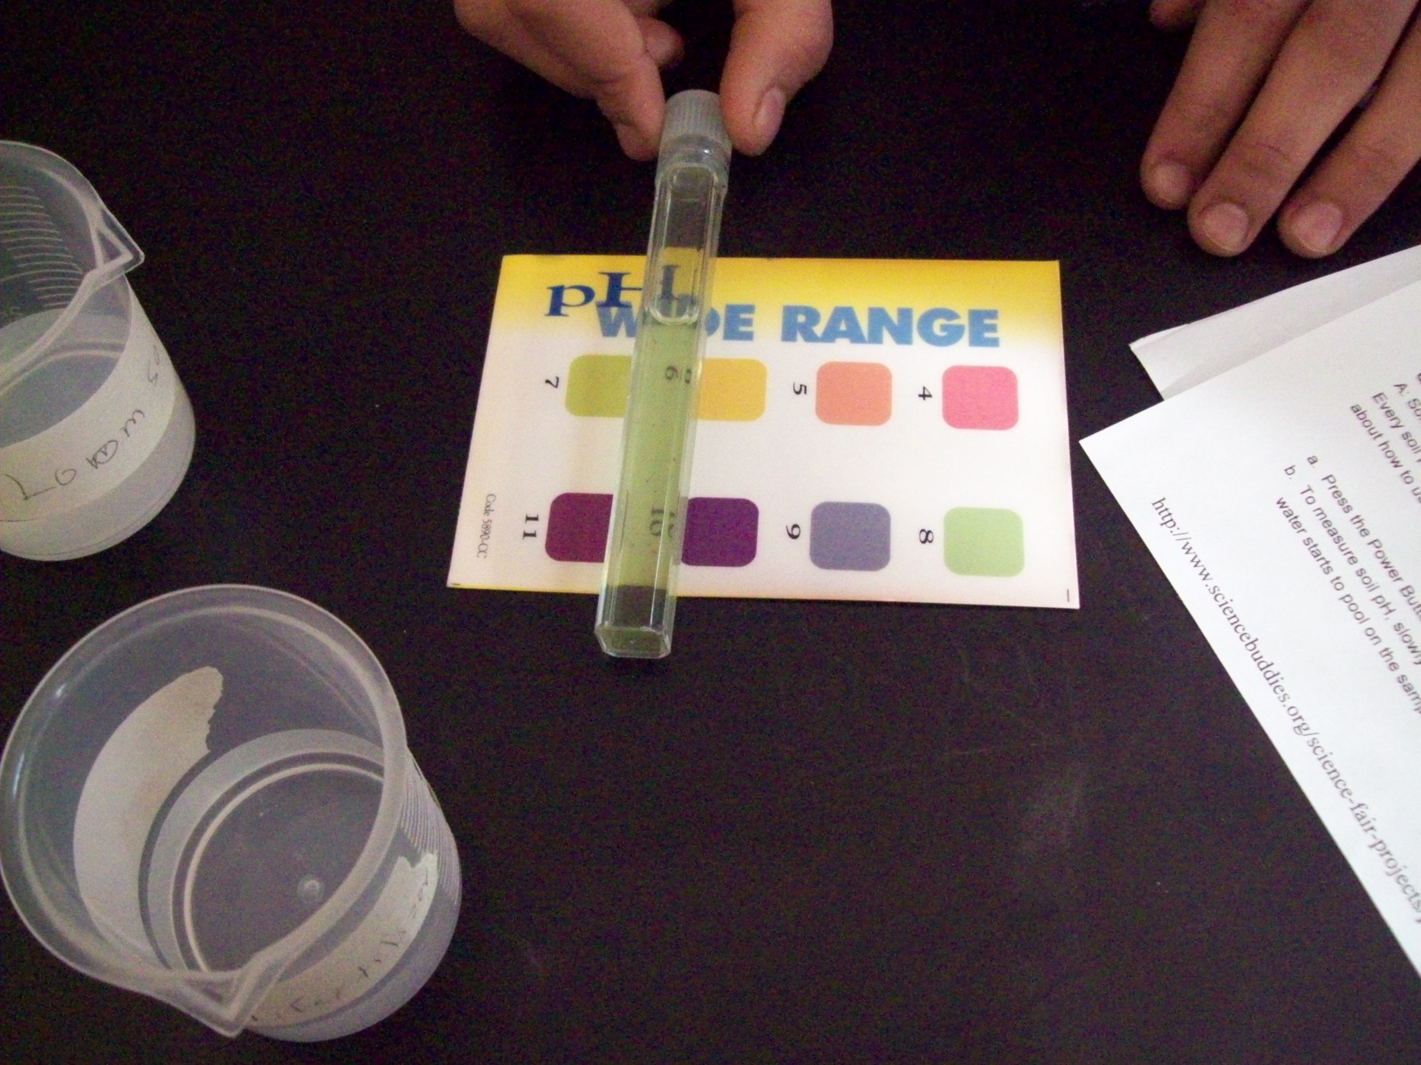
Water Quality Tests
Divide the students into groups
Phosphate
Nitrates
Dissolved Oxygen
Turbidity
pH
Jigsaw the Water Quality Indicators- Use information from the Earth Force resource page
http://www.earthforce.org/ViewResource.php?AID=1
Students practice using the water testing equipment

Slide 5
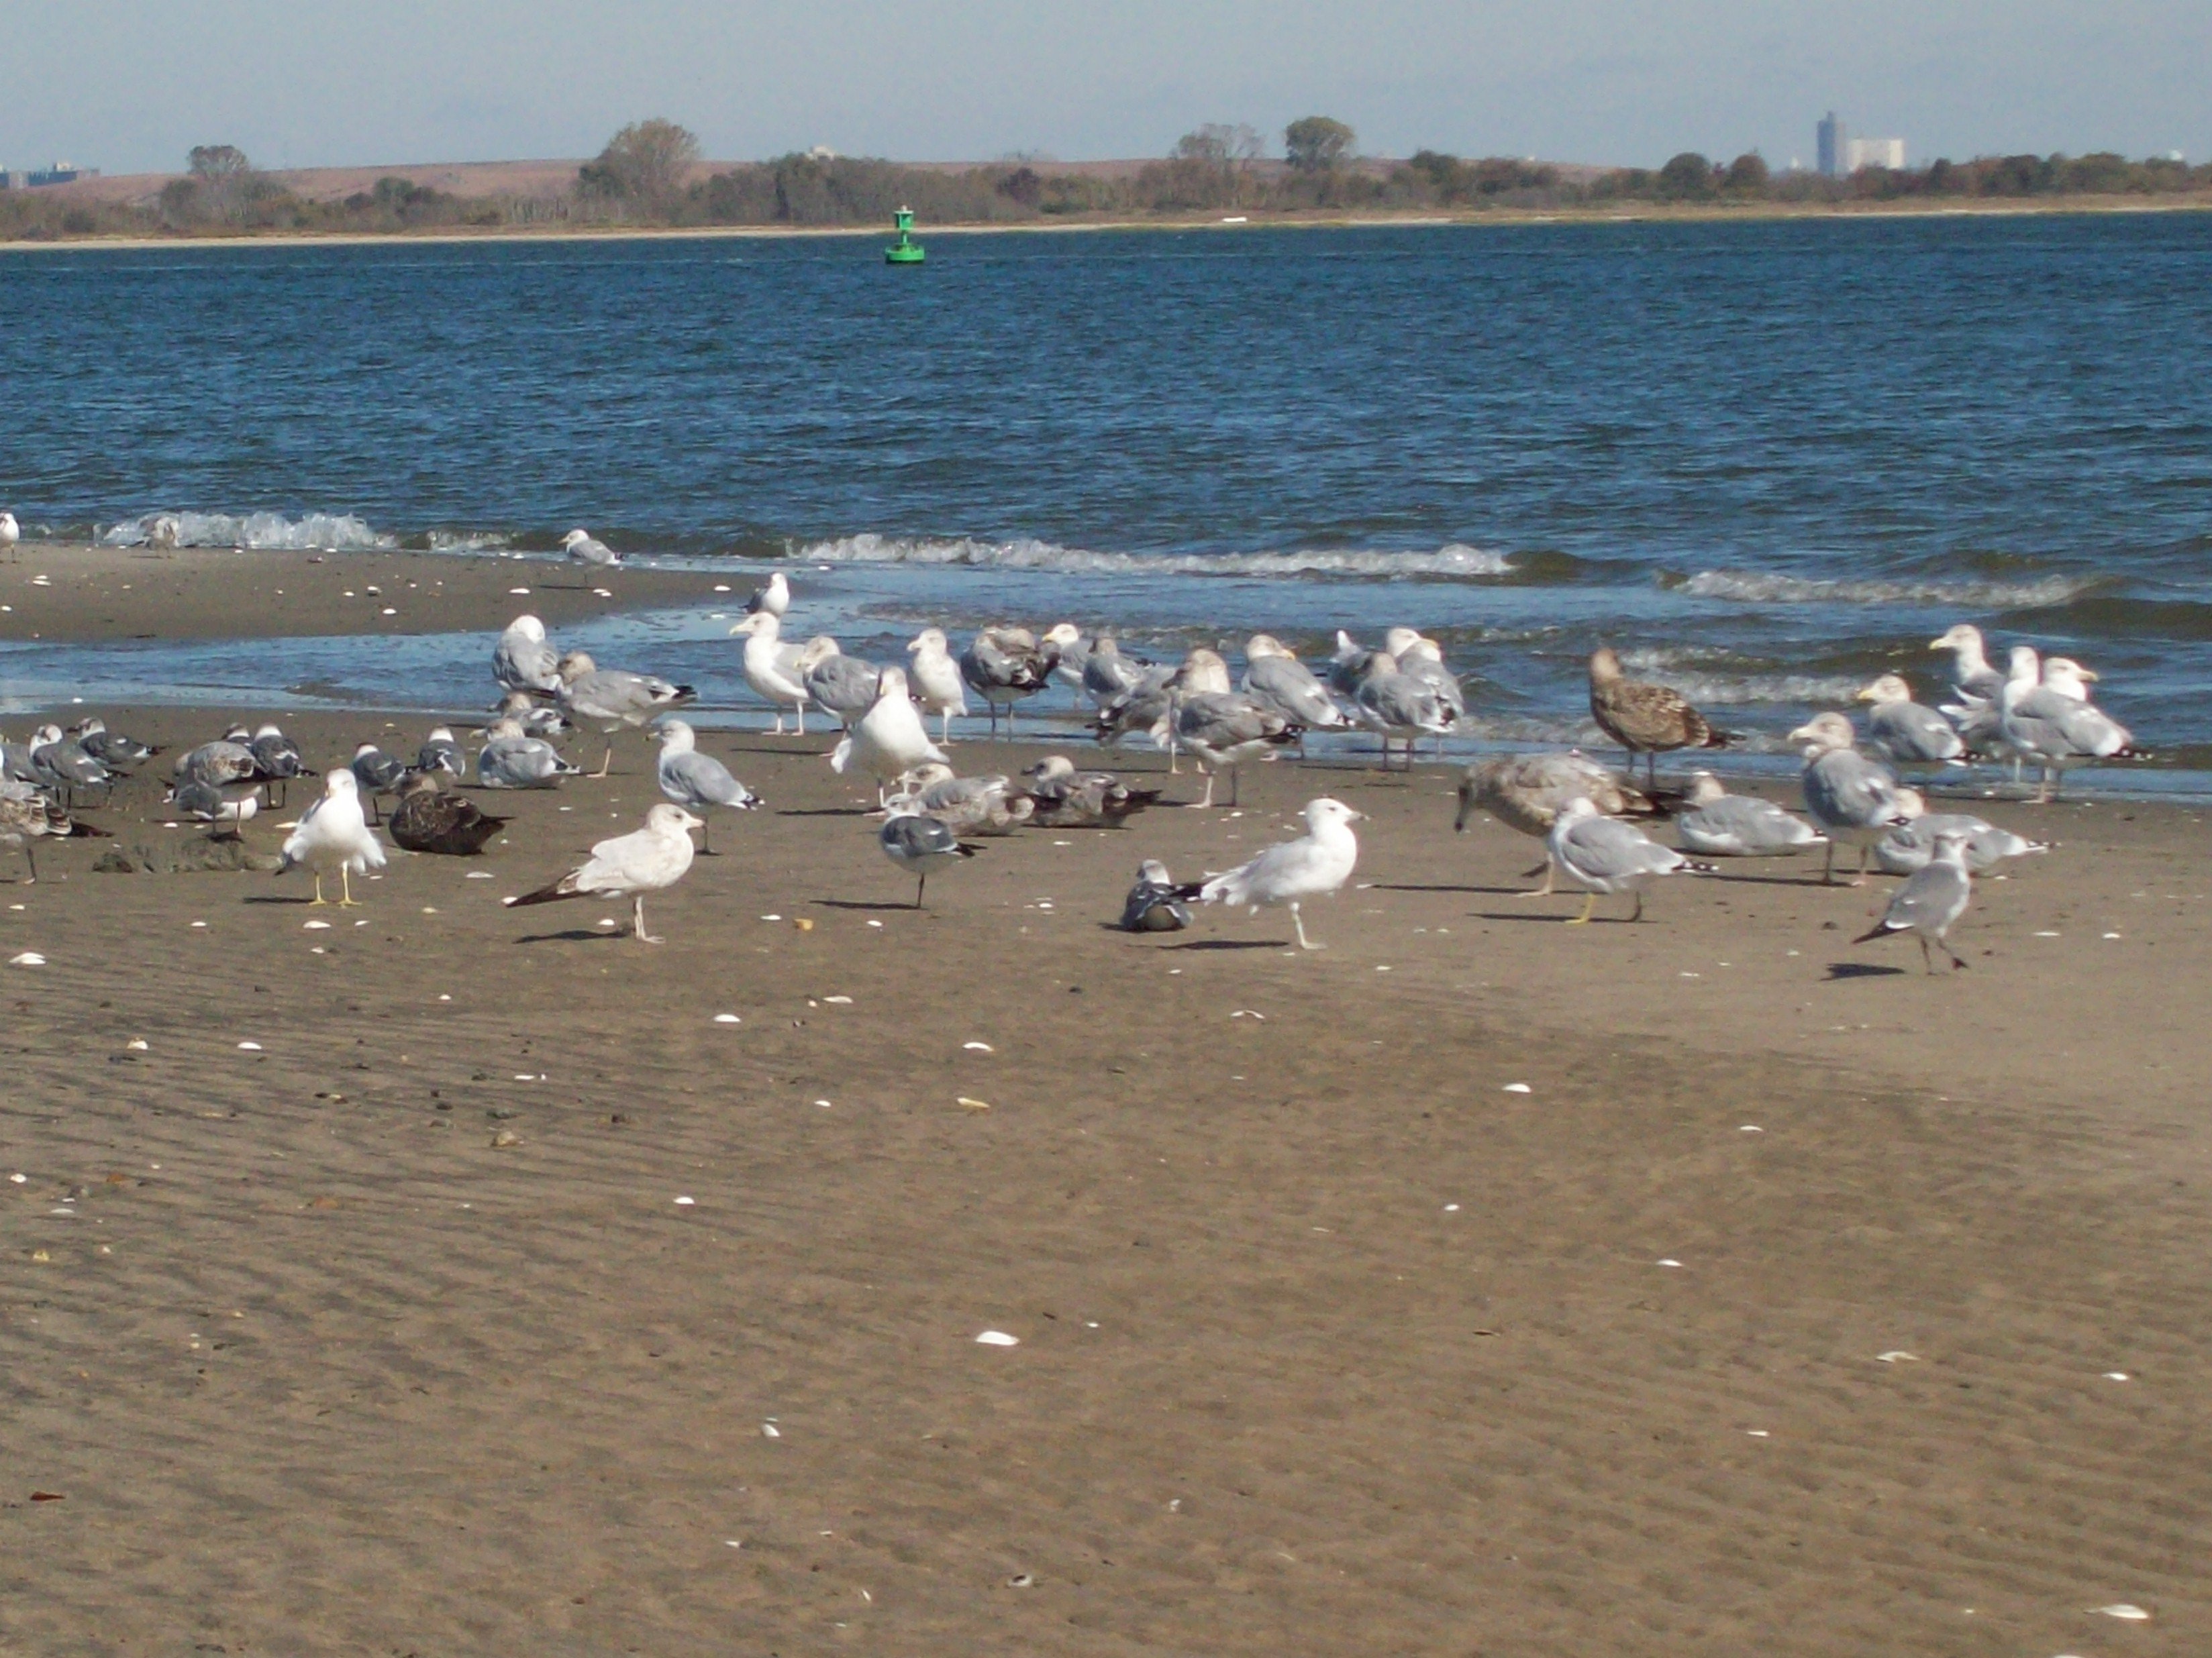
Sea Plane Ramp – Floyd Bennett Field
The class was divided into two groups/
One group explored the area, recording observations
Second group conducted testing.
After tests were completed the groups switched places.

Slide 6
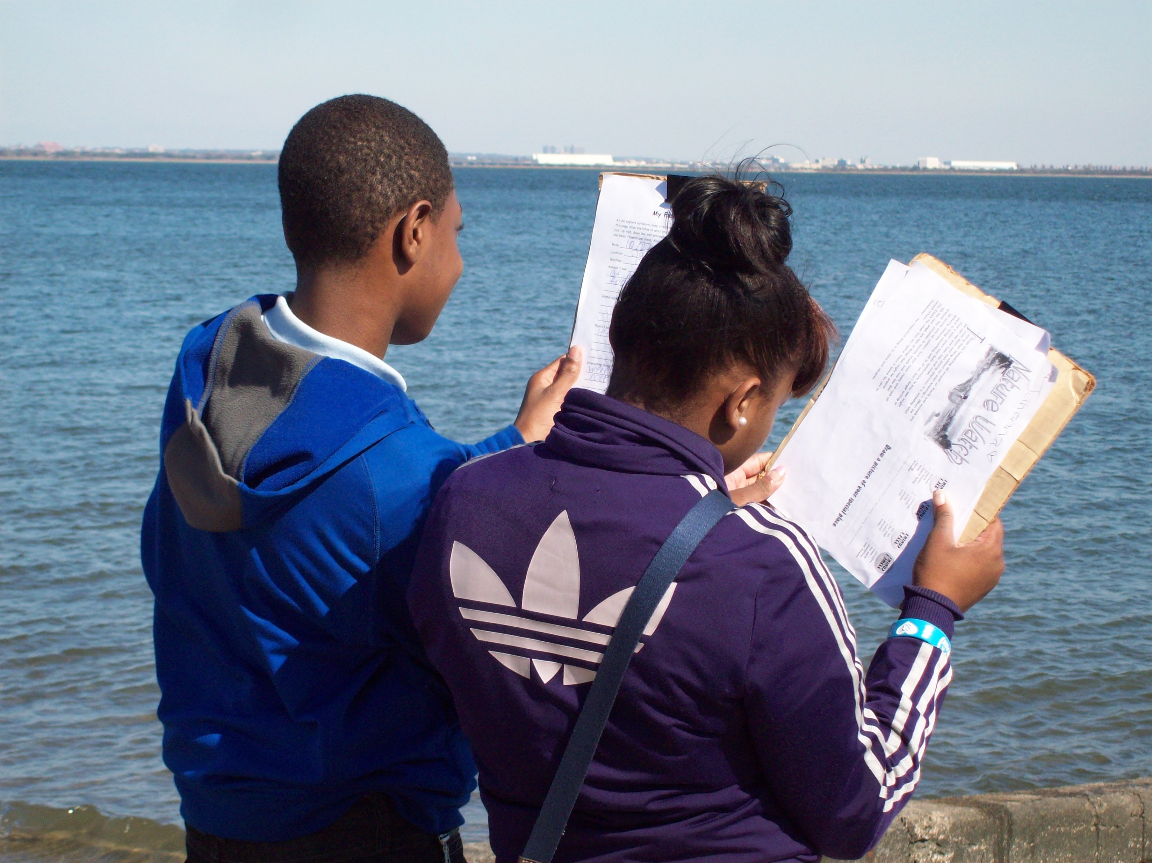
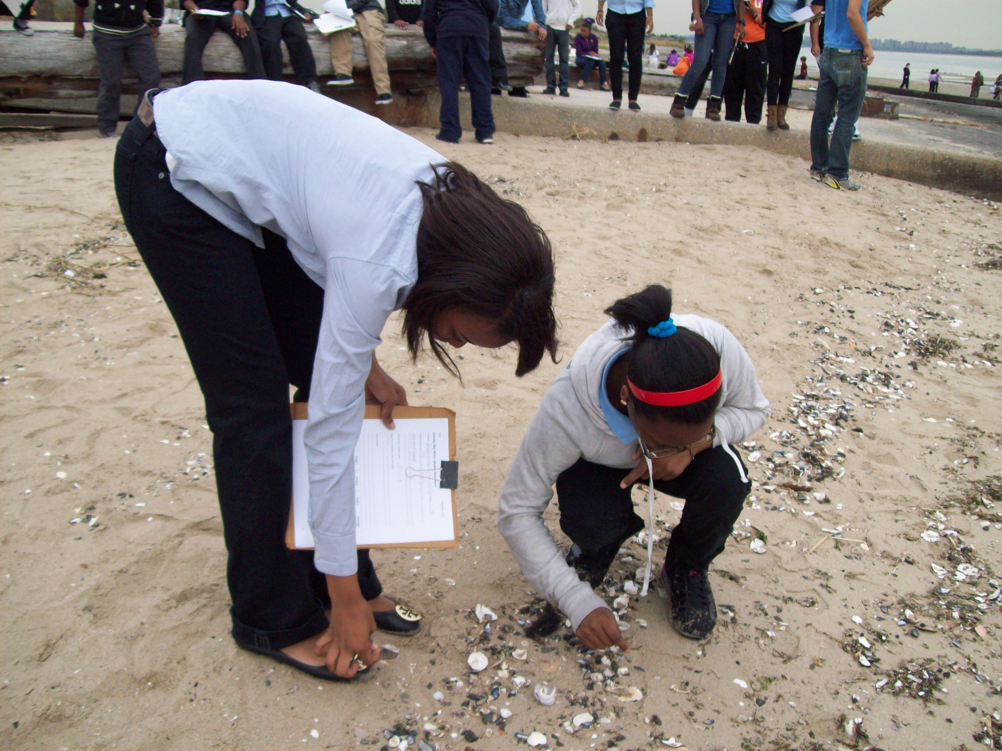
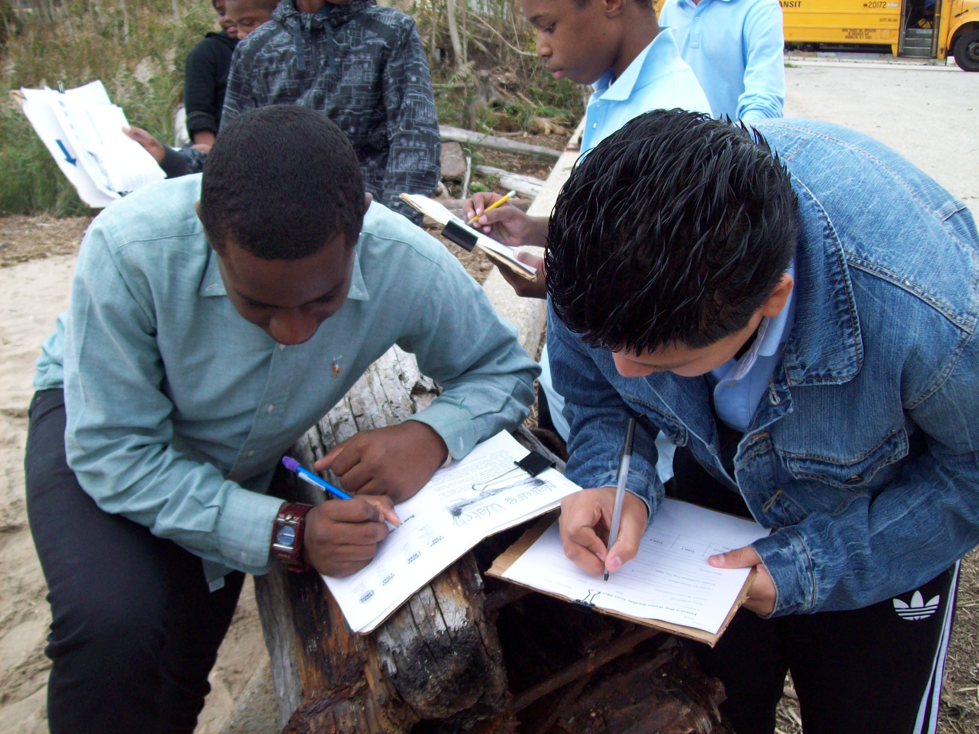

Slide 7
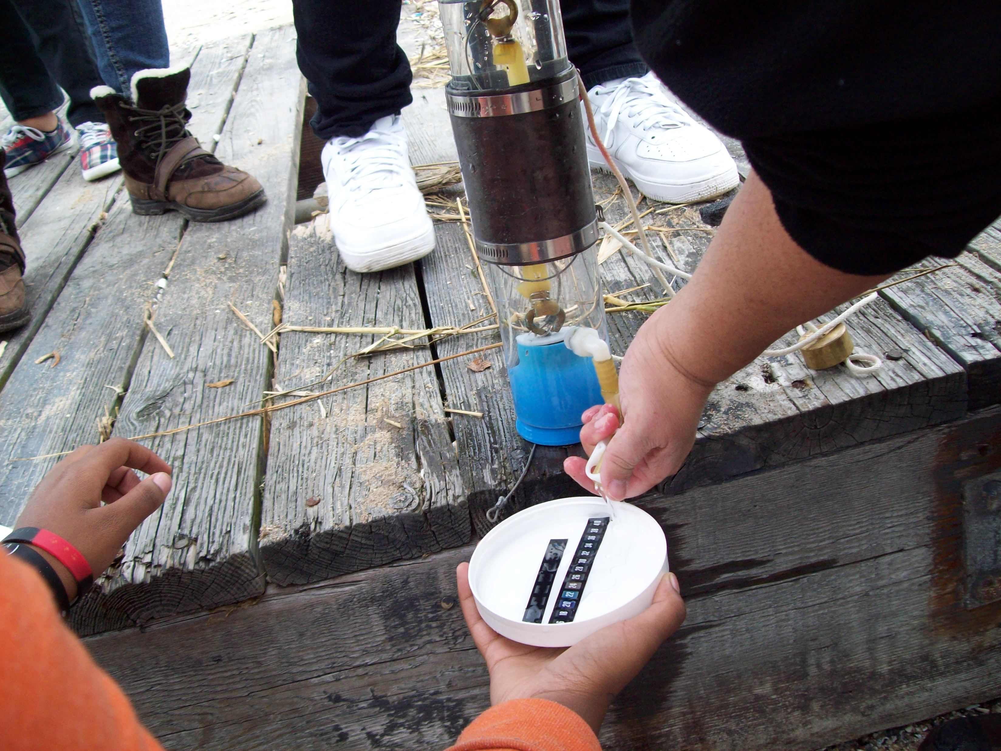
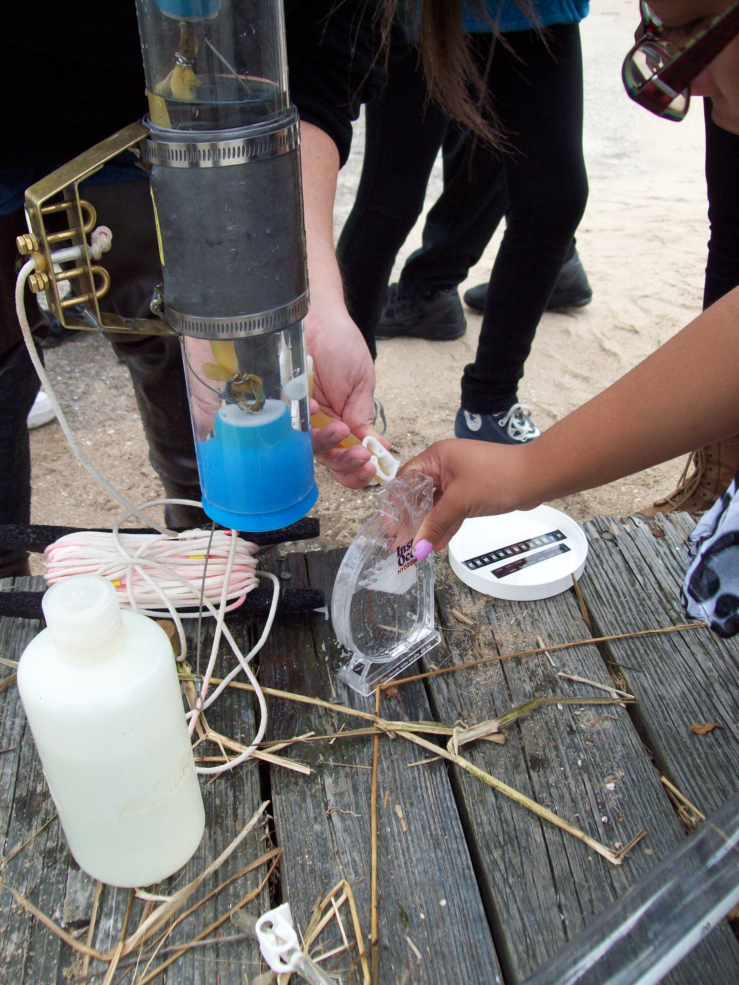
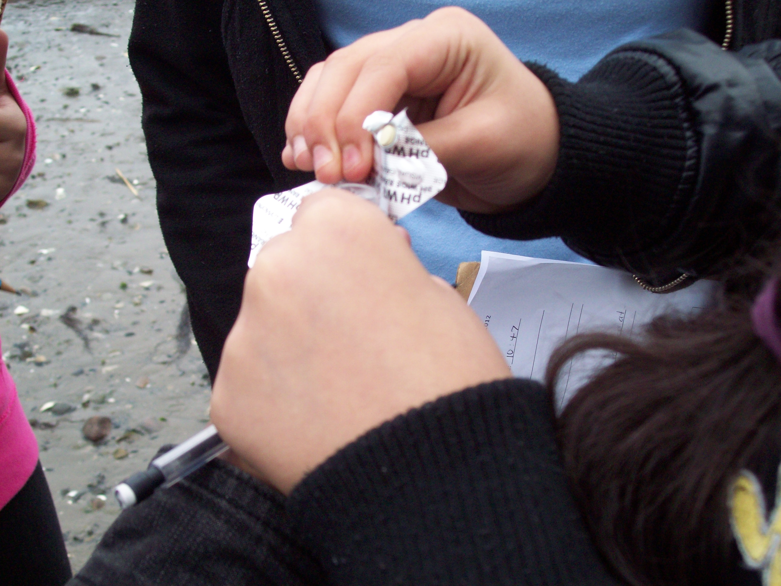

Slide 8
Post Trip Activity
Students wrote a reflection about the trip
What do your results indicate about the current condition of Jamaica bay?
What did you observe that could have an impact on the water quality in the Jamaica Bay?
What could you do to help maintain the water quality in Jamaica Bay?

Slide 9
Post Sandy Follow-up
Experiment: What is the effect of decaying material on the dissolved oxygen level?
Tanacredi, J.T. & Loret, J., Experiment Central, Understanding Scientific Principles Through Projects V1, pgs 138-149, UXL, 2000
Students set up three containers
Control
28g of leaves
57g of leaves
Tested the DO levels over four days.

Slide 10
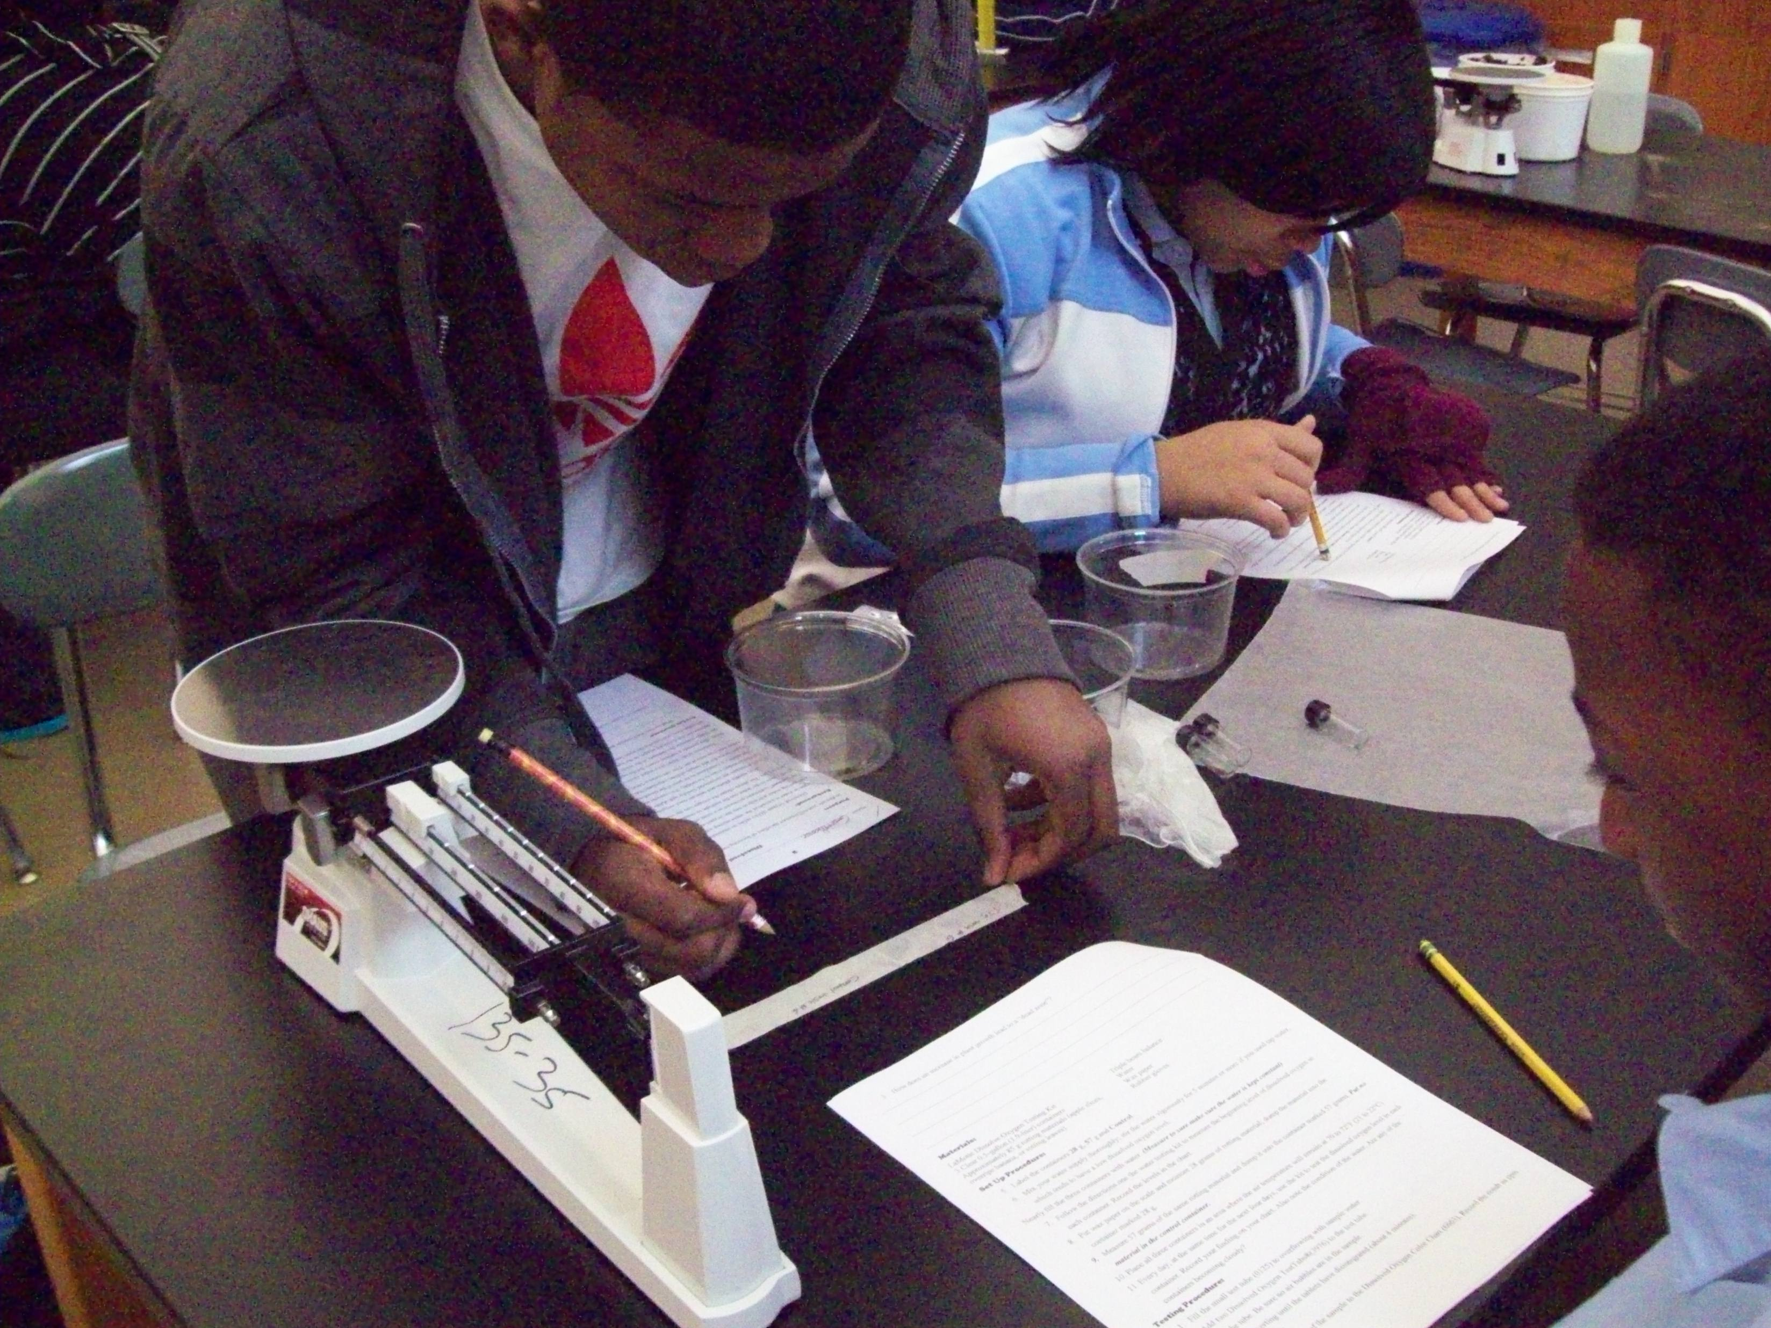
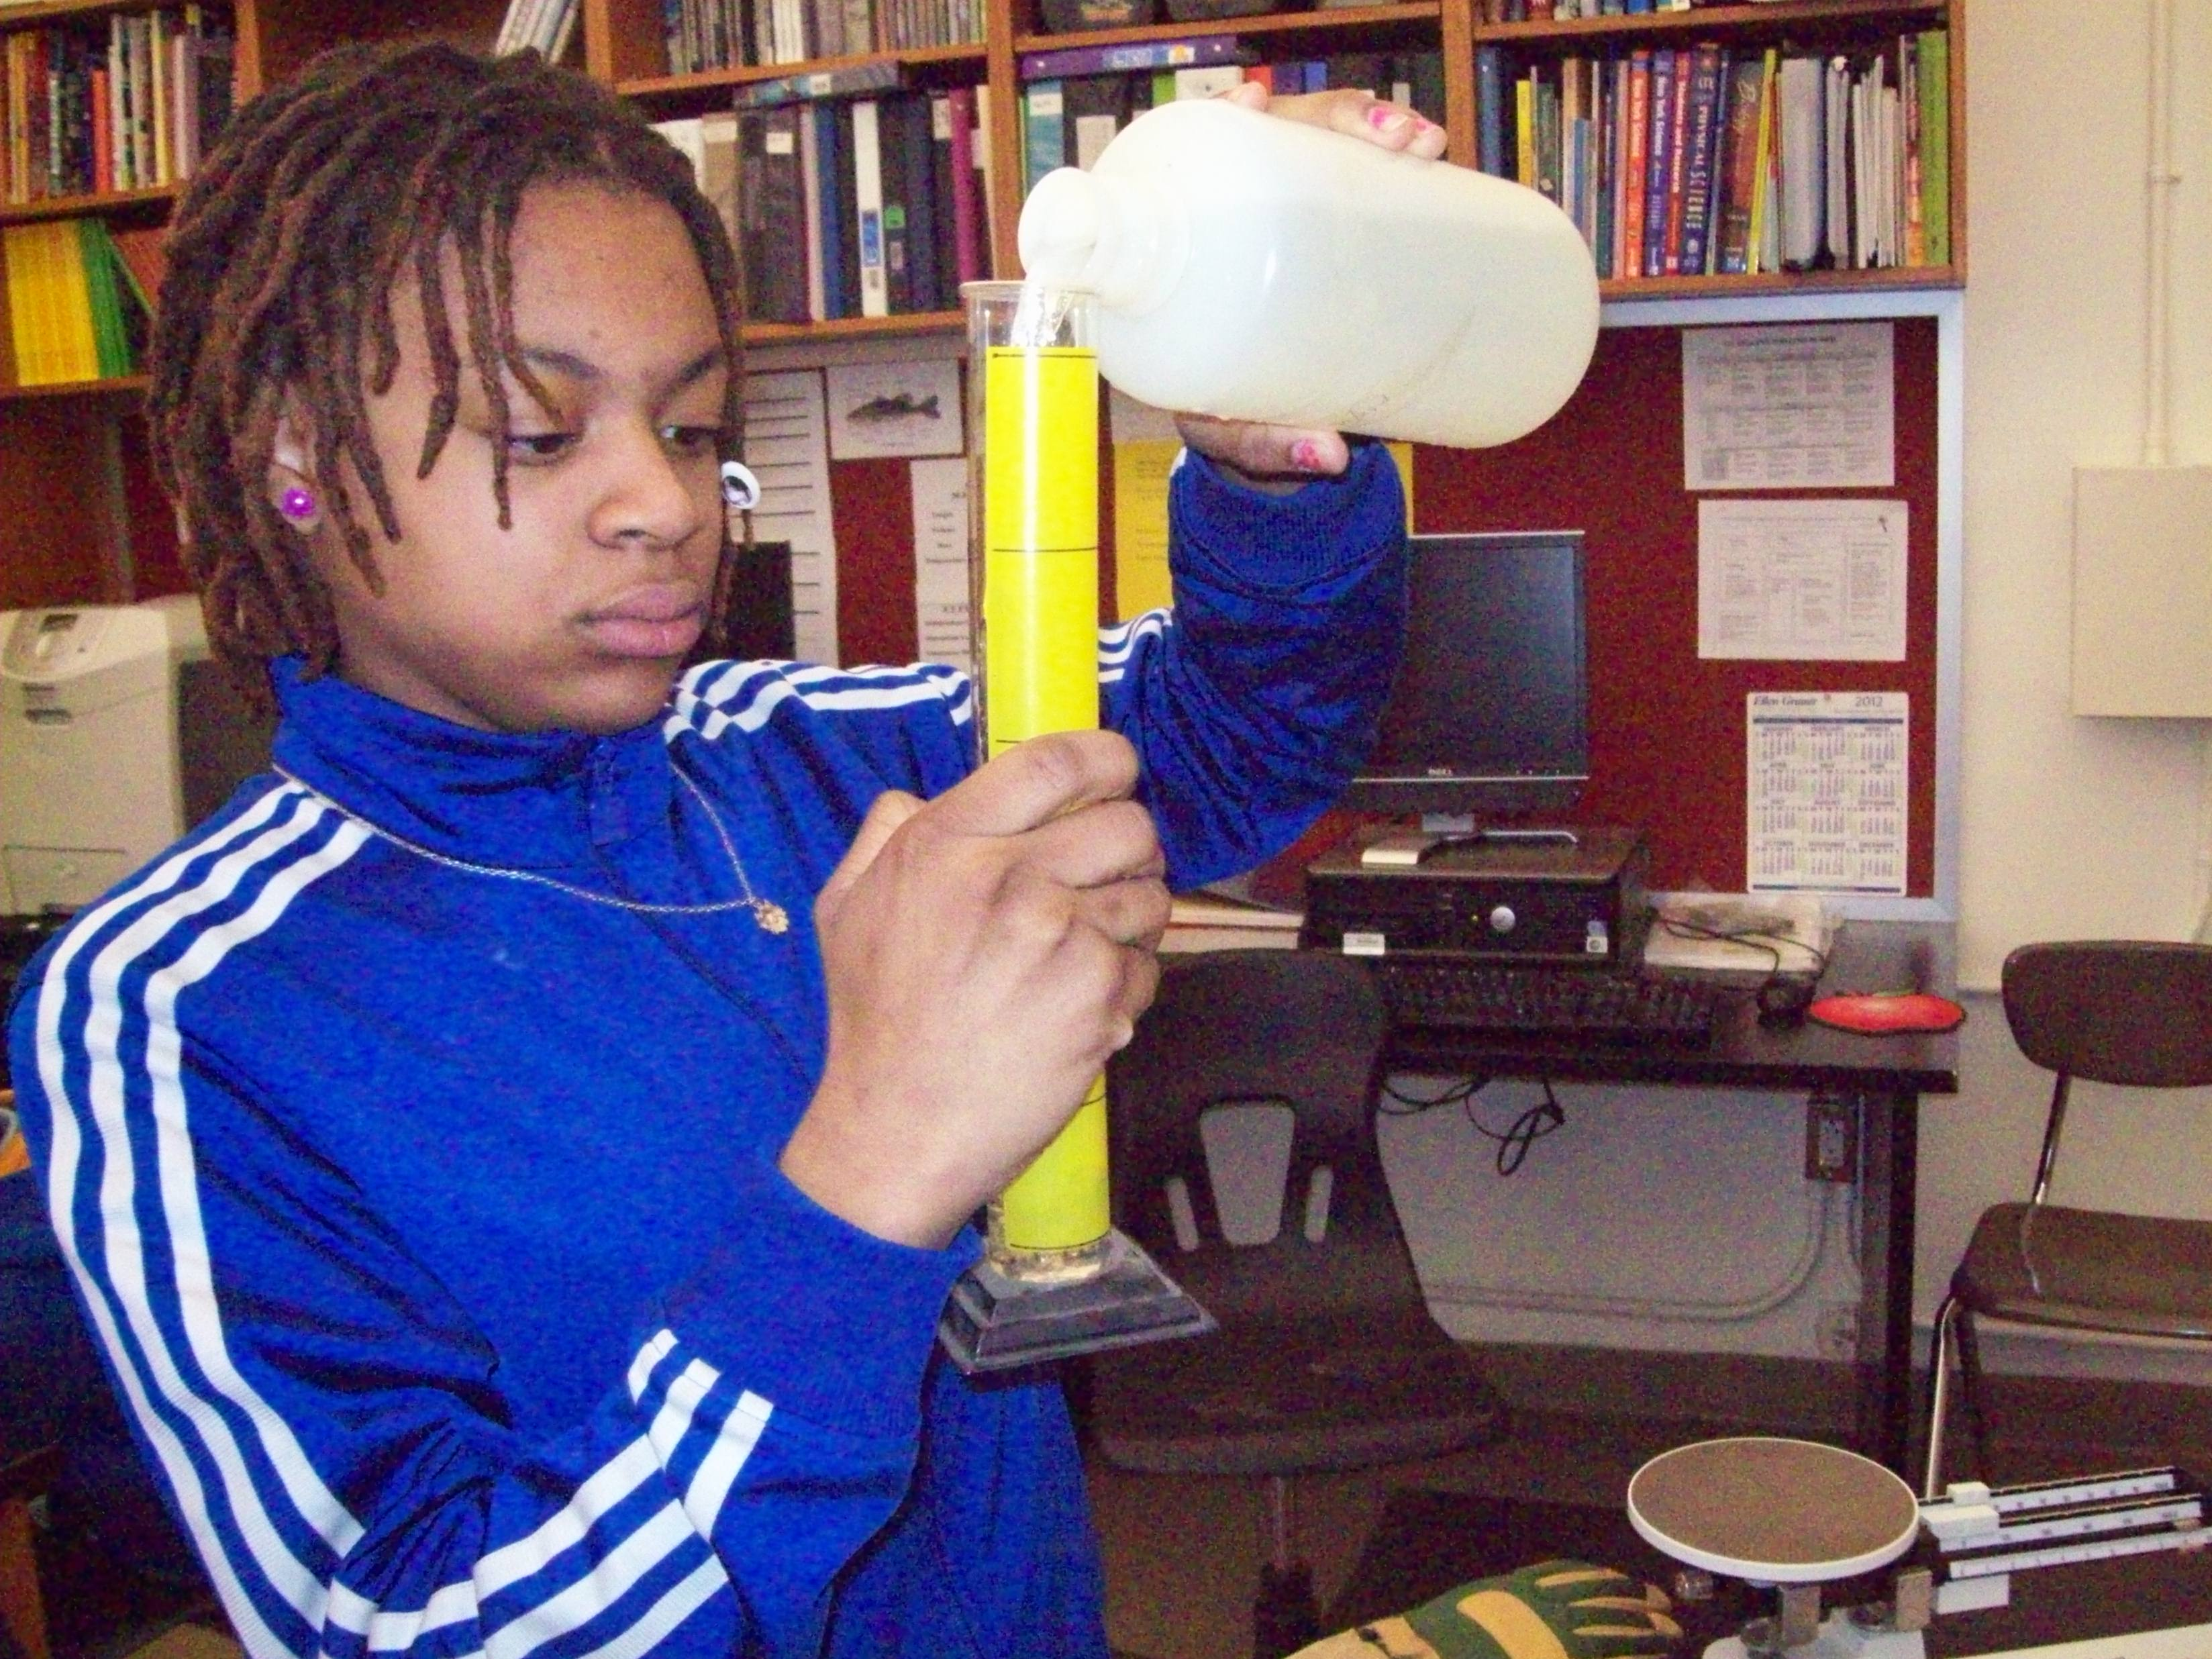
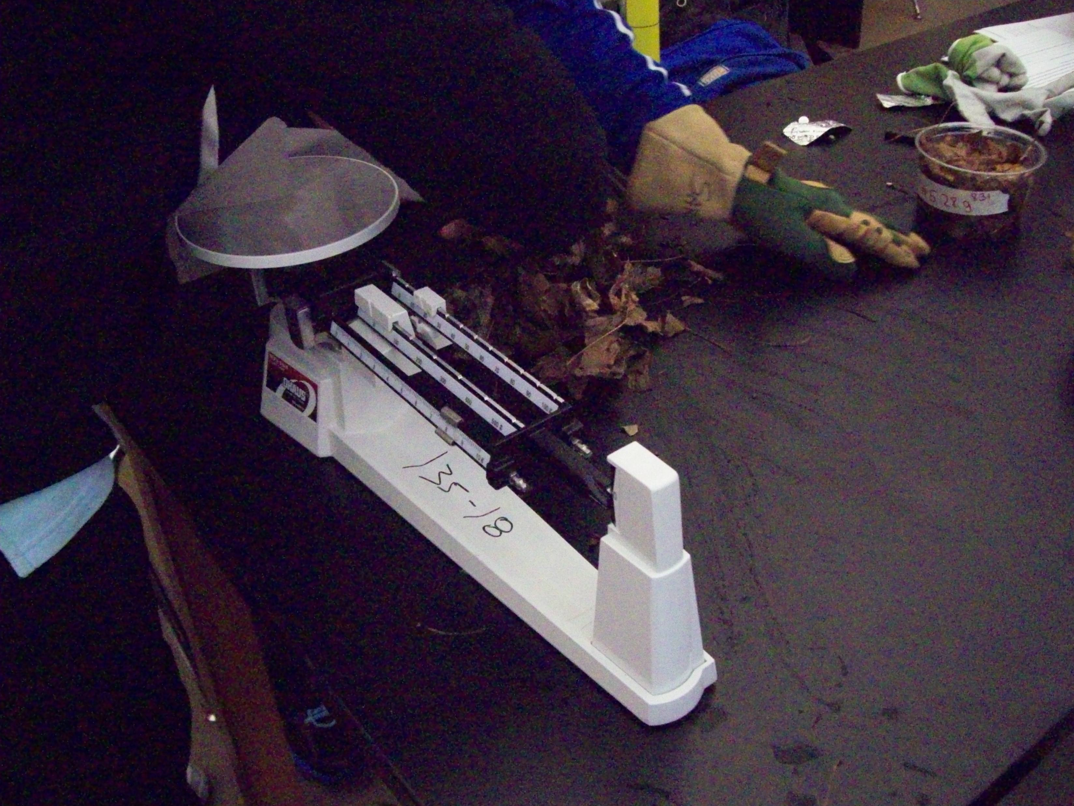
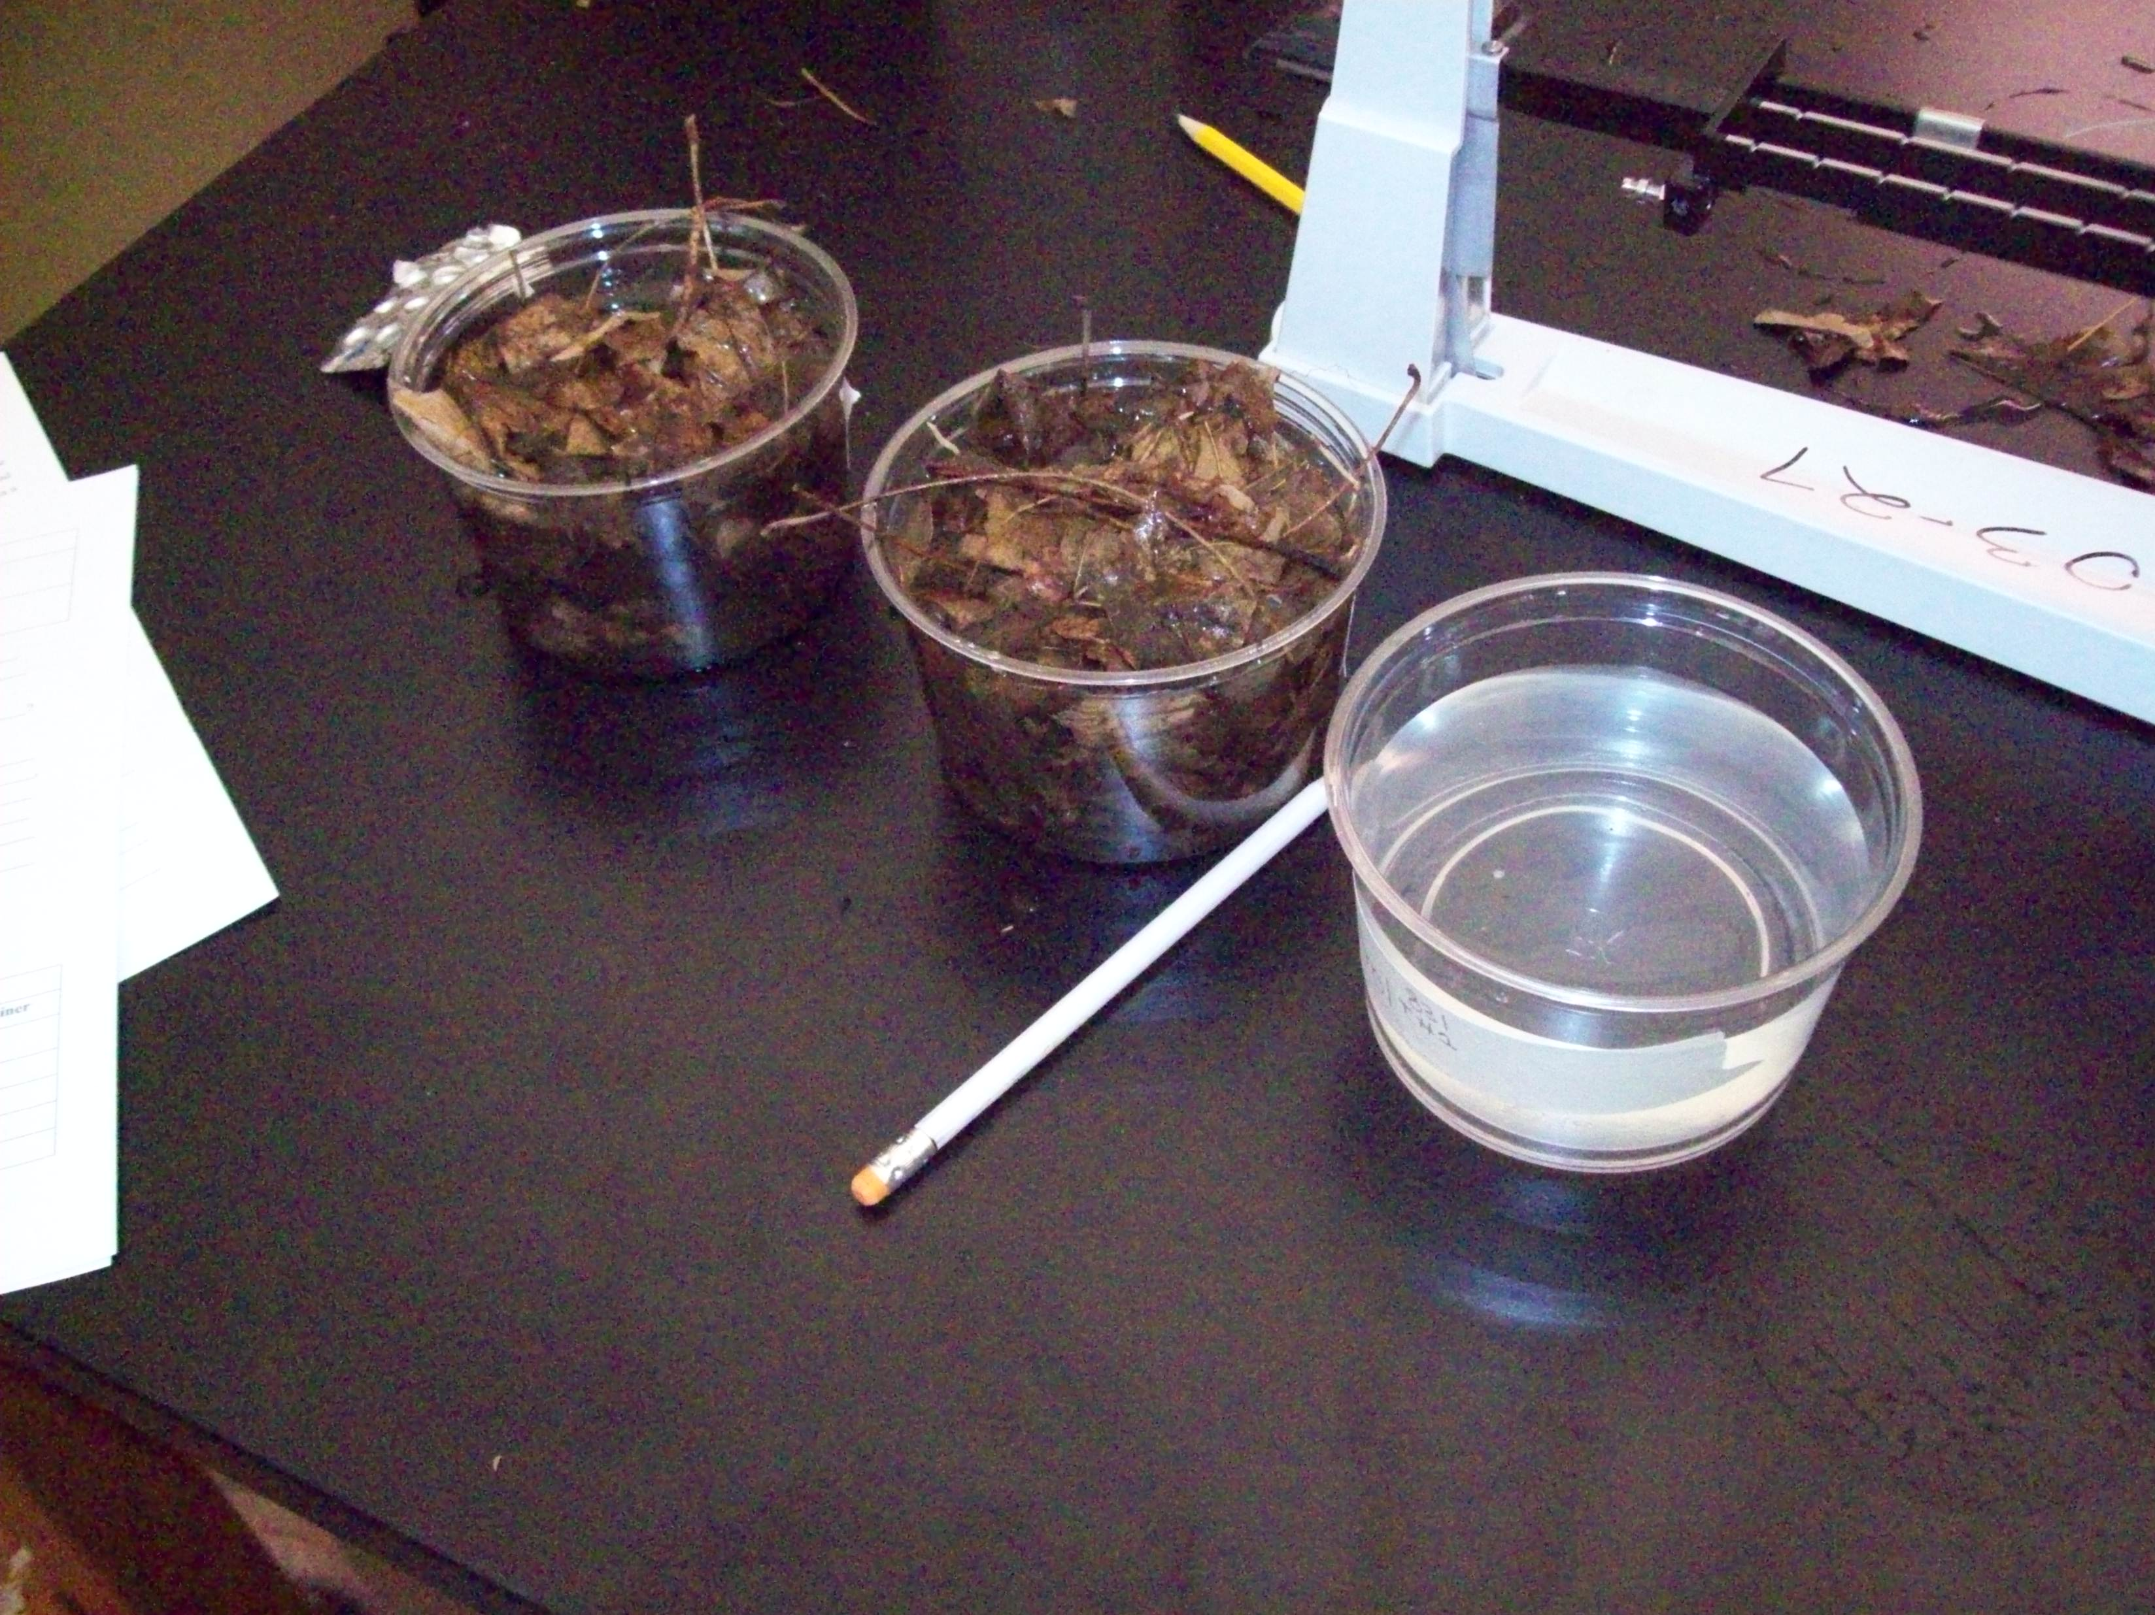

Slide 11
Superstorm Sandy
Using the map of the estuary, history of Jamaica Bay from NPS Adventures Program 2006, and various articles, the students tried to understand the factors involved in the major flooding caused by Superstorm Sandy.
Using paint trays, grass and paper models, the students tried to recreate the flood damage, testing out different types of land usage.(From New York New Jersey Harbor Estuary Program)
Beach
Urban
Wetlands

Slide 12
