Slide 1
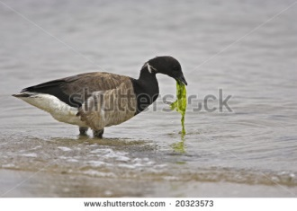
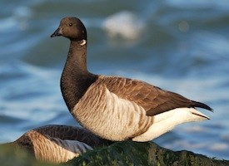
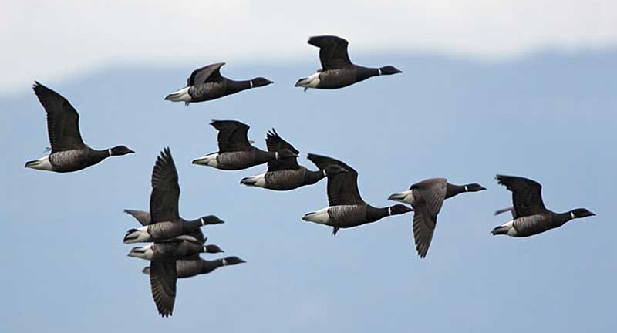
Brant Geese
Feeding
Cornell Lab of Ornithology-https://www.allaboutbirds.org/guide/Brant/id
Birdzilla- http://www.birdzilla.com/bird-identification/id-skill-development/bird-families/waterfowl-identification/duck-identification/identification-of-sea-ducks/325-center-for-bird-identification/id-skill-development/waterfowl/bci-geese.html

Slide 2
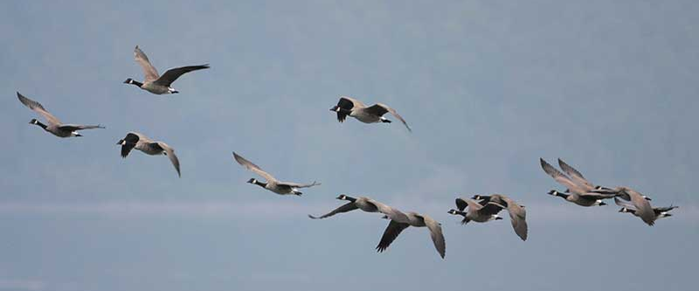
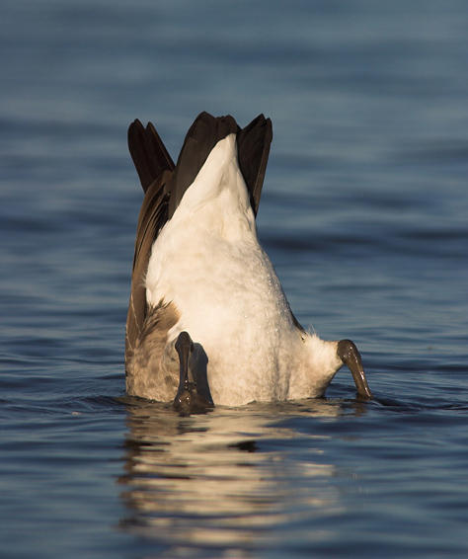
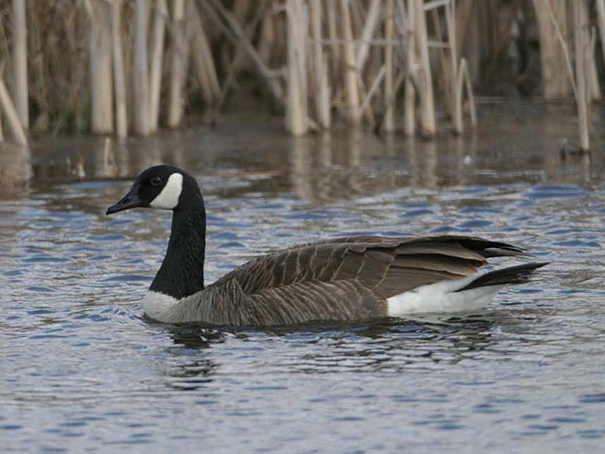
Canada Goose
Feeding
Swimming
Photos courtesy of Cornell Lab of Ornithology website- http://www.birdzilla.com/bird-identification/id-skill-development/bird-families/waterfowl-identification/duck-identification/identification-of-sea-ducks/325-center-for-bird-identification/id-skill-development/waterfowl/bci-geese.html

Slide 3
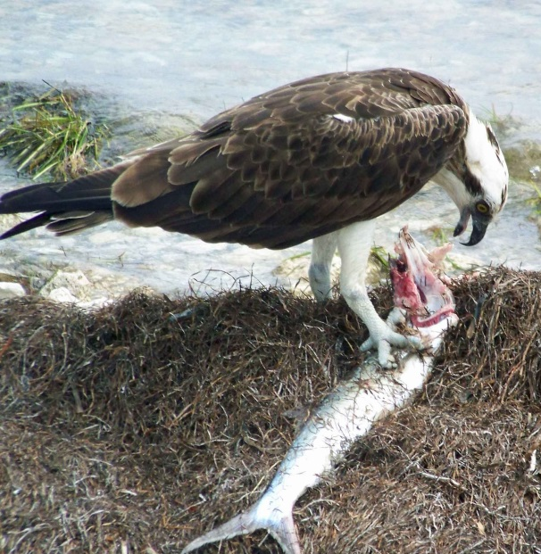
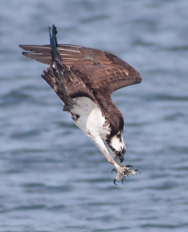
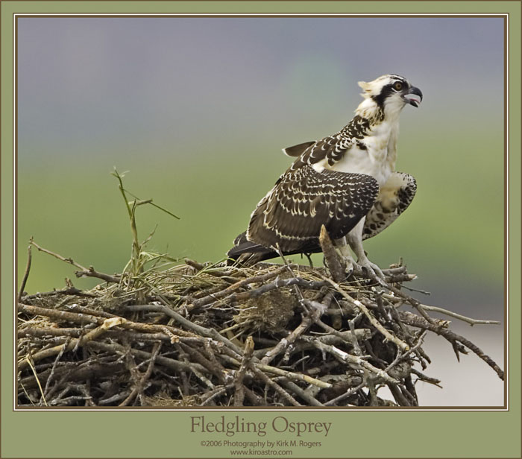
Osprey
Hunting
https://ospreytaleteller.com/2015/02/24/the-deadly-raptor-talon/
Feeding
http://ospreynest.info/?pagecontent=Feeding+Habits&user=9&adcode=117

Slide 4
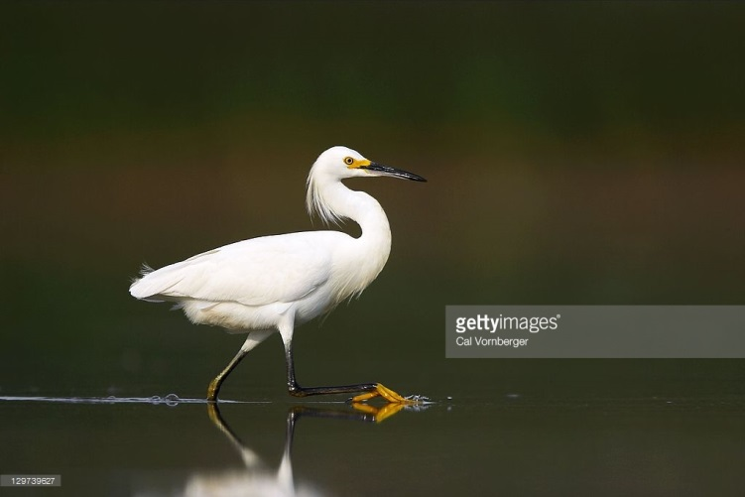
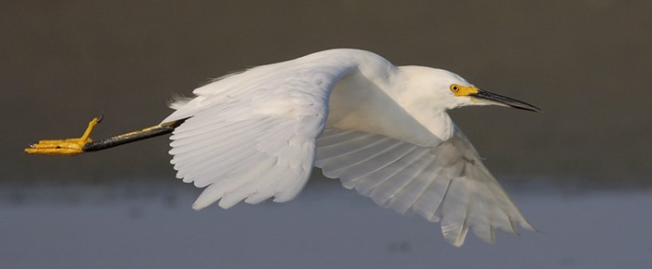
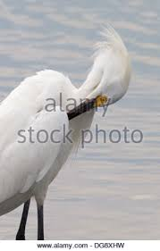
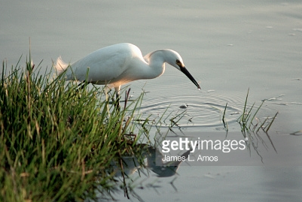
Snowy Egret
http://www.birdzilla.com/birds/snowy-egret.html?
Feeding/Hunting

Slide 5
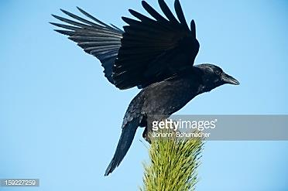
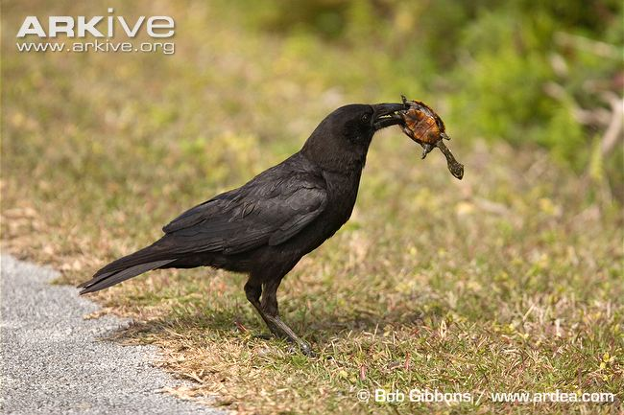
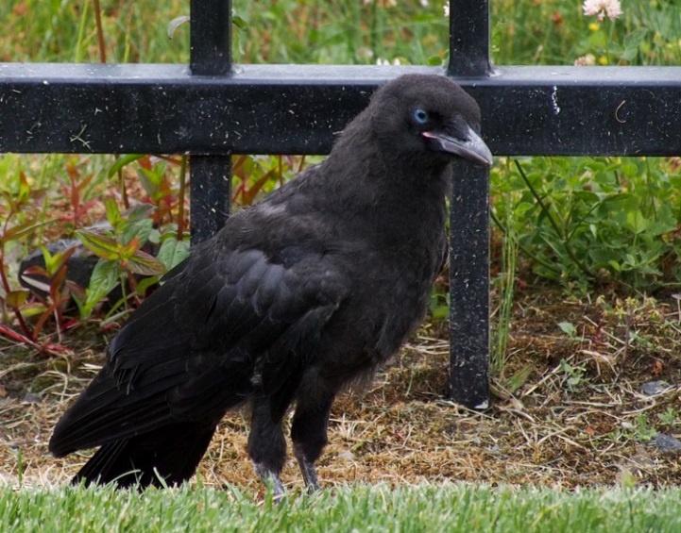
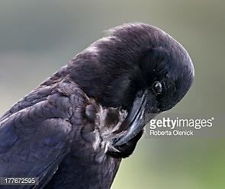
American Crow
Feeding
Grooming
Fledgling
©ingridtaylar via http://www.thewildbeat.com/2013/06/08/brake-for-birds/

Slide 6
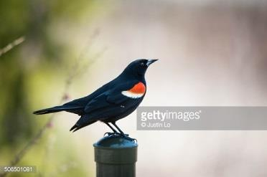
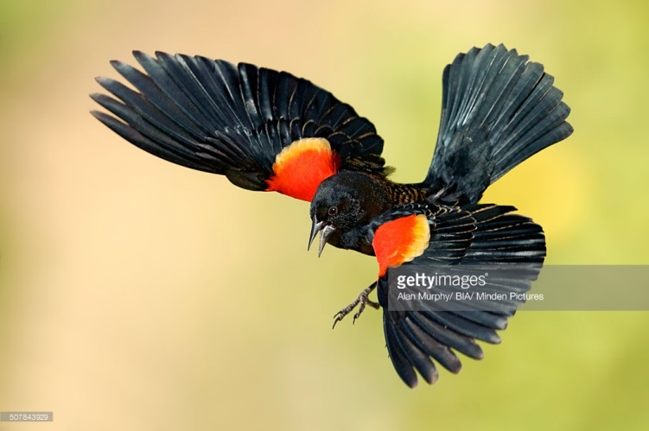
Red Wing Blackbird
Red Wing Blackbirds feed in marshy wetland areas, diving down amongst grasses to scoop up various insects.

Slide 7
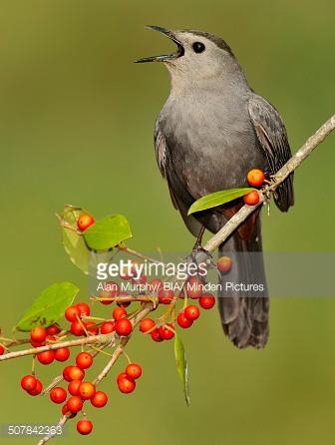
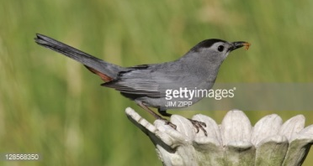
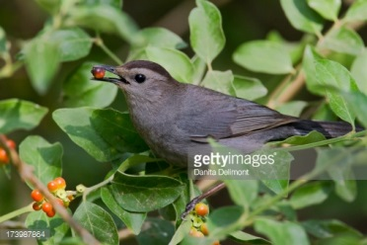
Gray Catbird
Catbirds swoop and dive for flying insects along with eating berries

Slide 8
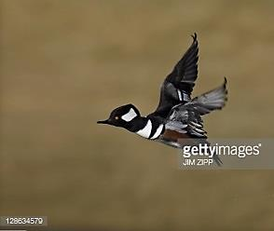
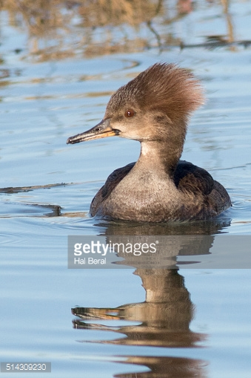
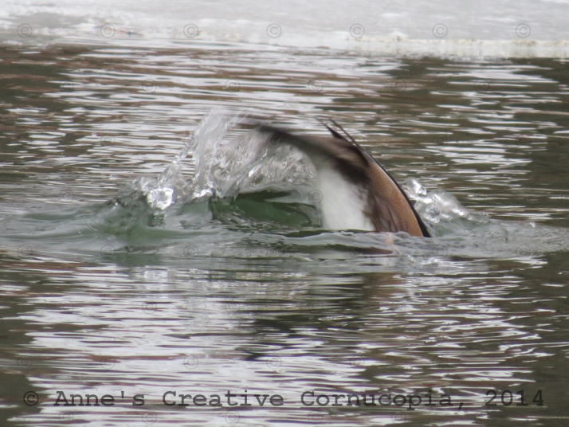
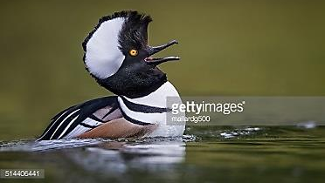
Hooded Merganser
Female Merganser
Mergansers dive for their food, often swimming underwater.

Slide 9
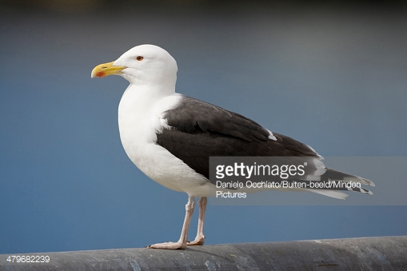
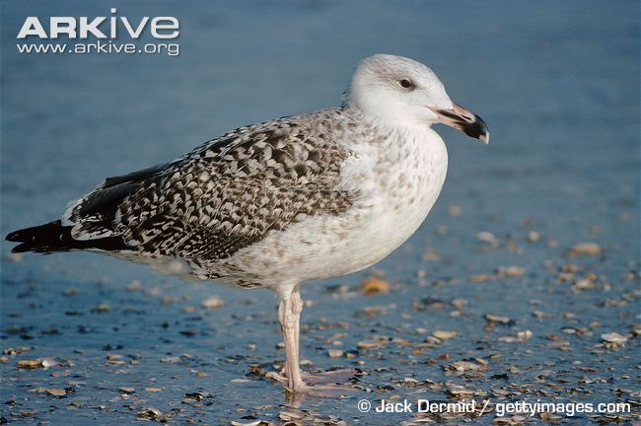
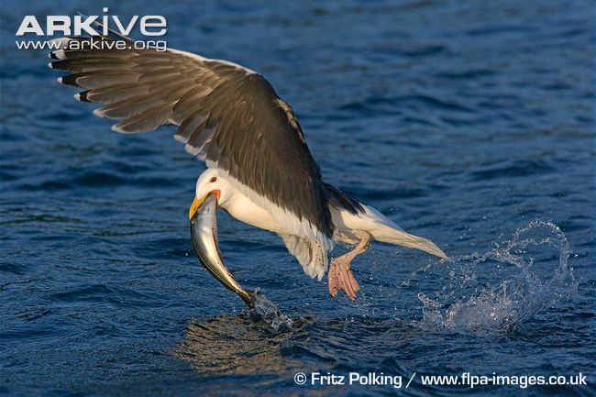
Greater Black-backed gull
Immature Gull
Hunting
The gulls will swoop over the water to pick up fish, but also walk the shore to find clams and other shellfish

Slide 10
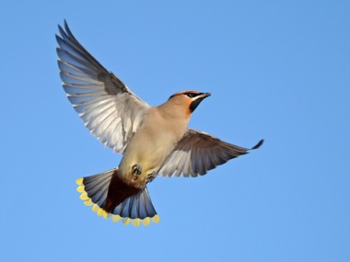
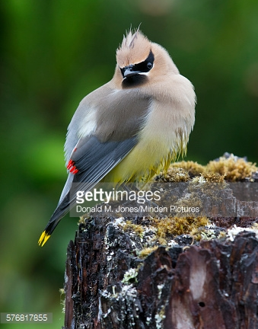
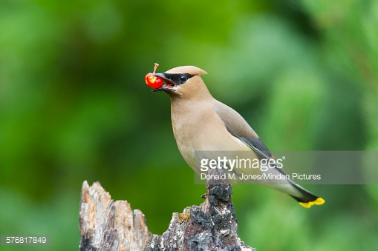
Cedar Waxwing
http://webzoom.freewebs.com/suffolkbirding/waxwings%20lowey%207%20Nov%2012%20252a_edited-1.jpg
Cedar Waxwings mostly eat berries in the winter and in the summer dive and catch flying insects

Slide 11
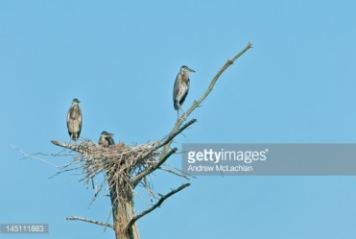
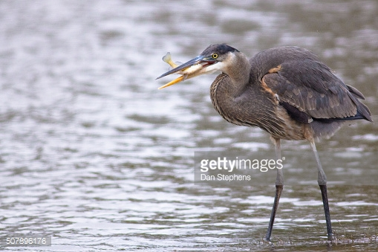
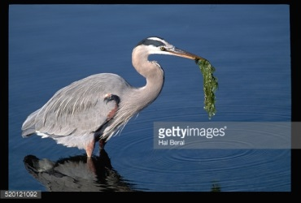
Great Blue Heron

Slide 12
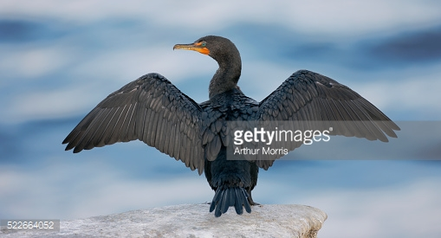
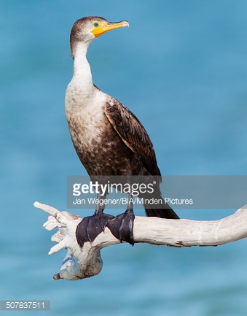
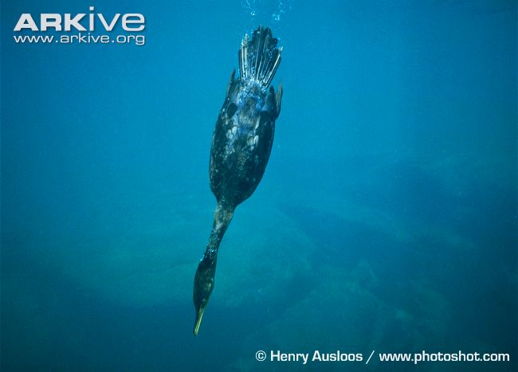
Double-Crested Cormorant
Cormorants dive for their food, often swimming underwater.

Slide 13
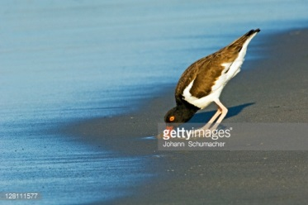
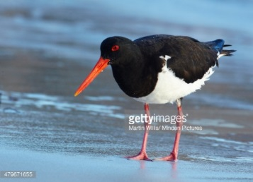
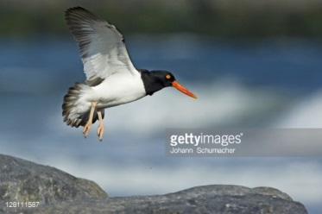
Oystercatcher
Oystercatchers feed along the shore, digging burrowing creatures out of the sand.

Slide 14
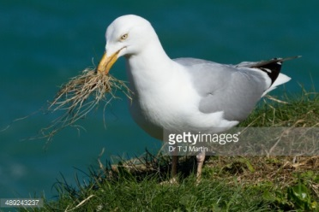
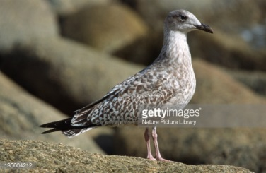
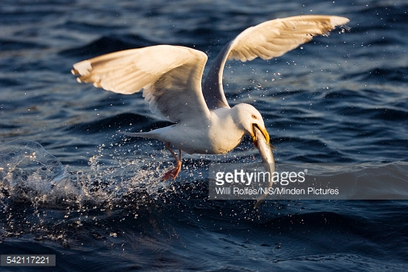
Herring Gull
Juvenile
Gulls will swoop over the water to pick up fish, but also walk the shore to find clams and other shellfish

Slide 15
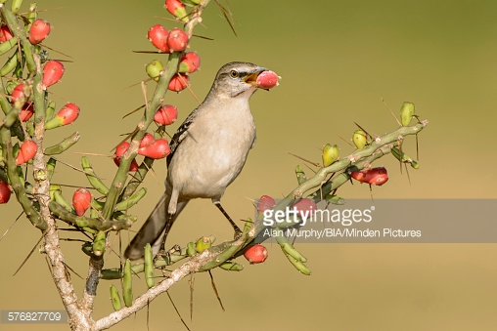
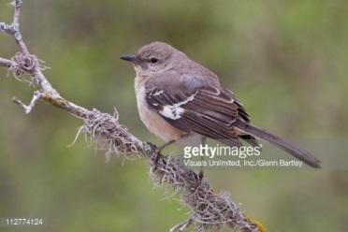
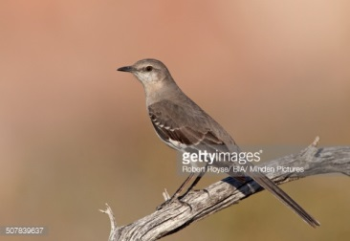
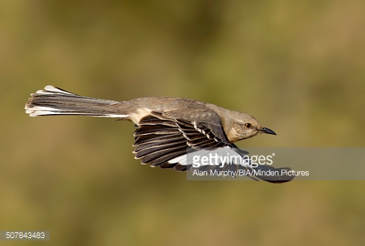
Northern Mockingbird
Besides swooping to catch a meal of flying insects, mockingbirds eat the berries of various plants and bushes

Slide 16
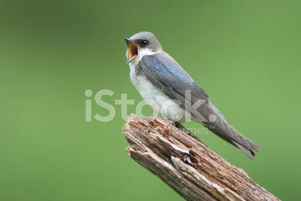
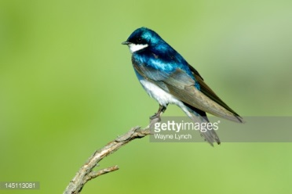
Tree Swallow
Tree swallows swoop to pick insects out of the air
Male and female tree swallows engaging in mating ritual. Female on left, male on right.

Slide 17
Yellow Throated Warbler
Female
These warblers swoop to catch a meal of flying insects
Photo by buffalostevep via https://little-buffalo.com/2012/08/24/warblers-are-migrating-southwards/

Slide 18
Black and White Warbler
These warblers swoop to catch a meal of flying insects
By Glen Davis viahttps://cmboviewfromthefield.blogspot.com/2014/09/morning-flight-15-september-2014.html

Slide 19
White Thoated Sparrow
Sparrows feed on insects and berries

