Slide 1
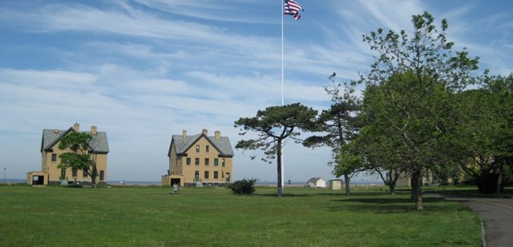
Fort Hancock Public Workshop
NOVEMBER 23, 2020
For technical assistance, contact Daphne Yun at: 917-282-9393
For better audio quality, consider dialing into the workshop by phone
Phone: 646-876-9923
Meeting ID: 969 0230 8381 | Passcode: join

Slide 2
Getting Started
  Workshop Objectives
Learn about leasing at Fort Hancock – history and the recent proposal
Hear perspectives from local officials
Share your thoughts
  Remember:
  This is just the start of the conversation
Notes:
Note here that we will be hearing from Pallone, Lillian, etc…..

Slide 3
Getting Started
  Agenda Topics
6:30pm | Welcome & Overview
6:40pm | A New Leasing Opportunity at Fort Hancock
7:10pm | Perspectives on Leasing at Fort Hancock
7:20pm | Opportunity for Public Comment
7:55pm | Wrap Up & Next Steps
7:55pm | Adjourn
Notes:
Note here that we will be hearing from Pallone, Lillian, etc…..
Mention intention to adjourn at 8 but willingness to stay longer if many speakers

Slide 4
Getting Started
  Workshop Discussion Protocols
What we expect from each other:
Be comfortable
Stay focused
Contribute but share time
Use Zoom to participate
Notes:
Q&A for questions about the project, Gateway policies, etc.
Chat – to share your thoughts on ideas being discussed here tonight – ask people to stay focused on discussion and presentations – will adapt on the fly as needed
Webinar being recorded – will be available on line

Slide 5

Getting Started
  How to Contribute
To contribute to the discussion:
Pose a question in the Q&A
Add a comment to the “Chat”
Raise a “virtual” hand
We’ll get to as many questions and comments as possible
Webinar to be recorded for those unable to attend
Notes:
Q&A for questions about the project, Gateway policies, etc.
Chat – to share your thoughts on ideas being discussed here tonight – ask people to stay focused on discussion and presentations – will adapt on the fly as needed
Webinar being recorded – will be available on line

Slide 6
History, Context & Current Proposal
Jennifer Nersesian, Superintendent, Gateway National Recreation Area
Stillman Development Proposal
Roy Stillman, Stillman Development International
A New Leasing Opportunity at Fort Hancock
Notes:
Start off the evening with two speakers:
Gateway Superintendent Jennifer Nersesian on leasing – history, context and current proposal
Opportunity to hear from Roy Stillman
If time, take some Q&As in the Q&A box.
Will then get perspectives from a couple of electeds and then into public comment

Slide 7

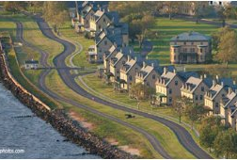
Gateway National Recreation Area
Sandy Hook, NJ
National Park Service
U.S. Department of the Interior
Gateway National Recreation Area
Notes:
Good evening, and welcome to our public workshop on the leasing program at Sandy Hook.

Slide 8
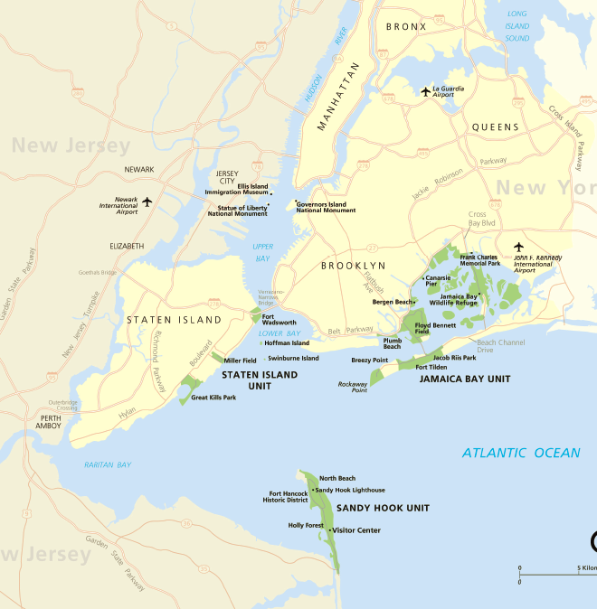
Gateway National Recreation Area
Park Overview​
Created 1972
New York metropolitan area: 20 million population
26,000 acres
2019 = 9,405,622 visitors
Multiple jurisdictions, high visibility
Significant natural, cultural and recreational resources
Notes:
Sandy Hook is part of GNRA, which spans over 26,000 acres from NJ, to sites in Staten Island, Brooklyn, and Queens in NYC.

Slide 9
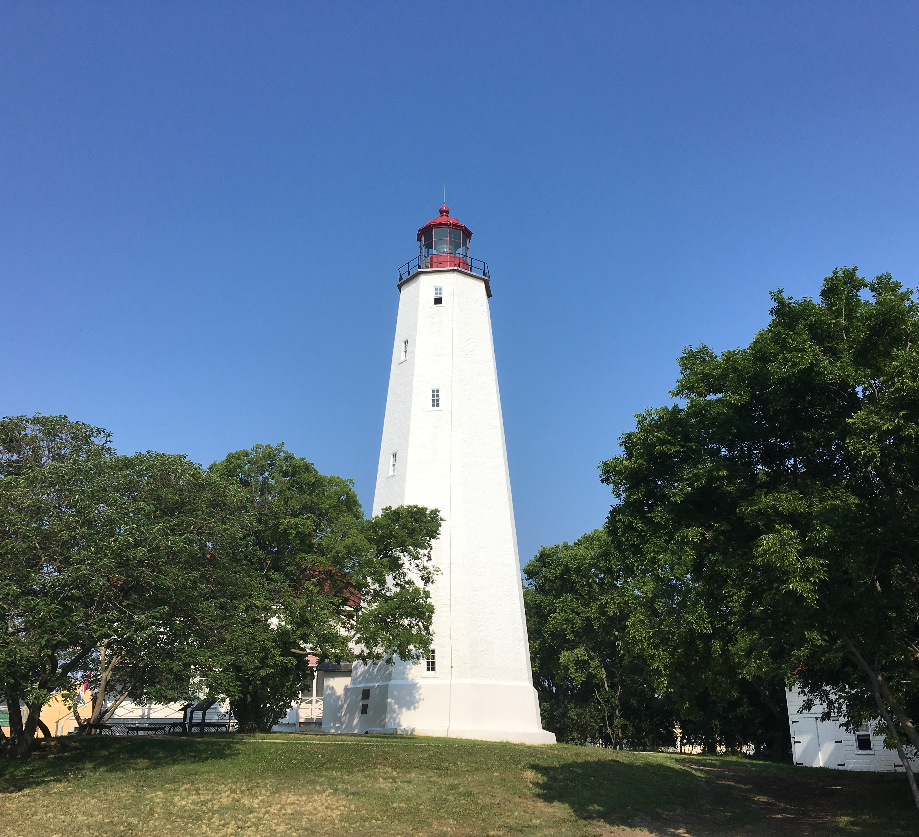
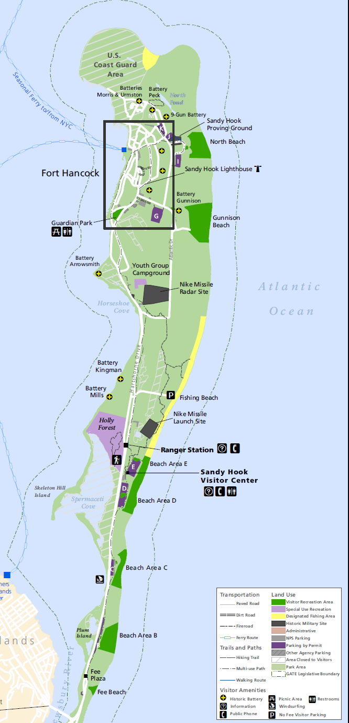
Sandy Hook
Overview​​
​Monmouth County, NJ​
​Part of Gateway ​
​7 miles long​
​2m+ visitors/year​
​​Ferry access​
​Significant natural, cultural and recreational resources​
Notes:
Zooming in on Sandy Hook, you see we have a seven-mile long peninsula, where we are home to many significant natural, cultural, and recreational resources that over 2 million visitors per year come to enjoy.

Slide 10
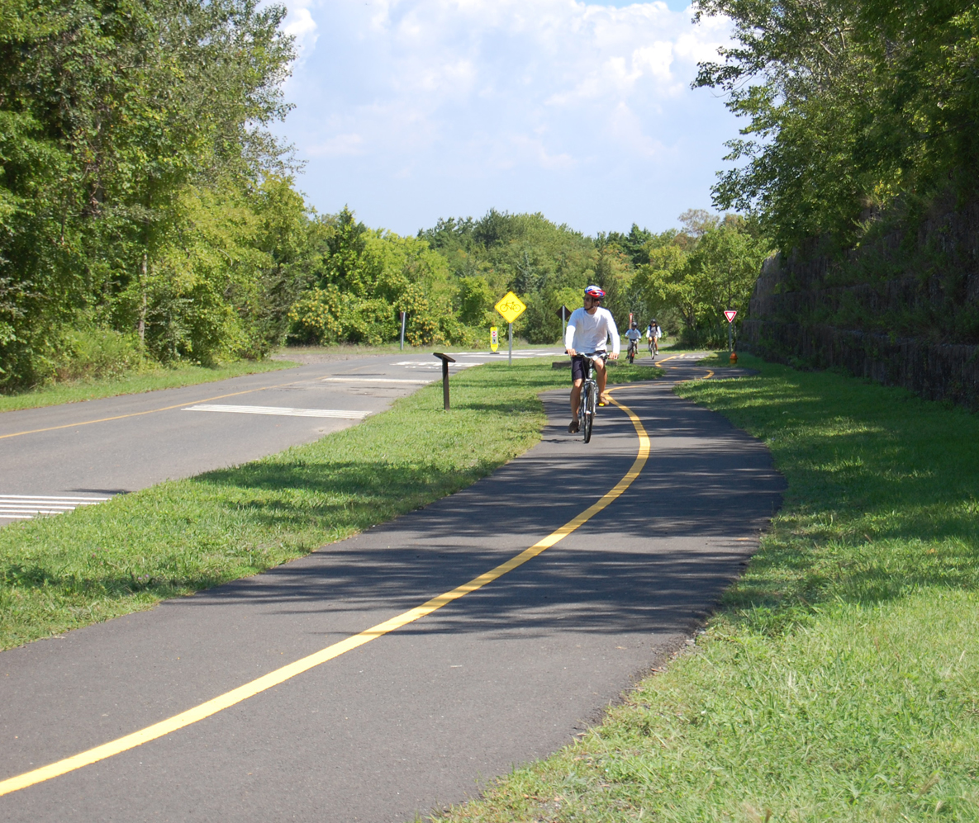

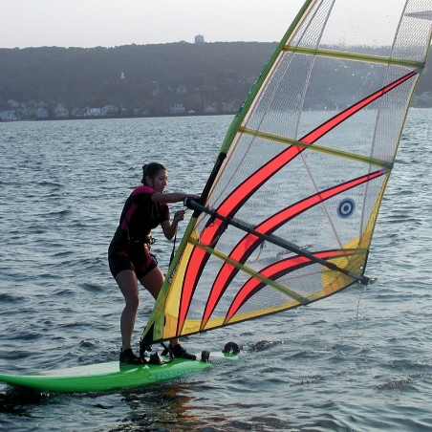

Recreational
Opportunities​
Lifeguarded swimming beaches
Fishing
Camping- 20 sites
Multi-Use Pathway – 7 Miles
Walking
Birdwatching
Canoeing, kayaking, Paddle boarding, surfing
Picnicking
Events and programs
Notes:
Now of course we are well known for our recreational opportunities – most of all, the seven miles of beautiful ocean-facing beaches.

Slide 11
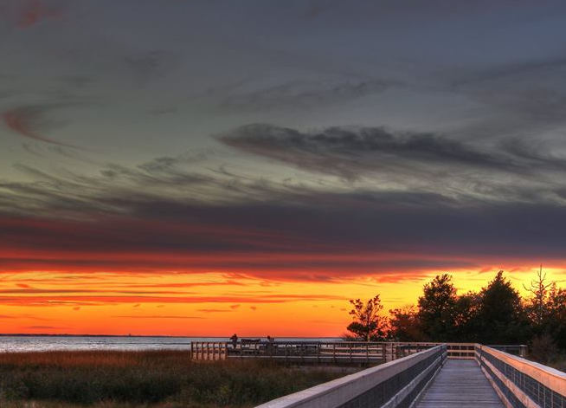

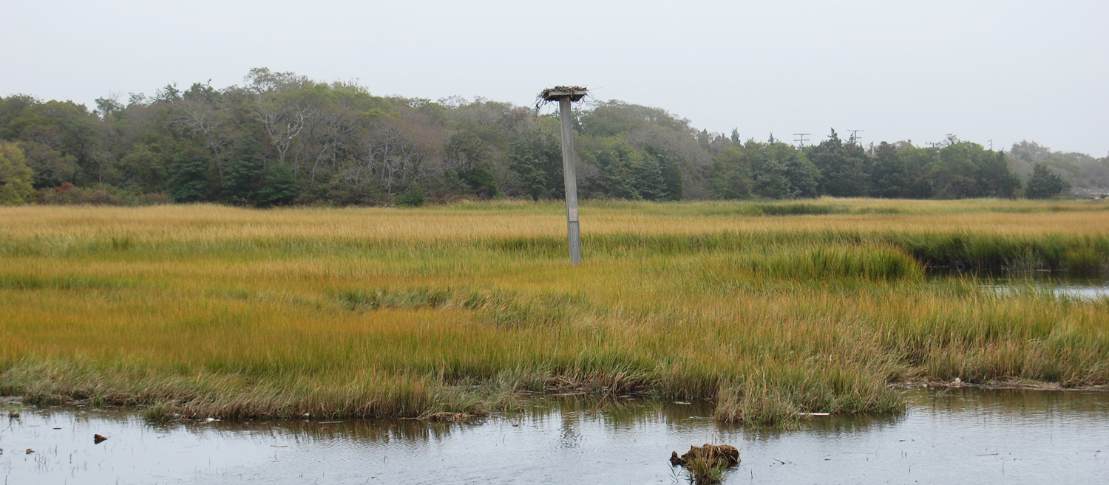
Natural Resources
One of the last vestiges of natural coastline in NJ
Globally significant maritime holly forest
Threatened and endangered species
Bird and marine species migration hotspot
Notes:
The site is also renowned for its natural resources. It is home to a globally significant maritime holly forest habitat, and is known as one of the premiere bird migration hotspots on the east coast.

Slide 12
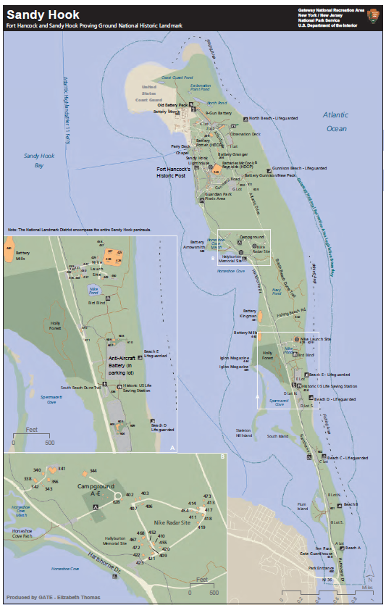
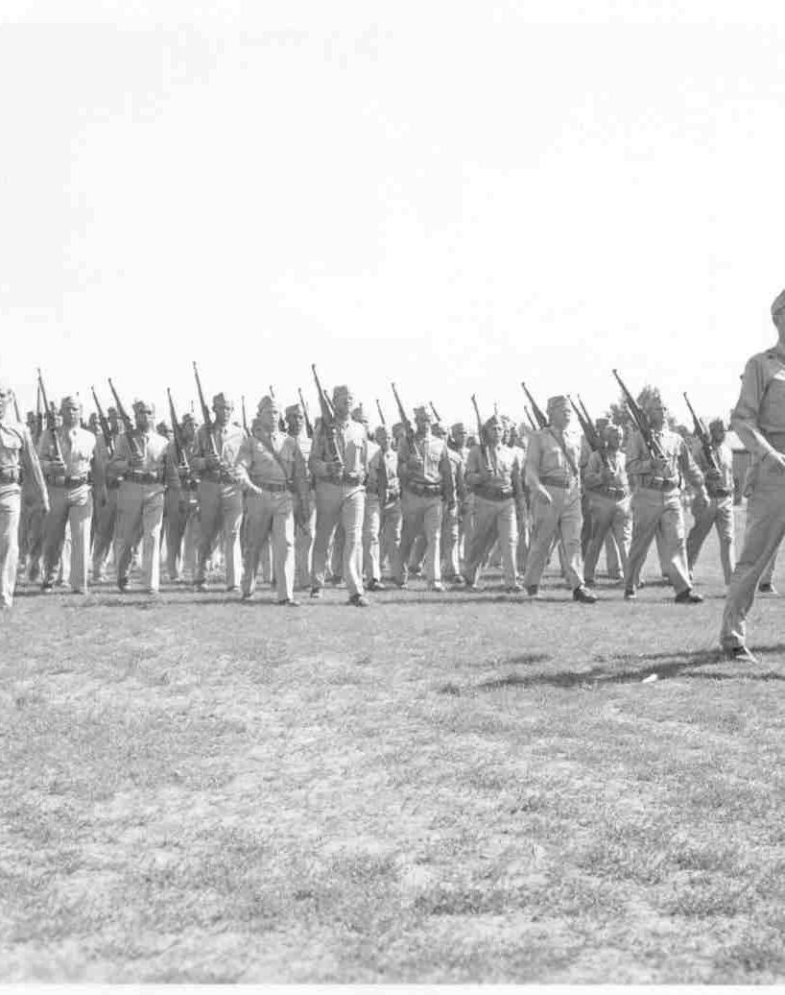
Cultural Resources
Fort Hancock and Sandy Hook Proving Ground National Historic Landmark
Sandy Hook Lighthouse National Historic Landmark
Military history from the Revolutionary War to the Cold War
Notes:
But we have very significant cultural resources as well. In fact, the entire peninsula is a National Historic Landmark. We also have a second landmark designation for the SH Lighthouse, which is the oldest continuously operating lh in the country.

Slide 13
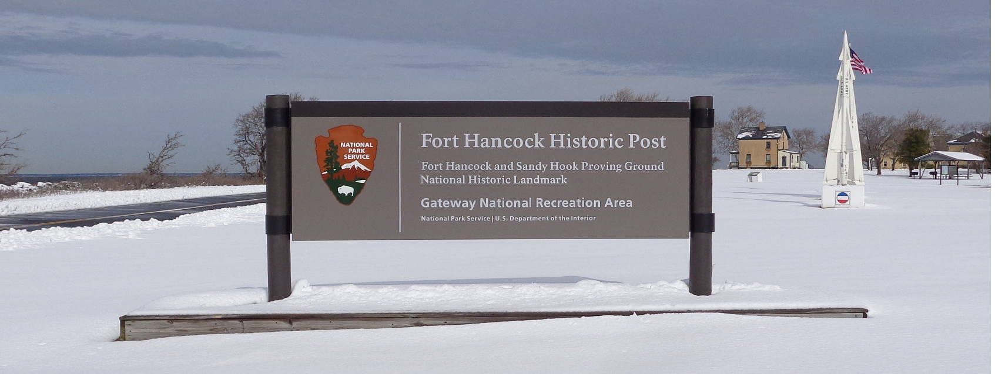
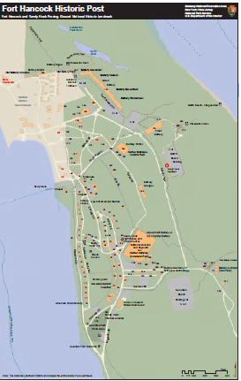
Historic Post
The significance of this site dates to the American Revolution, when British and Loyalist soldiers occupied the Hook for almost the entire duration of the Revolutionary War. The site continued to be significant throughout the War of 1812, and through the Civil War.
The Sandy Hook Proving Ground, which overlaps Fort Hancock in both time and space, was established in 1874 as a place to test new weaponry.
This area, known as the "Fortifications at Sandy Hook," was renamed Fort Hancock, and was thereafter used as the Army's permanent operational defensive fortifications from the Spanish-American War to the age of nuclear missiles -- missiles which were housed here.
Notes:
The historic significance of the site stretches from the American Revolution and continues throughout the military history of our country, from early weapons development in the 1800’s, through both World Wars when Fort Hancock was an extremely active base, and continuing through the Cold War when it served as a nike missile site.

Slide 14
Gateway NRA
Legislative Mandate
Public Law 92-592
The park's enabling legislation requires the Secretary to "inventory and evaluate all sites and structures having present and potential historical, cultural, or architectural significance" and to "provide for appropriate programs for the preservation, restoration, interpretation, and utilization of them."
Notes:
Our mission in the National Park Service is to preserve our natural and cultural resources, and provide for exemplary visitor experiences. The enabling legislation that brought Gateway into being specifically references our mandate to preserve and restore our historic sites and structures.

Slide 15
Preserving Areas of Significance
What are National Historic Landmarks?
National Historic Landmarks (NHLs) are historic places with exceptional value because they commemorate or illustrate the history of the United States. There are almost 2,600 National Historic Landmarks. All NHLs are also listed in the National Register of Historic Places.
NHLs come in many forms: buildings, sites, structures, objects, and districts. A historic site may be important enough to receive designation as an NHL if it:
  is the location with the strongest association with a turning point or significant event in American history.
  is the best location to tell the story of an individual who played a significant role in the history of the United States.
  is an exceptional representation of a particular building or engineering method, technique, or building type in the country.
  provides the potential to yield new and innovative information about the past through archeology.
Fort Hancock and the Sandy Hook Proving Ground National Historic Landmark includes the entire area of Sandy Hook. It contains approximately 110 significant historic buildings and 16 Batteries dating from the last quarter of the 19th through the first half of the 20th centuries
Notes:
The richness of that history is the reason for the landmark designation, which is in addition to the site’s designation at a national park, and adds an even greater imperative regarding the preservation of the historic resources here, and extra layer of protection to guard against destruction or inappropriate development.

Slide 16
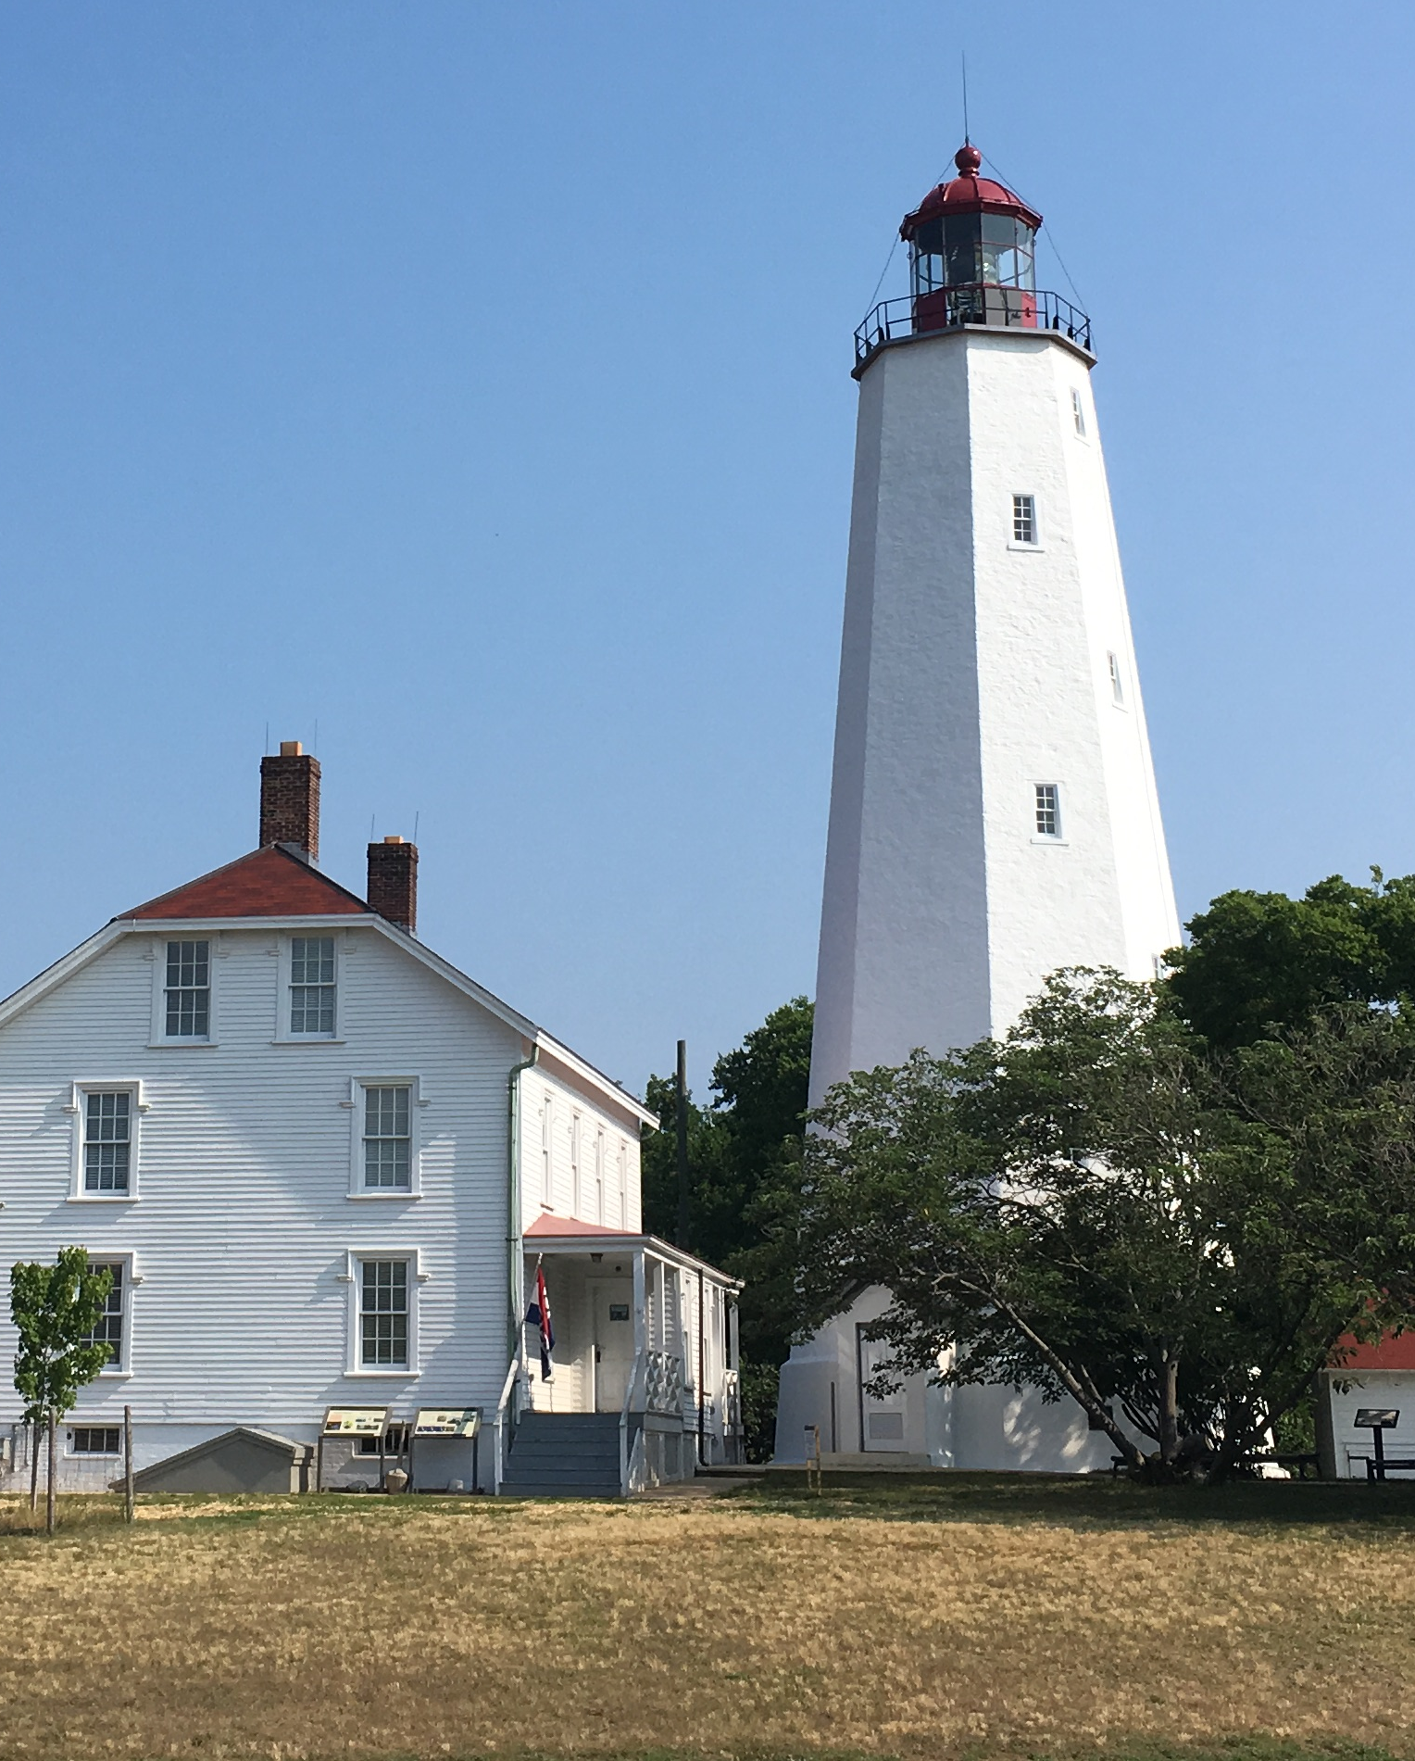
Sandy Hook Assets​
Park assets include many historic buildings, historic fortifications and critical utility infrastructure such as:
194 buildings and structures (mostly historic)
21 miles of paved road
250-year-old Sandy Hook Lighthouse
7 miles of paved multi-use path
7 miles of beaches
Wastewater and water treatment and delivery systems
Electrical services
Notes:
At Sandy Hook the NPS manages many assets, both historic buildings as well as non-historic infrastructure to provide all the necessary services to those two million visitors per year, including 194 buildings, 21 miles of paved roads, electrical systems, and water and wastewater systems, including our own wells and sewage treatment plant.

Slide 17
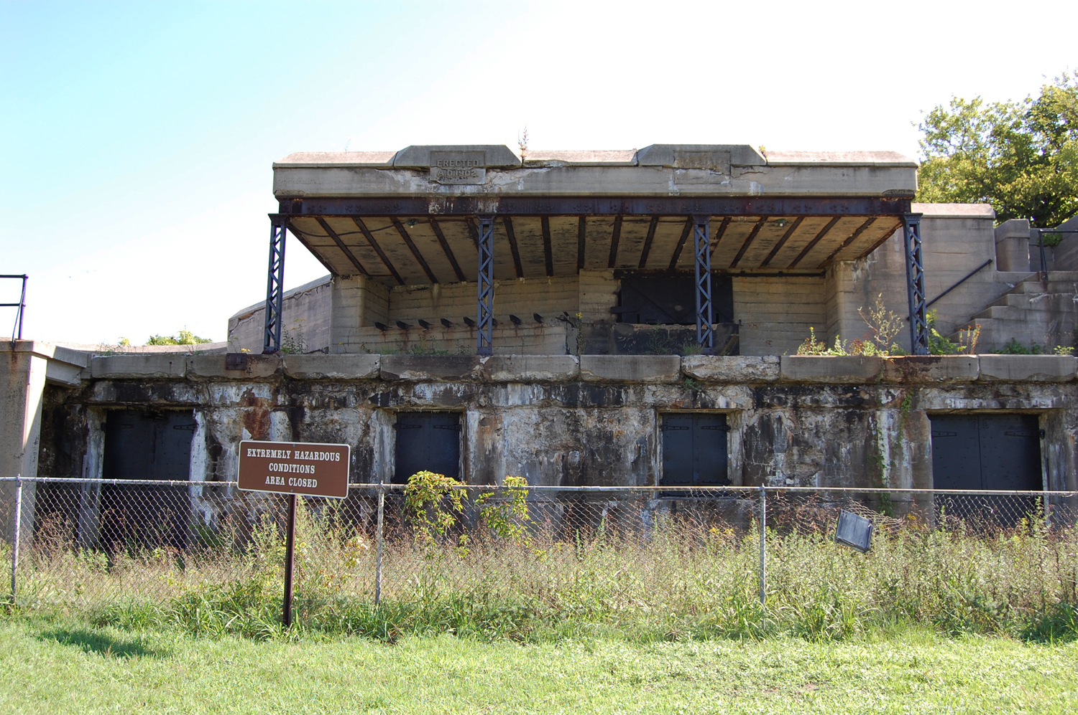
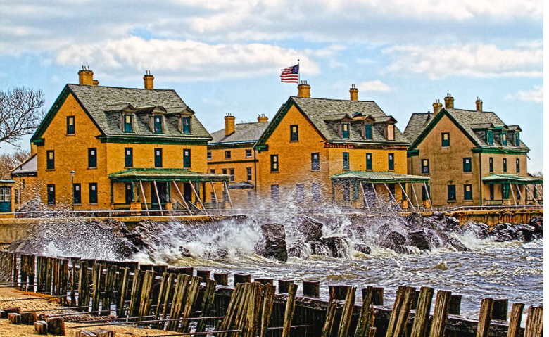
Deferred Maintenance ​
Gateway Total: $791 M
Inherited from Military
More inventory than needed for administrative or visitor use
Need to prioritize investments to match available resources
Notes:
For years the cost of maintaining this infrastructure has far outstripped our available resources, and as we’ve fallen behind, the deterioration has accrued. We refer to this as deferred maintenance – it’s not unique to Gateway, but is an issue all across the NPS that has gotten a lot of national attention. But at Gateway, we do have the distinction of having one of the highest def main tabs in the entire agency – our last official count in 2018 puts us around $800M for the park. We estimate that somewhere between $100-200M of this is at Sandy Hook.

Slide 18
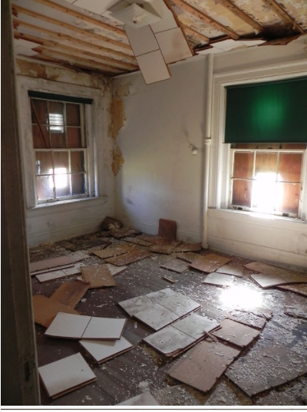
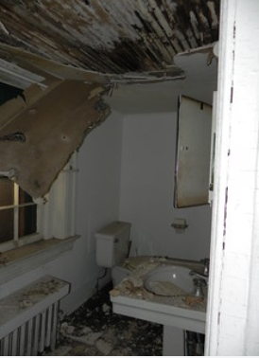
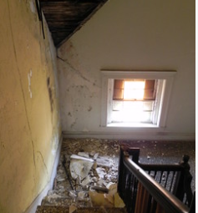
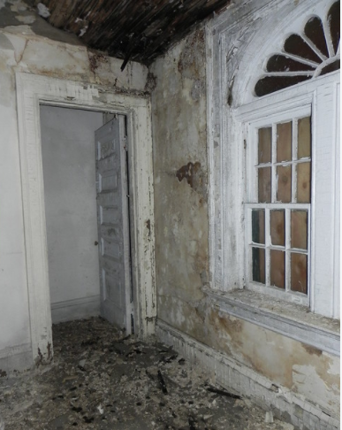
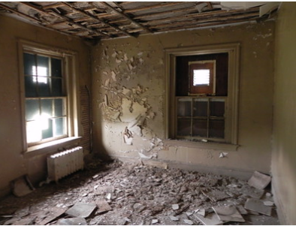
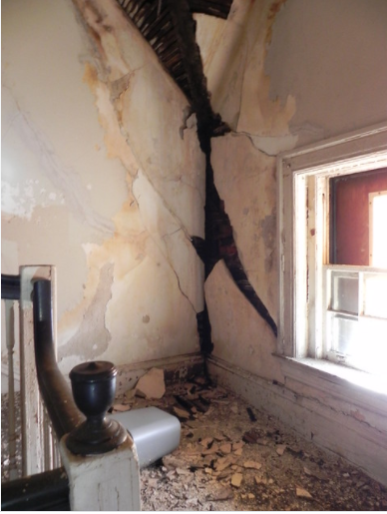
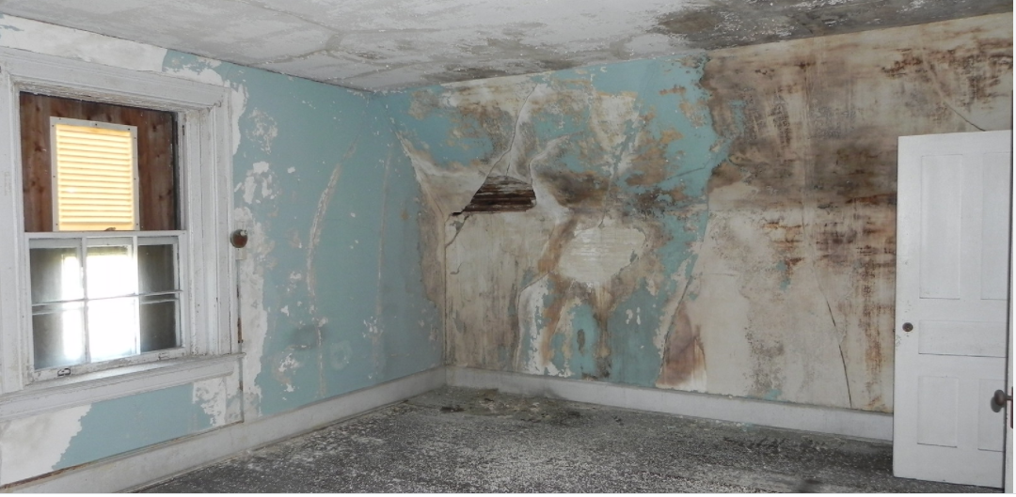
CURRENT BUILDING CONDITIONS
Notes:
Here you can see some of the severe deterioration inside our historic structures in the main post area of Fort Hancock, where our leasing program is focused. We have many unoccupied buildings in this area, far more than we need for museums or other NPS visitor service functions – and an unoccupied building rapidly falls into disrepair.

Slide 19
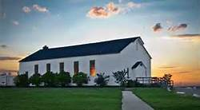
National Park Service Leasing
In general the Director may lease any property (except non-historic land) under this part if the Director makes the determinations required by §18.4.
“Appropriate forms of visitor enjoyment emphasize appropriate recreation consistent with the protection of the Park”
Allowable uses require consistency with relevant law, regulation and policy
Law | Public Law 105-391, Section 802 (16 U.S.C.)
Regulations | 36 C.F.R. Part 18
Policy | Director’s Order 38 Memorandum on Leasing vs. Contracting
Notes:
The NPS has special legal authorities to lease buildings, and specific authorities geared towards leasing historic structures, laws which were developed in part as a tool for preservation. By law, we are obligated to charge fair market rent for leased buildings. However, we can offset investments in their historic preservation against those rent payments for up to a sixty year term, making it a financially feasible deal for the investor and bringing the park the investment it needs to fulfill its historic preservation mission.

Slide 20
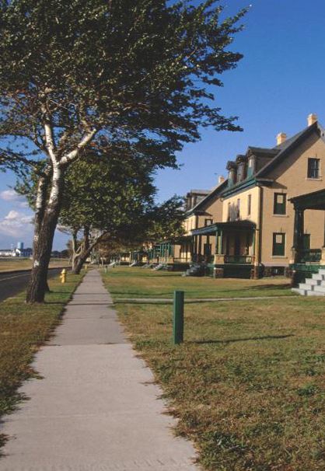
Past Fort Hancock Leasing Effort
Early 2000's leasing effort ended unsuccessfully due to:
  Lack of public outreach
  Community opposition to master developer
  Subsequent lawsuit
  Challenges to project funding
Notes:
In the early 2000’s, the park embarked on an initial leasing effort with a master developer for all of the buildings that ultimately failed. This was not set up in a very transparent manner, there was a lack of public involvement and community fears about privatization of the site which eventually led to a lawsuit. The NPS prevailed in court, but the project fell apart, and there was a lot of public mistrust and acrimony left in its wake.

Slide 21


The Federal Advisory Committee
Chartered by Secretary of the Interior
Committee is charged with providing advice. . . “on the development of a reuse plan and on matters relating to future uses of the Fort Hancock Historic District[.]”
The Committee is comprised of accomplished members from relevant areas of expertise
Notes:
To learn from this and ensure that moving forward we were working with local communities, we set up a Federal Advisory committee made up of representatives from local government as well as different sectors such as real estate, education, the environment, finance, and others. Together we have worked to develop a project that: made sense from a local perspective, benefited from expertise beyond the NPS sphere, and proceeded in a fully transparent manner.

Slide 22
Public Involvement
(35) Public meetings
Outreach efforts -Trade shows, Builders Conventions, Chamber of Commerce events
Open Houses
website (forthancock21.org)
Notes:
We’ve been at this process with the Advisory Committee now for over seven years.. During that time we have held 35 public meetings. You can find information on the leasing program as well as the notes from all of those meetings on the website listed on the screen, forthancock21.org.

Slide 23

REQUEST FOR EXPRESSIONS OF INTEREST
Released October 22, 2013, and closed on December 16, 2013
Site Visits Scheduled for November 6 and 14, 2013
Document designed to solicit a broad range of ideas
Responses helped:
  Gauge investors’ interest in Fort Hancock
  Aided in developing the Request for Proposals
Notes:
We started by releasing a request for expressions of interest in 2013 to brainstorm ideas with the public and understand what people would like to see here, gauge market interest, and inform the development of a formal solicitation.

Slide 24
OUTCOME
Request for Expressions of Interest
Reported in The New York Times and Asbury Park Press
Site visits attended by more than 200 prospective lessees
(41) Proposals Received
Primary interest Residential Use
  RESIDENTIAL: (14) Residential and (2) Residential/Office Use
  MASTER DEVELOPER: (4) Master Leases seeking use of all buildings
  STUDIO: (3) Art Studios
  B&B/RESTAURANT: (7) Bed & Breakfast and Restaurants
  HOSPICE: (1) Hospice
  MUSEUM: (2) Museum Operations with onsite housing
  RECREATION: (4) Recreation based use
  VISION: (4) Non-Building Specific Proposals/Statements Envisioning Fort Hancock Use
Notes:
Out of that, one of the surprising findings at the time was the strong interest in residential use.

Slide 25
Site Constraints &
Challenges
Seasonal Limitations
Remote
Access
Historic Preservation Cost Escalation
Shared Public Use
No New Construction
Notes:
Over the years we’ve learned there are a lot of challenges to attracting private investment at SAHO. Visitation to the site is extremely seasonal, with most of our 2M visitors coming in four months of the year. In terms of regional geography, it is relatively remote, and access can be an issue if you’re fighting summer beach traffic. Historic rehab projects are more complicated and expensive than a typical renovation. You don’t get a yard around your building, and the public is allowed to wander around the site. And because the whole site is historic, very little new construction is allowed, which in other situations is often what makes the undertaking financially feasible.

Slide 26
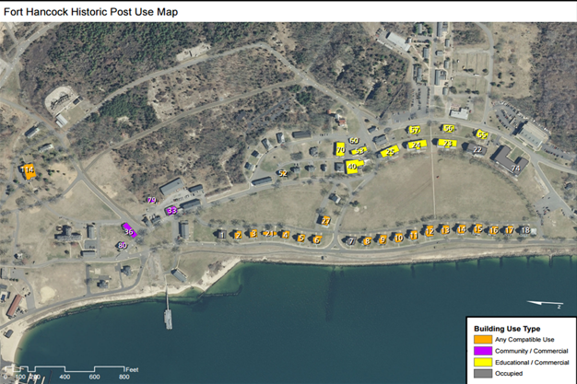
LAND USE MAP
Compatible Use . Community/Commercial . Educational
Notes:
Here you see the buildings in question in a land use map developed early on by the committee as a result of the rfei.

Slide 27
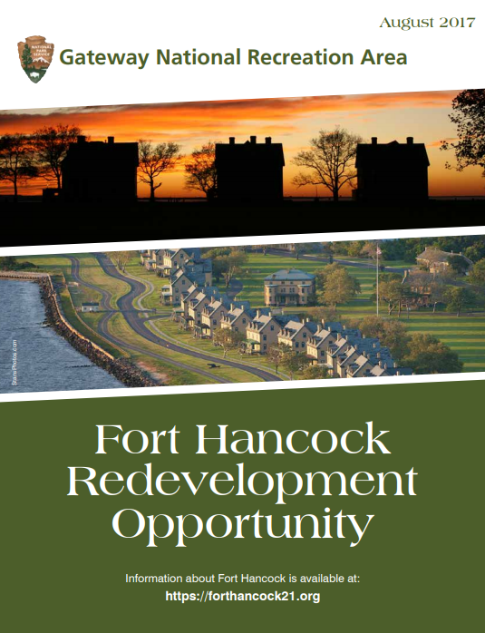
REQUEST FOR PROPOSALS
Rolling Until All Leased
Notes:
And today we have in place a rolling RFP, through which we have gotten several proposals.

Slide 28
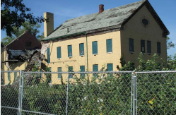
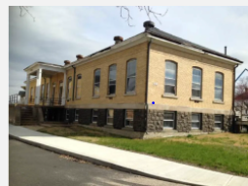
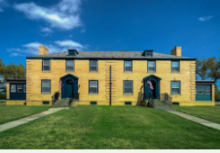
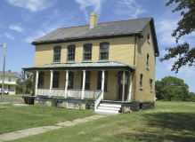
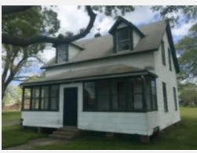
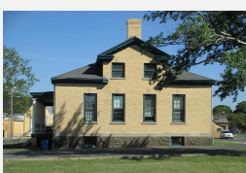
Buildings Currently Leased
(Clockwise 23, 53, 21, 52, 104, and 56)
Notes:
As a result we now have six buildings under long-term leases,

Slide 29
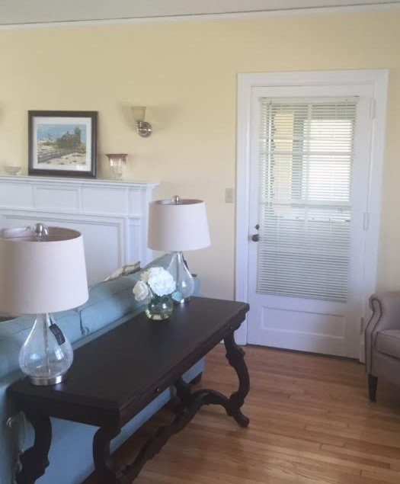
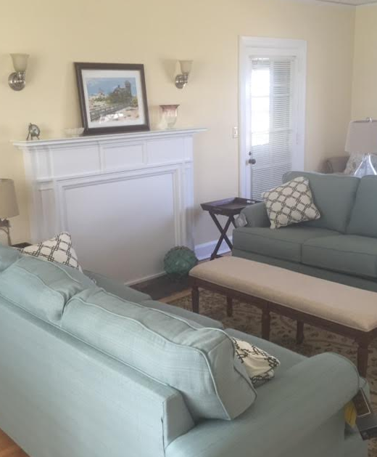
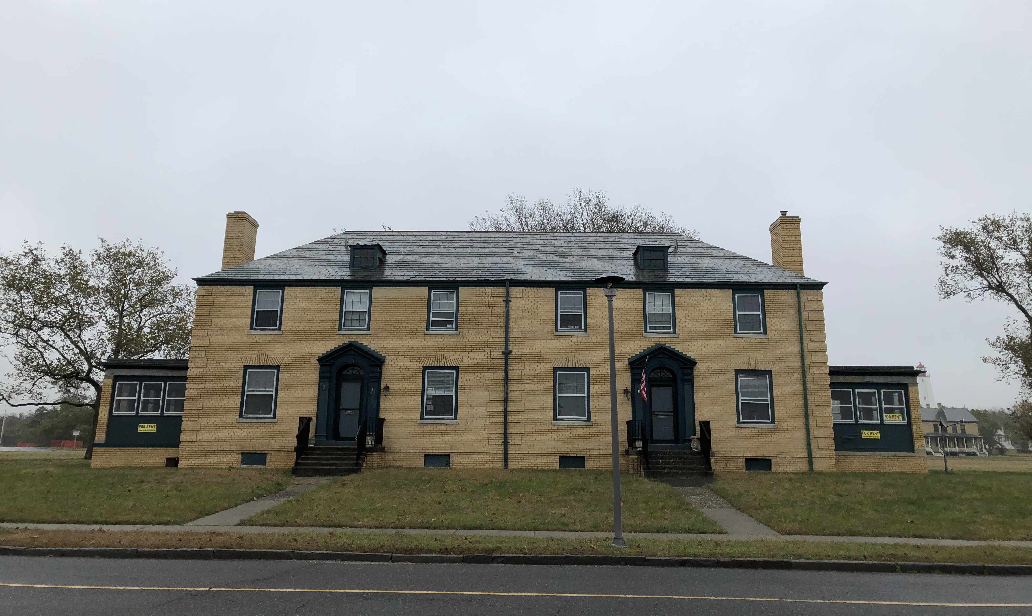
Building 21
Gateway National Recreation Area
Duplex, Sandy Hook
Building #21 was constructed in 1939 and is a 2 ½ story duplex divided into north and south single- family apartments. The building has 6 bedrooms and 2 baths consisting of a total of 3,810 square feet.
Notes:
Here we’ve got some photos of the buildings that are either finished or underway. Building 21, which is used as a short-term residential rental

Slide 30
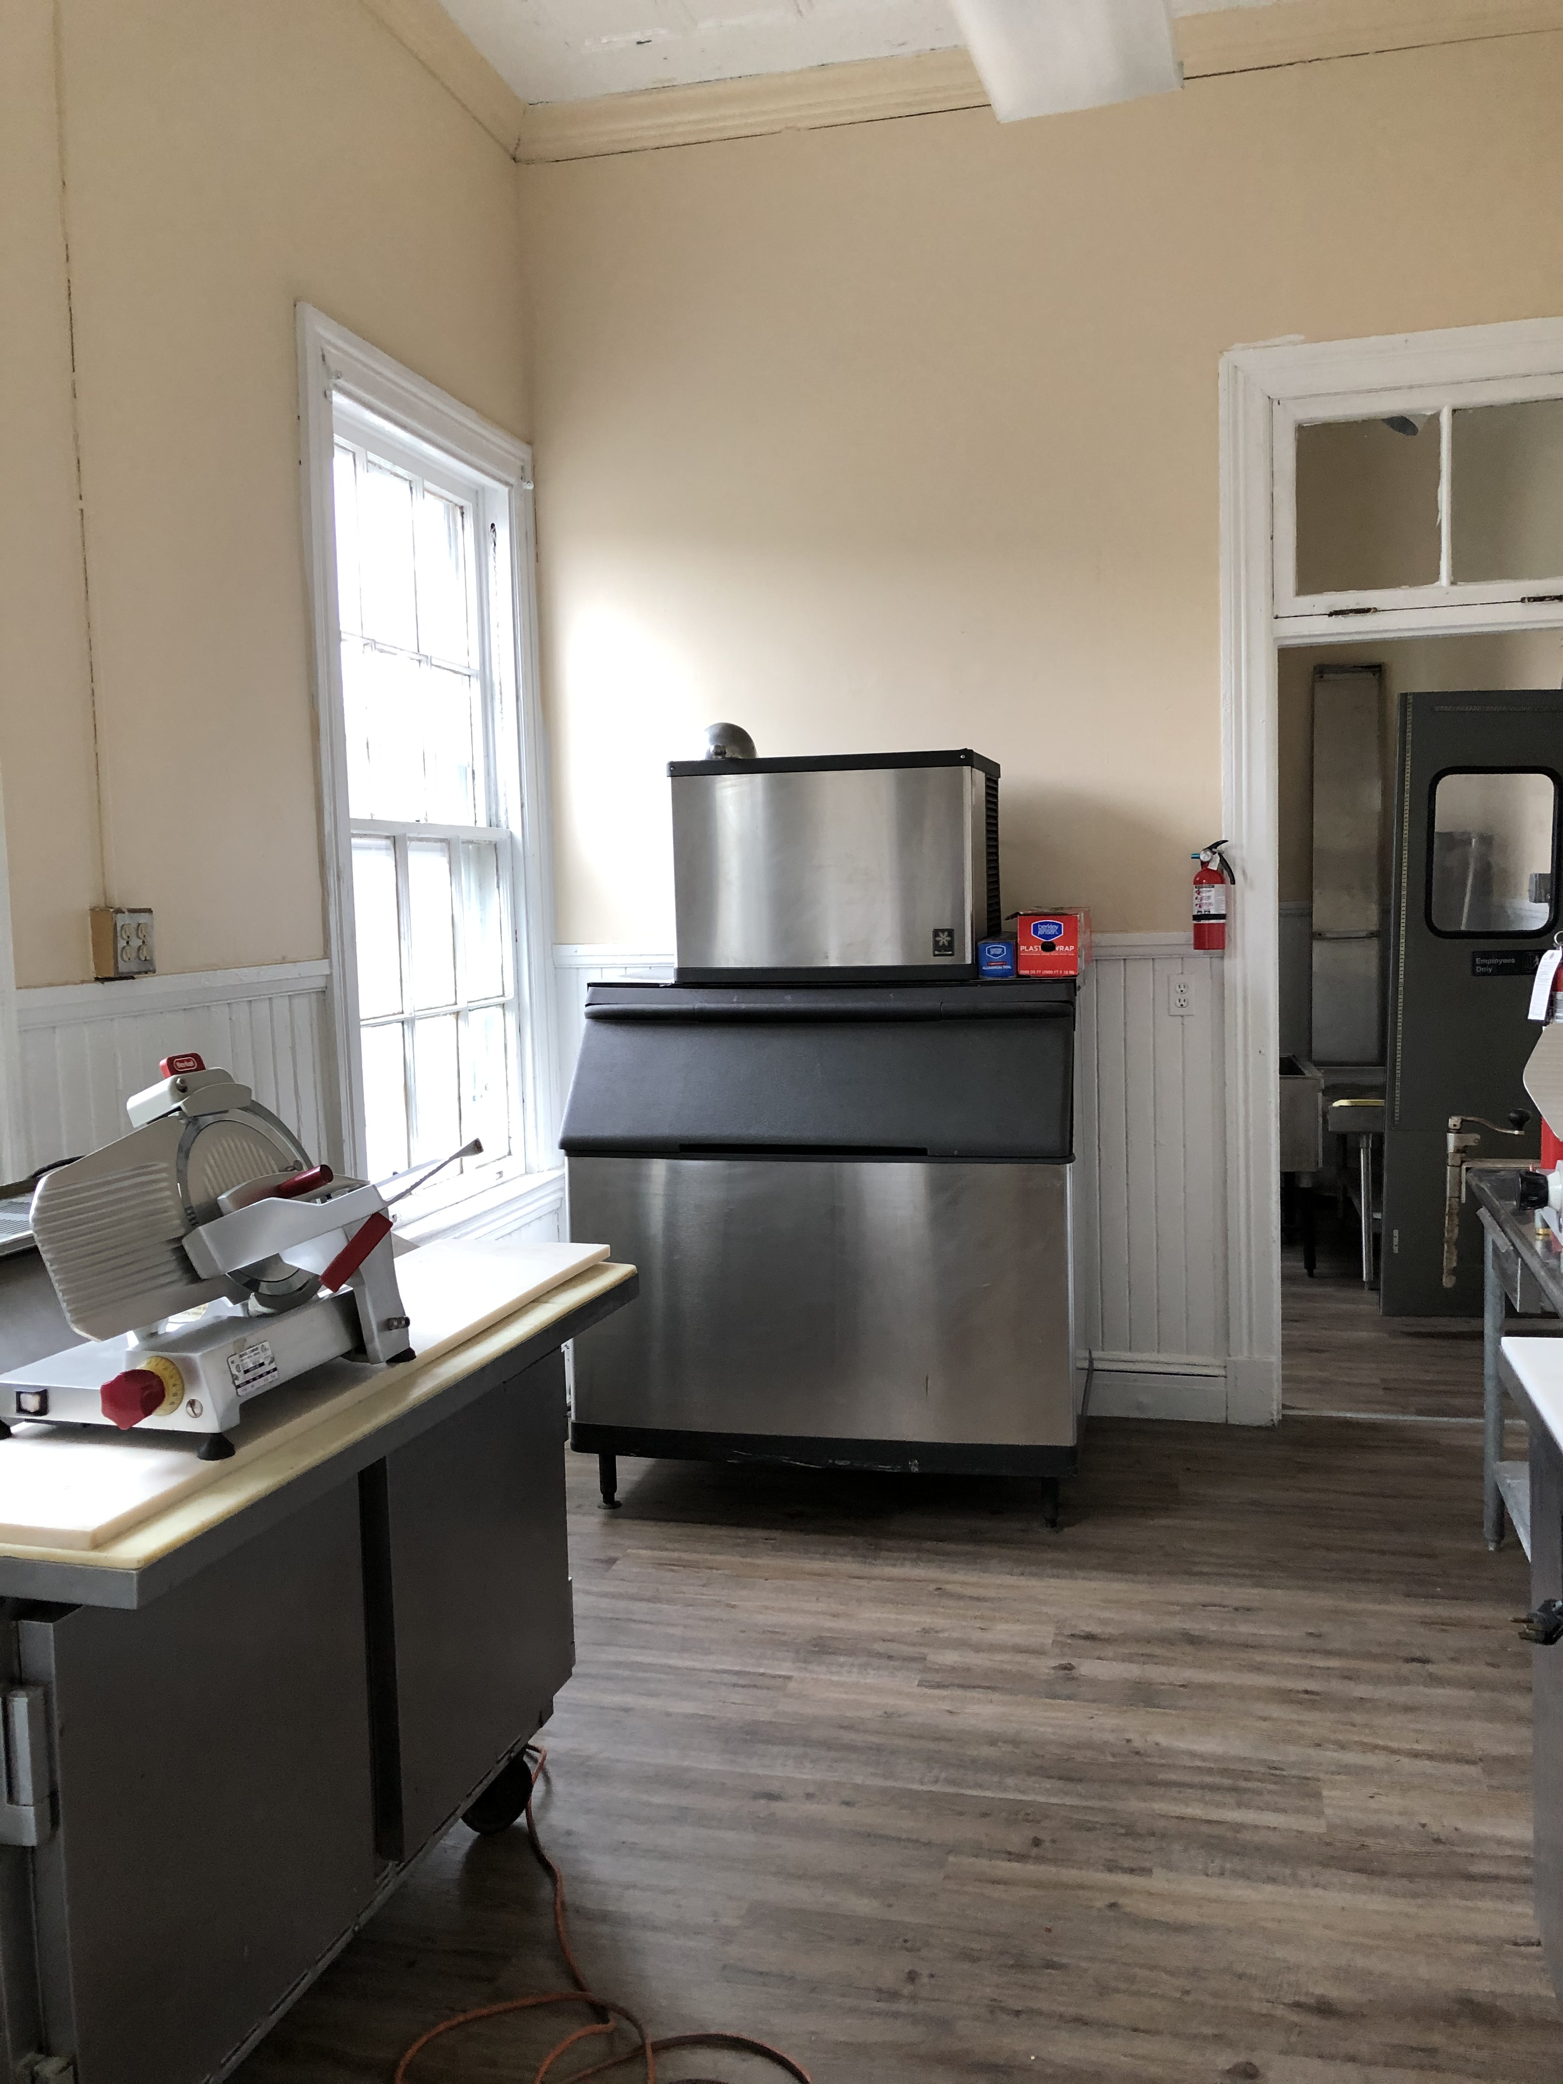
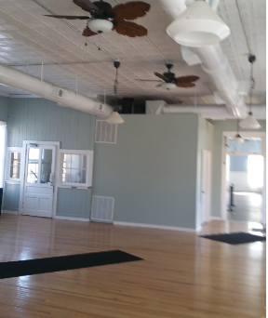
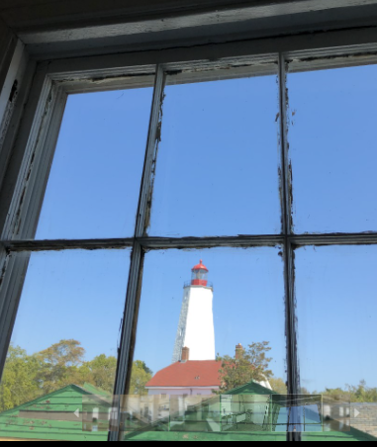
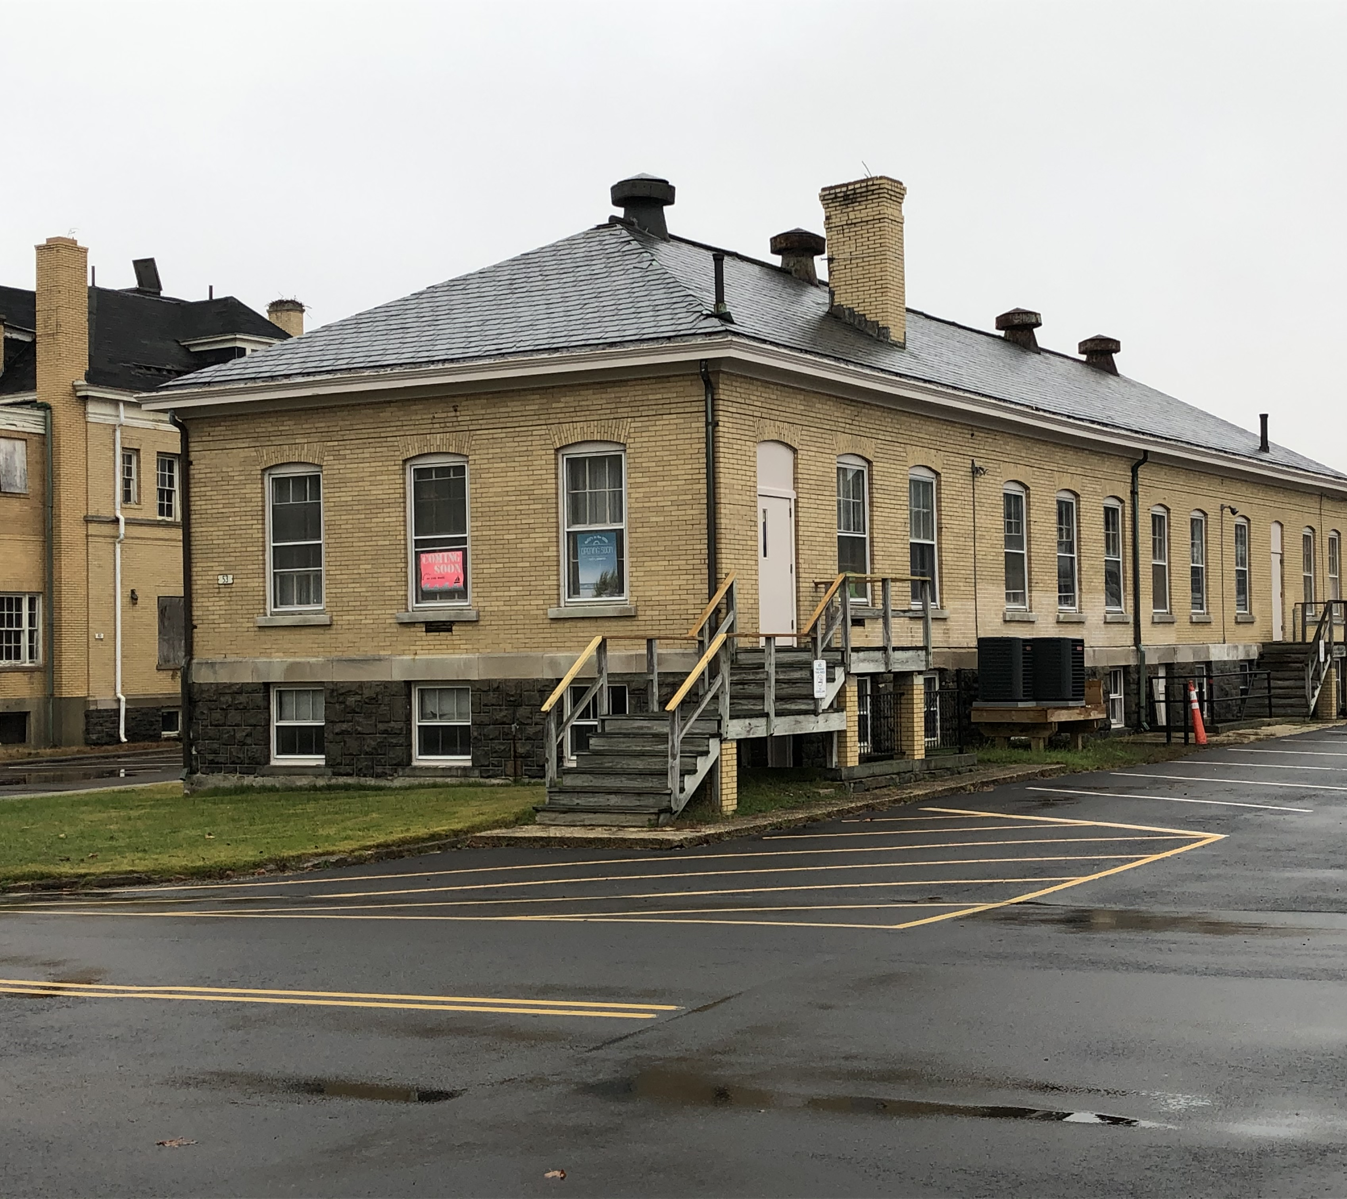
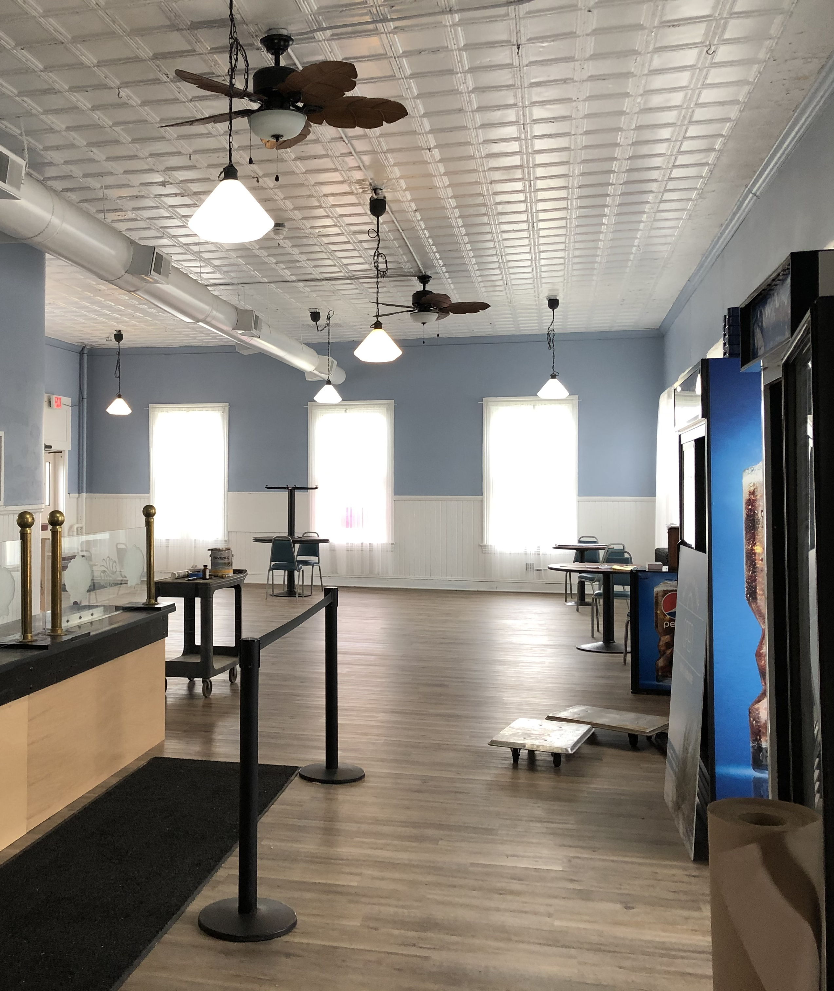
Building 53 ​​
Gateway National Recreation Area
Just opened!
McFly's at the Hook
Notes:
Building 53, which just opened within the past week or so as a deli and sundries spot

Slide 31
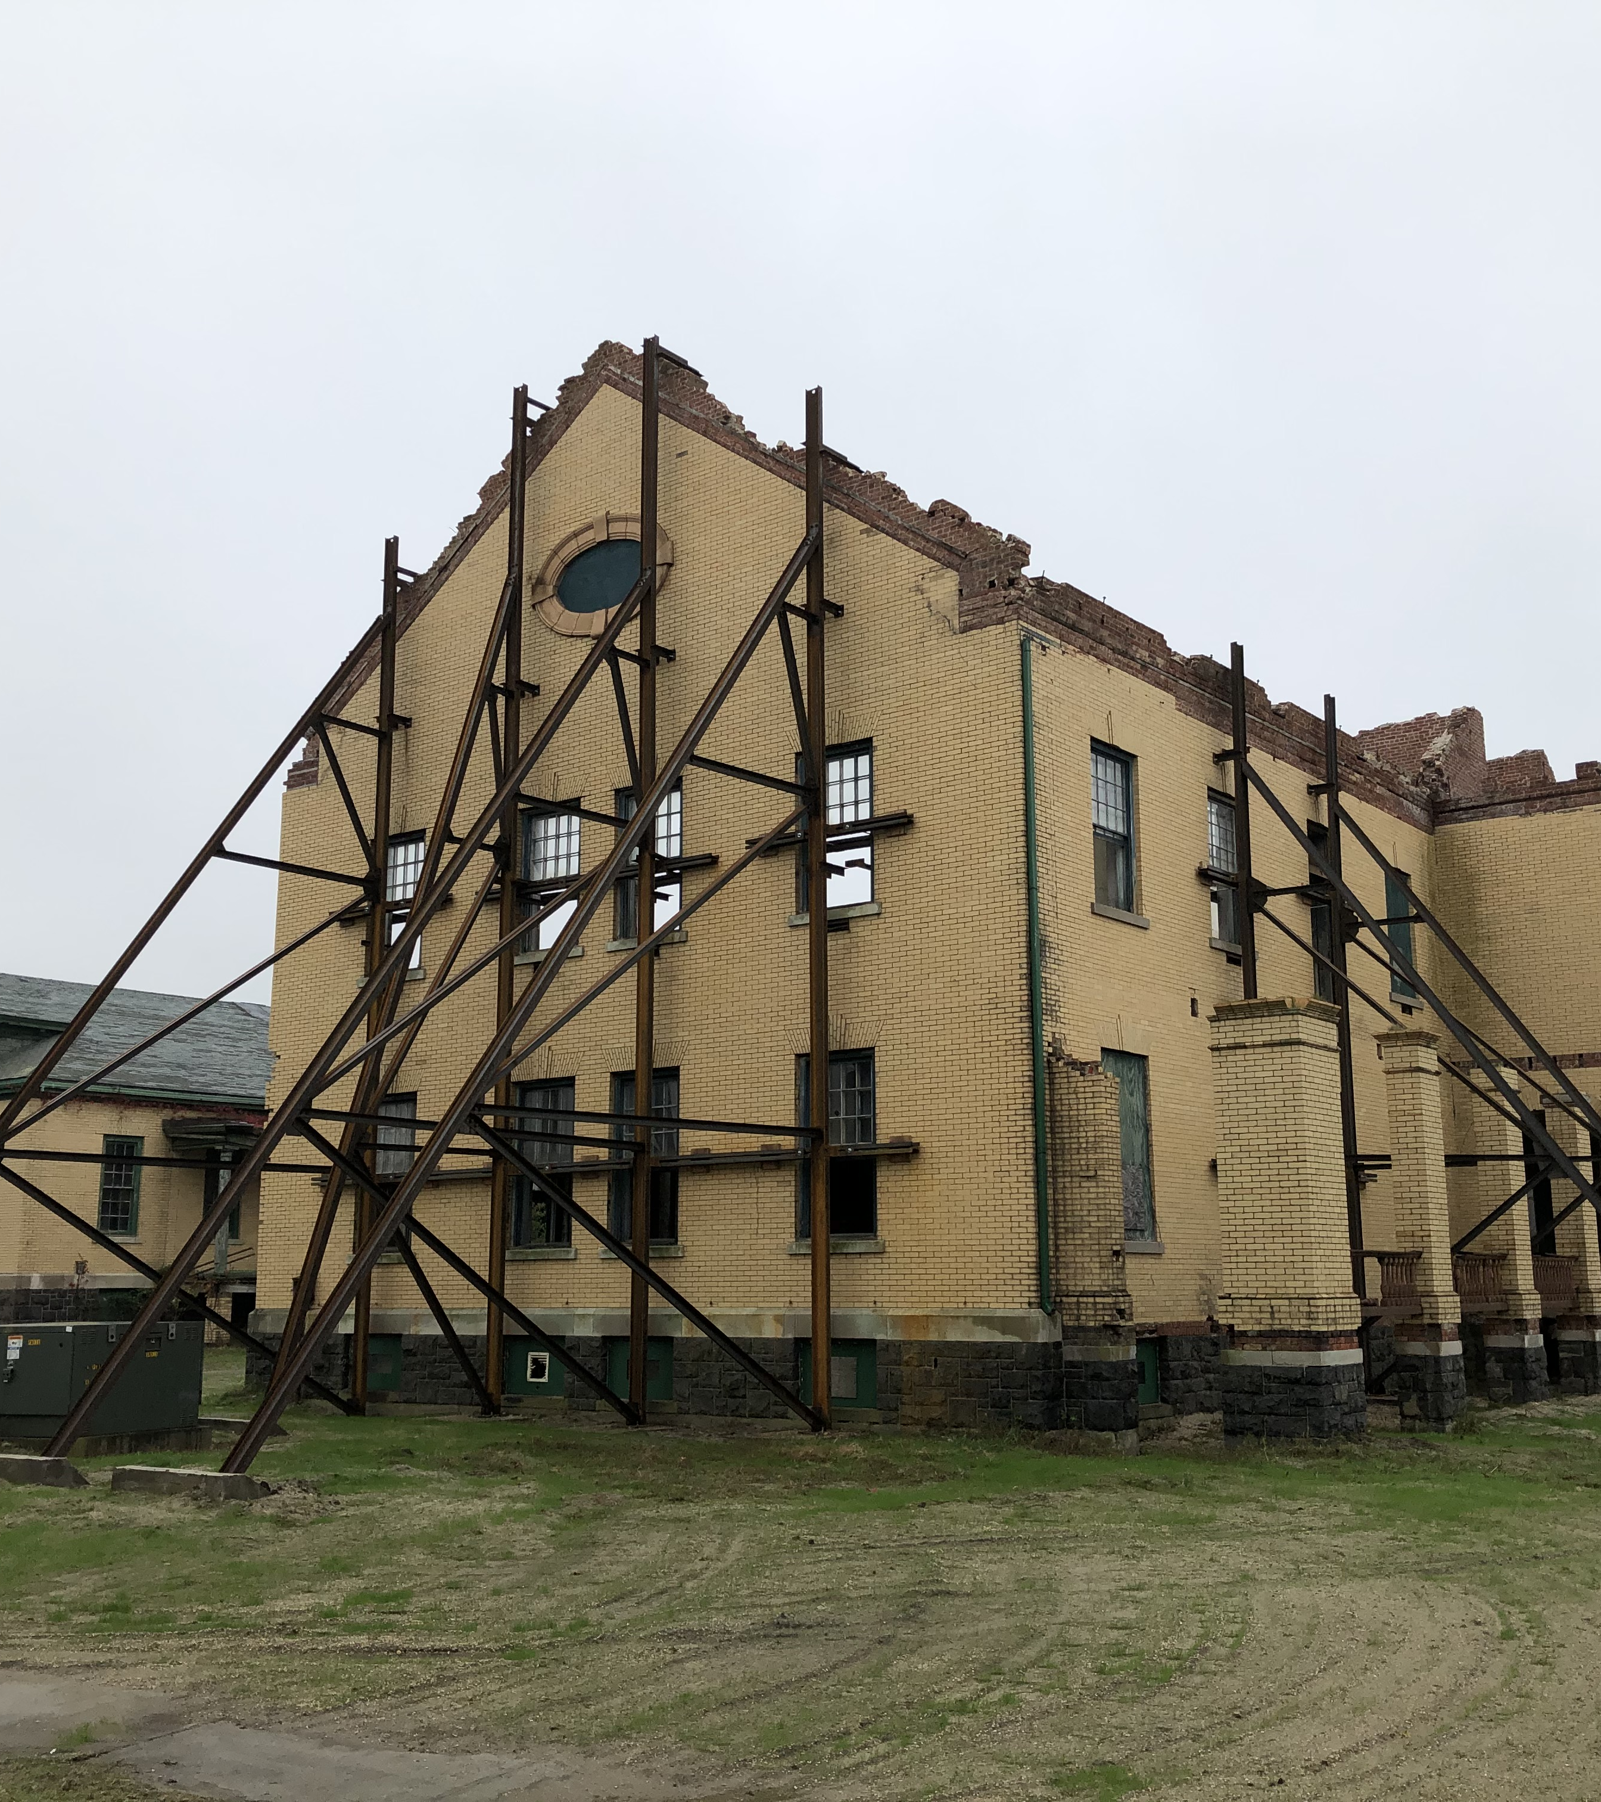
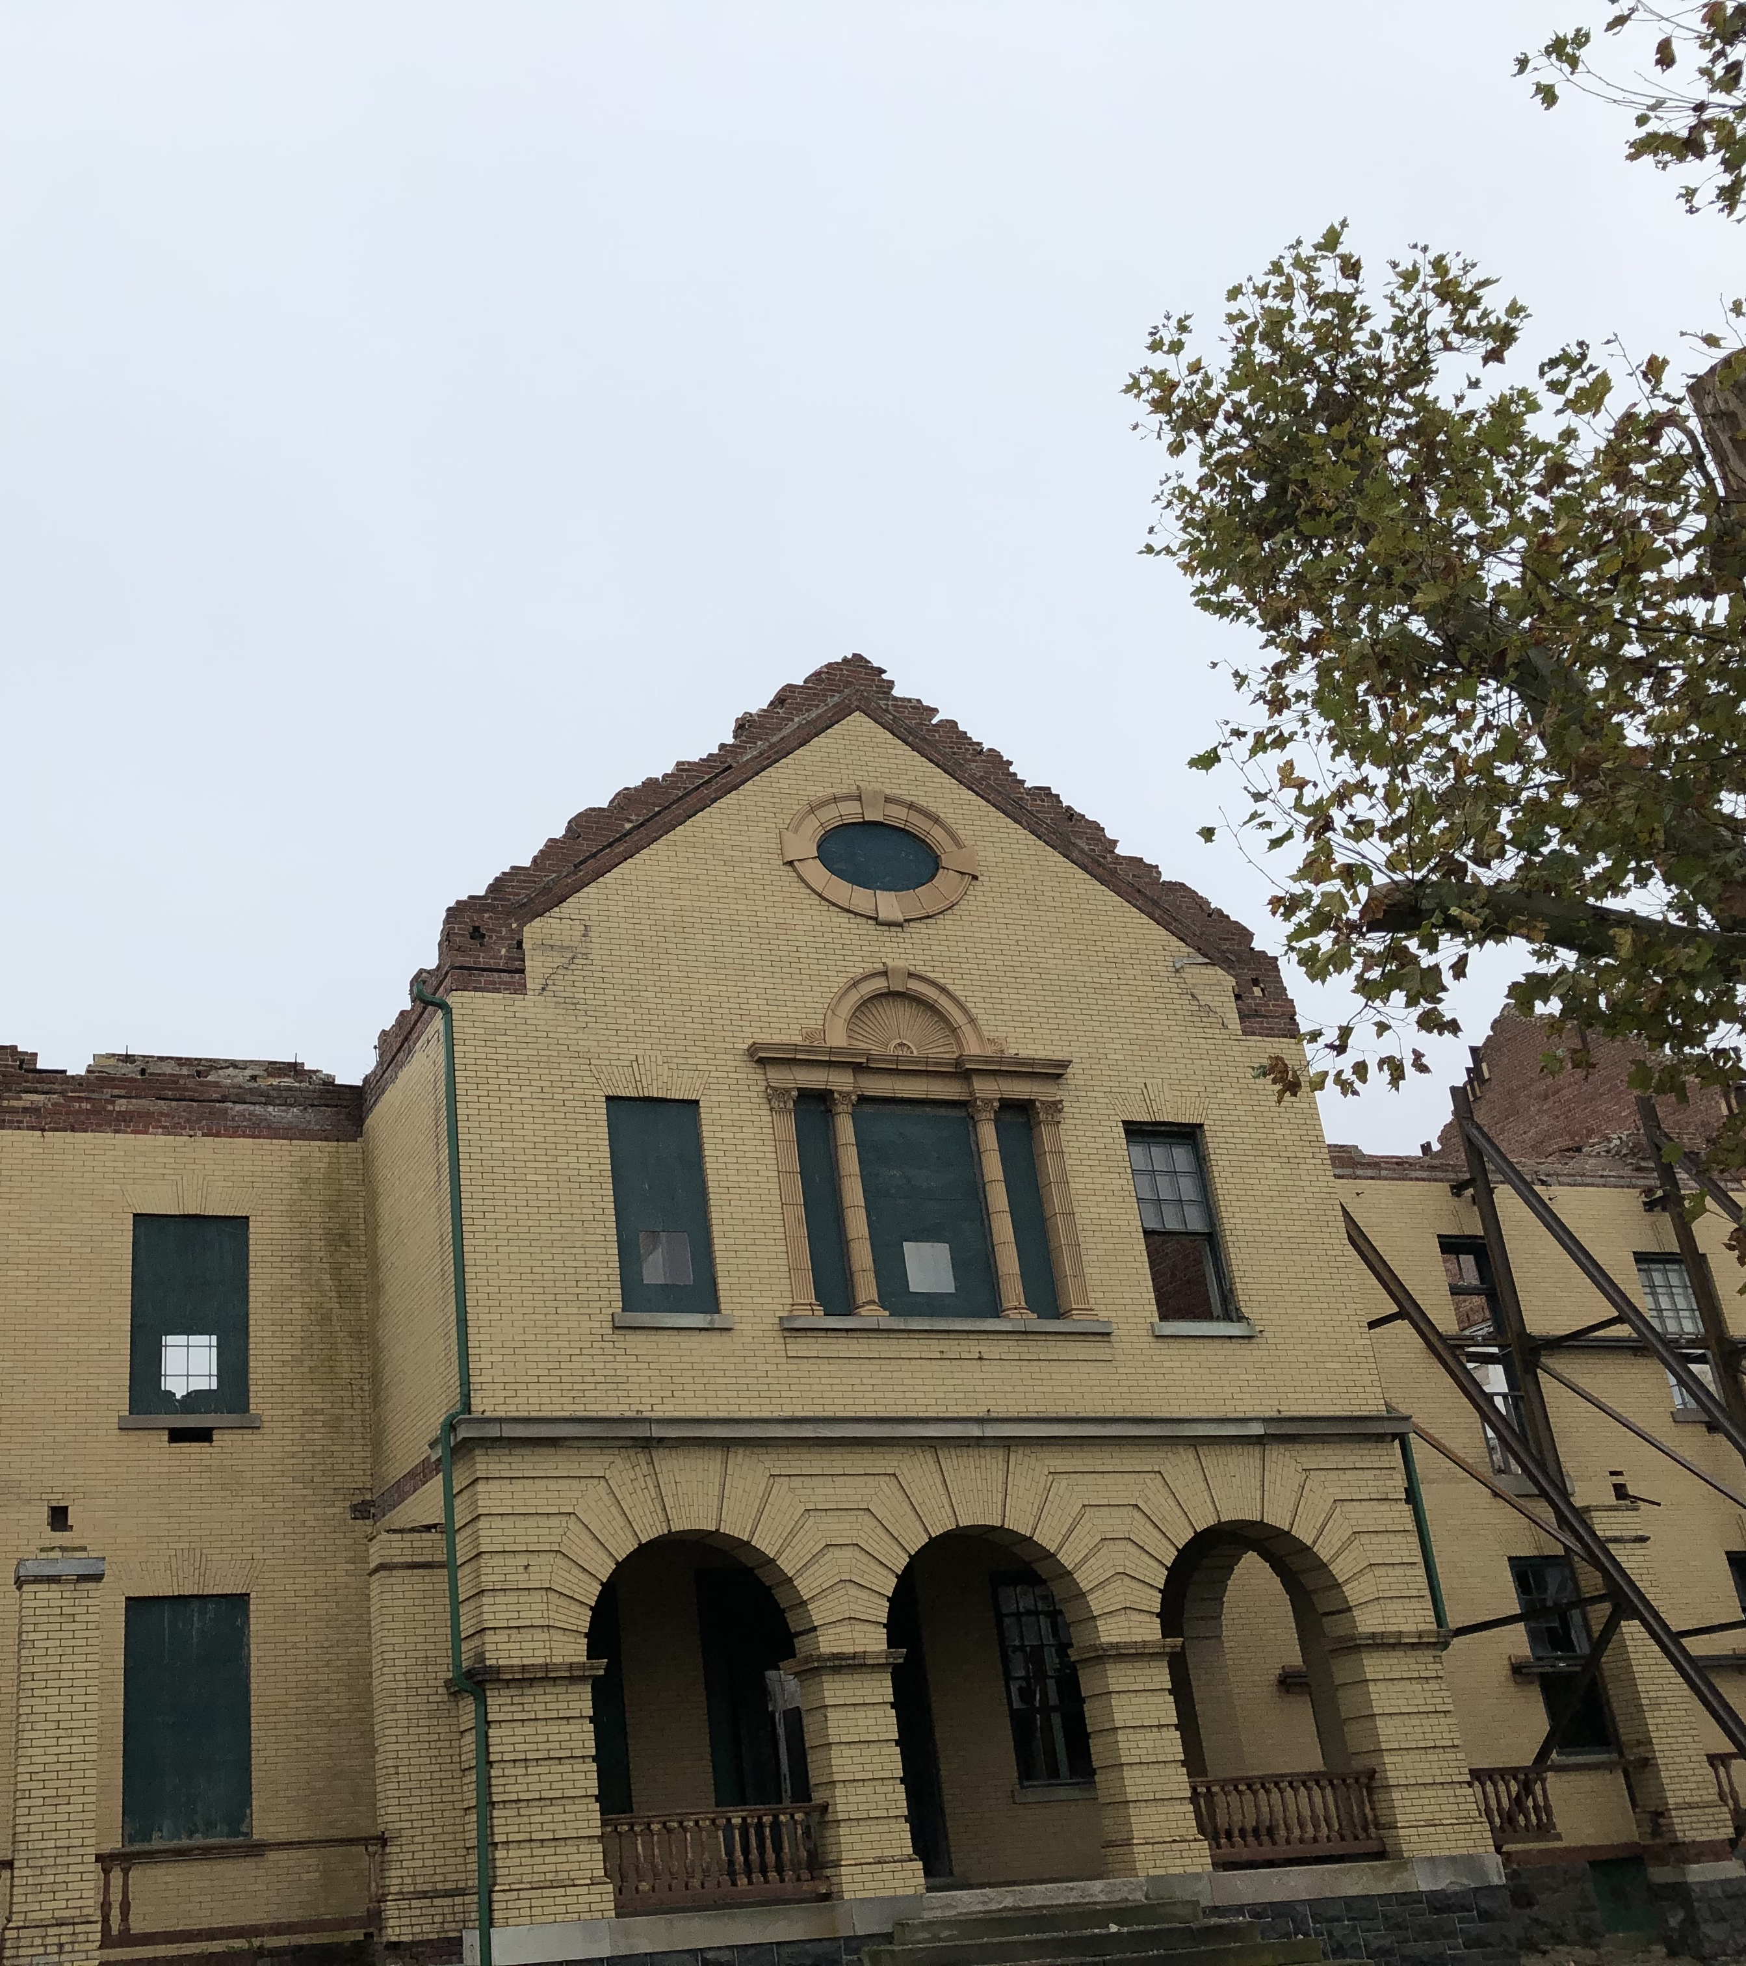
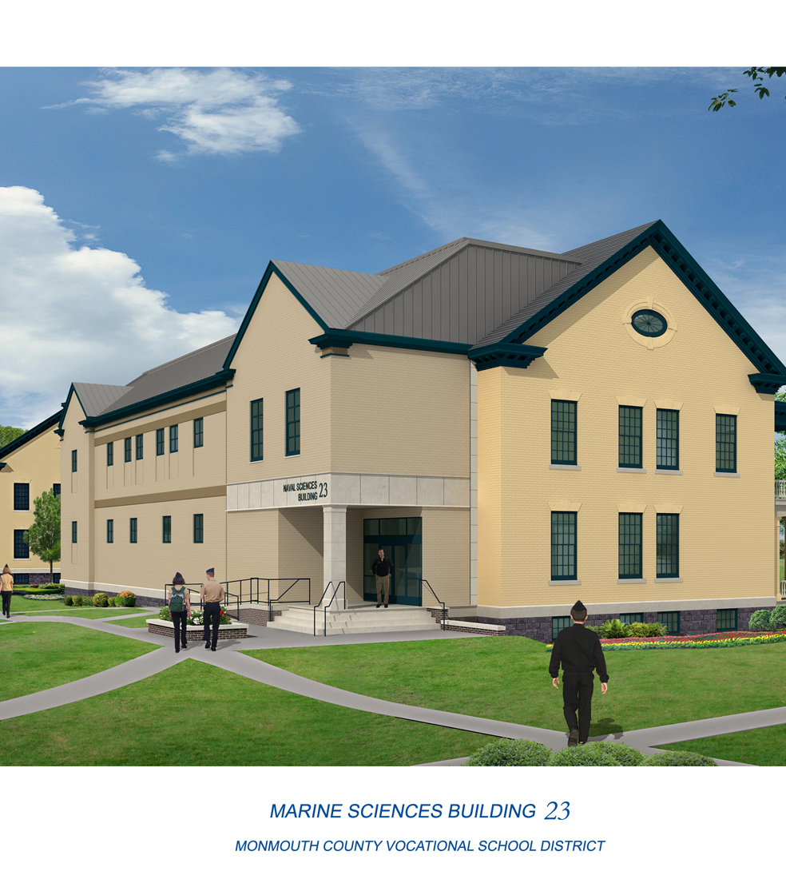
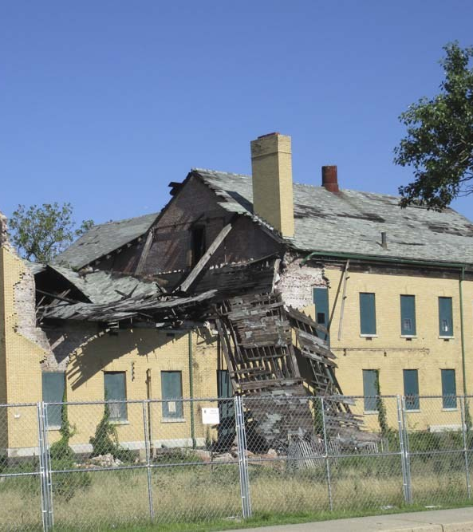
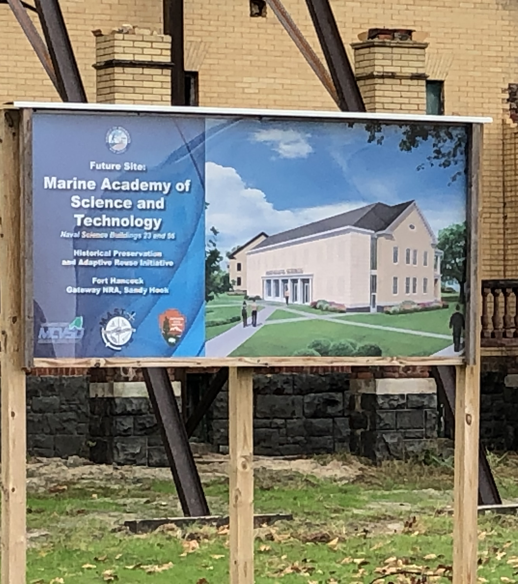
Building 23​
Gateway National Recreation Area​
Sandy Hook
All Purpose
classroom, gymnasium, office
Notes:
Building 23, which along with building 56 is being rehabilitated for use as part of the Marine Academy of Science and Technology, a Monmouth county high school located at Sandy Hook

Slide 32
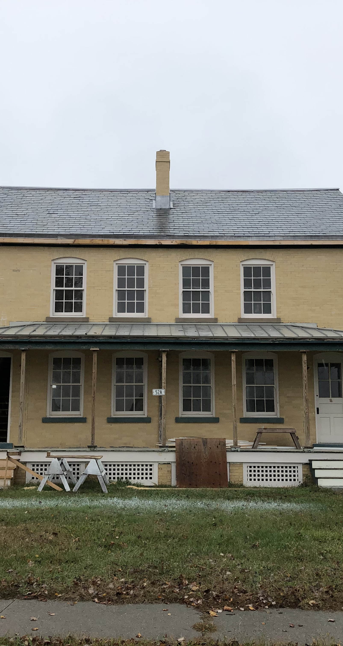
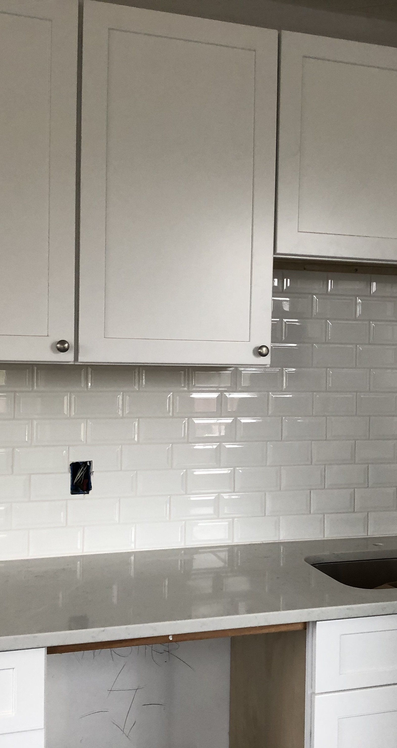
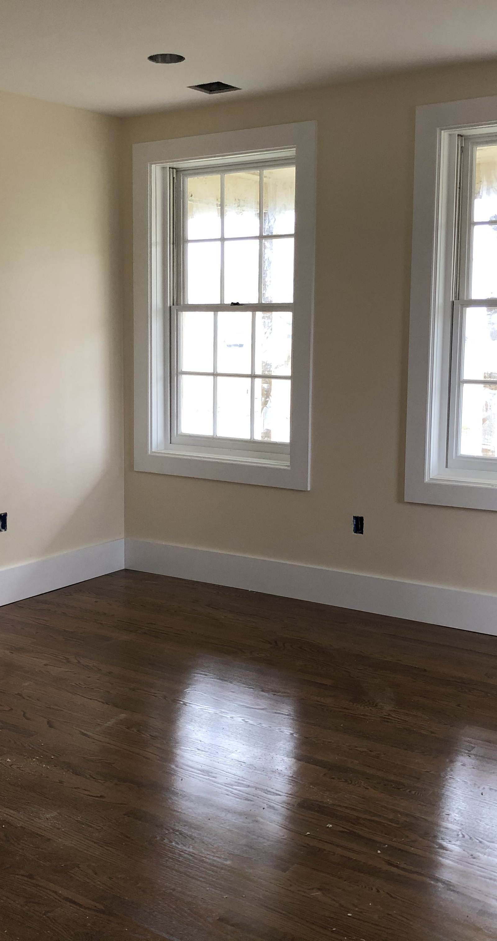
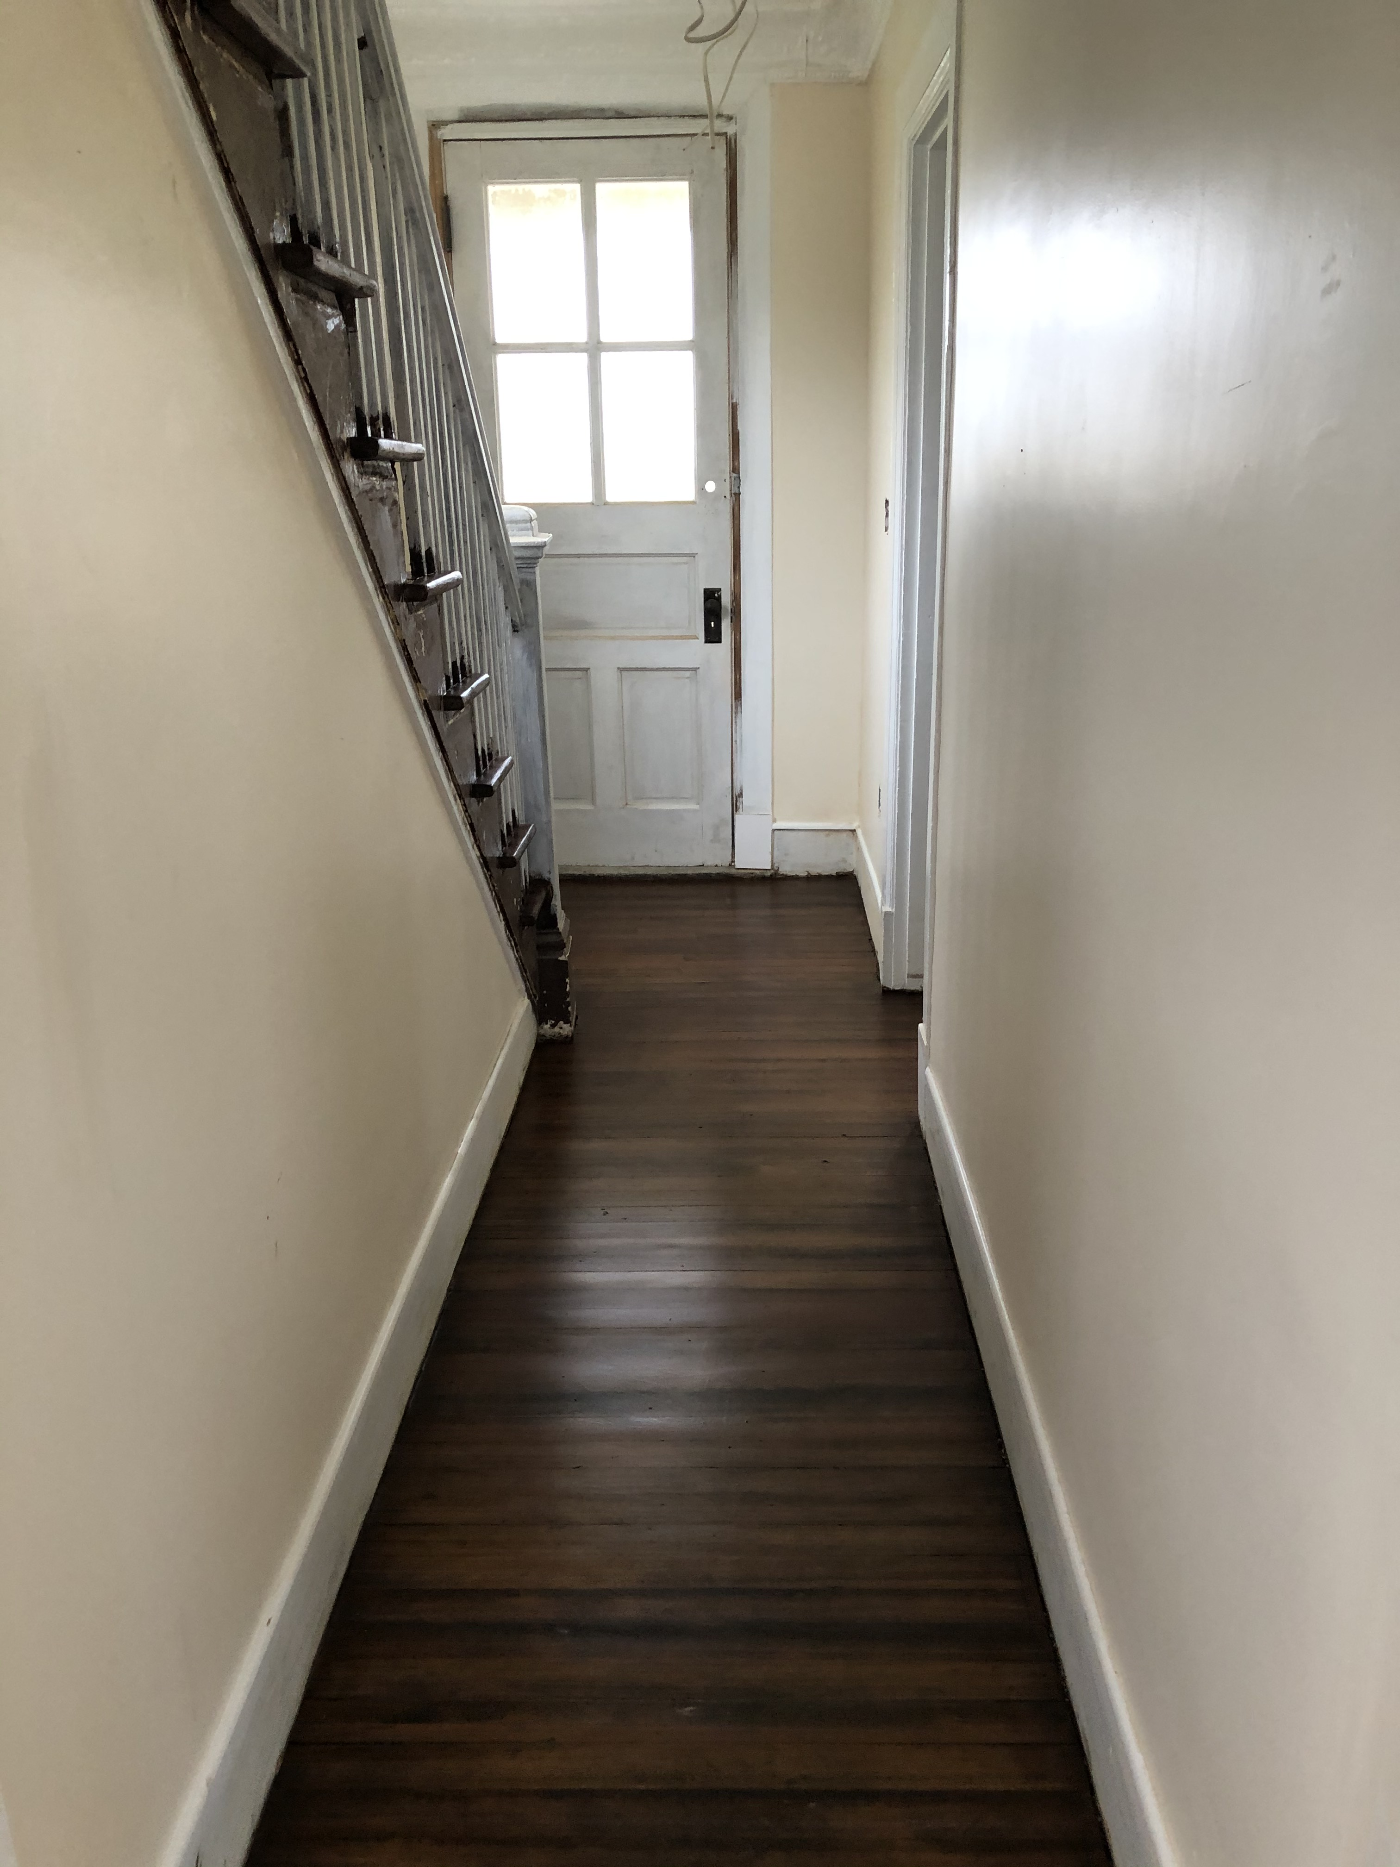
Building 52
Gateway National Recreation Area
Sandy Hook
Residential Duplex
Notes:
Short or long-term residential?

Slide 33





Building 104
Gateway National Recreation Area
Sandy Hook
Office/Residential

Slide 34



Chapel
Gateway National Recreation
Sandy Hook
The Chapel was rehabilitated by a prior Lessee and is now managed by NPS.
The Chapel is typically booked for events two years in advance.
Notes:
We also do short-term leasing at the Sandy Hook Chapel, which is a very popular venue for weddings and other events.

Slide 35
BLD | Type of Facility | Proposed Use
24 | Barracks | Bar/Restaurant and multi-unit residential
25 | Barracks | Bar/Restaurant and multi-unit residential
36 | Mule Barn | Bar/restaurant, event space, some retail
40 | Gymnasium | Event Space. Dining.
114 | Officers Club | Event Space. Dining. Lodging.
Buildings currently subject to Letters of Intent (LOIs)
Notes:
We also currently have another five buildings under letters of intent. This is the agreement we typically sign when we receive a successful proposal, to start a period of due diligence work where we flesh out a project concept to test whether it is feasible. This is when: design drawings are developed, consultation with the SHPO takes place, and, if everything is heading in the right direction, lease terms are negotiated. Only when we arrive at a complete package that is acceptable to all parties do we sign a lease and allow construction to begin. As you can see, this includes several multi-unit residential developments, as well as bars and restaurants and event space. We have been under these letters of intent for several years now as we work through the design process, and are getting very near to signing some new leases.

Slide 36

PROPOSAL
Stillman Development International, LLC.
21 Buildings
107,252 SF
  Lieutenants Quarters Buildings 2, 3, 4, 5, 6, 7, 8, 16, and 17.
  Captains Quarters Buildings 9, 10, 11, 13, 14, and 15.
  Commander’s Quarters, Building 12.
  Gas Station, Building 60.
  Mess Halls, Buildings 55 and 57
  Civilian Family Quarters, Building 80
HIGHLIGHTS
93 Apartments (Short-term, Long -term, Corporate, and Seasonal)
Building 60: Bodega” type facility with liquor license
Building 80: Short-term use to support adjacent wedding chapel
Notes:
Early this year we received a new proposal for the balance of the buildings remaining on the RFP, from Stillman Development International. Their submission proposed taking [16] buildings on officers row along with four other buildings on the post, and configuring them into a total of 93 residential units. Additionally, they proposed some ancillary commercial development in buildings 60 and 80. Because this is an initial proposal, it does not contain a high level of detail. We are still at the very beginning of the process where we would flesh out those initial concepts in a way that could ultimately lead to the signing of a lease.

Slide 37



Times Square Theater (historic) New York Retail Conversion 55,000 sf Beyer Blinder Belle Architects NYC EDC Master Lessor
The Schumacher (historic), New York Condominium Conversion 20 Residential Homes Morris Adjmi Architects
Stillman Development International, LLC.
Projects​
The Centurion, New York Condominium Development 47 Residential Homes Pei Partnership Architects with I.M. Pei
Notes:
Here you see some of the other projects they’ve undertaken, including historic rehabilitations.

Slide 38


Balance the Potential Lessee's need to address feasibility and minimize any risk associated with a single Leaseholder ​
General Agreement - Purpose
The purpose of the Agreement is to develop prototype, and to:
Test Feasibility
Advance the initial design
Consider alternatives
Establish parameters
It will also inform the development of the balance of the project.
Notes:
Normally when we receive a successful proposal, our next step has been to sign a letter of intent and move forward with the full project design. However, given that the scope of this project is much greater than previous proposals, and our desire to make sure the concept is feasible for both the park and the developer before committing to anything further, we are looking at a slightly different agreement structure. This would be to enter into a General Agreement with a phased approach under which we would pilot designs for just a couple of the buildings to test the concept before doing anything on a larger scale. This gives us the opportunity among other things to better understand whether the modifications being proposed could be accomplished under the historic guidelines, and explore variations or refinements on the original concepts that might improve the project. Phasing it in this way also gives us the opportunity to evaluate the impacts of re-introducing a higher level of use at the site, and develop the appropriate strategies for managing those as we move the concept forward.

Slide 39



Balance the Developer's need to address feasibility and minimize any risk associated with a single developer ​
General Agreement
Safeguards
The project will be completed in phases to:​
​Allow for the development of a comprehensive concept plan​
​Provide certainty that the project is financially feasible based on the outcomes of the first phase​
​Ensure SDI has the financial capability necessary to complete the project as anticipated ​
​
Notes:
In the end, we need a project that works for the park in terms of accomplishing our preservation goals as well as in its compatibility with the overall management of the site; and it needs to work for the developer from both an investment and management perspective as well. Like a letter of intent, the general agreement is non-binding if we are not able to find that sweet spot; but as long as we are still moving forward together, it holds these buildings in reserve as per the terms of the RFP.
If the design pilots are successful, and it looks like we have a feasible project, we will move on to more buildings.

Slide 40

ADAPTIVE
RE-USE THROUGH PUBLIC PRIVATE PARTNERSHIP
While federal funding does some great things for public lands, federal funding alone is not sufficient to address all the park's deferred maintenance projects
Our best tool is to leverage our leasing authority and focus on adaptive re-use of underutilized facilities
Notes:
So that is the overview of the current proposal at Sandy Hook. Both here and across the agency we see historic leasing as a primary tool for accomplishing our preservation mission. Even if we were able to fund the full restoration of these buildings with federal dollars, as I said before, an empty building rapidly falls into disrepair – so we would still be looking towards leasing as our means of keeping these buildings maintained and vibrant for the long term.
At a site like Sandy Hook, the public benefit that will be accomplished is a fully restored historic landscape that visitors will continue to have full access to get that first=hand feel of what life was like here during the heyday of the fort.

Slide 41
Public Benefits of Leasing
Value to Public
Preservation of Historic Landmarks properties for future generations
Enhancement of Cultural landscape
Provides the NPS opportunities to reallocate funding towards public programming, safety, and amenities to enhance the visitor experience.
Increases opportunities for the public to use the resource through lodging and dining experiences that are currently not available
Financial value to Park Service
Transforms underutilized real property
Leasing revenue can be used to finance repairs, renovation, infrastructure, and maintenance of park facilities
Modernizes assets
Park facilities can be refurbished with private sector development expertise and financing
Long-term planning and financing ensures assets continue to be well-maintained, enhancing the National Park Service mission
Preservation and Community Enhancement
Fosters economic growth in the local community
Can help fund historic preservation and maintenance costs
Provides unique experiences to Park visitors and engages the local community
More effectively achieves the NPS mission, providing for enjoyment while protecting resources
Occupancy is the best method to achieve historic preservation
Notes:
Here you can see those benefits articulated in more detailed form.

Slide 42

David Walker Farmstead Montessori School
Valley Forge National Historical Park
Notes:
And here we have a look at some other successful leasing initiatives around the NPS.
The proposal was to lease David Walker Farmstead to the Montessori Children’s House of Valley Forge for rehabilitation and re-use as a pre-school. All Funding being provided by MCHVF – no Government funds being invested.
The Farmstead is a significant contributing feature of the park’s cultural landscape
The park’s GMP determined that there is no feasible or necessary visitor or operational use currently or for the foreseeable future for the buildings and property
Project provides preservation and on-going maintenance of over 18,000 sq./ft of park assets
Benefits to Valley Forge NHP:
Elimination of deferred Maintenance
Rehabilitation and re-use of existing structures
Demolition of derelict non-contributing structures
Potential Revenue

Slide 43


Fort Mason Center Port of Embarkation
(1977-Present)

Slide 44



Upper Fort Mason Residential Program
(1998-Present)

Slide 45


Presidio (1994-Present)

Slide 46


Fort Baker Redevelopment (2005-Present)

Slide 47



Cape Cod short term residential rentals
Notes:
Cape Cod National Seashore has had residential leases in place since 1989. The park currently has 8 long term leases for long term residential use for terms between 10 and 45 years. ​Additionally, the park has 6 additional residential properties that are rented out on a weekly basis. There are at least a dozen additional leases in the pipeline for residential uses. ​

Slide 48


Gateway National Recreation Area
http://www.nps.gov/gate/index.htm
National Park Service
U.S. Department of the Interior

Slide 49
Perspectives on Leasing at Fort Hancock
Congressman Frank Pallone
Monmouth County Freeholder
Lillian Burry
Notes:
Start off the evening with two speakers:
Gateway Superintendent Jennifer Nersesian on leasing – history, context and current proposal
Opportunity to hear from Roy Stillman
If time, take some Q&As in the Q&A box.
Will then get perspectives from a couple of electeds and then into public comment

Slide 50


Opportunity for Public Comment
  To contribute to the discussion
Raise a “virtual” hand
Add a comment to the “Chat”
Public participants asked to limit remarks to 1 minute so others may contribute
News media invited to contact Gateway staff directly
Notes:
Eager to hear your thoughts – also want to be respectful of everyone’s time and long days in Zoom – ask speakers to do their best to keep remarks to 1 minutes - I will gently remind
If needed, will go past 8….but like to do that to accommodate many people, not long speeches.
Focus this time on public; news media invited to contact Gateway separately

Slide 51
Wrap-Up & Next Steps
Workshop recording to be made available on FACA and Gateway webpages
If additional comments, please email Gateway at: Gateway_Feedback@nps.gov
Opportunity for future discussions on Fort Hancock leasing
Media invited to contact Daphne Yun, 917-282-9393, or via email at Daphne_Yun@nps.gov
Notes:
Recording to be made available on FACA and Gateway webpages
Additional

