Slide 1




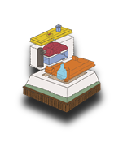


National Park Service
U.S. Department of the Interior
START
Fort Matanzas National Monument
ICONS TOUCH FOR:
SOUND
ZOOM OUT
HOME PAGE
ZOOM IN
BACK
FORT PAGE
+
FORWARD
MORE

Slide 2



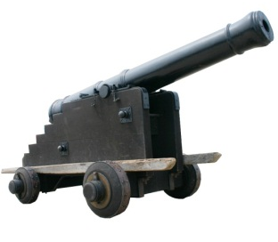
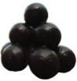
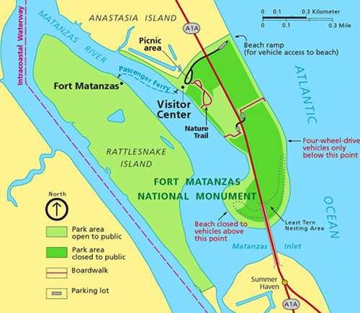
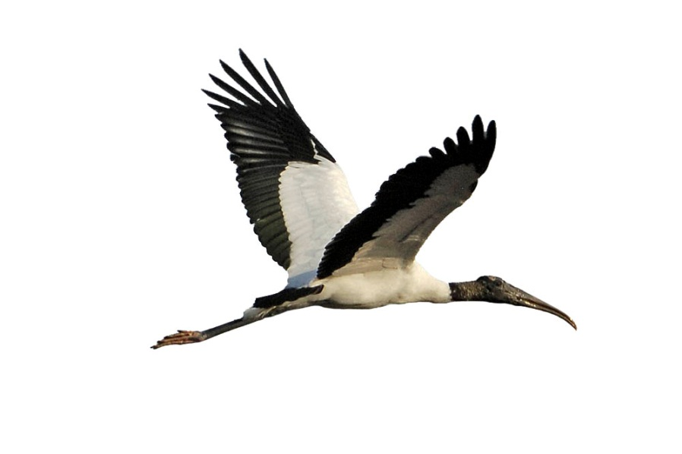
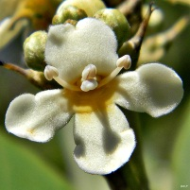
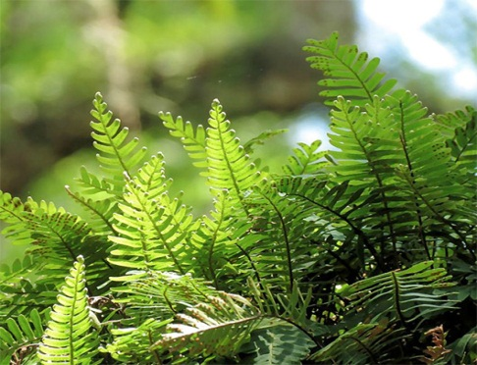
National Park Service
U.S. Department of the Interior
Touch the speaker
to hear instructions
Fort Matanzas National Monument
History
Fort
Park
Map
Plants
Wil
dlife

Slide 3
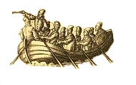

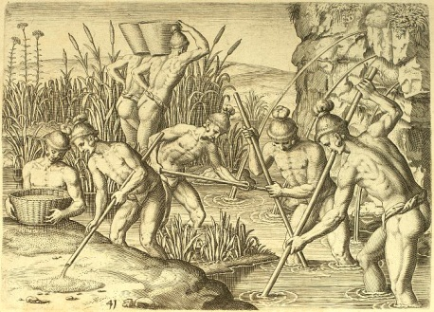



HISTORY
For over 4,000 years, the natives of this area used this shore for hunting and gathering food. In warmer weather, they established camps along the seashore. During colder weather, they retreated into the interior to villages where they grew corn and hunted game.
+
Then, just a few hundred years ago, large
ships began traveling along the coast.
These ships stopped and interacted with
the natives, trading, gathering supplies, and slaving. These early explorers were from many different countries. One explorer, the former Governor of Puerto Rico, Juan Ponce de Leon, claimed the land for Spain in 1513.
Soon, another European power, France, began exploring the coast. Following years of failure, King Philip II of Spain declared that the land known by the Spanish as “La Florida” should no longer be explored, since it had yielded no great riches. The Spanish had all but abandoned the place, and the French took this opportunity to begin their attempt at settlement.

Slide 4


HISTORY

Slide 5
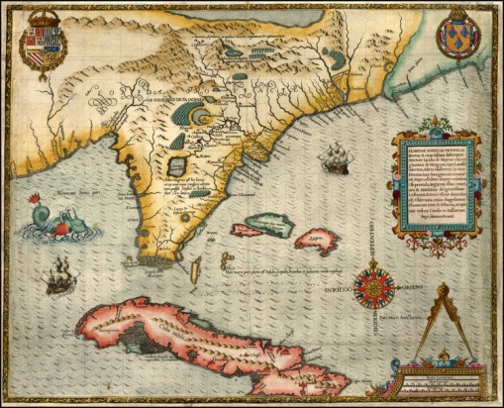

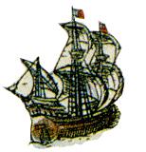
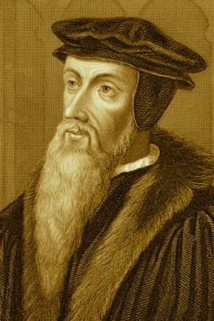
HISTORY
Captain Rene de Laudonniere commanded a French voyage
that commenced in 1564.
Colonists were brought to
settle the land and establish
a permanent colony for
France. “La Floride Francaise”
was located along a river the
French called “la riviére de
mai”, (the River of May).
Known as “Hugenots”, these
French colonist were
followers of the
“new religion” of
John Calvin, referred
to as Lutherans by
the Spanish Catholics.

Slide 6
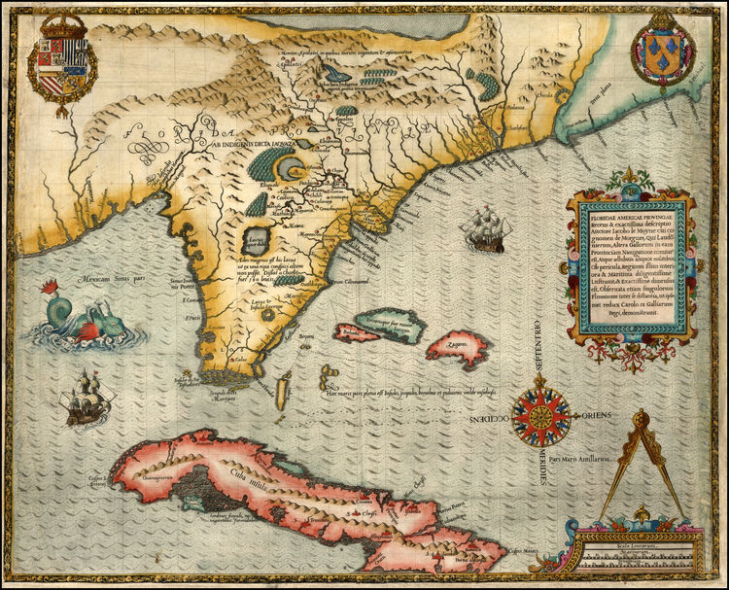


HISTORY

Slide 7
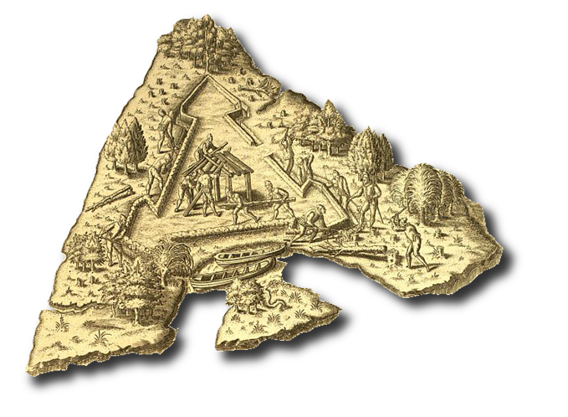
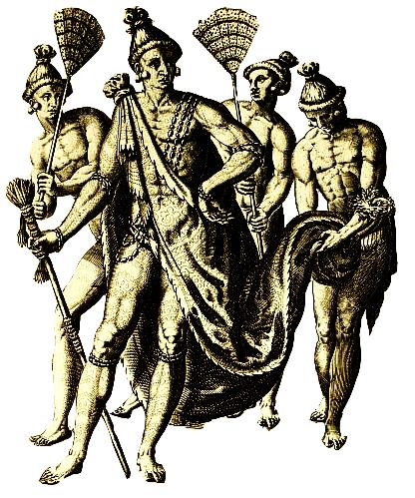
HISTORY
Named “La Caroline” for French King Charles IX, the
colony involved hundreds of settlers. Placed at the
base of “Le Montagne” (the mountain), a one
hundred foot tall ancient sand dune, the
French had the protection of a shallow
bar at the mouth of the river (known
today as the St. Johns) and a tall
lookout to spy enemy ships. There
were corn fields nearby and the welcome
of the natives referred to as
“Timuquans” (Spanish spelling).
Not all went well for the colony. Many sailors were anxious to raid Spanish shipping to the south in the Caribbean and along the Florida coast. Stealing a ship and heading south, some of the French were captured by Spanish authorities and the existence of the French
colony was discovered.

Slide 8
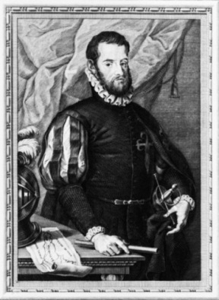
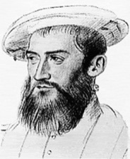

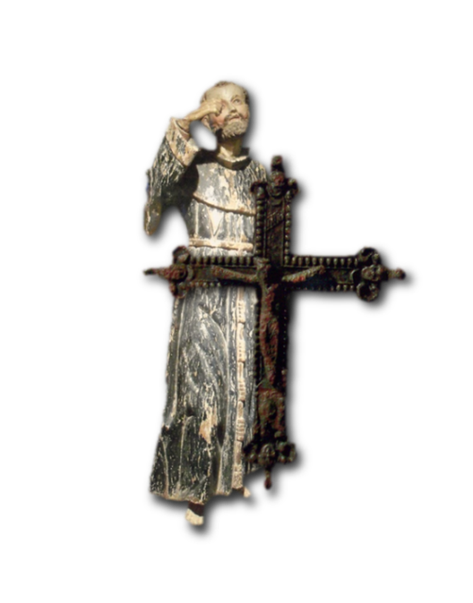
HISTORY
In September of 1565, two fleets arrived in Florida the
same day: one French, under the command of Captain Jean Ribault,
the other Spanish, under the command of Don Pedro Menéndez de Aviles. These two dynamic figures would fight to determine the future of Florida.
After reaching the coast of Florida, Menéndez sailed to the north searching
for the French. He discovered four French ships at the mouth of a river. The Spanish challenged the French ships and attempted to board them, but the French ships cut their anchor lines and managed to slip away.
Menéndez sailed south stopping at the village of Seloy where he started to construct a wooden fort. On September 8, 1565, with the sailors, settlers and Timuquans present, a celebration Mass was offered and “San Agustín” (Spanish spelling) was established for the Spanish empire.
Soon after, the French fleet reorganized and Jean Ribault decided to take the initiative and attack the Spanish. Sailing south with six ships and hundreds of sailors and soldiers, the French fleet was struck by a storm and forced south down
the coast.

Slide 9
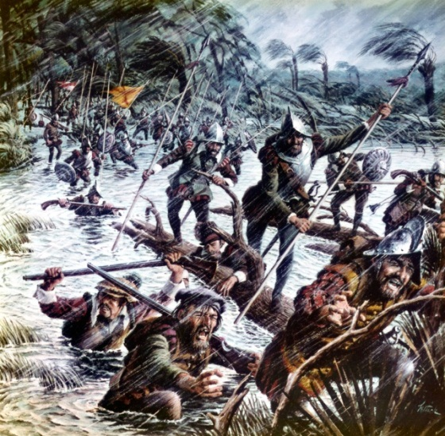

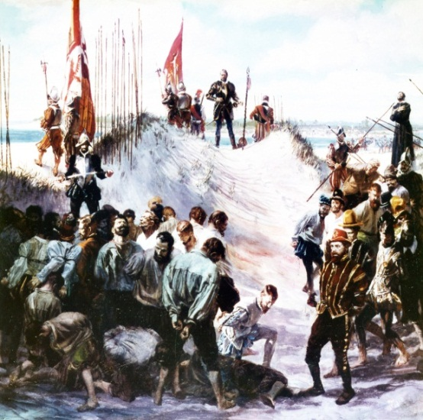
HISTORY
Seeing the French fleet carried south in the storm, Menéndez marched his men north to the French colony in the midst of a “great tempest”, walking through high water and winds. The risky decision paid off for the Spanish and the French colony was easily captured. The fort was renamed “Fuerte San Mateo”.
Returning to St. Augustine, Menéndez soon received a report of men walking on the beaches heading toward the new city. French survivors were heading north, hoping to return to La Caroline. A single natural feature stopped them: the inlet 15 miles south of St. Augustine. In two separate incidents, Menéndez arrived to find exhausted, hungry Frenchmen. On both occasions, the men were escorted across the inlet into the dunes and executed. Among the second group was their leader, Jean Ribault himself. Approximately 250 French were
executed at this place. The Spanish named it “Matanzas” which means “slaughters”. Two centuries later, this place would again serve to protect the Spanish in Florida against yet another European adversary: the English.

Slide 10
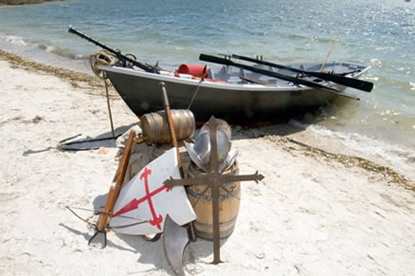
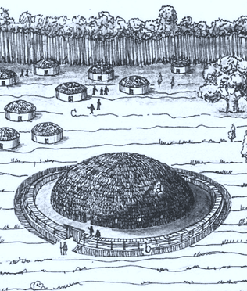
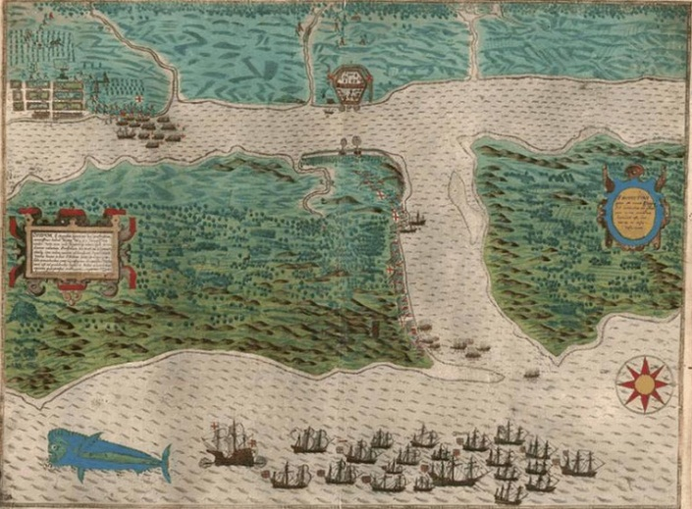
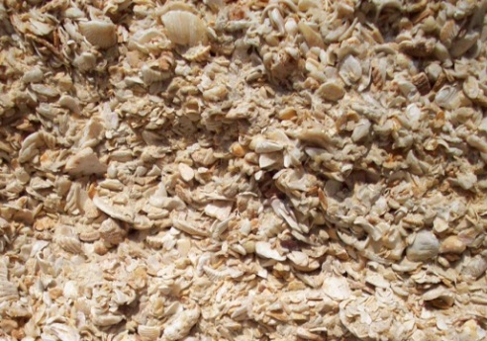
HISTORY
From “Fuerte San Juan” (1565), built in the native village
of Seloy, to the completion of the Castillo de San Marcos
(1695), the presidio of St. Augustine had nine wooden
forts. During this time, the community suffered from
natural and man made destruction.
In 1586, English privateer Francis Drake raided and burned the presidio, killing hundreds. In 1668, English pirate John Davis, also known as Robert Searles, raided the presidio, capturing and killing many. Due to these attacks and the establishment of the English colony Charles Towne, South Carolina, the Spanish monarchs authorized the construction of a stone fort.
The project would involve
hundreds of skilled workers,
slaves, natives and almost
a quarter of a century. Most
importantly, this was to be
built of the only available
stone. Made up of billions of small shells, it is known as “coquina” ( Spanish for small shell).

Slide 11

HISTORY

Slide 12
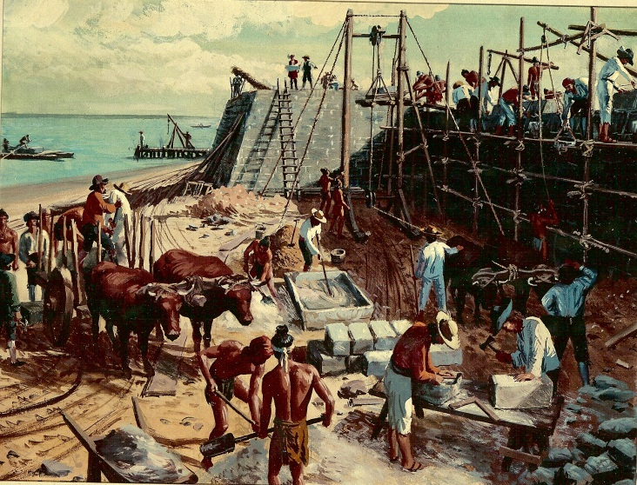

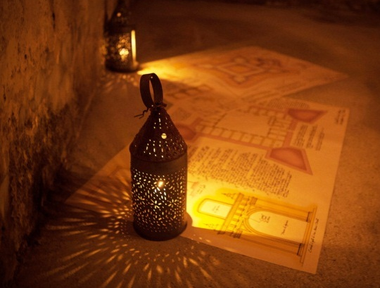
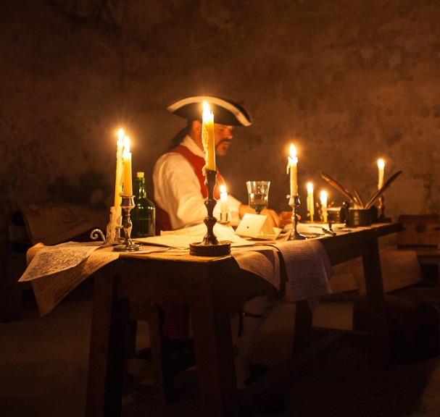
HISTORY
The small shells collected under the water and were naturally compressed into a soft material capable of stopping 18th century musket balls and non-exploding cannon shot. Most importantly to the townspeople, it could not be made to burn. It was safe and fireproof.
The ingredients for the fort were simple enough: water, sand, oyster shells, timber and coquina stone. In August of 1695, the fort was finally finished.
In 1702, Governor James Moore of Charles Towne invaded Florida and besieged the fort. The Castillo defended the population for more than 50 days, but the presidio was destroyed again. It was time for Spanish officials to design and implement a complete defense system.

Slide 13

HISTORY

Slide 14
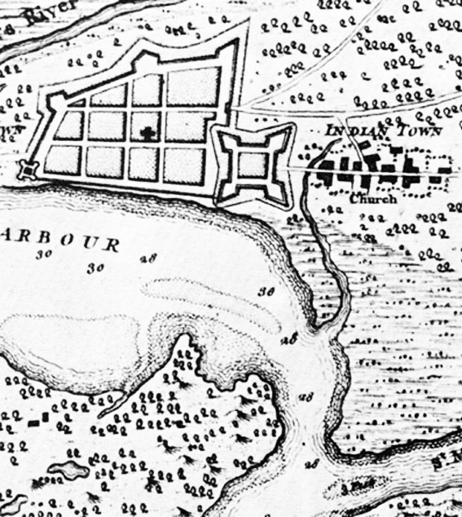
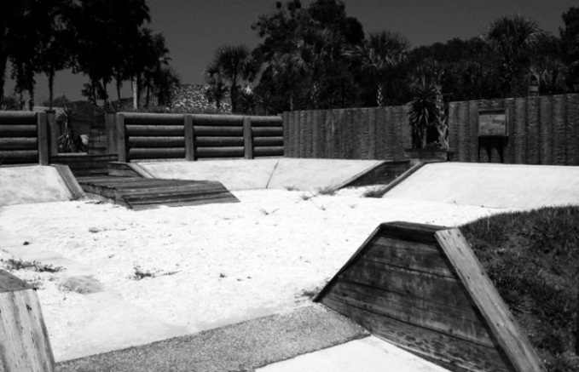

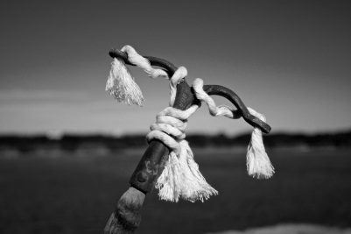
HISTORY
The new defense system began with the construction of walls enclosing the entire presidio. Although made of palm logs, this wall would give defenders a perimeter and gates to challenge an enemy. Redoubts were built along the wall for the placement of artillery. Even with the addition of two forts guarding the St. Johns River some 20 miles west and the large cattle estate 18 miles north at
Diego Espinosa’s hacienda,
there was a glaring weakness
in the system: Matanzas Inlet.

Slide 15
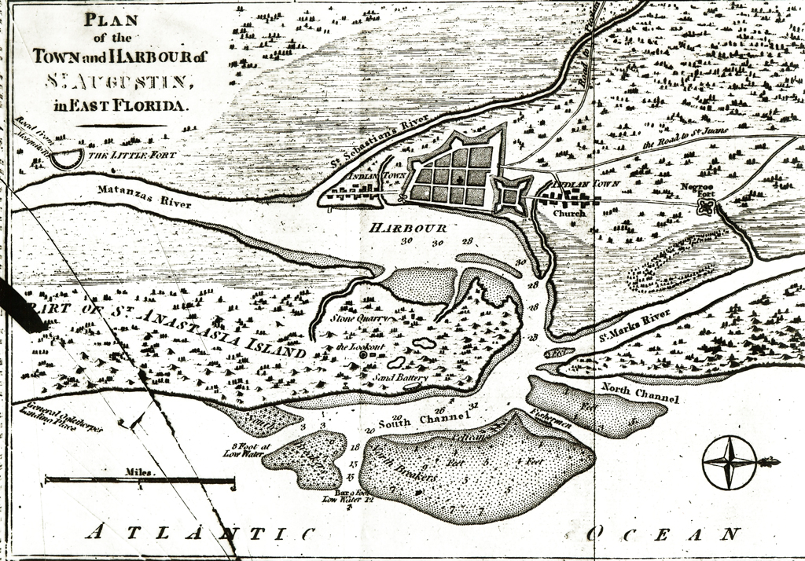
HISTORY

Slide 16

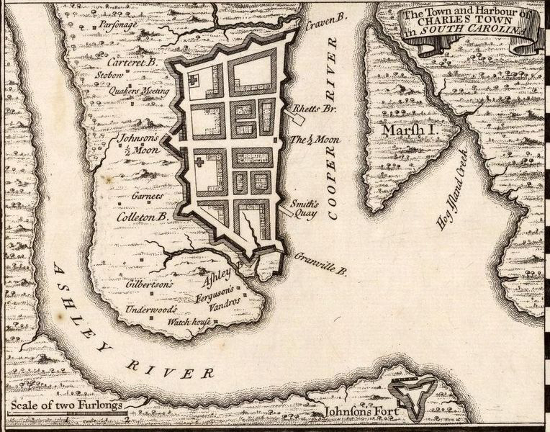
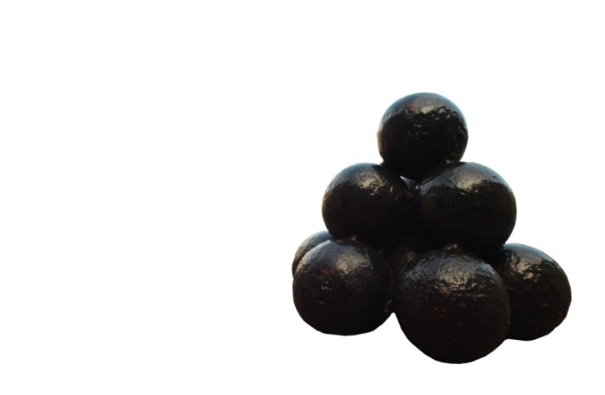
HISTORY
The inlet and thus the Matanzas River were left wide open in the defense perimeter scheme for St. Augustine. This weakness would become very apparent during the British invasion and siege in 1740.
Great Britain had established another colony between English Charles Towne and Spanish St. Augustine. Called Georgia, it was constructed in the “Debatable Lands”, an area claimed by both nations. Georgia would take on the responsibility of dealing with the Spanish.

Slide 17
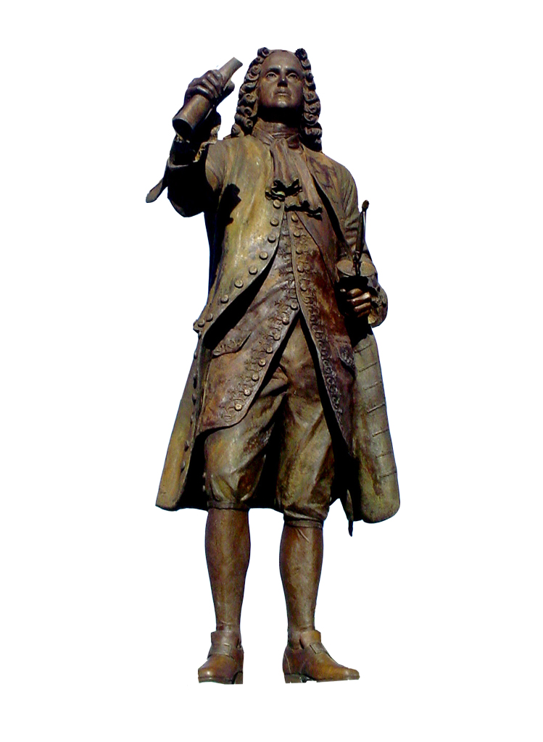
HISTORY
King George of Great Britain granted a trust to members of Parliament to operate this new colony with the purpose to capture and eliminate Spanish St. Augustine. The leader for this epic work was Colonel James Edward Oglethorpe, the youngest member of Parliament and wealthy member of an aristocratic and politically active family. The city he built was Savannah. Three years later, Oglethorpe would build a series of forts south down the coast toward Spanish Florida. He raised a professional Regiment and used colonists to establish a southern fort on the “Inland Passage” to protect his new colony from attack.

Slide 18
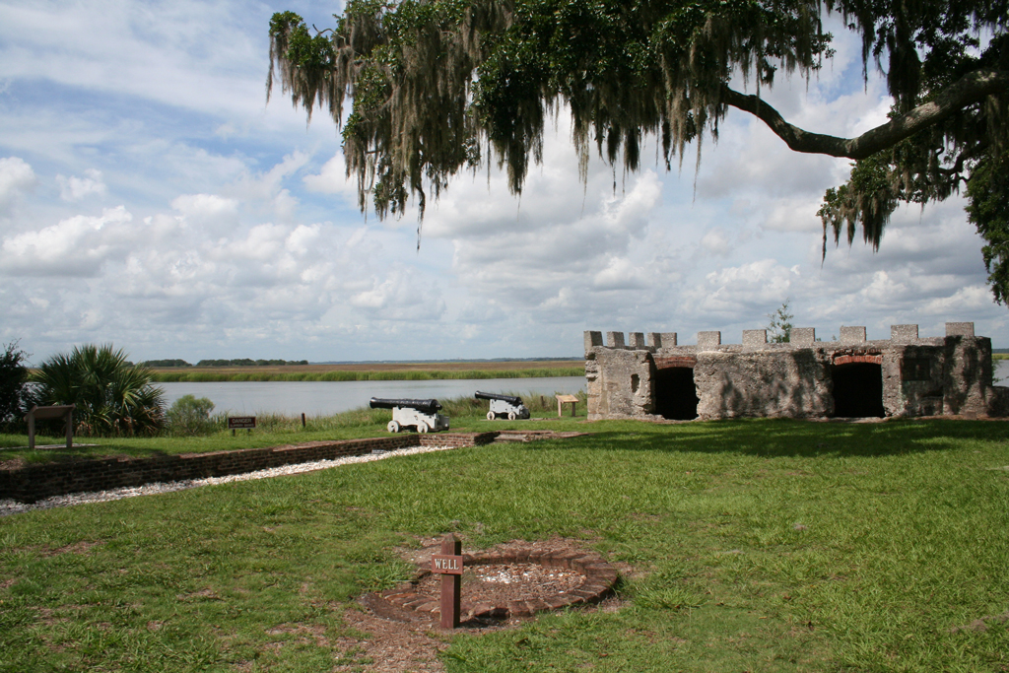
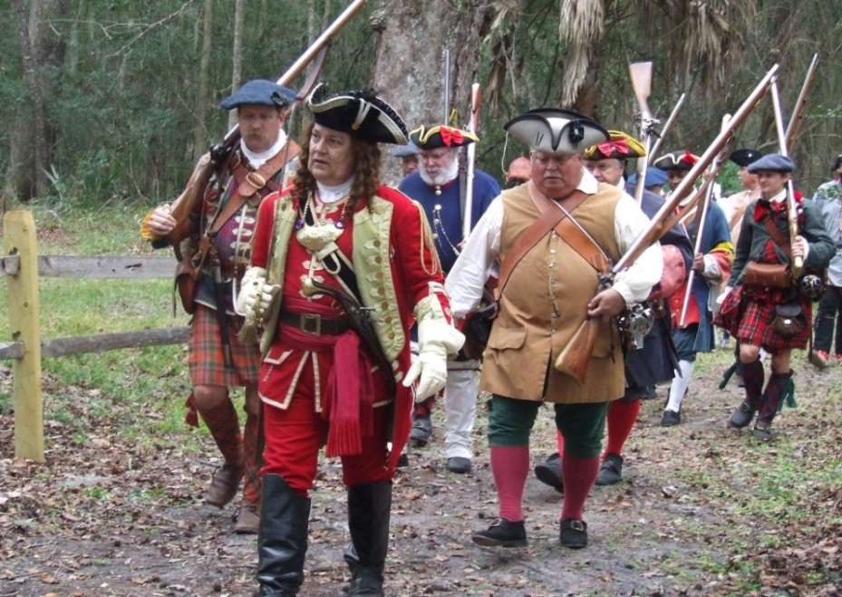
HISTORY
Built in 1736, Fort Frederica (named for Frederick Louis, Prince of Wales, eldest song of King George II) would serve as military headquarters for Georgia. With almost 100 acres of land, surrounded by a stockade fence and manned by militia Highland Scots and a Regiment of English soldiers, Georgia was ready to invade Saint Augustine and remove
the Spanish.
Vital to the plan was the complete
naval blockade of St. Augustine
from the ocean. This would include Matanzas Inlet, which provided communication and supplies to and from Habana, Cuba, some 550 miles to the south. The English seemed to have all the advantages over St. Augustine, but this was not the case.

Slide 19
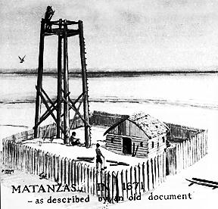
HISTORY
Soon after the arrival of British ships off
St. Augustine, boats were dispatched
through Matanzas Inlet to notify Cuba
of an imminent attack on Florida.
As in 1702, Cuba sent food, soldiers,
ammunition and a new hope to their
countrymen trapped inside the walled
presidio. Matanzas Inlet had again
proven its value to the safety and
protection of the presidio.
The Spanish knew that Matanzas Inlet was an important strategic location. Since 1569, wooden towers stood watch at the inlet. Over the years, these towers, built one after another, had seen many interesting things. The role of the wooden towers was simple: look out to the sea, watch for enemies and report any problems to the Spanish Governor in St. Augustine. The towers and the soldiers manning them faced many difficulties, such as dealing with natives both friend and foe, rescuing shipwreck survivors making their way north along the coast and even defending against pirate attacks.

Slide 20
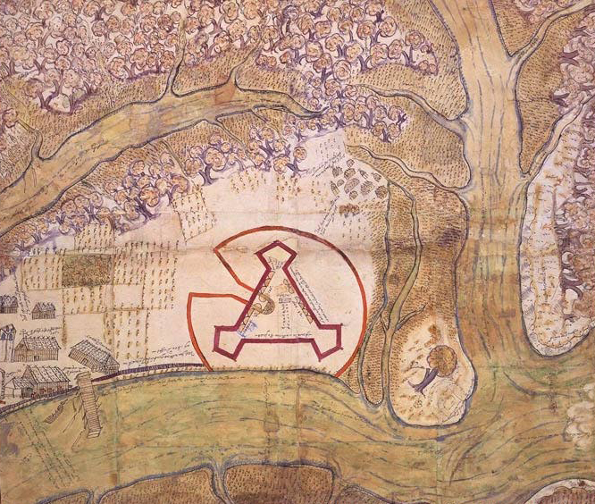


HISTORY
In 1683, a large group of pirates attacked and
captured some of the soldiers at the wooden
tower. The pirates then attempted to attack
St. Augustine by sailing up the river. They were
driven off just one mile south of the town after
being ambushed by Spanish soldiers. Pirates
would appear again at Matanzas Inlet just three years later but with much less success, losing a ship and its men to the Spanish in the process.
After the siege of St. Augustine in 1740, Spanish Governor Manuel Montiano and engineer-in-ordinary Pedro Ruiz set about strengthening
St. Augustine against future attacks. The two men realized that a fort
was needed south of the presidio at Matanzas Inlet, the weak link in
St. Augustine’s defenses. A fortification, however,
could not be erected without the express permission
of royal authorities. Obtaining such authorization
was a problem. In the days of sailing vessels,
coupled with government bureaucracy, permission
to build a fort could take a year or more.

Slide 21
HISTORY

Slide 22
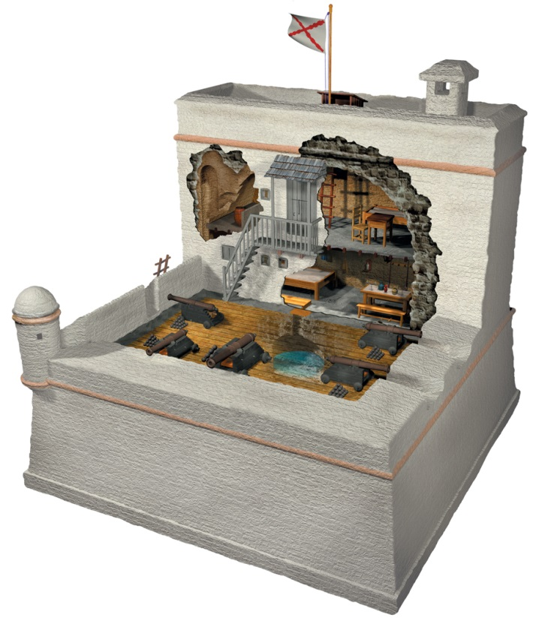
HISTORY
Governor Montiano, however, found a way around the
problem. Earlier, he had been ordered by royal
authorities to perform whatever repairs he judged
necessary for the security of St. Augustine.
Armed with that information, Montiano ordered the
construction of a fortified stone watchtower at
Matanzas Inlet to replace the wooden watchtowers
used at that location for more than 160 years.
Construction on the tower began in the fall of 1740.
On July 21, 1741 two British ships attempted to enter Matanzas inlet to attack two Spanish ships at anchor guarding the fort construction. The Spanish fired several shots at the approaching British but scored no hits. Darkness soon caused the British to abandon the attack but they resumed the following morning. In its haste to get underway, one Spanish ship ran aground. It was hit by British cannon fire killing two and wounding two. The crew abandoned ship and waded to the shore. The second Spanish vessel saved the day by exchanging shots with the British ships forcing the British to retreat to the safety of the open sea. If not for this second ship, Fort Matanzas would probably not exist today. The next six months saw the British return to Matanzas inlet several times but they did not engage the Spanish or halt construction work on the tower.

Slide 23

HISTORY

Slide 24
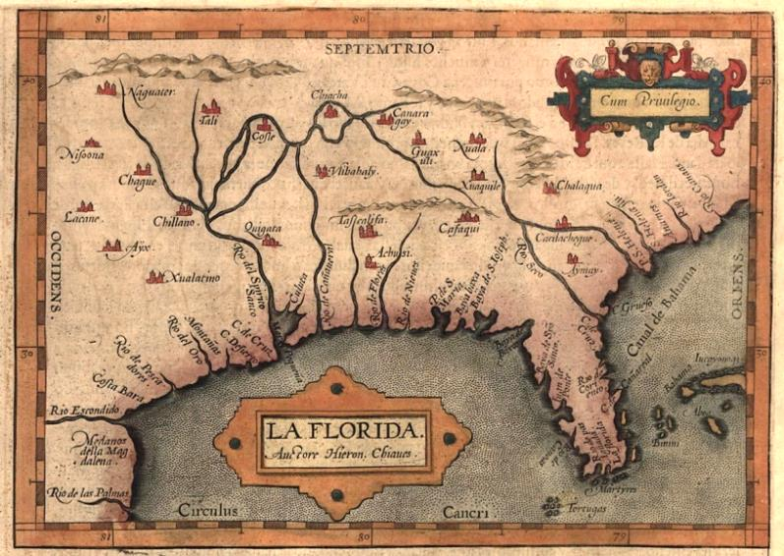
HISTORY
Construction of the fort was finally completed in the fall of 1742. Like the Castillo de San Marcos, it was constructed of simple ingredients: water, sand, oyster shells, timber and coquina stone. At its completion, it was armed with five cannon.
Since the engineer-in-ordinary Pedro Ruiz had placed the fort in the middle of the Matanzas River several hundred yards inside the ocean inlet, it was ideally located. Enemy ships would have to navigate through the narrow, shallow channel while under fire from the fort guns. The first to experience this effect was none other than Governor Oglethorpe. He arrived off the coast at Matanzas Inlet on September 10, 1742 with 13 ships. Entering the inlet in two longboats, he ordered soundings taken to determine the depth
of the water. This would allow him to calculate
which vessels in his fleet could enter through the
shallow waters. Those with shallow drafts would
then navigate their way upriver and into position
to attack St. Augustine. Using this approach,
Oglethorpe had hoped to avoid a repeat of the
defeat he suffered two years earlier when
Spanish vessels slipped through his naval
blockade of the inlet and sailed to Cuba for help.
The British Governor was to taste defeat again.

Slide 25
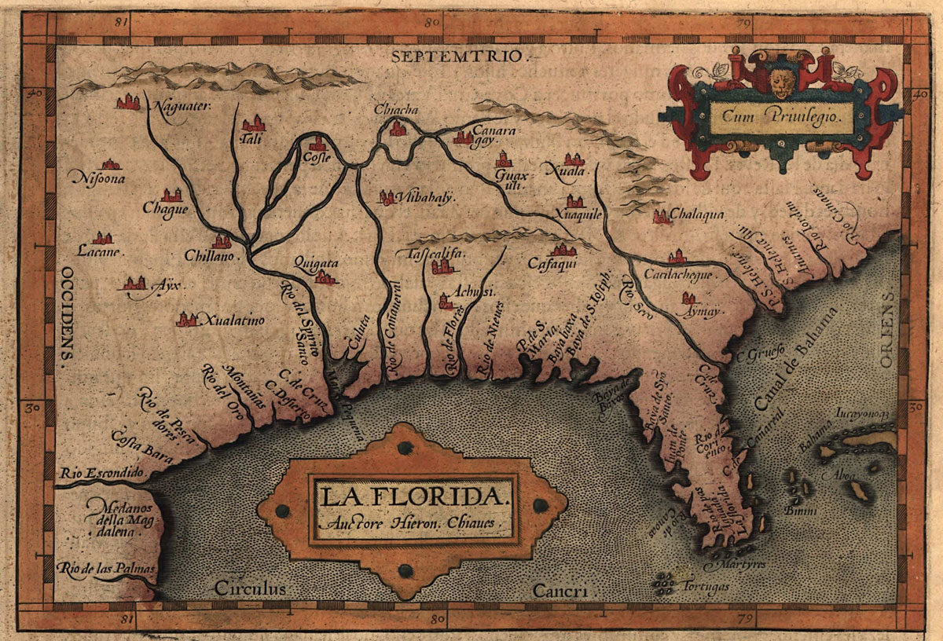
HISTORY

Slide 26
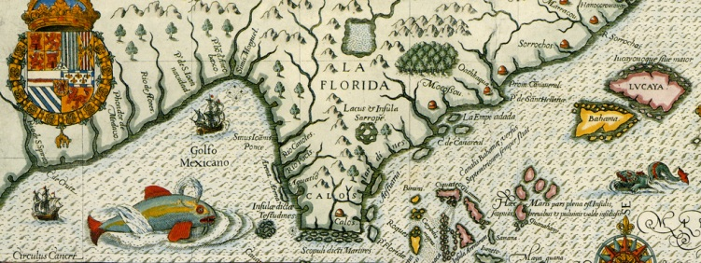
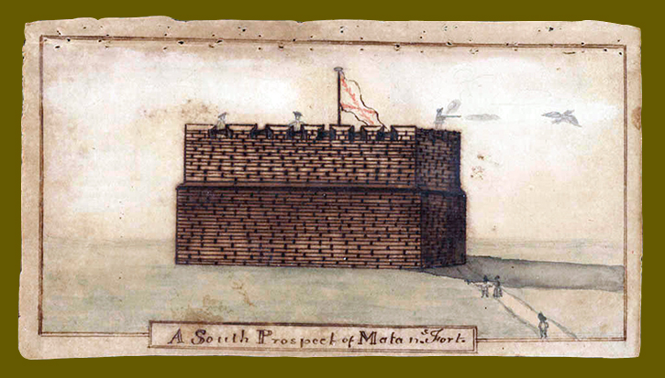
HISTORY
This time, the defeat would come from the
newly built watchtower. While Oglethorpe
was taking soundings, the Spanish at the watchtower were loading their cannon. The watchtower opened fire on the two vessels scoring a fatal hit to one of the boats and causing Oglethorpe to order a retreat. The crew of the damaged boat reported that they were barely able to make it back to a man-o-war off the coast before the boat sunk. The following morning the fleet weighed anchor and sailed north.
In its first defense, the watchtower
proved Montiano and Ruiz correct:
Matanzas was indeed the
location of the next invasion
attempt.
With 7 to 10 soldiers as a standard garrison, the watchtower also performed customs and coast guard activities dealing with ship wreck victims and ships on their way to Cuba.

Slide 27

HISTORY

Slide 28
HISTORY

Slide 29
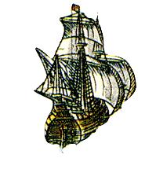
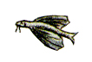
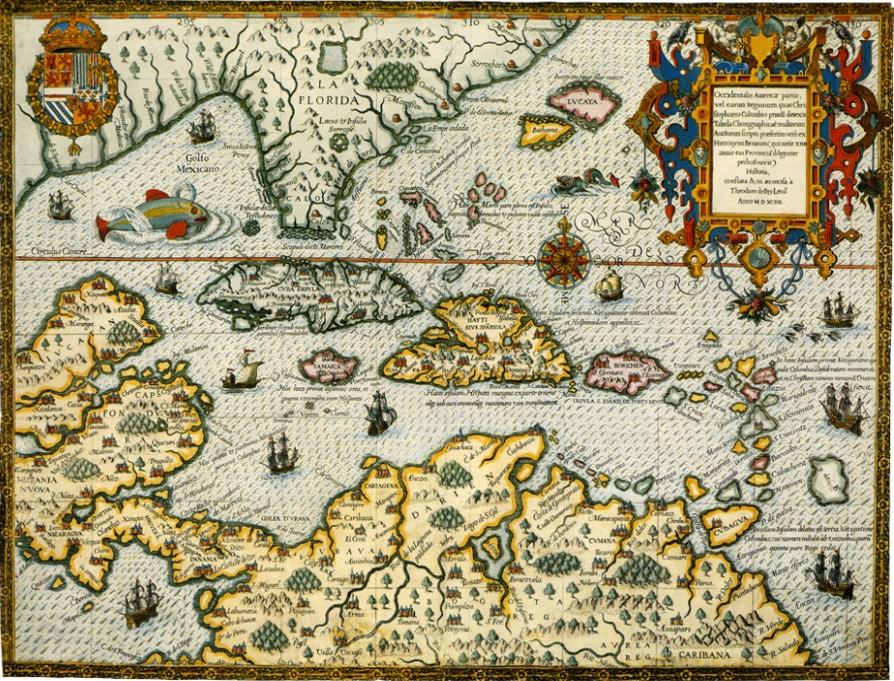
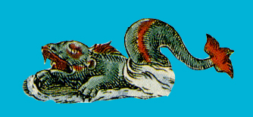
HISTORY
Following 80 years of service to two great empires, Spain for 60 years and Great Britain for 21 years, the United States would eventually claim the Matanzas
watchtower and all of Florida from
Spain in 1821. By that time, the
watchtower was in disrepair. After
the transfer to the United States,
the watchtower was abandoned to
face time and the elements.
History would eventually catch up
with Fort Matanzas as new generations
came to appreciate the past. The
United States Government, the
St. Augustine Historical Society, the
U.S. Army and even the President
believed that this one-of-a-kind structure,
built of one of the most unique substances
in the world, should be preserved.

Slide 30
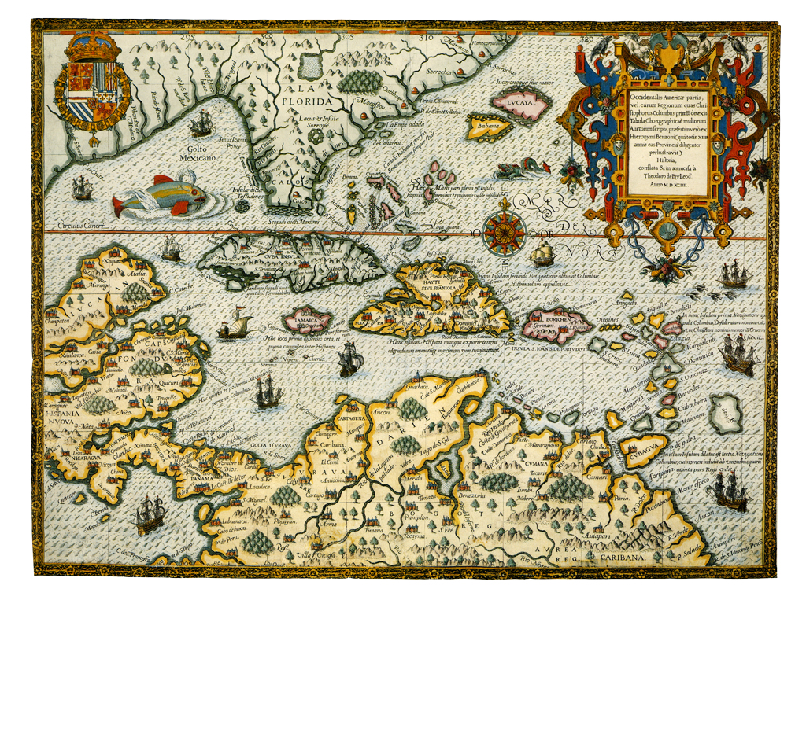
HISTORY

Slide 31
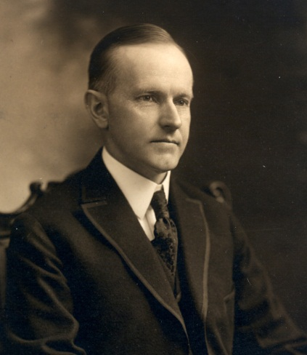
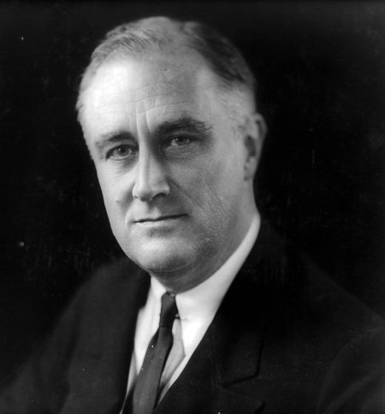
HISTORY
In 1924, President Calvin Coolidge created Fort Matanzas
National Monument. In addition, the Castillo de San Marcos
(known then as Fort Marion), Fort Pulaski in Savannah,
Georgia and Fort Wood in New York harbor became National
Monuments that year.
In 1933, President Franklin Roosevelt transferred all national military parks and monuments from the War Department to the National Park Service for operation as parks. Today, Castillo de San Marcos, the oldest masonry fortification in the continental United States and Fort Matanzas, the only existing fortified Spanish watchtower in the United States, are part of the U.S. National Park system, which has over 400 units across the country.
These two examples of Spanish design and architecture still stand to represent our past, a Spanish past, a British past and an American past that stretches back some 340 years. Fort Matanzas, without a single loss of life, performed its military duties for 80 years, has stood the passage of some 270 years, and now serves to educate the visiting public.

Slide 32



PARK
MAP

Slide 33




FORT
Observation Deck
Touch the colored boxes to the right and discover more about Fort Matanzas. Touch the miniature fort icon to return to this page.
Officer Quarter
Magazine
Guardroom
Gundeck
Walls
Water Cistern
Dirt Filling
Ground Level
Pilling Grillage

Slide 34



OBSERVATION DECK
Then, as now, a narrow ladder was the only access to the top of the tower. This opening probably had a structure shielding the interior from the elements. The deck provided an excellent view of the inlet to the south. In 1742 the inlet was about a half-mile closer than it is now, within easy range of the fort's guns. To the north, the waterway leads to St. Augustine, fourteen miles away. The structure on top of the roof is the chimney which vents the fireplace in the soldiers' quarters. This observation deck served an additional function to direct any rain water through a drain into the tower’s water cistern below.
+
+
+

Slide 35




OBSERVATION DECK
A visitor to the fort in the 1920’s looks down the remains of the chimney. An earlier photo below shows the roof prior to restoration. Heavily overgrown with vegetation; you can see the hatch to the officer’s quarters in the foreground. The chimney is hidden to view by the plants.

Slide 36


OBSERVATION DECK
Restoration progress
work can be see as
vegetation is gradually removed from the roof
area. The addition of a
wooden staircase
allowed access to the
roof from the gundeck.

Slide 37


OBSERVATION DECK
By the late 1930s, the fort had undergone major restoration work. A new roof, chimney flue and hatch were built. Visitors could now access the roof via a ladder through the hatch.
In the late 1990’s a full size chimney and a flag pole were added to better represent the fort’s past.

Slide 38





OFFICER’S QUARTERS
The commander of Matanzas had this room to himself. The entrance to his room was a staircase from the gundeck. Shown on the far left of the drawing below is a small wall separating the officer’s bedroom from a food storage area. The circle on the left is the powder magazine. Thick walls protected the gunpowder from any threat of enemy fire. The officer had one window looking to the North and three
smaller musket firing windows
looking South toward the inlet.
The fireplace flue did not
connect into the officer’s
room. At the room’s
center is a ladder to the
observation deck.
+
+
+

Slide 39



OFFICER’S QUARTERS
At the time the picture
above was taken,
visitors accessed the
officer’s quarters from
a staircase that went
to the roof and then climbed down a ladder into the room. Today a staircase on the outside goes directly into the officer’s quarters more accurately representing the original Spanish design.

Slide 40



OFFICER’S QUARTERS
These pictures show the second floor looking west. Many changes have taken place over the years. First a wooden floor was added and later replaced with masonry to better hold up to the wet Florida climate.

Slide 41



OFFICER’S QUARTERS
Here you see a good view of the arched ceiling of the second floor and the east side of the room. Today the officer’s bed and desk are located here. A ladder going up to the observation deck completes the furnishings.

Slide 42







MAGAZINE
Located within the west wall of the fort and accessed only through the upstairs officer's quarters, the powder magazine kept the dangerous black powder from open flames used for heat and light. The magazine extends down into the wall to the level of the gundeck. Although thick walls protected the black powder, the Florida humidity
was often a problem.
+
+
+

Slide 43


MAGAZINE
On the west side of
the officer’s quarters
is the access to the
fort’s powder magazine. A wooden door once covered the magazine which is located in the west wall. The magazine extends down toward the fort’s first floor from the officer’s quarters above.

Slide 44



MAGAZINE
Looking into the powder storage, one would find it a very tight fit. The narrow opening leads to a cylinder shaped room with
a domed ceiling.
The floor of the magazine is at the same level as the guard’s quarters.

Slide 45


MAGAZINE
These pictures show the interior of the powder storage room. The large picture shows a ladder leading to the floor of the magazine and the small picture shows a platform later installed to limit access into the room.

Slide 46





GUARDROOM
This lower room served as the enlisted men's quarters. The soldiers cooked, ate and slept in this room. Opposite the fireplace, shown on the right side of the image below, was a long wooden sleeping platform. Benches and a table completed the furnishings. On average, six people shared this room. More men could be assigned as needed. The smaller openings near the windows in this room were loopholes for soldiers firing muskets. The windows had shutters to keep out rain and the damp chill of the winter winds. The powder magazine is shown on the left side of the image below. It can only be accessed through the officer’s quarters.
+
+
+

Slide 47



GUARDROOM
Many changes to the guardroom have taken place over the years. The most obvious change is the furniture, added to better represent how the soldiers once lived. Earlier visitors experienced only an empty room. Notice the changes to the ceiling structure due to restoration work.

Slide 48



GUARDROOM
Living history programs have evolved over the years. In the 1970’s the fort had no furniture but visitors occasionally had a costumed guide. Today the building is furnished to represent the 1740’s. Park staff and volunteers provide a narrative of the fort’s history to visitors.

Slide 49



GUARDROOM
Early visitors to the fort could not access this room due to restoration projects. The top picture looks East towards the fire place and door. Other images show the west wall of the room and a view out the south-west window.

Slide 50




GUNDECK
Fort Matanzas is a very simple structure, its main strengths being the artillery and its strategic location. Five cannons once guarded the fortress facing in the three approaching directions. Each cannon could easily reach the inlet, then only a half-mile away. Two original cannon still stand guard at the fort today. These guns were placed at the fort in 1793 and left behind by the Spanish when they departed Florida in 1821. The other two cannon now on the gun deck are modern reproductions used in the park's living history cannon firing demonstrations.
+
+
+

Slide 51



GUNDECK
After the overall structural was stabilized more projects followed. Some of these projects included a wood gun platform and reproduction cannons for the park’s Historic Weapons Program.

Slide 52



GUNDECK
These images were taken prior to the addition of the wood gun platform. Old photographs of the fort when it was in ruins show a missing sentry tower. The tower to the right was constructed in 1938. It is a replica of the original sentry tower that had fallen from the fort long ago.

Slide 53


GUNDECK
Today Fort Matanzas displays two original 8-pounder iron cannons. These guns were used at the fort by Spanish soldiers and later left behind when Spain sold Florida to the United States. The guns were found on the fort gundeck under heavy vegetation and later preserved for display.

Slide 54





WALLS
Matanzas stood 50 feet on each side with a 30-foot tower. It was built of local shell stone called coquina. This stone was quarried south of the inlet and transported by boat to the construction site. The stones were held in place on the fort with mortar, made by burning oyster shells until they became ashes. This “lime ash” was also used to plaster the walls which were then whitewashed to waterproof the structure. Plaster that was red in color was placed on some of the architectural elements such as the Sentry Tower. The opening on the west wall was the entrance into the fort. Soldiers would climb a removable wooden ladder to reach this location on the gun deck. If needed, a cannon could be moved to point through this opening. Today, sturdy stairs
allow easy access for visitors
to the fort.
+
+
+

Slide 55



WALLS
Officer’s log reports often comment
about high tides washing against the sides of the fort.
This eventually led
to the need for
major structural repairs and the Fort’s first sea wall in 1936.

Slide 56




WALLS
The fort saw major restoration projects
in the 1920s and 1930s. At the time, the best way to complete repairs often called for removing a section
of wall and rebuilding the area.

Slide 57




WALLS
After nearly 100 years of neglect, plant growth covered the fort. One major concern was the stability of the structure due to a partial collapse of the second floor arch. It was decided to tear down and rebuild the arch before a full collapse could occur.

Slide 58






WATER CISTERN
The fort's cistern is located under the gundeck with its opening under the stairs. The roof of the fort collected rain water which drained into the cistern through a wooden pipe. There was no other source of fresh water on the island. However, if needed, the soldiers could bring water in barrels from St. Augustine or from nearby creeks.
+
+
+

Slide 59



WATER CISTERN
Prior to installing a safety screen on the lid to the cistern, park staff photo documented the inside of the water tank. These pictures show the lid of the tank before and after the screen was installed.

Slide 60


WATER CISTERN
Here you see the inside of the cistern looking up at the opening. The smaller image shows the remains of a pipe that connected the cistern to the wood downspout. This pipe directed all rain from the fort’s observation deck into the tank.

Slide 61


WATER CISTERN
In the 1970s the interior floor and walls of the cistern were documented. The tank was lined with plaster to stop the water from leaking out through the coquina walls.
It measures 13 feet deep and about 8 feet in diameter.

Slide 62



DIRT FILLING
With the exception of the water cistern at the center, the lower level of the fort is filled in with dirt and construction debris. There was no need for extra storage space or to spend the time and resources to construct the fort’s base with solid stone. The solid outer walls provided adequate protection against possible attacks. The dirt filling provided enough support for the living space and observation tower as well as heavy cannons on the gundeck.
+
+

Slide 63


DIRT FILLING
Restoration was sometimes invasive, as shown with the Bobcat tractor in the lower photograph. Even so, excavations found that the interior of the fort was filled with nothing more than dirt
and construction debris. Today excavations, archeological research and repairs are completed with less invasive techniques.

Slide 64



DIRT FILLING
There were several attempts to repair the gundeck of the fort. After removing vegetation and repairing the walls, crews searched through the debris for the original masonry floor. After locating the original floor it was covered with a protective layer of masonry which later proved ineffective. This layer was removed and the current floor was added.

Slide 65




GROUND LEVEL
The landscape around Fort Matanzas has undergone many changes over the years. Logs written by the fort’s officers describe the island as less than two acres in size. Officers also made log entries describing the condition of the fort. Officer Estevan LaCal, who was stationed at the fort in July 1796, wrote “The cement of the fort is deteriorating under the ocean waves.”
Most of the land and rocks surrounding the fort today were added by the National Park Service to help secure the foundations from further erosion. The current size of Rattlesnake Island is due, in part, to the
dredging of
the Intracoastal
Waterway which
can be seen to the
West of the fort.
+
+
+

Slide 66


GROUND LEVEL
The absence of a sea wall around the fort created preservation problems for the National Park Service. The installation of a metal sea wall in 1936 stabilized the shoreline and helped to preserve the fort for future visitors.

Slide 67


GROUND LEVEL
The sea wall was raised higher than the base of the fort and the void was filled in with dirt to help hold the walls and wood foundation of the fort in place. A second, Coquina stone sea wall, along with jetties were added to help build up the shoreline around the fort.

Slide 68


GROUND LEVEL
Before filling the void between the sea wall
and fort with sand,
stone pavers were used. This was later considered historically intrusive and was replaced with sand. A second coquina sea wall was later added to help build up the land. This was the extent of the fort’s island for
many years.

Slide 69



PILLING GRILLAGE
Techniques for building stable foundations in unstable environments have evolved and improved over time. During the 18th Century, wooden foundations were often the best option in soft environments such as the marshy shores of the fort.
A series of wooden poles were installed as a foundation for the fort. This is known as “friction pile” construction and consist of sturdy pine poles sunk vertically deep into the marsh. The actual depth is unknown. The poles were then attached together with a grillage of square timbers. The next step was to place the Coquina stone on top of the wood. A 1978 archeological investigation of Fort Matanzas showed the wood
foundation still exists.
Over the years, this
foundation has
settled with the
changing
environment.
+
+

Slide 70


PILLING GRILLAGE
Even with all this work, occasional storms would wash out the dirt between the sea wall and the fort, leaving the wood foundation exposed. Crews occasionally brought over generators and water pumps to clear out the water and replace the sand.

Slide 71




PILLING GRILLAGE
Here you see the
original wooden foundation exposed
by high tides. The drawings help to illustrate what the foundation looked
like when it was completed by
Spanish workmen.

Slide 72
Explore our Plants
LIVE OAK
COONTIE FERN
SPANISH MOSS
BLACK MANGROVE
SABAL PALM
SPANISH BAYONET
SAW PALMETTO
YAUPON HOLLY
RESURRECTION FERN
RED CEDAR

Slide 73



LIVE OAK
Season In the spring, live oaks form long, cylindrical, yellow strands of pollen-bearing flowers. Nearing fall, the oaks begin to produce and drop acorns.
Description Trunks are thick, covered in a rough bark. Trunk circumference can measure up to 30 feet. Leaves are oval-shaped, dark green, and of a leathery texture. Branches extend far from the trunk and grow in all directions.
Habitat In open, woodland areas.
Range Extends from Virginia to southern Florida and continues along coastal areas of the Gulf of Mexico into Texas.
Nature Fact Live oaks are often draped with Spanish moss, a signature image of Florida’s natural heritage.
PLANTS

Slide 74

SPANISH MOSS
Season From spring to fall, Spanish moss produces many tiny blue or green flowers that turn to seeds. The seeds are equipped with sail-like structures that allow them to float to other branches where they may take root and grow.
Description Light gray, hanging in long, tangled clumps off of tree branches. Roots become established on the bark of the branches from which the plant is suspended.
Habitat On trees in areas with high levels of humidity, specifically on trees that grow in the southeastern United States in areas near swamps, estuaries, and rivers.
Range Southeastern United States and tropical regions of the Americas.
Nature Fact Spanish Moss in neither a moss nor Spanish. It is native to the Americas and is a bromeliad, related to the pineapple!
PLANTS

Slide 75

SABAL PALM
Season In early summer, the sabal palm produces 3-foot long clusters of small, white flowers. In the fall, the flowers are replaced with black, half-inch wide fruits.
Description Trunks are smooth and gray on older trees. The trunks of younger trees are covered in husks from the bases of dead leaves that are left behind as the tree grows.
Habitat Due to its hardiness and ability to withstand a variety of environments within its range, the sabal palm will grow anywhere with the exception of areas with standing water or dense shade.
Range Coastal South Carolina and Georgia and throughout most of Florida. Also present on islands of the Bahamas.
Nature Fact The sabal palm is the state tree of both Florida and South Carolina.
PLANTS

Slide 76

SAW PALMETO
Season One to three long-branched clusters of tiny, white flowers (called a spadix) are produced in the spring. The fruits (3/4 inch black drupes) mature during the summer.
Description Rough textured, brown trunks usually grow 6 to 12 feet in length along the ground, forming dense thickets. The leaves are fan-like, 3 to 4 feet wide divided fronds, usually green though sometimes silvery-blue in color. Saw tooth-like spines grow along the frond stalks.
Habitat Coastal secondary dunes and sandy pinewoods. Can be a dominant understory species.
Range Coastal Carolinas to southern Mississippi, including all of Florida.
Nature Fact Occasionally, the prostrate trunks of the palmetto grow upright into a tree-like form, reaching heights of 15 to 20 feet. Based on average growth rates, some very long or tall palmettos are estimated to be upwards of 700 years old.
PLANTS

Slide 77

RESURECTION FERN
Season Being a fern, this plant reproduces itself by producing spores. The spores are contained in small, dark dots (sori) lining the lower surface edges of the fronds. Sori appear during summer when there is adequate heat and moisture.
Description Grows no more than 8 inches in height. Possesses small, deeply divided fronds that are open and dark green when there is plenty of moisture. During dry periods, the fronds curl up and appear brown and dead.
Habitat The plant is epiphytic, meaning it grows on other plants, usually the rough bark of tree limbs and trunks (like live oaks), and occasionally rocks (including coquina walls).
Range Southeastern United States, including throughout Florida.
Nature Fact Resurrection fern absorbs water from humid air and the surface upon which it sits.
PLANTS

Slide 78

COONTIE FERN
Season Coonties bear cones instead of flowers. The cones emerge in late winter, with the female cones persisting until the following autumn, when they will split open, revealing a multitude of fleshy, orange-red seeds.
Description The leaves are stiff, feathery fronds up to three feet in length, each possessing a dozen or more narrow, opposite, shiny, dark green leaflets. The fronds all emanate from a large, underground stem called a caudex. The plant grows from two to three feet in height maximum.
Habitat Open pine woods and coastal woodlands.
Range Southeastern Georgia and peninsular Florida, as well as several Caribbean islands.
Nature Fact Though it looks like a fern
or a palm, the coontie is neither. It is a cycad,
an ancient type of gymnosperm (cone-bearing plant) that dates to the time of the dinosaurs.
PLANTS

Slide 79



BLACK MANGROVE
Season Produces small, white, fragrant flowers with yellow centers during the spring and early summer. Furry, lima bean-shaped fruits are found on the plant throughout most of the year.
Description The leaves are pointed and oval in shape, dark green above and fuzzy, grayish-white below. The trunk has a rough texture and is dark brown in color.
Habitat Mud flats and brackish swamps along the coast and tidally influenced, low energy shorelines.
Range Tropical west Africa and from Brazil and Peru north to southern Florida. St. Johns County contains the northernmost black mangroves on the east coast of Florida.
Nature Fact The roots of the plant produce vertical growths (pneumatophores) which project above the surface of the ground around the plant. The help the plant to transpire (breathe).
PLANTS

Slide 80


SPANISH BAYONET
Season Flowers (large panicles of 2.5 inch white flowers) from May to September, with the fruit (drooping brown capsules, 3 inches long) maturing from summer into fall.
Description Plant consists of rosettes of hard, dark green leaves, 2 feet long, tapering to a very sharp point. The overlapping leaves form a rough, woody trunk as the plant ages. Can grow to 15 feet in height.
Habitat Dry, sandy areas near the coast.
Range North Carolina south along the coast to Mexico, as well as some Caribbean Islands. Found throughout coastal Florida.
Nature Fact Spanish colonists planted Spanish bayonet along defensive walls such as the Cubo Line, which once surrounded old St. Augustine. The plant’s common name derives from this practice.
PLANTS

Slide 81


YAUPON HOLLY
Season This tree produces tiny white flowers in the spring and summer. Female trees bear heavy crops of red, translucent berries through the fall and winter.
Description Grows to 20 to 25 feet in height. Possesses a single to multi-stemmed trunk with whitish-gray bark. The leaves are small, glossy, and about a half inch long with an oval shape.
Habitat Grows in full sun to partial shade and is tolerant of cold and salt spray. It can be a major component of the coastal hammock understory.
Range Along the coast from New Jersey to Texas, including Florida south to the central part of the state.
Nature Fact The berries the yaupon holly produces sometimes persist from the fall into the following spring, providing a welcome food source to migrating and winter resident birds.
PLANTS

Slide 82

RED CEDAR
Season The red cedar is actually a juniper, which is a conifer (related to the pines) and a gymnosperm. Gymnosperms do not possess flowers or fruits but rather cones. The female cones of the red cedar, once they are fertilized and mature, resemble small, hard blueberries. The cones mature anytime from late July to mid-November.
Description A tree with an open-growing growth form. Its bark is an exfoliating red to gray, while its leaves are fragrant, compact, scaly needles ranging from bluish-green to yellow-green in color.
Habitat Grows in various types of soil, from riverbanks to dry rocky slopes or bluffs.
Range Found east of the Rocky Mountains from Canada to southern Florida.
Nature Fact The red cedar’s blue “berries” (cones) are a major food source for wildlife.
PLANTS

Slide 83
Explore our Wildlife
AIR
LAND
WATER
PREY
CRABS
SEA TURTLES
SONG
LIZARDS
GAME FISH
WADING
SPIDERS
SHELLFISH
DIVING
SNAKES
MARINE MAMMALS
SHORE
TORTOISES - TURTLES
SHARKS
THREATENED - ENDANGERED
MAMMALS
JELLYFISH

Slide 84




PREY
+
+
Great Horned Owl
Osprey
AIR

Slide 85
GREAT HORNED OWL
Season Present year-round. Breeding and nesting occur from November to March, during which time the owls will remain in the vicinity of their nest.
Description Large (21 inches in height, with a wingspan of about 50 inches) with long ear tufts. Gray-brown in color above; black, white and buff below.
Habitat Hardwood swamps, dry prairies, mesic (moderately moist) hammocks, mixed pine and hardwood forests, wet prairies, marshes, urban and agricultural environments, pine flatwoods and sandhills.
Range Found from sub-arctic Canada to Argentina, including all of Florida.
Nature Fact If adequate nest sites and food resources are available, Great Horned Owls may reside in close proximity to humans. This is sometimes the case at Fort Matanzas National Monument!
Prey

Slide 86
OSPREY
Season Present year-round. Local population increases in early spring and fall as northern birds migrate through. Breeding and nesting can occur any time of the year, though is more likely from late spring through early summer.
Description About two feet in length. Dark brown above, white below, with a dark eye-stripe.
Habitat Coastal beaches, salt marshes, open saltwater and freshwater, mangroves and wet prairies.
Range Migrants found from Canada to Argentina. Florida supports year-round residents statewide. Found throughout Africa, Europe, most of Asia and coastal Australia as well.
Nature Fact Each osprey foot has a reversible front toe, as well as barbs, for catching and holding slippery fish, its favorite prey item.
Prey

Slide 87


SONG
+
+
Cardinal
Mockingbird
AIR

Slide 88

NORTHERN
CARDINAL
Season Present year-round. Breeding season extends from March to August.
Description Male: all red, with a crest, a black face, and an orange bill. Female: brown or buff color, with a reddish crest, wings, and tail.
Habitat Xeric (dry) scrub, mesic (moderately moist) hammocks, mixed pine and hardwood forests, urban environments, pine flatwoods, sandhills and agricultural environments.
Range Extreme southeastern Canada, eastern half of the United States (including all of Florida) and extending down through Mexico to Belize and northern Guatemala.
Nature Fact Cardinals are prolific breeders. Up to three broods of two to five chicks can be raised each year by a single pair. They are primarily seed and fruit eaters but will also eat insects when abundant and when feeding their young.
Song

Slide 89
NORTHERN
MOCKINGBIRD
Season Present year-round. Breeding season extends from March to August.
Description Overall gray in coloration. Has black wings with white bars and patches and a long black tail with white outer feathers.
Habitat Xeric (dry) scrub, dry prairies, mesic (moderately moist) hammocks, mixed pine and hardwood forests, urban environments, pine flatwoods, sandhills and agricultural environments.
Range Southern Canada through Mexico and the Caribbean. Found throughout Florida.
Nature Fact The mockingbird derives its name from its ability to imitate nearly any sound familiar to it. The calls, usually repeated in threes, most often imitate other birds, but may also include domestic animals and a variety of human-made sounds. In spring, the male may sing long into the evening, especially on moonlit nights.
Song

Slide 90


WADING
+
+
Snowy Egret
Great Blue Heron
AIR

Slide 91
SNOWY EGRET
Season Present year-round. Breeding season stretches from December to August.
Description About two feet in height. Feathers all white. Has thin black bill, black legs and yellow feet.
Habitat Coastal beaches, salt marshes, hardwood and cypress swamps, wet prairies and urban and agricultural environments.
Range Wide-ranging, from summer breeding grounds in Idaho and Maine to permanent populations in Chile and Argentina. Found throughout Florida.
Nature Fact Nests in multi-species colonies located in shrub-covered wetlands or islands in lakes and coastal lagoons. Nesting begins by April and continues until August. Two to five light blue eggs are laid in a loosely constructed stick nest.
Wading

Slide 92

GREAT BLUE HERON
Season Seen year-round. Capable of breeding and nesting from November to July
of each year.
Description A large bird that reaches almost 4 feet in height, gray-blue in coloration with a heavy yellow bill.
Habitat Coastal beaches, salt marshes, open freshwater, mangroves, hardwood swamps, cypress swamps, wet prairies, urban environments, and agricultural settings.
Range Widespread from Canada to Venezuela, including all of Florida.
Nature Fact The great blue heron obtains its food by “still-hunting”, waiting for prey to swim or slither within striking range. Prey includes many species of fish as well as frogs, lizards, snakes, small mammals and on occasion, other birds. Foraging occurs on moonlit nights, as well as during daylight hours.
Wading

Slide 93


DIVING
+
+
Brown Pelican
Cormorant
AIR

Slide 94


BROWN PELICAN
Season Breeding season occurs all months except October. However, the species is present year-round.
Description Weighs about 8.2 pounds, about 50 inches in length and with a wingspan of over 6.5 feet. The body is grayish-brown with a white head and neck.
Habitat Coastlines, open saltwater and mangrove environments.
Range Coastlines throughout the United States and Central America.
Nature Fact Brown Pelicans will dive 20 to 30 feet under the water to catch fish.
Diving

Slide 95

DOUBLE CRESTED
COMORANT
Season Present year-round in all parts of the state. Nesting can occur all year, but is concentrated beginning March until August.
Description Adults are about 32 inches in length and weight 4 pounds. Their plumage is all dark brown or black. They have a patch of orange on their throats and hooked bills.
Habitat Cypress swamps, mangroves, open freshwater and saltwater environments.
Range Across the United States, into part of Canada, Central America and the Caribbean.
Nature Fact Juvenile cormorants will group together in clusters called crèches and only return to their nests to feed.
Diving

Slide 96


SHORE
+
+
Least Tern
Wilson’s Plover
AIR

Slide 97
LEAST TERN
Season Nest locally from April to August. In September they begin to migrate south to Brazil where they spend their winters.
Description Adults can be about 9 inches in length and weigh about 1.5 ounces. Their plumage is mostly white with black crown feathers, and their tails are V-shaped.
Habitat Coastal beaches and salt marshes. Flat, open and sandy beaches provide ideal conditions for nesting.
Range All of Florida and Northern parts of Brazil.
Nature Fact While they are small, they will “dive-bomb” anyone that gets too close to their nests.
Shore

Slide 98
WILSON’S PLOVER
Season Found year-round.
Description Medium-sized plover weighing about 2 ounces, with a length
of nearly 8 inches and a wingspan of 19 inches. Has a dark neck ring, grayish-brown upper parts, a white underside and flesh-colored legs. Its heavier black bill and larger body distinguish it from similar looking plover species.
Habitat Typically found in sparsely vegetated coastal areas, including beaches, sandbars, salt flats, lagoons and barrier and dredge spoil islands.
Range Atlantic coast from Virginia to northern South America.
Nature Fact The Wilson’s plover will feign a broken wing and try to lead potential predators away from its nest if eggs or chicks are present.
Shore

Slide 99


THREATENED-ENDANGERED
+
+
Woodstork
Bald Eagle
AIR

Slide 100

WOODSTORK
Season Seen throughout the year, though they tend to be less numerous in north Florida during the colder winter months when many
migrate to southern areas of the state.
Description Stands about 3.3 feet tall with a wingspan of 5 feet. Most of the plumage is white except for the black tail and primary and secondary wing feathers. Lacks feathers on head, upper neck, long legs and feet. The feet are light colored while the other areas are dark gray. Head is wrinkled and possesses a long, massive bill.
Habitat Tidal creeks and flats, marshes, cypress swamps, ponds, ditches and flooded fields possessing shallow water levels. Nests in cypresses, mangroves and willows.
Range South Carolina to Argentina, including
all of Florida.
Nature Fact A wood stork pair feed upon about 440 pounds of fish during the breeding season.
Threatened

Slide 101
BALD EAGLE
Season Late September to early April, the breeding and nesting season. Young eagles migrate up the east coast in spring, while immature and older eagles disperse more locally.
Description Can grow to 3 feet in height and have a wingspan of almost 8 feet. Females are larger and heavier than males. Distinctive white feathers on the head and tail. Body feathers blackish to dark brown, and the eyes, bill and legs are yellow.
Habitat Mangrove swamps, shorelines of lakes and rivers, pinelands, seasonally flooded flat woods, hardwood swamps and open prairies and pastureland with scattered tall trees.
Range Canada to Mexico, including less densely populated areas of Florida with suitable habitat.
Nature Fact In Florida, eagles most commonly eat mullet, catfish, trout, needlefish and eels.
Endangered

Slide 102


CRABS
+
+
Fiddler Crab
Ghost Crab
LAND

Slide 103
FIDDLER CRAB
Season Seen year-round except in cold winter weather when they hibernate in their burrows.
Description 1 – 1.5 inches long. Males possess a distinctively large, vividly colored claw.
Habitat Sandy and muddy beaches and salt marshes that are uncovered during low tide.
Range Along the coast from Massachusetts to north Florida.
Nature Fact Male fiddler crabs use their one enlarged claw, which can weigh up to half their body weight, to attract females and intimidate other males. They are only able to eat with their smaller claw. If the enlarged claw breaks off, the other smaller claw grows larger and a new small claw grows where the large claw was. Females have two smaller claws.
Crabs

Slide 104
GHOST CRAB
Season Seen throughout the year except for about 6 weeks during winter when it hibernates in its beach burrow.
Description A lightweight, swift-footed crab with a pale, square body and yellowish legs. Possesses two stalked, black eyes.
Habitat Beaches and dunes.
Range Atlantic coast from Rhode Island to Brazil, including most of Florida coastline.
Nature Fact Primarily a nocturnal creature, ghost crabs leave their burrows to feed before dusk and are active through dawn. They are a common predator of sea turtle hatchings. During a hatching event, ghost crabs will catch and drag the hatchlings down into their burrows where they are devoured.
Crabs

Slide 105



LIZARDS
+
+
Green Anole
Brown Anole
LAND

Slide 106

GREEN ANOLE
Season Can be seen throughout the year, but much less active in cooler weather.
Description Reaches a maximum length of 8 inches. Slender body with fine, grain-like scales. Snout long, pointed and uniform in color. Males have a pink or red dewlap and a slight ridge down the center of the back. Tale is long and slender and may break away easily. Toes have adhesive pads on the undersides which allow it to move on smooth surfaces.
Habitat Sub-tropical landscapes, from dry woodlands to cypress swamps, as well as gardens and developed properties.
Range Found from Texas to North Carolina, including all of Florida.
Nature Fact The color of the green anole can in fact change rapidly from bright green to brown, tan or gray.
Lizards

Slide 107

BROWN ANOLE
Season Can be seen throughout the year, but much less active in cooler weather.
Description A long, slender lizard that is distinguished by the light keel extending down the center of the back, long pointed snout, the series of small yellowish spots over the back and by the orange-red, white-fringed dewlap on the males.
Habitat Tropical and sub-tropical landscapes, especially forest edges, disturbed areas, and open sites. Rarely found perching higher than five feet above the ground on plants and structures.
Range Originally endemic to several Caribbean islands. Has spread to many other areas, including the United States from Hawaii to Texas and along the coast to Georgia, including most of Florida.
Nature Fact The dewlap is used to help the male brown anole protect his territory and attract mates.
Lizards

Slide 108


SPIDERS
+
+
Golden Silk
Argiope
LAND

Slide 109
GOLDEN SILK
Season Late July to early December.
Description Females range from 24 to 40 mm in length. Carapace silvery, with yellow spots on a dull orange to tan cylindrical body. Legs banded brown and orange. Males are an inconspicuous dark brown, slender and average only 6 mm in length.
Habitat Webs found most frequently at edges of forest clearings, alongside and across forest trails and across forest watercourses.
Range North Carolina south throughout Florida and across the Gulf States and south to Argentina.
Nature Fact Receives its common name from the yellow-orange, iridescent color of its silk web.
Spiders

Slide 110
ARGIOPE
Season July to October
Description Females range from 14 – 28 mm in length; males 5 – 8 mm. Carapace silver; top of oval abdomen patterned in black and yellow. Legs long. Total of eight eyes.
Habitat Webs found in gardens, orchards, forest edges, old fields and farms.
Range Found throughout most of the United States, and from southern Canada to Costa Rica.
Nature Fact When threatened, the argiope will rapidly shake and vibrate its web as a defensive strategy to scare off predators.
Spiders

Slide 111


SNAKES
+
+
Eastern Indigo
Black Racer
LAND

Slide 112
EASTERN INDIGO
Season Active throughout the year, but much more so May through November, particularly in August.
Description Can reach a length of 104 inches. Glossy blue-black with smooth iridescent scales. Chin and throat may be rusty to blood red.
Habitat Strongly associated with high, dry, well-drained soils, closely paralleling
the sand hill habitat preferred by gopher tortoises. During warmer months, indigos also frequent streams and swamps. Gopher tortoise burrows and other subterranean cavities are commonly used as dens for egg laying.
Range Throughout Florida and the coastal plain of Georgia.
Nature Fact The indigo snake (which is a threatened species) is the largest nonpoisonous snake in North America.
Snake

Slide 113

BLACK RACER
Season Active during warmer months of the year, seeks shelter from colder temperatures.
Description Adults are a satiny black or slate gray and reach a maximum length of 70 inches. Scales are large and smooth. Eyes are large and have rich, brown irises. Chin and throat are usually white; nose may be brownish. Underside is slate gray to blue gray.
Habitat Prefers dry, sunny areas with access to cover, including old fields, open woodland, hedgerows, thickets and wood edges.
Range Southern Arkansas to southern Illinois, across to southern North Carolina and south through central Florida.
Nature Fact Although a fast snake, as its name implies, it cannot outrun a human, as is sometimes believed.
Snake

Slide 114


TORTOISES - TURTLES
+
+
Gopher Tortoise
Florida Box Turtle
LAND

Slide 115

GOPHER TORTOISE
Season Can be seen throughout the year, but are most active during the warmer months.
Description Have a rounded, oblong carapace (upper shell) which is gray or tan and may reach a length of 12 inches. Front feet are spade-like with heavy protective scales. Toenails are broad and short. Hind feet are rounded and elephant-like. Anterior plastron (bottom shell) has fork-like projections under the chin. Head is large and rounded.
Habitat Dry, well-drained locales including longleaf pine-turkey oak forest, beach scrub, oak hammocks and pine flat woods.
Range Southern Mississippi east to southern South Carolina and throughout Florida.
Nature Fact While declining in numbers throughout its range due to habitat destruction, it is abundant within Fort Matanzas National Monument, averaging 4.5 tortoises per acre.
Tortoise
Herbivorous that lives primarily on the land, and has clawed limbs for digging.
Tortoise

Slide 116
FLORIDA BOX TURTLE
Season Warm days throughout the year, but most active in hotter months.
Description Carapace is domed, narrow, and up to 6.5 inches in length. Each carapace scute (section) is usually black with bright radiating yellow stripes. Plastron has one hinge which permits the shell to close tightly. Males have a depression in the posterior section of the plastron. Head is dark with yellow stripes extending along each side. Hind feet usually have three long-clawed toes.
Habitat Mesic (moderately moist) hammocks and pine flat woods.
Range Throughout most of the eastern United States.
Nature Fact Box turtle diet includes
fungi, some of which are toxic, but to which
the turtle is immune.
Turtle
Live in or near the water and is able to swim and hold its breath.
Turtle

Slide 117


MAMMALS
+
+
Raccoon
Marsh Rabbit
LAND

Slide 118

RACCOON
Season Active year-round.
Description Gray to brown fur. Distinctive black band across face, eyes, and down to chin. Snout white. Bushy, black-tipped tail with 4-6 evenly spaced dark bands.
Habitat Found in almost all Florida habitats, rural and urban, as long as there is access to water.
Range Throughout Florida, and from southern Canada to northern South America.
Nature Fact The raccoon has very nimble fingers, and uses them to pick apart its food, sometimes using water to help in the process. (It does not wash its food, as is commonly believed.)
Mammals

Slide 119
MARSH RABBIT
Season Active year-round.
Description Overall rusty brown hair grizzled with black. Gray or white hair on belly. Small head relative to body size. Short, broad, rounded ears, sparsely haired. Pale eye-ring. Short legs and small feet. Short puffy tail. Large dark eyes.
Habitat River bottoms, coastal marshes, mangroves, lowlands, wetlands, along streams. Prefers areas with shallow, standing water.
Range Coastal plain from Virginia to Alabama, including most of Florida.
Nature Fact The marsh rabbit is an excellent swimmer. It will take to water when pursued, or to get where it wants to go. It may swim completely submerged, keeping only its eyes and nostrils above water.
Mammals

Slide 120


Sea Turtles
+
+
Green
Loggerhead
WATER

Slide 121

GREEN
Season The breeding and nesting seasons occur from June into September. This is when green turtles are more likely to be seen in shallow waters or digging nests on the beach.
Description Has an adult shell length of 60 inches and may weigh up to 280 pounds. Front legs are large and paddle-shaped. Overall color is brown to olive brown.
Habitat Oceanic beaches (for nesting), open ocean and coastal near shore waters.
Range Globally distributed in tropical and sub-tropical waters. Nests along the U.S. coast from North Carolina to Texas, including beaches throughout Florida.
Nature Fact Though they range across the open ocean, female green turtles return to their natal beach (the beach where they hatched) to lay their own eggs once they reach sexual maturity (between 20 and 50 years of age).
Sea Turtle

Slide 122
LOGGERHEAD
Season The breeding and nesting seasons occur from March into September. This is when loggerhead turtles are more likely to be seen in shallow waters or digging nests on the beach.
Description Has a large, elongated, reddish-brown carapace (upper shell). May attain a length of 48 inches and weigh up to 200 pounds. A large head and blunt jaws characterize this species. Plastron (lower shell) is yellow and flippers are reddish-brown.
Habitat Oceanic beaches (for nesting), open ocean, and coastal near shore waters.
Range Globally distributed in tropical and subtropical waters. Nests along the U.S. coast from Virginia to Texas, including beaches throughout Florida.
Nature Fact Loggerhead turtles use their powerful jaws to feed on hard-shelled prey such as whelks and conch.
Sea Turtle

Slide 123


Game Fish
+
+
Striped Mullet
Sheephead
WATER

Slide 124

STRIPED MULLET
Season Congregate in large numbers in estuaries and river mouths in the early fall prior to offshore spawning.
Description 1 – 2 feet in length, with a blunt nose, dusky longitudinal stripes on sides, and a clear covering over eye.
Habitat Fresh to very salty coastal waters over sand or mud bottoms. Spawns at sea November to January.
Range Distributed worldwide. In western Atlantic from Cape Cod to Brazil.
Nature Fact Striped mullet are catadromous; i.e., they reside in fresh/estuarine waters but spawn in the ocean. Spawning occurs in depths of up to 5,400 feet over the outer continental shelf and slope.
Game Fish

Slide 125

SHEEPHEAD
Season Found year-round in brackish (mix of salt and freshwater) in-shore waters. Moves to near shore waters during late winter and early spring to spawn.
Description 1 – 2.5 feet in length, possessing distinctive incisor teeth, black and white vertical bars on sides and a large pectoral (side) fin.
Habitat Brackish water river mouths, bays, estuaries, and tidal creeks, especially near oyster bars, piers and bridge pilings.
Range Along the Atlantic coast from Nova Scotia to Cedar Key, Florida.
Nature Fact Sheephead fish use their impressive incisors for scraping barnacles from rocks and pilings. However, it is omnivorous, and will eat a wide range of food, including other shelled prey, small vertebrates and occasional plant material.
Game Fish

Slide 126


SHELLFISH
+
+
Eastern Oyster
Lightning Whelk
WATER

Slide 127
EASTERN OYSTER
Season Found year-round.
Description A bivalve mollusk whose rough and lumpy, unequally-sized shells can vary from oval to a “clown-shoe” shape. Inner surface is smooth and features a purple muscle scar if the mucous-like oyster itself has been removed.
Habitat Shallow, brackish waters where the salinity is lower than ocean water. Oyster larvae drift with the tides until they attach to a hard surface, often a pre-existing oyster bar.
Range East coast of North America from Canada to Venezuela, including most of the Florida coastline.
Nature Fact Eastern oysters were a common food item of now extinct Timucuan Indians. Oyster shell middens have been found in northeast Florida which are 4,000 years old and 50 feet high.
Shellfish

Slide 128
LIGHTNING WHELK
Season Found year-round.
Description Cream to gray in color, with younger shells showing brown, lightning-bolt, axial streaks. Have a dozen or more petite knobs on their body whorl, which spirals to their left. Can reach up to 16 inches in length. Produces a tan-colored egg mass containing dozens of discs attached by a common string. Miniature whelks are contained in the discs.
Habitat Sandy and shelly marine shallows less than ten feet deep.
Range Along the coast from North Carolina to Texas, including the entire Florida coastline except for the “big bend” area which lacks prominent beach habitat.
Nature Fact Most other univalve gastropods (marine snails) have apertures that open to the right. The lightning whelk is one of the few that is “left-handed”.
Shellfish

Slide 129


MARINE MAMMALS
+
+
Atlantic Bottlenose
Manatee
Dolphin
WATER

Slide 130
ATLANTIC BOTTLENOSE
DOLPHIN
Season Active year-round.
Description Smooth and streamlined gray body with a large head, short stocky snout, and lighter belly. Small, round eyes on the sides of the head. Breathing hole on top of the head behind the eyes. Large fin on the back curves back and points toward the short, thick, powerful tail. Males are longer and heavier than females.
Habitat Open ocean, bays, inlets, and estuaries.
Range Cape Cod to the Gulf of Mexico, including the entire coast of Florida.
Nature Fact Individuals of a group often work together when feeding. Sometimes several dolphins will herd fish into tight schools while others wait at the bottom and swim up to feed. Or they may chase fish into shallow water where they become easier prey.
Marine Mammal

Slide 131

MANATEE
Season Most often seen pre and post winter season when they migrate to and from spring-fed inland waters to more coastal habitats such as estuaries.
Description Extremely large aquatic animal. Uniformly gray overall with two front flippers and a large, wide, round tail. Large blunt snout and tiny dark eyes. Large, flexible, prehensile upper lip, acting much like an elephant’s trunk. Female is usually longer and heavier than the male.
Habitat Wide range of near shore and inland habitats such as estuaries and freshwater rivers, and around power plants discharging warm water. Never far from the coast.
Range Throughout most of coastal Florida and south to Brazil.
Nature Fact Though an air breather, the it can remain underwater for up to fifteen minutes at a time.
Marine Mammal

Slide 132


SHARKS
+
+
Bonnet Head
Black Tip
WATER

Slide 133
BONNET HEAD
Season Found along and off the Florida coast most of the year, except during cold winters when it migrates south to the Gulf and beyond.
Description 3 – 5 feet in length, with a flattened shovel-shaped head (as opposed to the larger hammer-shaped head of the hammerhead shark) and small dark spots on sides.
Habitat Near shore and inshore waters over sand, mud, or sea grass beds; and on coral reef outcrops.
Range Warm waters of the western hemisphere, from New England to Brazil on the Atlantic coast and California to Ecuador in the Pacific.
Nature Fact Sharks breathe through their gills and in order to receive oxygen they must force their gills open by swimming. This means they must remain in constant motion.
Sharks

Slide 134
BLACK TIP
Season Found along and off the Florida coast most of the year, expect during cold winters when it migrates south to the Gulf and beyond.
Description 4 – 8 feet in length, with long gill slits and black tips on all its fins except for the anal fin.
Habitat Inshore waters off river mouths, estuaries and muddy bays; in passes and channels; and offshore near reef drop-offs.
Range Tropical and subtropical coastal, shelf, and island waters globally. On the Atlantic coast, found from Canada to Brazil, including the entire coast of Florida.
Nature Fact Black tip sharks have been observed leaping and spinning out of the water, which is likely a feeding behavior. They attack schooling fish from below at high speed.
Sharks

Slide 135


JELLYFISH
+
+
Portuguese
Cannonball
Man-o-War
WATER

Slide 136

PORTUGUESE
MAN-O-WAR
Season Most abundant in April and May. Beachings most common December through May.
Description A blue-tinged “balloon” with a pink-crested sail, 1 – 10 inches long. Many tentacles trail beneath, which can reach 150 feet in length when fully extended at sea.
Habitat Open ocean and also washed up on beaches.
Range Warm waters throughout the world’s oceans.
Nature Facts The Portuguese Man-o-war is actually a siphonophore, which is a colony of four sorts of polyps (balloon, stinging, feeding and breeding). The tentacles are the stinging polyps. They sting and kill small sea creatures which come into contact with the tentacles that trail below the main “body” of the creature. The stinging cells of the tentacles release a barbed, threadlike tube that delivers a paralyzing sting when propelled into the prey with which they come into contact.
Jellyfish

Slide 137
CANNONBALL
Season Potentially present throughout the year.
Description About 8 inches in diameter, having a thick, rigid, dome-shaped bell with no marginal tentacles. The bell in live specimens is a cloudy yellow in color, turning brown around the margins.
Habitat Along coastlines, sometimes entering bays and estuaries on incoming tides.
Range From North Carolina to the Caribbean, including the Florida coastline.
Nature Facts A number of small fish and invertebrates such as trunkfish, grunts, and several species of spider crabs live commensally with the cannonball jellyfish. These species are protected inside the bell from potential predators, while foraging on food that may be swept into the bell as the jellyfish propels itself through the water and is carried in the ocean currents.
Jellyfish

