Slide 1

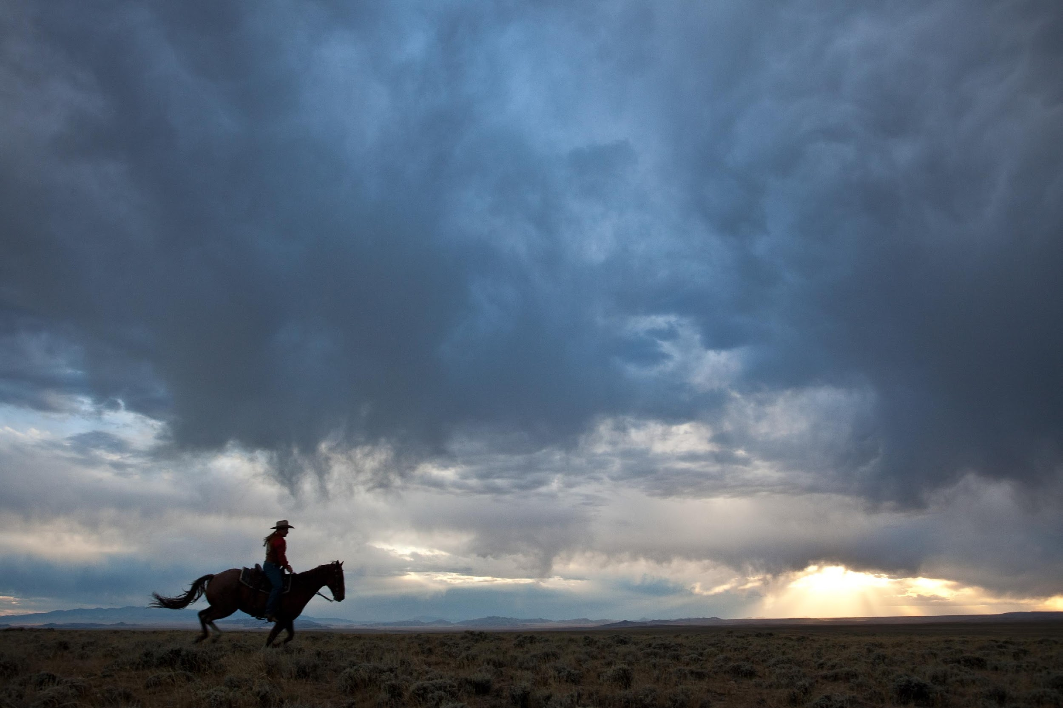
Note to Teachers
The following are writing prompts attached to the presentation of NPS Ranger Joe Reasoner.
This presentation is intended to
  Give your students writing prompts inspired by information about the Pony Express, its history, riders and relationship to Fort Laramie National Historical Site.
  Give your students some examples of writing by various authors
  Give your students inspiration to write for your classroom and to share with Rangers at Fort Laramie.
  Give “stops” for writing time on various suggestions.
  PLEASE, FEEL FREE TO USE ALL OR SOME OF THIS
  PRESENTATION.

Slide 2
WITH THESE RESOURCES YOU ARE ALLOWED TO
- print as many copies as needed for your classroom and for the
students under your immediate instruction.
- use in conjunction within a secure and closed online environment,
such as Google Classroom or Schoology. This means only people in
your online “classroom” will have access to the material.
-share with partnering teachers in your building
YOU ARE NOT ALLOWED TO
- post this resource on any class/personal website or blog.
- edit, redistribute, sell, or post this resource as your own.

Slide 3
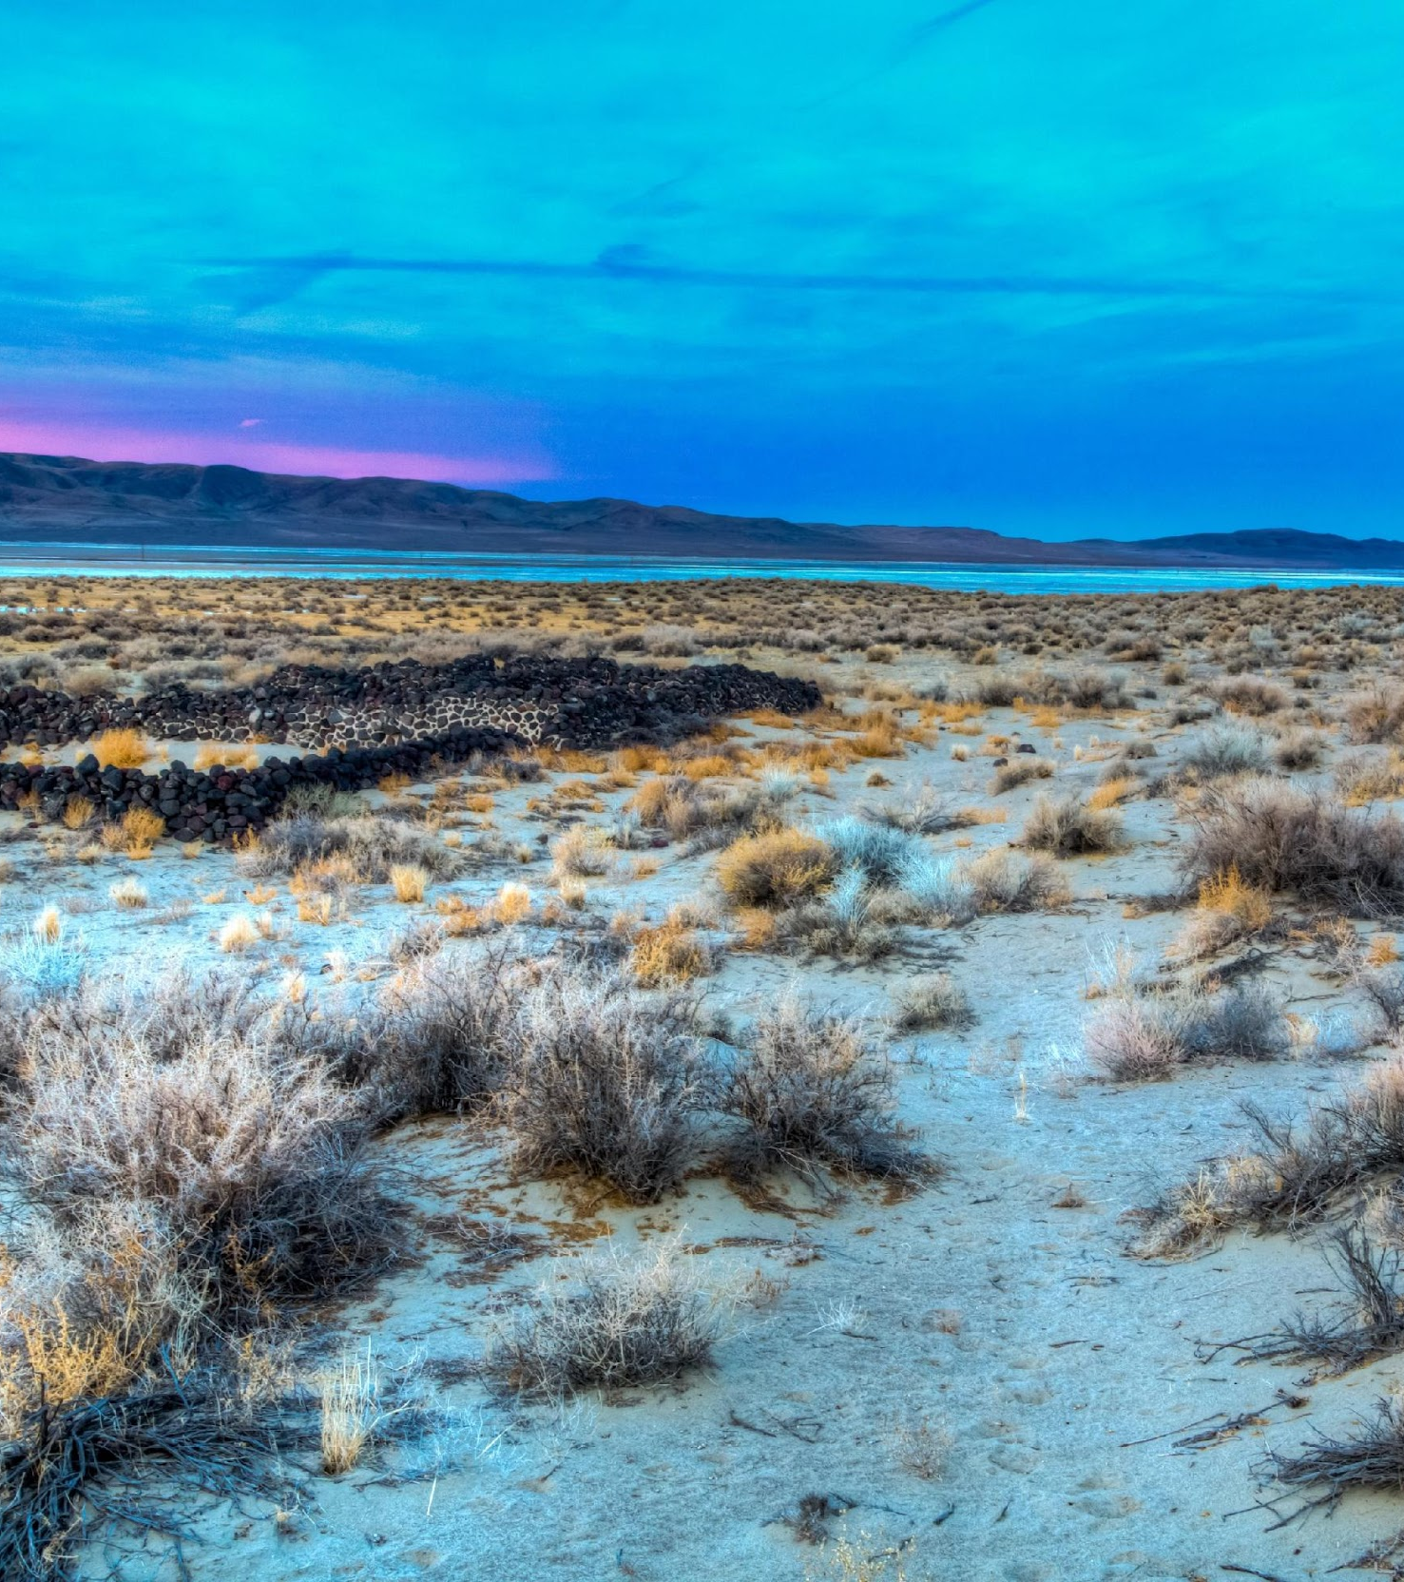
Fort Laramie National Historical Site
“The American West”
PONY EXPRESS: THE MAIL MUST GO ON…
A VIRTUAL FIELD TRIP AND WRITING EXPERIENCE
BY NPS RANGER JOSEPH REASONER AND TEACHER/CONSULTANT JAN KNISPEL, NEBRASKA WRITING PROJECT

Slide 4
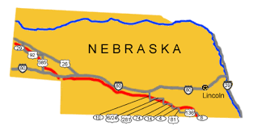
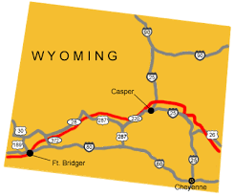
Innovation in Communication!
WRITING ACTIVITY:
The Pony Express was a new method of receiving communications. Write about how you would plan for a new technology in the 21st century that would change how we communicate. What kind of communication might that be, what kind of planning would it take, where would it have to go, how much would it cost? Who would be responsible for completing the job of communication?
The maps above show the route of the Pony Express, a new journey and
method of sending communication in 1860.
https://www.nps.gov/poex/planyourvisit/tour-route-nebraska.htm

Slide 5

Communication and Innovation
WRITING ACTIVITY
Consider computers and cell phones. The first computers filled an entire room. When cell phones were first available, they were the size of a small loaf of bread. How do you suppose the first computer or cell phone inventor felt?
How was that person like the individuals who first conceived of the Pony Express?
How do you suppose the first cell phone user felt the first time using that phone? Contrast the first use of the cell phone to the persons who first received or sent a letter by the Pony Express.
Today you can own a computer that is the size of a large book or a cell phone that fits in the palm of your hand to a watch you wear on your wrist to answer your phone.
Write about how the ability of people to receive communication by the Pony Express is equal to using a cell phone or other technology today.

Slide 6
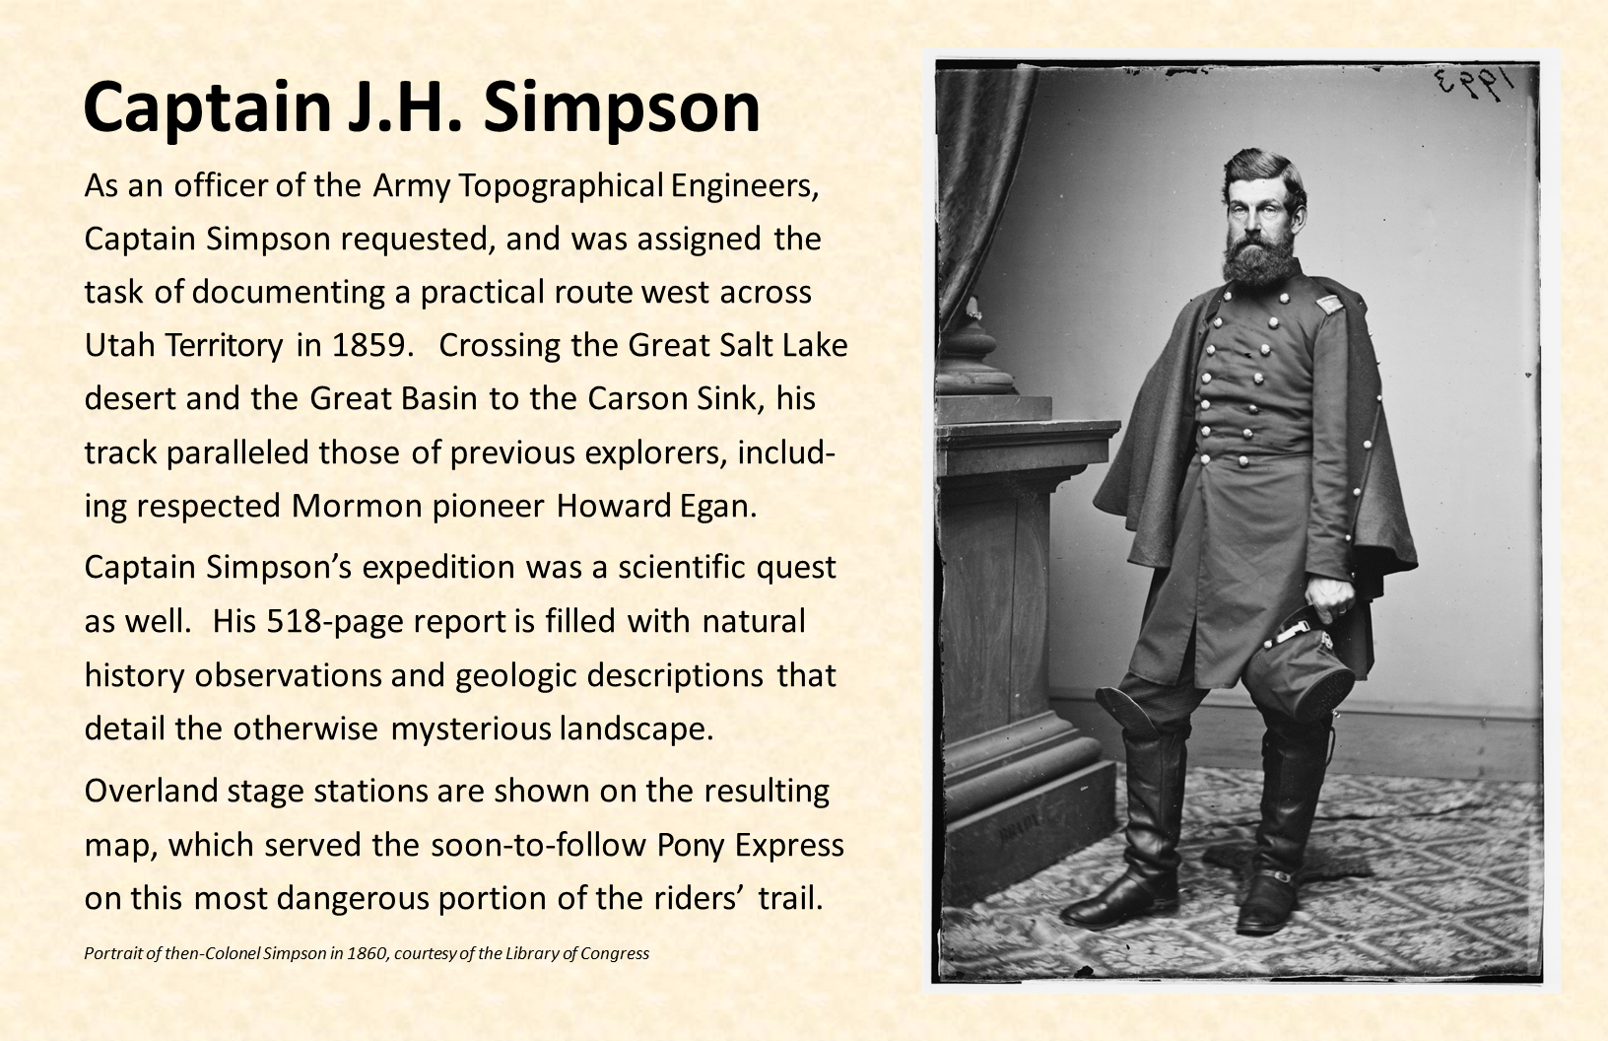
Planning The Route
WRITING ACTIVITY:
Consider what kinds of skills a person needs to plan a route across the continent.
What have you explored? What was that like?
Right now, a robot is the exploring Mars How are these two instances of planning and exploring alike and different?

Slide 7
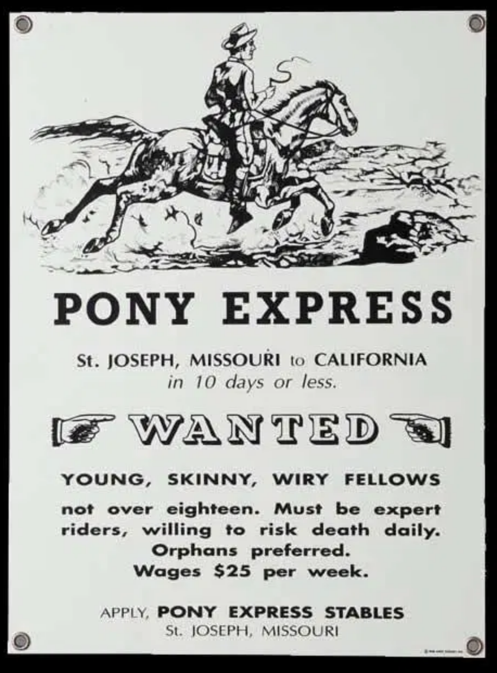
HELP WANTED: PONY EXPRESS RIDERS
WRITING ACTIVITY;
Being a Pony Express Rider was a new and unusual job created for a specific purpose in 1860. Why were orphans preferred? What decisions must the first Pony Express Riders must have had to make to take this job?
Write about how it must have felt to be the first Pony Express rider. Consider the dangers of doing a job that was totally new/that no one had done before. How would this equate to jobs today? What kind of job might be created today that would be totally new and different and what kind of technology would need to be used to complete such a new job?

Slide 8
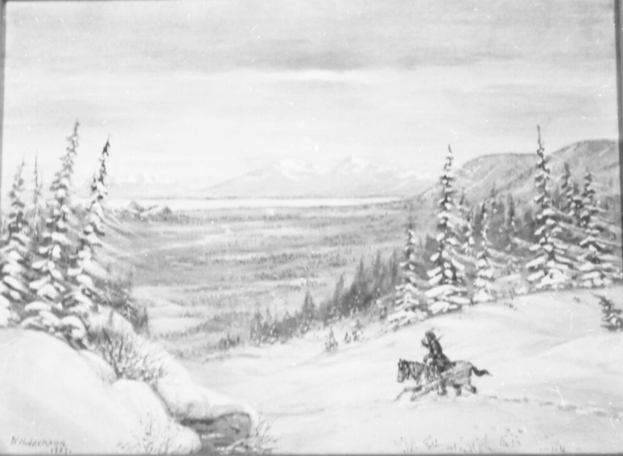
We’re the Riders By Dave Rhodes (a descendant of Major Howard Egan)
We’re all excellent horsemen
and the mustang is our ride . . .
the wilder and faster the better
to get the job done in stride.
An oath we all took in earnest
and made a promise not to fail.
We’re the Pony Express riders,
the boys that carry the mail.
You could say that we are brave
and we have all been scared,
but mostly we’re just too young
to know what should be feared.
Racing time and the telegraph
out here on the lonely trail . . .
we’re the Pony Express riders,
the boys that carry the mail.
It’s a thankless life we lead
’cause nobody knows our name
We are silhouettes on the hills
and shadows on the plains.
What we carry runs the nation
and we execute our duty well.
We’re the Pony Express riders,
the boys that carry the mail.
We’ve been shot at and ambushed,
chased down and almost kilt,
soaked through and frozed,
survived heat that made us wilt.
The food is a little scarce
and the pay is hardly scale.
We’re the Pony Express riders,
the boys that carry the mail.
Major Howard Egan Family Foundation 2021
https://majorhowardegan.com/2013/10/pony-express-poetry/

Slide 9
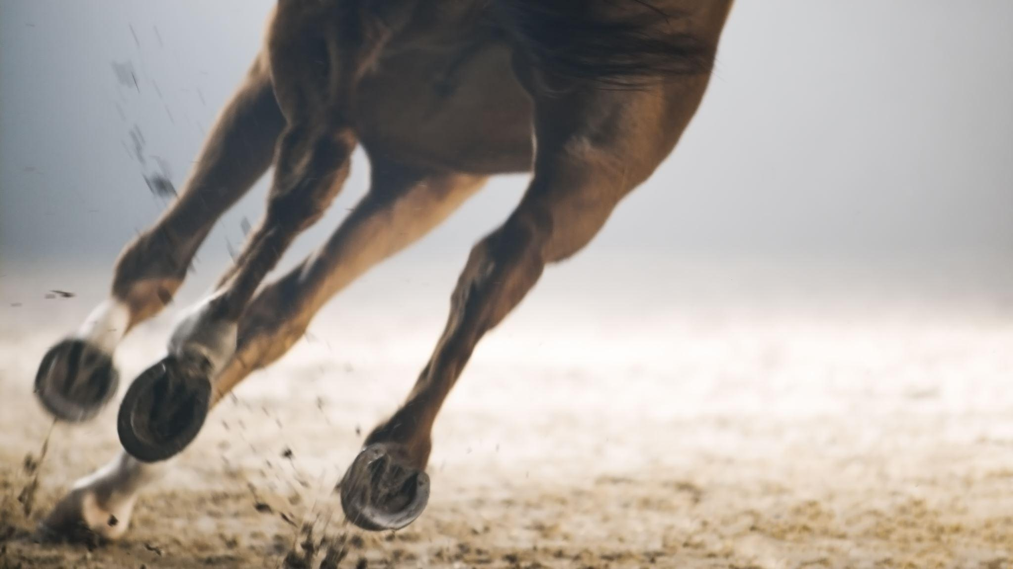
Who were the Pony Express Riders?
Names of Pony Express Riders. Pony Express National Museum online. 2020. https://www.ponyexpress.org/pony-express-riders Accessed December 30, 2020.
Listed are 227 names of Pony Express Riders. This list may or may not be complete as there never was a list kept by the Pony Express company.
WRITING ACTIVITIES: Look at the list of names and choose one. Write his story from your imagination. Where did he come from? Why did he want to be a rider?
How must he have felt when chosen? What was it like to be a rider?
Imitate the poem on the previous slide and write a description of doing a job which few people do that requires a great deal of courage.

Slide 10
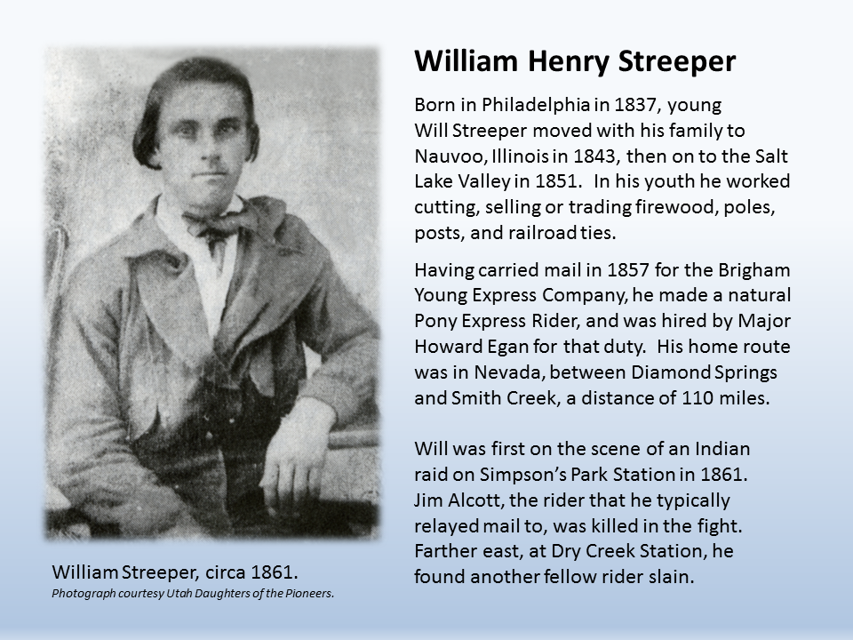
Some of the Pony Express
Riders….

Slide 11
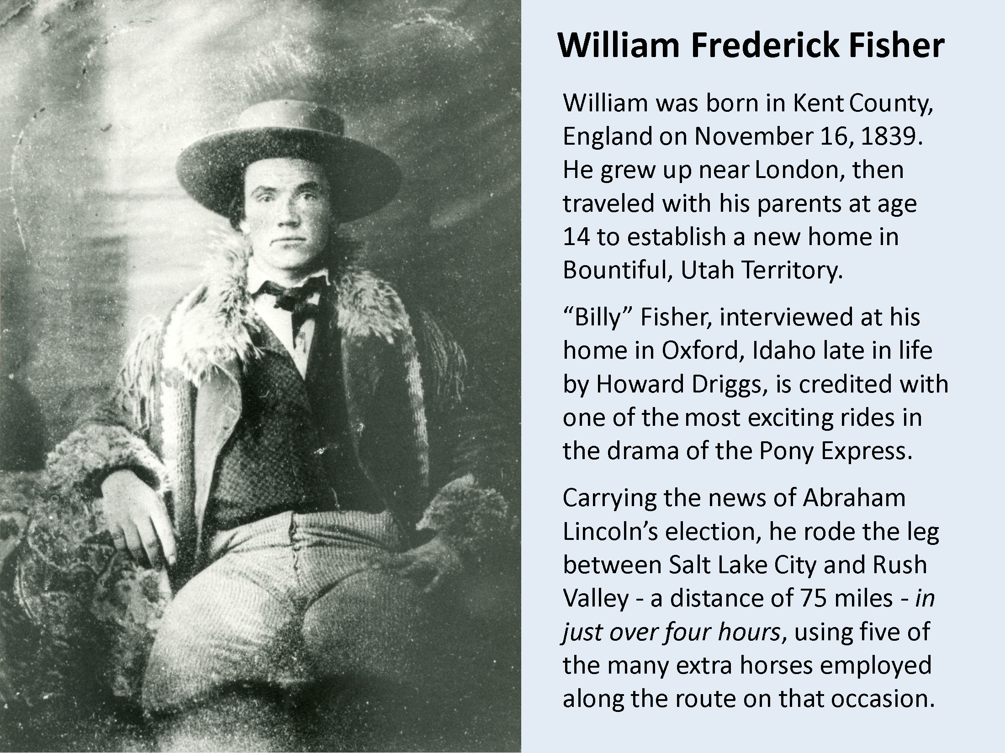





Slide 12
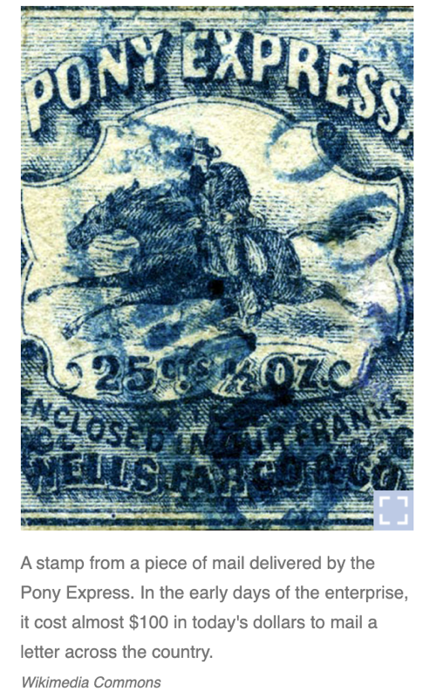
“HERE HE COMES!”
Every neck is stretched further, and every eye strained wider. Away across the endless dead level of the prairie a black speck appears against the sky, and it is plain that it moves. Well, I should think so!
In a second or two it becomes a horse and rider, rising and falling, rising and falling—sweeping toward us nearer and nearer—growing more and more distinct, more and more sharply defined—nearer and still nearer, and the flutter of the hoofs comes faintly to the ear—another instant a whoop and a hurrah from our upper deck, a wave of the rider’s hand, but no reply, and man and horse burst past our excited faces, and go winging away like a belated fragment of a storm!
Twain. Mark. “Chapter VIII”. Roughing It. Project Gutenberg. https://www.gutenberg.org/files/3177/3177-h/3177-h.htm#linkch08 Accessed December 30. 2020.

Slide 13
The Excitement of the Rider described by Mark Twain
WRITING ACTIVITY:
Mark Twain, one of America’s foremost writers at the time, anticipates and describes the fast approach and departure of a Pony Express rider.
Write about an event or activity that you found as fascinating as Mark Twain saw the Pony Express rider.
Write as if you were the Pony Express rider seeing Mark Twain or others watching you speed by. What would you be doing and thinking as you went by? What would it mean to see people celebrate you doing this job?
What kind of job today would be as fascinating to watch as Twain found seeing the Pony Express rider? Describe a job or activity in the same way Twain did seeing the Pony Express rider. Make this writing as exciting as possible so readers would feel the excitement of the activity as Twain did.

Slide 14
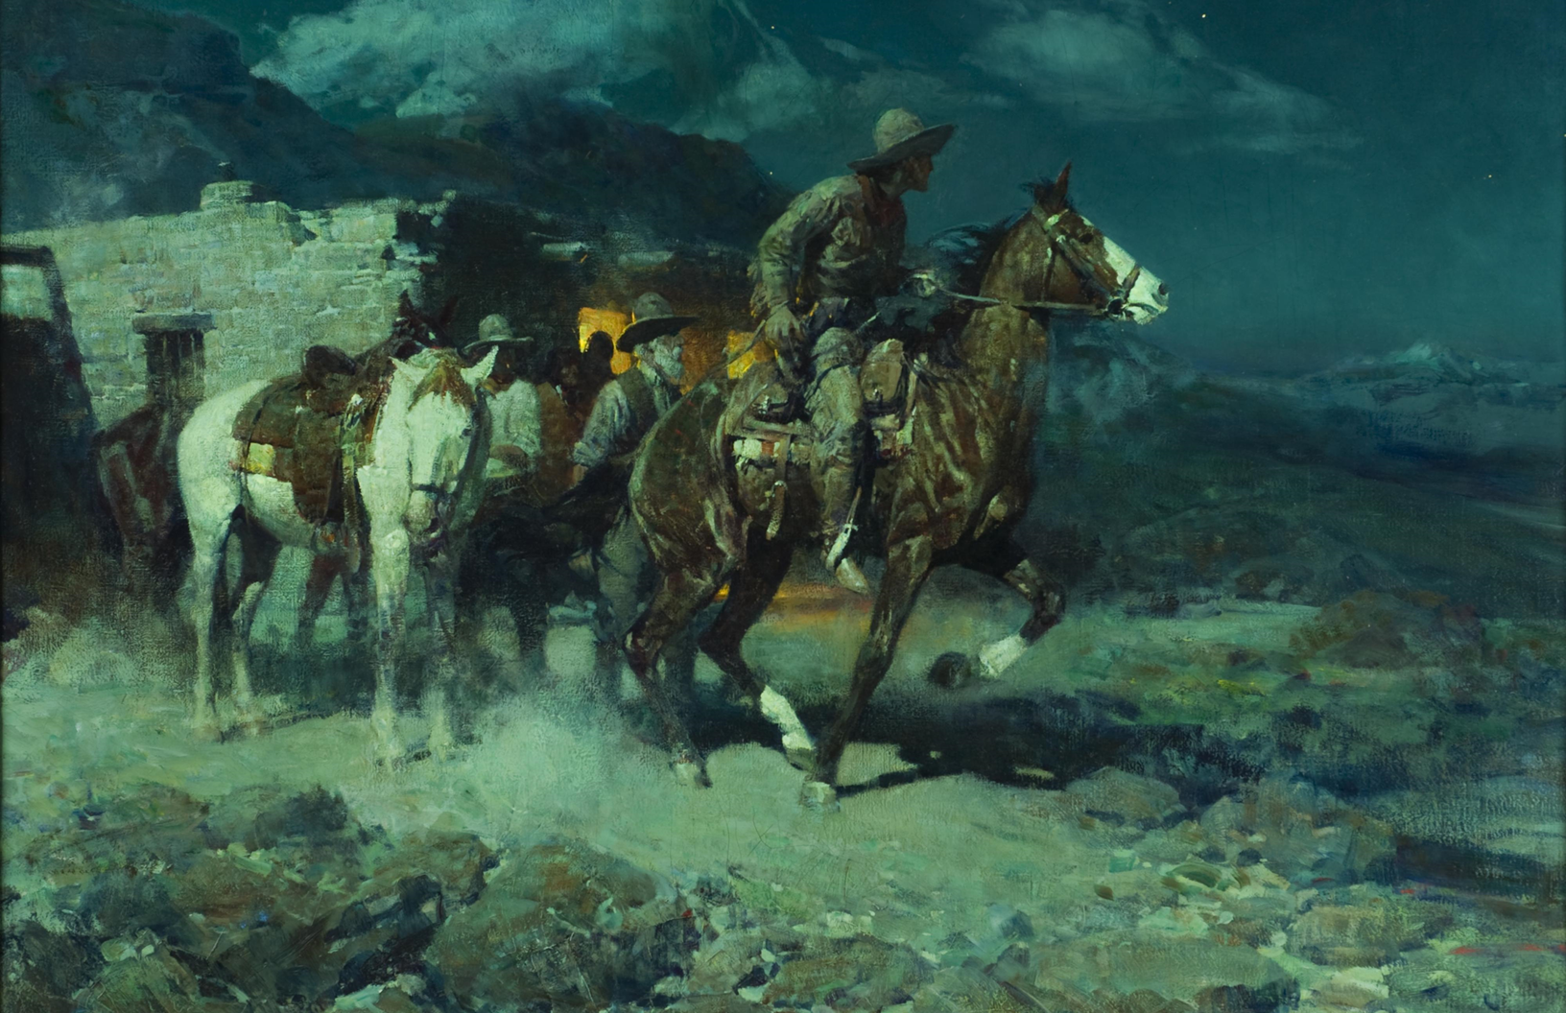
Hiring of the Pony Express
Riders …
The firm of Russell, Majors, and Waddell had a reputation
as an employer with ethical standards. Their written instructions to bullwhackers
about how to care for draught animals on the old Santa Fe Trail,
for example, is remembered and respected in the west to this day.
Likewise, they were careful and demanding about the men they hired.
Rider J.G. Kelley remembered that “the boys had the greatest veneration
for them because of their general good treatment at their hands.
They were God-fearing, religious, and temperate themselves,
and were careful to engage none in their employ who did not come up to their standard of morality.”
Notes:
Inspired by love of their country and confident in their skills, about 120 young men would initially respond to the opportunity of a lifetime, by answering the call to ride for the Pony Express. Most of them were over fifteen, but few were over twenty years old. Nearly all had ranching, livestock raising and horse-handling skills, knew how to shoot, and did not lack for courage and common sense. The many hazards that they faced could rise up in their path with little warning.

Slide 15
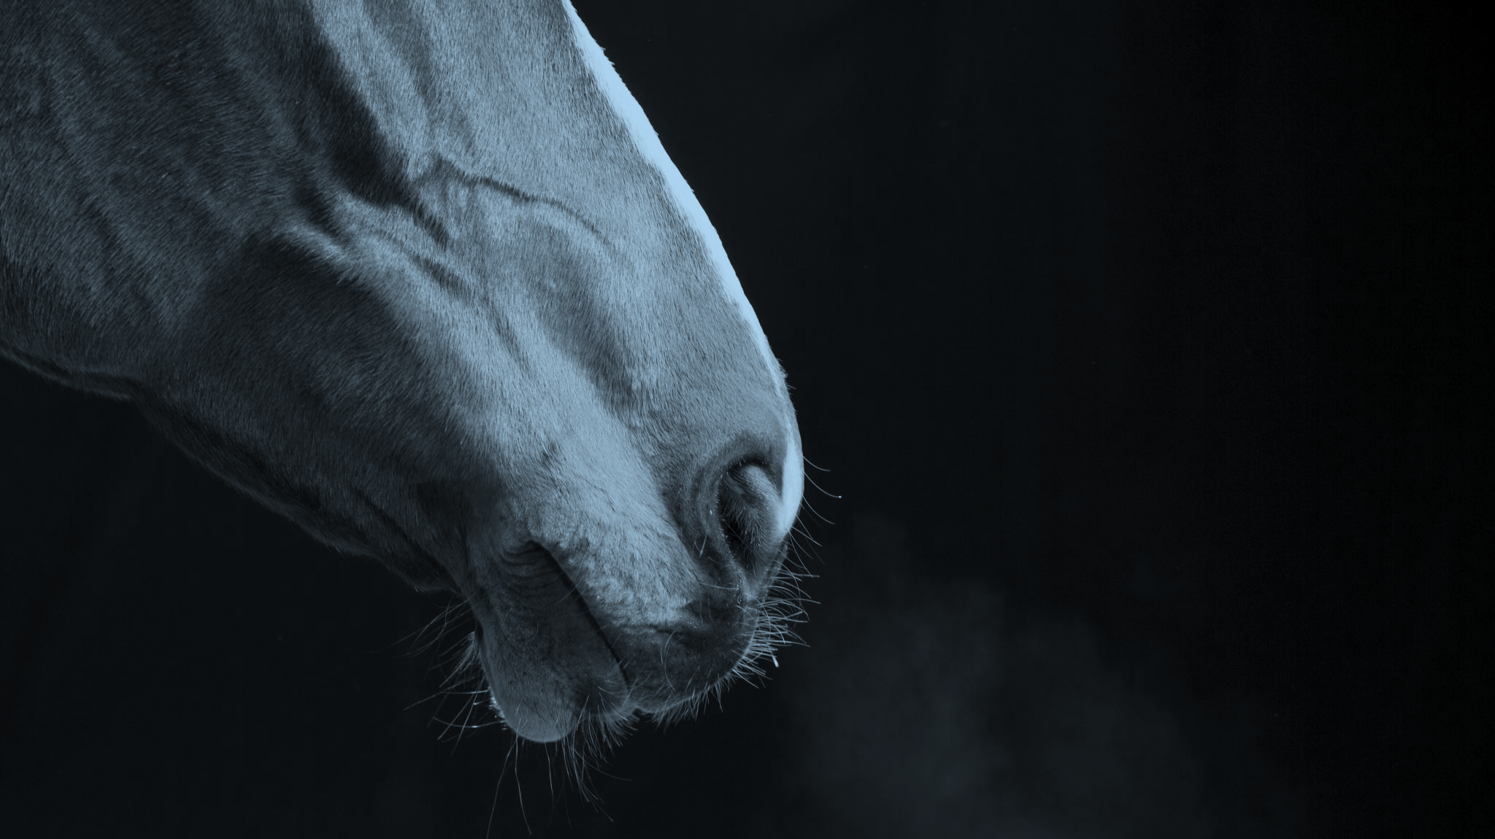
160th Anniversary of the Pony Express.
The U.S. Postal Service celebrates the history of the Pony Express, despite its short life.
"It's a legend, and I think deservedly so," says Postal Service historian Meg Ausman. "Because something is successful in its own time and not successful forever, I don't think that diminishes the importance of it at that time."
150 Years anniversary, Pony Express Rides On In Legend. National Public Radio online. 2021. https://www.npr.org/templates/story/story.php?storyId=125447499 accessed January 7, 2021.
WRITING ACTIVITY: Write about how the riders of 1861/62 would feel to know that their job was being celebrated 150 years later. What kinds of jobs do you think have been or will be obsolete that may be celebrated in the future? Who would do those jobs? Why would the jobs become obsolete? Why would it be important to celebrate them?

Slide 16
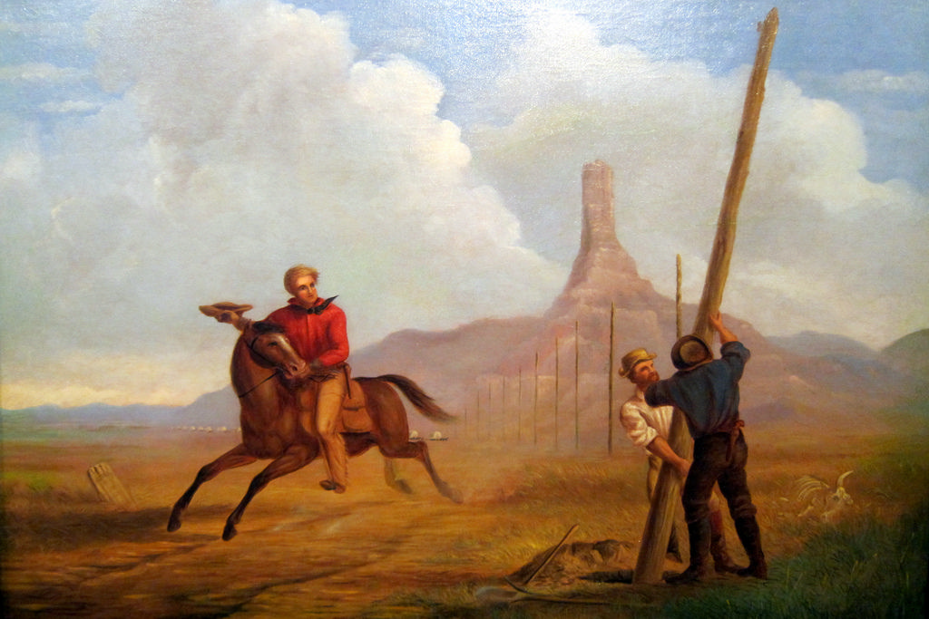
The End is Near
Even the horses of the Pony Express seemed to sense that the operation was drawing to a close, almost as soon as it got underway. They did their part and the enterprise was in fact rewarded with a contract by the Postmaster General, but the coming telegraph would cut short its performance.

Slide 17
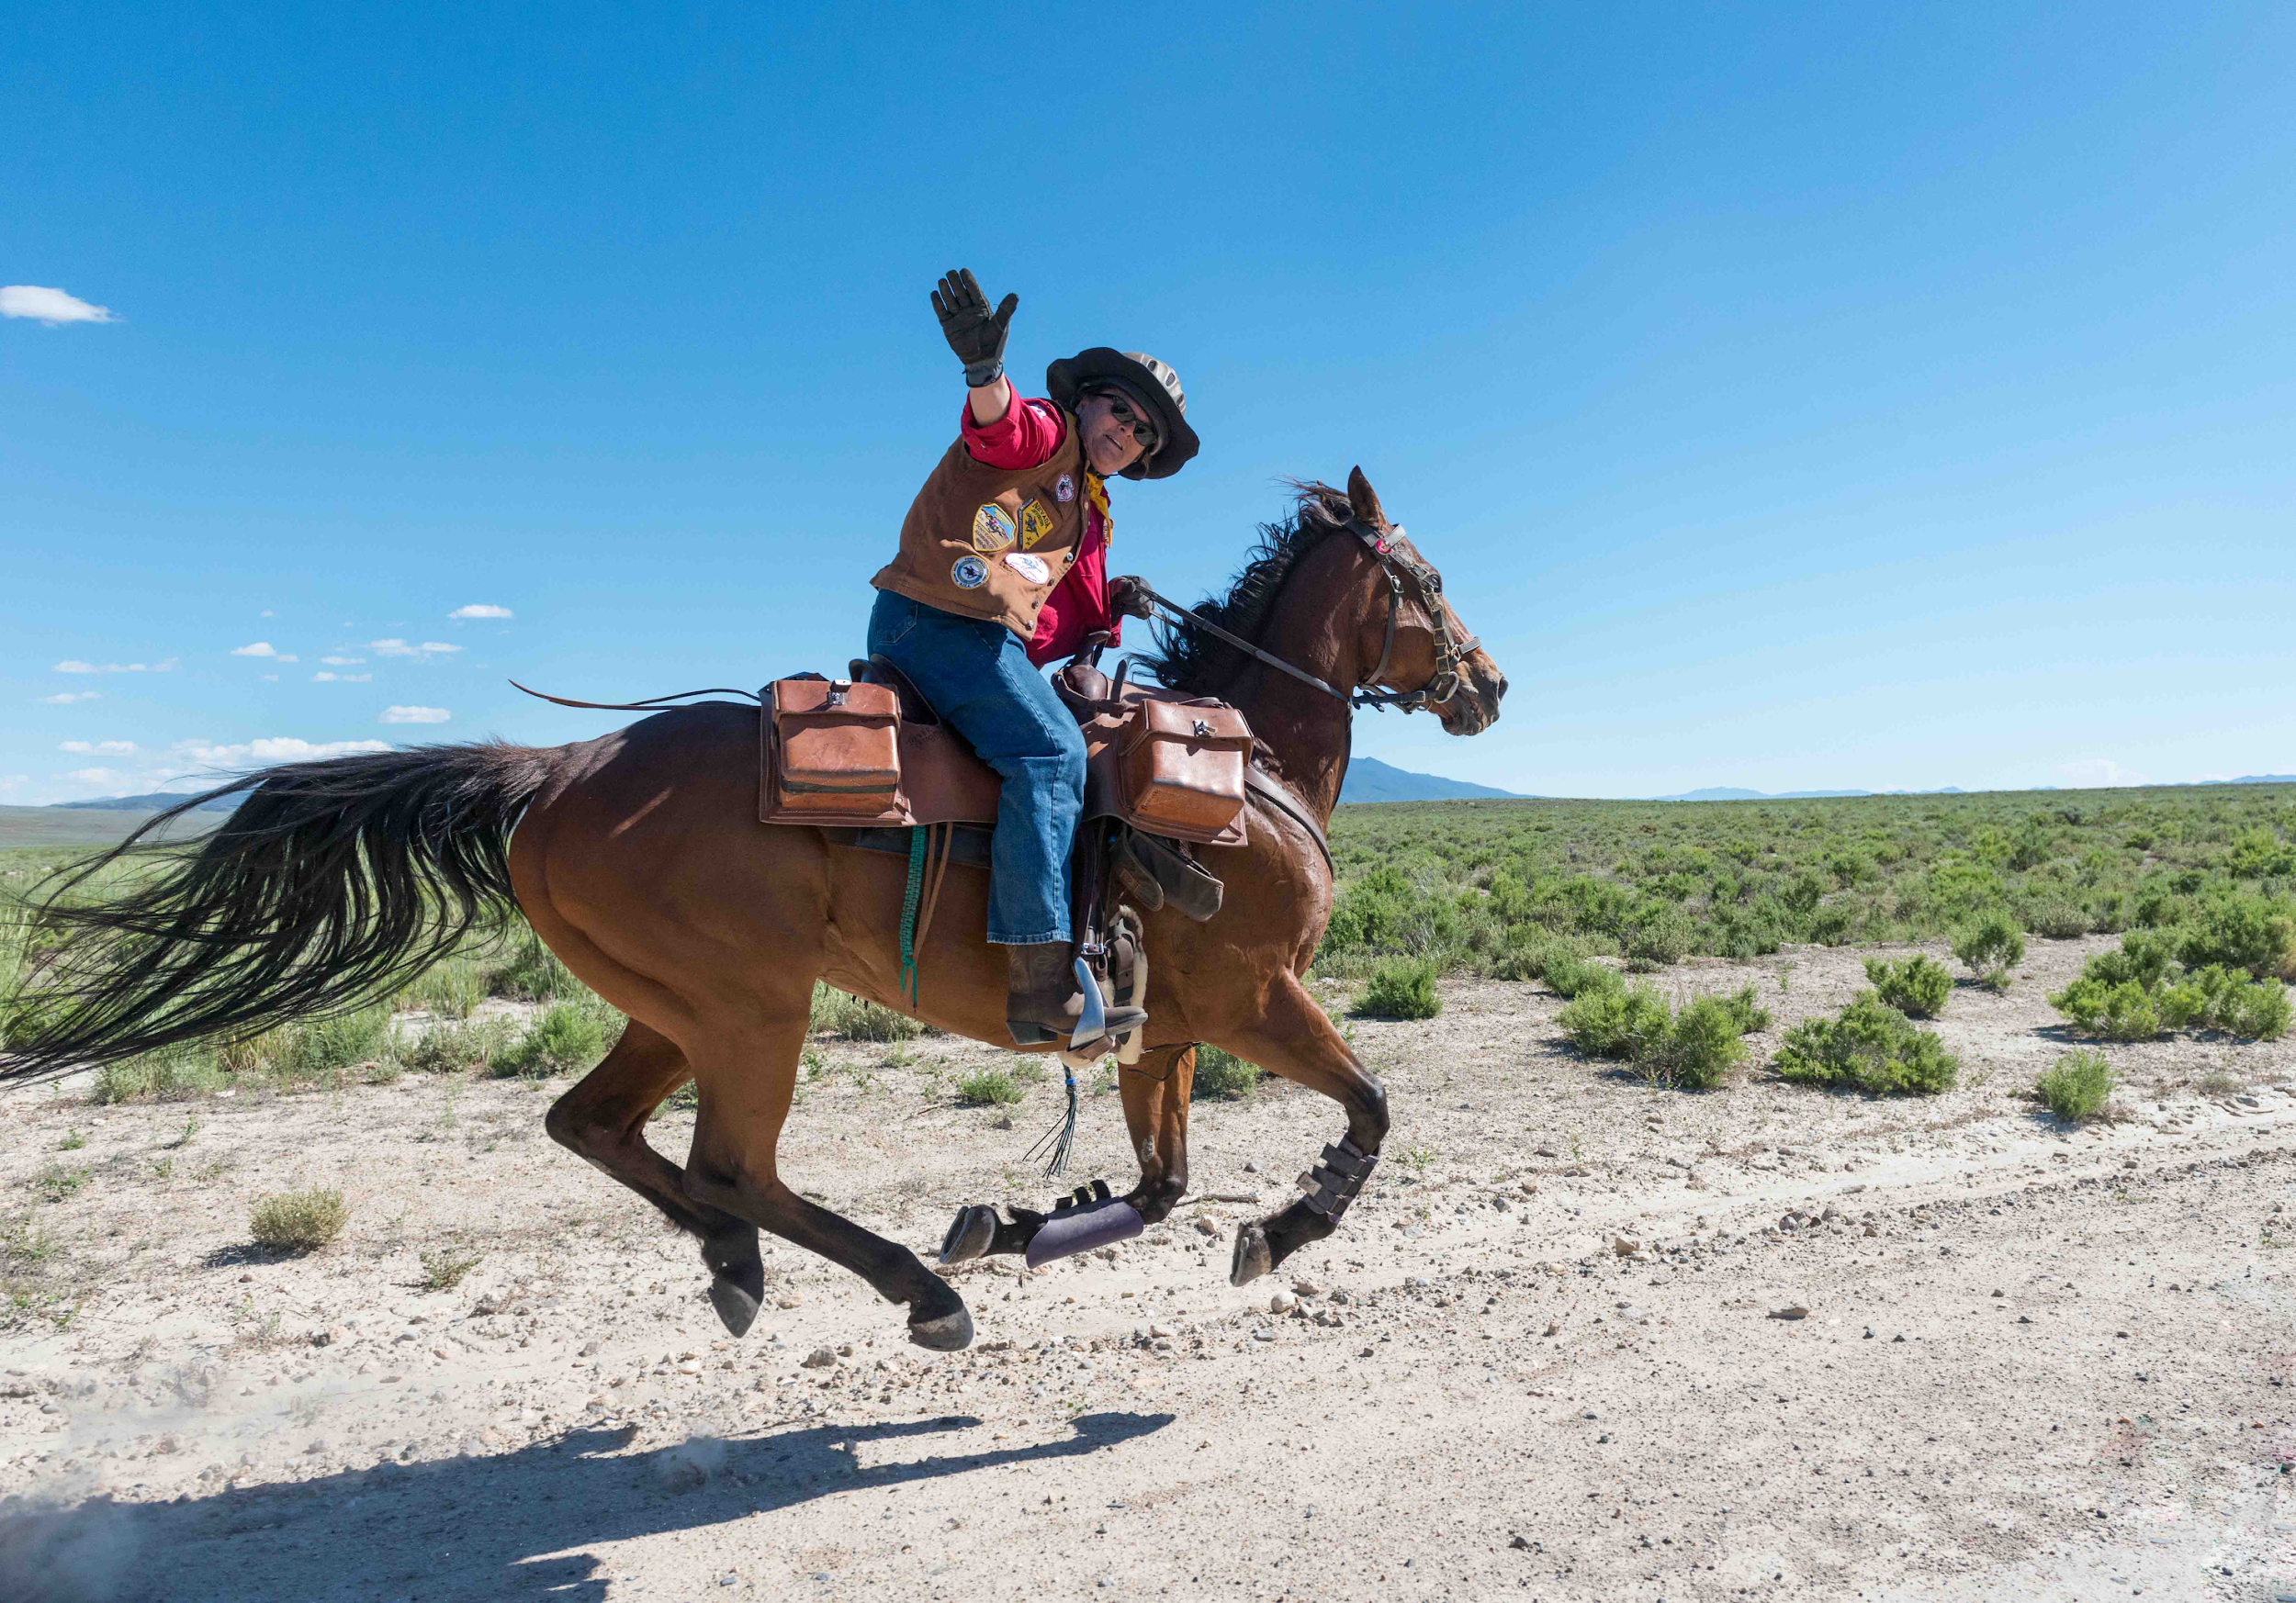
Write about your experience with the Pony Express virtual field trip!
After writing your first draft, share with another person or group.
  Don’t give a critique. Just appreciate what the other person/people wrote.
  Write a second draft for your instructor/teacher.
  Share your writing in your class and with the Rangers at Fort Laramie National Historical Site!
  GOOD WRITING AND GOOD LUCK!
Thanks to Marion Reid Miller of the Bureau
of Land Management for many
of pictures and illustrations in this power point.

