Slide 1
Mountain Men of Ft. Laramie
and their
TALL tales
Interpretation video by Chris Mather, Museum Curator Fort Laramie National Historic Monument

Slide 2
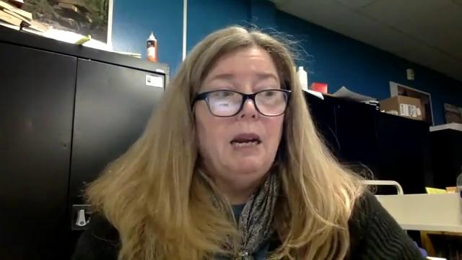

Slide 3
KWL chart
Worksheet/checklist

Slide 4
jjohnson@gceagles.org
Please share your completed stories with me at the above address!

