Slide 1
What is a Watershed?
From Precipitation to the River

Slide 2
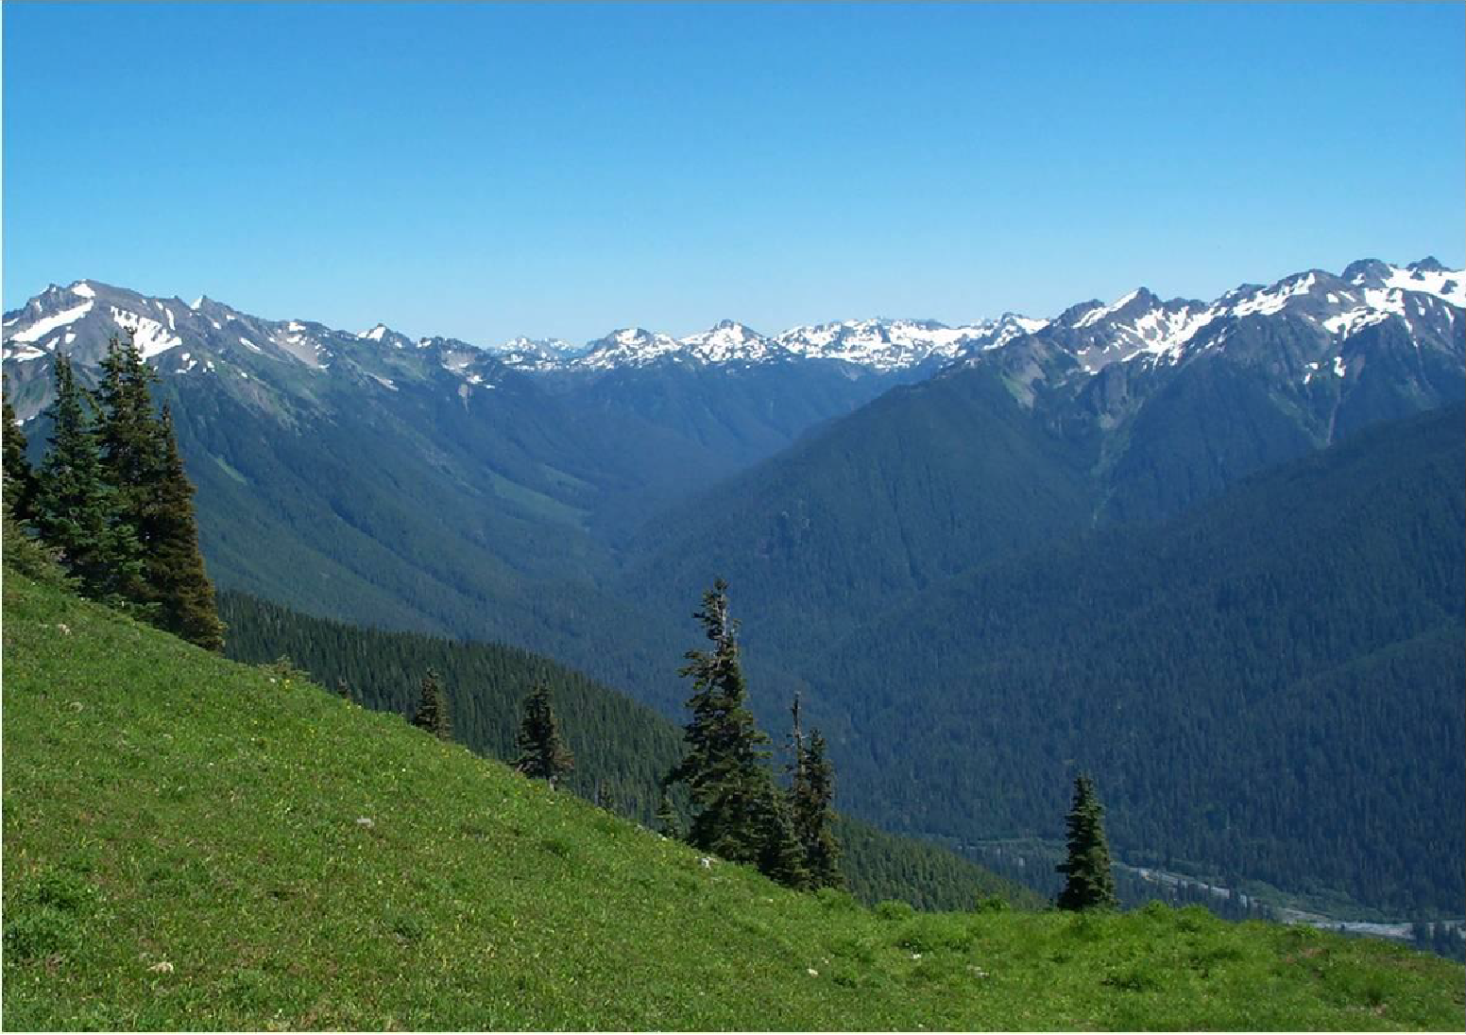
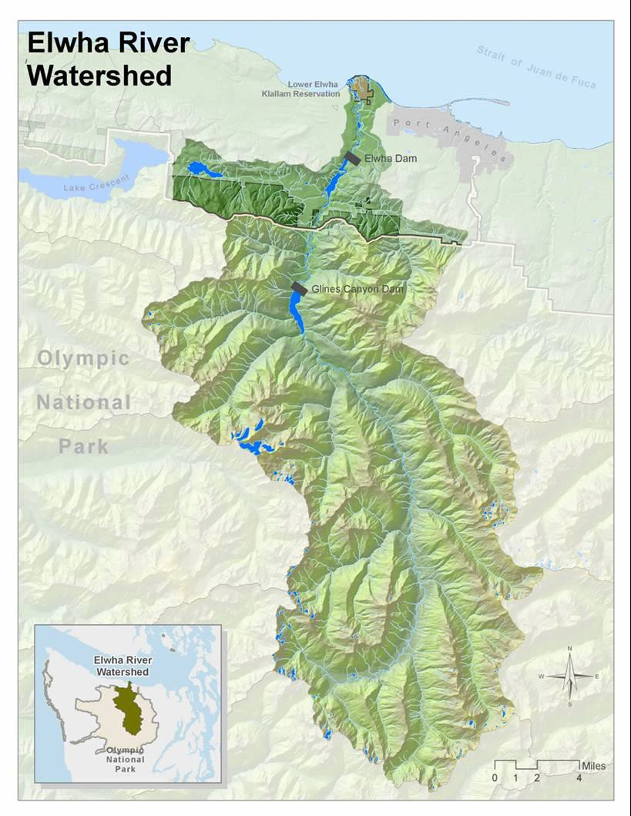

What is a Watershed?
All the area where precipitation that falls funnels down into a
river that flows to the sea.

Slide 3
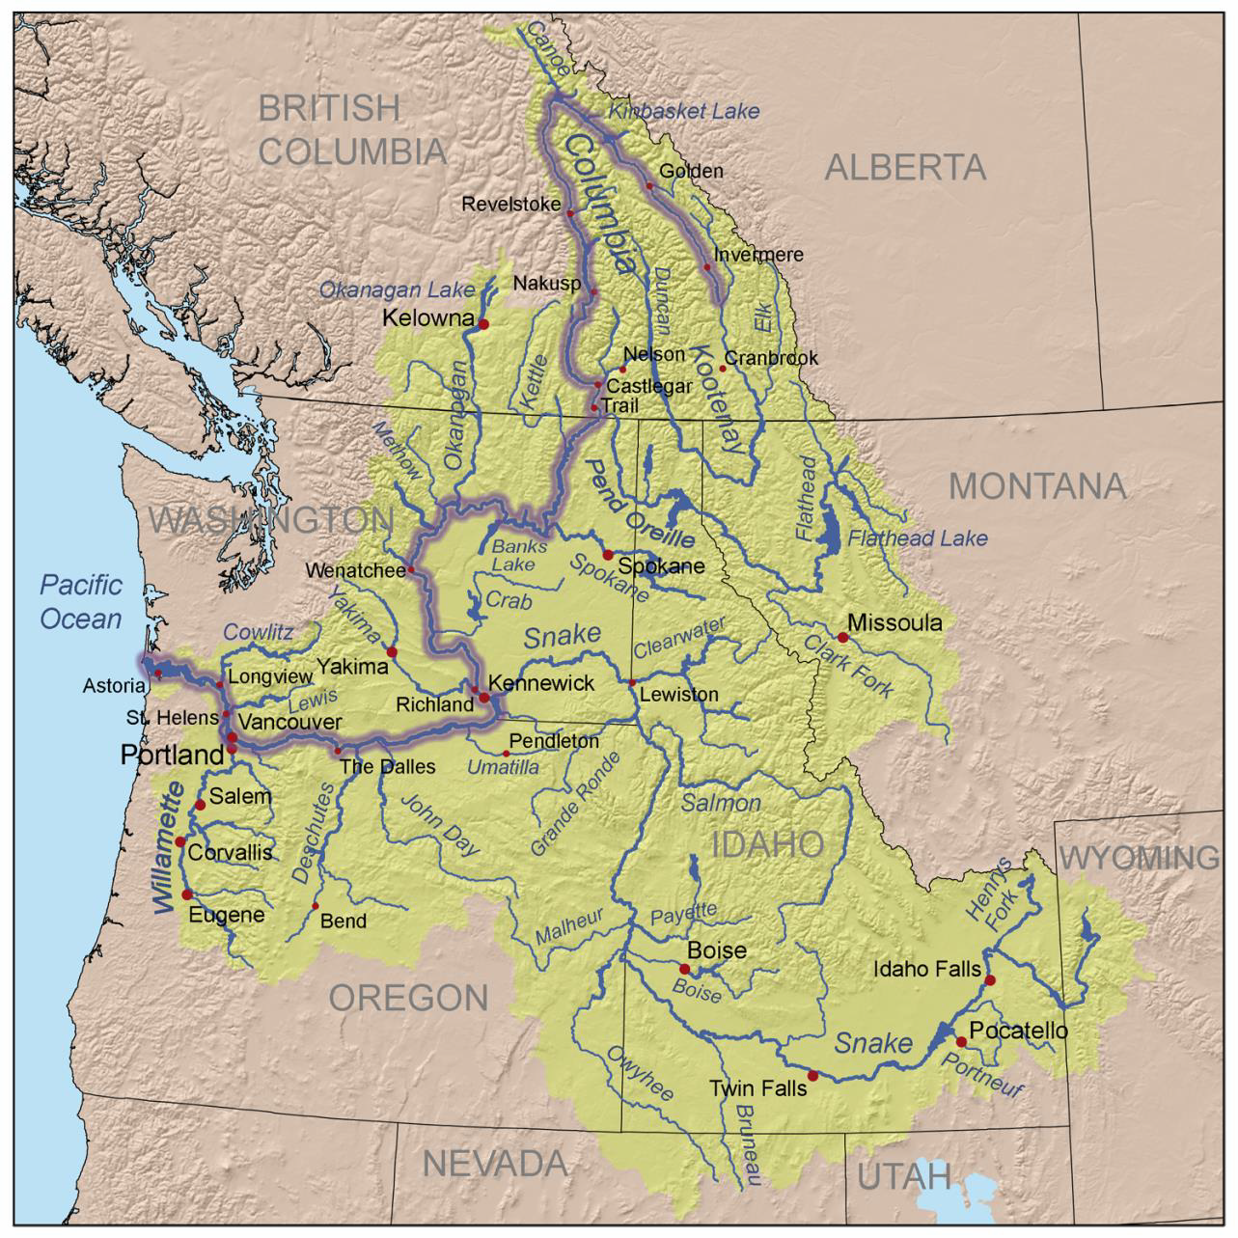
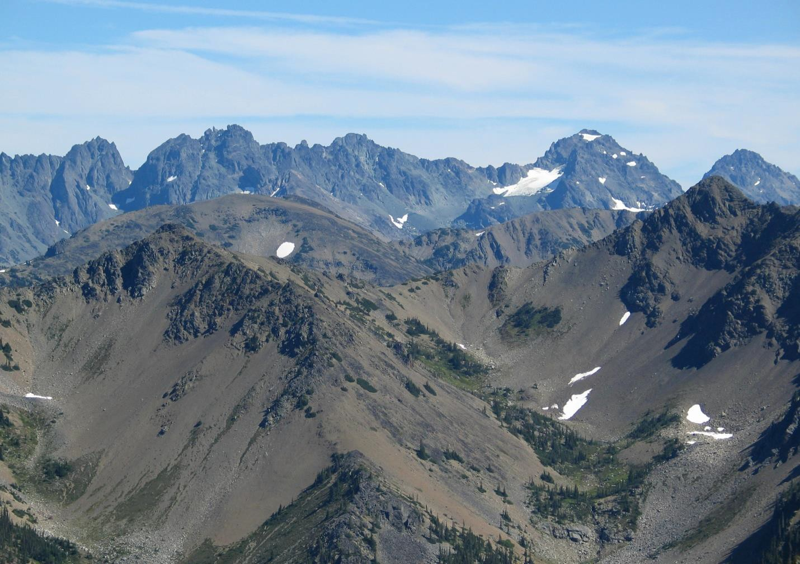




Watersheds Can Vary Widely in Scale
Columbia Basin
Basins are depressions surrounded by
higher terrain that collect water

Slide 4
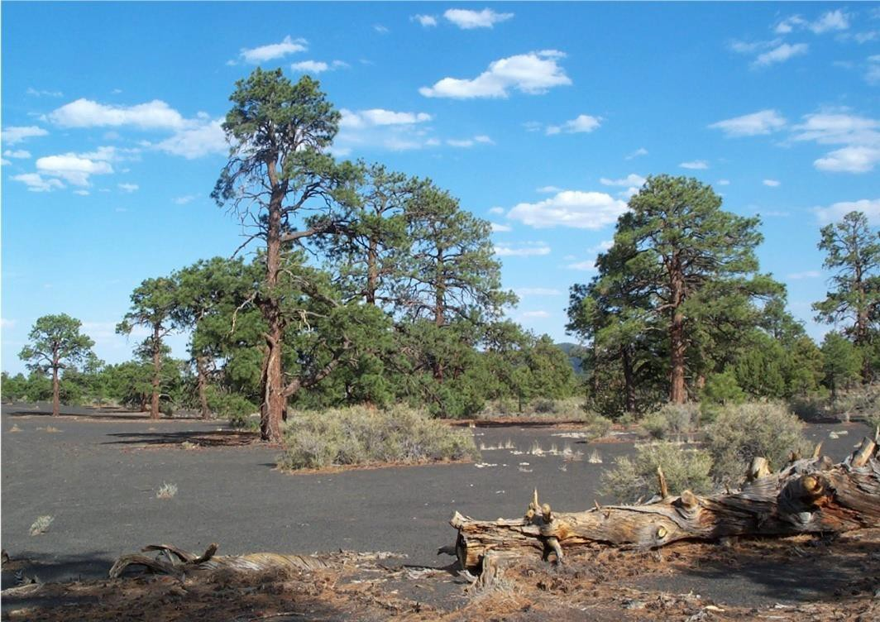
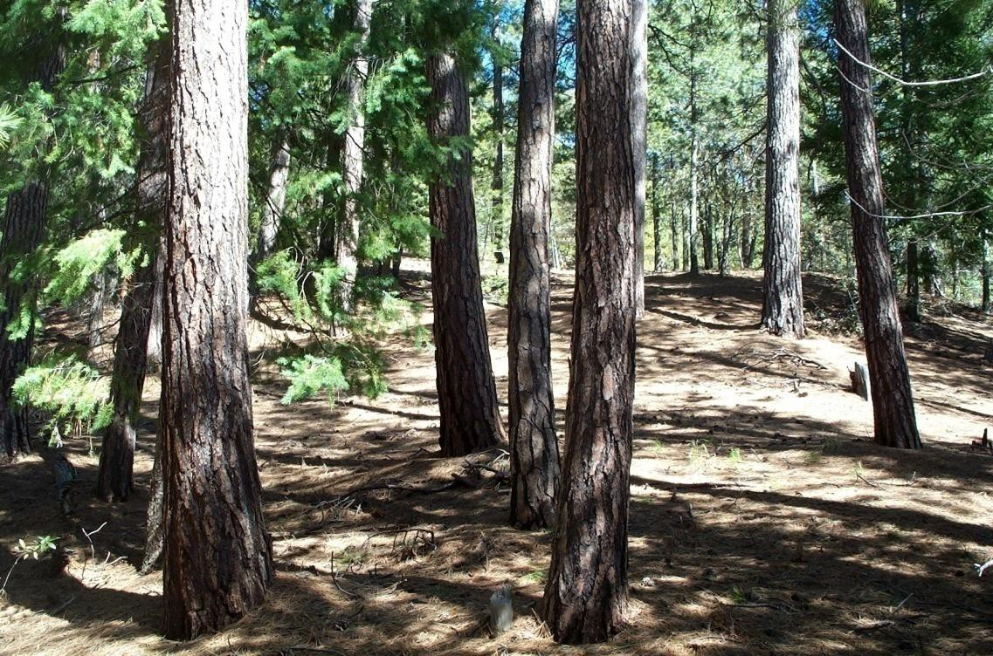
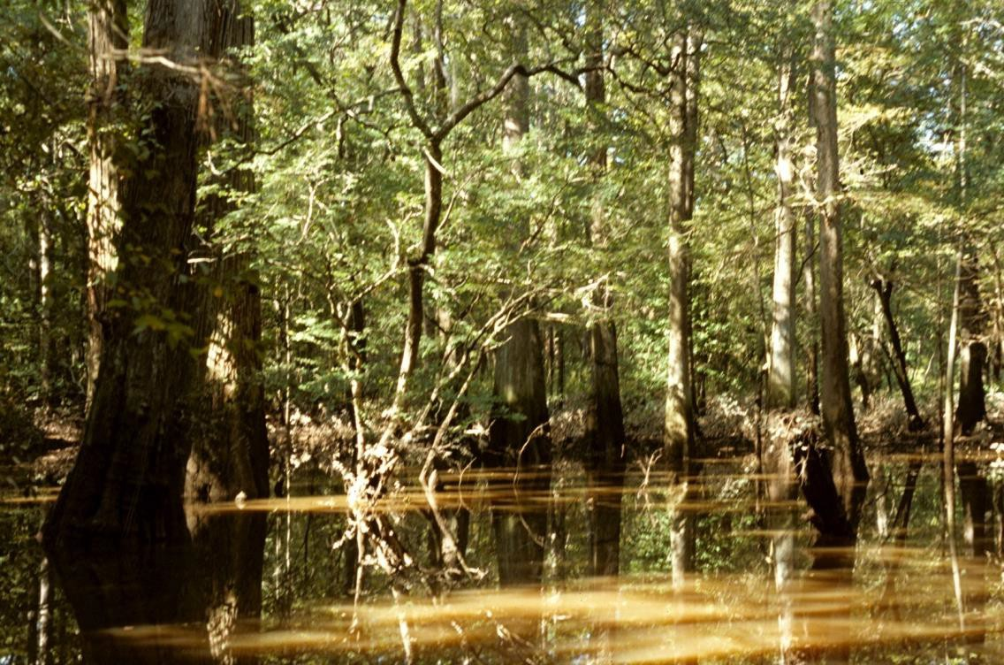
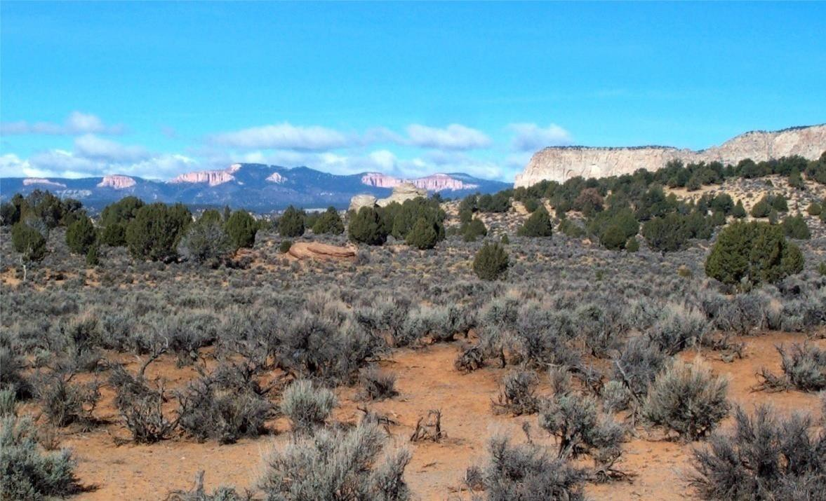
Infiltration: Surface Runoff or Infiltration

Slide 5
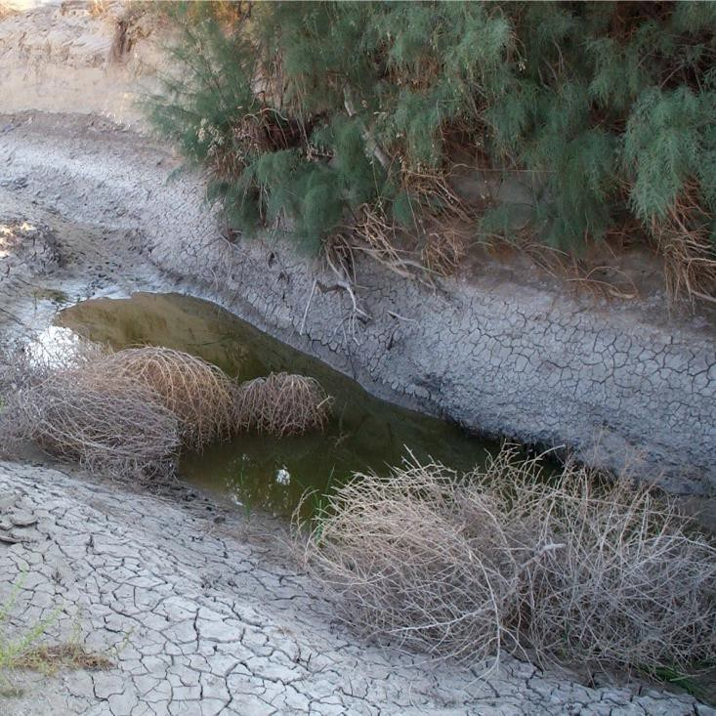
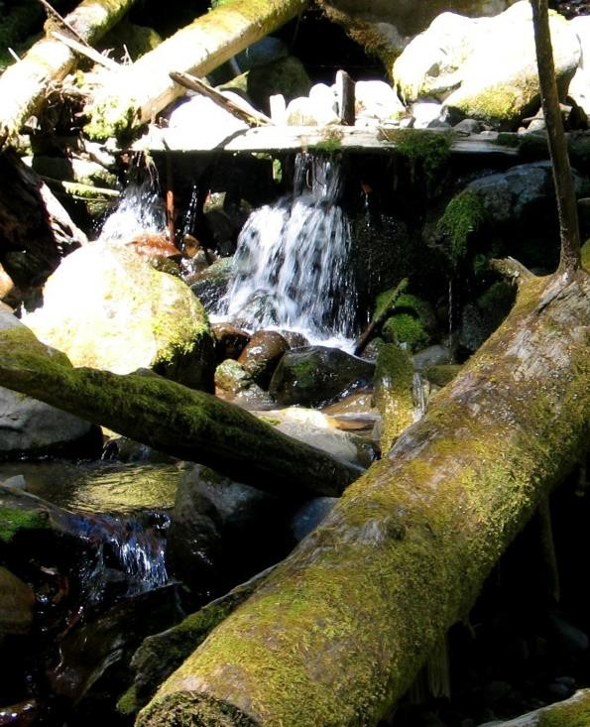
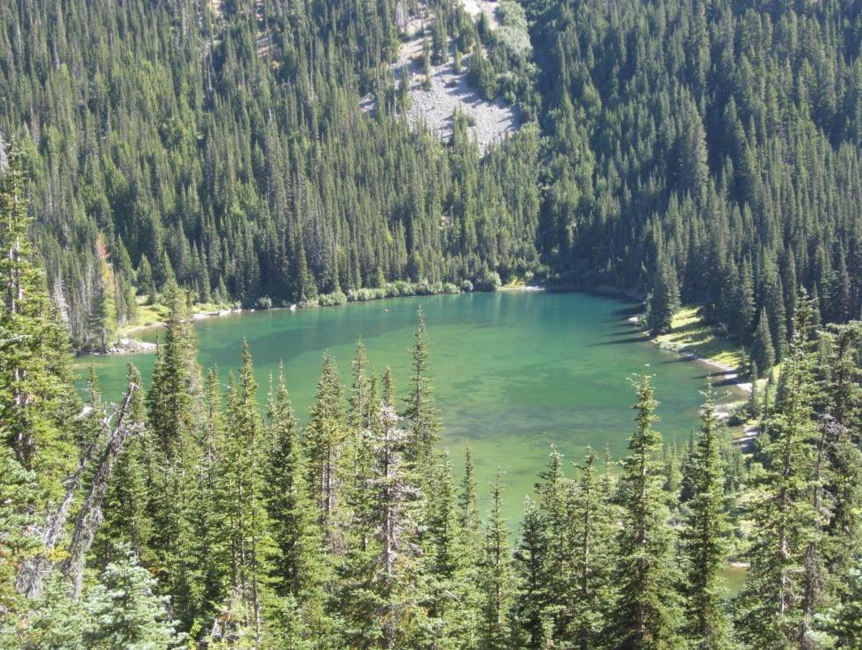




Aquifer and the Water Table
Pond
Spring
Aquifer
River

Slide 6
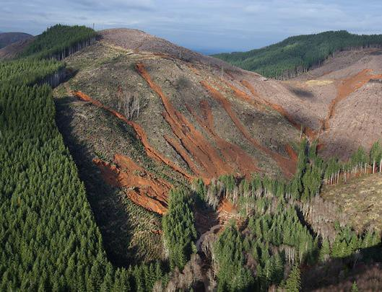
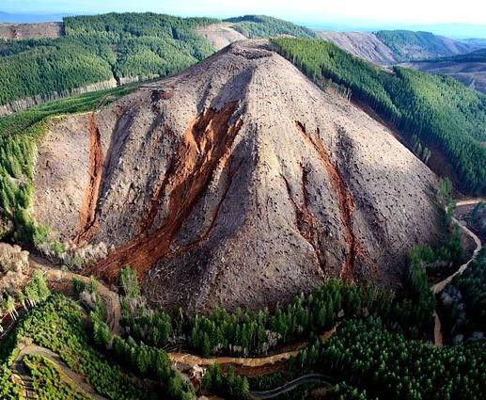
Effects of Surface Materials on
Infiltration and Surface Runoff
Why did the soils in the areas that were clear-cut have landslides and river flooding,
while the areas that still had trees suffer few problems?
Photos courtesy of Seattle Times

Slide 7

This project was made possible in part by a grant from
Washington’s National Park Fund.

