Slide 1
Transition to core program slide

Slide 2
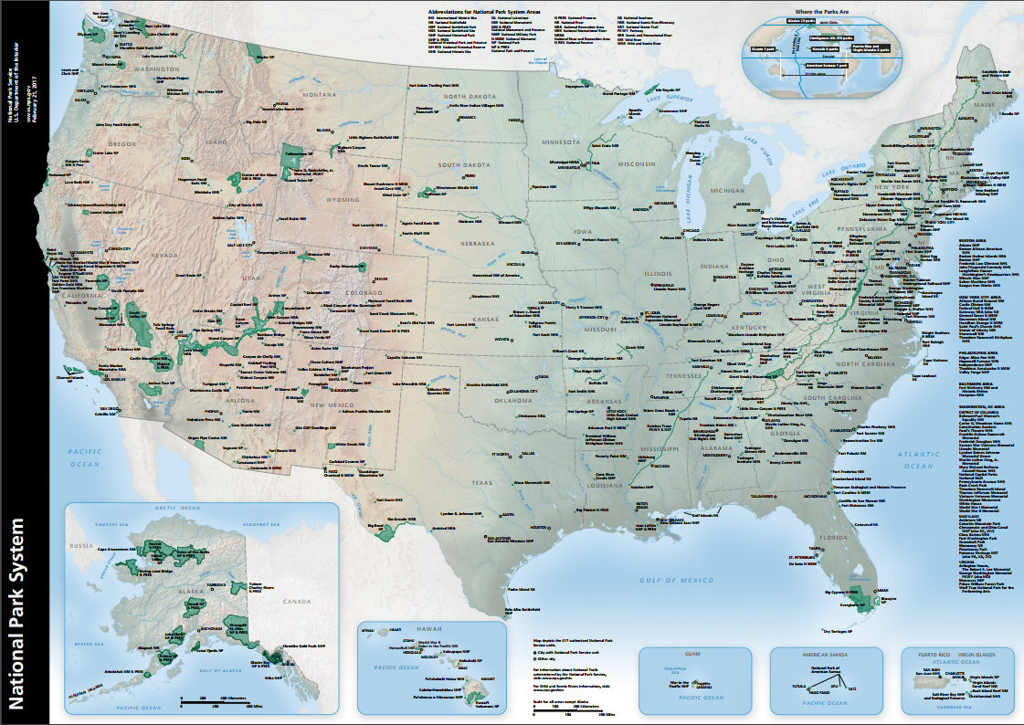
Map of the National Park Service sites

Slide 3
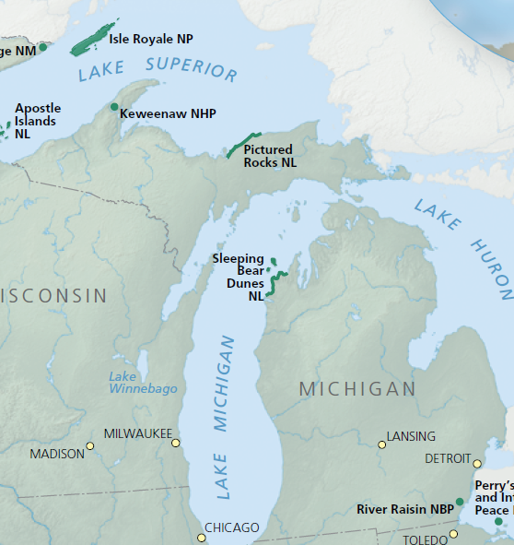
Map of the Great Lakes region showing Sleeping Bear Dunes National Lakeshore

Slide 4
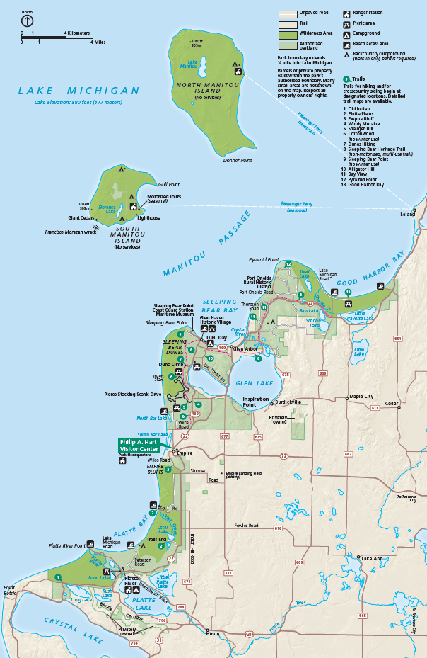
Detailed map of Sleeping Bear Dunes

Slide 5
“Find Your Park” welcome video
Notes:
Ranger: Grab a pencil and paper. I am going to play a video. Look or listen for something at Sleeping Bear Dunes you would like to experience. Write it down. If you have been to Sleeping Bear Dunes maybe you will get a new idea.
Teacher resource: Audio Described video available at: Audio Described - Sleeping Bear Dunes National Lakeshore Find Your Park - YouTube

Slide 6
Discussion slide for the welcome video
What did you take away from the video? Other thoughts?
Notes:
Ranger: What were the things you noticed that you’d like to do here at Sleeping Bear Dunes? Any other comments?

Slide 7
Introductory title slide
Watching our Watersheds
Sleeping Bear Dunes National Lakeshore

Slide 8
H₂O: The Chemistry of Water

Slide 9
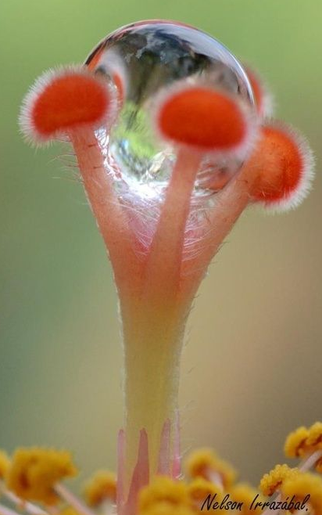
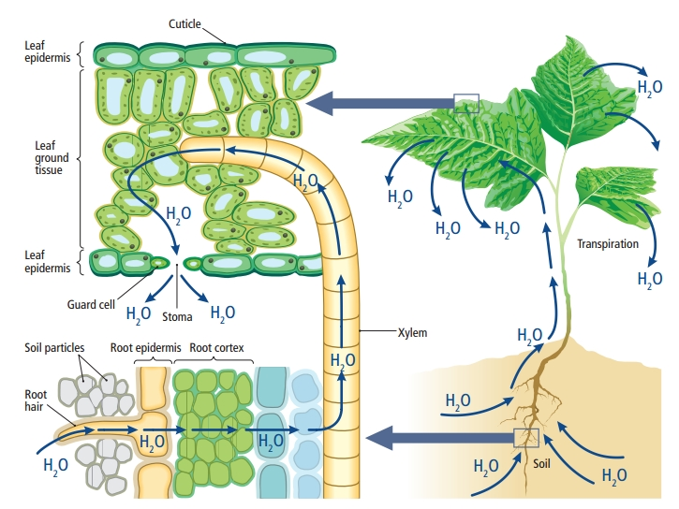
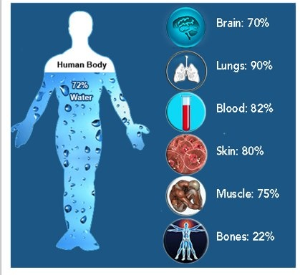
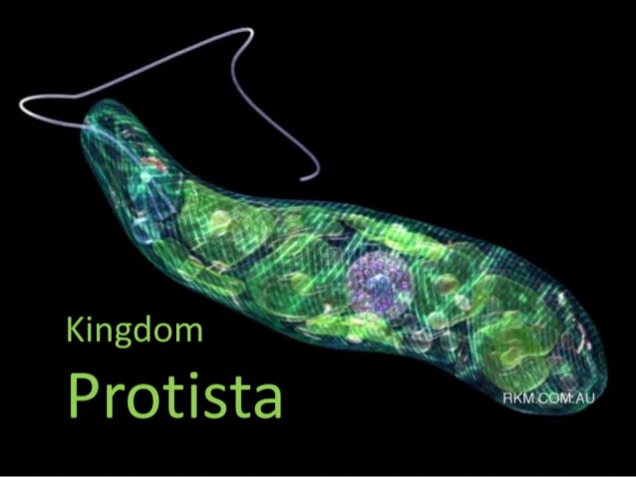
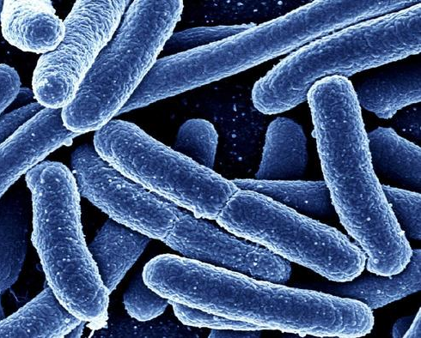
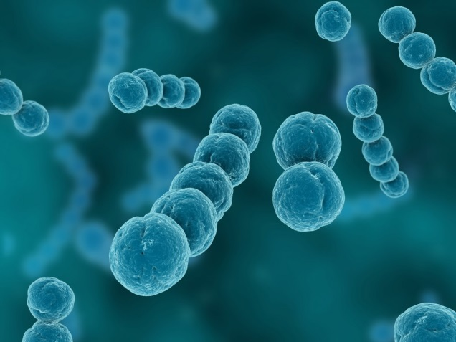
Water is essential for all life…
Plantae
Animalia
Fungi
Eubacteria
Archaebacteria
Protista

Slide 10
Earth from space

Slide 11
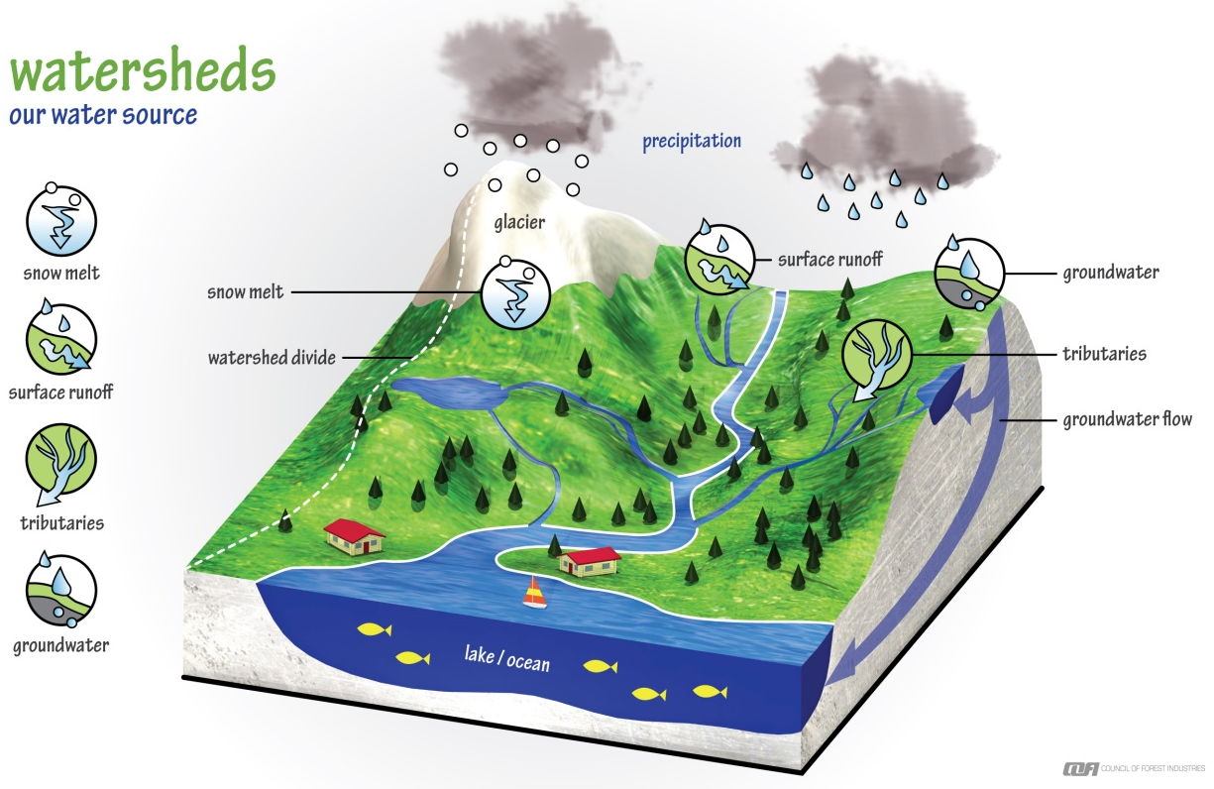
Watershed definition
Watershed:
An area of land that water flows across or through.
Flows in the same general direction and collects as a large body of water like a lake or ocean.

Slide 12
Activity: Build Your Own Watershed!

Slide 13
Map of the continental divides of North America

Slide 14
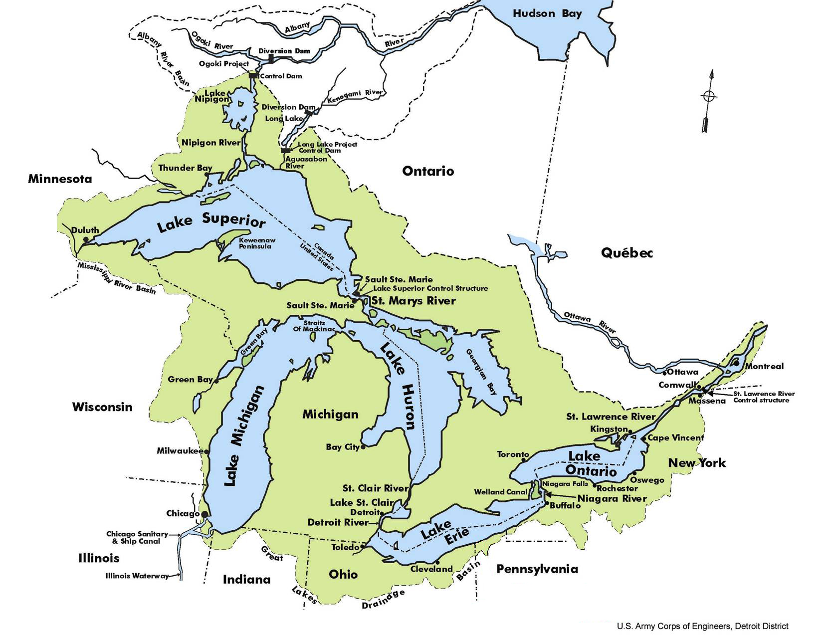
Map of the Great Lakes Basin
Notes:
The Great Lakes may seem like they don’t move, but actually they flow like a giant river from the highest lake (Superior) down through Lake’s Michigan and Huron (actually one large lake!) into Lake Erie, Lake Ontario and finally out the St. Lawrence Seaway to the Atlantic Ocean.

Slide 15
What’s Stressing Our Watershed?

Slide 16
How Does It Happen?
Notes:
Litter on land eventually finds its way to the rivers and streams because they are the lowest areas around elevation-wise. How many different sources do you see? Where will the trash eventually end up?

Slide 17
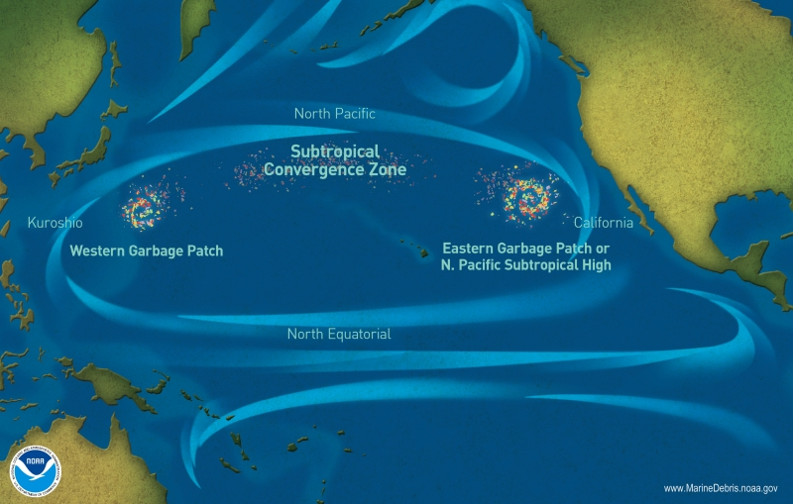
Where does it all end up?

Slide 18
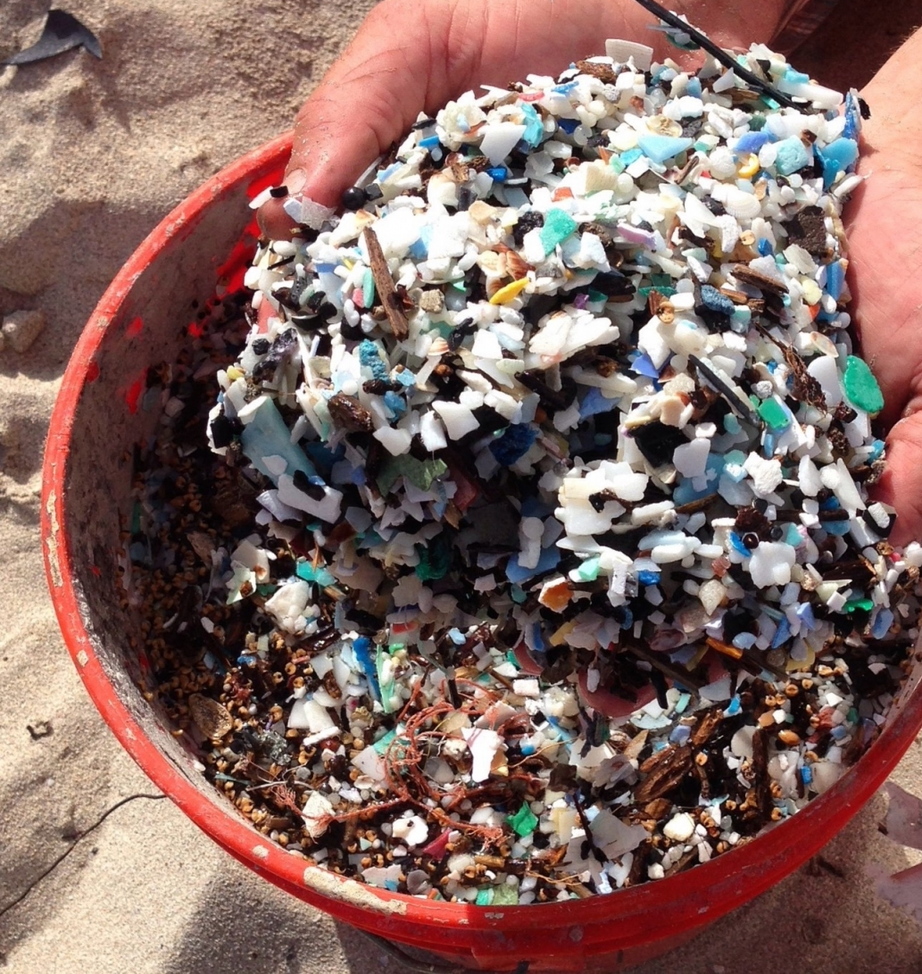
Microplastics – tiny pieces, BIG problems

Slide 19
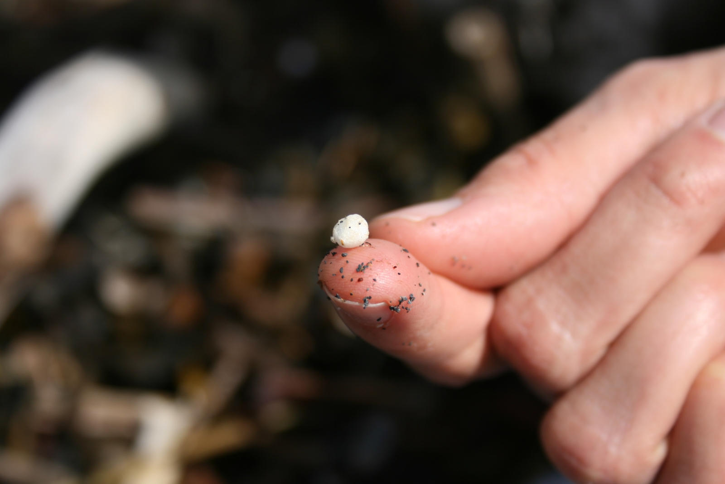
How do microplastics get into the foodweb?

Slide 20
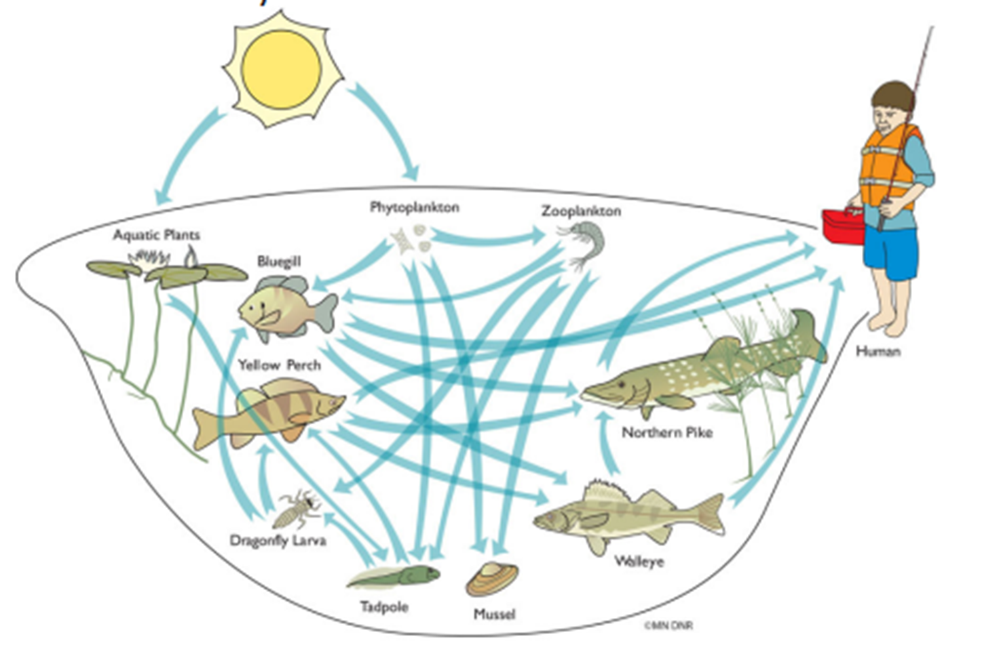
Example of a food web diagram

Slide 21
How do we help protect our watershed?

Slide 22
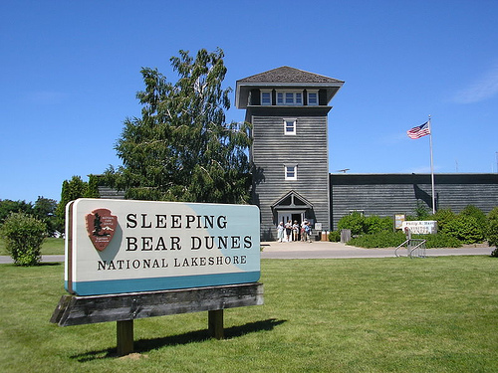
We don’t sell disposable water bottles at our visitor centers.

Slide 23
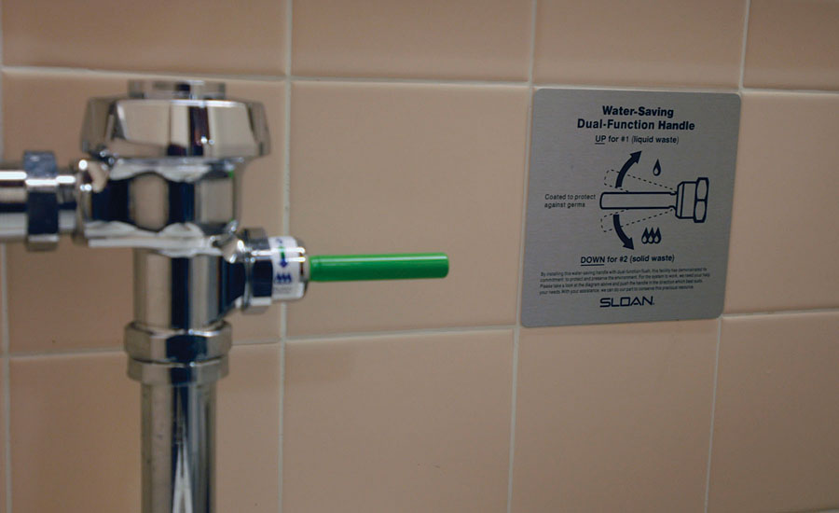
We installed water conserving flushers on our toilets.

Slide 24
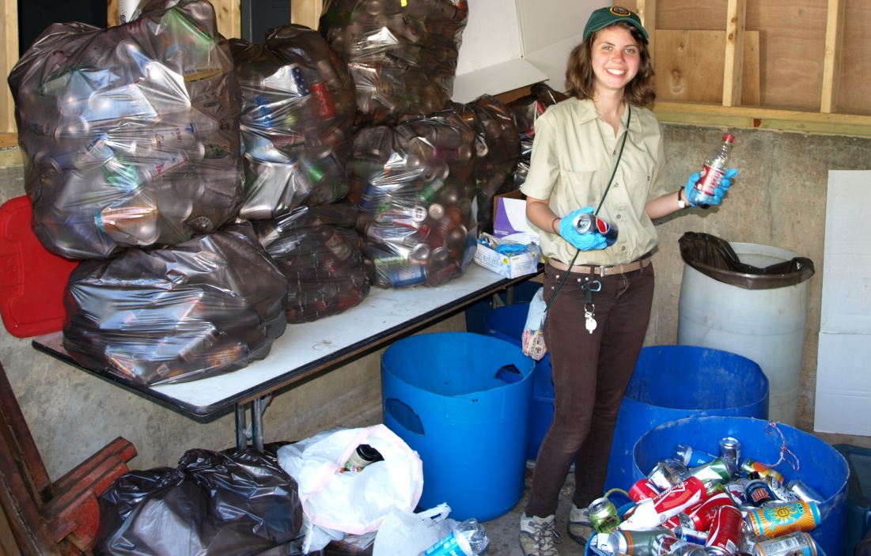
We reduce, reuse, and recycle.

Slide 25
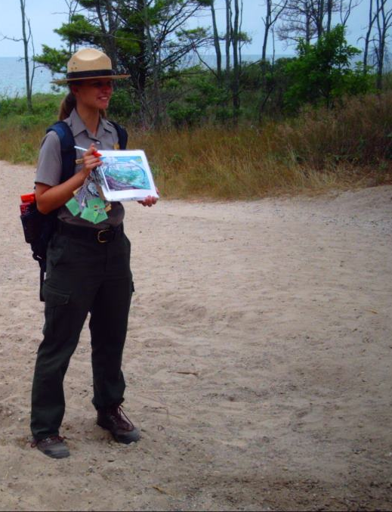
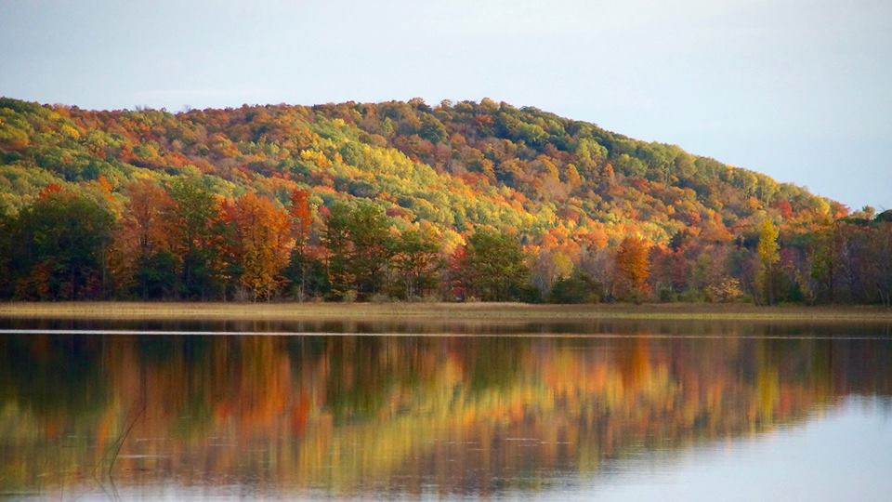
We educate others on the importance of water conservation, waste management, and invasive species.

Slide 26
We care for our watershed, and you should too!

Slide 27
End slide
Thank you!
Questions?

