Slide 1
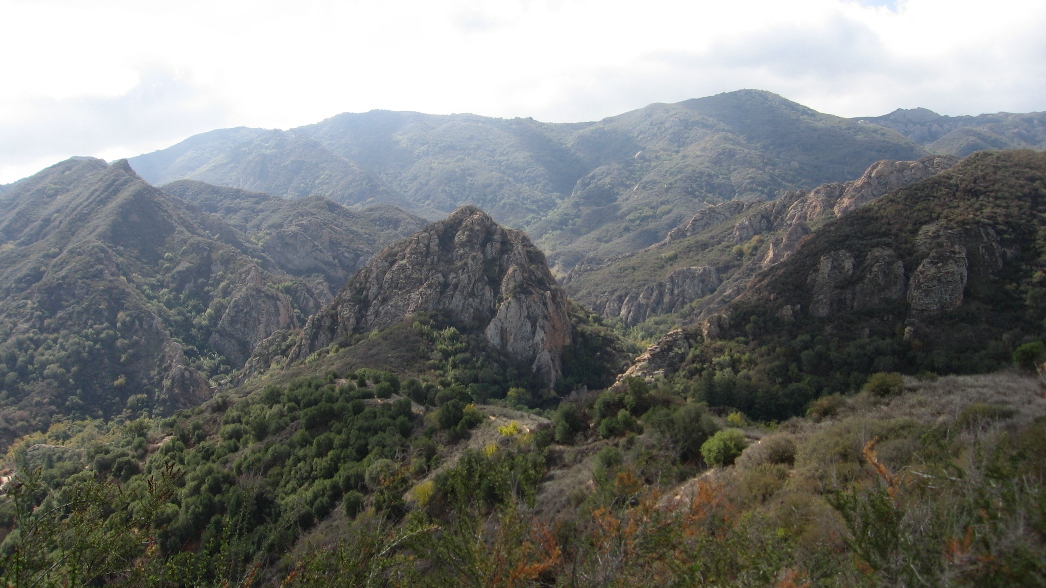
Mediterranean Biomes, Climate, & Ecosystems
Santa Monica Mountains National Recreation Area
Photo: Robert Taylor

Slide 2
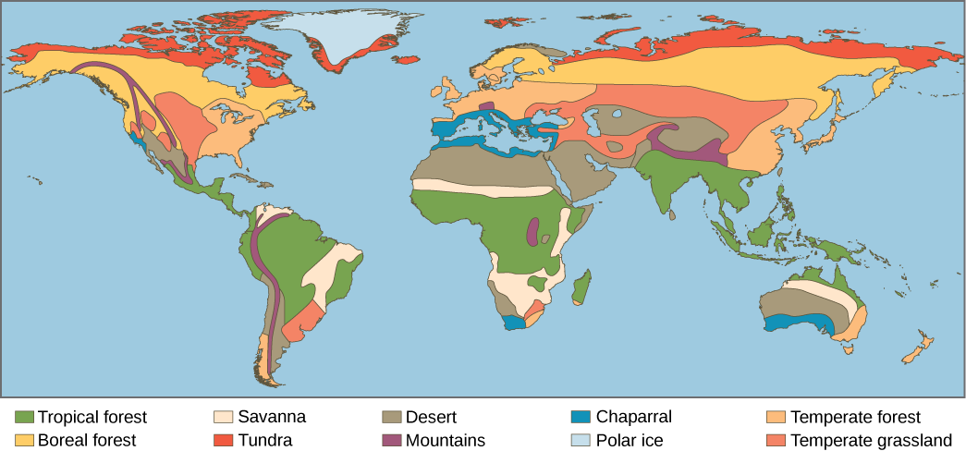
Biomes of the World
When looking at life on Earth (the biosphere), the terrestrial components of the planet can be broken down into distinctive groupings known as biomes.
Biomes are determined by the climate (temperature and precipitation). That, in turn, influences what biota (plants and animals) will live there.
The biota of each biome have adapted to their environment by evolving similar characteristics.
(Image: NVCC & OSC, n.d.)
(Lena Lee, NPS, Personal Communication, 5/16/18)
Notes:
The following features distinguish one biome from another:
Climate
The characteristics of a biome are determined by temperature and rainfall.
Example: Tropical Rain Forests have year-round rainfall with warm temperatures ideal for lush, leafy plant growth. A Boreal Forest (evergreen coniferous) has plants and trees that must endure cold, snowy weather in winter and little rain in the summer. The plant life of each of these areas is significantly different as each has adapted to survive the area’s climate conditions.
Soil
Certain soil types characterize a biome. Soils are very important because they determine what types of plants will grow within a biome. They are influenced by the parent-rock geology and the climate.
Example: The soils of a Temperate Broadleaf biome are characterized by a dark brown, slightly acid soil. This is due to the heavy tree cover of the biome and its warm, wet summers that cause a buildup of organic materials forming a loamy soil.
Vegetation
The plant life of biomes is dependent on the soil and climate of the area. Plants adapt to specific conditions by changing such characteristics as leaf shape and size.
Example: Adapting to the long, dry summer conditions, the chaparral plants of the Mediterranean biome are woody shrubs containing small, thick, waxy leaves capable of retaining water moisture.
Animals
Climate, soil, and vegetation all help determine the animal life and adaptations of the animals to a biome.
Example: Burrowing, nocturnal animals are typical of a Desert biome, having adapted to hot daytime temperatures.
Location
Some biomes have similar location patterns around the world. Similar biomes are often found at the same latitude around the world.
Example: Various Desert biomes around the world are located between 20° and 30° latitude, including Chihuahuan Desert in Mexico, Sahara Desert in North Africa, and Great Indian Desert in India. Altitude similarities exist as well. Ascending a tall mountain, the higher in altitude you climb, the cooler the temperature, the thinner the air, and the longer the winter. Several different climates exist on one mountain, so different biomes can exist as well.
Example: As one climbs in altitude, a Temperate Deciduous Forest biome (broadleaf deciduous trees) can change to a Boreal Forest biome (evergreen pine trees) and eventually become a Tundra biome (treeless and cold).
(NPS)

Slide 3
Each Biome has a Characteristic Climate
Can you guess which climate
you live in?
(Taylor, n.d.)
Notes:
Climate: the statistics of weather over long periods of time.
Determined by temperature and rainfall, climate impacts ecosystems and is one way of distinguishing biomes.
Compare the temperature, precipitation, and drought of the different geographical areas.
Image: This way of visualizing climate data was invented by Walter and Lieth in the 1960s.

Slide 4
Southern California is in a Mediterranean Climate
All Mediterranean climates experience hot, dry summers and mild, wet winters.
(Taylor, n.d.)
Notes:
This way of visualizing climate data was invented by Walter and Lieth in the 1960s.
Here is what our Mediterranean climate in southern CA looks like when represented this way (Pasadena). It rains in the winter and every year we have a 6-month drought called “Summer.”
Mediterranean climate is different than climate in other biomes with hot, dry summers and mild wet winters. (Taylor, n.d.)

Slide 5
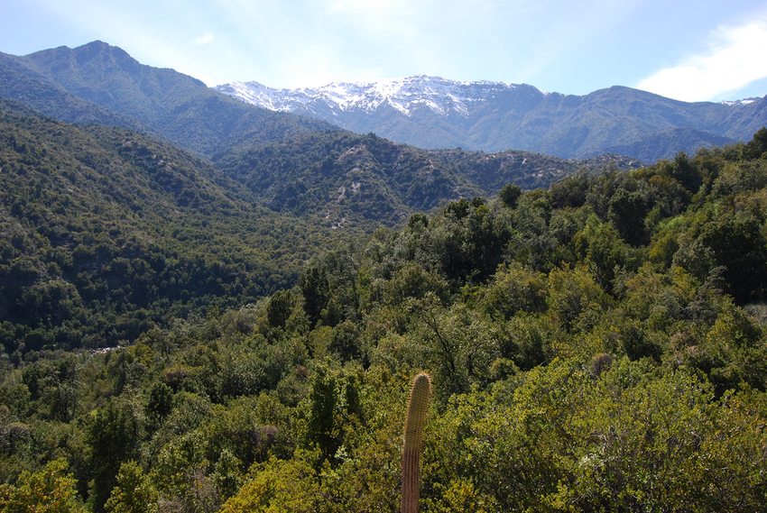
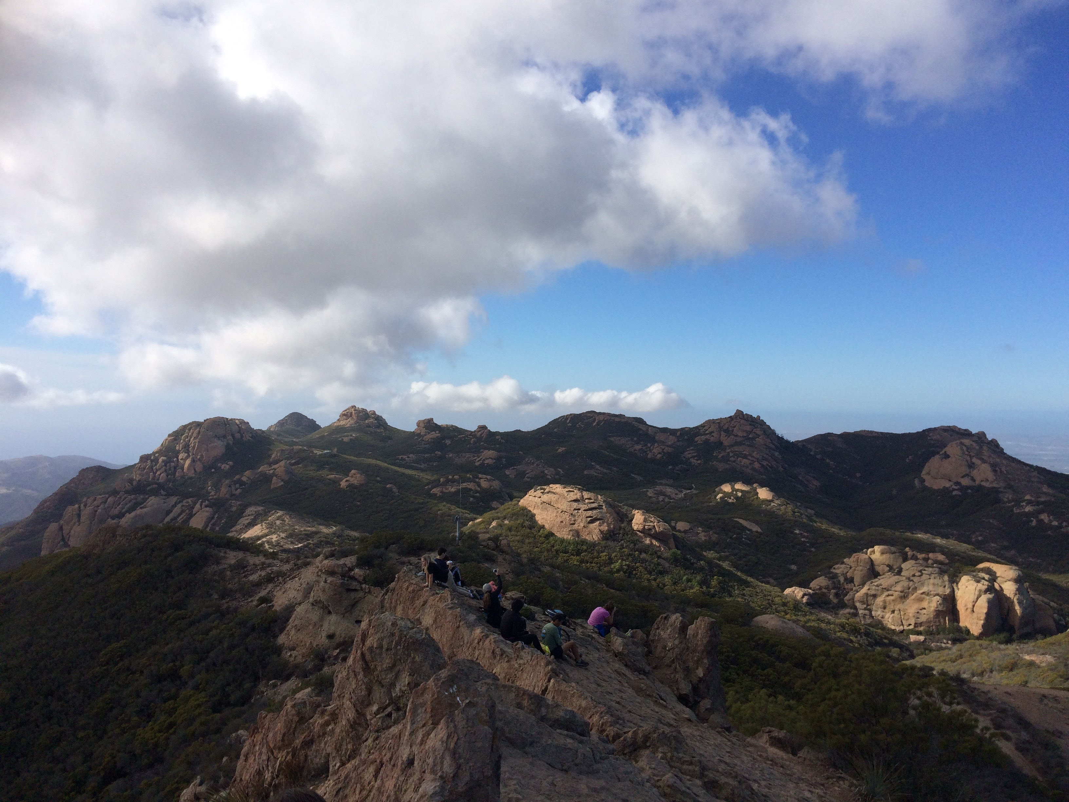
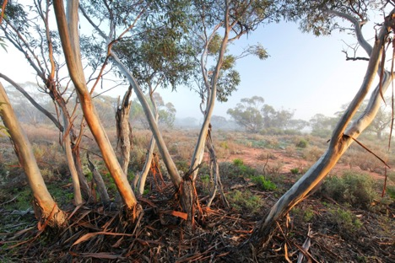
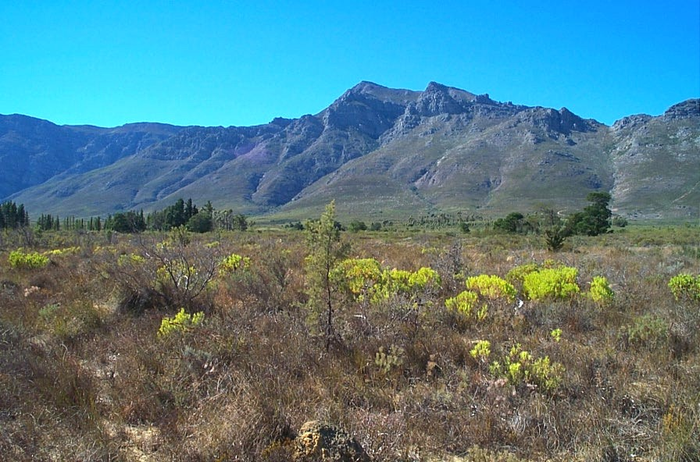
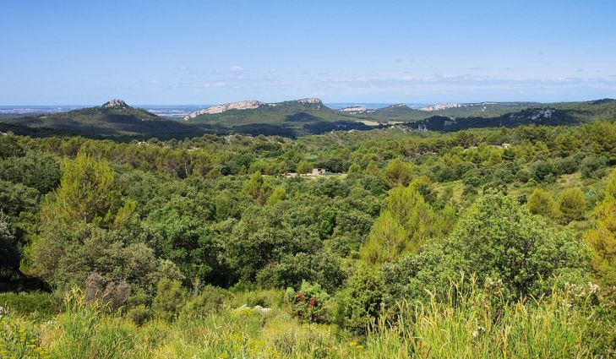
There are 5 areas around the world that are characterized by the Mediterranean Biome:
Southern California “chaparral”
Chile “matorral”
Mediterranean Basin “maquis”
South Africa “fynbos”
Southwestern Australia “mallee”
(Lena Lee, NPS, Personal Communication, 5/16/18)
Notes:
Images:
Chaparral: Bethany Szczepanski
Matorral: https://www.researchgate.net/figure/Mid-elevation-matorral-at-Reserva-Nacional-Rio-Clarillo-south-central-Chile_fig7_292985514
Maquis: https://www.worldatlas.com/articles/the-different-types-of-shrubland-biomes-across-the-world.html
Fynbos: http://pza.sanbi.org/vegetation/fynbos-biome
Mallee: http://www.australianwildlife.org/sanctuaries/mallee-cliffs.aspx

Slide 6
Characteristics of the Mediterranean Biome:
Distributed between 30-40 degrees latitude
Located on the western edges of continents
Climate is moderated by cold ocean currents
Do you notice any similarities between the Mediterranean biome regions?
(Taylor, n.d.)
Notes:
The Mediterranean Ecosystem occurs only in five relatively small areas around the planet: the area bordering the Mediterranean Sea, central Chile, the Cape region of South Africa, southwestern and southern Australia, and, of course, southern California and northern Baja California (NPS, n.d.).
These areas are distributed between roughly 30 and 40 degrees latitude – north and south – and are located along the western edges of continents where the climate, characterized by mild, rainy winters and warm, dry summers, is moderated by cold ocean currents offshore (NPS, n.d.).
These places are far apart geographically, but have certain similarities in weather patterns.
Their flora are very different taxonomically, but the species show many common adaptations of life history, anatomy and physiology. This is convergent evolution- when unrelated species develop similar features to address similar environmental challenges. (Taylor, n.d.).

Slide 7
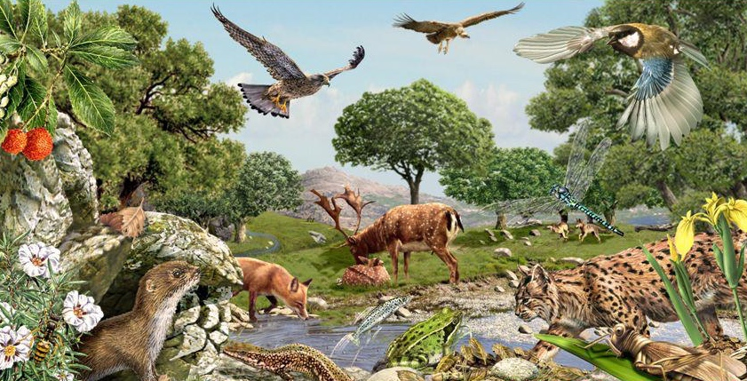
What is an Ecosystem?
Ecosystems exist within a biome which can be large or small.
An ecosystem is a geographic area where biotic (living) and abiotic (non-living) components work together to form a bubble of life.
Biotic (living) factors include plants, animals, and other organisms.
Abiotic (non-living) factors include rocks, temperature, and humidity (i.e. weather).
https://youtu.be/FhaldPmkoNE
(Video: Anderson, 2015; Lena Lee, NPS, Personal Communication, 5/16/18; NGS, 2012)
Notes:
Click on the link to watch an 11 minute video covering Ecosystem Ecology by Paul Anderson at Bozeman Science.
Image from: http://slideplayer.com/slide/321700/

Slide 8
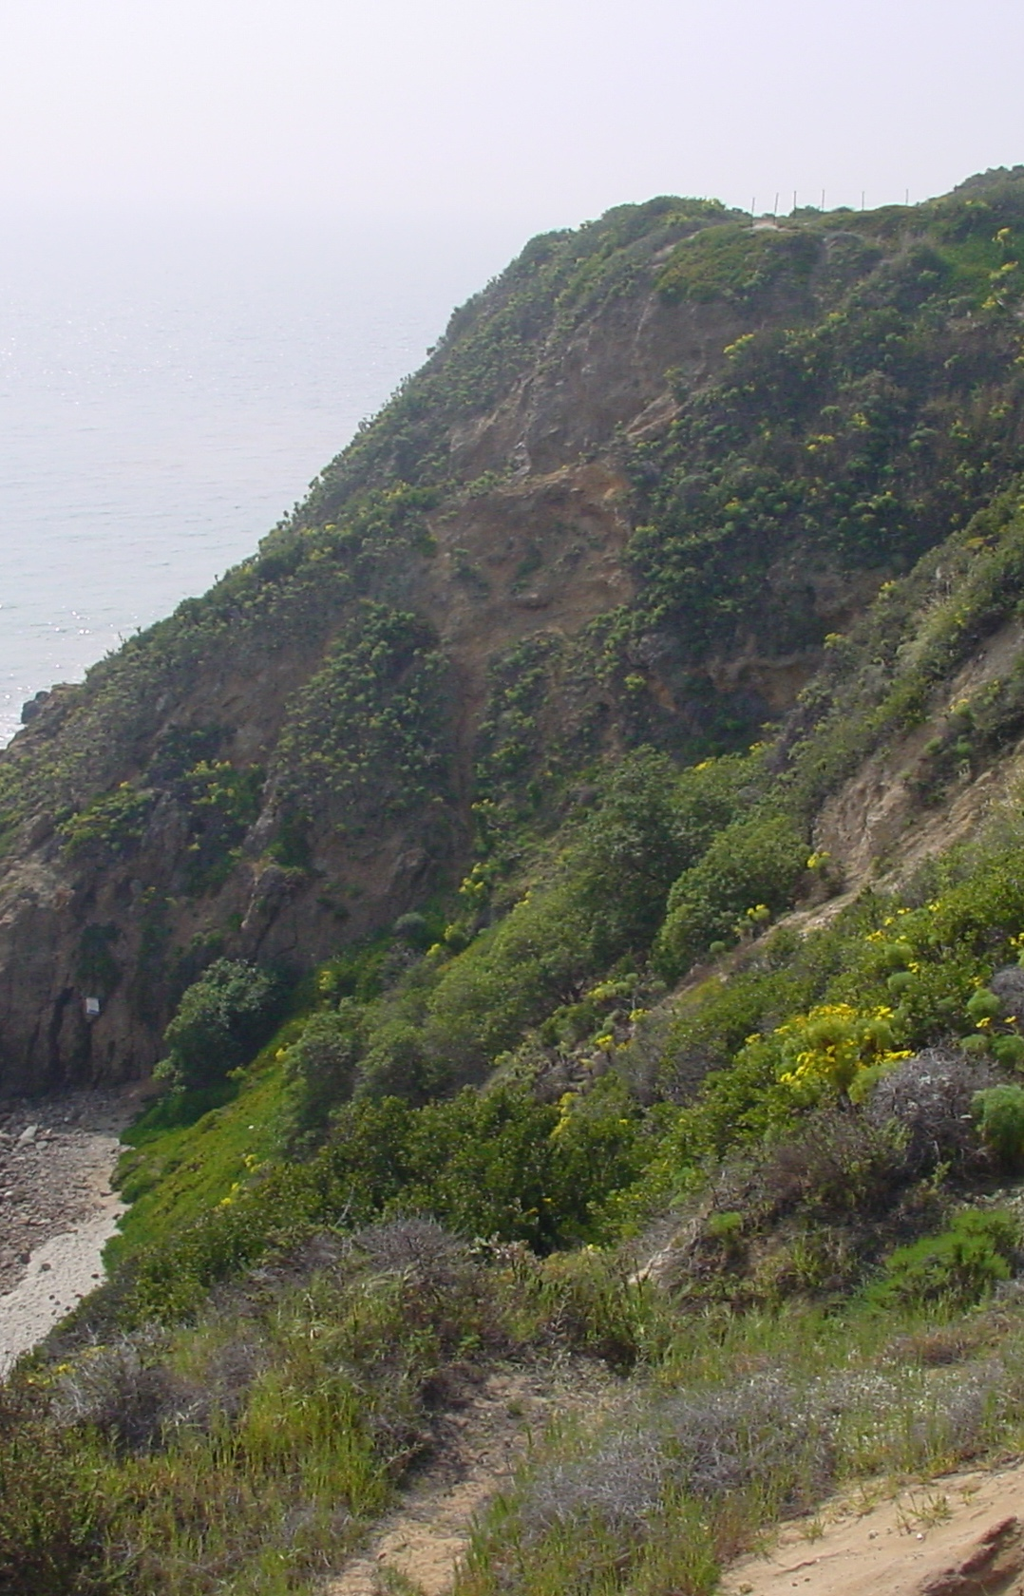
Mediterranean Ecosystem
Characteristics
Plants are adapted to drought
Evergreen or drought deciduous (i.e. drop their leaves) shrublands
Wildfire is a common natural element
High degree of endemism (restricted to a certain area) in flora & fauna
Coastal Sage Scrub
(NPS, n.d.; Photo: Robert Taylor NPS)
Notes:
Throughout the world, the Mediterranean Ecosystem is characterized by evergreen or drought deciduous shrublands.
The chaparral of southern California is echoed in the old world Mediterranean maquis, the Chilean matorral, South African fynbos and the Australian mallee scrub communities. Due to the limited extent and isolation (almost island-like) of each area of the Mediterranean Ecosystem, there is frequently a high degree of endemism in the flora and fauna. (NPS, n.d.)

Slide 9
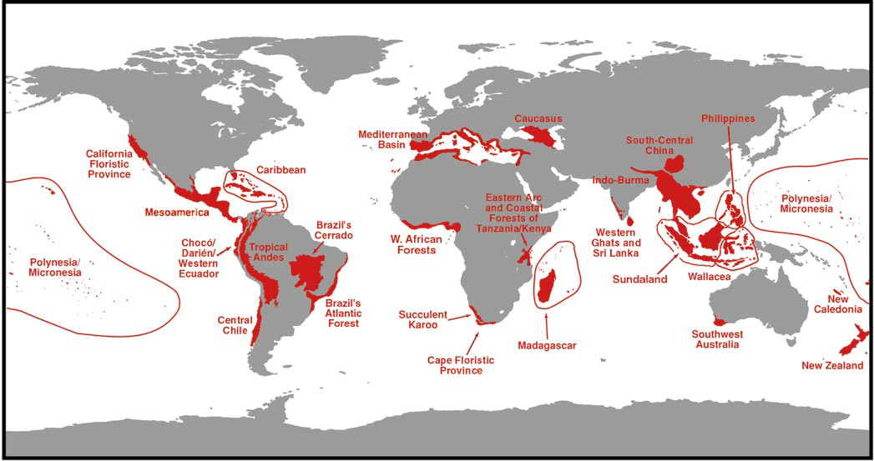
The California Floristic Province is a globally significant hotspot of biodiversity
(Taylor, n.d.)
Notes:
Biodiversity: variation of life
The Mediterranean-type ecosystem of southern California has been identified as one of the world's "hot spots" for biodiversity. Additionally, the southern California bight, an ecologically unique area of near-shore Pacific Ocean coastal habitat extending from Point Conception south and encompassing the San Diego area, provides conditions that promote high species richness and diversity. (NPS, n.d.)
This map shows the names and locations of 25 hotspots of biodiversity on Earth, published in the 1999 analysis, published in the book Hotspots: Earth’s Biologically Richest and Most Endangered Terrestrial Ecoregions, and a year later in the scientific journal Nature (Myers, et al. 2000), . These are ranked based on a combination of endemic species richness and threats to their survival.
Collectively, these areas held as endemics no less than 44 percent of the world’s plants and 35 percent of terrestrial vertebrates in an area that formerly covered only 11.8 percent of the planet’s land surface. The habitat extent of this land area had been reduced by 87.8 percent of its original extent, such that this wealth of biodiversity was restricted to only 1.4 percent of Earth’s land surface.
All 5 Mediterranean climate zones are included. And it turns out the California floristic province is one of the world’s top 10 biodiversity hotspots. So California is kicking biodiversity butt. (Taylor, n.d.)

Slide 10
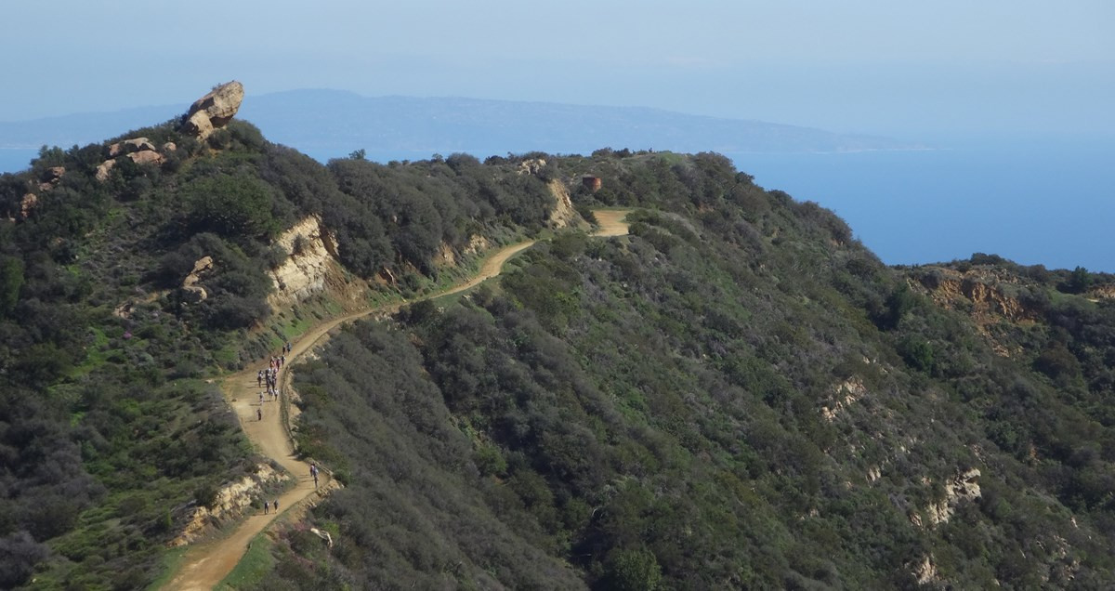
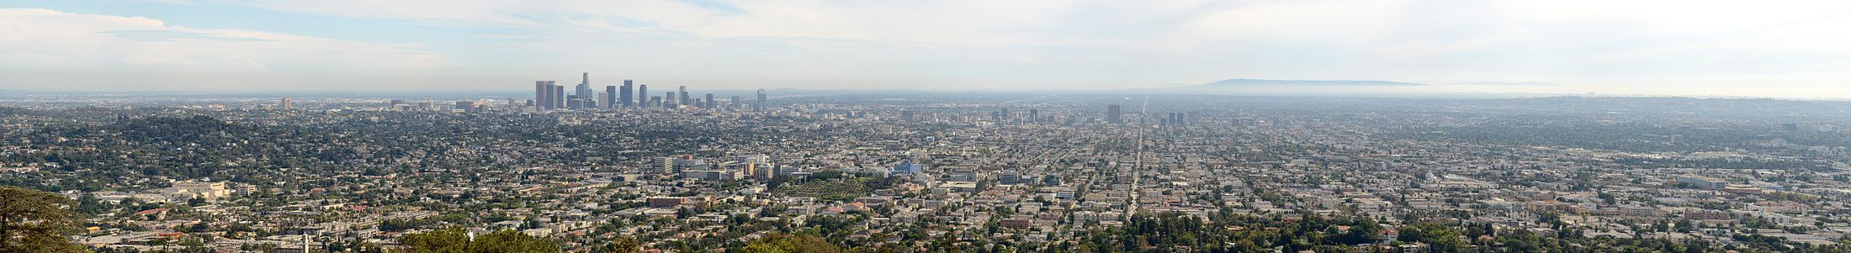
Human Habitation
Because of the pleasant climate year-round, the five Mediterranean Biomes around the world have been highly favored by humans for habitation.
Mediterranean Ecosystems are one of the most highly altered on the planet and contain the least undisturbed area of any ecosystem.
This high habitation increases:
Development
Recreation
Agriculture
(NPS, n.d.)
Notes:
The five Mediterranean regions have been highly favored and impacted by humans for habitation, agriculture and recreation.
As a result, this ecosystem type (which only occurs on about two percent of the earth's total land area) is one of the most highly altered on the planet and contains the least undisturbed area of any ecosystem.
The high degree of urbanization along the southern California coastline has resulted in the loss of significant natural areas and increasing human impacts to natural systems. (NPS, n.d.)
Trail picture from: https://www.nps.gov/samo/planyourvisit/aboutthebbt.htm
Los Angeles image from: https://en.wikipedia.org/wiki/Los_Angeles

Slide 11
Santa Monica Mountains National Recreation Area
But there are places where Mediterranean Ecosystems are protected like:
Notes:
The Santa Monica Mountains National Recreation Area protects one of the largest expanses of the Mediterranean climate in Southern California. (Lena Lee, NPS, Personal Communication, 5/16/18)

Slide 12
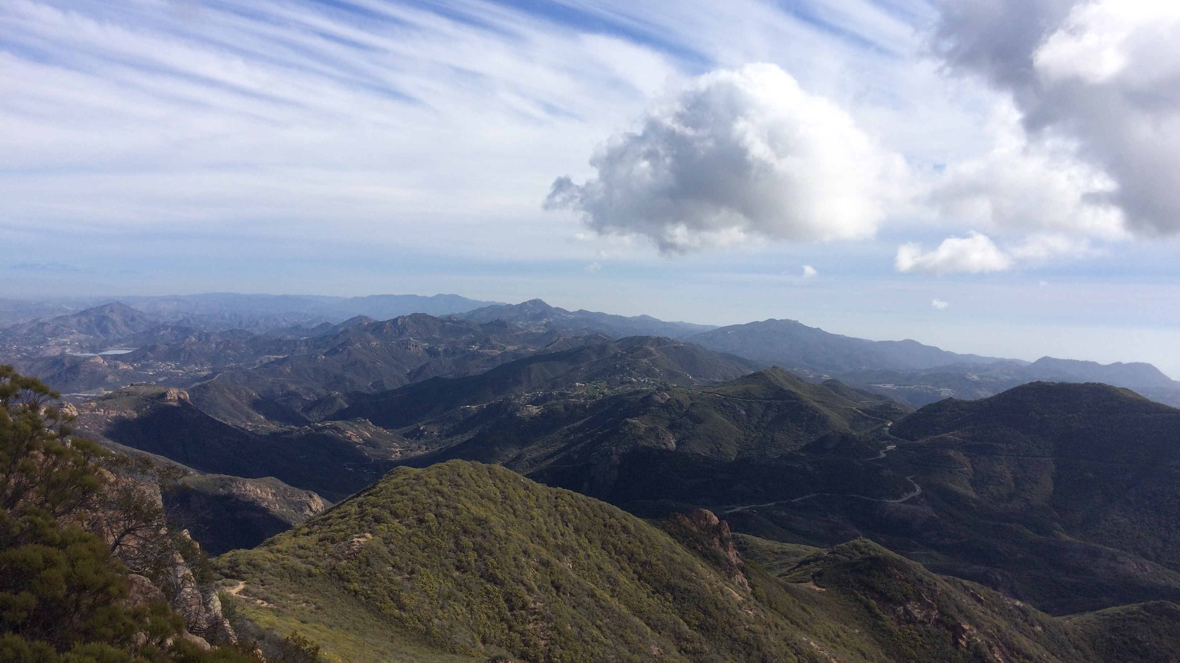
Santa Monica Mountains National Recreation Area
Do you know that you have a National Park very near you?
Part of the National Park System, Santa Monica Mountains National Recreation Area was created in 1978 to protect the scenic, recreational, educational, scientific, archaeological, historic, and public health aspects of the Santa Monicas, as well as its unique Mediterranean chaparral ecosystem.
View from Sandstone Peak: The highest peak in the mountains.
Photo: Bethany Szczepanski
Notes:
The best example of a Mediterranean biome here in Southern California exists in the Santa Monica Mountains just adjacent to Los Angeles. In 1978, because these mountains and adjacent seashore exhibit the components of a Mediterranean biome, Congress established Santa Monica Mountains National Recreation Area – a unit of the National Park System – to protect the resources of this unique ecosystem. (NPS, n.d.)
“Congress established the SMMNRA in November 1978 to protect the largest expanse of mainland Mediterranean Ecosystem in the national park system. This extraordinarily diverse ecosystem is home to 26 distinct natural communities, from freshwater aquatic habitats and coastal lagoons to oak woodlands, valley oak savanna and chaparral. Situated in densely populated southern California, the recreation area is a critical haven for more than 450 animal species, including mountain lions, bobcats and golden eagles. It is also home to more than ten threatened or endangered plants and animals. More than 1,000 archeological sites are located within the park boundary, one of the highest densities of archeological resources found in any mountain range in the world. The 26 known Chumash pictograph sites, sacred to traditional Native American Indians, are among the most spectacular found anywhere. Nearly every major prehistoric and historic theme associated with human interaction and development of the Western United States is represented here. No other national park features such a diverse assemblage of natural, cultural, scenic and recreational resources within easy reach of more than 12 million Americans, nearly 5% of the nation’s total population (GMP 2003)” (NPS, 2006).
Visit the park to see examples of flora and fauna in our local Mediterranean biome and the chaparral and coastal sage scrub plant communities within.

Slide 13
Where can you take a walk in a Mediterranean Ecosystem?
Right outside your door!
Southern California is in a Mediterranean Biome.
A wonderful place to experience a Mediterranean Ecosystem is just a short distance away in the Santa Monica Mountains where you can hike, camp, ride bicycles, rock climb, and more!
Visit https://www.nps.gov/samo/index.htm to learn more about the park and https://www.samofund.org/calendar/ to learn about special events and hikes that you, your friends, and your family can enjoy in the park. Many are free of charge.
(Image: NPS)
Notes:
Map of Santa Monica Mountains National Recreation Area
More maps found at: https://www.nps.gov/samo/planyourvisit/maps.htm
Thank you for learning about Mediterranean Biomes. To continue your journey into Santa Monica Mountains National Recreation Area: Fire Ecology continue on to the Chaparral: Plant Communities unit.

Slide 14
References
Anderson, P. (2015, September 14). Ecosystem Ecology [Streaming Video]. Retrieved from https://www.youtube.com/watch?v=FhaldPmkoNE
National Geographic Society (NGS). (2012, October 09). Ecosystem. Retrieved March 30, 2018, from https://www.nationalgeographic.org/encyclopedia/ecosystem/
National Park Service (NPS). (n.d.). Mediterranean Ecosystem. Retrieved March 28, 2018, from https://www.nps.gov/samo/learn/nature/mediterraneanecosystem.htm
National Park Service (NPS). (2006, March 6). Santa Monica Mountains National Recreation Area Fire Management Plan (United States, National Park Service, Santa Monica Mountains National Recreation Area). Retrieved May 8, 2018, from https://www.nps.gov/samo/learn/management/upload/SAMO_FMP_Review_Final_2012.pdf
Northern Virginia Community College (NVCC), & OpenStax College (OSC). (n.d.). Biology II: Terrestrial biomes. Retrieved from https://courses.lumenlearning.com/biology2xmaster/chapter/terrestrial-biomes/
Taylor, R. S. (n.d.). Fire regime, fire history, and fire behavior in the Santa Monica Mountains [PowerPoint slides].

