Slide 1
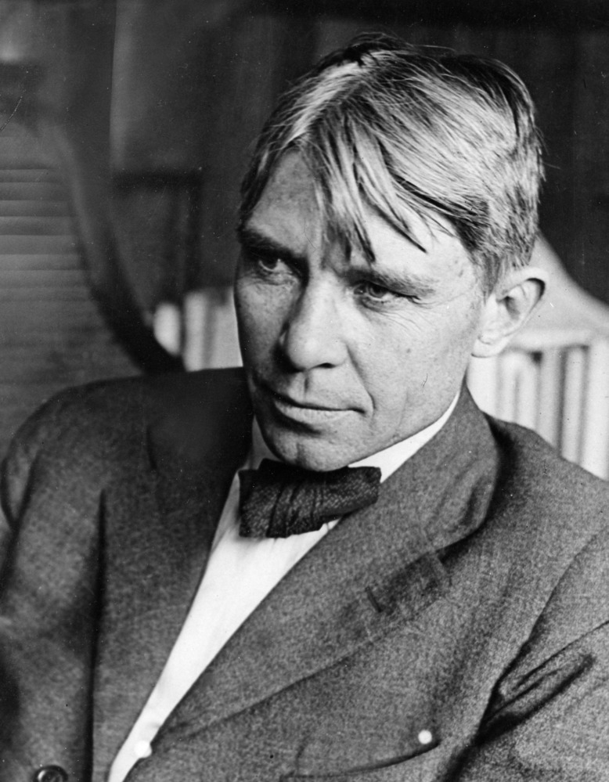
"Poet of the People“
Carl Sandburg provided a popular voice for the American people of the twentieth century and still speaks to us through his words, activism, music and the beauty and serenity of Carl Sandburg Home National Historic Site.
www.nps.gov/carl

Slide 2
Let Your Voice be Heard: Expressing your voice through reflective writing
Expressing your views is a fundamental right of being an American.
This lesson gives you the opportunity to reflect on your feelings and experiences relating to important issues. Then examine ways you can use reflective writing to let your voice be heard.
Tasks:
Progress through slides three through seven starting with the reading of “I am the People, the Mob” by Carl Sandburg.
Select a project from the Reflective Writing List to complete on the blank slide.
Submit your Work!

Slide 3
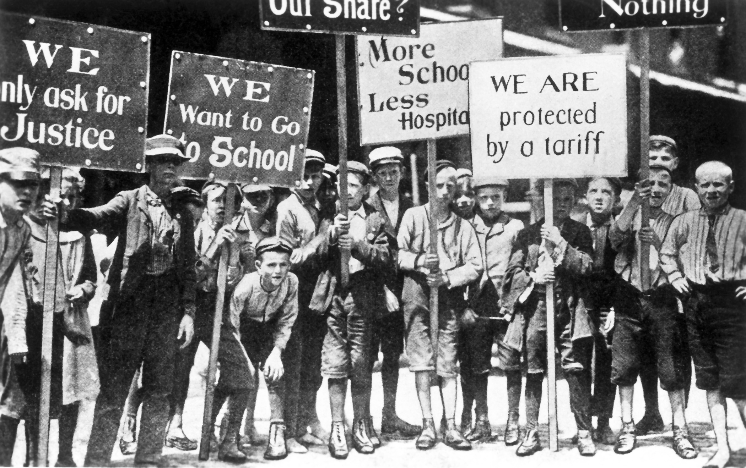
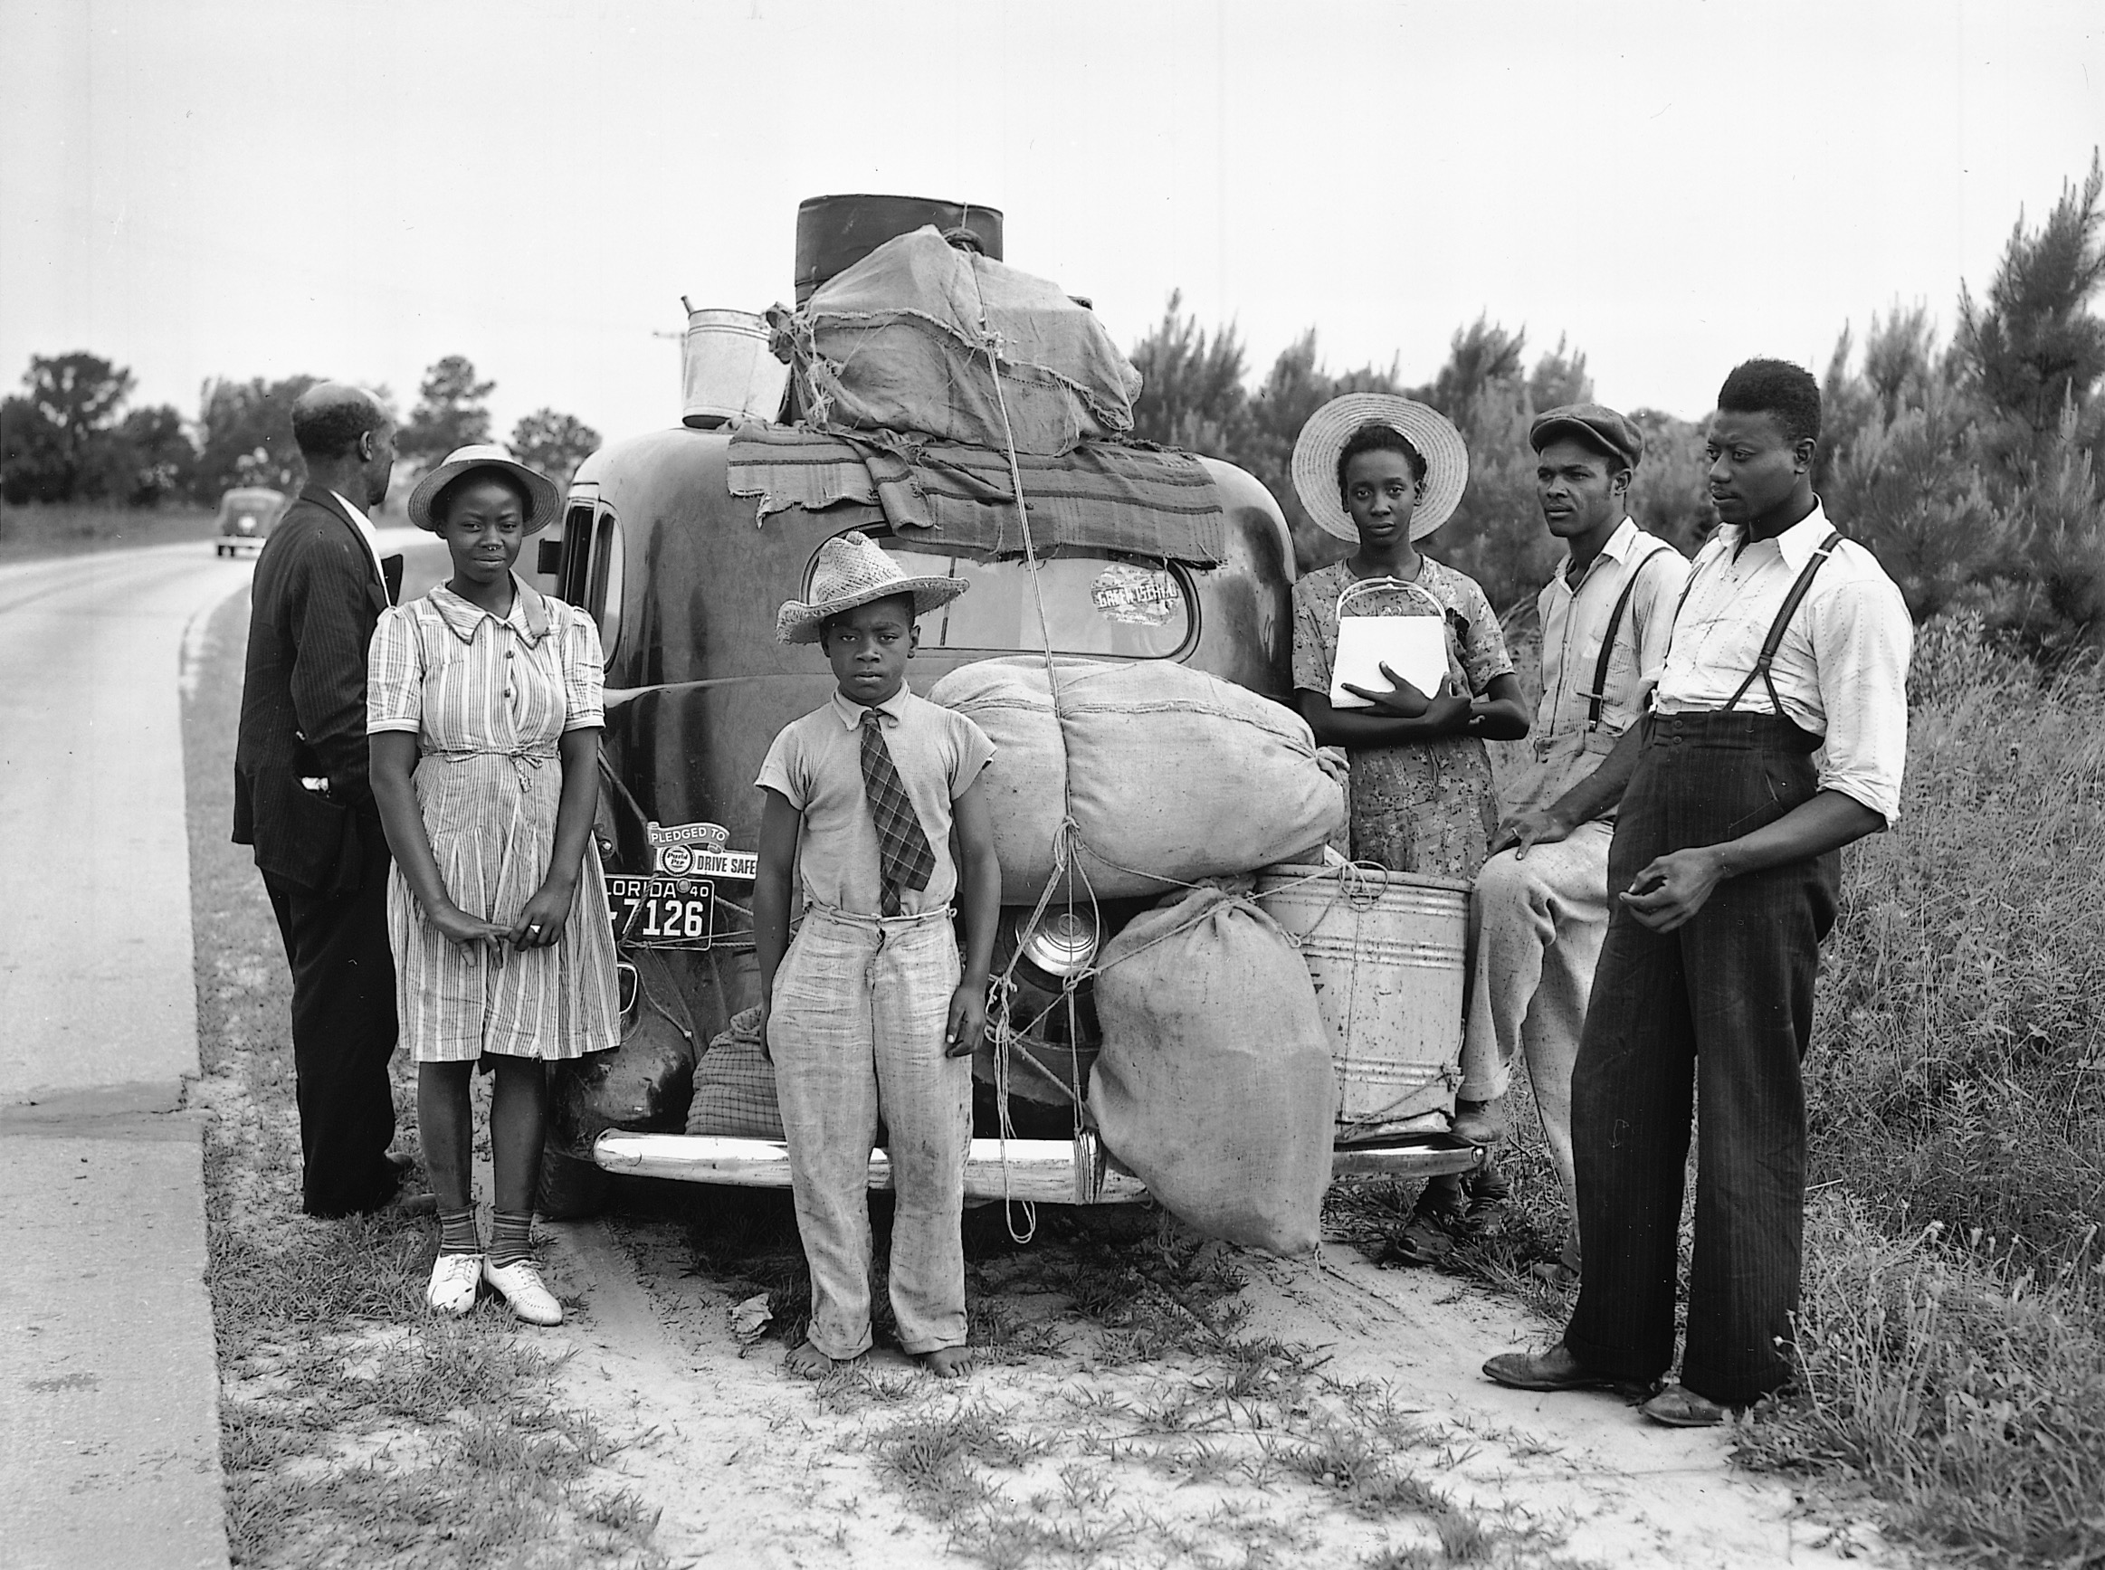
I Am the People, the Mob
By Carl Sandburg
I am the people—the mob—the crowd—the mass.
Do you know that all the great work of the world is done through me?
I am the workingman, the inventor, the maker of the world’s food and clothes.
I am the audience that witnesses history. The Napoleons come from me and the Lincolns. They die. And then I send forth more Napoleons and Lincolns.
I am the seed ground. I am a prairie that will stand for much plowing. Terrible storms pass over me. I forget.
The best of me is sucked out and wasted. I forget. Everything but Death comes to me and makes me work and give up what I have. And I forget.
Sometimes I growl, shake myself and spatter a few red drops for history to remember. Then—I forget.
When I, the People, learn to remember, when I, the People, use the lessons of yesterday and no longer forget who robbed me last year, who played me for a fool—then there will be no speaker in all the world say the name: “The People,” with any fleck of a sneer in his voice or any far-off smile of derision.
The mob—the crowd—the mass—will arrive then.
Click here https://www.youtube.com/watch?v=Vhi0T0aNklU to watch a reading of the poem.
Notes:
3

Slide 4
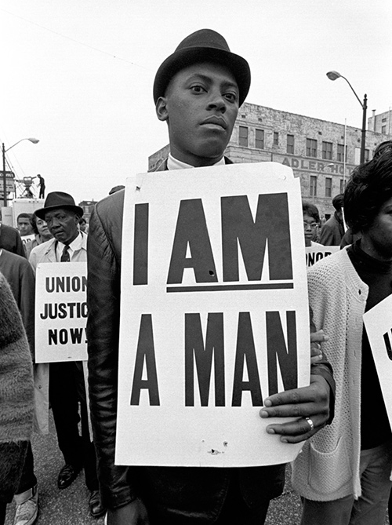
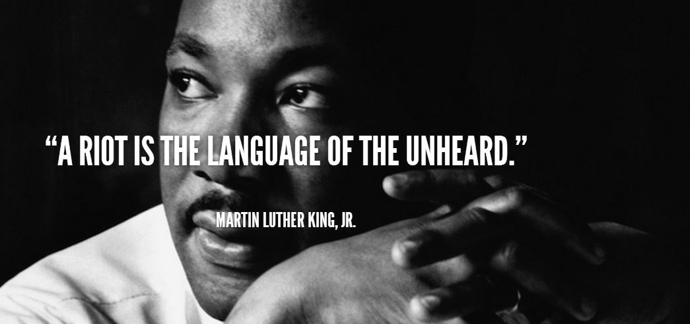
The First Amendment protects your right to assemble and express your views through protest.
A protest is a public expression of objection, disapproval, or dissent towards an idea or course of action. Artists oftentimes share their views on a social issue through their particular form of art such as writing, photography, painting, sculpture, and music.
Individuals and large groups have been protesting for a very long time, about a variety of issues, to stand up for what they believe in.
However, even when you believe wholeheartedly in your social movement or course of action, there may be others who wholeheartedly support a different or even opposing view. Strive to be open to dialogue with those who feel different than you.
Carl Sandburg reflected on his feelings about the world around him and expressed his voice through his journalism articles covering the Chicago Race Riots.
He also wrote poetry about the working class and farmers, children working in factories, unequal conditions for black Americans, companies stirring up unrest among different groups of workers, and people all over the country struggling to achieve "The American Dream.“
He became known as the “Poet of the People” because he used his voice to speak out for those who did not have the means or power to speak for themselves.

Slide 5
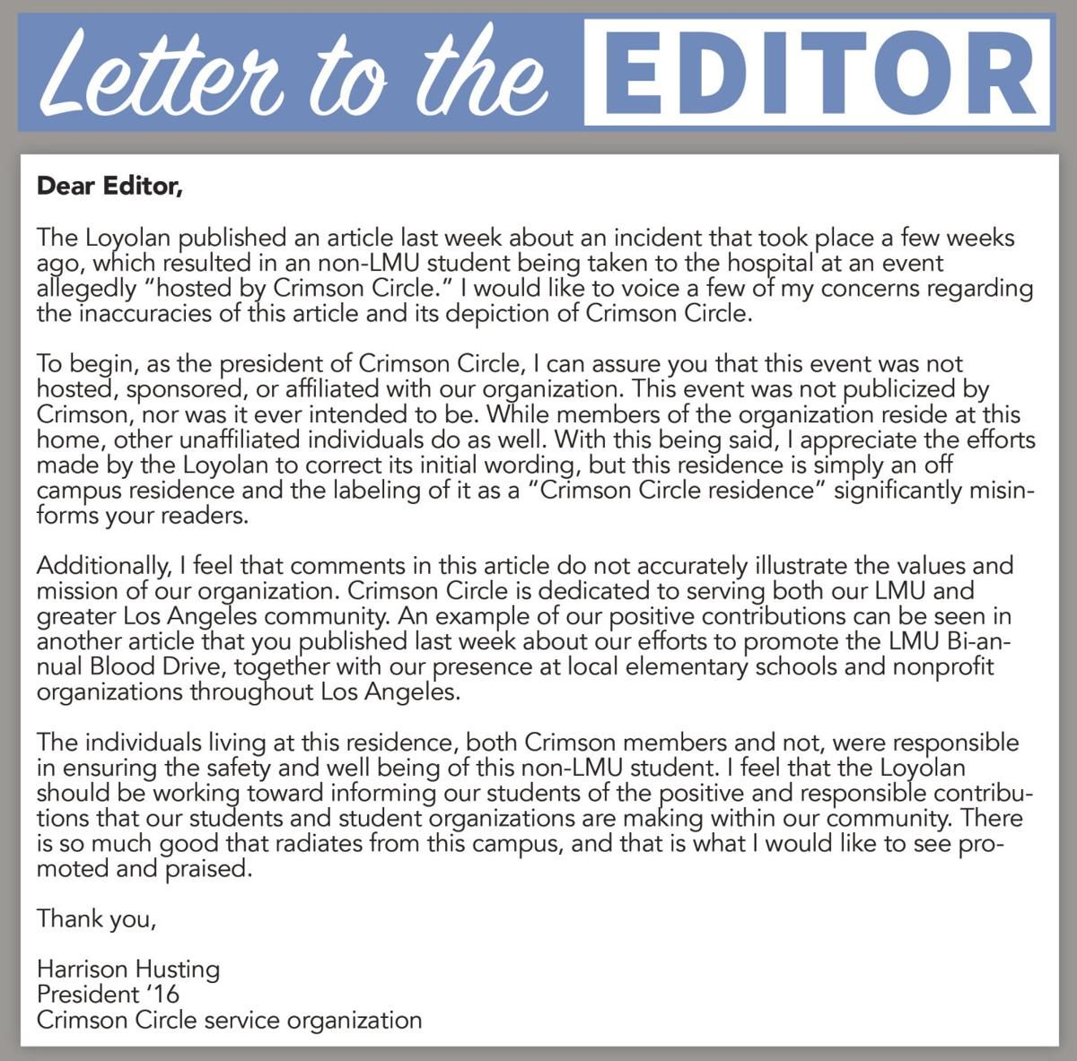
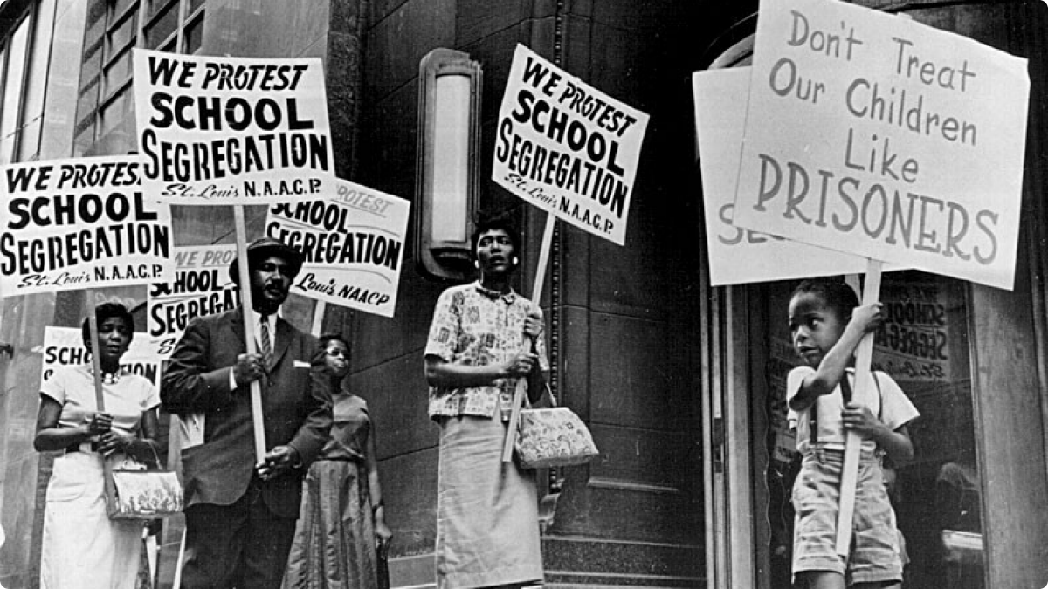
People sometimes write articles, make videos, create posters or signs. They might write journals or letters, pay for billboards or television commercials, use artistic expressions, or take to social media to express their views.
Look at these examples and think about how you want to express your voice.
Notes:
5

Slide 6
Express your voice using one the following reflective writing prompts.
2
Write an email to send back in time to Carl Sandburg. Describe some of the ways you have similar or different interests or views, then share how you feel about something going on in the society you live in!
1
Can you think of any big movements going on today, locally or nationally? Do you have an idea that could improve society as a whole? Talk with your family and friends and create a short list of social causes that you feel are important.
Once you have the list, choose the one you are most passionate about and write a letter to the editor, a poster, or social media post with a unique graphic.
3
Research a national park that tells a story of a person who had an impact on society. Write a short poem about this park or person so that someone else might learn about their contributions

Slide 7
Writing or Drawing Page

