Slide 1
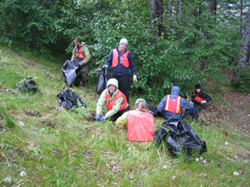
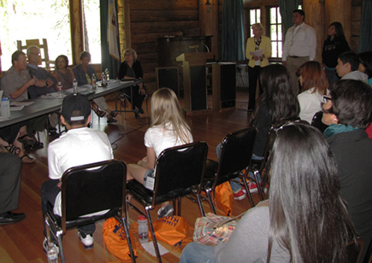
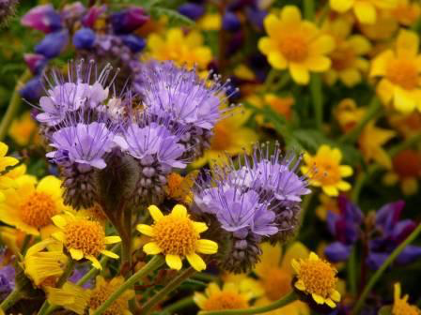
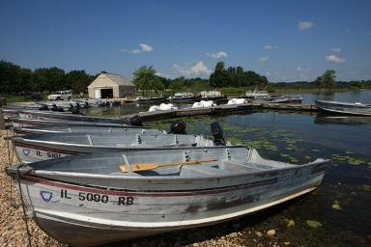
WHAT IS OUR LEARNING OBJECTIVE TODAY?
Notes:
Person keyboarding: http://www.ocpe.nt.gov.au
Pulling weeds: http://www.nps.gov/kefj/learn/news/volunteers-needed-for-exit-glacier-community-weed-pull.htm
Wildflowers: http://www.nps.gov/samo/learn/news/national-park-service-presents-free-lecture-on-wildflowers.htm
Students in meeting: http://www.nps.gov/nr/twhp/youthsummits/How_to_Guide.html
Boats: http://www.dnr.illinois.gov/recreation/boating/Pages/default.aspx

Slide 2
WHAT IS OUR LEARNING OBJECTIVE TODAY?
Communicate to inform others of invasive species problem
Volunteer to eradicate invasive species in your community
Be informed about invasive species—do not release pets or other animals into the wild
When buying plants for your yard or garden, make sure they are not invasive species and try to plant native flowers
If you are a boater, be sure you are not transferring plants/animals from one water body to another
Notes:
Person keyboarding: http://www.ocpe.nt.gov.au
Pulling weeds: http://www.nps.gov/kefj/learn/news/volunteers-needed-for-exit-glacier-community-weed-pull.htm
Wildflowers on road side: http://www.dep.wv.gov/dlr/reap/ow/pages/default.aspx
Students in meeting: http://www.nps.gov/nr/twhp/youthsummits/How_to_Guide.html
Boats: http://www.dnr.illinois.gov/recreation/boating/Pages/default.aspx

Slide 3
Bibliography
"Invasive Plant Species Invasive Species Education | The Nature Conservancy." Invasive Plant Species Invasive Species Education | The Nature Conservancy. The Nature Conservancy, n.d. Web. 30 Mar. 2015. <http://www.nature.org/ourinitiatives/habitats/forests/help/invasive-plant-species-invasive-species-education-1.xml>.

