Slide 1
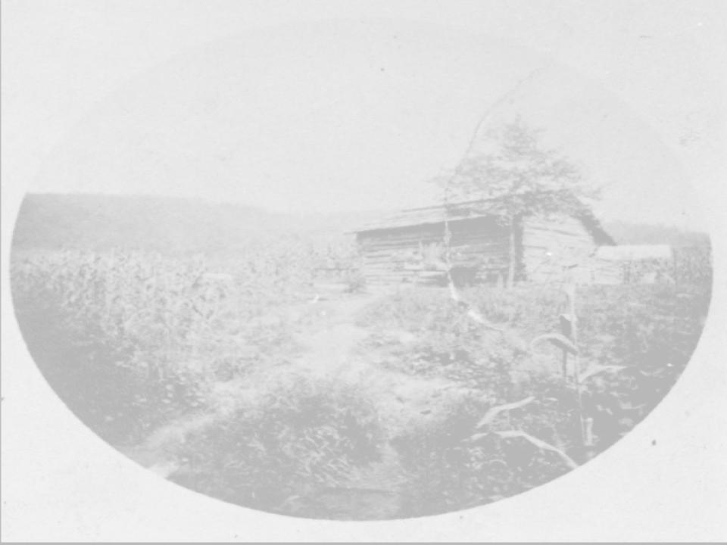
The Lost Cause and Slave Narratives in Western North Carolina

Slide 2
~Western North Carolina and the Lost Cause Narrative Data Based Questions (DBQ) ~
Background:
The Lost Cause is a revisionist movement that made strides in reframing the narrative of the Civil War. This resulted in idolization of Confederates and misinformation about the struggle for civil rights in the post war era. The Lost Cause was largely promoted by Confederate sympathizer groups, such as the Daughters of the Confederacy. Sympathizers in the education field, petitioned and raised money for monuments. They also promoted the creation of textbooks and materials that portrayed the Confederacy in the role of victimhood. educational
“The Lost Cause is this narrative. It is a way of recalling the past, and it was propogated by Confederate veterans and their allies, especially their wives and daughters, that focuses on noble Confederates fighting for a worthwhile cause. I want to talk about the basic tenants, the basic lost cause narrative falsehoods. I sometimes refer to it as the False Cause…Here are the four claims we’re going to deal with. The first is that slavery was not the cause of the war. The second is that slavery was benevolent. The third understanding was actually not about the war so much as about Reconstruction, which argued that reconstruction disrupted antebellum race relations and was a corrupt period of misrule. Finally, they were the most valiant and dedicated soldiers of all time.”
Adam Donby C-Span 2020 https://www.c-span.org/video/?507231-1/white-supremacy-lost
“The Cult of the Lost Cause had its roots in the Southern search for justification and the need to find a substitute for victory in the Civil War. In attempting to deal with defeat, Southerners created an image of the war as a great heroic epic. A major theme of the Cult of the Lost Cause was the clash of two civilizations, one inferior to the other. The North, “invigorated by constant struggle with nature, had become materialistic, grasping for wealth and power.” The South had a “more generous climate” which had led to a finer society based upon “veracity and honor in man, chastity and fidelity in women.” Like tragic heroes, Southerners had waged a noble but doomed struggle to preserve their superior civilization. There was an element of chivalry in the way the South had fought, achieving noteworthy victories against staggering odds. This was the “Lost Cause” as the late nineteenth century saw it, and a whole generation of Southerners set about glorifying and celebrating it.”*
M. Landrieu. In the Shadow of Statues a White Southerner Confronts History. Penguin Books. 2019. 166.
*Found on an application for federal funding to preserve three Confederate statues as historically important specifically states that the statues commemorate the Cult of the Lost Cause.

Slide 3
Questions 1-2:
1. Define the Lost Cause narrative.
_______________________________________________
_______________________________________________
_______________________________________________
_______________________________________________
2. In what ways have you encountered the Lost Cause narrative in your life?
_______________________________________________
_______________________________________________
_______________________________________________
_______________________________________________

Slide 4
Disputes Over What Started the Civil War:
Events that Lead up to the Civil War
Documents 1:
Missouri Compromise –The Missouri Territory was admitted to the United States as a slave state and Maine was added at the same time as a free state. This law also prohibited chattel slavery in the Louisiana Territory north of the 36° 30´ latitude line, also refered to as the Mason-Dixon line.
Compromise of 1850 – This was an attempt to resolve disputes over chattel slavery in new territories added to the United States. It admitted California as a free state, left Utah and New Mexico to decide for themselves whether to be a slave state or a free state, defined a new Texas-New Mexico boundary, and made it easier for enslavers to recover freedom seekers under the Fugitive Slave Act of 1850.
Fugitive Slave Act – A law that required the seizure and return of enslaved people who saught freedom by escaping from one state into another or into a federal territory. The law authorized state or federal commissioners to decide without a jury trial the status of alleged “fugitive” freedom seekers.
Kansas-Nebraska Act - The Kansas-Nebraska Act repealed the Missouri Compromise, created two new territories, and allowed for popular sovereignty. It also produced a violent uprising known as “Bleeding Kansas,” as supporters of chattel slavery and abolition activists flooded into the territories to sway the vote.
Bleeding Kansas - Violent fighting over chattel slavery in new western states caused by the Kansas-Nebraska Act.
John Brown’s Raid – An effort by abolitionist John Brown to start an armed slave revolt in 1859. He attacked and captured the United States arsenal at Harpers Ferry, Virginia. Brown's raid was defeated by a platoon of U.S. Marines led by Colonel Robert E. Lee.
Pew Research Center asked Americans: What was the Main Cause of the Civil War?
48% - States’ Rights
38% - Slavery
Heimlich, R. (2019, December 30). What Caused the Civil War? Pew Research Center. Retrieved March 7, 2022, from https://www.pewresearch.org/fact-tank/2011/05/18/what-caused-the-civil-war/

Slide 5
Questions 3-4:
3. Using the list of events, identify the main cause of the Civil War.
_______________________________________________
_______________________________________________
_______________________________________________
_______________________________________________
4. Public opinion seems split on the issue of what caused the Civil War. What might have caused that?
_______________________________________________
_______________________________________________
_______________________________________________
_______________________________________________

Slide 6
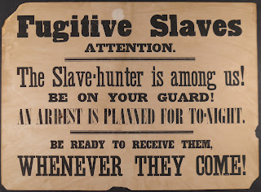
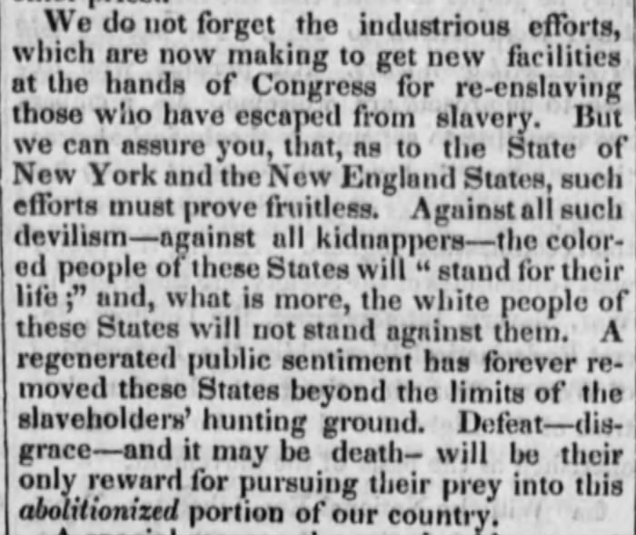
Fugitive Slave Act of 1850
Document 2:
Section 9
And be it further enacted, that, upon affidavit made by the claimant of such fugitive, his agent or attorney, after such certificate has been issued, that he has reason to apprehend that such fugitive will he rescued by force from his or their possession before he can be taken beyond the limits of the State in which the arrest is made, it shall be the duty of the officer making the arrest to retain such fugitive in his custody, and to remove him to the State whence he fled, and there to deliver him to said claimant, his agent, or attorney. And to this end, the officer aforesaid is hereby authorized and required to employ so many persons as he may deem necessary to overcome such force, and to retain them in his service so long as circumstances may require. The said officer and his assistants, while so employed, to receive the same compensation, and to be allowed the same expenses, as are now allowed by law for transportation of criminals, to be certified by the judge of the district within which the arrest is made, and paid out of the treasury of the United States.*
Signs like these were posted as warnings in towns to warn African American communities of the threat of human trafficking and kidnapping present. This sign is undated but many abolition supporting newspapers reported similar warnings throughout the 1850s.
19th Century, Undated, Unsigned Broadside, Rauner Library.
Anti-Slavery Bugle, Lisbon, Ohio, September 28, 1850, Pg. 4.
*Passed on September 18, 1850 by Congress, The Fugitive Slave Act of 1850 was part of the Compromise of 1850. The act required that slaves be returned to their owners, even if they were in a free state. The act also made the federal government responsible for finding, returning, and trying escaped slaves. Commissioners in the trials were paid $10 if a fugitive was returned to slavery but only $5 if the fugitive was freed.
Avalon Project - Fugitive Slave Act 1850. (n.d.). Avalon Project. Retrieved March 5, 2022, from https://avalon.law.yale.edu/19th_century/fugitive.asp

Slide 7
Questions 5-7:
5. What did the Fugitive Slave Act of 1850 do?
____________________________________________________________
____________________________________________________________
____________________________________________________________
____________________________________________________________
6. How was this a violation of free states’ rights?
____________________________________________________________
____________________________________________________________
____________________________________________________________
____________________________________________________________
7. If the slave states were dedicated to the issue of states rights, why would they infringe on the rights of the northern states to be a haven for freedom seekers?
____________________________________________________________
____________________________________________________________
____________________________________________________________
____________________________________________________________

Slide 8
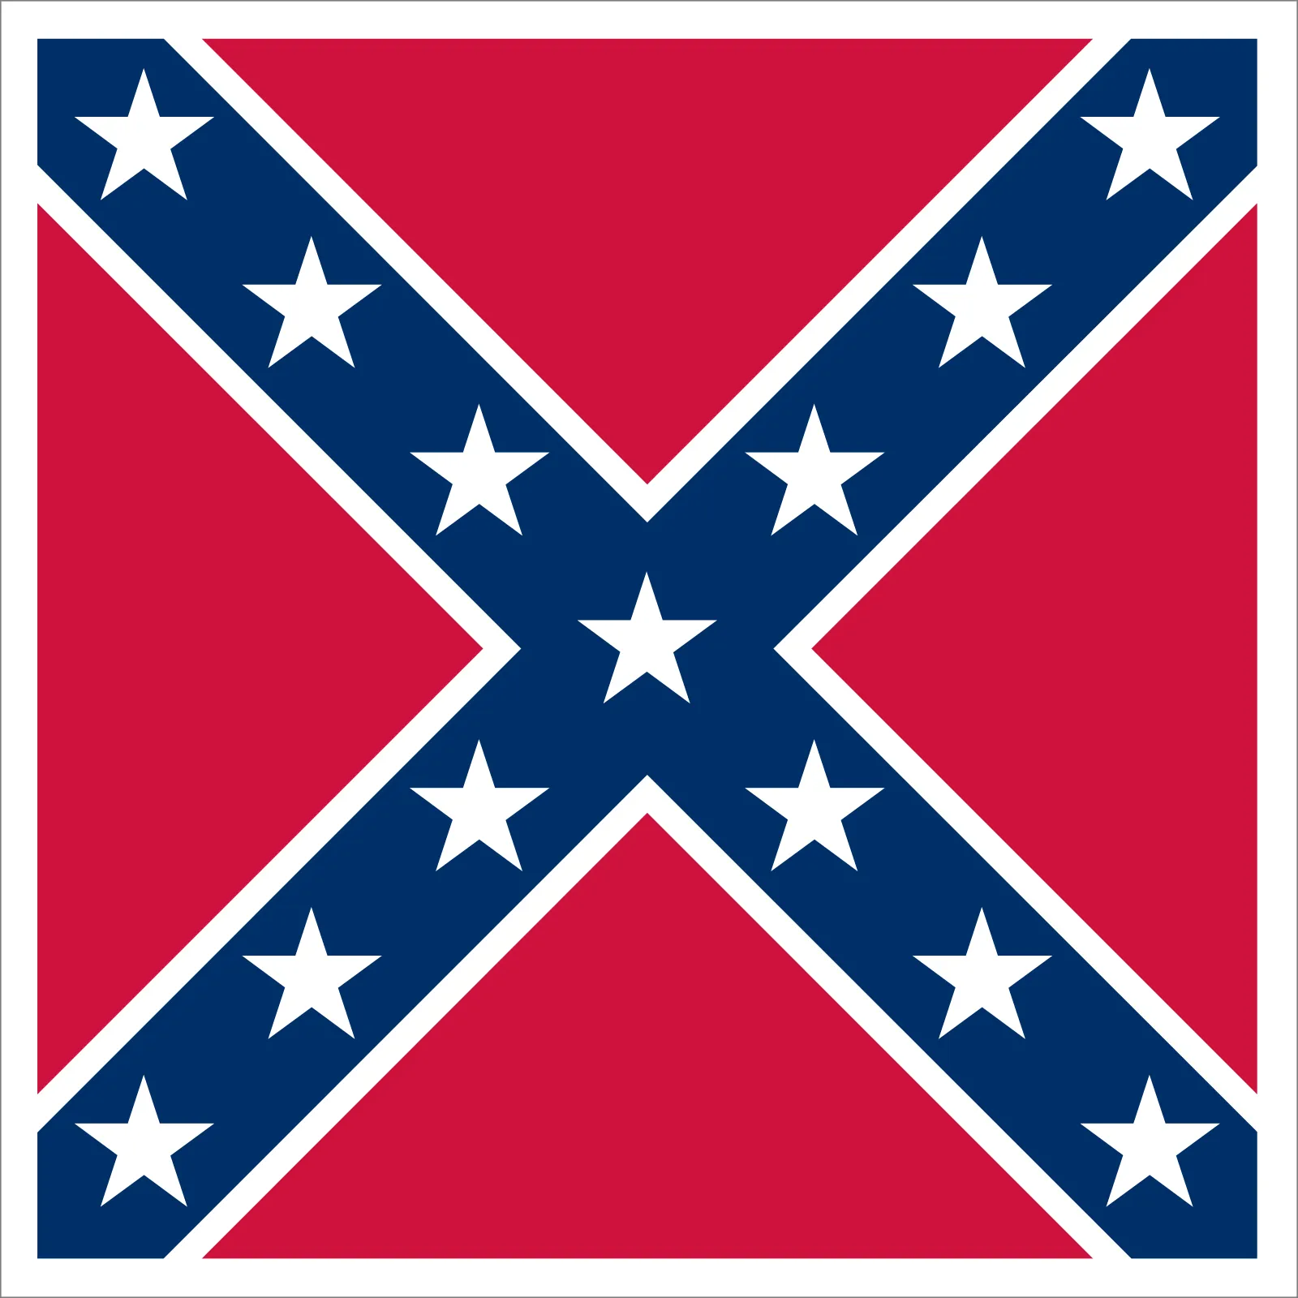

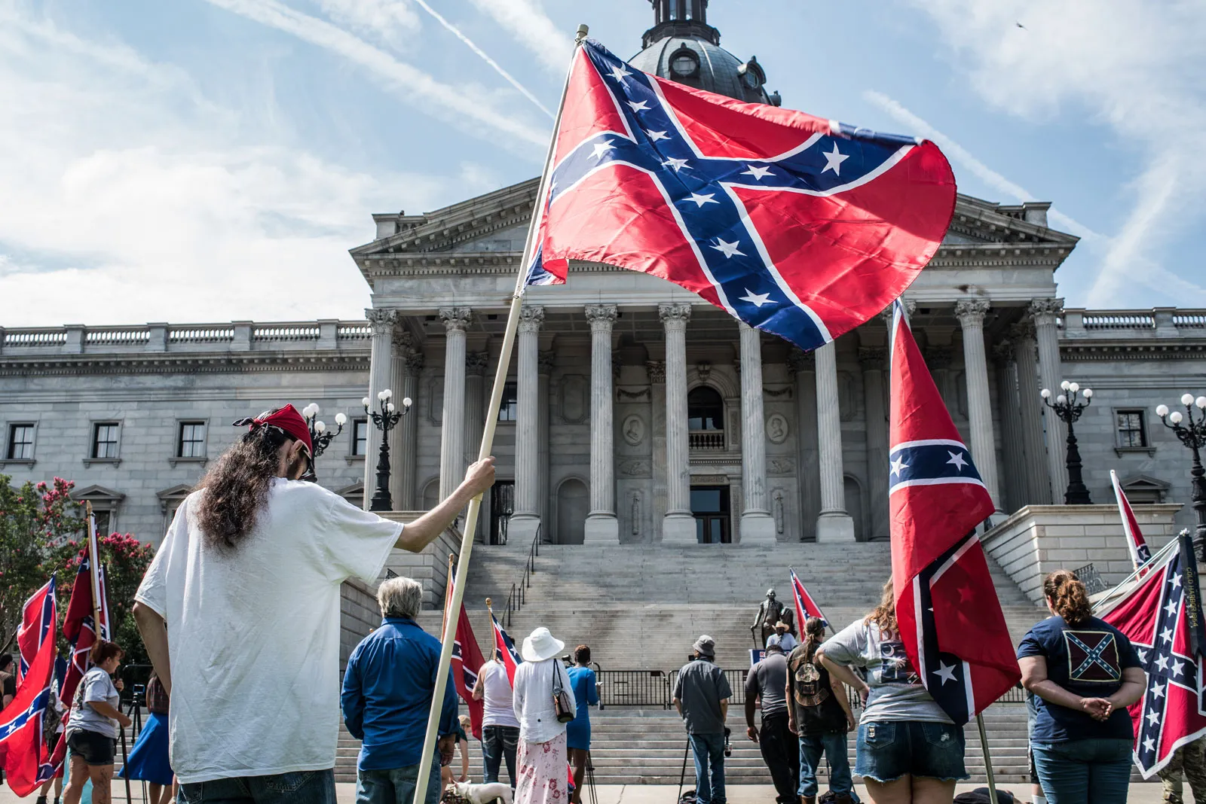
Document 3:
“As a people, we are fighting to maintain the heaven ordained supremacy of the white man over the inferior or colored race: a white flag would thus be emblematical of our cause... soon it will rank among the proudest ensigns of the nations, and be hailed by the civilized world as THE WHITE MAN'S FLAG”
-William T. Thompson
Savannah Morning News, April 23, 1863.
The “Southern Cross” version of the Confederate Battle flag.
Original national Confederate flag.
Jordan, D. (2020, July 31). Statement on Display of Confederate Flag. Evanston Public Library. Retrieved March 5, 2022, from https://www.epl.org/statement-on-display-of-confederate-flag/
“Protesters demonstrating against the removal of the Confederate Battle Flag from the grounds of the South Carolina State House, Columbia, South Carolina, 2017.”
Britannica, T. Editors of Encyclopedia. "flag of the Confederate States of America." Encyclopedia Britannica, November 1, 2022. https://www.britannica.com/topic/flag-of-the-Confederate-States-of-America.

Slide 9
Questions 8-9:
8. What was William T. Thompson’s view of the Confederacy? How is that view reflected in modern society?
__________________________________________
__________________________________________
__________________________________________
__________________________________________
9. How is his view contradicted in modern society?
__________________________________________
__________________________________________
__________________________________________
__________________________________________

Slide 10
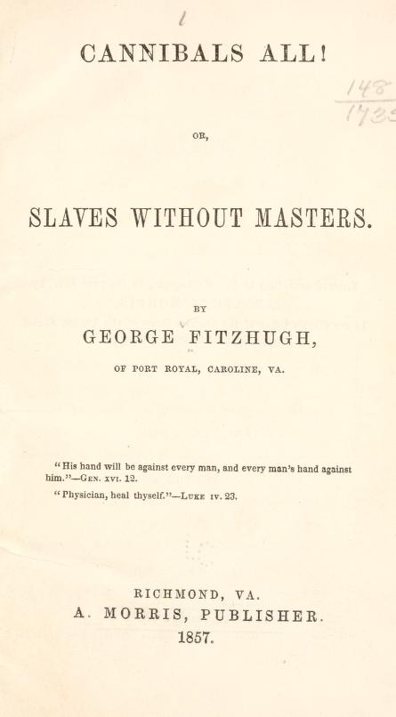
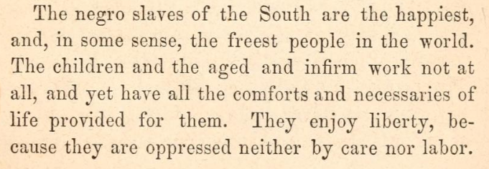
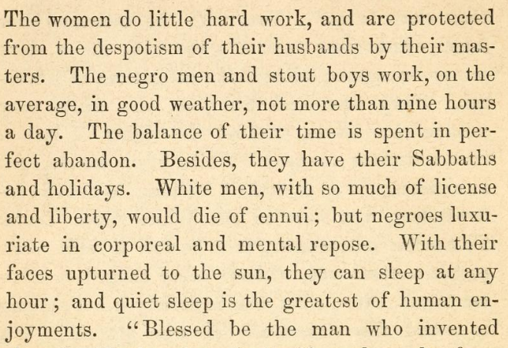
Document 4:
At the time of publication Fitzhugh was a sociologist from North Carolina. Cannibals All! Was one of his most famous works.
Cannibals All! Or Slaves Without Masters, Richmond, Virginia, 1857, Pgs. 29-30.
https://archive.org/details/cannibalsallorsl00fitz/page/28/mode/2up?q=happiest

Slide 11
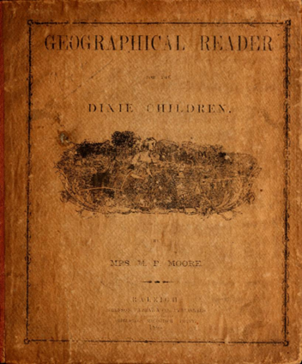
Document 5:
Geographical Reader for the Dixie Children, Marinda Branson, 1863.
This reader was a textbook for school children in the Confederate States during the US Civil War.
“3. Then the Northern people began to preach, to lecture, and to write about the sin of slavery. The money for which they sold their slaves, was now partly spent in trying to persuade the Southern States to send their slaves back to Africa. And when the territories were settled they were not willing for any of them to become slaveholding. This would have made the North much stronger than the South; and many of the men said they would vote for a law to free all the negroes in the country. The Southern men tried to show them how unfair this would be, but still they kept on.
4. In the year 1860 the Abolitionists became strong enough to elect one of their own men for president. Abraham Lincoln was a weak man, and the South believed he would deprive them of their rights. So the Southern states seceded, and elected Jefferson Davis for their President. This so enraged President Lincoln that he declared war, and has exhausted nearly all the strength of the nation, in a vain attempt to whip the South back into the Union. Thousands of lives have been lost, and the earth has been drenched in blood; but still Abraham is unable to conquer the “Rebels” as he calls the south. The South only asked to be let alone, and divide the public property equally. It would have been wise in the North to have said to her Southern sisters, “If you are not content to dwell with us longer, depart in peace. We will divide the inheritance with you, and may you be a great nation.””
Geographical Reader for the Dixie Children, Marinda Branson, 1863. Pgs. 13 – 14. https://archive.org/details/geographicalrea00moor/page/13/mode/1up

Slide 12
Questions 10-11:
10. Documents 4 and 5 were published before and during the Civil War. How does each document lay the groundwork for the Lost Cause narrative after the Civil War?
__________________________________________
__________________________________________
__________________________________________
__________________________________________
11. In your view, how influential is popular media in shaping public opinion? How influential is school curriculum? What leads you to believe that?
__________________________________________
__________________________________________
__________________________________________
__________________________________________

Slide 13
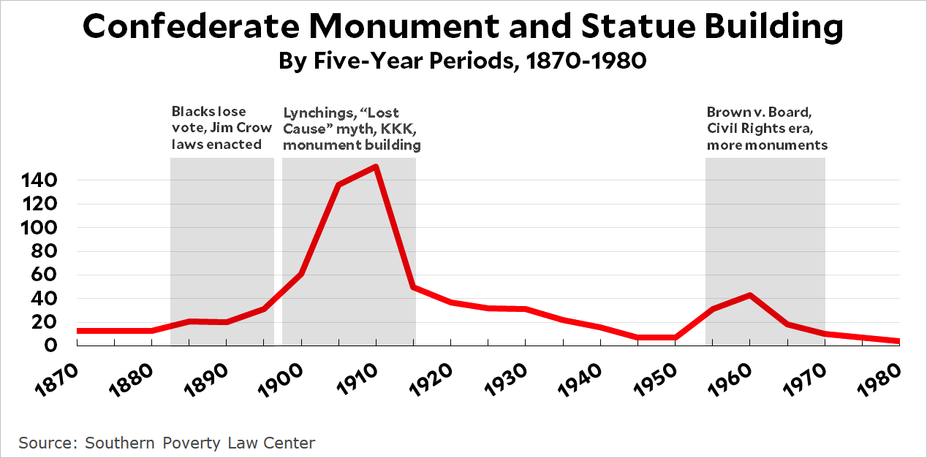
Document 6:

Slide 14
Document 7
My research looks into what are the ties between lies and White supremacy and historical memory. The book looks at everything from pension fraud, to made up stories about deserters, who deserted for love of their wives to myths, more recently, of Black Confederates. Which, just to to be clear, did not exist. There were not Black Confederates, the Confederate military did not allow African Americans to serve. It was illegal until March of 1865 under Confederate law. But, there is the myth that has been propagated for a variety of reasons, and the book looks at that as well. The book and what has gotten the book the most attention is the fact that the book also looks at Confederate monuments, and Confederate monuments are a topic that is front and center right now. One of the easiest ways to understand what these monuments were meant to do is to actually look at the dedications. The literal moments when they put them up, at the individuals who put them up and see how they understood these monuments… We are going to use the example of Julian Carr, who called himself a general, although he served as a private during the war. He earned his general stars not through military service, but actually because he was the head of Confederate Veterans… Carr was a North Carolinian industrious. He was a major philanthropist. He was the namesake of Carrborough North Carolina, at one point he was probably the richest man in North Carolina…He was a White supremacist. He considered himself a conservative. He was a Democratic party leader and he was perhaps the most prolific speakers at Confederate monument dedications, at least in North Carolina, if not everywhere. He is always at dedications…You can see him at the dedication of the Unity monument. You can see him in the center speaking in his Confederate uniform. And through these speeches and fundraising, he was a leading propagator of the Lost Cause and his mission was to recall the war in a specific way. Which frequently overlapped with his goals around his political views. And he was very explicit that these monuments were meant to celebrate White supremacy. During these speeches, he would say as much. So it was not a secret.
–Adam Donby, author and presenter. “The Civil War: White Supremacy and the Lost Cause.” C-Span 2020. https://www.c-span.org/video/?507231-1/white-supremacy-lost

Slide 15
Questions 12-13:
12. What does Document 6 demonstrate about Confederate monuments?
__________________________________________
__________________________________________
__________________________________________
__________________________________________
13. What conclusions can be drawn from Document 7?
__________________________________________
__________________________________________
__________________________________________
__________________________________________

Slide 16
Document 8:
A Portion of Julian Carr's Speech at the Dedication of Silent Sam, “Unveiling of Confederate Monument at University. June 2, 1913.”
“There are no words that I have been able to find in the vocabulary of the English language that fittingly express my feelings in this presence of this occasion. But you know and I know, that though I might speak with the tongue of men and of angels, neither song nor story could fittingly honor this glorious event. The whole Southland is sanctified by the precious blood of the student Confederate soldier. Their sublime courage has thrown upon the sky of Dixie a picture so bright and beautiful that neither defeat, nor disaster, nor oppression, nor smoke, nor fire, nor devastation, nor desolation, dire and calamitous, and I might with truth add, the world, the flesh nor the Devil has been able to mar or blemish it. The tragedy of history fails to record anywhere upon its sublime pages anything comparable to it. All the time will be the millennium of their glory…
The present generation, I am persuaded, scarcely takes note of what the Confederate soldier meant to the welfare of the Anglo Saxon race during the four years immediately succeeding the war, when the facts are, that their courage and steadfastness saved the very life of the Anglo Saxon race in the South – When “the bottom rail was on top” all over the Southern states, and to-day, as a consequence the purest strain of the Anglo Saxon is to be found in the 13 Southern States – Praise God.
I trust I may be pardoned for one allusion, howbeit it is rather personal. One hundred yards from where we stand, less than ninety days perhaps after my return from Appomattox, I horse-whipped a negro wench until her skirts hung in shreds, because upon the streets of this quiet village she had publicly insulted and maligned a Southern lady, and then rushed for protection to these University buildings where was stationed a garrison of 100 Federal soldiers. I performed the pleasing duty in the immediate presence of the entire garrison, and for thirty nights afterwards slept with a double-barrel shot gun under my head.
With pardonable pride I look upon the grand record of my Alma Mater, near whose confines I first beheld the light; in whose classic halls three of my sons have graduated and a fourth is now a student, and where my brother and three of his sons also matriculated. The glorious record of this seat of learning is embalmed in affections of our family.”
Julian S. Carr, “Unveiling of Confederate Monument at University. June 2, 1913” in the Julian Shakespeare Carr Papers #141, Southern Historical Collection, The Wilson Library, University of North Carolina at Chapel Hill.
Transcription: Carr Speech - Hilary N. Green, PhD (ua.edu)

Slide 17
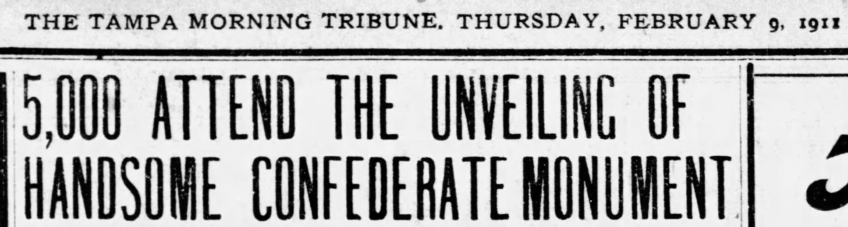
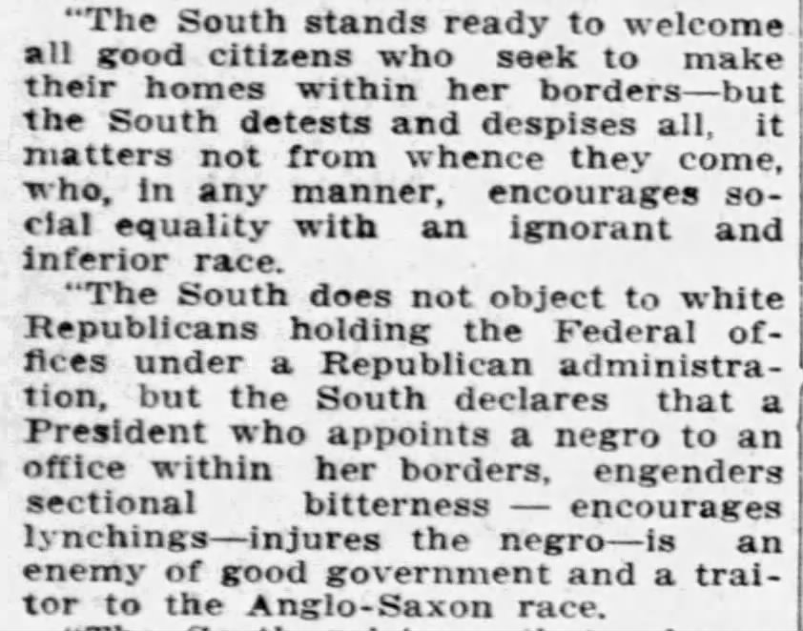
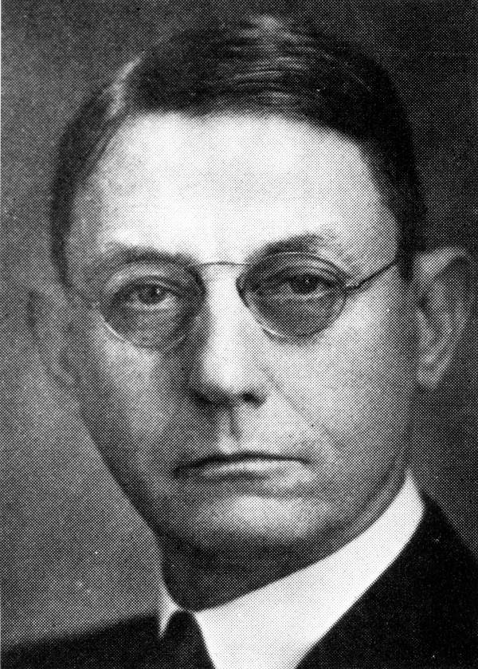
Document 9:
Herbert S. Phillips, born Milltown Georgia in 1871. Admitted to Florida bar in 1899. Practiced law in Tampa since 1900. State Attorney for the 6th Judicial Circuit 1903-1913. U.S. Attorney Southern District 1913-1921.
Herbert Phillips, Florida State Attorney, February 8th, 1911. The Tampa Morning Tribune, Thursday, February 9, 1911. Pgs. 3 & 5.
Photo: Herbert S. Phillips, State Attorney. 1899 (circa). State Archives of Florida, Florida Memory. <https://www.floridamemory.com/items/show/19942>, accessed 15 March 2023.

Slide 18
Questions 14-15:
14. Documents 8 & 9 are sources from Confederate monument dedications. In Document 8, what is Julian Carr suggesting about White southerners? What is he suggesting about Black southerners?
__________________________________________
__________________________________________
__________________________________________
__________________________________________
15. In document 9, what is Herbert Phillips suggesting about the south? Who does he blame for violence against African Americans?
__________________________________________
__________________________________________
__________________________________________
__________________________________________

Slide 19
Document 10:
An August 2020 NPR poll stated that about 50% of Whites and 83% of Blacks agreed that racism is built into US institutions and that Whites have advantages, while support for reparations had scant support among Whites (21%) but substantial support among African Americans (80%).
Most Americans acknowledge institutional racism exists in America.
More than half, 58%, agree that racism is built into the American economy, government, and educational systems.
Though more white Americans agree (50%) than disagree (36%), they are less likely to believe this than any other racial or ethnic group.
More than two-thirds of Asian (67%) and Hispanic (69%) Americans agree, along with 83% of Black Americans.
There are significant gaps in perception between white and Black Americans when it comes to attitudes around racism and racial justice.
For example, though most Americans (58%) agree that white people have an advantage, compared to people of color, in our society, there is a 34 percentage point difference between white and Black respondents. Eighty-three percent of Black Americans feel this way, compared to just 49% of white Americans.
The biggest difference in agreement between the two groups is on the question of reparations. Eighty percent of Black respondents agree that Black Americans whose ancestors were enslaved deserve reparations from the federal government, compared to just 21% of white respondents.
White Americans are divided on whether our country needs to continue making changes to give Black Americans equal rights with white Americans (51%) or if our country has made the changes needed (49%).
However, a majority of Black (89%), Asian (66%), and Hispanic (63%) Americans all believe our country needs to continue making changes.
On the question of whether certain behaviors are seen as racist, people of color are significantly more likely than white people to perceive the following as racist: mispronouncing someone’s name, insisting people speak English in public, and telling someone of another race they are intelligent or articulate.
Mallory Newall and Sara Machi. “White and Black Americans Far Apart on Racial Issues.” August 27, 2020. Ipsos and NPR.
White and Black Americans far apart on racial issues | Ipsos

Slide 20
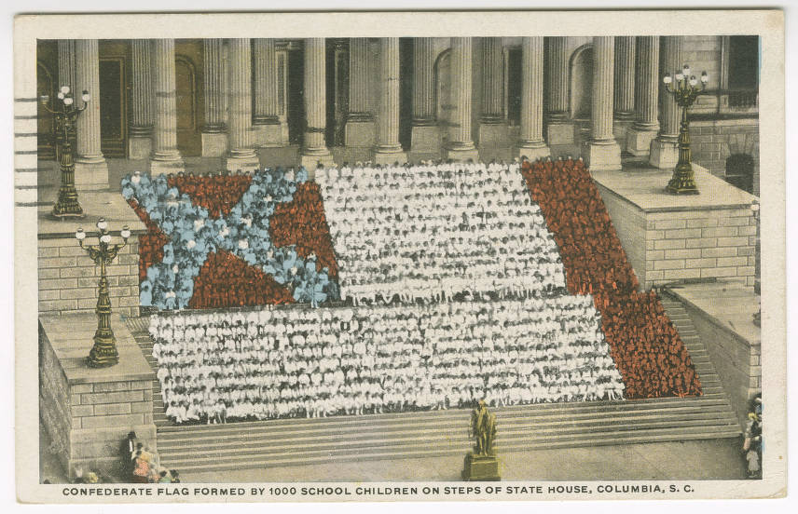
Document 11:
Post Card from August 27th, 1923. A Confederate flag formed by 1000 school children on steps of the State House, Columbia, South Carolina.
University of South Carolina University Library.
https://digital.tcl.sc.edu/digital/collection/sclvispc/id/9158

Slide 21
Questions 16-17:
16. According to Document 10, there is some discrepancy in how racism is perceived by White and Black Americans. What role might the Lost Cause narrative play in that?
__________________________________________
__________________________________________
__________________________________________
__________________________________________
17. What does Document 11 imply about Lost Cause education in the South in the early 1900s?
__________________________________________
__________________________________________
__________________________________________
__________________________________________

Slide 22
What are the regional impacts of the Lost Cause narrative?
Document 12:
C.G. Memminger is the former treasury of the confederacy, and former owner of the Carl Sandburg home in Flat Rock, NC.
“One can now say unequivocally that C. G. Memminger believed that blacks were inherently inferior to whites, that he himself enslaved people, that as a lawyer he provided legal expertise that enabled other slave owners to transact business involving human property, and that he continued to defend the institution of slavery throughout his life. He was a central player in Confederate politics and by his sunset years in the 1880s (spent in Flat Rock), was someone “in whom all who loved the Lost Cause feel an interest.” That the reporter of this sentiment was North Carolina newspaperman Josephus Daniels—who soon thereafter became an architect of a virulent white supremacy campaign by North Carolina’s Democratic party—is itself telling.”
David E. Whisnant and Anne Mitchell Whisnant, Black Lives and Whitened Stories: from the Lowcountry to the Mountains (National Park Service 2020), 106.

Slide 23

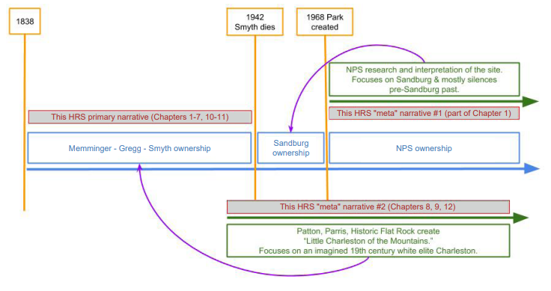
Document 13:
Between 1967-1968, when the Sandburg home was under consideration to become a federal historic site, there was a lot of debate about what history found the site upon. Several lowland enslavers, a prominent Confederate, and White supremacists had lived in the home since its construction in 1834. Sandburg himself was, and is still considered, a leading biographer of President Abraham Lincoln and a poet, famously known for his activist stances on union and labor rights.
David E. Whisnant and Anne Mitchell Whisnant, Black Lives and Whitened Stories: from the Lowcountry to the Mountains (National Park Service 2020), 5.

Slide 24
Questions 18-19:
18. What does Document 12 state about C.G. Memminger, as it relates to civil rights and race? Again, how is C.G. Memminger connected to western North Carolina?
__________________________________________
__________________________________________
__________________________________________
__________________________________________
19. Using Document 13 and previous information, why might the Sandburg historic site have only focused on the last 20 years of Carl Sandburg’s life, when there’s so much other history in the area and associated with the home?
__________________________________________
__________________________________________
__________________________________________
__________________________________________

Slide 25
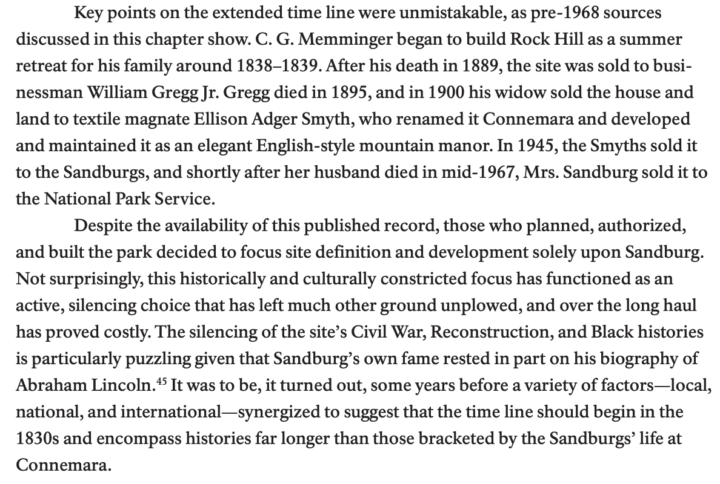
Document 14:
Since 1834, four families have owned what is now the Carl Sandburg home: The Memmingers, the Greggs, the Smyths, and the Sandburg's. The following source outlines the general history of the site, and implies that there were political reasons for keeping the site vested in only a small sliver of history.
David E. Whisnant and Anne Mitchell Whisnant, Black Lives and Whitened Stories: From the Lowcountry to the Mountains (National Park Service 2020), 23.

Slide 26
Questions 20-21:
20. Why is it puzzling that the Carl Sandburg home site has been largely silent on issues of civil war, reconstruction, and black histories of the home?
__________________________________________
__________________________________________
__________________________________________
__________________________________________
21. What’s happening locally, nationally, and/or internationally that may be prompting sites like the Sandburg home to expand their historic timelines and stories?
__________________________________________
__________________________________________
__________________________________________
__________________________________________

Slide 27
22. What more can be done to ensure more accurate education surrounding the Civil War?
__________________________________________
__________________________________________
__________________________________________
__________________________________________

