Slide 1
Animal Adaptations/Habitats
Vocabulary
Death Valley National Park

Slide 2
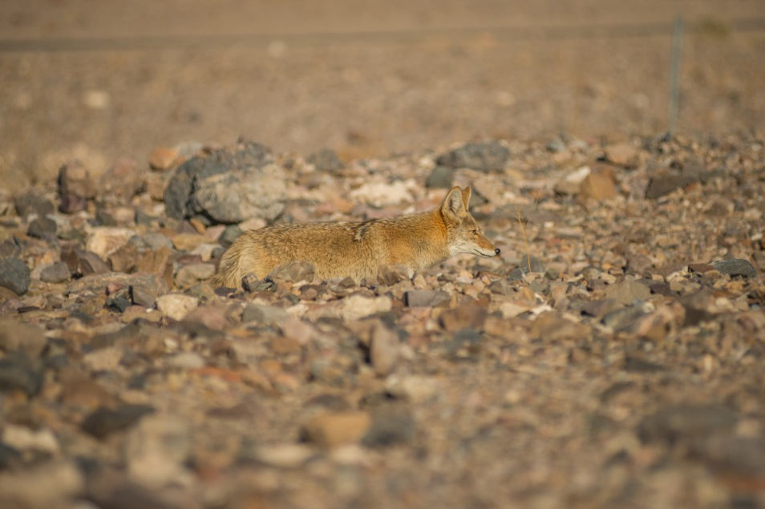
adaptations
a change or the process of change by which an organism or species becomes better suited to its environment.
For example, a coyote’s fur blends in with its surroundings
Photo Credit Kurt Moses NPS

Slide 3
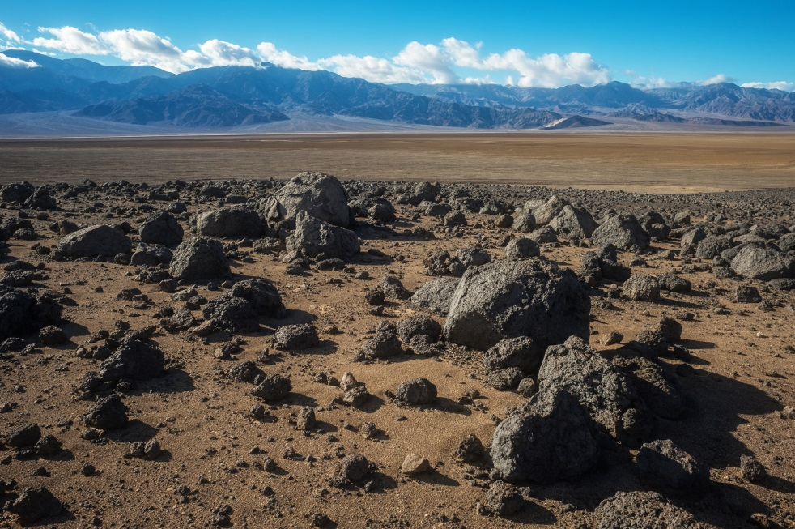
habitats
the natural home or environment of an animal, plant, or other organism.
For example, Death Valley or the Mojave Desert
Photo Credit Kurt Moses NPS

Slide 4
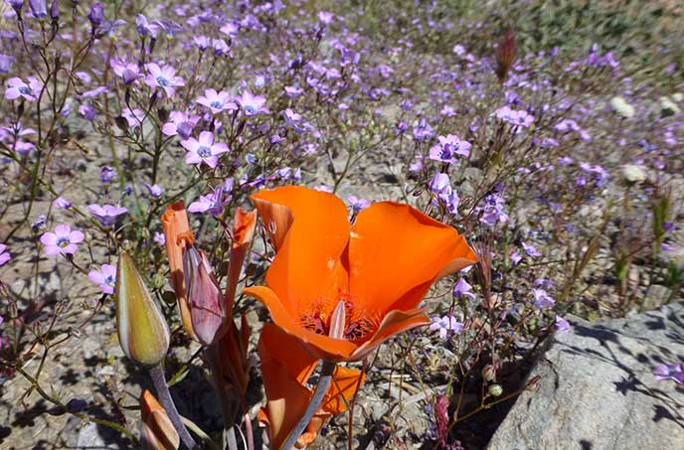
thrive
(of a child, animal, or plant) grow or develop well or vigorously.
For example, a flower growing in the ground
Photo Credit Kurt Moses NPS

Slide 5
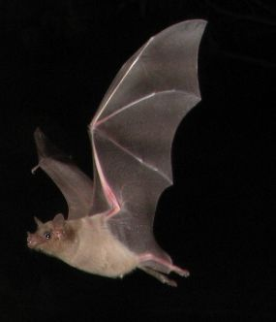
nocturnal
animals that sleep during the day and are active at night
For example, a bat will sleep during the day and forage for food at night.
Photo Credit Microsoft Clip Art

Slide 6
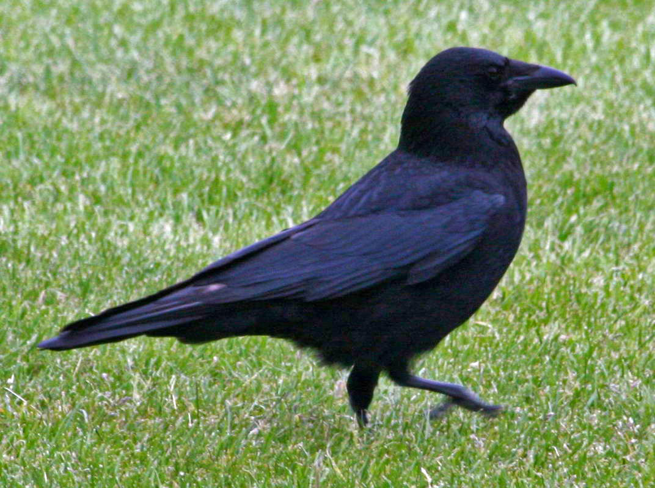
diurnal
active during the day
For example, a raven is active during the day and sleeps at night.
Photo Credit Microsoft Clip Art

Slide 7
Resources
Dictionary.com - http://www.dictionary.com/
Photo Credit:
Kurt Moss NPS
Microsoft Clip Art

