Slide 1
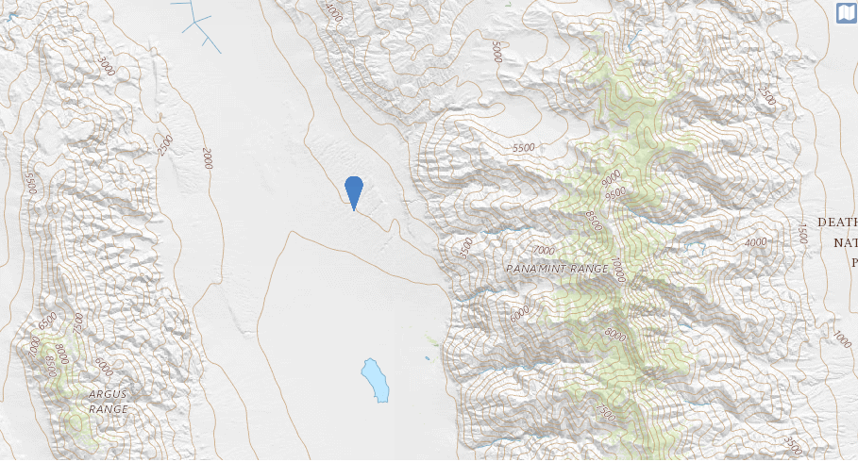
Elevation and
Topographic Maps
Death Valley National Park
Background photo credit USGS

Slide 2
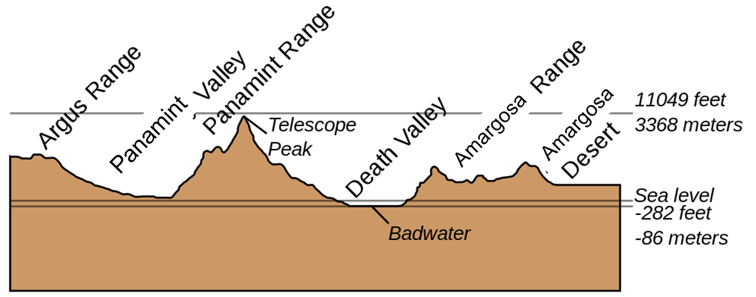
We look at elevations…
Photo credit USGS

Slide 3
What is a topographic map?
Topography is a detailed map of the surface features of land. It includes the mountains, hills, creeks, and other bumps and lumps on a particular hunk of earth.
Reference: https://www.vocabulary.com/dictionary/topography

Slide 4
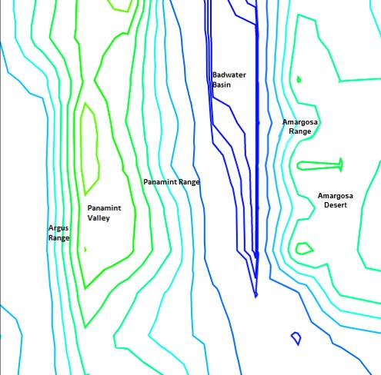
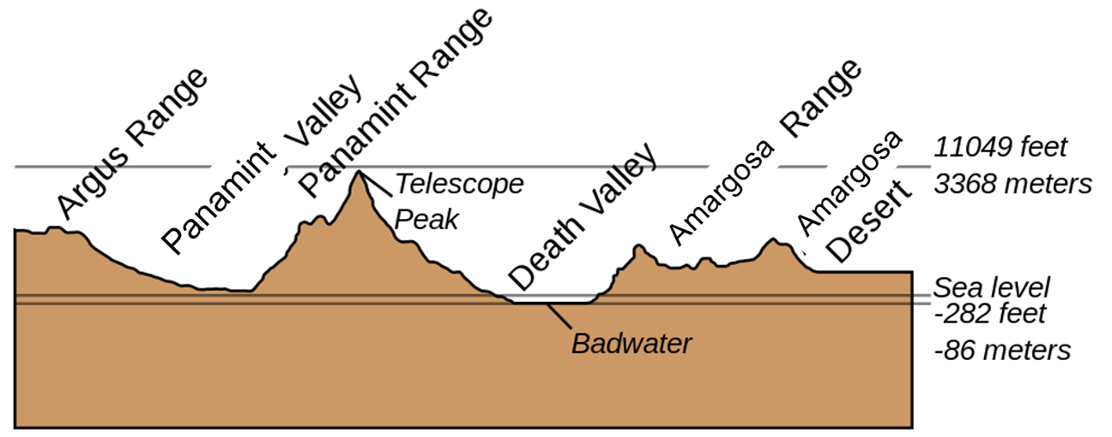
How do we see elevation?
Side View
Bird’s Eye View
Photo credit USGS
Map made with http://contourmapcreator.urgr8.ch/
Notes:
Teacher Notes: Compare and contrast the side view and the birds eye view with the students. What does Badwater look like from the side view? What does Badwater look like from the top view?

Slide 5
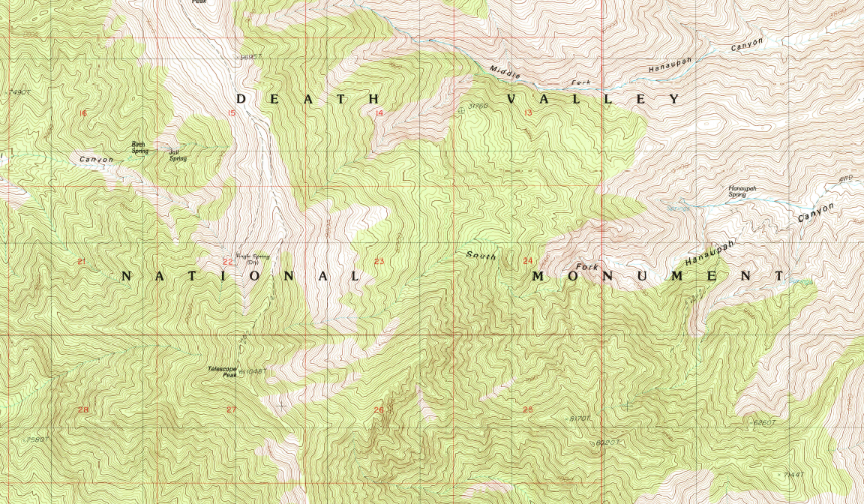
What’s with the lines?
The irregular lines and circles outline the areas that are higher in elevation.
Lines that are close together show that the area is steeper.
Lines that are further apart show that the area is flatter.
Background photo credit USGS

Slide 6
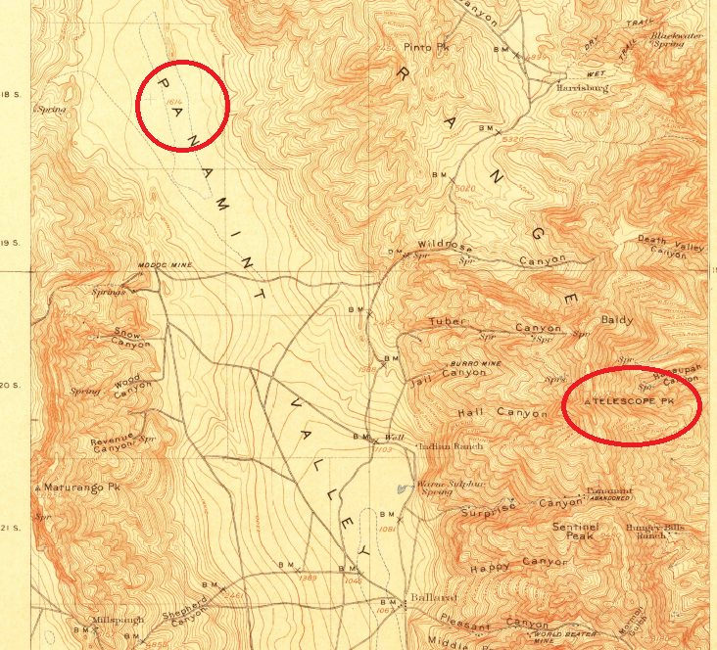
Take a closer look…
Look at the locations in the two circles.
You will see Telescope Pk. & Panamint Valley
What is different about the way they look on this map?
What could that mean?
Map courtesy of usgs.gov

Slide 7
Compare and Contrast
Map and drawing courtesy of usgs.gov
Notes:
Teachers Notes: Compare and Contrast the side view to the map view.

Slide 8
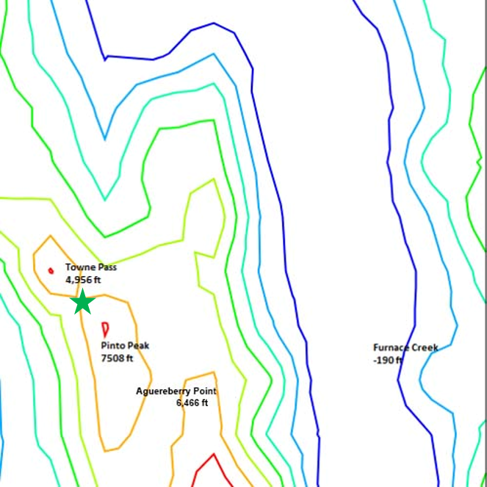
Share what you know!
What is the highest elevation (number and name) on this map?
Map made with http://contourmapcreator.urgr8.ch/

Slide 9
Share what you know!!
What is the lowest elevation (number and name) on this map?
Map made with http://contourmapcreator.urgr8.ch/

Slide 10
Sea Level
“Sea level” is a term used to calculate the height of landforms such as hills, mountains, and salt flats.
Map made with http://contourmapcreator.urgr8.ch/

Slide 11
Point out “sea level” on this diagram
Photo credit USGS

Slide 12
Reading Sea Level
Furnace Creek is
-190 ft
We can read the – sign as “below”
Map made with http://contourmapcreator.urgr8.ch/

Slide 13
Reading Sea Level…
Furnace Creek is
-190 ft
We would say:
The elevation of Furnace Creek is
190 feet
BELOW sea level.
Map made with http://contourmapcreator.urgr8.ch/

Slide 14
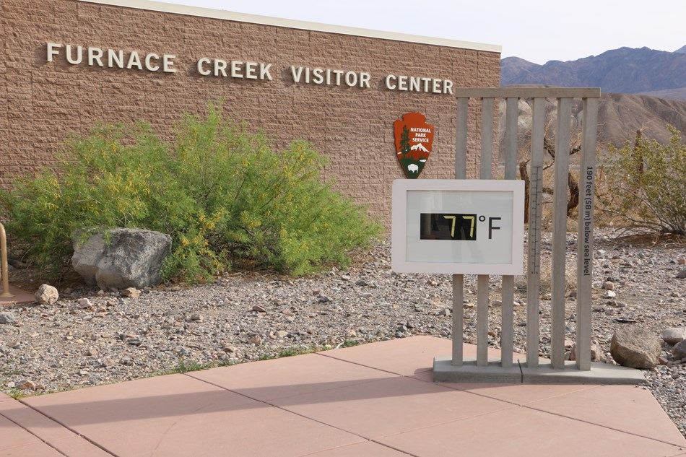
Sea Level at Furnace Creek
In Death Valley, the visitor center is at Furnace Creek, 190 feet BELOW sea level.
It is not underwater!
Notes:
Teachers Notes: Click to make “It is not underwater!” appear.

Slide 15
Reading Sea Level….
Pinto Peak
is 7,508 ft
We would say:
The elevation of Pinto Peak is 7,508 feet
ABOVE sea level.
Map made with http://contourmapcreator.urgr8.ch/

Slide 16
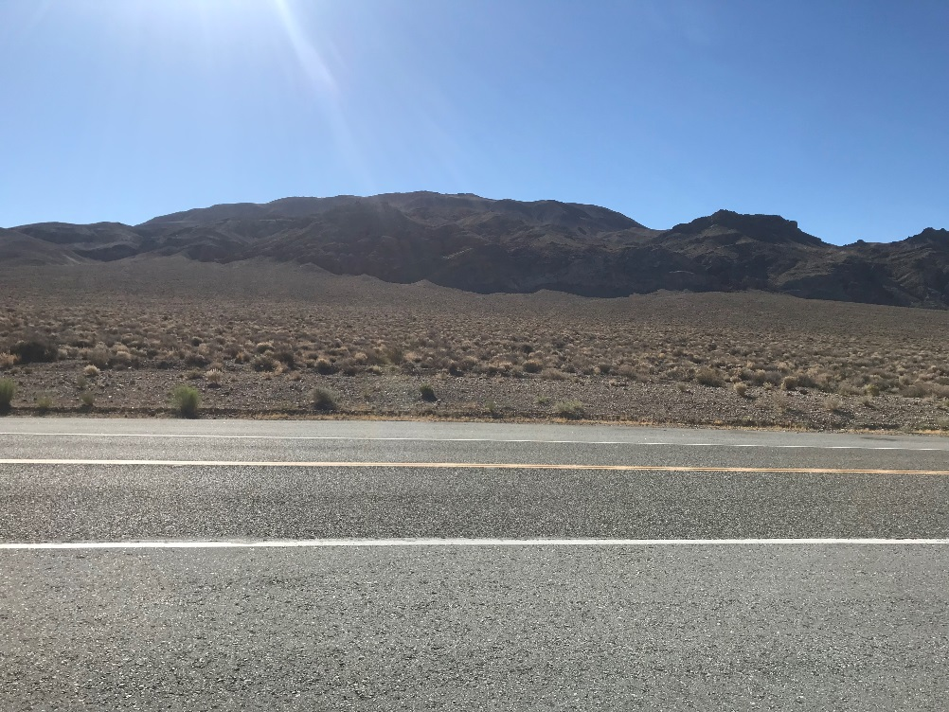
Reading Sea Level…..
Pinto Peak
is 7,508 ft
We would say:
The elevation of Pinto Peak is 7,508 feet
ABOVE sea level.
Notes:
Teacher Note: This photo is taken from Towne Pass, where the green star is on the map.

Slide 17
Can you complete the sentence?
Towne Pass
is 4,956 ft
We would say:
The elevation of Towne Pass is _______ feet
_______ sea level.
Map made with http://contourmapcreator.urgr8.ch/

Slide 18
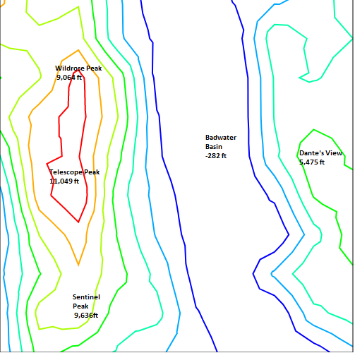
Now It’s Your Turn!
Badwater Basin
is -282 ft
We would say:
The elevation of Badwater Basin is _______ feet
_________ sea level.
Map made with http://contourmapcreator.urgr8.ch/

Slide 19
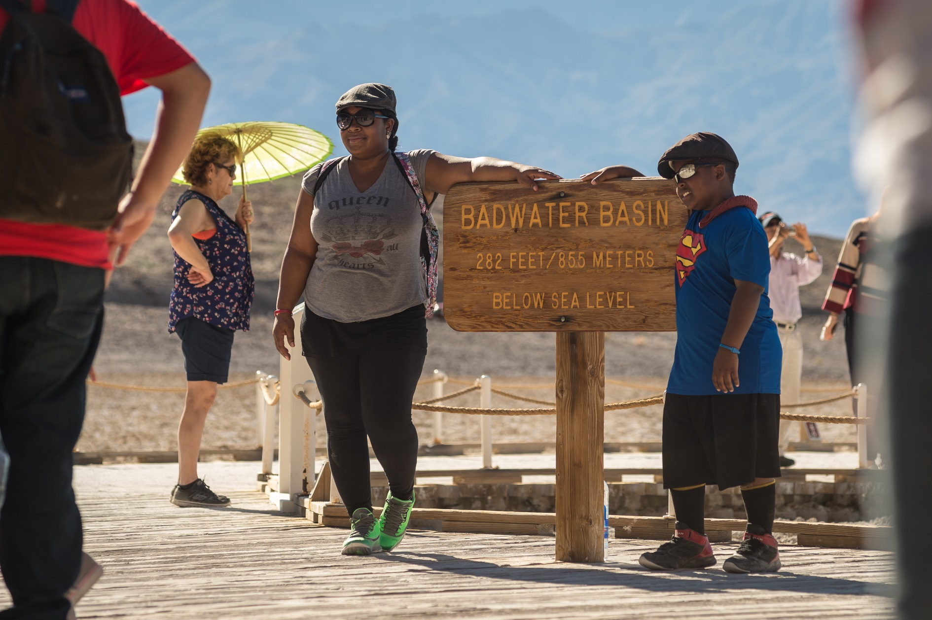
Badwater Basin

Slide 20
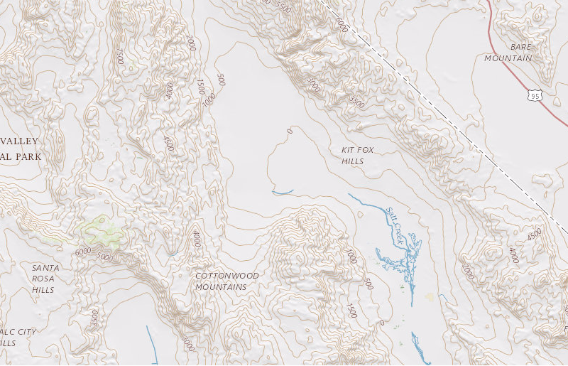
Activity
Explore topography on you!
Background photo credit USGS

Slide 21

For more maps or information:
https://www.usgs.gov/products/maps/topo-maps

