Slide 1
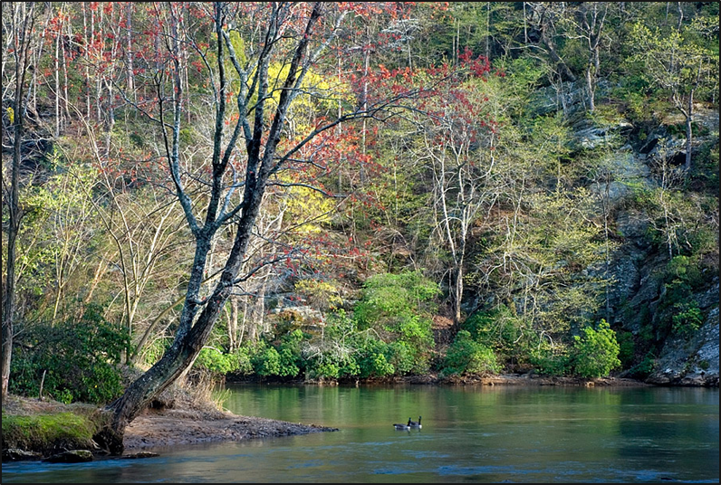
Chattahoochee River National Recreation Area
NPS Compliance Procedures, Permitting, and Best Management Practices
July 19, 2012
Georgia Association of Environmental Professionals

Slide 2
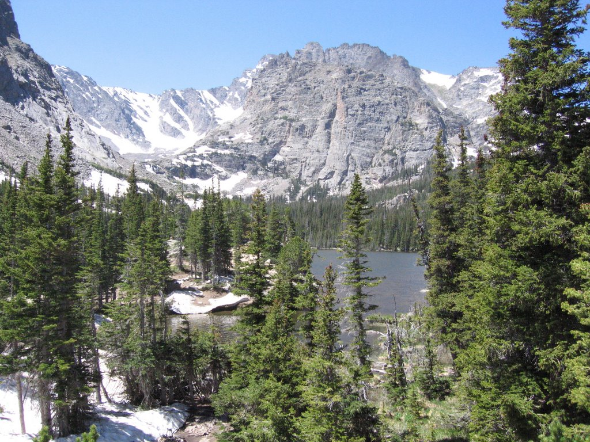
National Park Service Organic Act of 1916
“to conserve the scenery and the natural and historic objects and wildlife therein and to provide for the enjoyment of the same in such a manner and by such a means as will leave them UNIMPAIRED for the enjoyment of future generations”
Notes:
While Congress has given the Service the management discretion to allow impacts within parks, that discretion is limited by the statutory requirement (generally enforceable by the federal courts) that the Park Service must leave park resources and values unimpaired unless a particular law directly and specifically provides otherwise. This, the cornerstone of the Organic Act, establishes the primary responsibility of the Nation Park Service. It ensures that park resources and values will continue to exist in a condition that will allow the American people to have present and future opportunities for enjoyment of them.

Slide 3
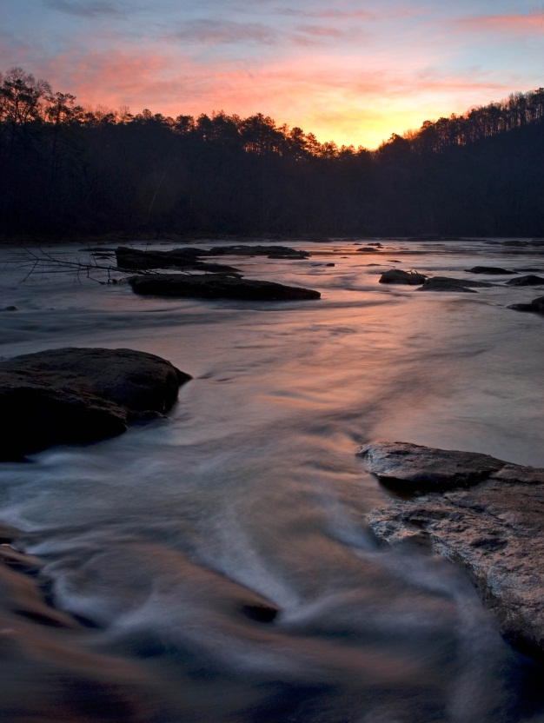
CRNRA Enabling Legislation
1978 (Public Law 95-344): “The recreation area shall consist of the river and its bed together with the lands, waters and interests therein.”
1984 Amended Legislation
(Public Law 98-568): Provides
specific framework for
coordination among
federal agencies for two
scenarios.
Notes:
Park’s mission is to lead the preservation and protection of a 48-mile section of the Chattahoochee River corridor and its associated natural and cultural resources, for the benefit and enjoyment of the people.

Slide 4
Federal Permitting
Federal action within 2000 ft corridor of the river:
Lead agency must notify NPS, provide NPS opportunity to comment and make recommendations, notify NPS of specific decisions made in respect to NPS comments.
Federal action on Land or Waters Administered by NPS:
Action may not commence until NPS has concurred with action.
Notes:
Here, we are talking about any permits that need to be acquired by any federal agency with respect to a project falling within these two categories in the slide.
Within 2000’ – Essentially NPS becomes a formal stakeholder to the action. The federal agency undertaking the action must specifically address, in writing, any comment or recommendation we make to them.
Within our legislated jurisdiction, which includes any of our owned property as well as the river in its bed up to the ordinary high water mark: We must concur with the federal agency’s action before they may undertake the action. In these cases we become a major participant.
The take-home message here for consultants or project proponents is to be sure that NPS involvement is being sought early in the process for any federal action that falls within these two categories. It doesn’t hurt to confer with your federal agency contact that this step is being accomplished.

Slide 5
NPS Permitting
When would a project need to be permitted by NPS?
Action would take place within legislated boundary of the park which includes the Chattahoochee River and its bed, up to the ordinary high water mark.
NPS Special-Use Permit (SUP) instrument.
All NPS costs associated with application, issuance,
and project monitoring are recoverable.
Constitutes a “federal action” for the purposes of
compliance. NPS responsible for compliance.
Notes:
Here, we are talking specifically about a scenario that would require a separate permit from NPS for a project.
Issuance of a SUP would constitute a “Federal action.” Thus SUP activities need to be evaluated for compliance with NEPA, NHPA, ESA and all applicable laws, executive orders, and policies. If a proposed special use is not covered by a categorical exclusion, an EA or EIS will need to be prepared. The park is responsible for identifying reasonable alternatives, both inside and outside the park, and completing appropriate compliance documentation. Compliance documentation may be prepared by either the park or the applicant at the discretion of the superintendent. Although the park may require that the applicant prepare the documentation, the NPS remains responsible for all content. Regardless of who prepares the documents, the applicant is responsible for paying all NPS costs incurred in meeting all requirements. Note: This is true even when the decision process leads to a denial of a permit. Applicants should be prepared early for this possibility and encouraged to work closely with NPS to identify alternatives that are consistent with NPS mission and park vision. Recoverable costs include all costs to the NPS from the time the first inquiry is received until a proposed activity is either denied or carries through to completion.

Slide 6
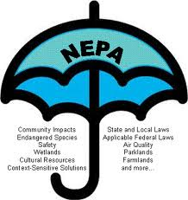
NEPA
Some pointers –
Purpose & Need Clearly Stated:
Articulated from the perspective of the NPS action.
Impact Analysis Objective and Candid:
Accurate presentation of credible data and knowledgeable interpretation of data.
Notes:
A pitfall that consultants will often run into is in presenting the NEPA from the perspective of NPS. If working for a municipal or private client, remember that the purpose and need should to be defined in the context of NPS’s action– whether this is issuance of a permit, permission to allow another entity to use NPS land, etc.
It is of upmost importance that the Impact Analysis is Objective and Candid in it’s evaluation. An objective and accurate presentation of data is particularly important, as is the knowledgeable interpretation of those data in all appropriate contexts.
Court battles on EAs have been lost on the basis that the EA included undocumented information; that methods used to collect data or that data themselves were inaccurate or controversial; or that the EA depended entirely on mitigation to reduce impacts to below a significance threshold.

Slide 7
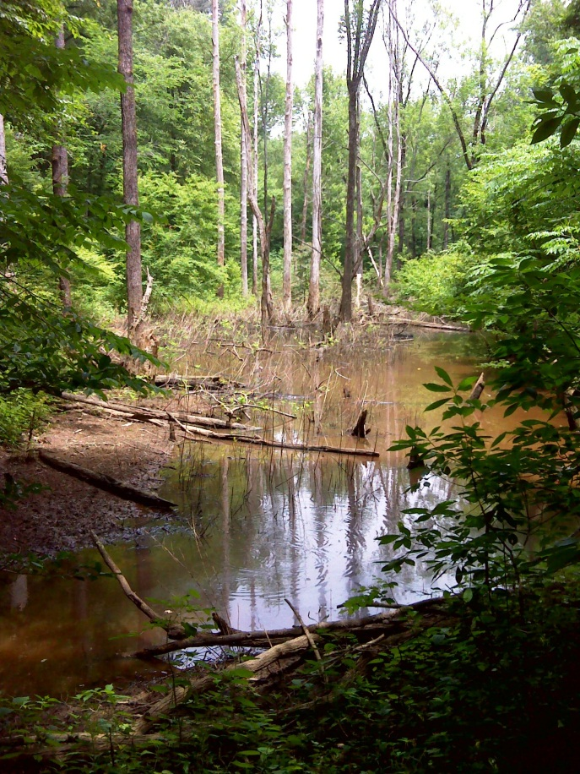
Wetland Protection Requirements
Executive Order 11990
Purpose is to avoid to the extent possible
the long and short term adverse impacts
associated with the destruction or
modification of wetlands and to avoid
support of new construction in wetlands
whenever there is a practicable alternative.
Determination and delineation of
wetlands according to Cowardin
et al. 1979 definition.
Notes:
Under the Cowardin definition, a wetland must have one or more of the following three attributes:
At least periodically, the land supports predominantly hydrophytes (wetland vegetation);
the substrate is predominantly undrained hydric soil; or
The substrate is a non-soil and is saturated with water or covered by shallow water at some time during the growing season of each year.
Note that this may add complexity to the wetland delineation requirements for a project if the project spans NPS-managed lands and non NPS-managed lands. Different delineation procedures may apply to the separate project segments. This underscored the need to consult with both NPS and any other involved federal entity early in the process.

Slide 8
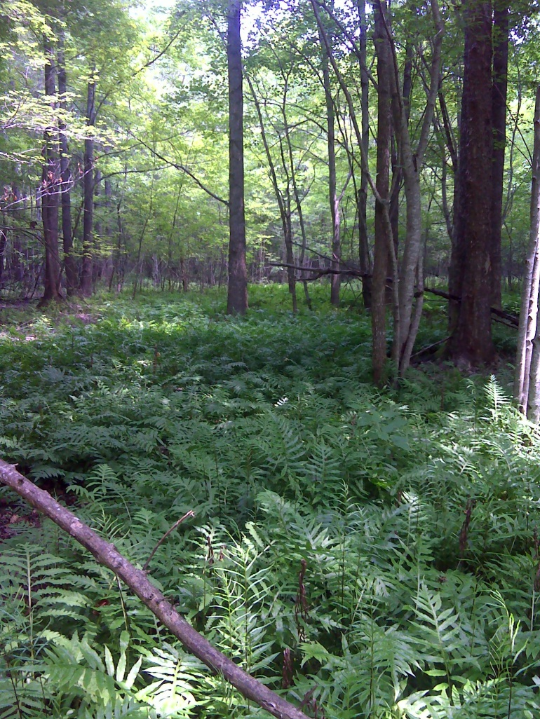
Wetland Protection Requirements
NPS procedures apply to any impact to wetland function.
              Sequential 3-step process:
                Avoidance
                Minimization of remaining
                Mitigation in the form of wetland replacement.
              Mandatory application of BMPs
              Preparation of formal Wetland Statement of Findings document (separate document to be approved by NPS National Office)
Notes:
Sequential 3-step process of avoidance of wetland impacts, minimization of remaining wetland impacts, and mitigation in the form of wetland replacement must be implemented for any form of impact to wetland function (not restricted to placement of fill material or dredging as for CWA section 404). In addition mandatory application of Best Management Practices as outlined by NPS.
It is important to point-out that NPS requirements have no provision for the use of “credits” for mitigation. Again, if your project spans both NPS and non NPS-managed lands, please confer early with all involved parties to come to agreement on how mitigation may be collectively handled.
A formal Wetland Statement of Findings must be prepared describing project, site, justification for use of the wetland, and detailed description of the sequential 3-step process and best management practices to be implemented. This is a separate document to be approved by NPS National office before the compliance process can be considered complete. Description of type and magnitude of wetland impacts with description of avoidance, minimization, and mitigation efforts should also be included within the NEPA document itself.
Several specific action may be excepted for formal WSOF preparation and replacement requirement. In these cases Avoidance and Minimization must still occur and must be specifically outlined within the NEPA document. Exceptions are made on case-by-case basis, and ultimately it is the NPS National office is who makes this determination.

Slide 9
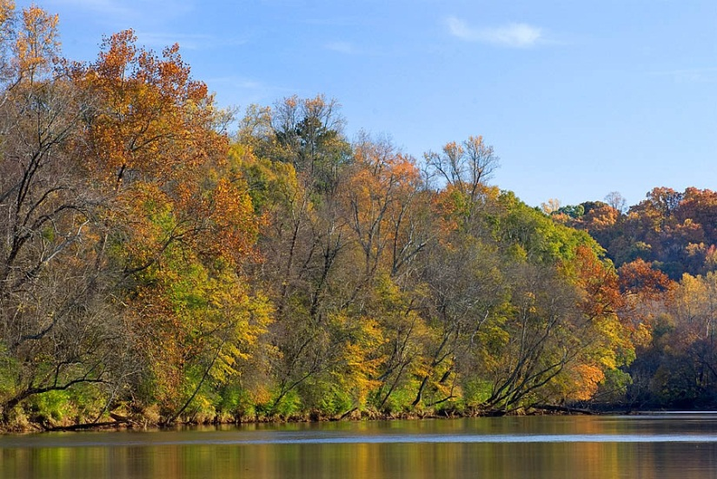
Floodplain Protection
Executive Order 11988
Purpose is to avoid to the extent possible the long and short term adverse impacts associated with the occupancy and modification of floodplains and to avoid support of floodplain development wherever there is a practicable alternative.
Determination of
regulatory floodplain.
Preparation of formal
Floodplain Statement of
Findings document (to be
approved by NPS National Office)
Notes:
Unlike in the case of wetlands discussed in the previous slide, there are no exceptions for the preparation of a formal Floodplain Statement of Findings document (FSOW)—if an action would take place in floodplain, the document must be prepared.

Slide 10

Migratory Birds
E.O. 13186
Purpose is to support the conservation intent of the Migratory Bird Treaty Act and migratory bird conventions by integrating bird conservation principles, measures, and practices into agency activities and by avoiding and minimizing, to the extent practicable, adverse impacts on migratory bird resources.
And to prevent or abate the
pollution or detrimental alteration
of the environment for the benefit
of migratory birds, as practicable.
Notes:
Ensure that environmental analyses of Federal actions required by the NEPA or other established environmental review processes evaluate the effects of actions and agency plans on migratory birds, with emphasis on species of concern; provide notice to the USFWS Service in advance of conducting an action that is intended to take migratory birds.
Develop and implement conservation measures in cooperation with USFWS to avoid or minimize unintentional take of migratory birds. NPS must evaluate and document possible effects of proposed action on migratory birds.
Some things for projects to consider: timing of construction, noise, artificial lighting, creating human access to migratory bird habitat where that access could foreseeably lead to an undesirable impact, etc.

Slide 11
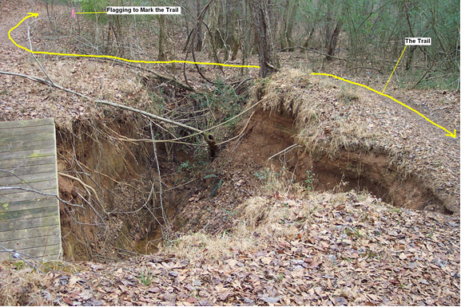
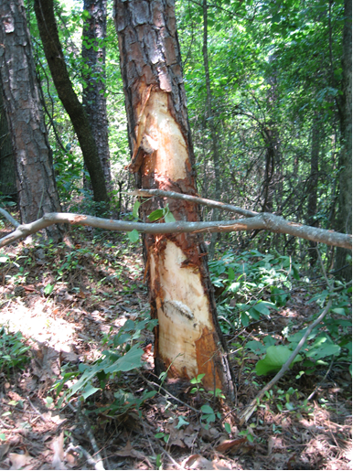
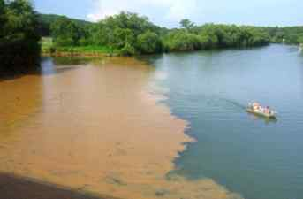
What, exactly, is a “impairment”?
An “impact that harms the integrity of park resources”
Sherpa Guides
Notes:
An impact that “harm(s) the integrity of Park resources or values, including the opportunities that otherwise would be present for the enjoyment of those resources or values”
The NPS must evaluate “the particular resources and values that would be affected; the severity, duration, and timing of the impact; the direct and indirect effects of the impact; and the cumulative effects of the impact in question and other impacts”
(NPS Management Policies 2006, Section 1.4)
Remember, the resources found at CRNRA are to be left “unimpaired” for future generations. That your children’s children should be able to enjoy the park as it is today.

Slide 12
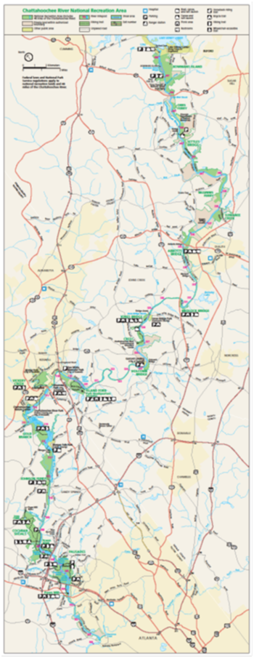
CRNRA
Established 1978 by Jimmy Carter to protect the river and the Brevard Fault line
48 miles of river
15 land units
~6,000 acres
Significant botanical diversity
First nationally designated Water Trail
Recreation changing from terrestrial to water-based

Slide 13
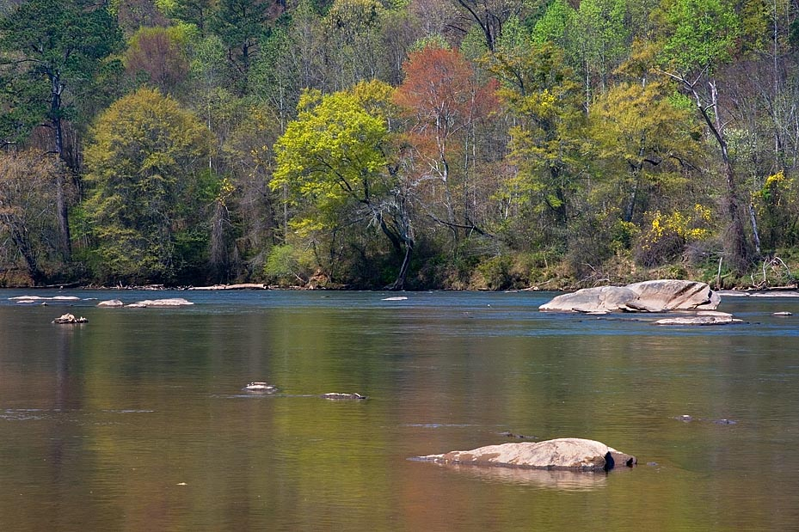
Chattahoochee River NRA
Provides 70% of Atlanta’s drinking water

Slide 14
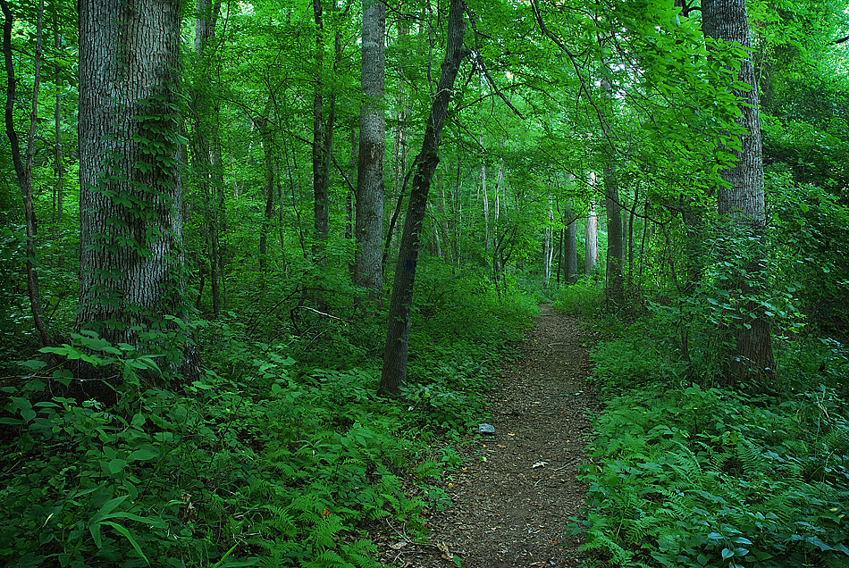
CRNRA
Provides 65% of Atlanta’s green space

Slide 15
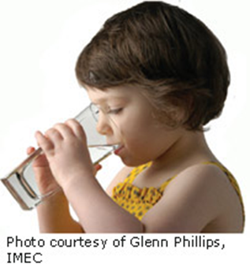
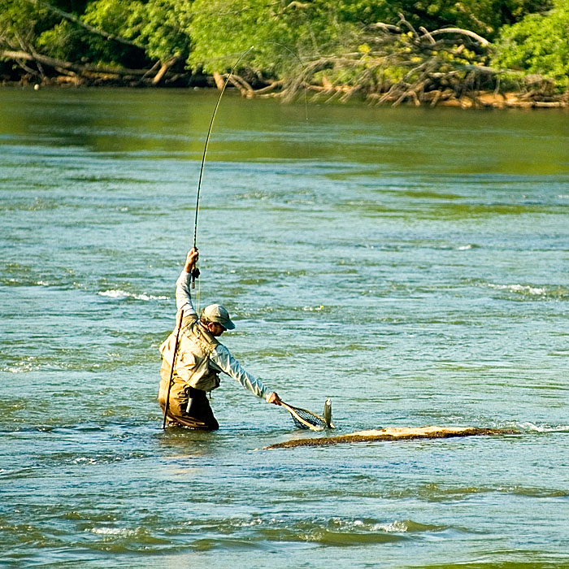
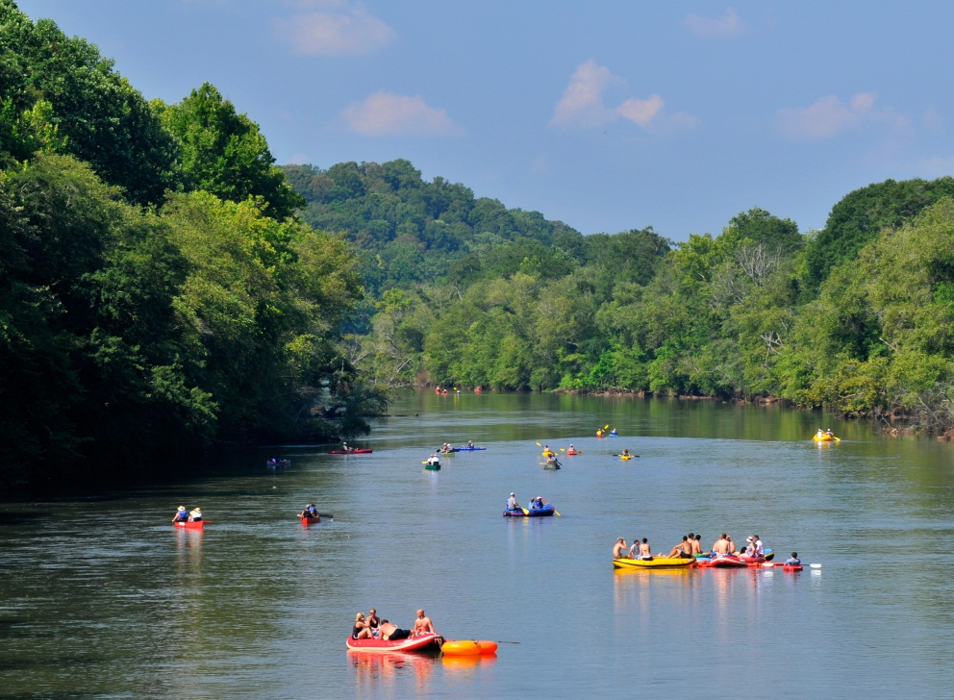
Designated Uses and Classification
Notes:
Water quality is protected by the State’s water uses and classifications – Secondary trout stream, recreation, and drinking water.

Slide 16
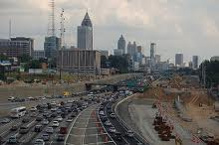
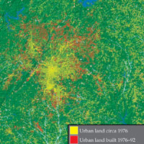
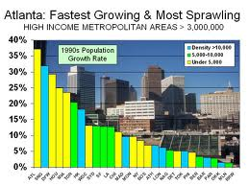
Protecting Water Quality
It’s a constant battle.
Notes:
48 miles of river and 15 land units = over 6,000 acres and our jobs are to preserve it for future generations. We are up against development, golf courses, waste water treatment plants, intakes, outtakes, encroachments from all sides, and erosion and sedimentation like you would never guess – e.g. Ray’s on the River has lost 65 feet of land since it opened 25 years ago. Think about that – 65 feet. What can we possibly do to prevent that sort of land loss? Calls like this are coming in every day. But we also have the resources that an urban environment offers and that is the knowledge and expertise to protect the greenspaces, the drinking water, and the recreation opportunities.

Slide 17
Erosion and Sedimentation at CRNRA: The Issues
Buford Dam
  Releases in pulses
Increasing population and ensuing development
  Removal of or decreasing the size of riparian buffers on streams and river
  Increasing impervious surface area
  Point sources
  Stormwater events and flows
The “Edge” effect
Notes:
The ‘Edge effect’ = long linear park with 15 discrete units

Slide 18
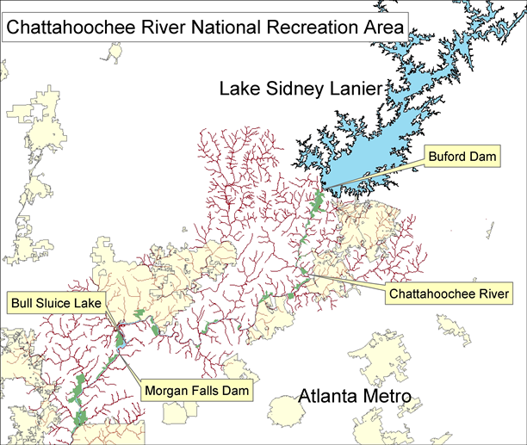
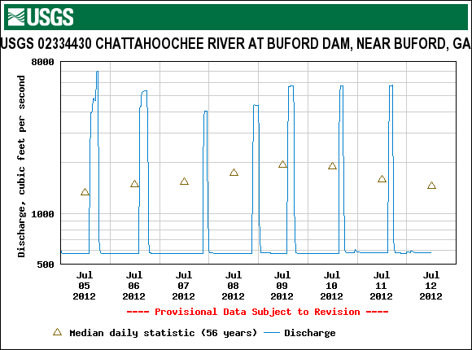
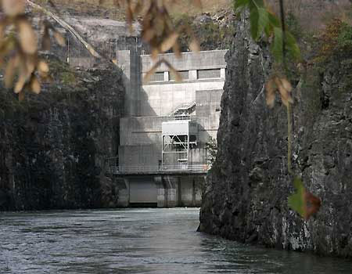
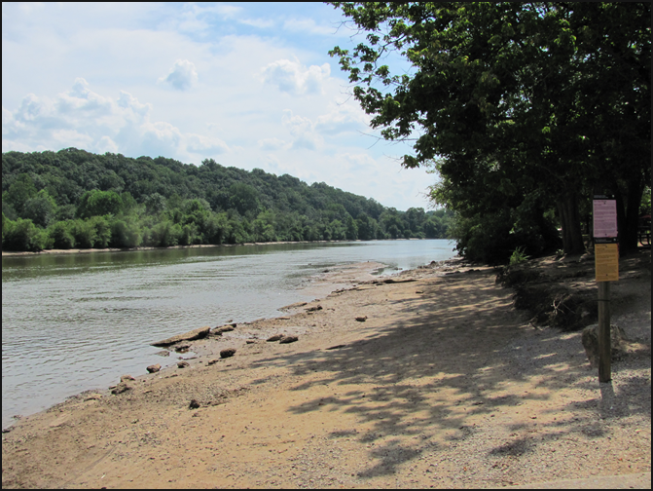
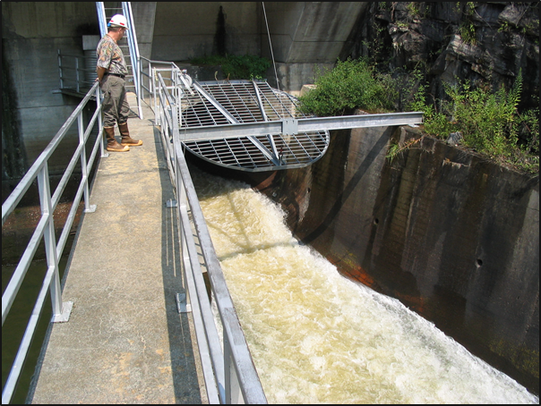
Buford Dam
Notes:
Buford Dam is a hydro power facility. In order to get the most “bang for the buck”, the flow is on or off, no ramping up or down.

Slide 19
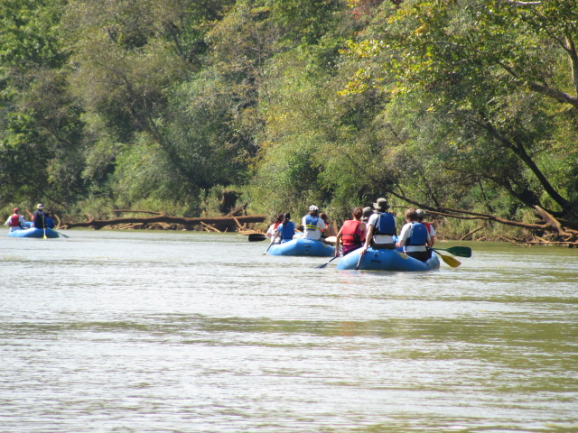
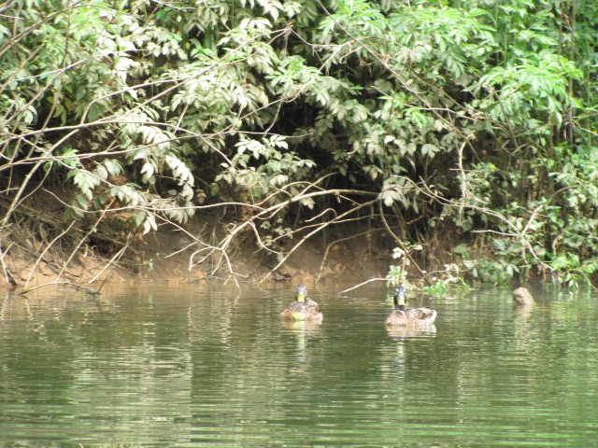
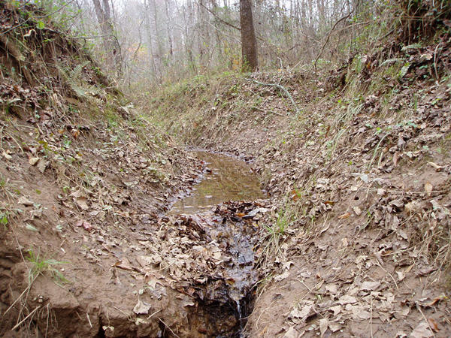
Buford Dam
The fluctuations in flow causes scouring of the river bottom, banks, and tributaries
Fallen trees line the river
Eroded banks
Incised tributaries

Slide 20
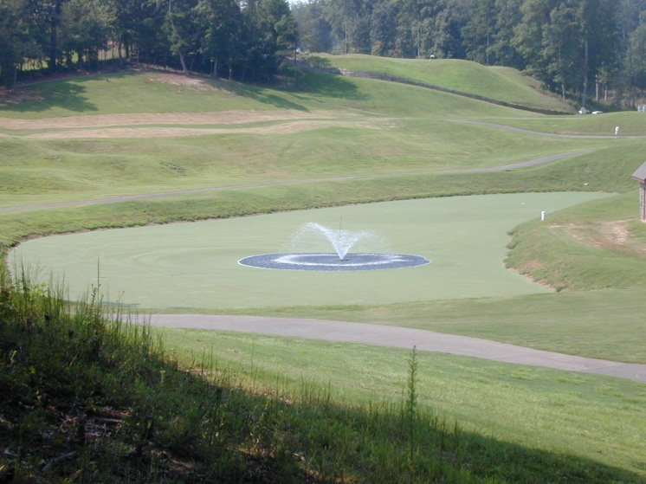
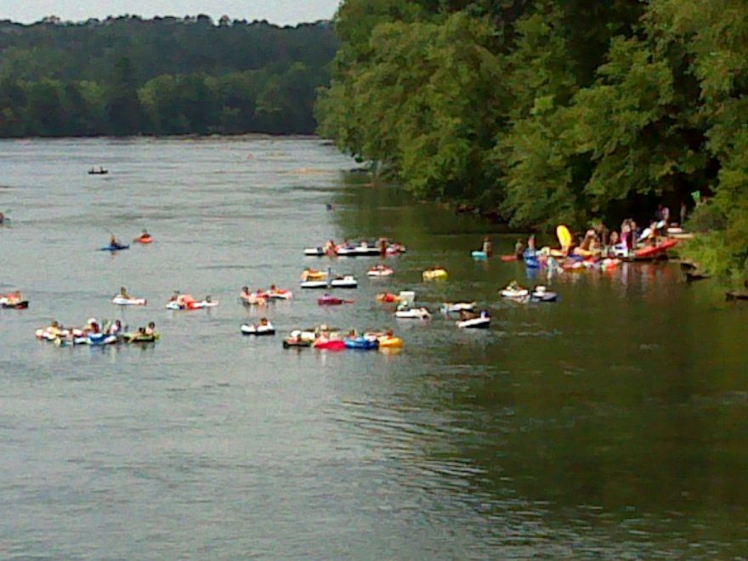
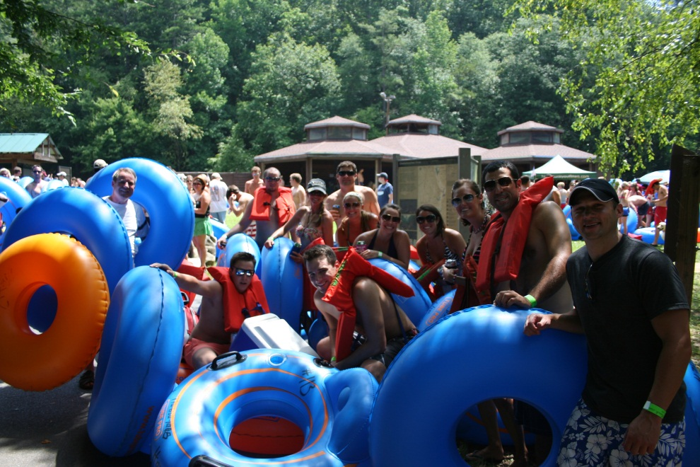
Increasing Population and Development
Notes:
Everybody wants to be on the river for the water, the view and the cool breeze.

Slide 21
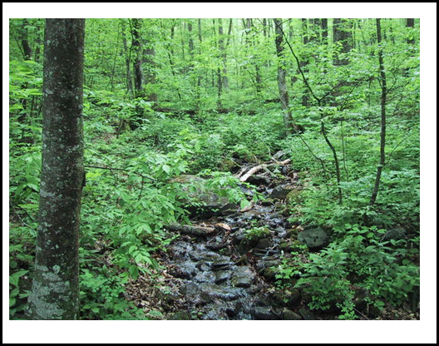
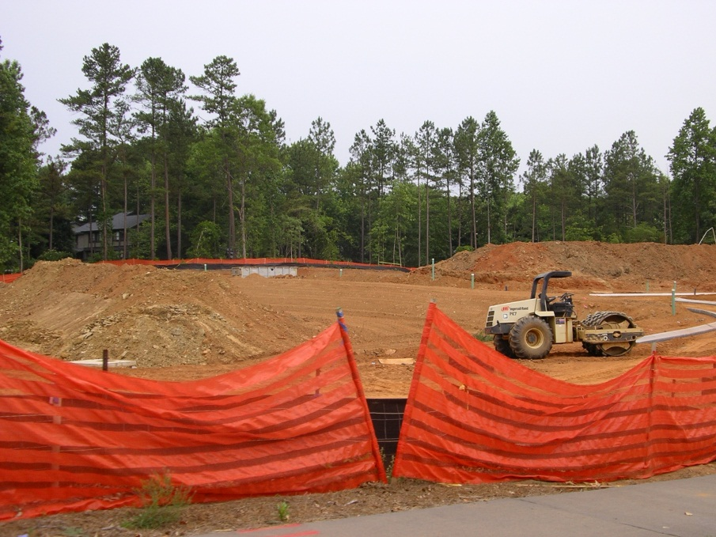
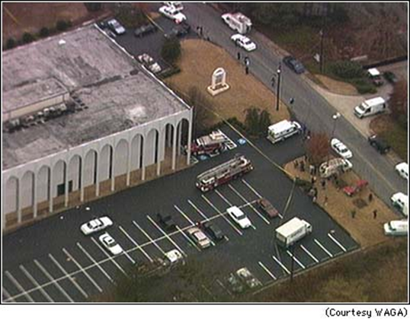
Impervious Surfaces
28
acres/day
54
acres/day

Slide 22
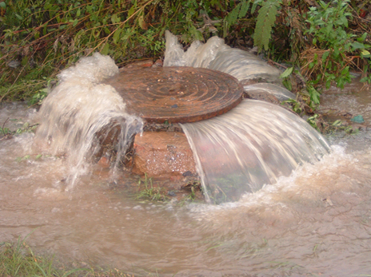
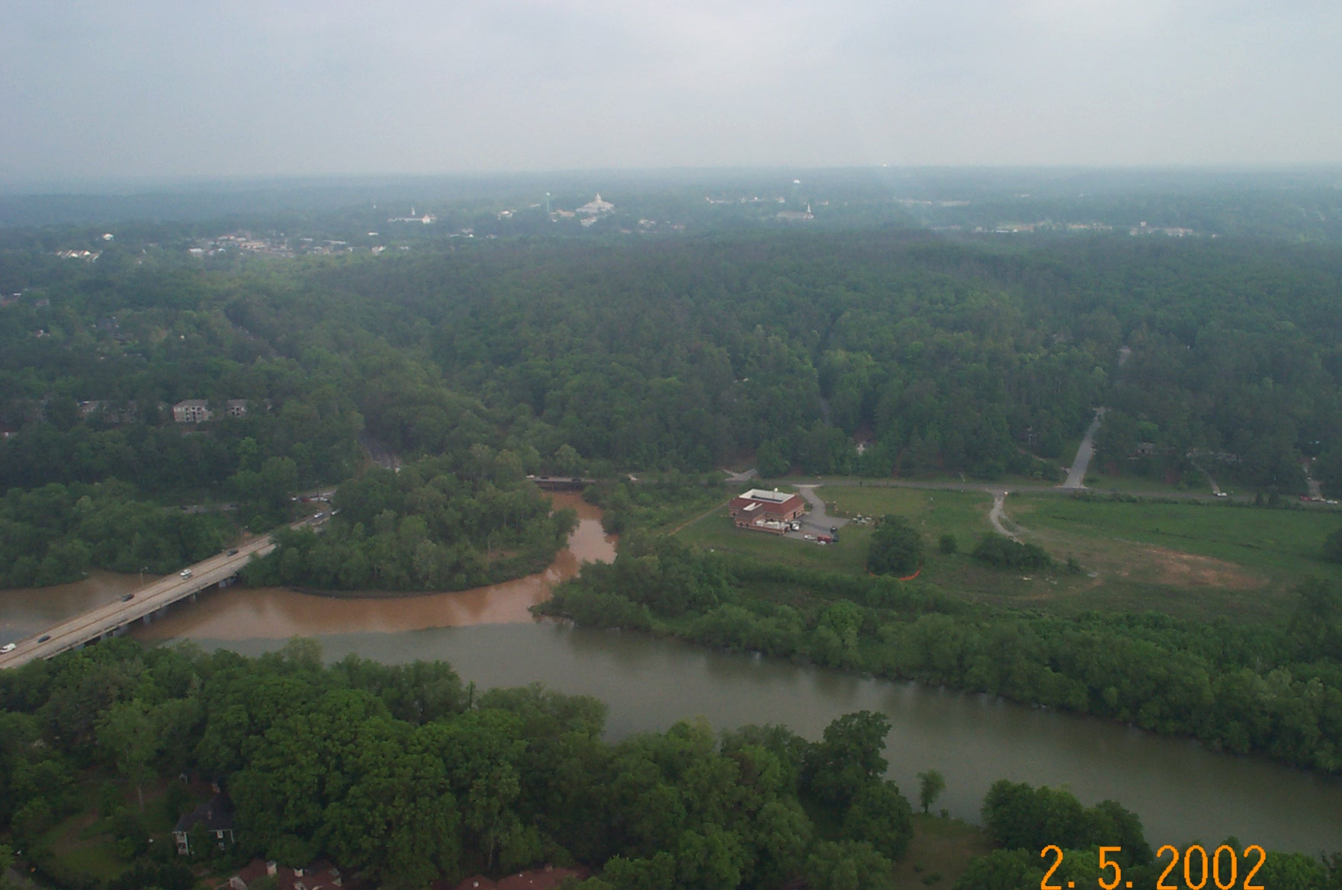
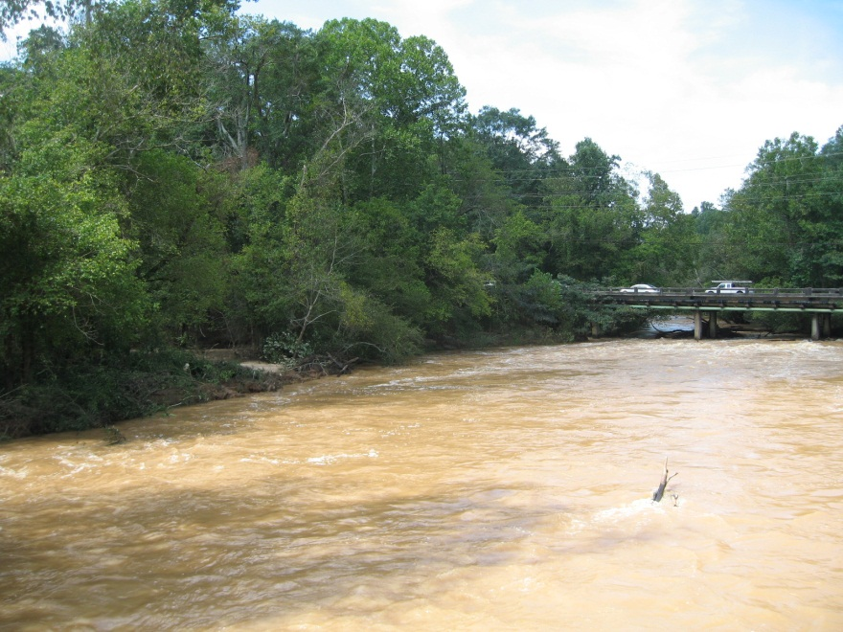
Stormwater Runoff
Notes:
Stormwater runoff from tributaries has a significant impact on the river system, the vegetation and land in the park units, and even on our cultural resources.

Slide 23
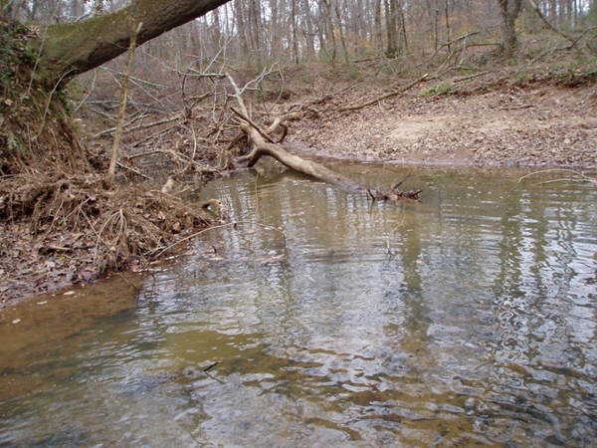
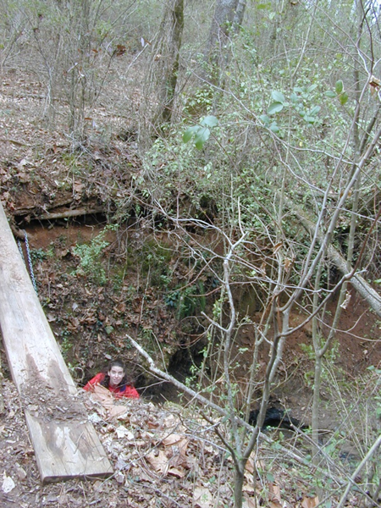
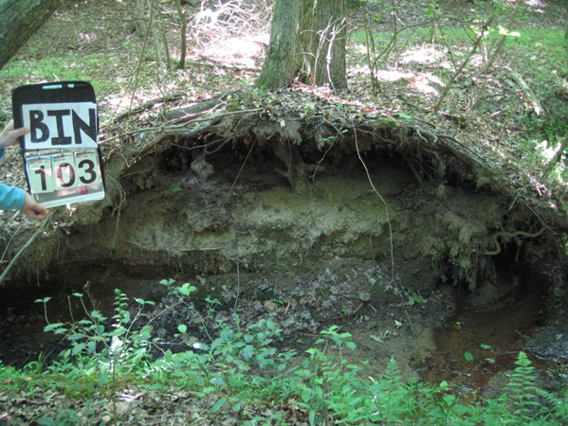
Stormwater Runoff
Notes:
Streams are incised from both the upland development and the fluctuation in river flow.

Slide 24
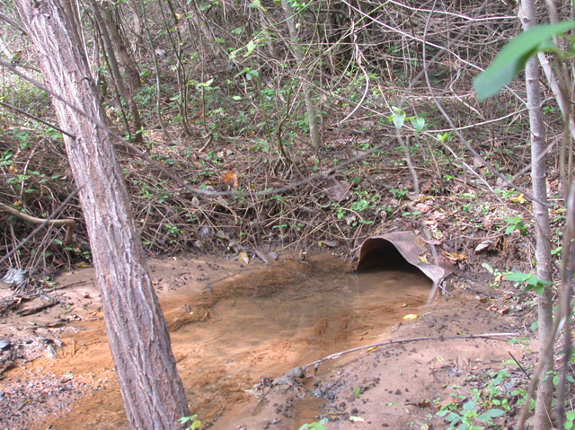
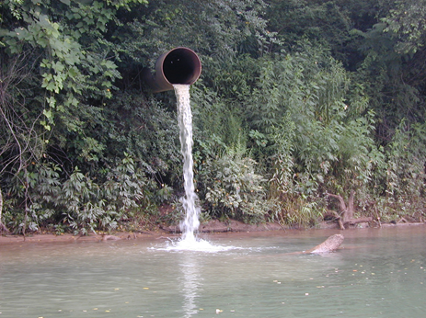
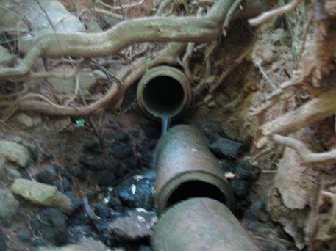
Point Sources
Notes:
Developments like the one shown here take the water that would naturally hit the ground and be absorbed into the soil and direct it into culverts pointed away from the development and towards the nearest stream and river. This leads to many man-made streams that erode during high rainfall events, incising ever deeper as they transport the silt and sedimentation into the tributaries and river. These, really are the bane of our existence here at the park. Even the road gutters and drains take what used to be sheet flow and direct it into a point source that will erode the area where it hits the ground. These unnatural streams cause tremendous damage to park resources through erosion, sedimentation, the unsightly aesthetics of the structures and the removal of the natural sheet flow and saturation into the ground.

Slide 25
The “Edge” Effect
Notes:
We are surrounded!

Slide 26
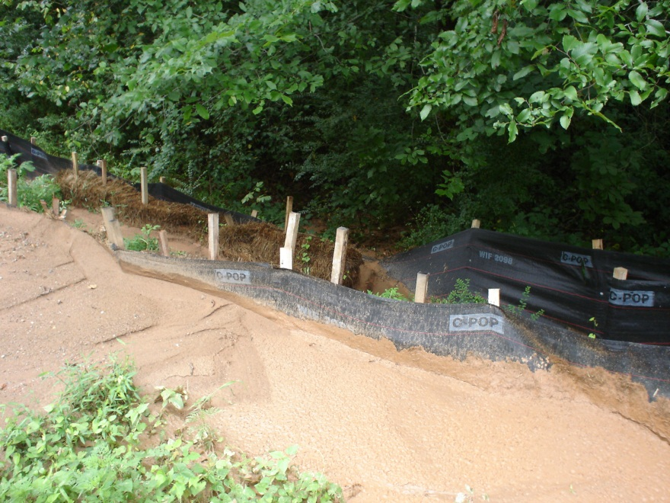
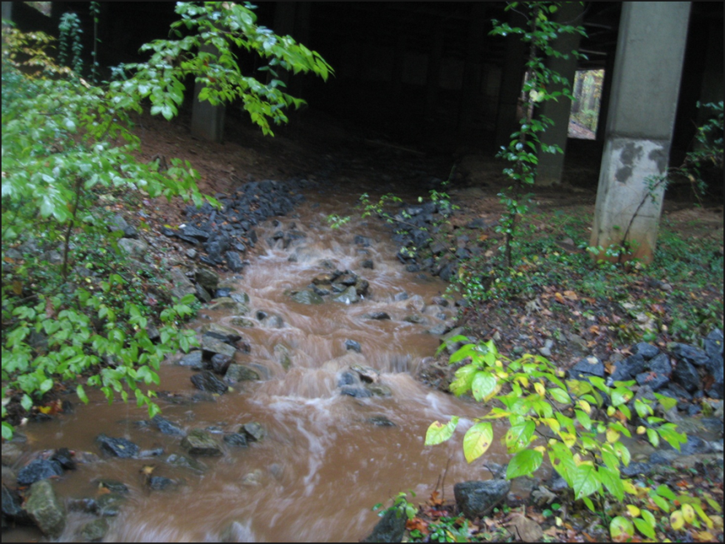
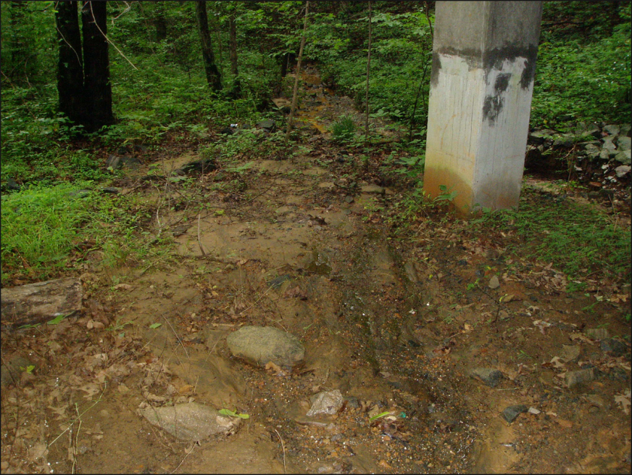
The “Edge” Effect
Surrounding construction and development should consider the impacts to neighboring lands.
Notes:
Death by a thousand cuts.

Slide 27
Erosion and Sedimentation at CRNRA: Control Standards
Standard erosion-control measures are used that comply with:
  Current Georgia Soil and Water Conservation Commission (GSWCC) Green Book practices,
  Georgia Erosion and Sedimentation Act of 1975,
  Georgia Erosion and Sedimentation Act (amended 2000),
  Redwoods Amendment of 1978,
  NPS Management Policies, and
  CRNRA Construction Standards.
Notes:
Redwoods Act – acknowledged that the NPS can not allow activities to occur on park land that violate established legislation (including Organic Act and enabling legislation). The park boundaries Of Redwoods NP were expanded to better protect the resources from outside activities.

Slide 28
Best Management Practices (BMPs)
Required in and around park lands
Improper use of or negligence may lead to:
  16 USC §19jj
    “Damages” includes:
    (1) Compensation for:
      (A) (i) the cost of replacing, restoring, or acquiring the equivalent park system resource; and
      (ii) the value of any significant loss of use of a park system resources pending its restoration or replacement or the acquisition of an equivalent resource; or
      (B) The value of the park system resource in the event the resource cannot be replaced or restored.
Notes:
Unfortunately, we have had several 19jj cases in this park over the years and many of the more severe impacts were the result of the improper use of or neglect to use BMPs.

Slide 29
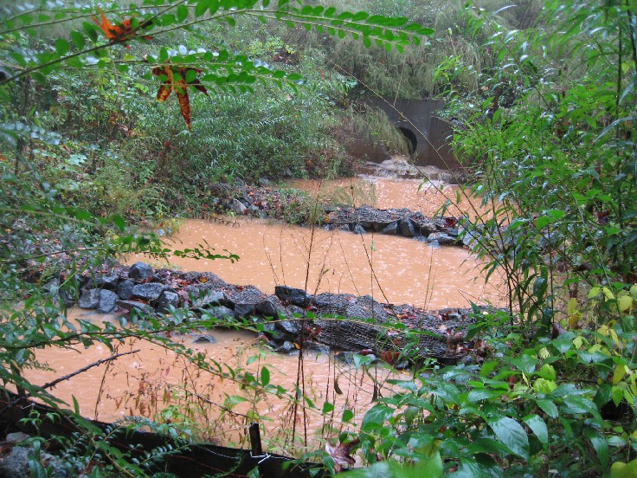
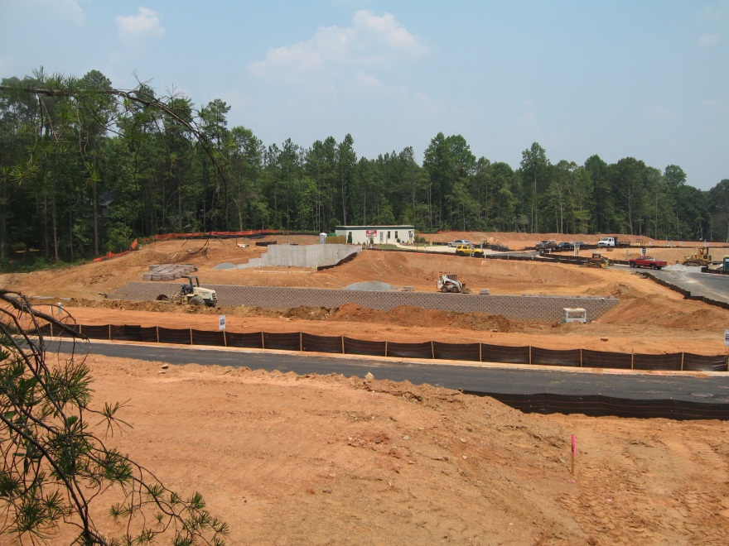
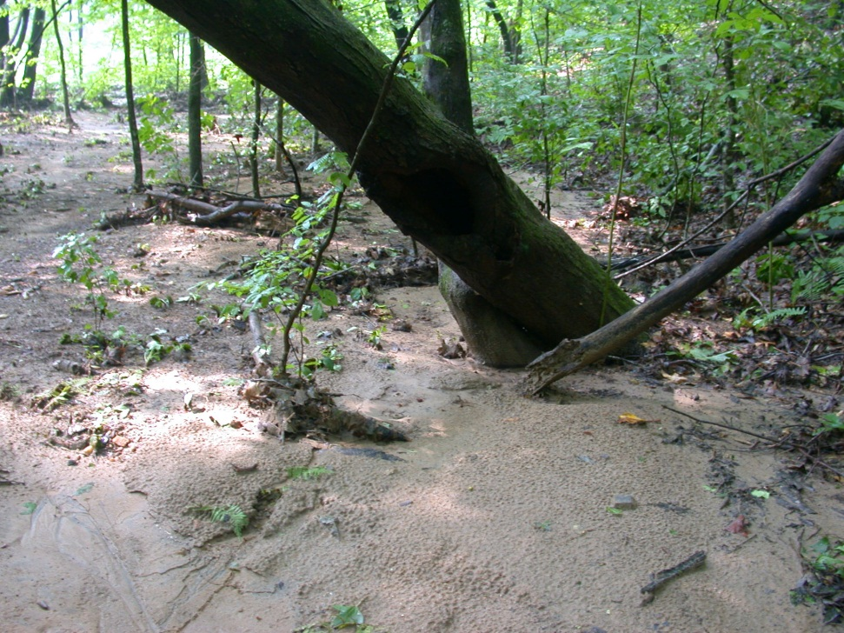
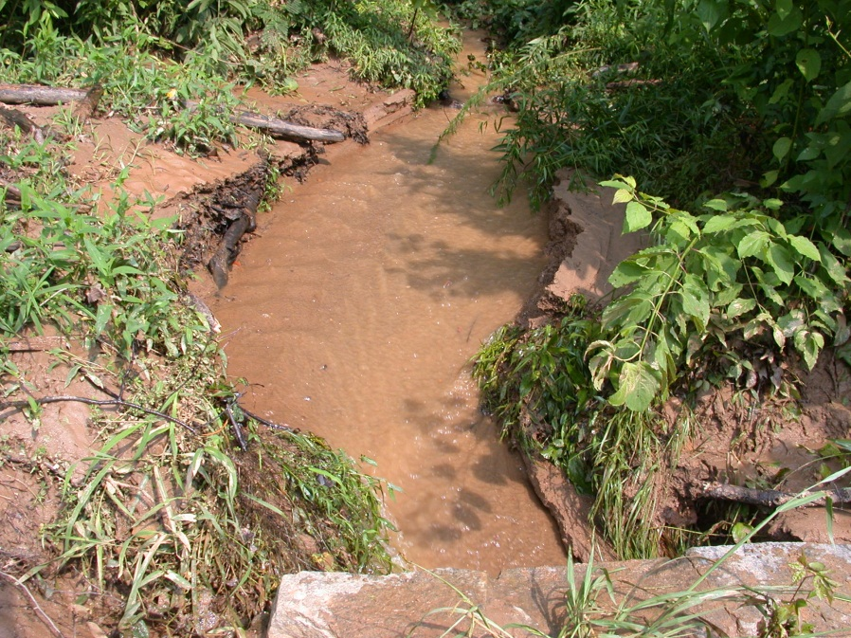
19jj Damages
Notes:
Improper BMPs led to a costly 19jj case and a stream restoration.

Slide 30
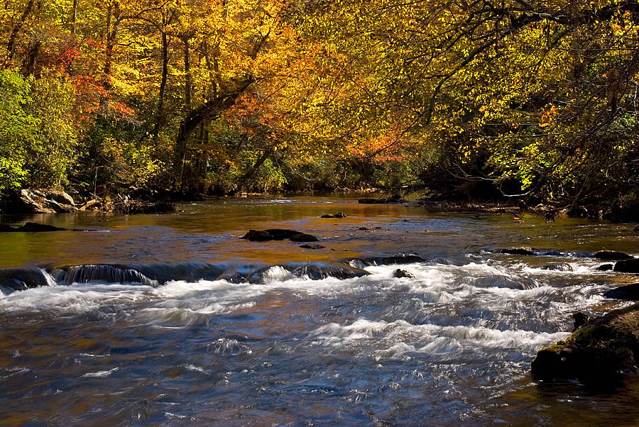

Preserve for Future Generations!
Notes:
Aesthetics is an important component of the park values as well as sound and light.

Slide 31
Riparian Buffers: The Importance of Protecting the Protection
Metropolitan River Protection Act (MRPA) –
The Chattahoochee Corridor is hereby defined as “all land within 2000 feet of the banks of the Chattahoochee River, including any impoundments thereon, or within the floodplain, whichever is greater, from directly below Buford Dam downstream to the downstream limits of Fulton and Douglas counties, including the entire bed of the river and any improvements and all islands therein.”

Slide 32
Riparian Buffers: The Importance of Protecting the Protection
MRPA Buffer Zone Standards:
  35-foot undisturbed vegetative buffer on all streams
  50-foot undisturbed vegetative buffer on river and impoundments
  150-foot impervious surface setback along river and impoundments

Slide 33


Riparian Buffers
River - 50’ undisturbed
Protected watershed
Cleared buffer
Streams - 35’ undisturbed
Notes:
Even if the buffer is primarily made up of privet it is still providing the protection needed by the streams and river to filter runoff, stabilize banks, and give shade to the waterways. This is one area where we leave the invasive exotics. Remember Ray’s? The nice green lawn that was there for years while he lost about 2-3 feet of land/year. The unnatural fluctuation in flows of the river exacerbate this situation and there is nothing that we can do about that at this time other than PROTECT THE BUFFERS!!!

Slide 34
Native Plantings and Seed Mixes
The State Botanical Garden of Georgia
  Sourcing for native plants
CRNRA Native Seed, Plant, and Rock Sources
UGA Cooperative Extension Service “Native Plants of Georgia” publications
  Trees, Shrubs and Woody Vines
  Ferns
  Wildflowers
  Grasses (is in the works)

Slide 35


Use Native Rock and Stone
Which do you prefer?

Slide 36


Matting
http://www.fhwa.dot.gov/environment/wildlifeprotection
NEVER USE the plastic turf reinforcement matting
ALWAYS USE coir, jute, or natural material matting
Notes:
The snake photo is taken from the US DOT Federal Highway Administration website under the subject line of “Keeping it Simple: Easy Ways to Help Wildlife Along Roads” http://www.fhwa.dot.gov/environment/wildlifeprotection/

Slide 37


Inspect and Clean Equipment
Notes:
We are mandated to treat invasive exotics in the parks and keep others from entering. Cleaning all equipment helps to prevent the spread of invasives by removing dirt and debris that can carries seed and propagules from these plants.

Slide 38


The Importance of Using the Correct Silt Fencing
Notes:
Sometimes the state standard is not enough. Consider the site.

Slide 39


…leave them UNIMPAIRED for the enjoyment of future generations.

