Slide 1

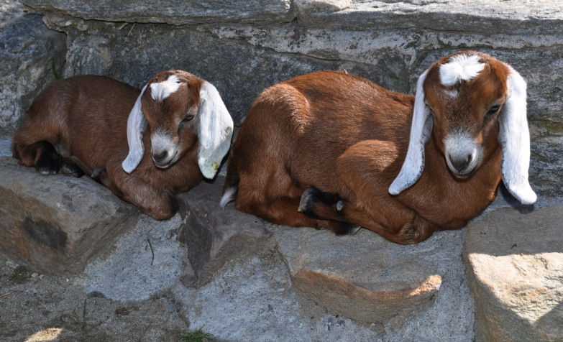
Connemara Farms

Slide 2
Connemara Farms Jeopardy
Sandburg Family | Sandburg’s Writing | National Park Service | Connemara Farm | Goats at Connemara
200 | 200 | 200 | 200 | 200
400 | 400 | 400 | 400 | 400
600 | 600 | 600 | 600 | 600
800 | 800 | 800 | 800 | 800
1000 | 1000 | 1000 | 1000 | 1000
Bonus Question: 2000 pts

Slide 3
Sandburg Family 200
Question:
How many daughters did Carl and Lilian Sandburg have?
Answer
What is three?
Back

Slide 4
Sandburg Family 400
Question:
How many grandchildren lived here at Connemara?
Answer
What is two?
Back

Slide 5
Sandburg Family 600
Question:
How many years were Carl and Lilian Sandburg married?
Answer
What is almost 60 years? (59 years)
Back

Slide 6
Sandburg Family 800
Question:
Which of Carl’s daughters helped run the goat milk dairy?
Answer
Who is Helga?
Back

Slide 7
Sandburg Family 1000
Question:
Which of Carl’s daughters took care of the baby goats in the summer kitchen downstairs in the house?
Answer
Who was Janet?
Back

Slide 8
Sandburg’s Writing 200
Question:
Carl Sandburg wrote a biography of which American president?
Answer
Who was Lincoln?
Back

Slide 9
Sandburg’s Writing 400
Question:
In which poem did Carl Sandburg compare a cat to a type of weather?
Answer
What was “Fog”?
Back

Slide 10
Sandburg’s Writing 600
Question:
What was Carl’s collection of whimsical stories for children?
Answer
What are the “Rootabaga Stories”?
Back

Slide 11
Sandburg’s Writing 800
Question:
In which Sandburg poem does Carl write “come up” and “there is a dance to be danced for you”?
Answer
What is “Spring Grass”?
Back

Slide 12
Sandburg’s Writing 1000
Question:
Which Sandburg poem about math can be seen on a video at Connemara?
Answer
What is “Arithmetic”?
Back

Slide 13
NPS 200
Question:
What program helps children learn more about each National Park?
Answer
What is the Junior Ranger program?
Back

Slide 14
NPS 400
Question:
What famous statue is a part of the National Park Service?
Answer
What is the Statue of Liberty National Monument?
Back

Slide 15
NPS 600
Question:
Besides the Carl Sandburg Home National Historic Site, what is another National Park that can be found in our area?
Answer
What is the Blue Ridge Parkway? (or Great Smoky Mountains or King’s Mountain)
Back

Slide 16
NPS 800
Question:
What animal is pictured on the National Park Service badge?
Answer
What is the bison?
Back

Slide 17
NPS 1000
Question:
What was the first National Park?
Answer
What is Yellowstone National Park?
Back

Slide 18
Connemara Farm 200
Question:
How many breeds of goats did Lilian Sandburg have here at Connemara?
Answer
What is three?
Back

Slide 19
Connemara Farm 400
Question:
What other animals does the National Park Service have living at Connemara Farm now?
Answer
What are chickens (or cats)?
Back

Slide 20
Connemara Farm 600
Question:
What did Carl call “the thief of time”?
Answer
What was a TV?
Back

Slide 21
Connemara Farm 800
Question:
What was the house garage used as before Lilian Sandburg turned it into a garage?
Answer
What was the kitchen?
Back

Slide 22
Connemara Farm 1000
Question:
In what year was the house built?
Answer
What is 1838?
Back

Slide 23
Goats at Connemara 200
Question:
What goat breed from Switzerland is solid white?
Answer
What is a Saanen?
Back

Slide 24
Goats at Connemara 400
Question:
What goat breed from Switzerland is brown and white?
Answer
What is a Toggenburg?
Back

Slide 25
Goats at Connemara 600
Question:
What goat breed from Africa has long, floppy ears?
Answer
What is a Nubian?
Back

Slide 26
Goats at Connemara 800
Question:
What is the name for a female goat?
Answer
What is a doe?
Back

Slide 27
Goats at Connemara 1000
Question:
What is the name for a male goat?
Answer
What is a buck?
Back

Slide 28
Bonus Question: 2000 pts.
Question:
Jennifer II was Mrs. Sandburg’s world-record holding goat for milk production. On average, how many gallons of milk did she produce in a day?
Answer
What is two and a half gallons?
Back

