Slide 1

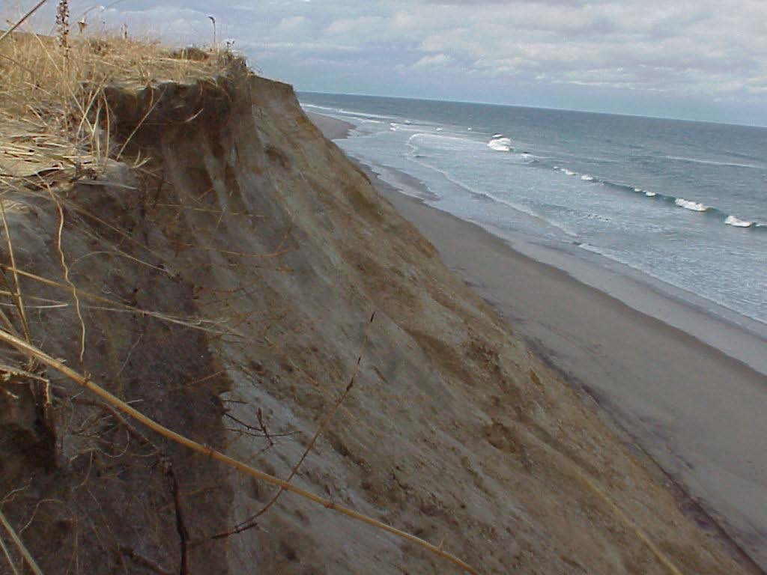
Sensing Cape Cod :
Beaches in Motion-Coastal Vulnerabillity
Parks as Classrooms - Cape Cod National Seashore

Slide 2

Earth Systems Science
Geosphere
Hydrosphere
Atmosphere
Biosphere
Cryosphere (glaciers and ice)
Which spheres affect beaches and dunes?

Slide 3
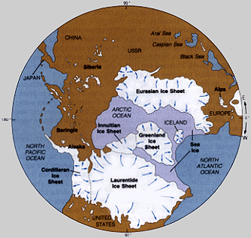
Global Extent of Glaciers 18,000 Before Present (BP)
How and when was Cape Cod formed?
Cape Cod was made by a glacier.

Slide 4
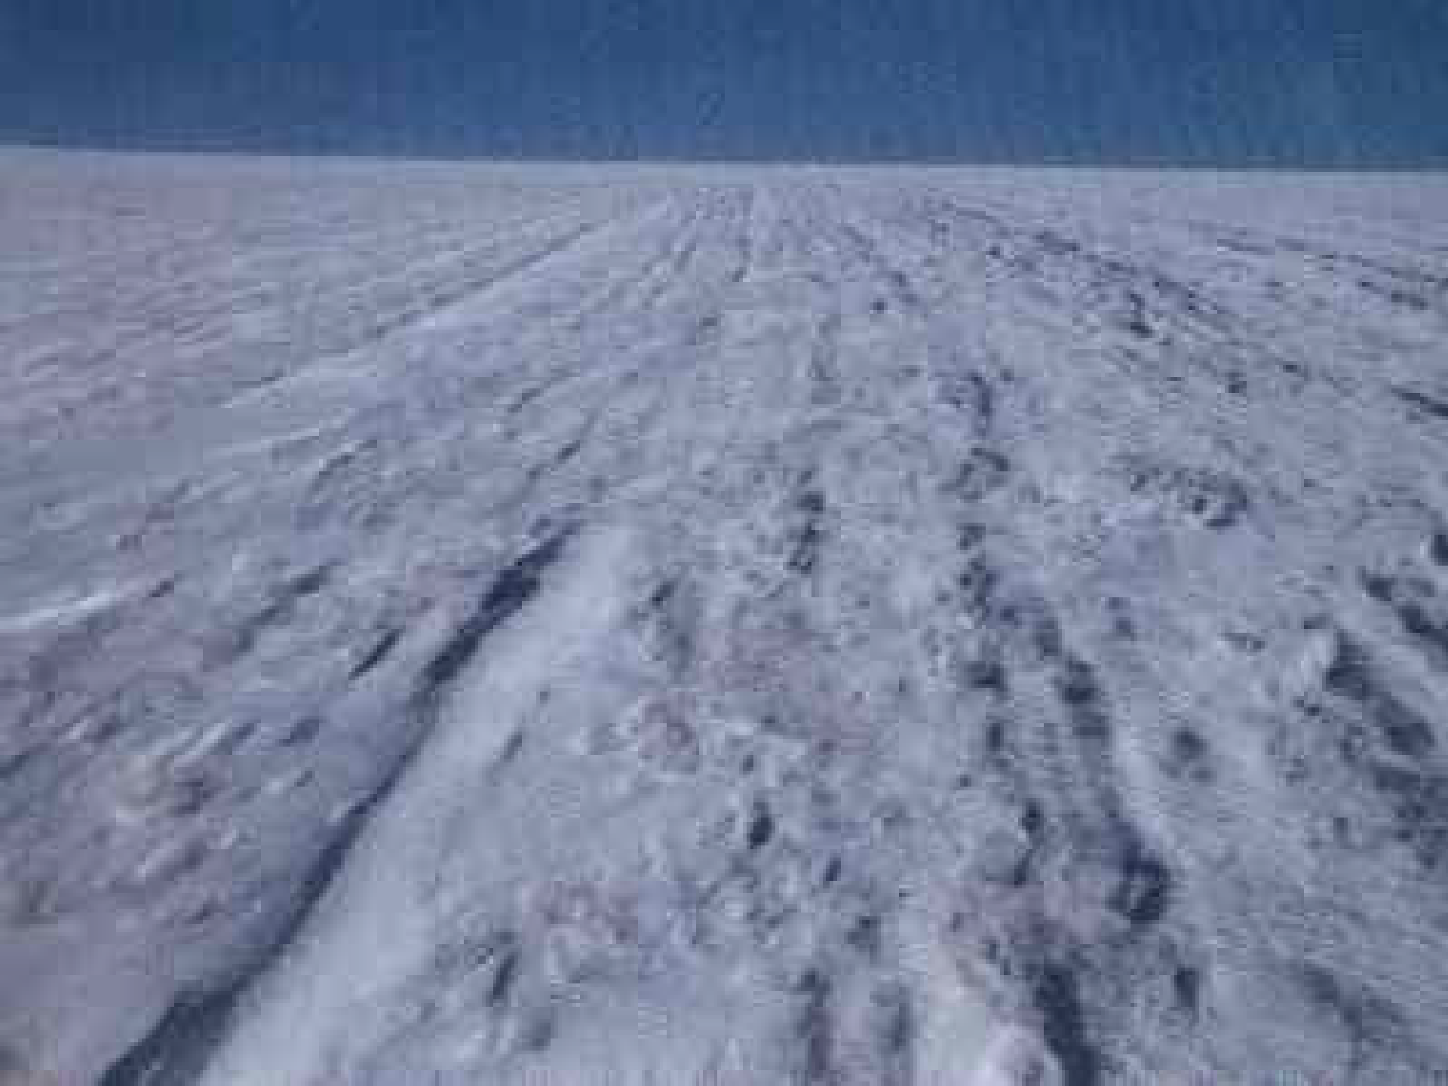
About 18,000 years ago a glacier covered most of New England including the area that would become Cape Cod.

Slide 5
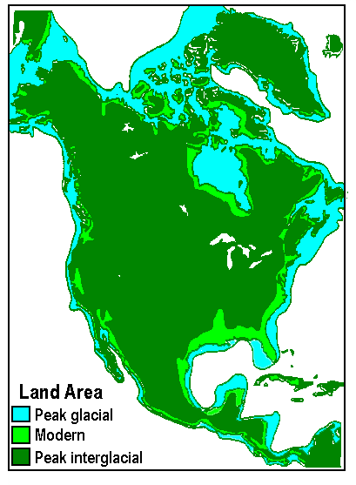
During the glacial period, sea level was much lower.
Water was frozen as glacial ice and did not run-off into the oceans.
The blue area shows the extend of the land

Slide 6
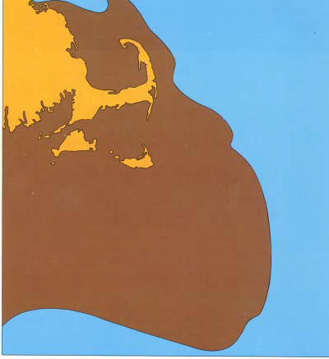
Maximum Exposed Land
The coastline- was here!
The shape we recognize as Cape Cod did not exist until after atmospheric temperatures rose (about 14,000 BP). The melt waters filled the ocean, submerging low lying land.

Slide 7
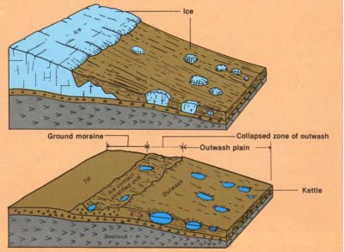
Outwash Plain
As the glaciers melted the sediment the glacier had picked up was dropped or carried away by streams. The streams formed from melting glacial ice.
Sometimes chunks of ice broke off which led to the formation of kettle ponds.

Slide 8
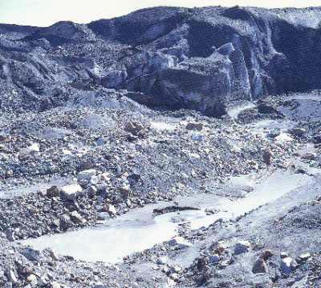
As the glacier melted, till, sediment of all sizes washed out and was deposited as a huge glacial “dump”. Cape Cod is formed from till and outwash sediments deposited by glacial melt water streams.
Cape Cod is like a sand box- a pile of sand left by the glacier.

Slide 9
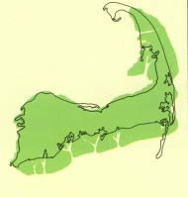
6000 Years BP Sea level continues to rise, Cape Cod’s landform begins to take shape (green color)
Note – the shape of the area known as the Province Lands in not shaded green. So how did the Province Lands form?

Slide 10
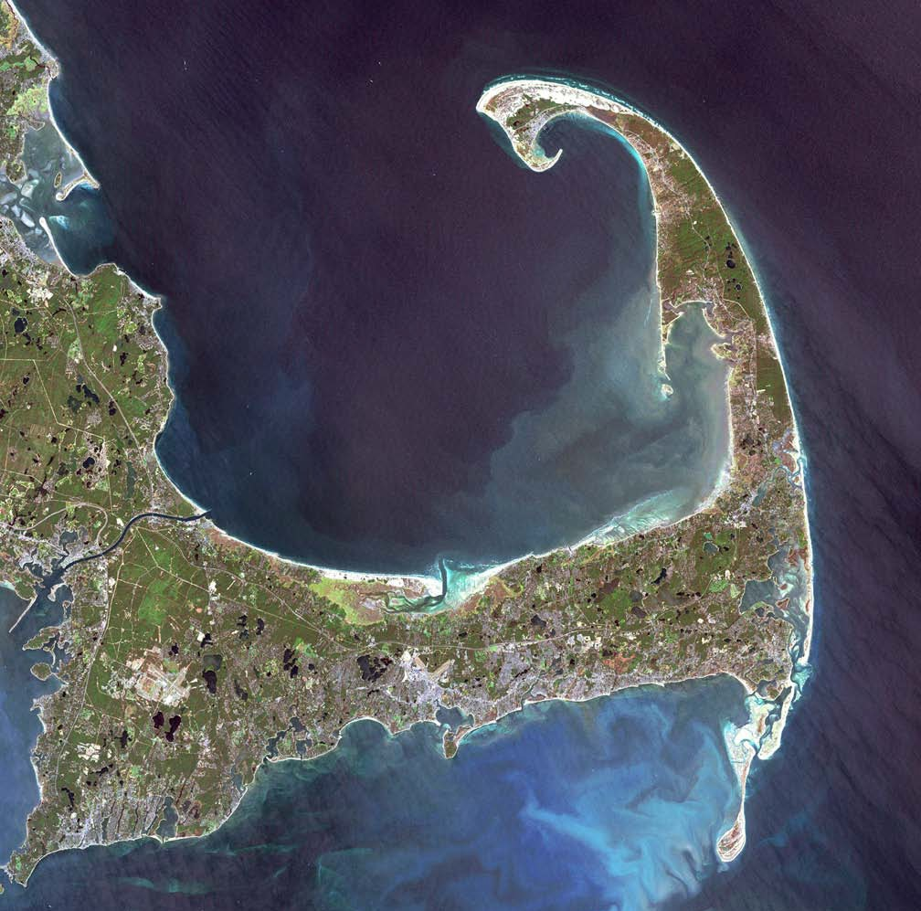
Eventually through the action of wind and waves the familiar shape of Cape Cod was formed.
Can you identify your location?

Slide 11
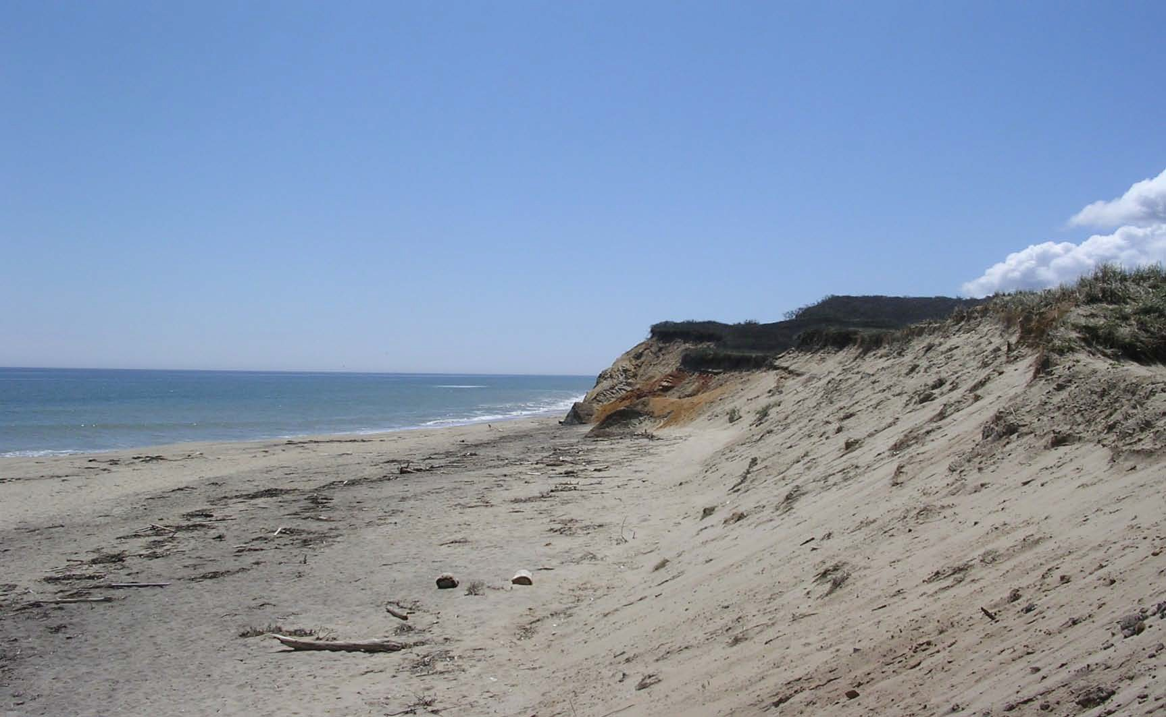
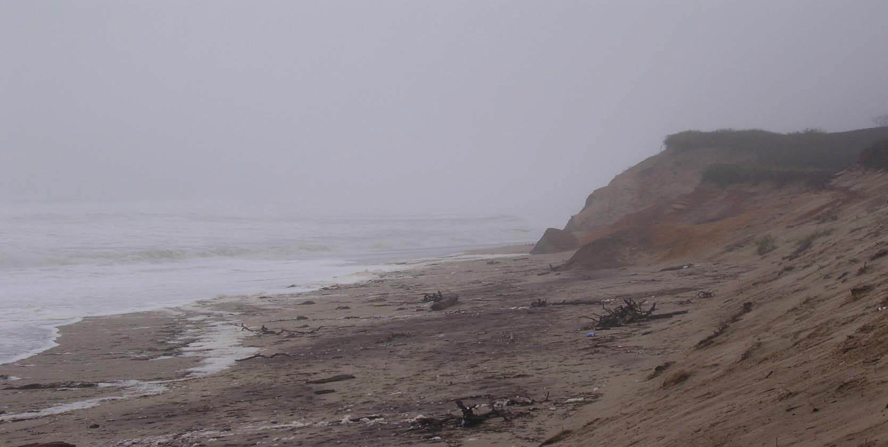
Cape Cod is still changing. Every wave, whether small or large, moves sediment. Wind blowing across the beach also moves sediment. Scientists study and measure the changes in order to help predict what will happen to the coast and its beaches and dunes as sea level rises as a result of climate change.

Slide 12
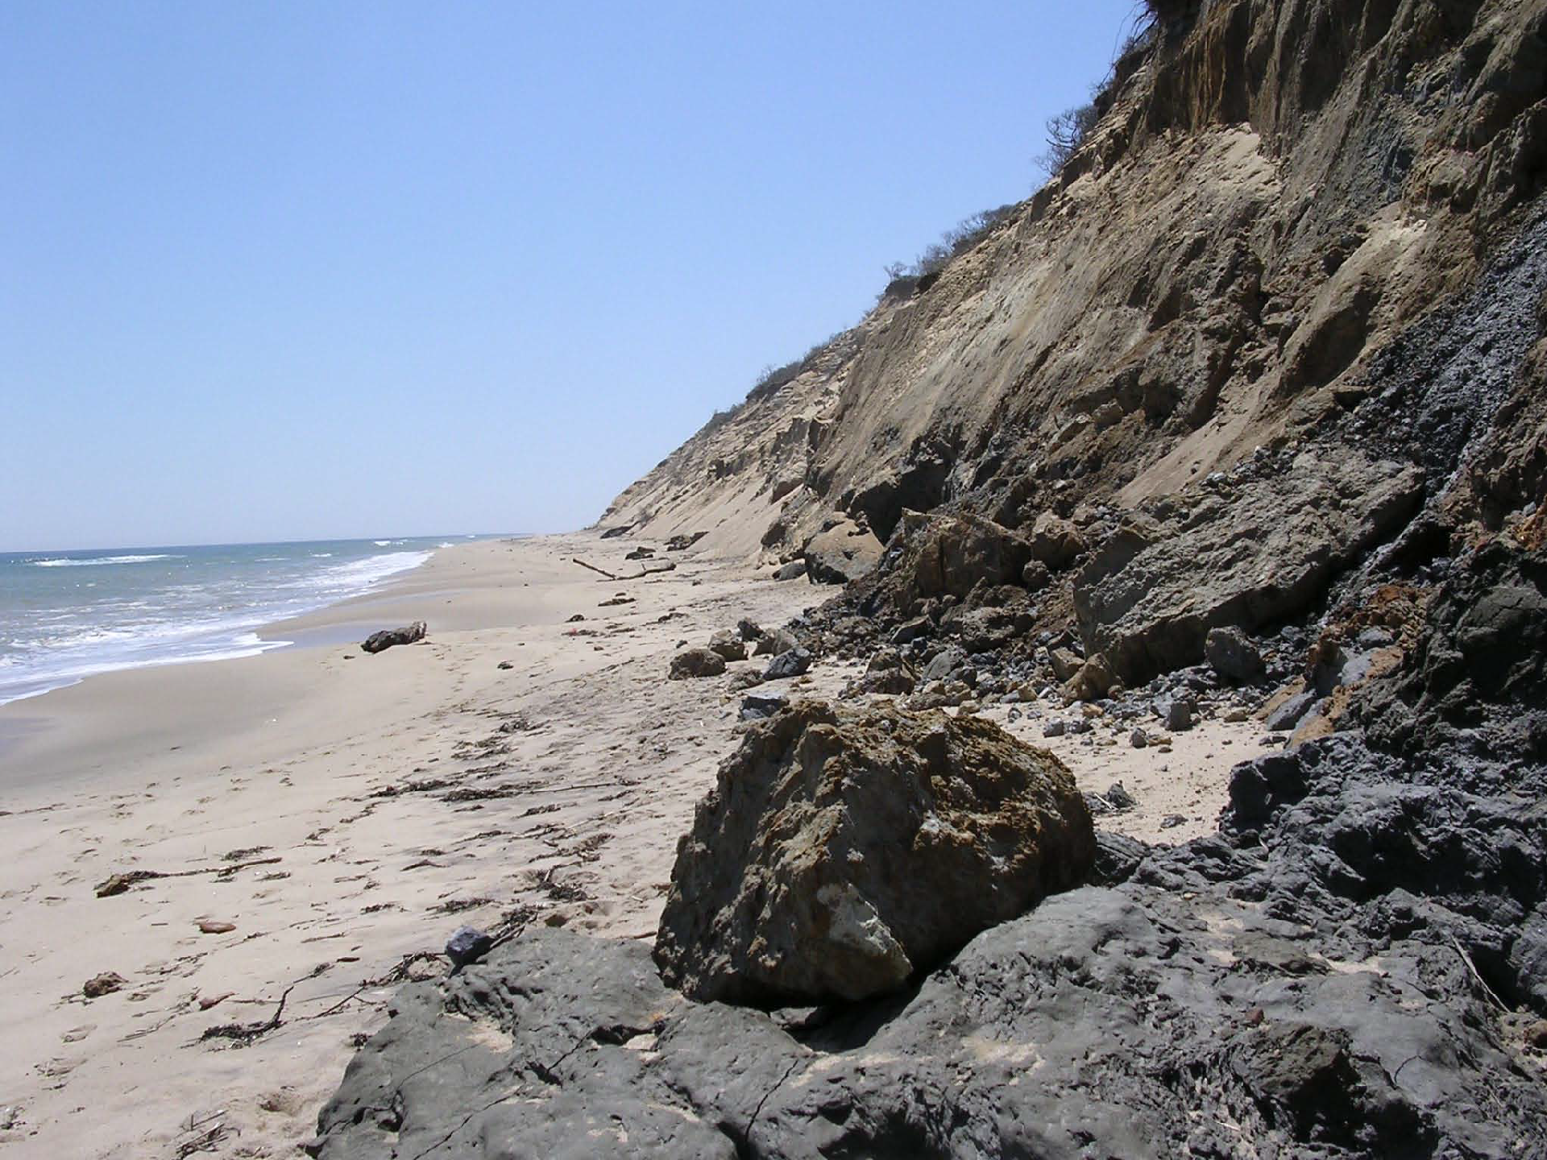
As waves break against the base of the dunes and cliffs sediment is carried away to be deposited elsewhere and buried deposits are exposed.

Slide 13
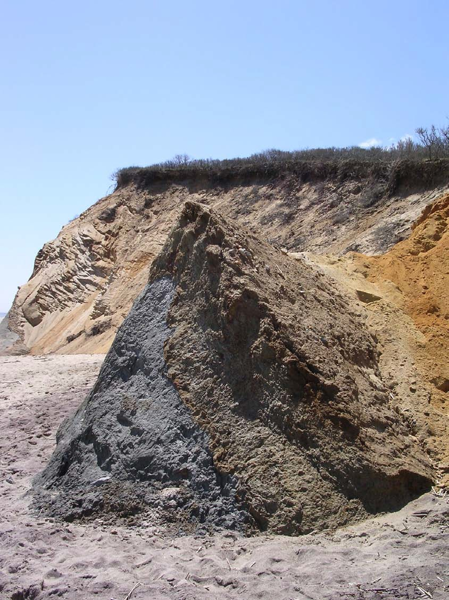
Wind blown sand, waves and rain erode the deposits.
The type (size) of sediment in the deposit affects the rate of erosion.
At one time this clay/silt deposit was buried in a dune similar to the one visible in the background. The loose sand has washed away leaving the clay. Eventually it will wash away too.

Slide 14
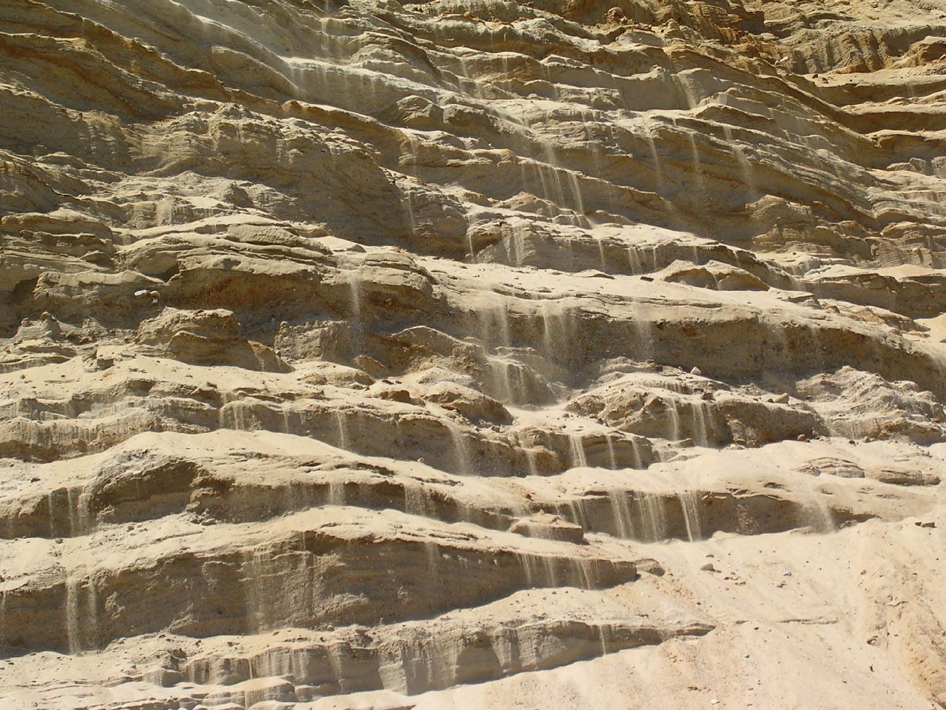
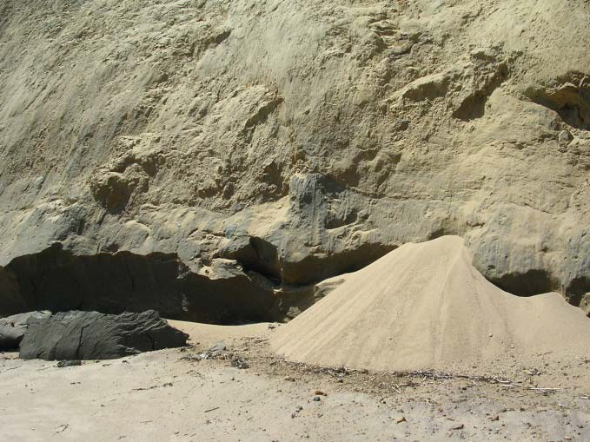
Gravity causes loose sand from the dune to fall to the base of the bank.

Slide 15
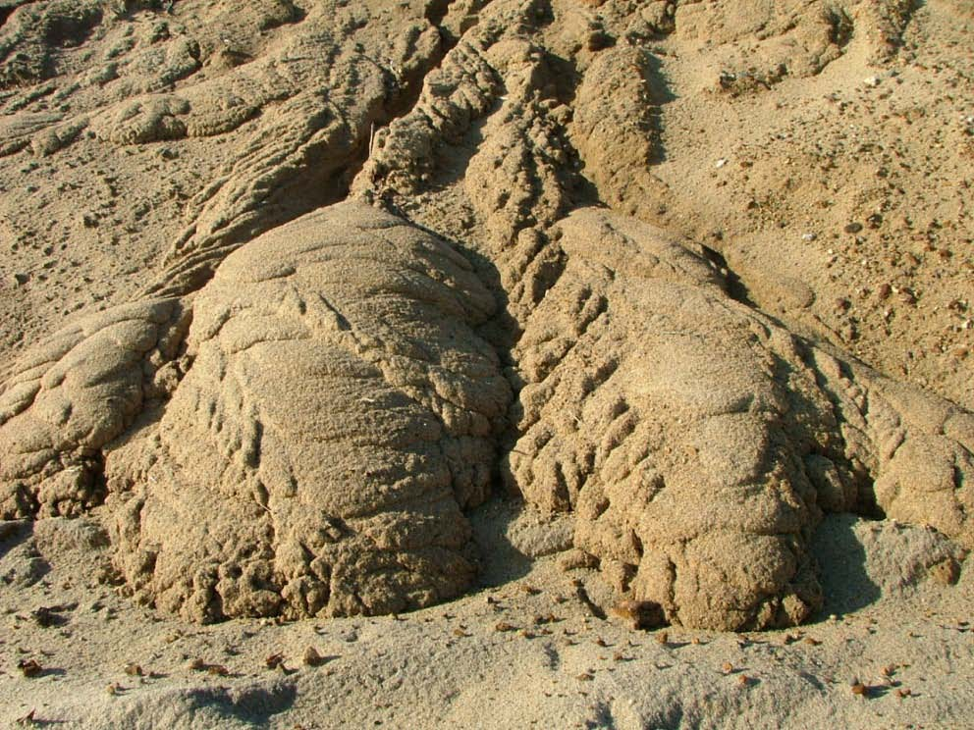
Materials eroded from the bank are added to the beach. Once material is lost form a coastal bank, it is not returned. Cape Cod gets a little smaller each year, about 5 acres/year are lost to the sea. The bank’s loss is the beaches gain. Beaches gain (accretion) and lose (erosion) width through the seasons and from storm to storm. Sand spits get longer and sometimes wider.
Sediment washed by rain and gravity from the cliff has slumped to the base or toe of the cliff .
Wind and waves will move and mix this new beach sand with existing beach sediments.

Slide 16
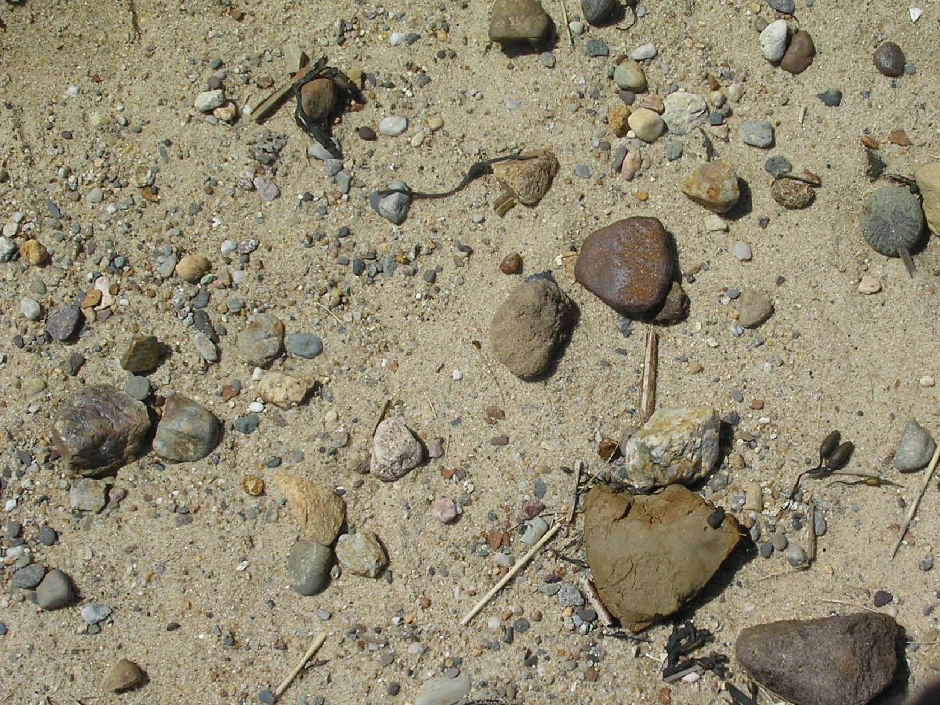
Grain sizes that include clay, sand, granules, pebbles and cobbles have eroded out of the coastal bank. Wave action and wind sort the sediment by size. The lighter minerals such as quartz, feldspar and mica move more easily than heavier minerals such as magnetite and garnet.

Slide 17
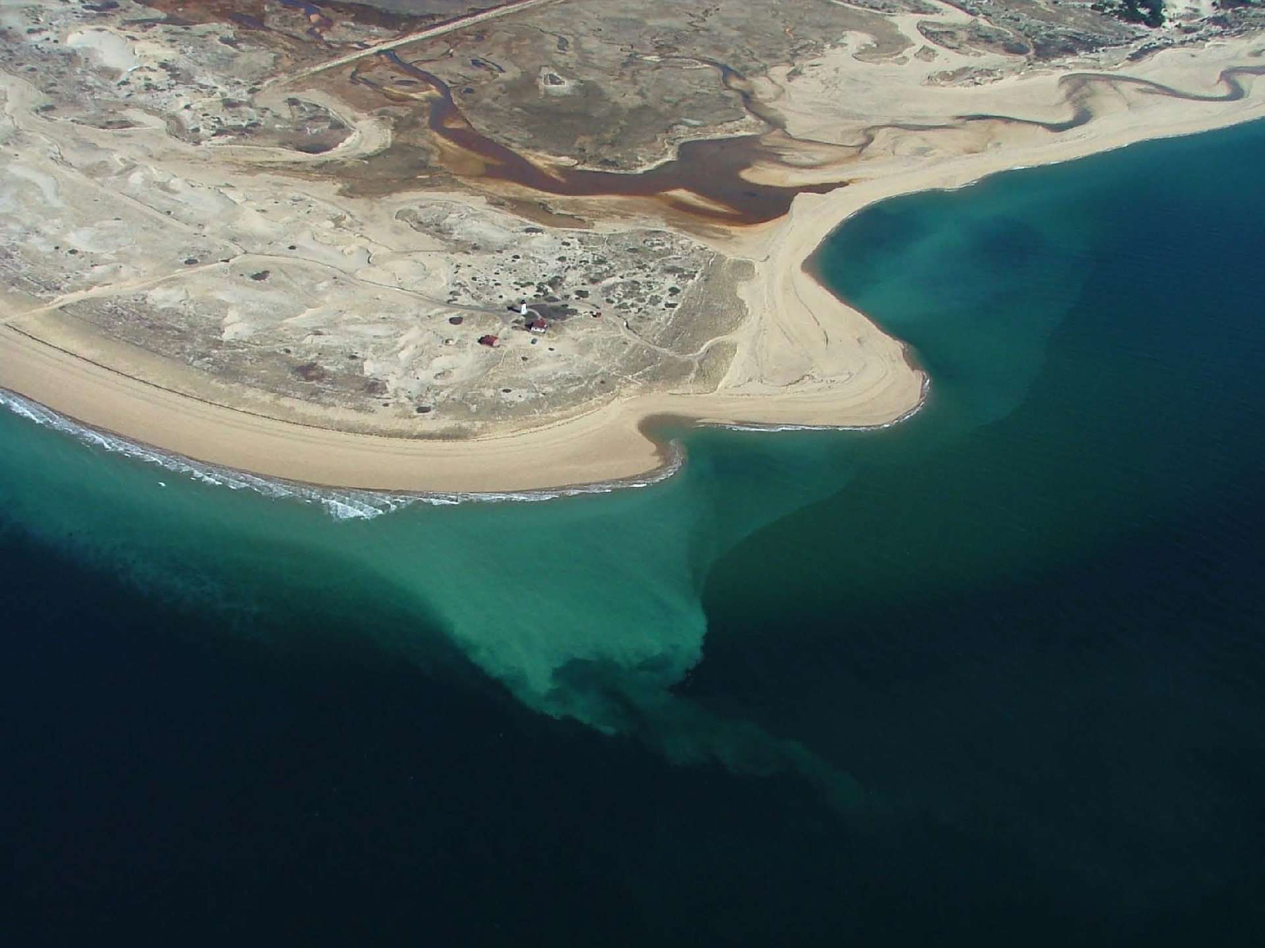
Wave motion moves sediment on and off the beach (erosion). Currents then transport sediment along the shoreline depositing the sand elsewhere (accretion.) The process of sediment being move by currents is called longshore transport or longshore drift. This process continuously moves sediments from one place to another shaping and reshaping the coastline. The light green color is sediment being transported by longshore drift /transport or littoral drift.

Slide 18
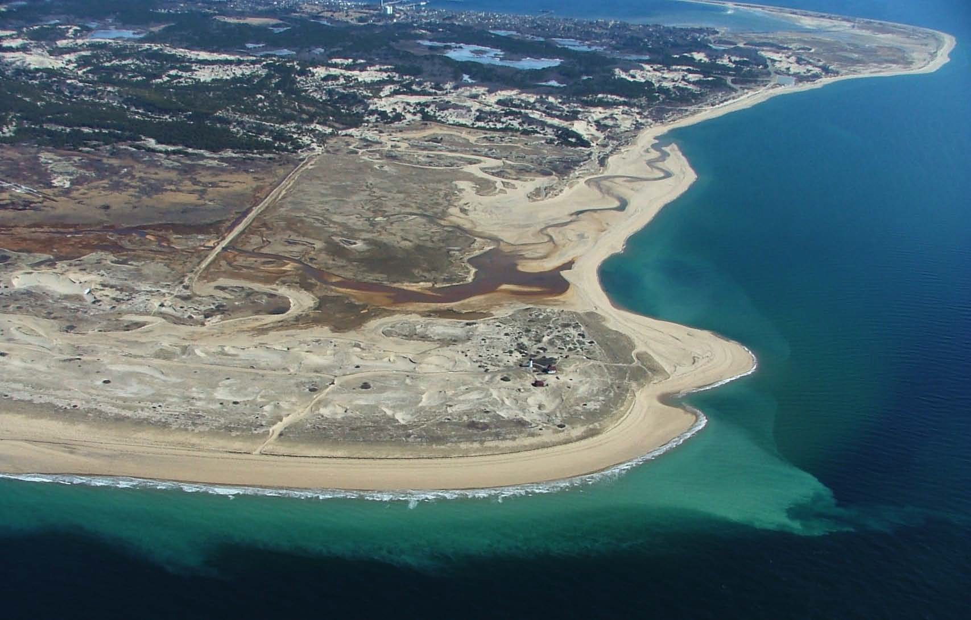
Longshore transport of sediment takes place in the surf zone where breaking wave action has enough energy to lift and transport sediment. This area of energy usually is between the foreshore of the beach and where waves start to swell and form just off shore. Look at the picture…you can observe why the longshore transport current is also called a River of Sand.

Slide 19
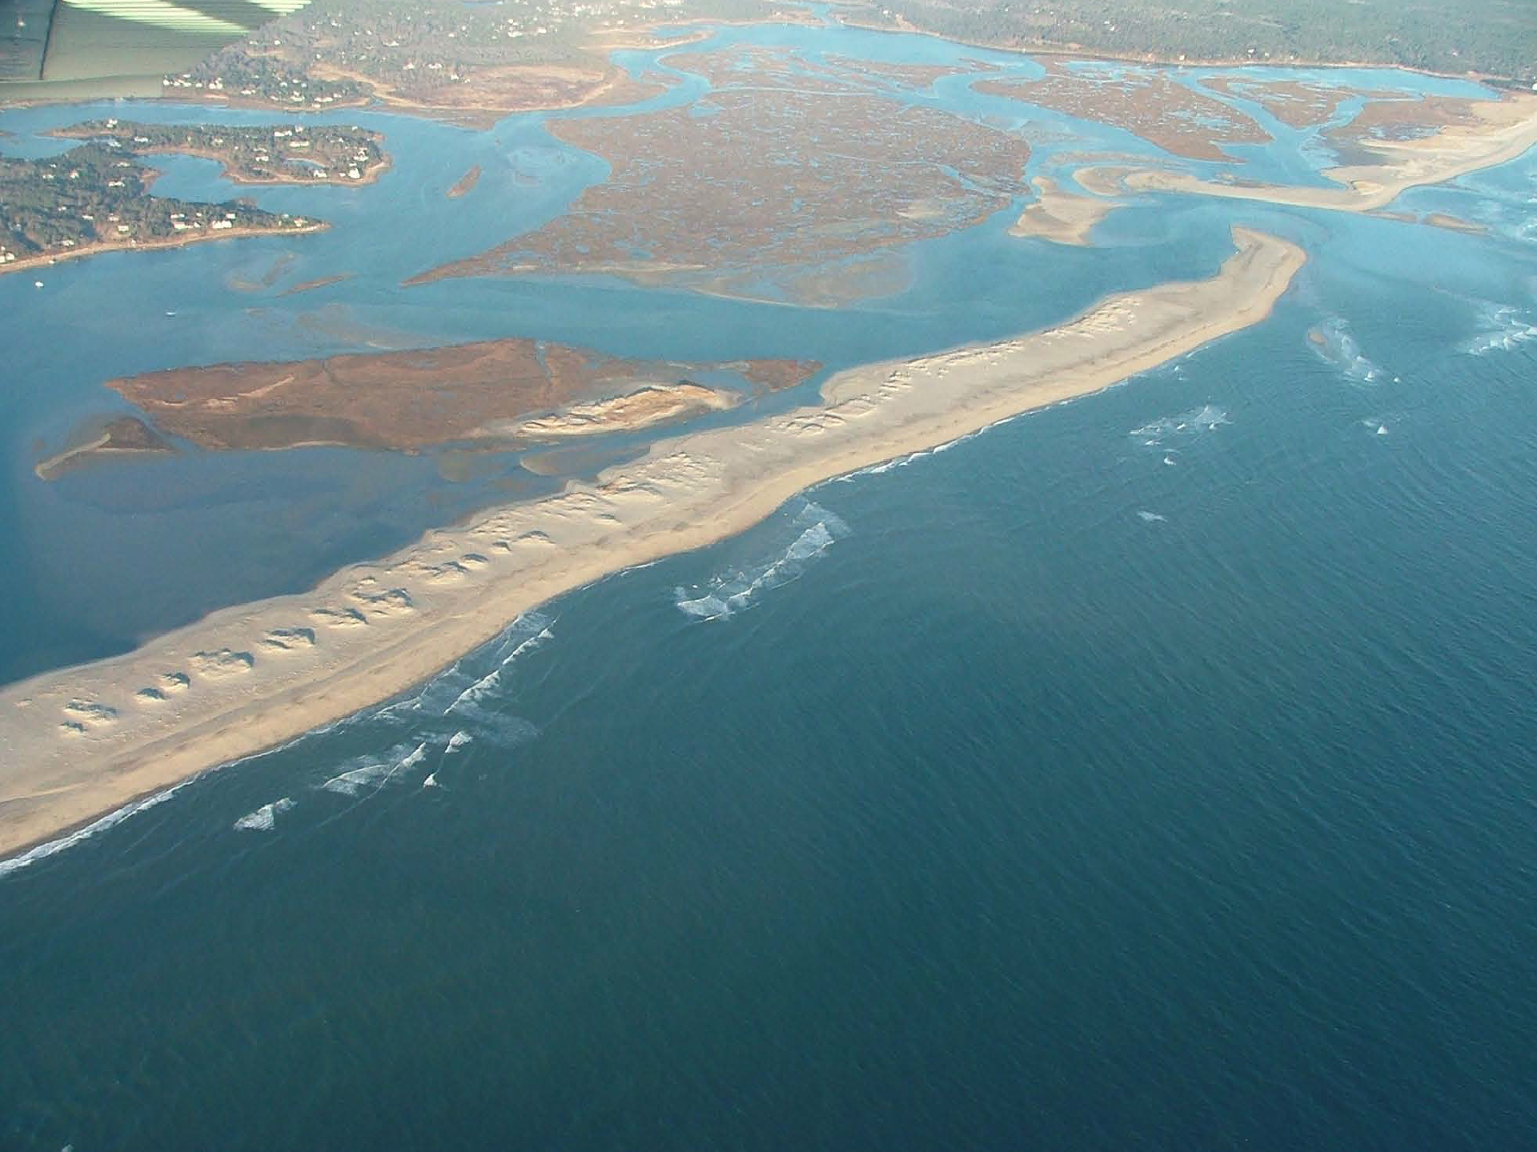
Barrier beaches, spits and dunes are formed by sand moved by longshore transport. Can you hypothesize how sand transported by water is deposited above the water line and made into a sand dune?

Slide 20
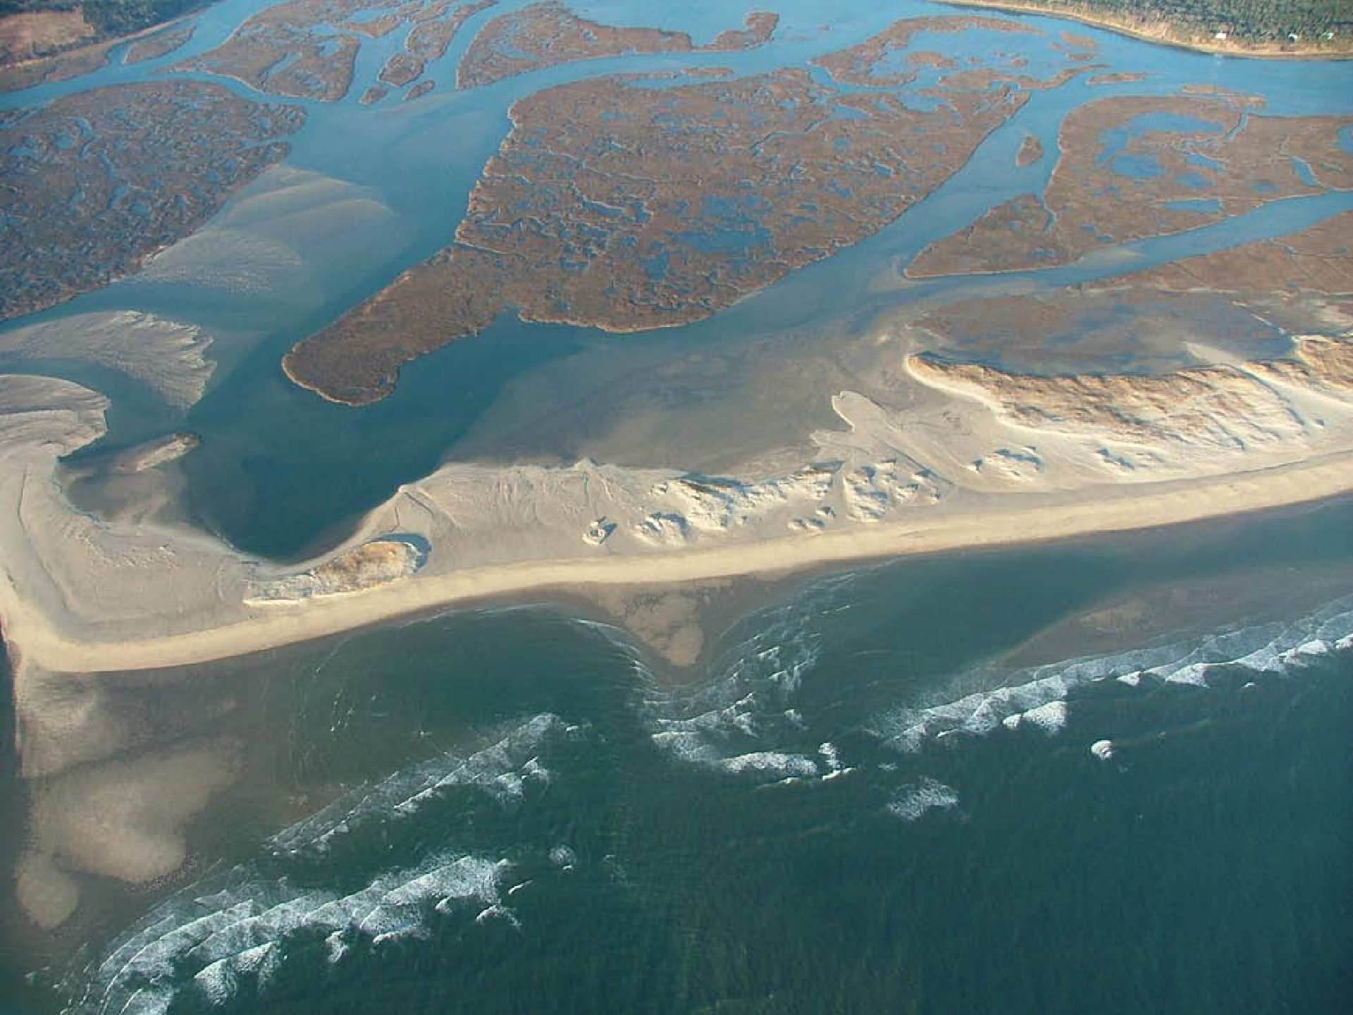
Sand bars shift on and off shore with changes in wave energy. Usually, waves are stronger in the winter and pull sand off shore, in summer, the waves have lower energy and push sand onto the beaches. During periods of high or storm tides waves can overwash the low elevation “barrier beaches “ and dunes depositing sand landward.
What forces cause waves to form?
Can you see where overwash has happened ?
What will happen to the salt marsh as overwashes continue?

Slide 21
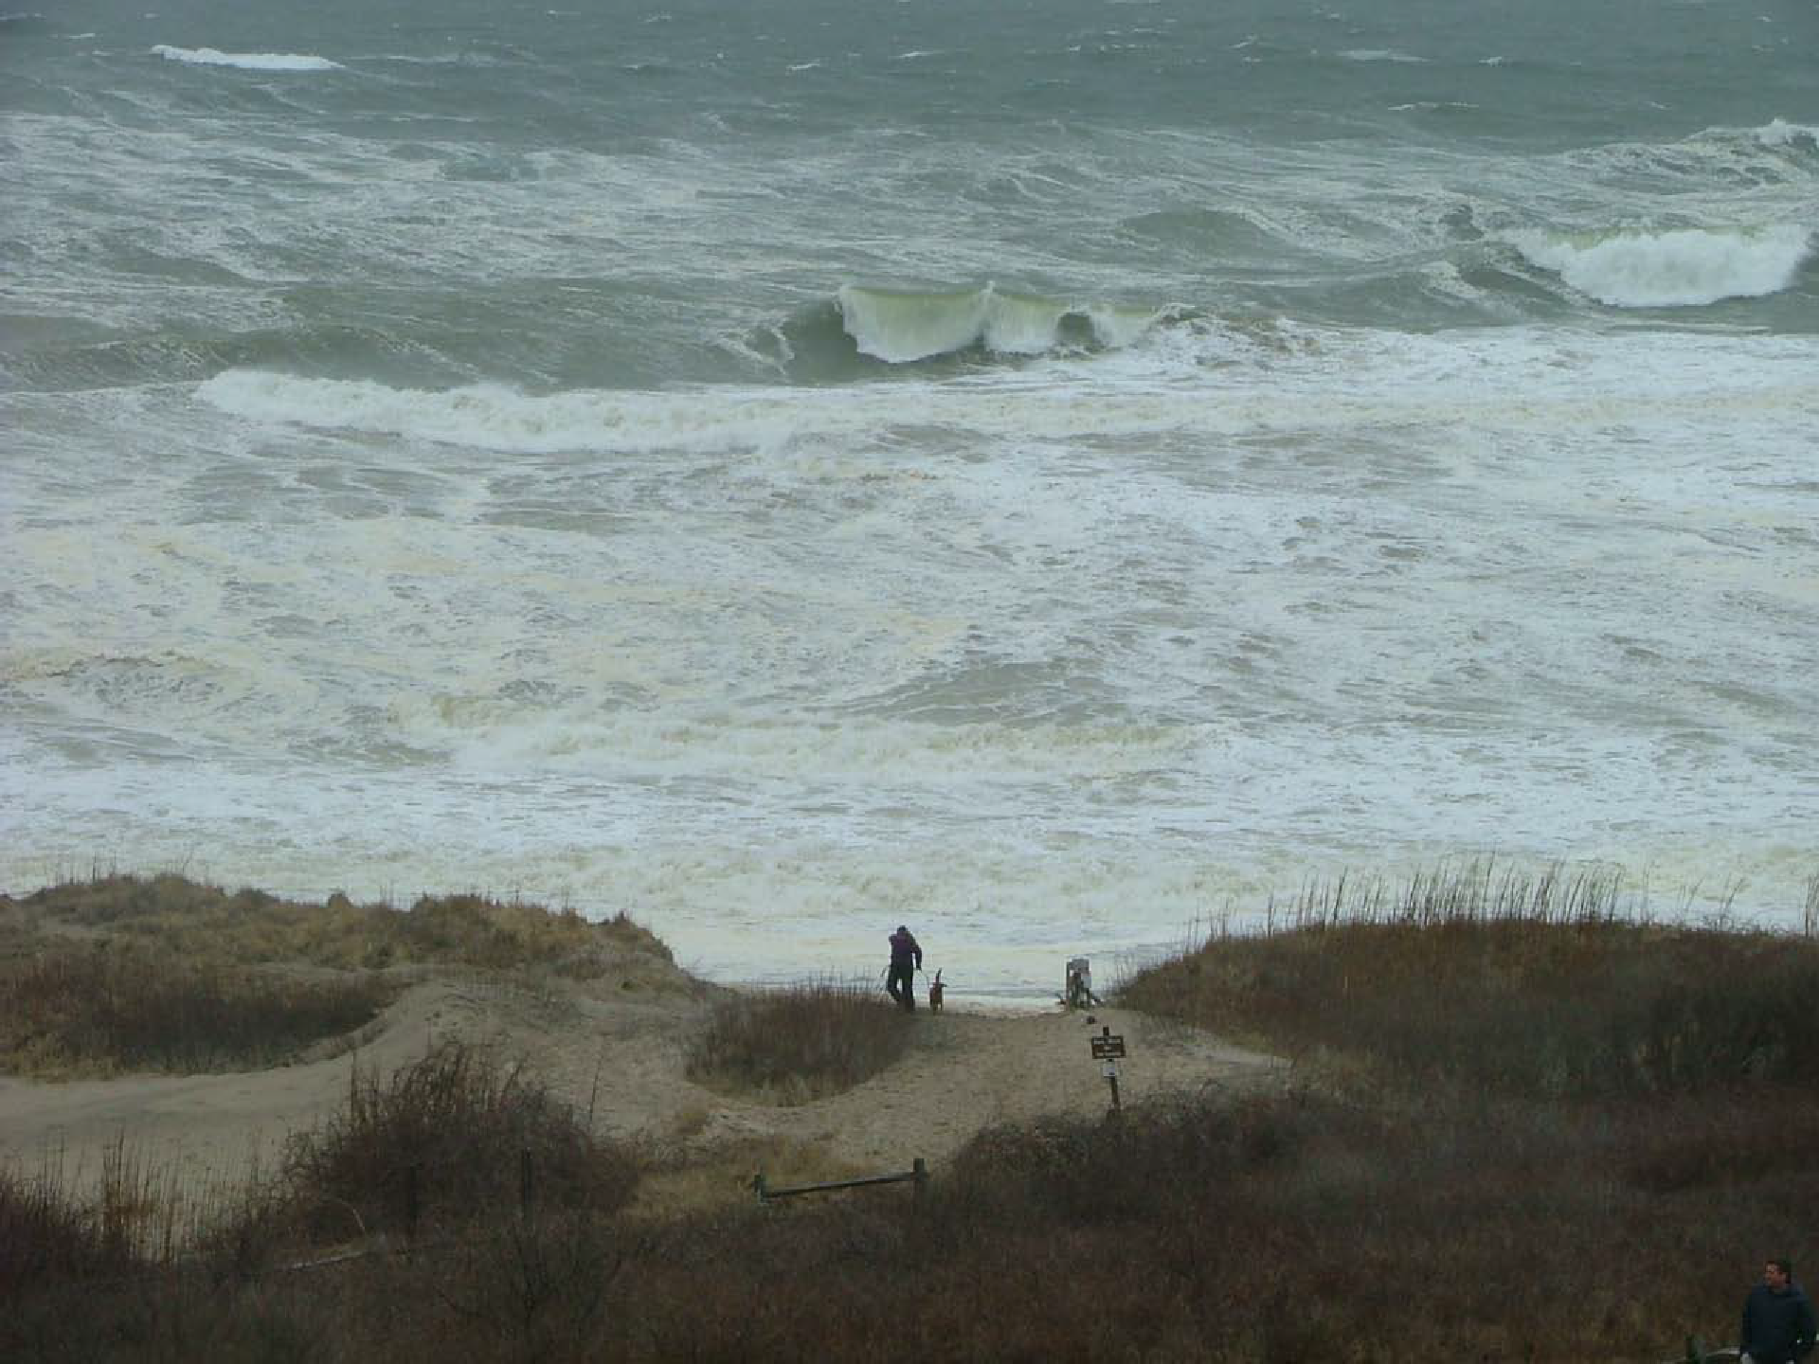
What factors affect the vulnerability of beaches, dunes, and coastal banks (the glacially deposited cliffs behind the beach) to erosion?
Coastal Vulnerability factors:
beach profile-slope
elevation
sediment size and mineral type
wind speed and direction
wave action

Slide 22
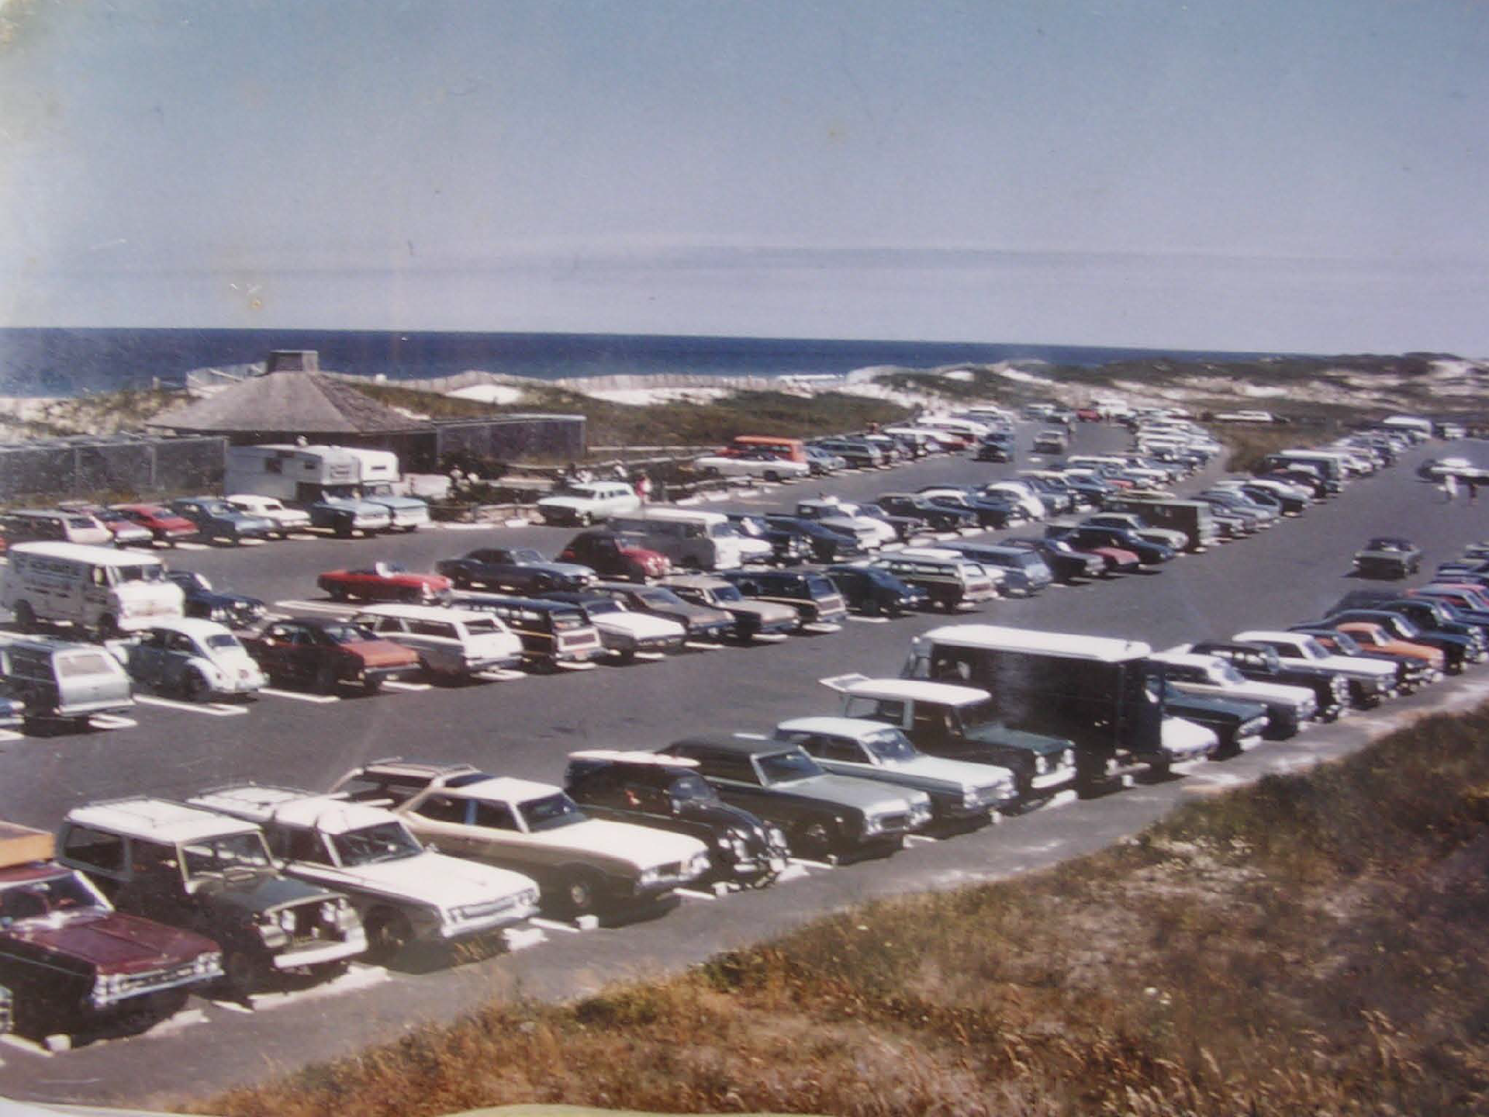
Observe the coastal vulnerability factors in this image. Predict what happened to this beach parking lot and facilities?

Slide 23
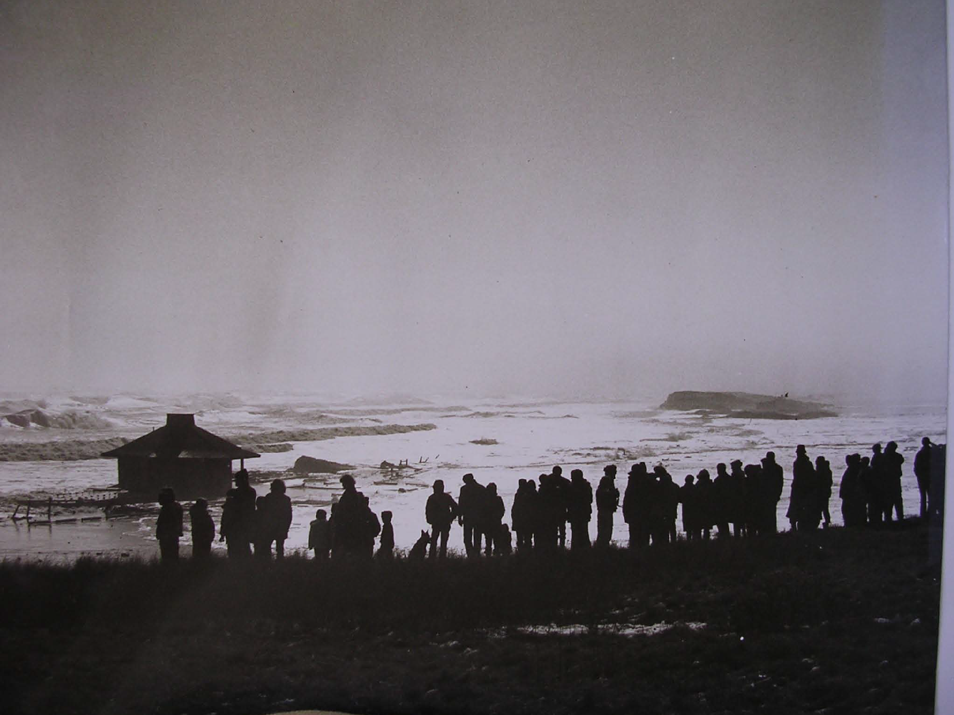
This is the same parking lot shown in the previous slide after the “Blizzard of 1978”. Wind driven waves overwashed the barrier dunes and destroyed the parking lot and bathhouse. Scientist now study how the waves and wind interact with the land to help people make good management decisions. Would it be a good idea to rebuild this parking lot in the same location?

Slide 24
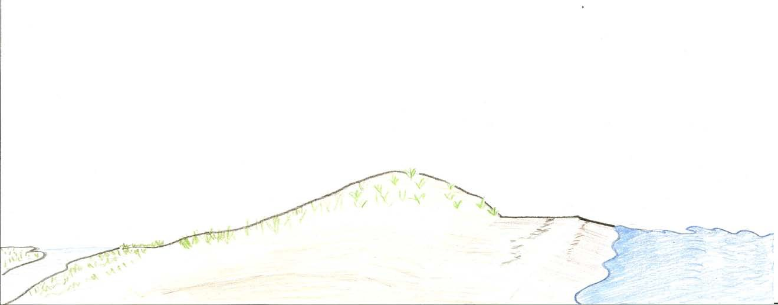
Thank you for using this Powerpoint from Cape Cod National Seashore to learn about coastal ecosystems. Learn more about beach features by using the other Powerpoint in this Coastal Vulnerability Lesson: Beach Zones
Typical Cape Cod National Seashore Barrier Beach Profile
Dune Crest
Berm
Surf Zone
Swash Zone
Backdune
Foredune
Salt marsh
Wrackline
Foreshore

