Slide 1

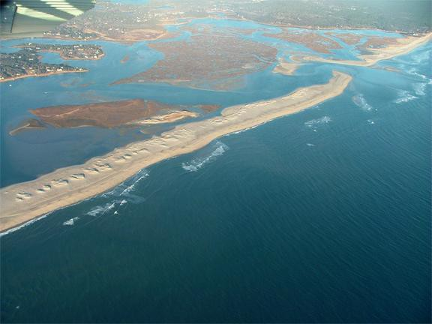
Sensing Cape Cod:
Exploring Beaches and Dunes: Identifying zones
and beach features
Parks as Classrooms Cape Cod National Seashore

Slide 2
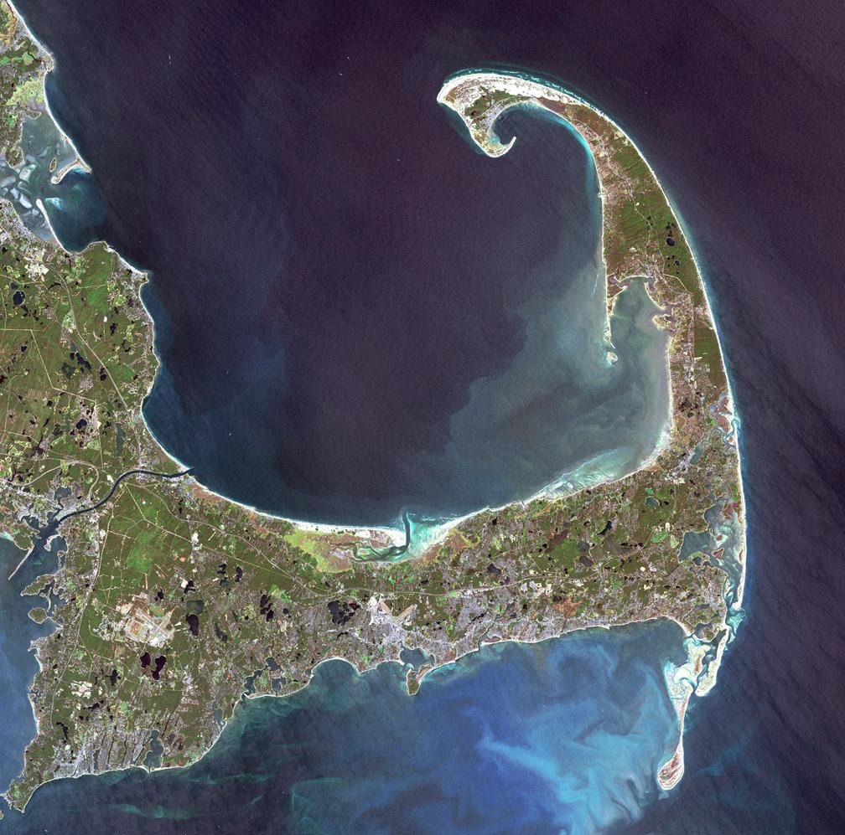

Slide 3
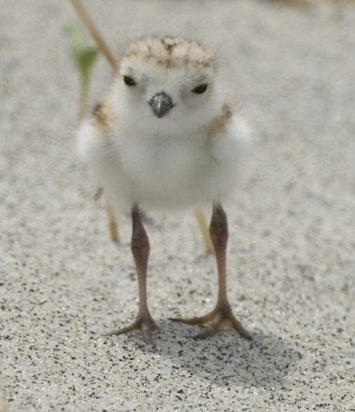
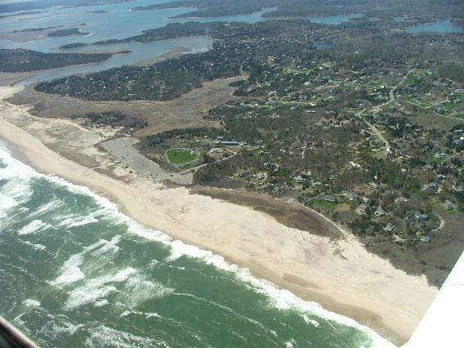
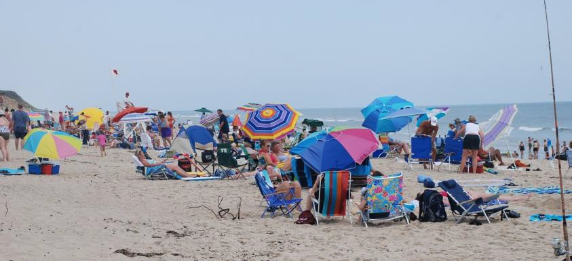
Why is it important to understand coastal geomorphology (landscape shape) and beach processes?
What kind of scientists study the coast, beaches , and oceans?

Slide 4
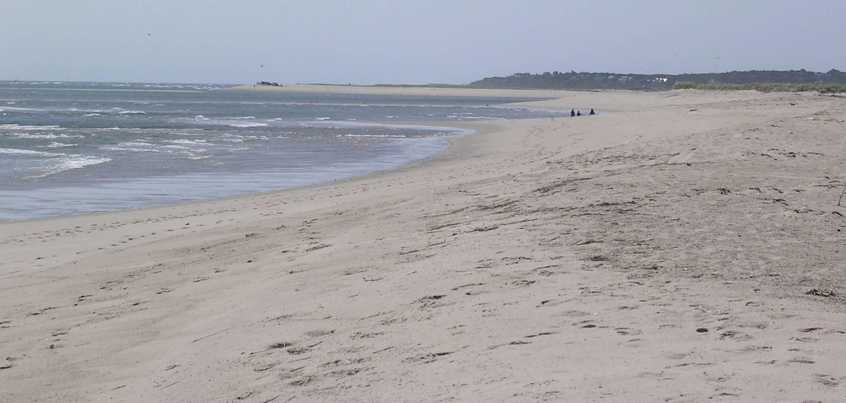
Can you identify “Beach Zones”? This program will teach
you about beach zones and why it is important to know them.

Slide 5
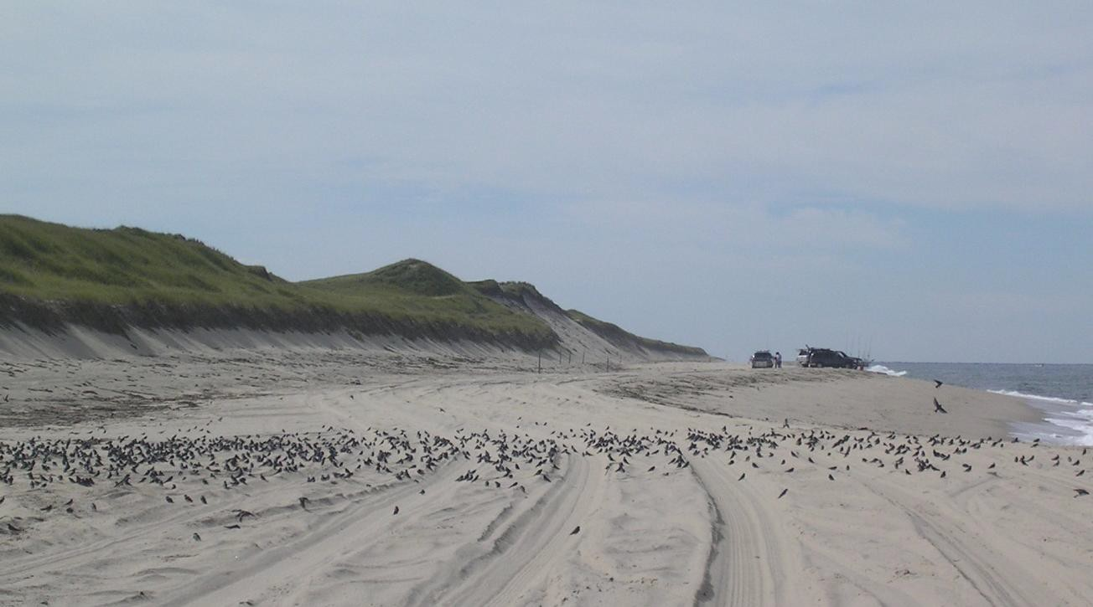
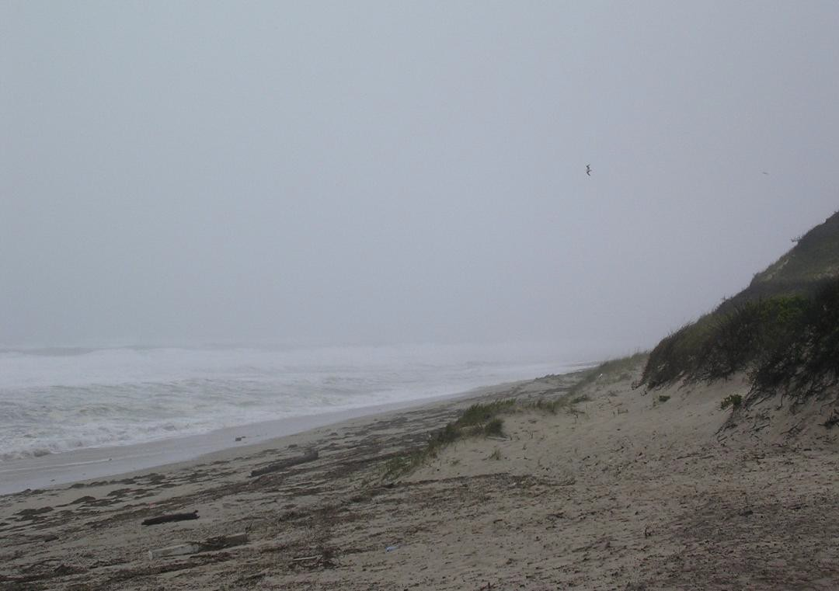
What are beaches?
Beaches are defined as places along a shoreline that are exposed to wave action.
Beach materials may include fragments of rocks, corals, and shells.
Each beach has a profile just like each of us has a profile.
Beaches vary, but all have similar
features.

Slide 6
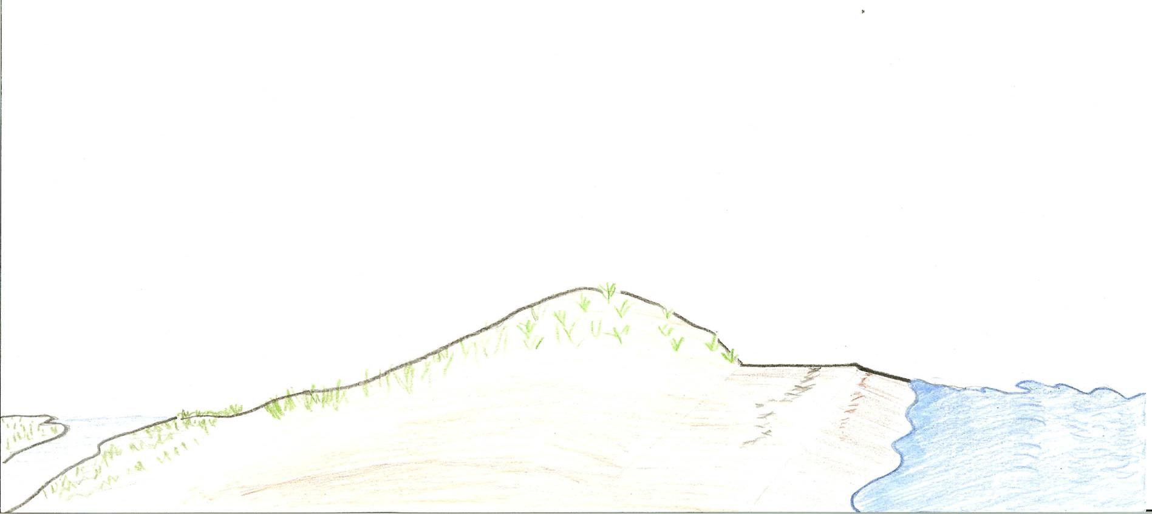

Typical Cape Cod National
Seashore Barrier Beach Profile
Dune Crest
Berm
Surf Zone
Swash Zone
Backdune
Foredune
Salt marsh
Wrackline
Foreshore

Slide 7
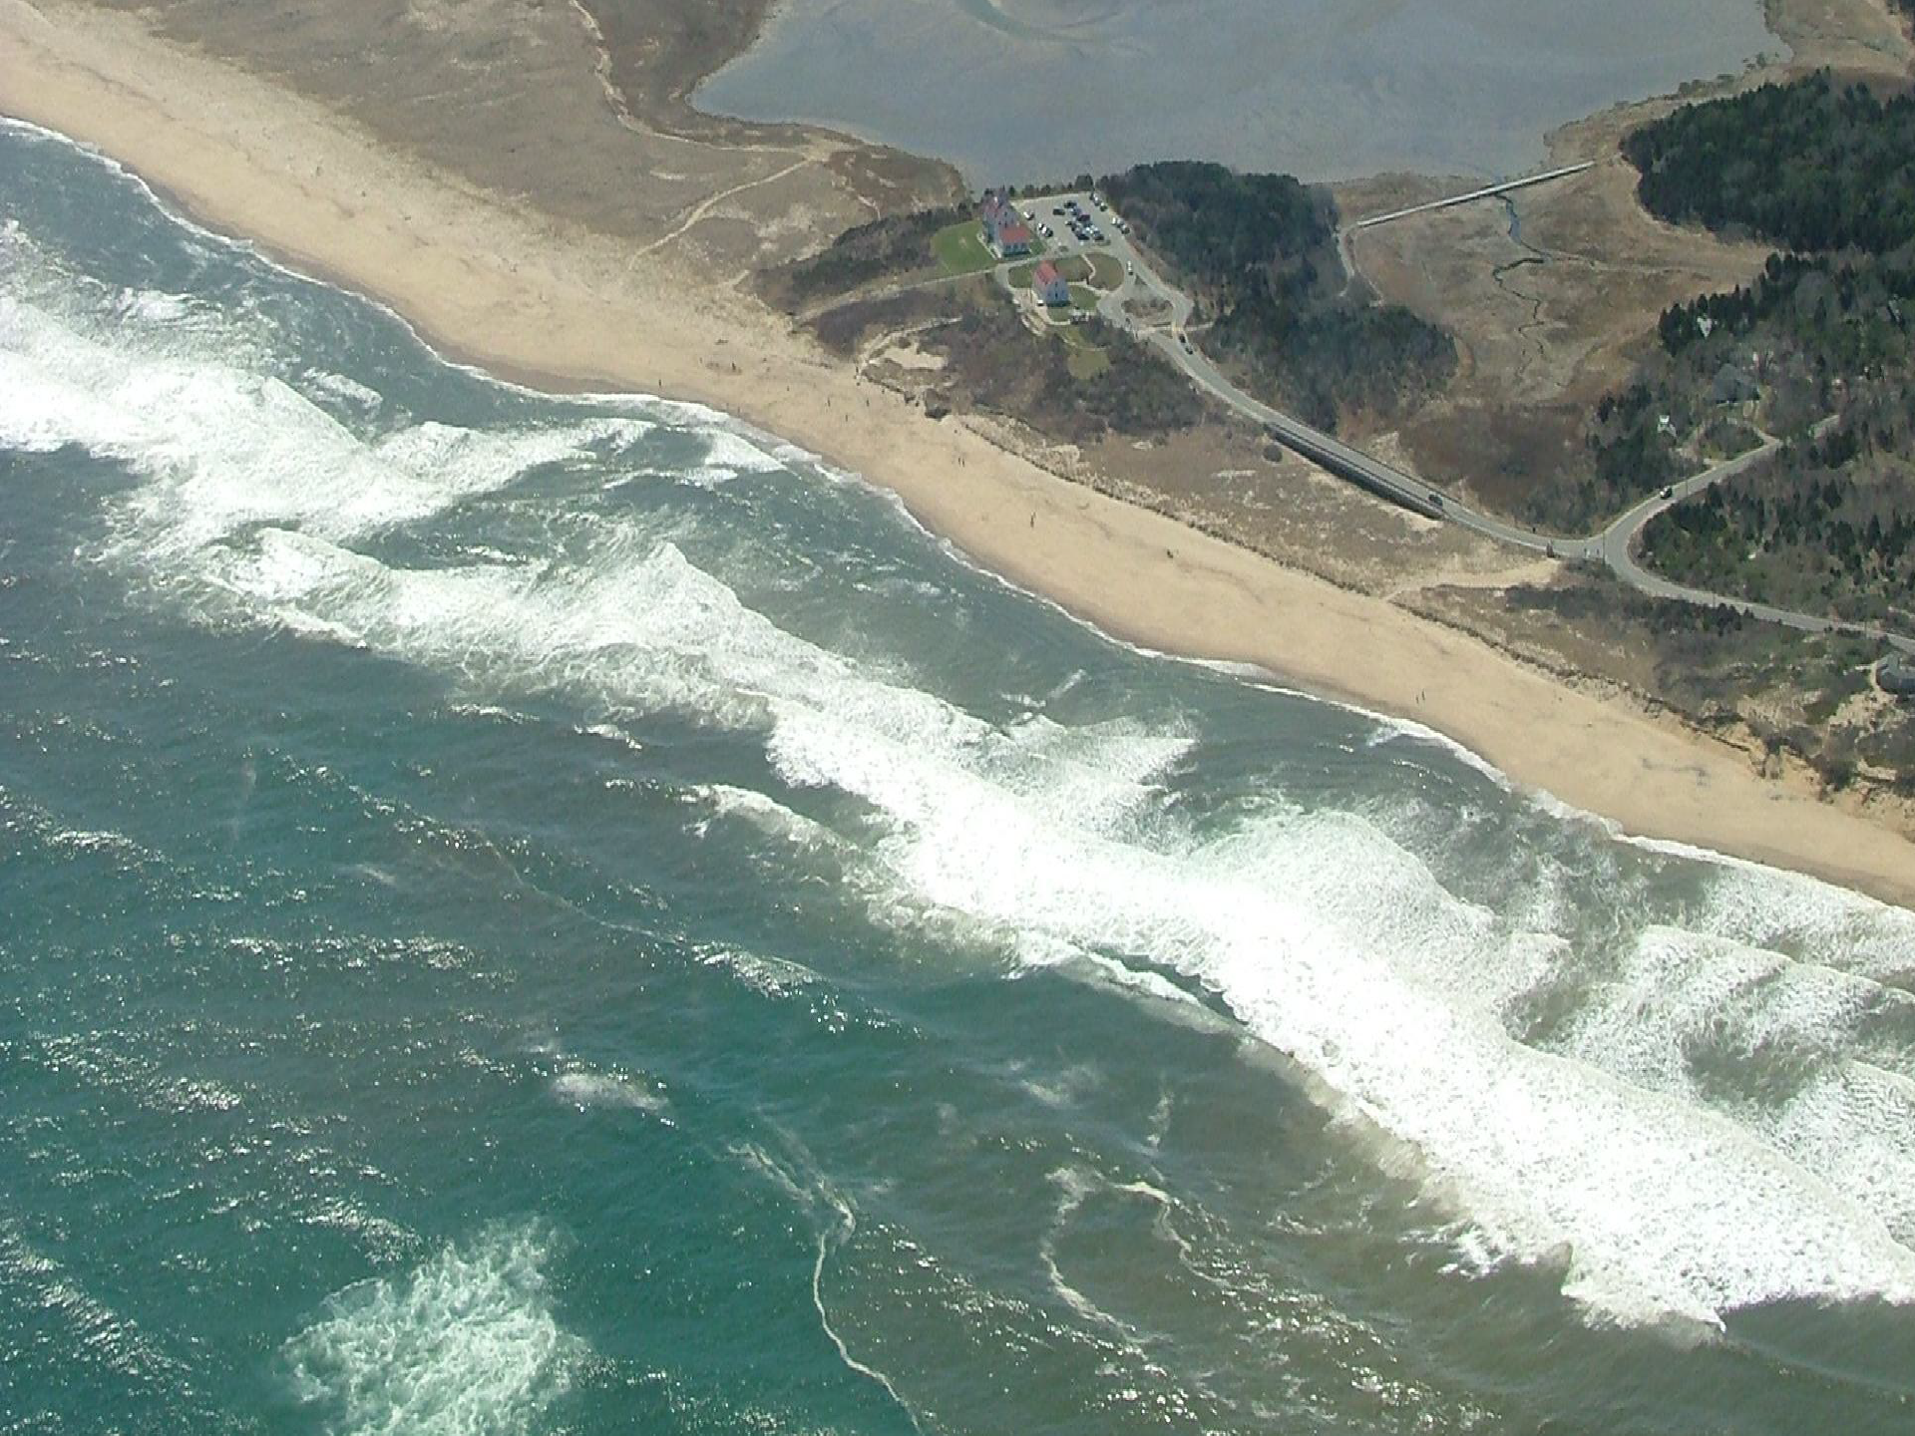
Surf Zone- The area between the seaward line of breaking waves and the landward limit of the upward wave rush. The surf zone’s seaward boundary changes with changing wave conditions caused by varying weather and storm conditions. Longshore transport of sediment takes place in the surf zone.

Slide 8
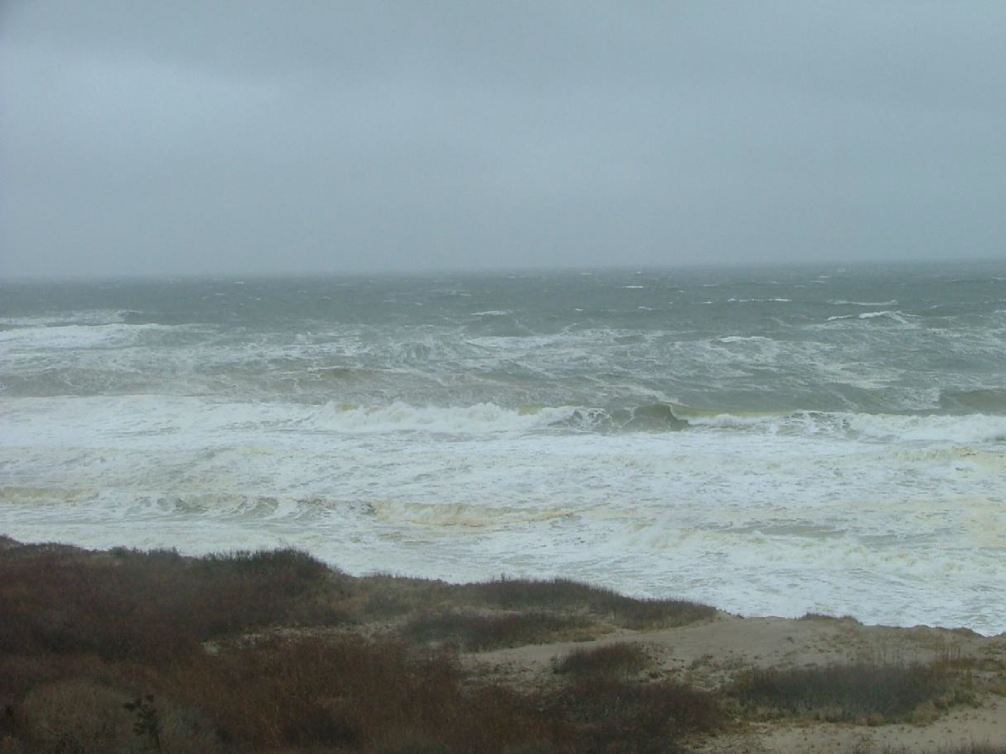
The surf zone on this day was very wide and had both spilling, and plunging or curling breakers.

Slide 9
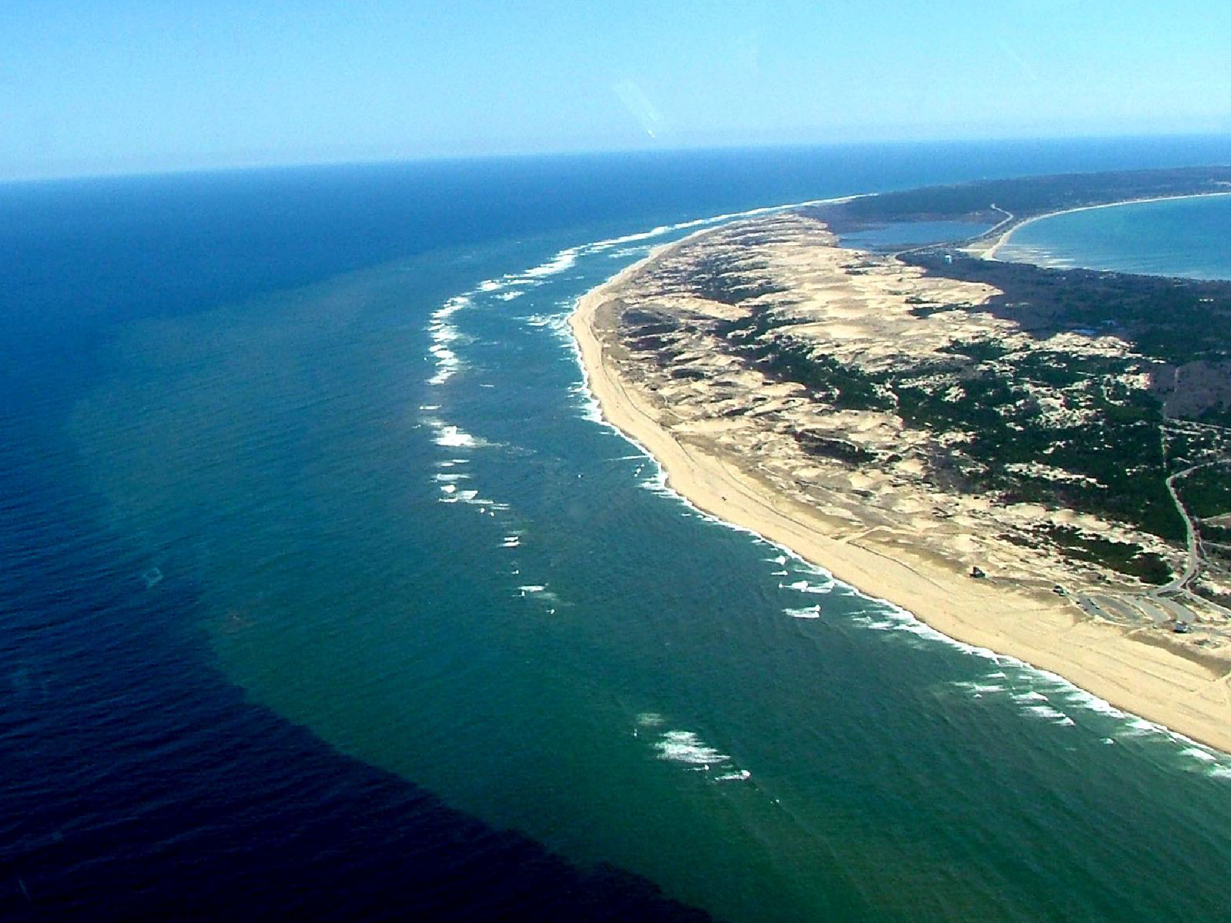
Offshore sand bars cause waves to break in the surf zone. Sand bars are always shifting location. They are important, they cause waves to break and lose energy prior to reaching the beach. Notice the sediment in suspension as it is transported by currents- A River of Sand.

Slide 10
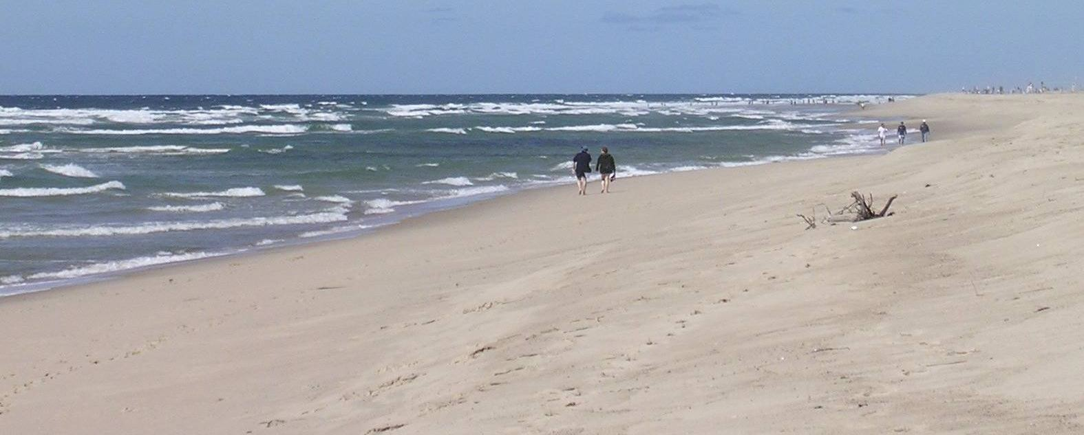
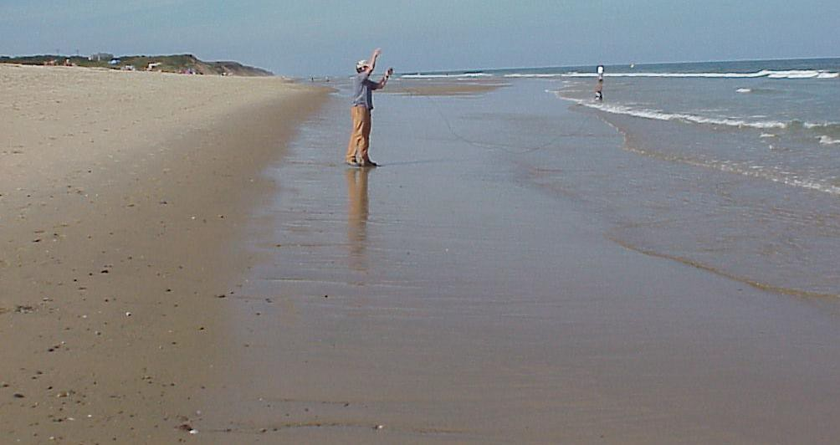
Foreshore
The foreshore or beach face is the seaward sloping zone on a beach between high and low tides. The foreshore’s profile or slope changes from season to season and after storms. What season of the year do you think it is the steepest?

Slide 11
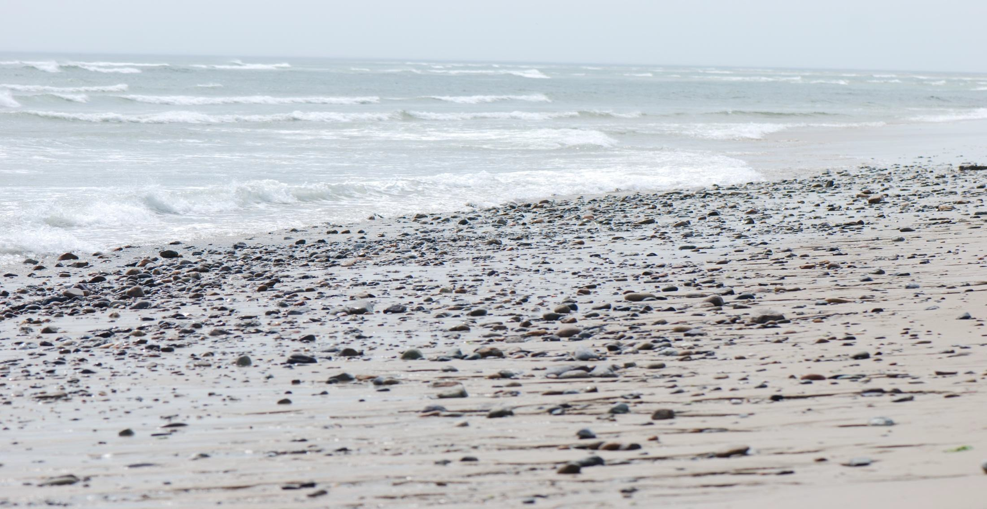
Each wave moves beach sediments. You can hear the sound of the backwash as wave action moves pebbles and sand up and down the slope of the foreshore.

Slide 12
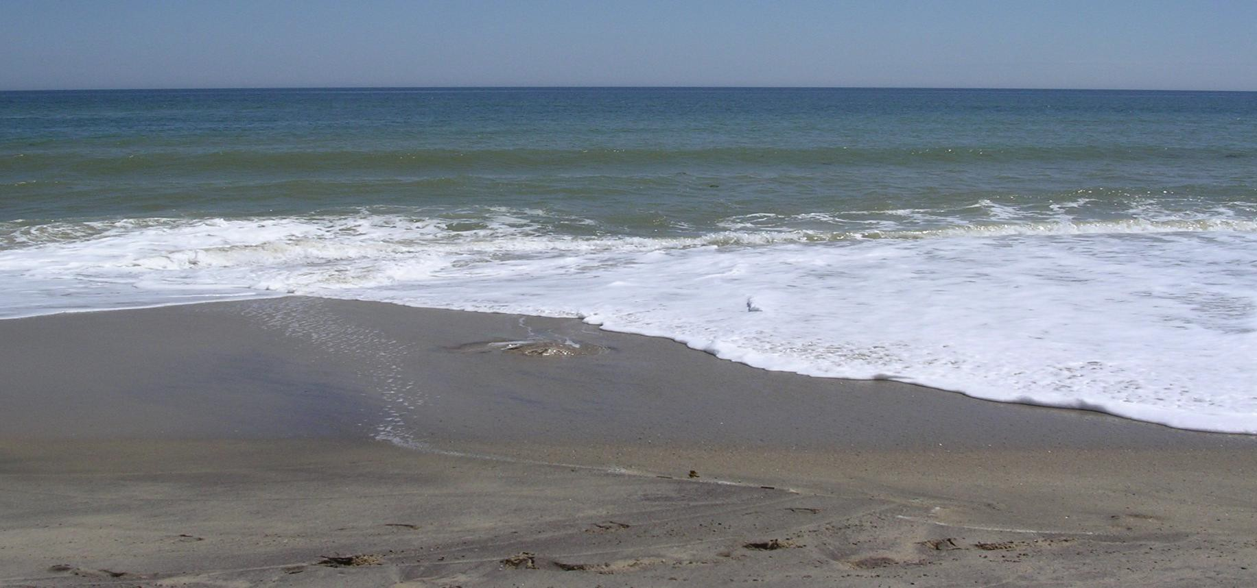
Swash Zone- Swash is a thin layer of water, the final remains of a wave that rolls up the beach. The swash zone is the area of the beach where the swash is running up and down. Usually the swash zone is in the foreshore, but during very high tides and storms the swash zone may be may not exist at all if the waves are crashing against the cliffs!

Slide 13
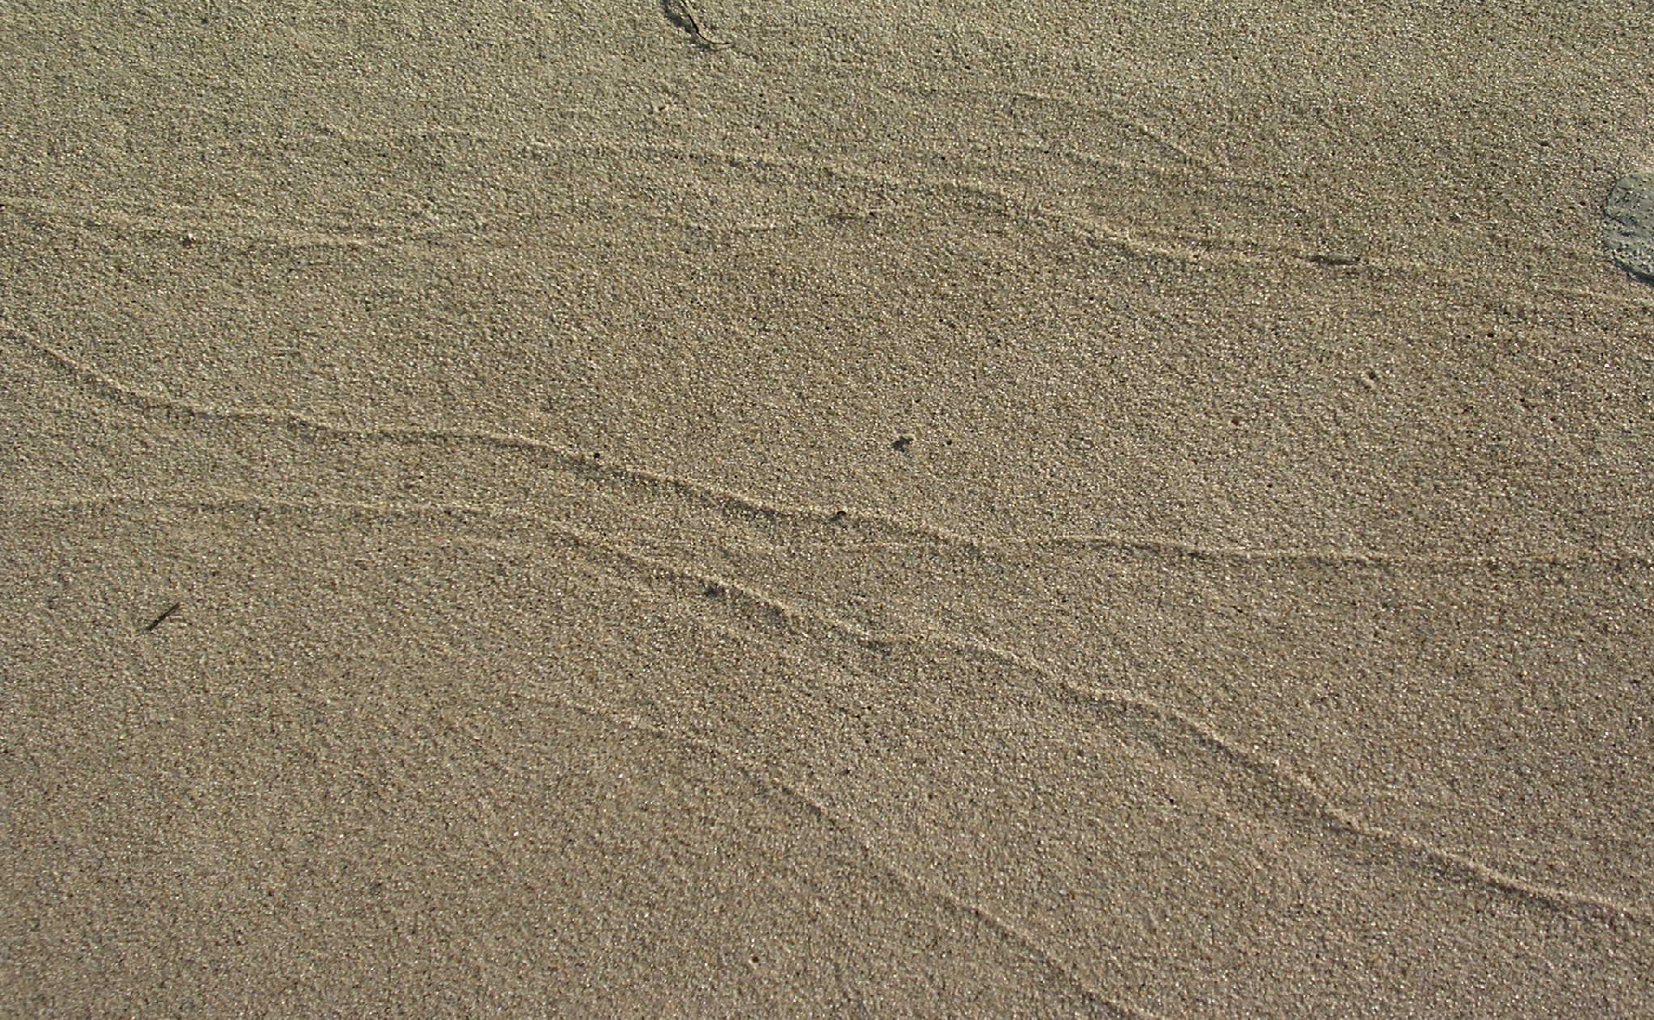
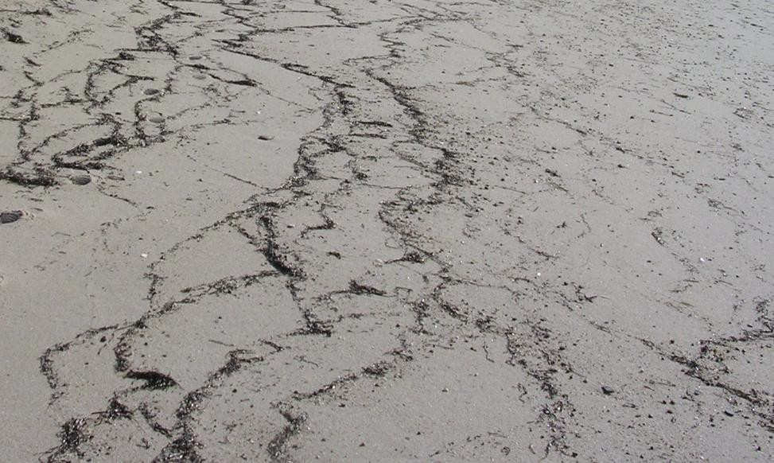
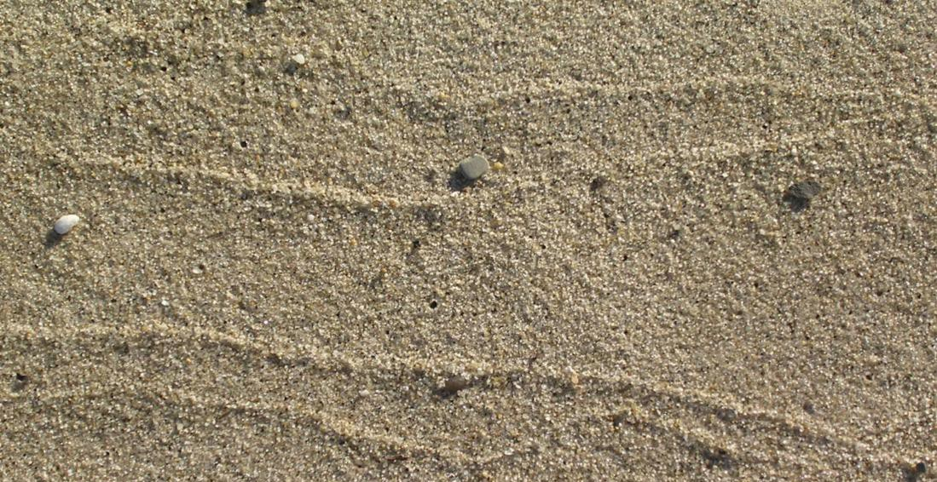
The leading edge of breaking waves push sediment ahead them. As the waves loose energy, the sand being pushed and carried may be deposited in a “swash line.” As the waves’ waters wash back down the foreshore, sediment is pulled off beach. The energetic waves suspend these sediments and currents transport the sediment elsewhere. How does the slope of the beach affect sediment deposition and erosion?
Can you see the swash mark lines?

Slide 14
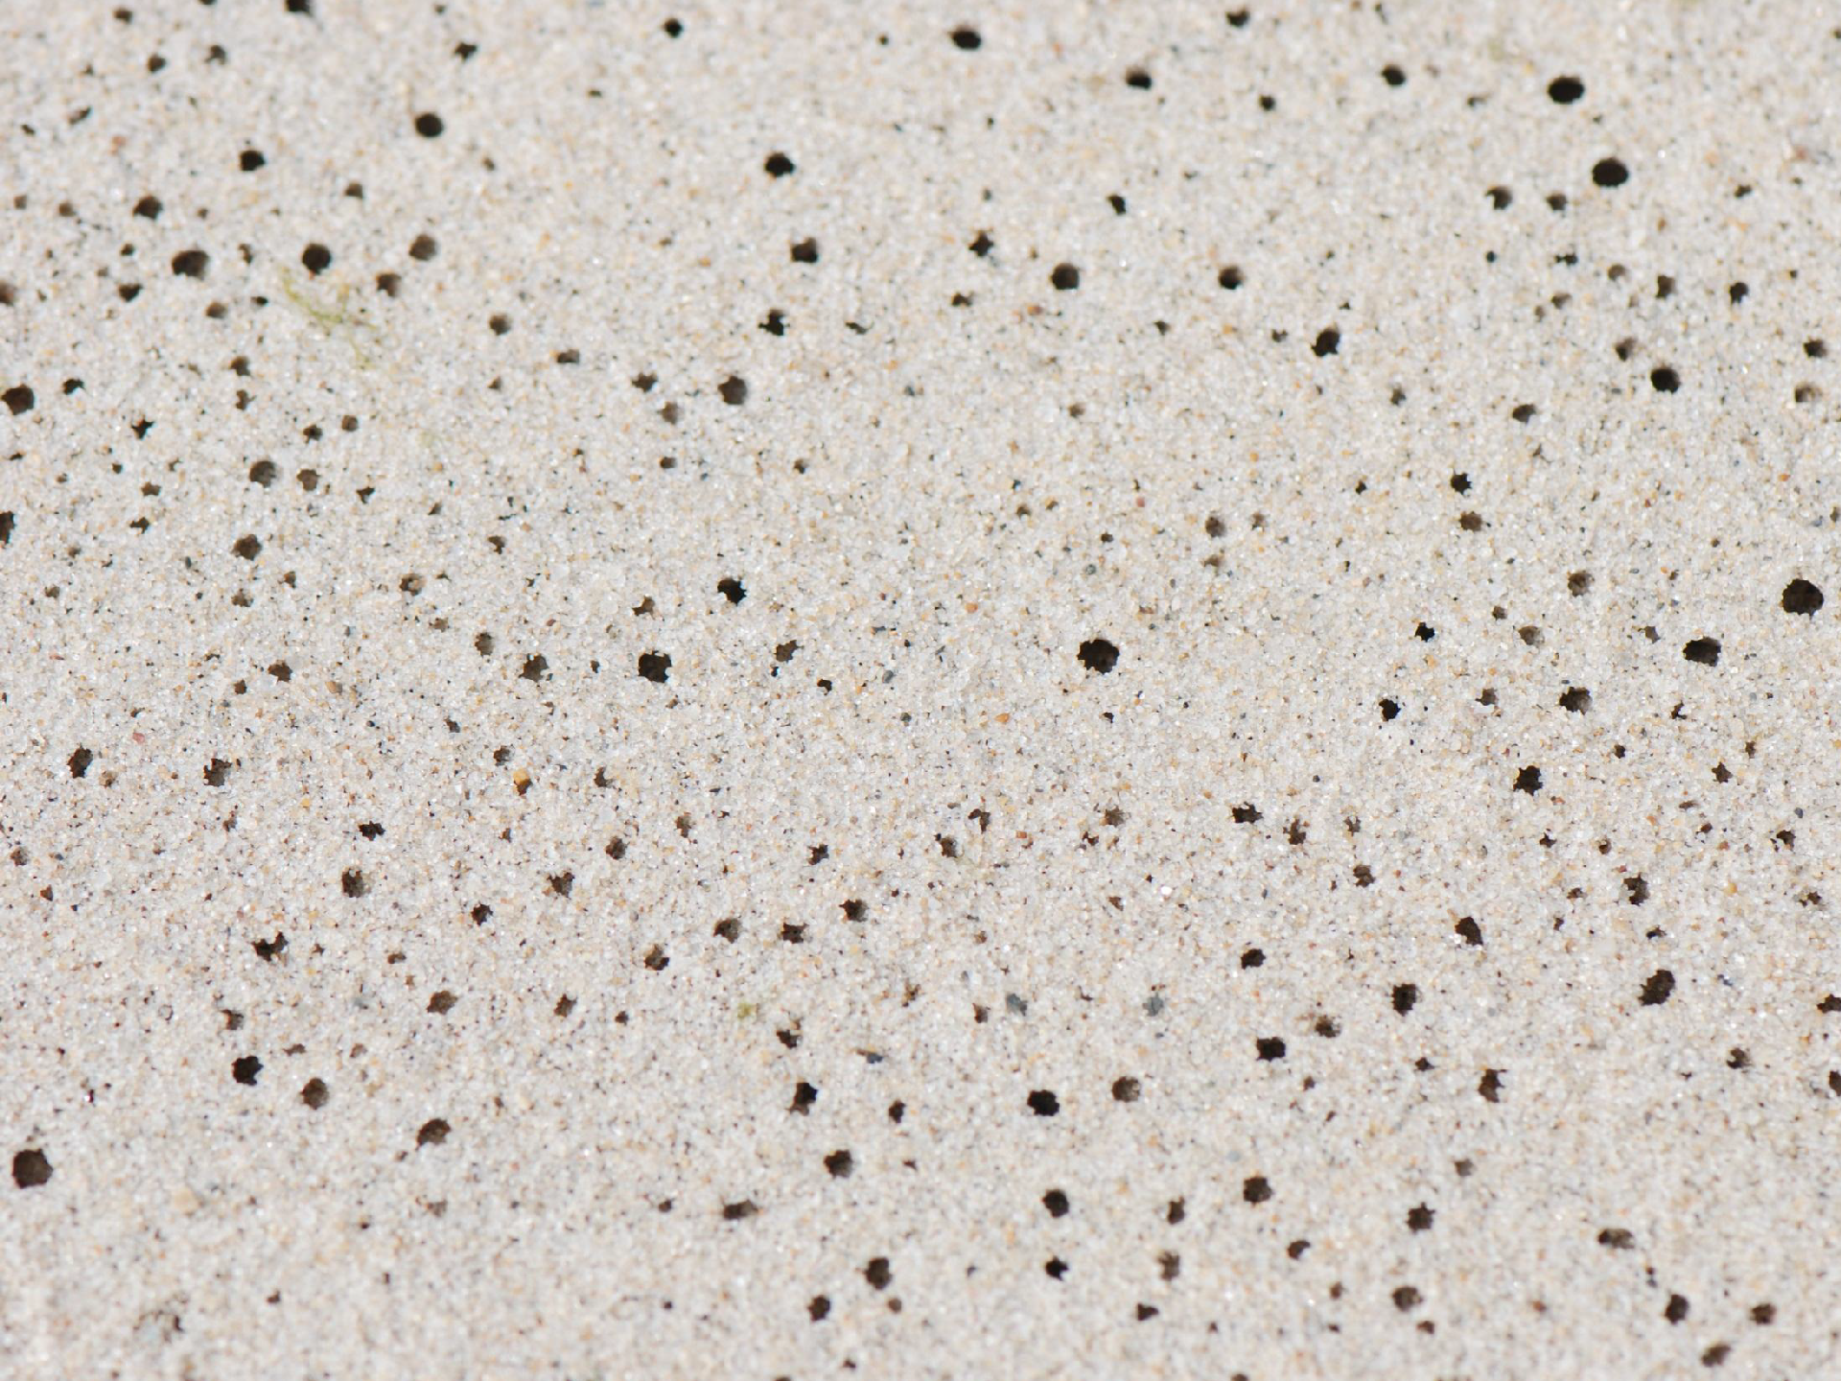
Air Holes or Pin Holes are minor beach features. These small holes form after wave water seeps through the sand and displaces air trapped between grains of sand. The air is forced upward and leaves pin holes as it escapes.

Slide 15
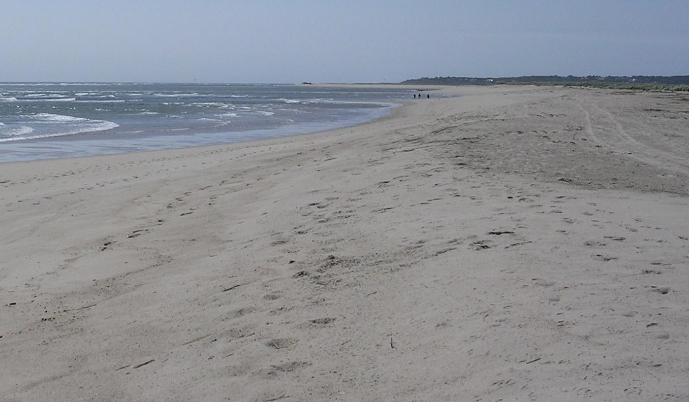
Berms are
high terraces, they form the upper beach. The berm is sometomes called the backshore .
Backshore
This zone is where most beach users place their blankets.
Berm
Foreshore
The berm crest is
where the steeper slope of the foreshore changes to the more gradual slope of the berm.
Berm Crest

Slide 16
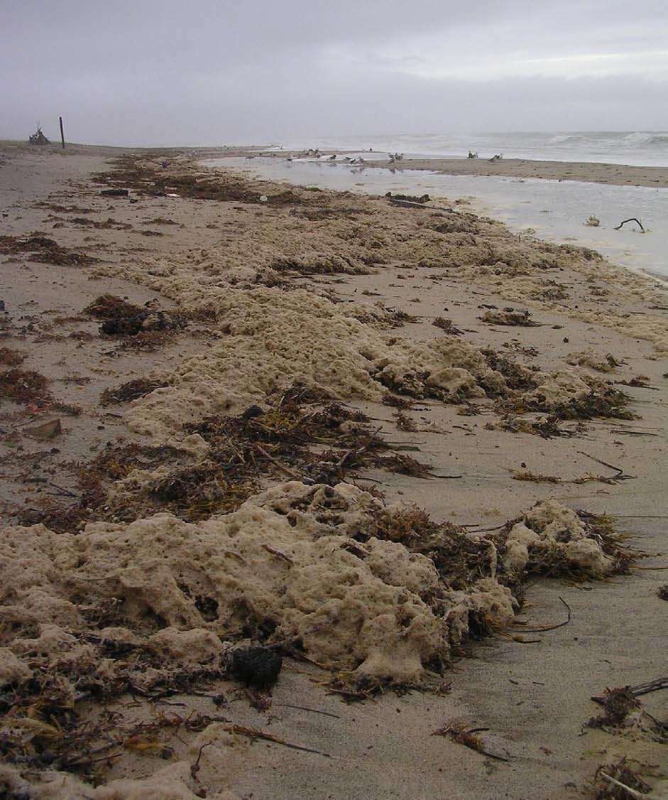








Sometimes the berm crest (the location where the foreshore slope changes to berm’s more level slope, is difficult to determine as the beach is reshaped constantly by waves and wind.

Slide 17
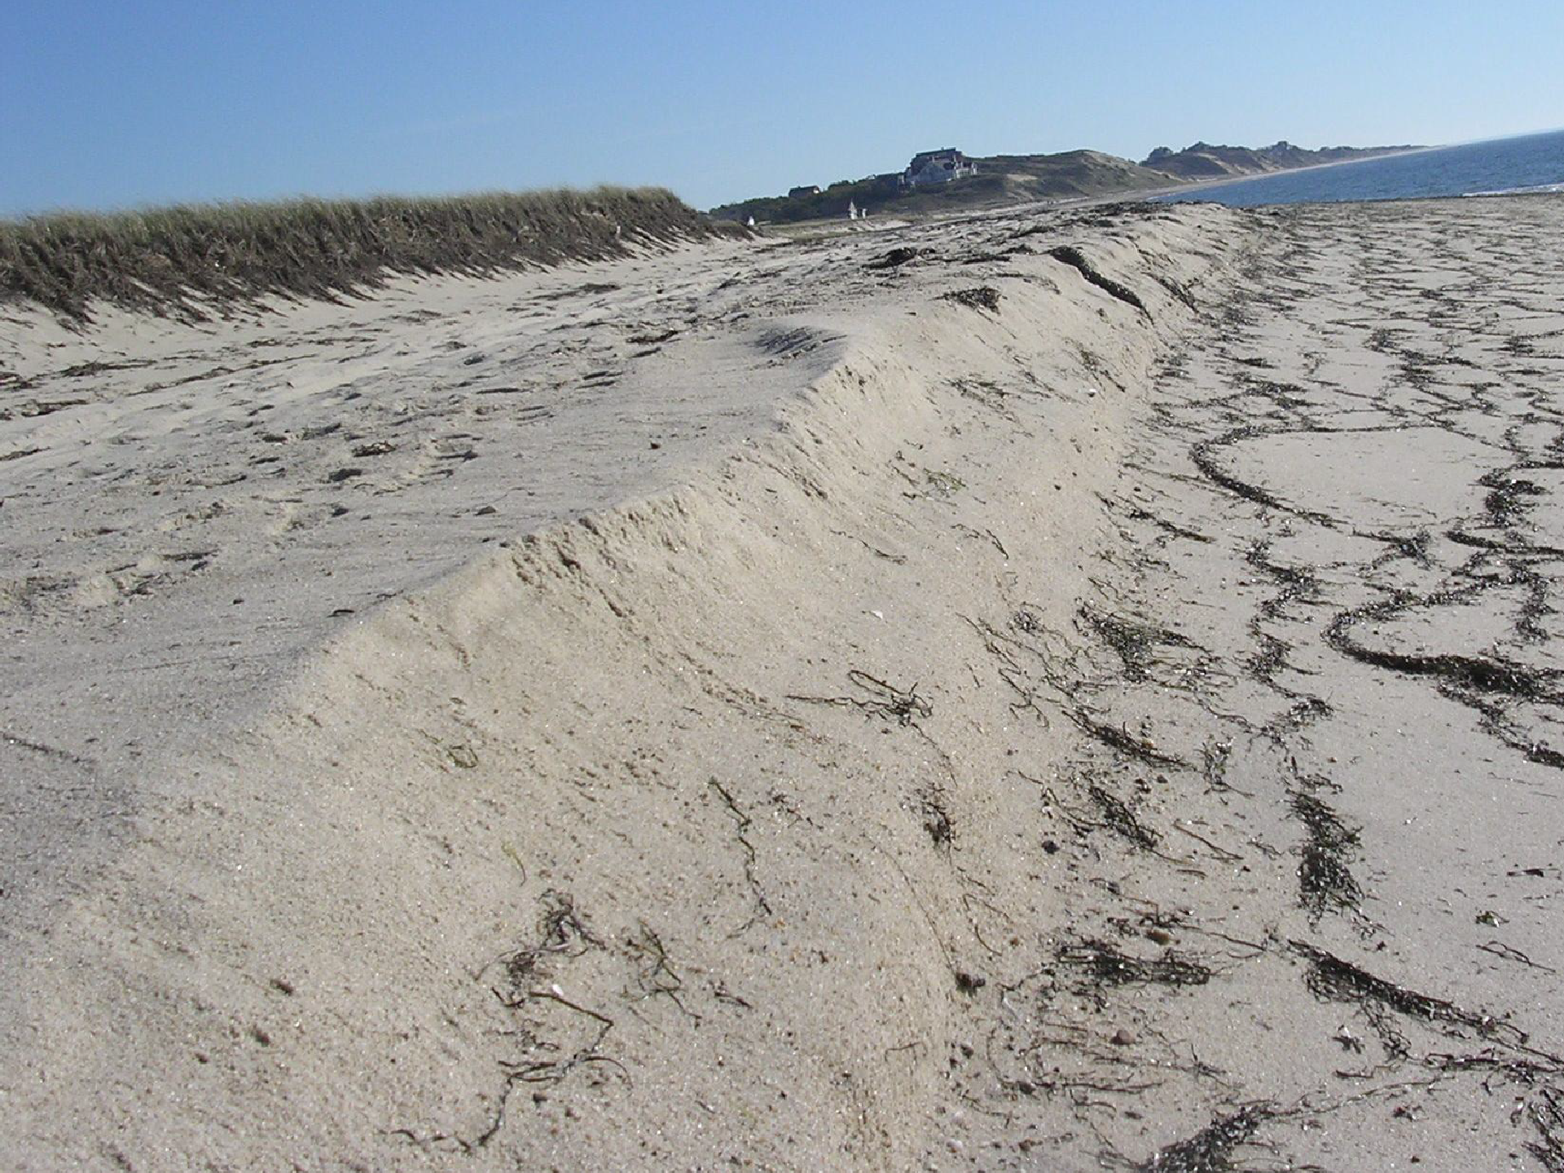
Scarps are steep faced cuts, they are evidence of erosion from high energy waves. Scarps form on berms, dunes, and coastal banks.

Slide 18
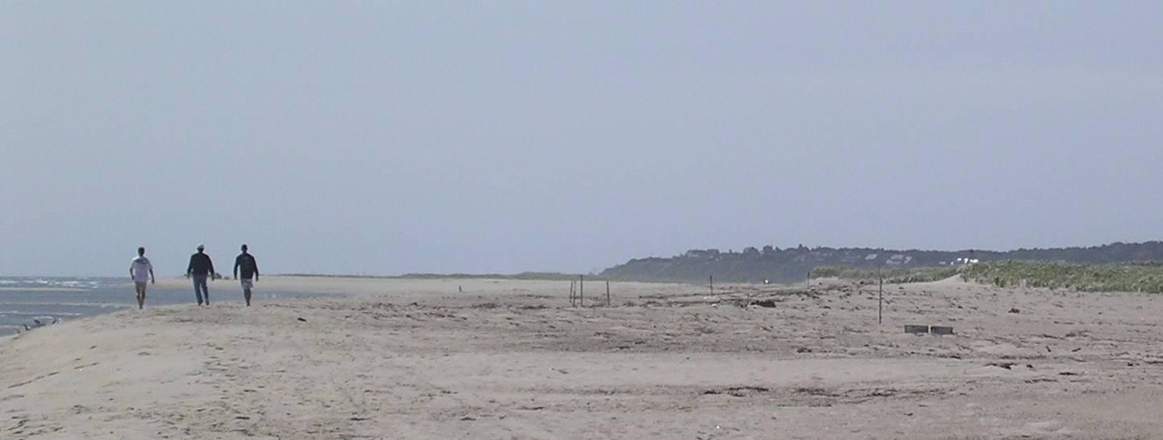
Berm or Backshore
The backshore is another common name for the berm. It is usually flat and dry except when storm waves wash over it. If undisturbed by waves and people, plants will grow at its upper limits. These plants help build the beach and dunes vertically by catching and holding sand in place. Some birds also nest and feed in this zone.

Slide 19
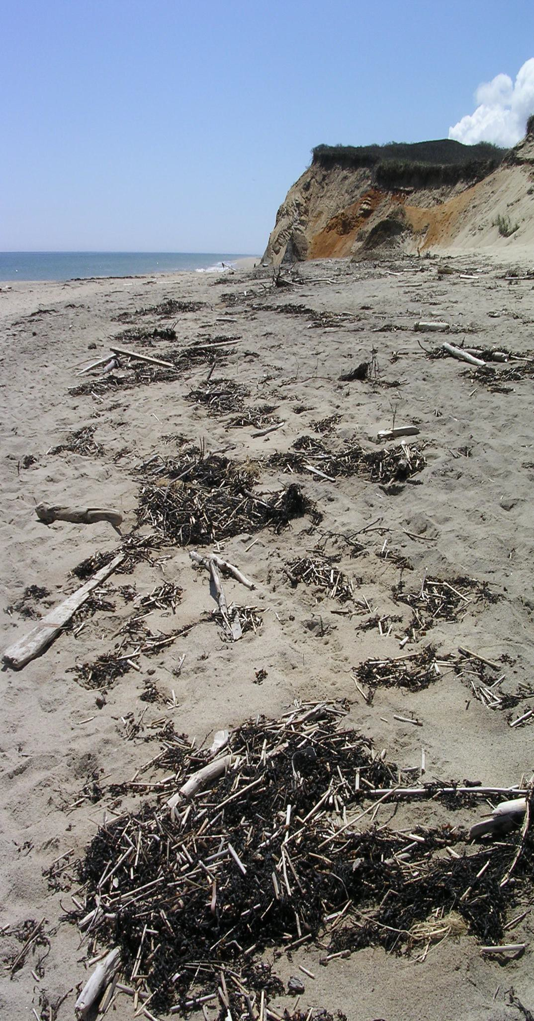
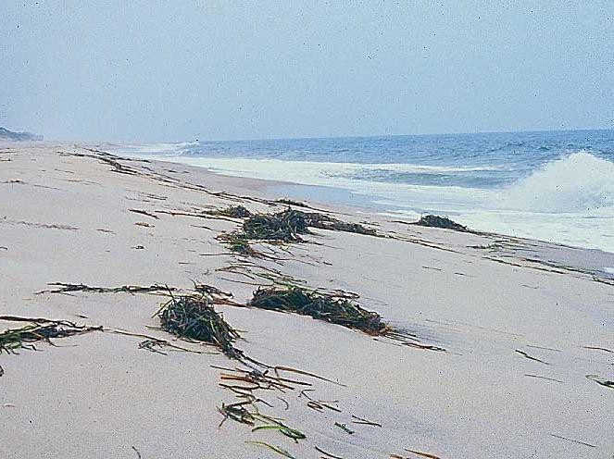
Wrackline
The wrackline is a line of wave deposited debris roughly parallel to the water’s edge.
The height or reach of tides varies from day to day, so the position of wracklines also varies day to day. Wracklines are also called strandlines.

Slide 20
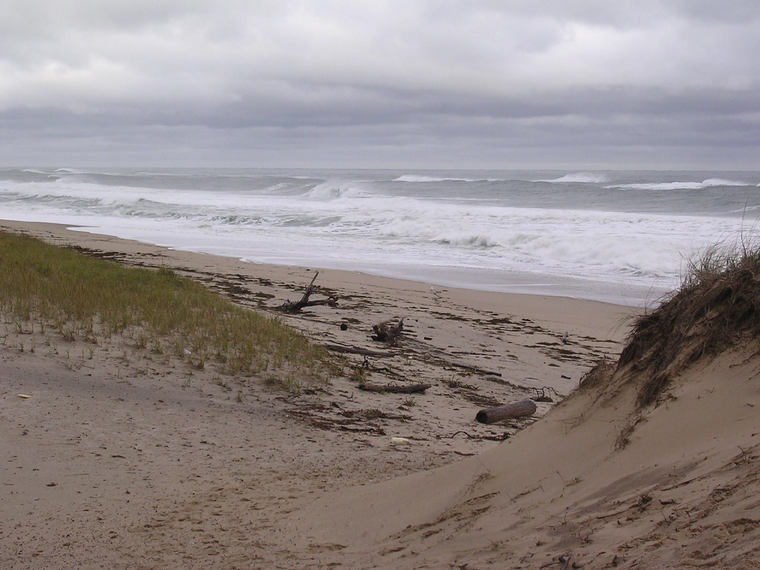
On this day, storm waves washed over the backshore and deposited debris “wrack” near the “toe” of the dunes.

Slide 21
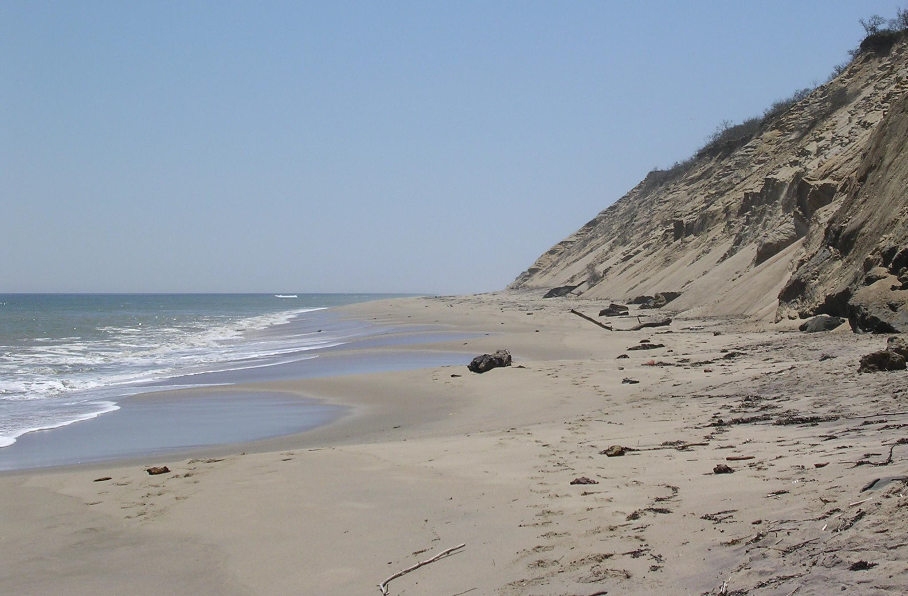
Coastal bank
Many beaches at Cape Cod National Seashore are backed by a coastal bank. Coastal banks mark the edge of glacial Cape Cod deposits. The “loose” sediments in the bank vary in size and shape and are easily eroded by wave action. The coastal bank is truly a “sand bank” ; they are the major source for Cape Cod’s beach sediment. If the banks were to be covered with a hard rock wall, then there would be no source of new sand to replace sand taken off the beach. If the park’s coastal banks were “walled”, it is estimated that our beach sand would be gone in about 100 years. Park managers depend on scientists to determine the “sand budget” - what is lost off shore and how it is replaced with sand from the coastal bank.

Slide 22
The “toe” of a coastal bank or dune is very important, it marks the place that the glacial land deposit ends and the beach begins.
“Toe”

Slide 23
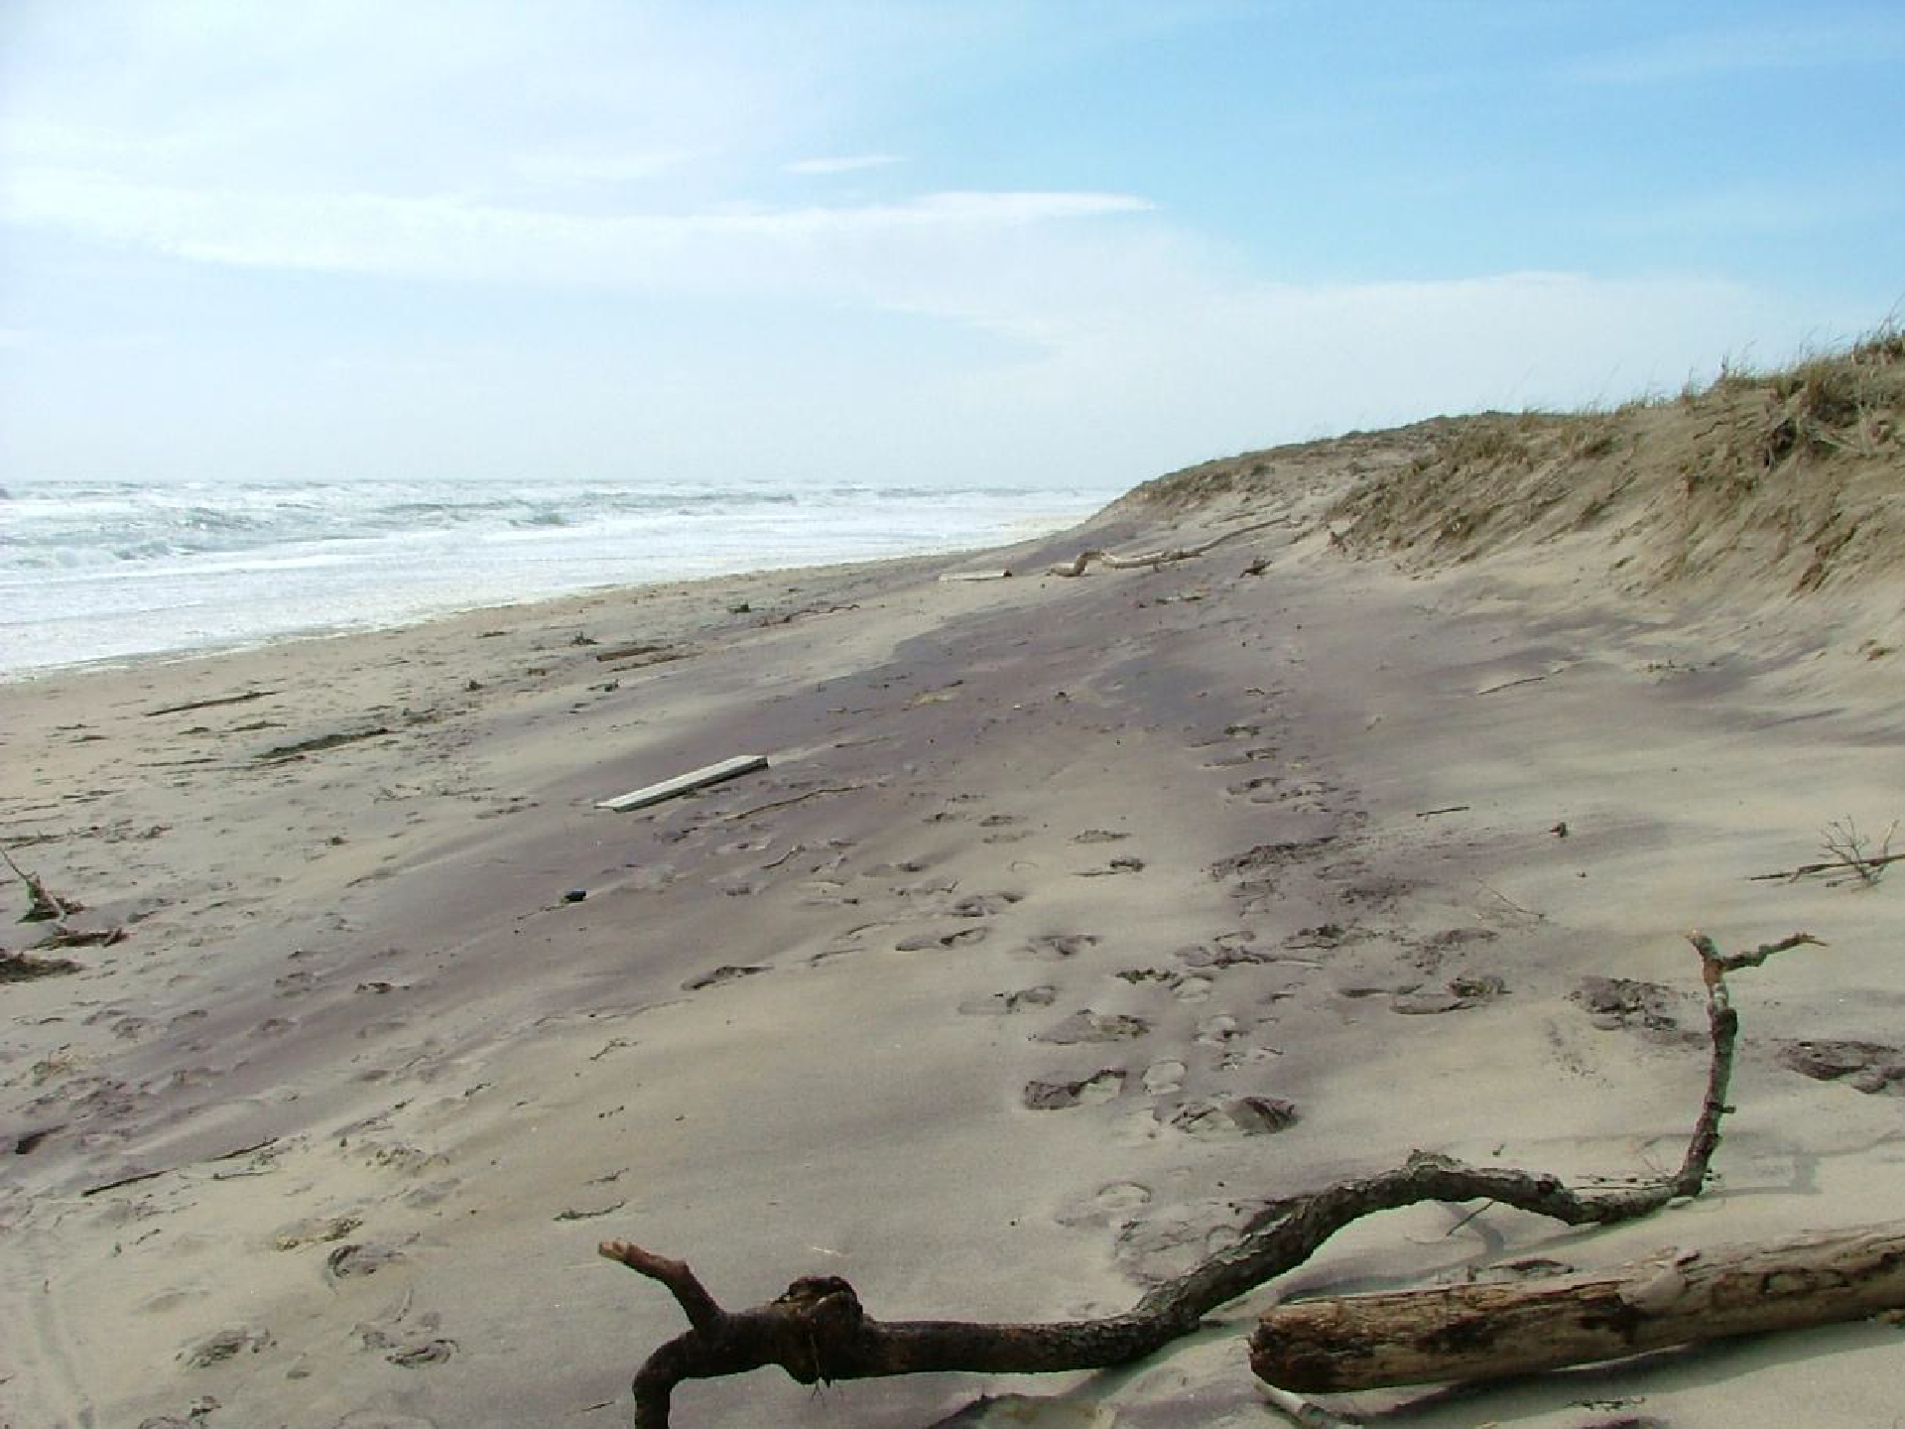
Dunes are mounds or hills of sand. They form from wind blown and water transported sand. Dunes protect the land behind them from high energy ocean waves and are a habitat for many unusual coastal species.

Slide 24
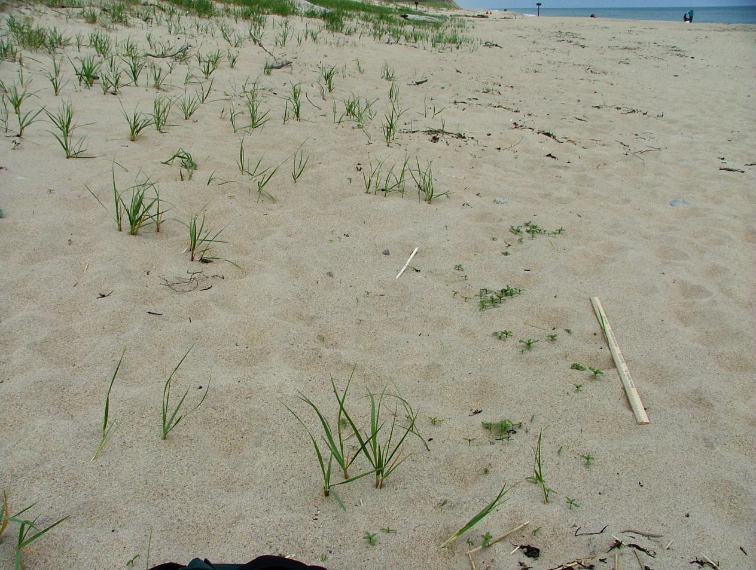
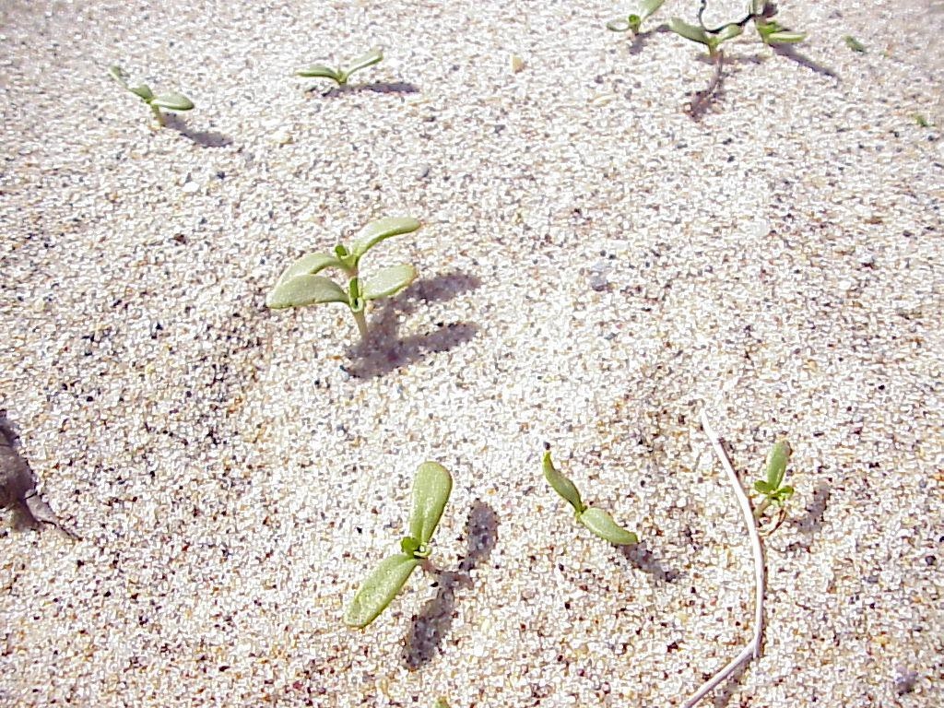
Spring sprouts of Sea Rocket- Cakile edentula, a pioneer plant of the beach/dune community.
Sea rocket is a common beach/dune plant at Cape Cod National Seashore. Sea Rocket is a “pioneer” plant, it grows closer to the ocean than other dune plants. Like a few other species, they grow from seeds mixed in with wrackline debris left at the backshore/toe of the dunes. This zone of plants is sometimes called the dune strandline.

Slide 25
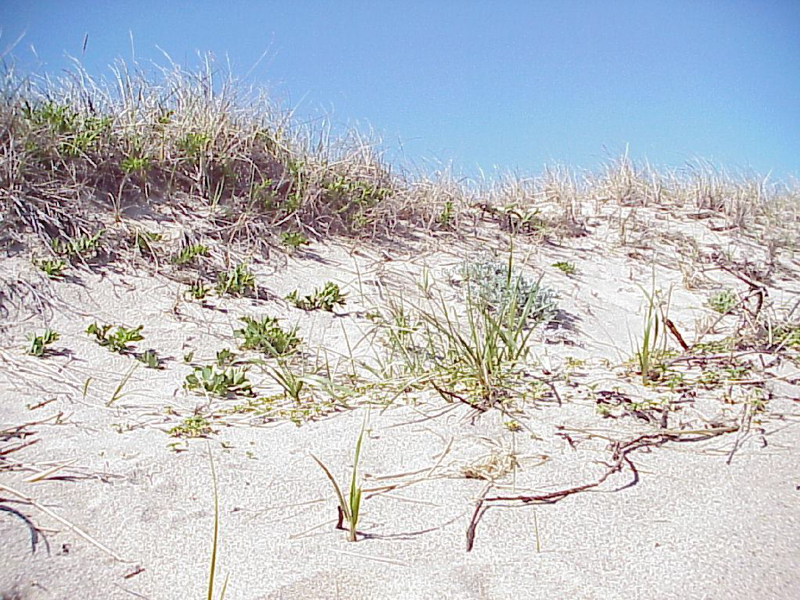
The dune strandline and dune plants build and stabilize the dunes. No plants? Probably no dunes. Why?
How are Cape Cod dunes like a desert and how are they different?
Discuss adaptation features of dune plants to heat, drought, wind, salt spray and being buried by sand.

Slide 26
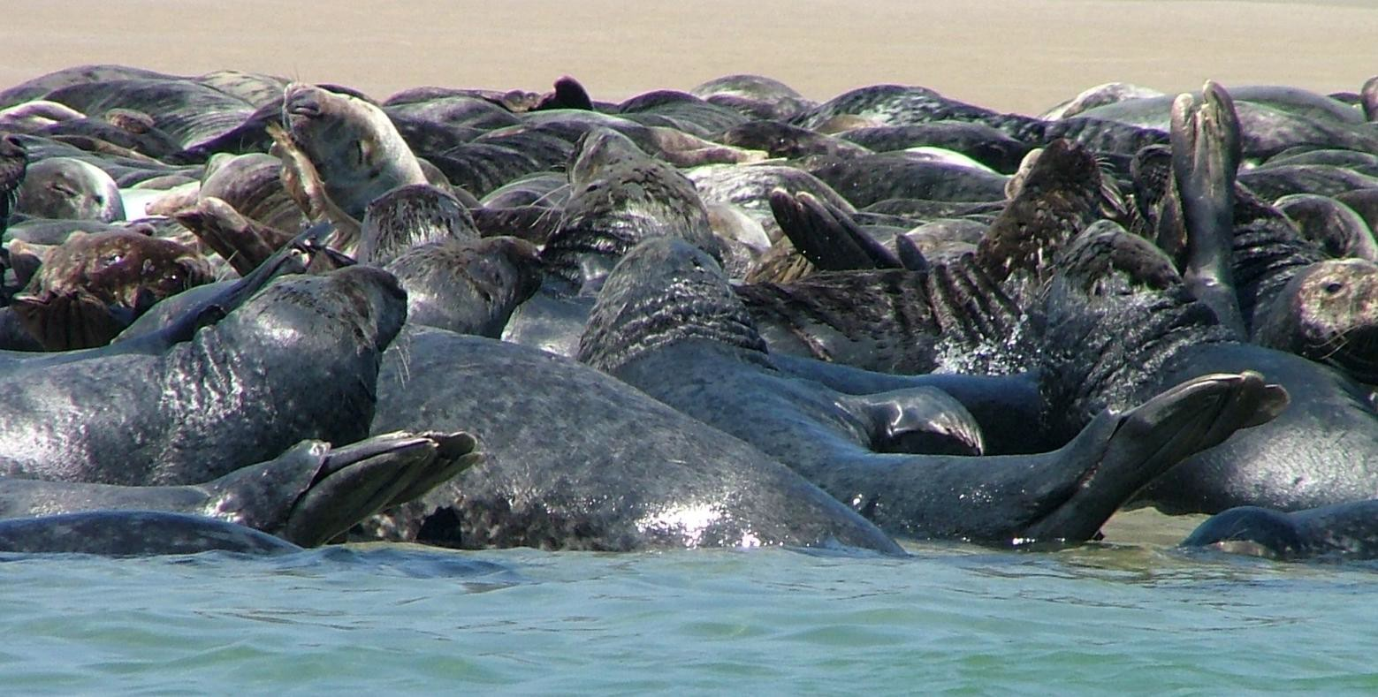
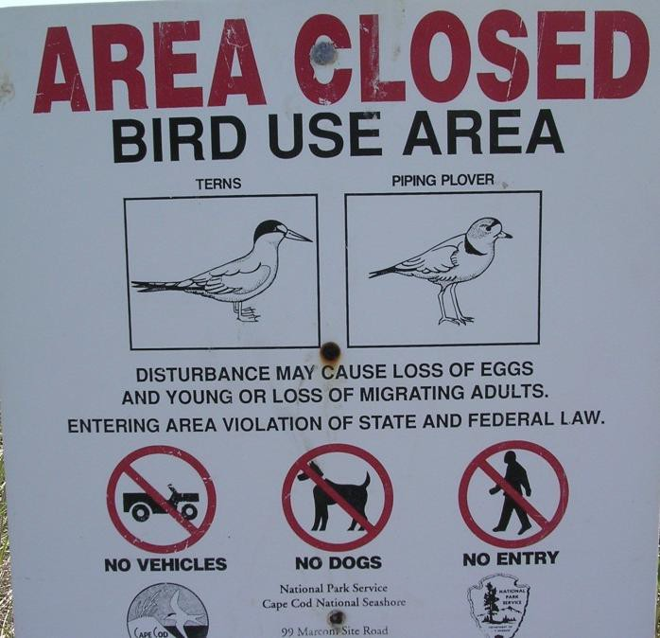
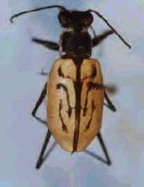
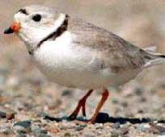
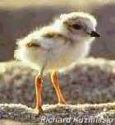
Animals use all parts of the beach/dunes. From largest to smallest they have adapted to beach/dune conditions and find food, shelter and a place to raise their young. Some animals are so small they live between the grains of sand! Some are threatened with extinction and need special protection. Name the zones each are found in, (can be more than one zone!)
Above- gray seals. Protected
Left - Northeast Beach Tiger Beetle. Endangered
Right –Piping plovers, adult/chick Threatened

Slide 27
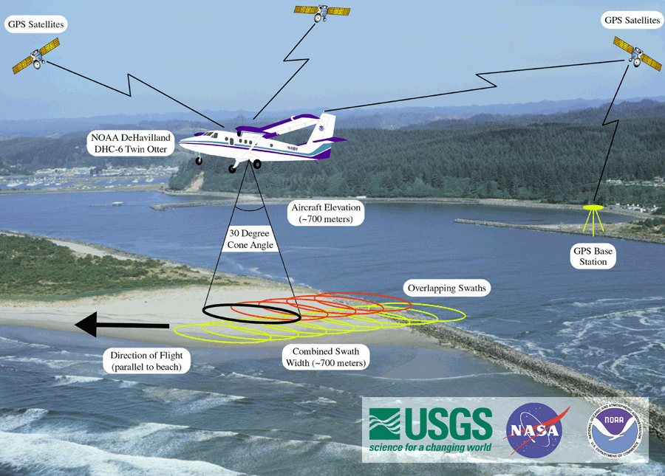
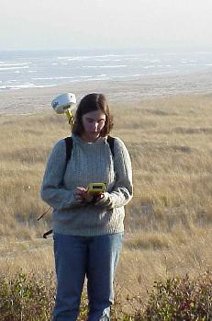
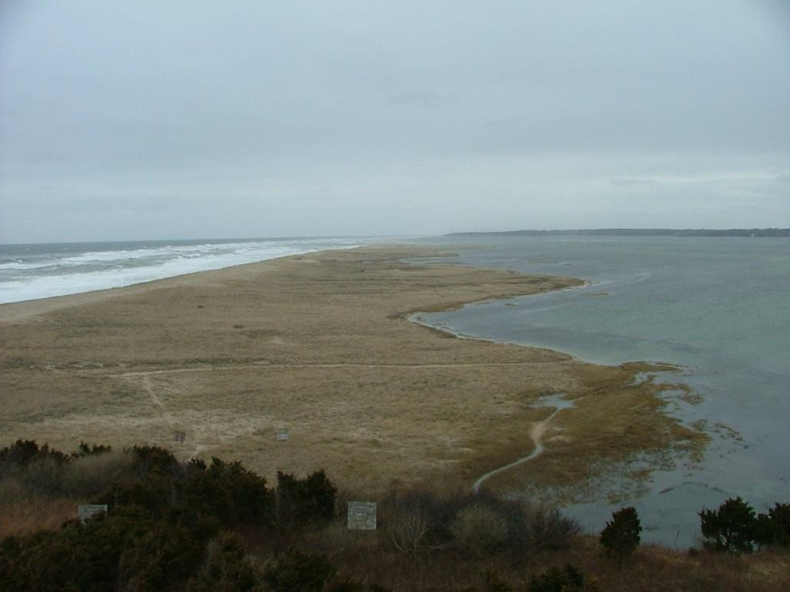
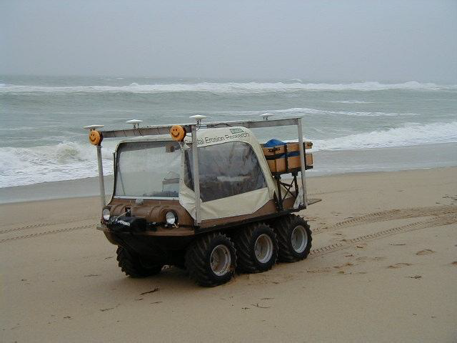
Researchers actively inventory and monitor the beach ecosystem to determine its health and to measure changes; they use many tools and methods. Shoreline change due to sea level rise is of special concern to scientists, park managers and citizens.

Slide 28
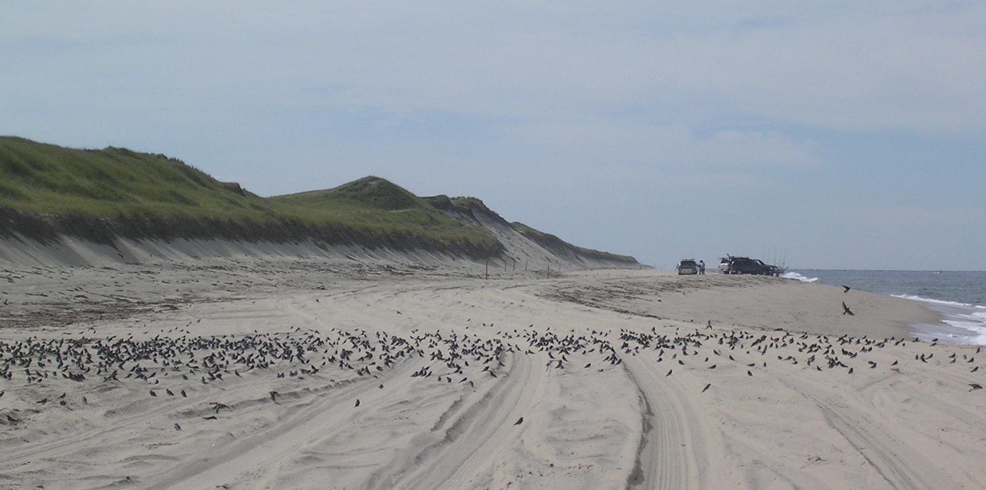
People need to understand ecosystems, the interactions between the living
and the non-living elements, to protect it for the present and future . Beaches and dunes are important because they protect the land behind them from storm waves, provide a place for plants and animals to live, and a special place for people to enjoy for both recreation and just to watch a sunset or sunrise. Beaches are always changing.

Slide 29
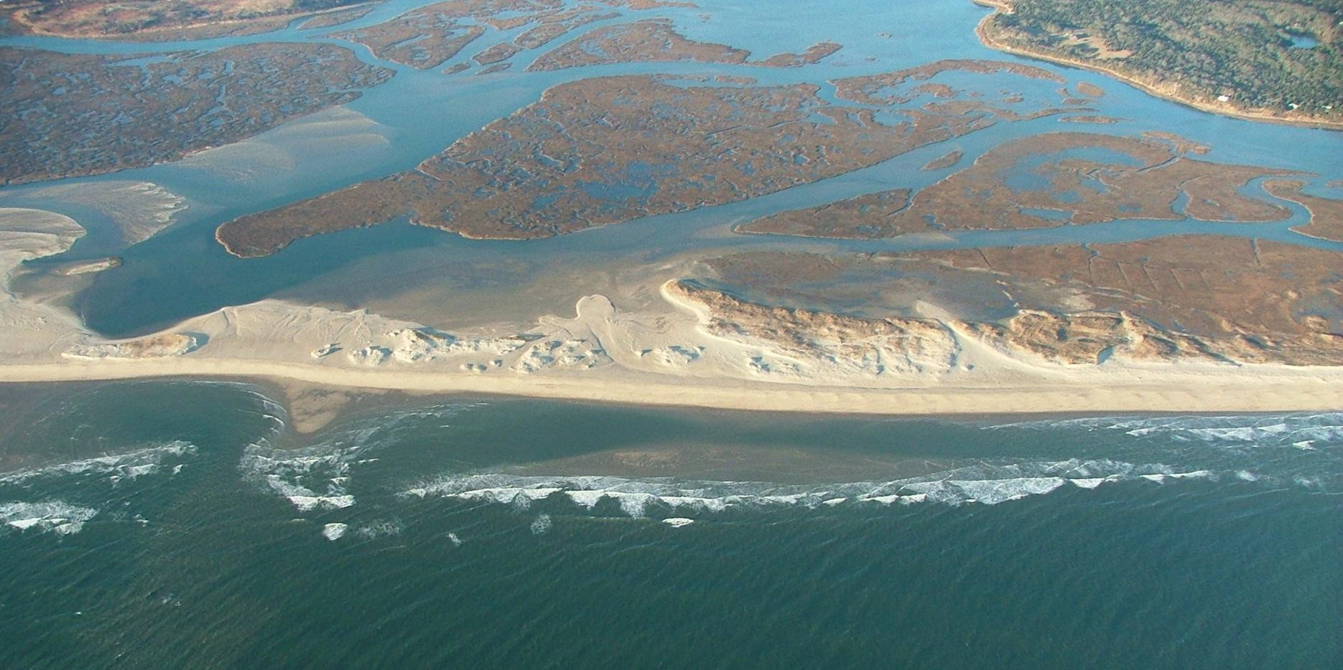
Coast Guard Beach spit in Eastham, a barrier beach
Quiz:
What is a barrier beach or spit? How did it form?
Locate these features: sand bar, runnel, foreshore, berm, berm crest, overwash, dune, dune grassland, salt marsh grass, upland. How many beach zones can you identify in this picture? Predict how sea level rise could change this beach and dune system.

Slide 30
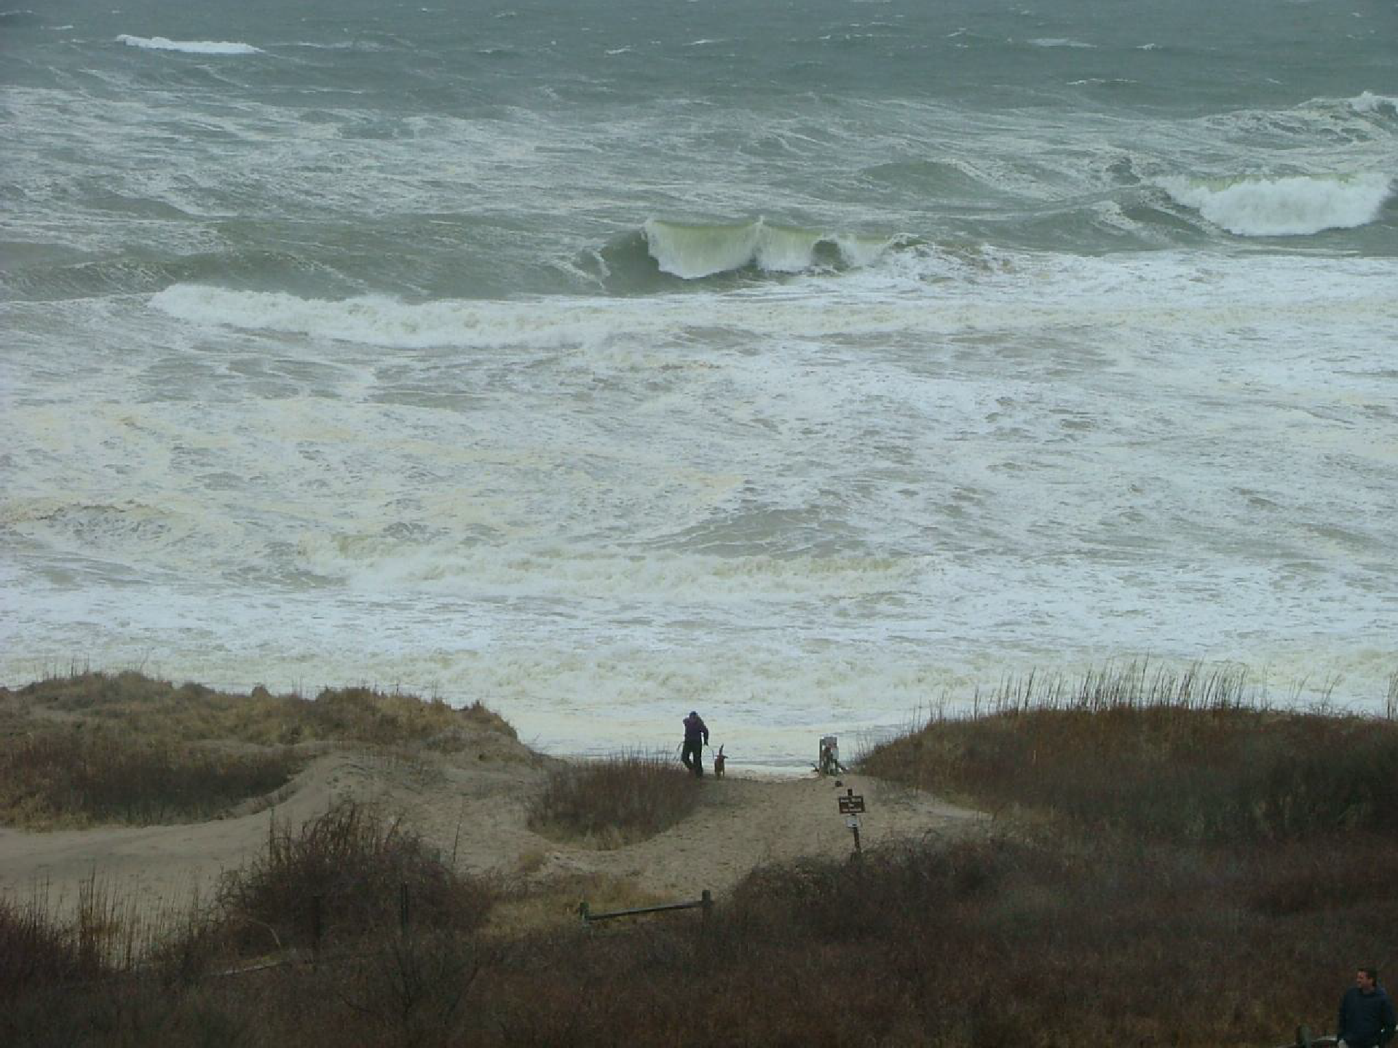
Thank you for learning about beaches and dunes. Help preserve our beaches and dunes for people, plants and wildlife.

