Slide 1
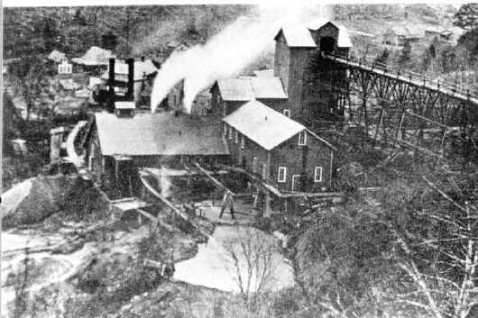
Rush, The Ghost Town

Slide 2
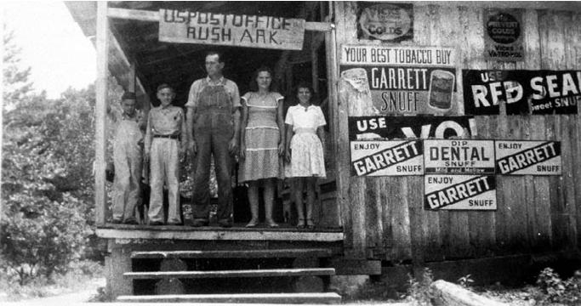
The Taylor-Medley store was a center of the community. Residents bought goods, picked up mail and got married at the store. It operated until the 1950s.
The remains of the store at Rush today have been stabilized, but entry is prohibited as the ruins can still be dangerous.

Slide 3
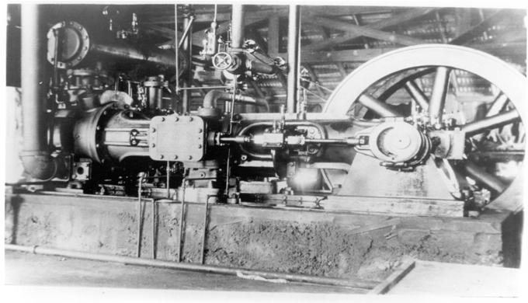
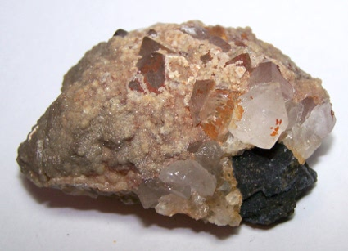
Looked for silver, but found zinc
Zinc ore processing mill machinery
Silver smelter
Zinc ore

Slide 4
Old zinc mines provide habitat for bats but are dangerous for people to explore. The Rush mines have been gated to allow bats free access and keep people out and safe.

Slide 5
Enjoy the Rush town loop trail.

