Slide 1
Boxley Grist Mill

Slide 2
Boxley Mill is in the Lost Valley area of the park.

Slide 3
The Mill is a short walk from the highway. Parking is limited. Do not block gates into fields.

Slide 4
What is a grist mill and why did Boxley need one?
Construction of the mill began in 1869 and it was open for business in 1870. Water turned a wooden wheel in the early years to power the mill. Later the water powered a turbine.

Slide 5
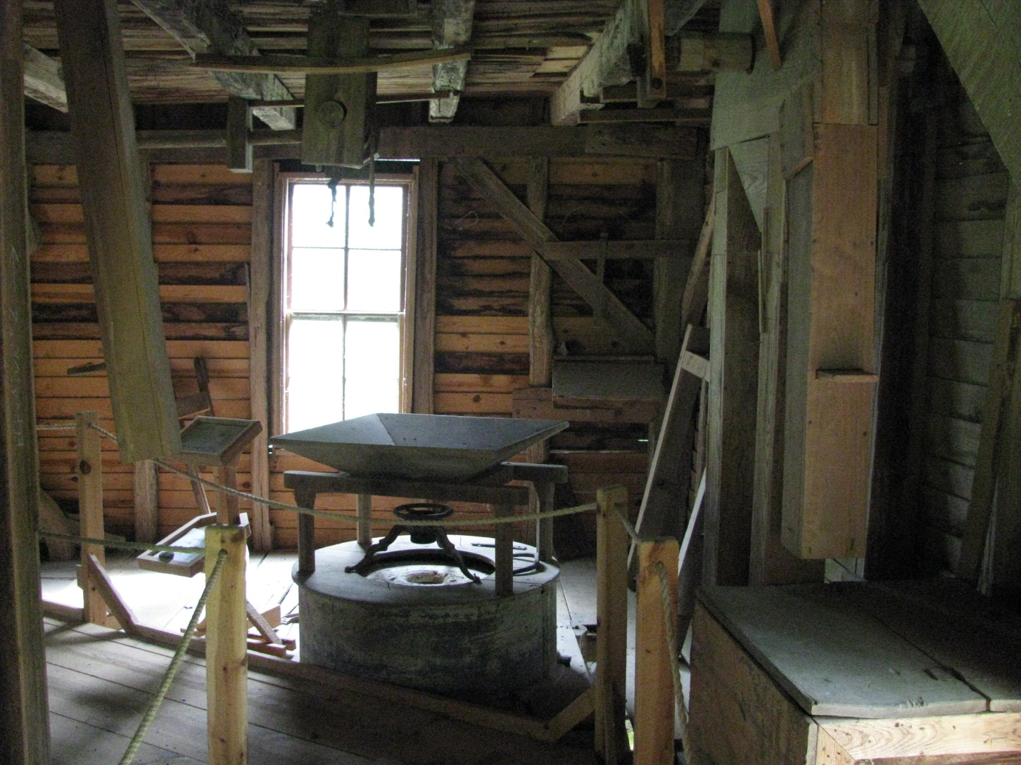
When you visit Boxley Mill, you will participate in activities inside the mill to determine how the mechanisms worked. Activities outside the mill will provide some history of the mill and Boxley Valley.

Slide 6
Boxley Valley was prime bottomland. Settlers farmed and raised families here for many years. Today Boxley fields are grass which is cut for hay
and grazed by cattle …

Slide 7
and Elk.

Slide 8
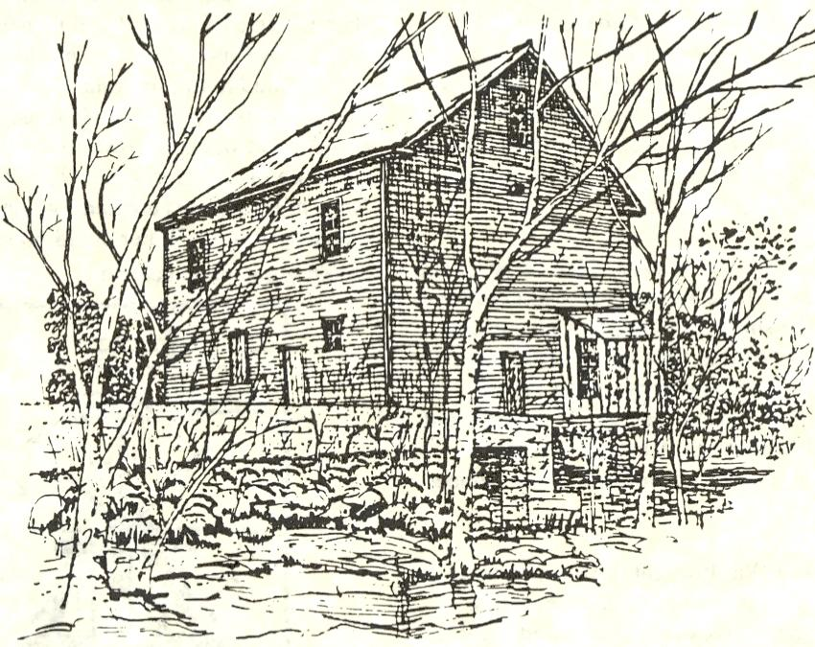
The mill pond held water from a spring so that the mill would have a power supply when it was needed. The water flowed to the mill in a wooden raceway to turn a large wooden wheel that powered the machinery inside the mill.
Drawing from Gorgas Foundation publication.

Slide 9
Today, the mill pond serves a variety of wildlife, including trumpeter swans.

Slide 10
Grist mills served entire communities so they were a meeting place. At the mill you gathered your finished product (from corn to cornmeal) and the latest news from your friends and neighbors.
Do you have a place like this today in your community?
Mill shuts down in when raceway falls in. Boxley Grist Mill was a working mill until the 1950’s. The raceway, damaged by flooding, collapses ending the working life of the mill.

Slide 11
Boxley Grist Mill

