Slide 1
At the Water’s Edge
Enjoy a close look at Buffalo River and its inhabitants.
(This program is available at all locations.)

Slide 2
Program locations at Buffalo National River

Slide 3
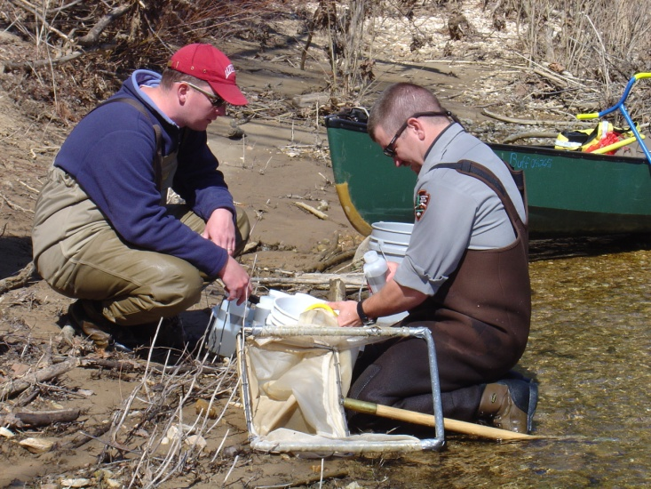
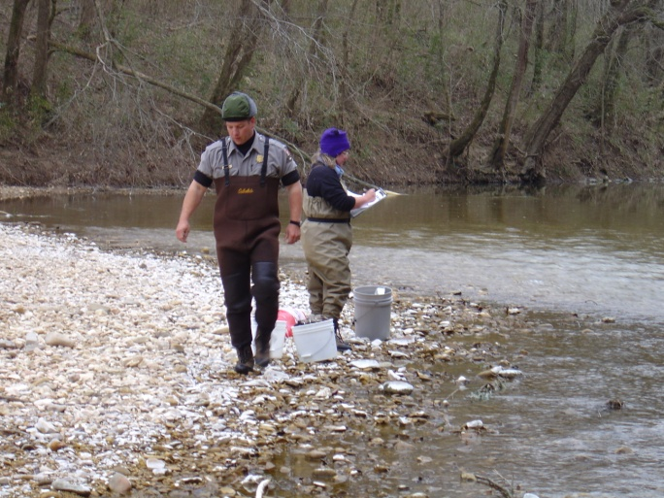
You will get wet!
We will examine the river, its habitat, and inhabitants using techniques similar to that used by our researchers.

Slide 4
IMPORTANT!
Remember this activity takes place in the river.
We will have safety precautions in place as needed and safety reminders during the program.
This is intended to be wading only. However, some students have “accidently, on purpose” gone swimming. Be prepared with dry clothes.
All participants should wear shoes and clothes that can get wet. No one will go into the river barefoot.

Slide 5
Buffalo National River encompasses the green area on the map below. The pale blue is the watershed of the river. What is a watershed? What happens in the watershed that affects the river?

Slide 6
Since we’re talking about water, let’s review the water cycle.
Precipitation
Evaporation
Transpiration
Run off
Ground water

Slide 7
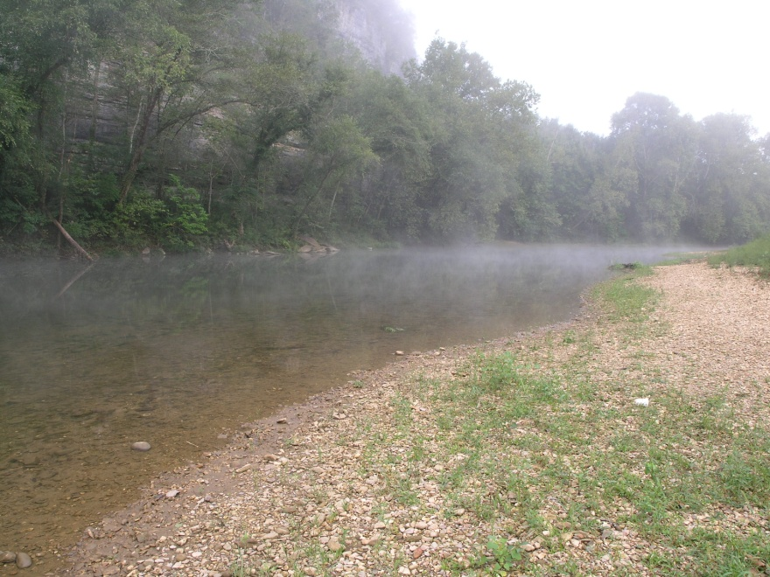
We will discuss the watershed, review food chains for the river, organize teams and equipment, and go over procedures.
Then it’s into the water!

Slide 8
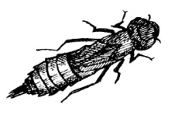
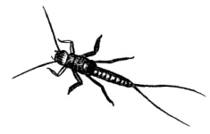
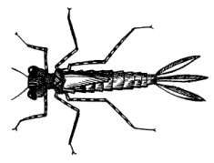
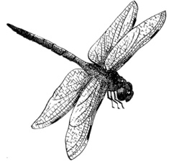
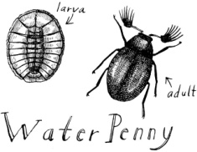
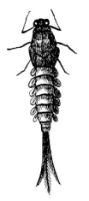
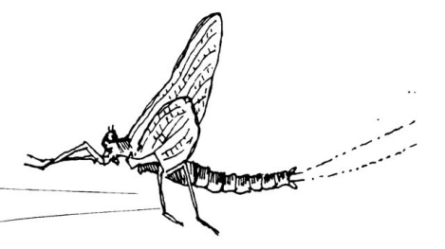
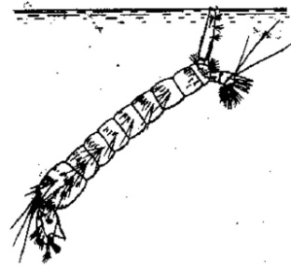
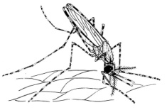
What are we looking for? What in the world is a macroinvertebrate?
Drawings not to scale
nymph
nymph
nymph
Caddisfly adult
Dragonfly
Stonefly
Damselfly
adult
Caddisfly larva
adult
adult
nymph
Mayfly
larva
adult
adult
Mosquito

Slide 9
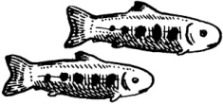
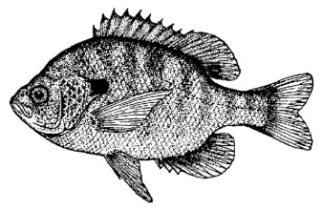
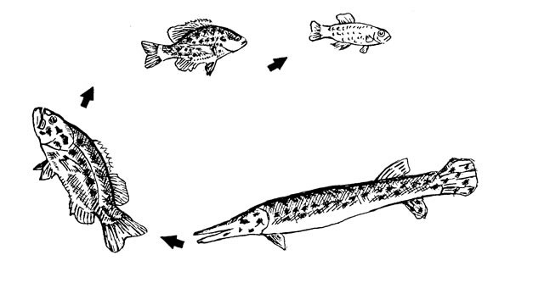
We’ll also look for a variety of fish species.
This is a food chain for fish. What does the littlest fish eat?

Slide 10
Try creating a food web with the fish and macroinvertebrates. What might the macroinvertebrates eat? We’ll explore all these questions and more when you come to the river for “At the Water’s Edge”.

