Slide 1
Collier Homestead Tour

Slide 2
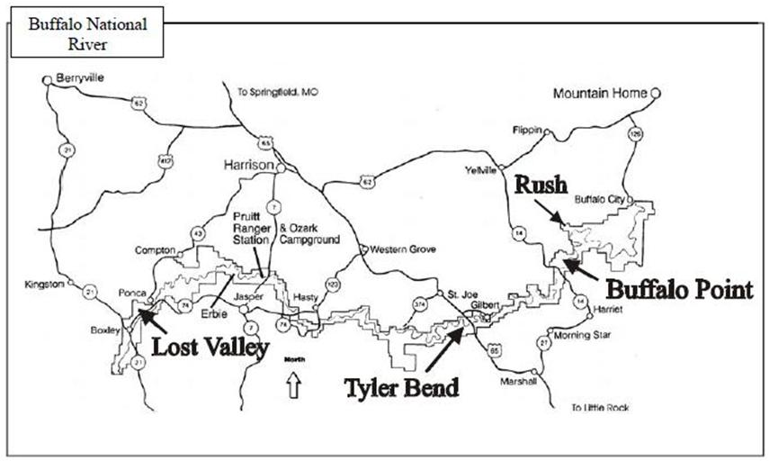
Program locations at Buffalo National River

Slide 3
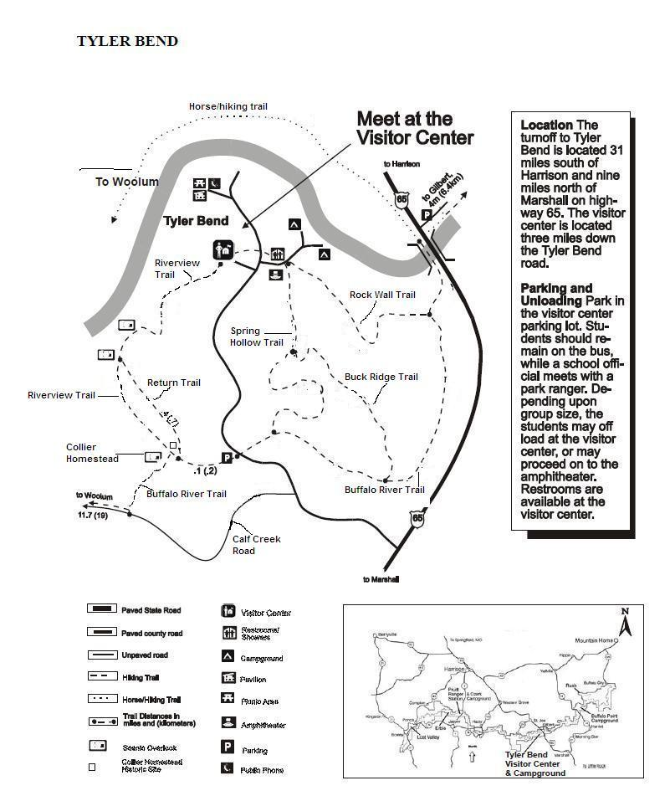
Collier Homestead
Program location map

Slide 4
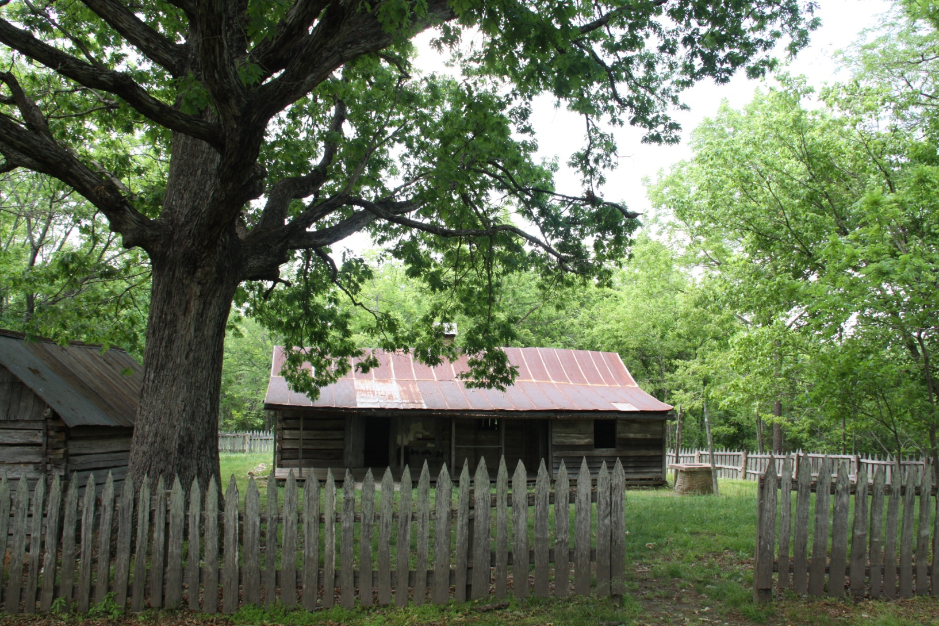
What would it be like to live here?

Slide 5
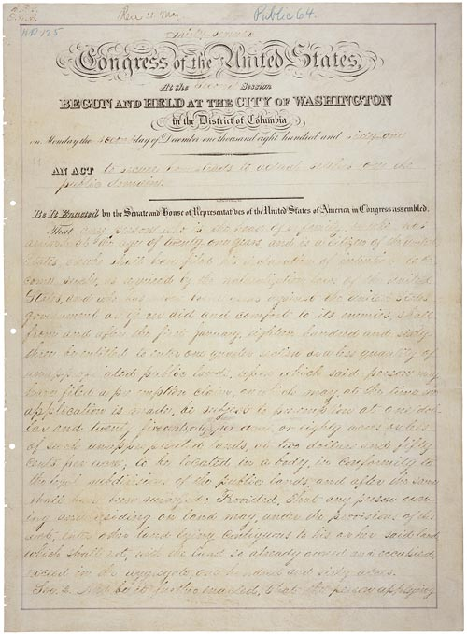
Homestead Act of 1862

Slide 6
The Homestead Act provided the means for people to claim unsettled land for little or no cash money. The claimant was required to settle or cultivate the land. After 5 years, the claimant would own the land outright.
Text from the Homestead Act of 1862
…“the person applying for the benefit of this act shall, …make affidavit before the said register or receiver that he or she is the head of a family, or is twenty-one years or more of age, or shall have performed service in the army or navy of the United States, and that he has never borne arms against the Government of the United States or given aid and comfort to its enemies, and that such application is made for his or her exclusive use and benefit, and that said entry is made for the purpose of actual settlement and cultivation, …
…That no certificate shall be given or patent issued therefor until the expiration of five years from the date of such entry ; and if, at the expiration of such time, or at any time within two years thereafter, the person making such entry …
shall. prove by two credible witnesses that he, she, or they have resided upon or cultivated the same for the term of five years immediately succeeding the time of filing the affidavit …”

Slide 7
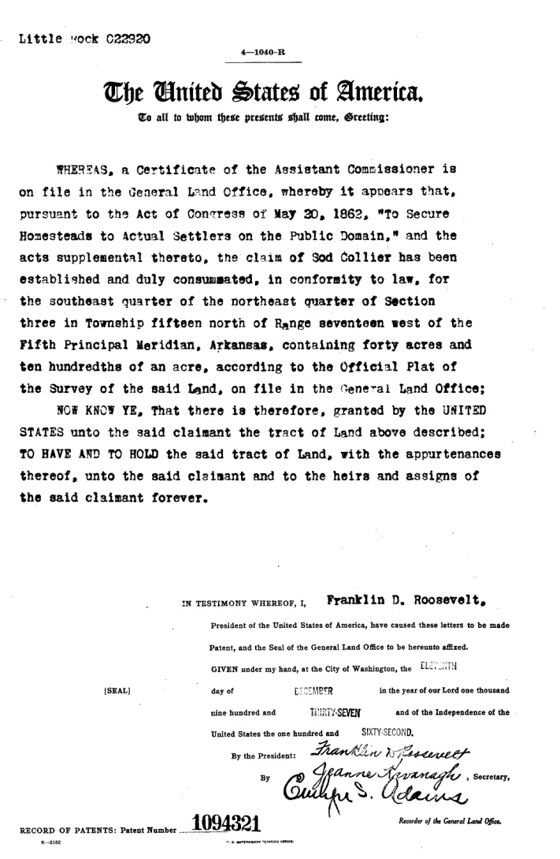
This patent certified that “the claim of Sod Collier has been established and duly consummated” and dated December 11, 1937.

Slide 8
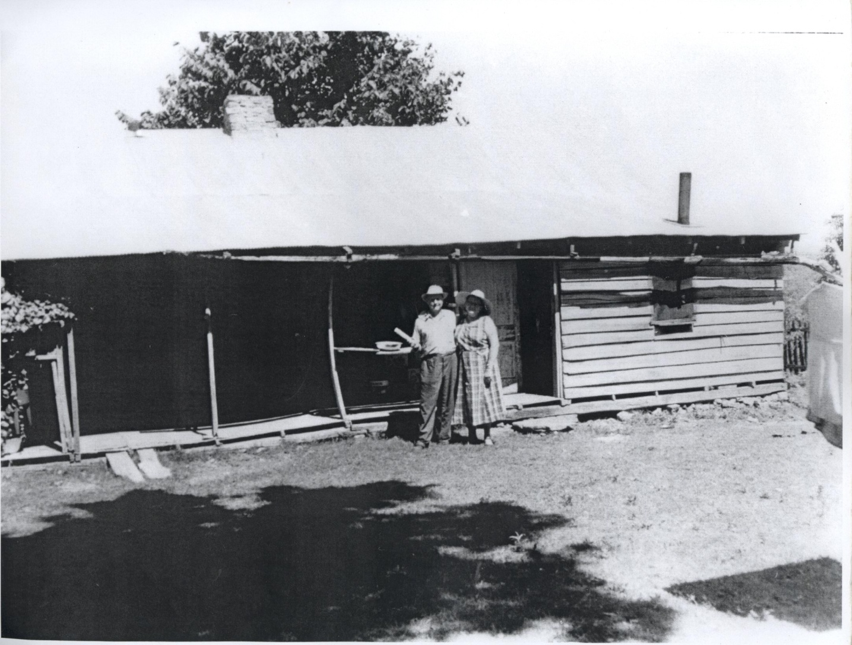
Sod and Ida Mae Collier at their homestead.

Slide 9
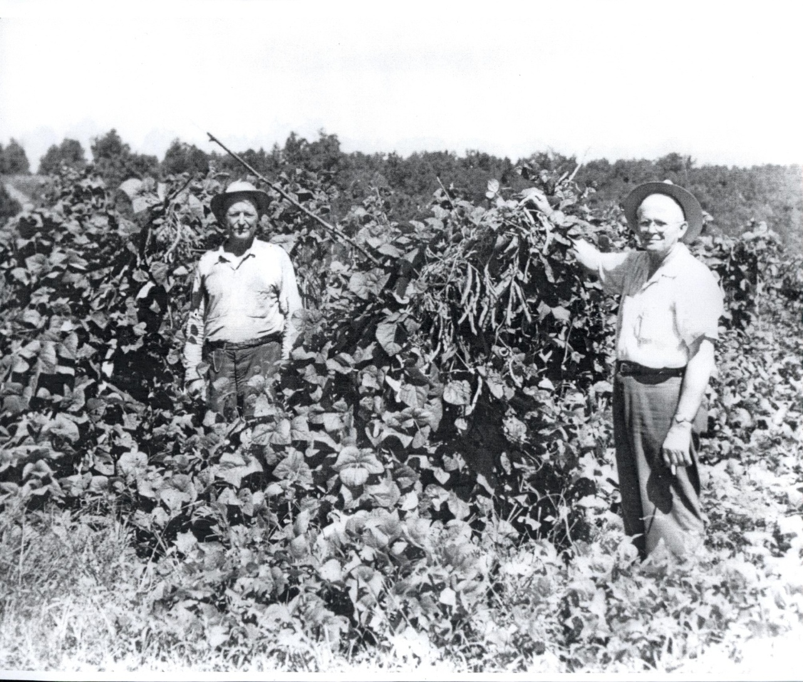
Early settlers were able to homestead the rich farmland down near the river. Later arrivals, like the Collier family were left with the poorer ground along the ridges. The thin soil and dryer conditions made farming difficult. Sod and his brother William did manage to produce good bean crops.

Slide 10
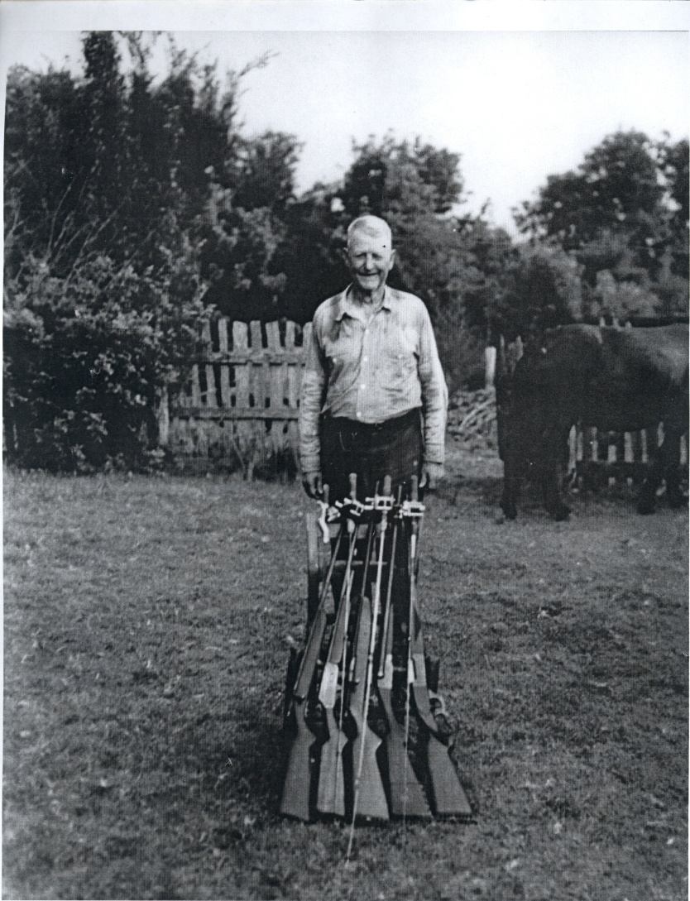
Sod was an expert shot and often guided others for hunting and fishing trips to supplement his farming income.

Slide 11
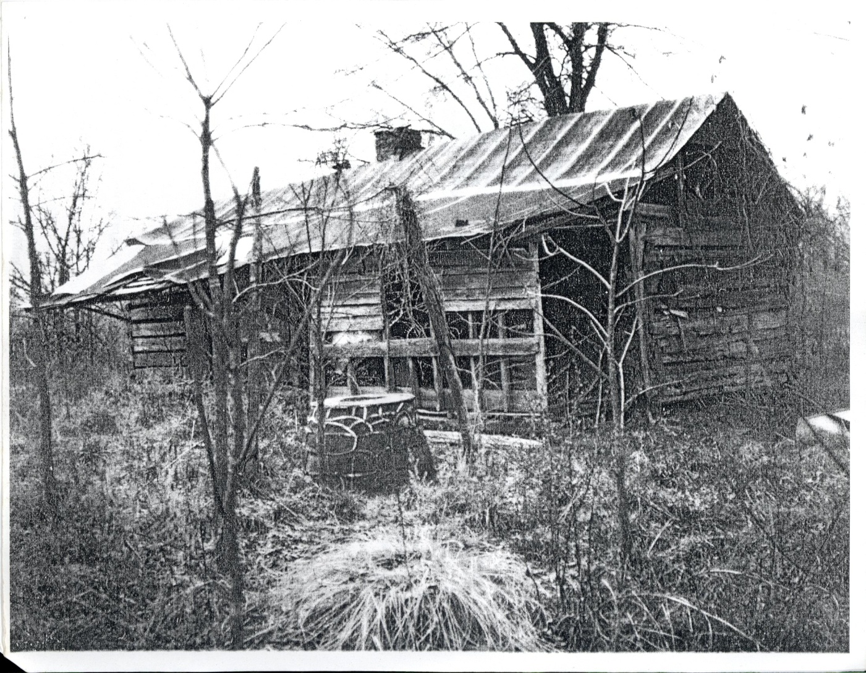
The Colliers lived on their homestead until the early 1960s. By the time the area became part of the park, the homestead was being reclaimed by the forest.

Slide 12
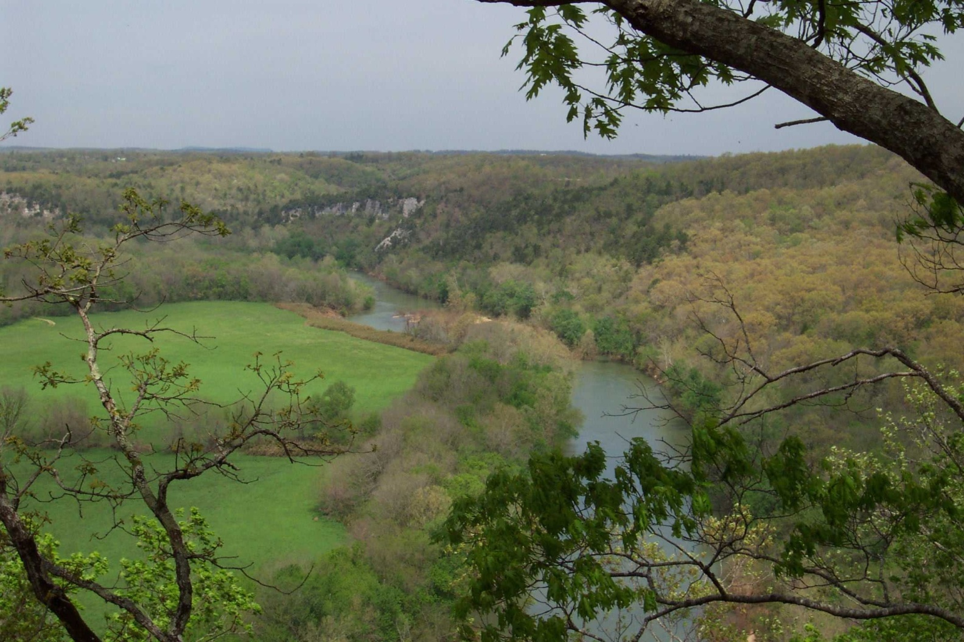
A short hike beyond the homestead provides a better understanding of the ridgetop land and forests. We’ll also get a view of the river and some bottomland fields.

