Slide 2
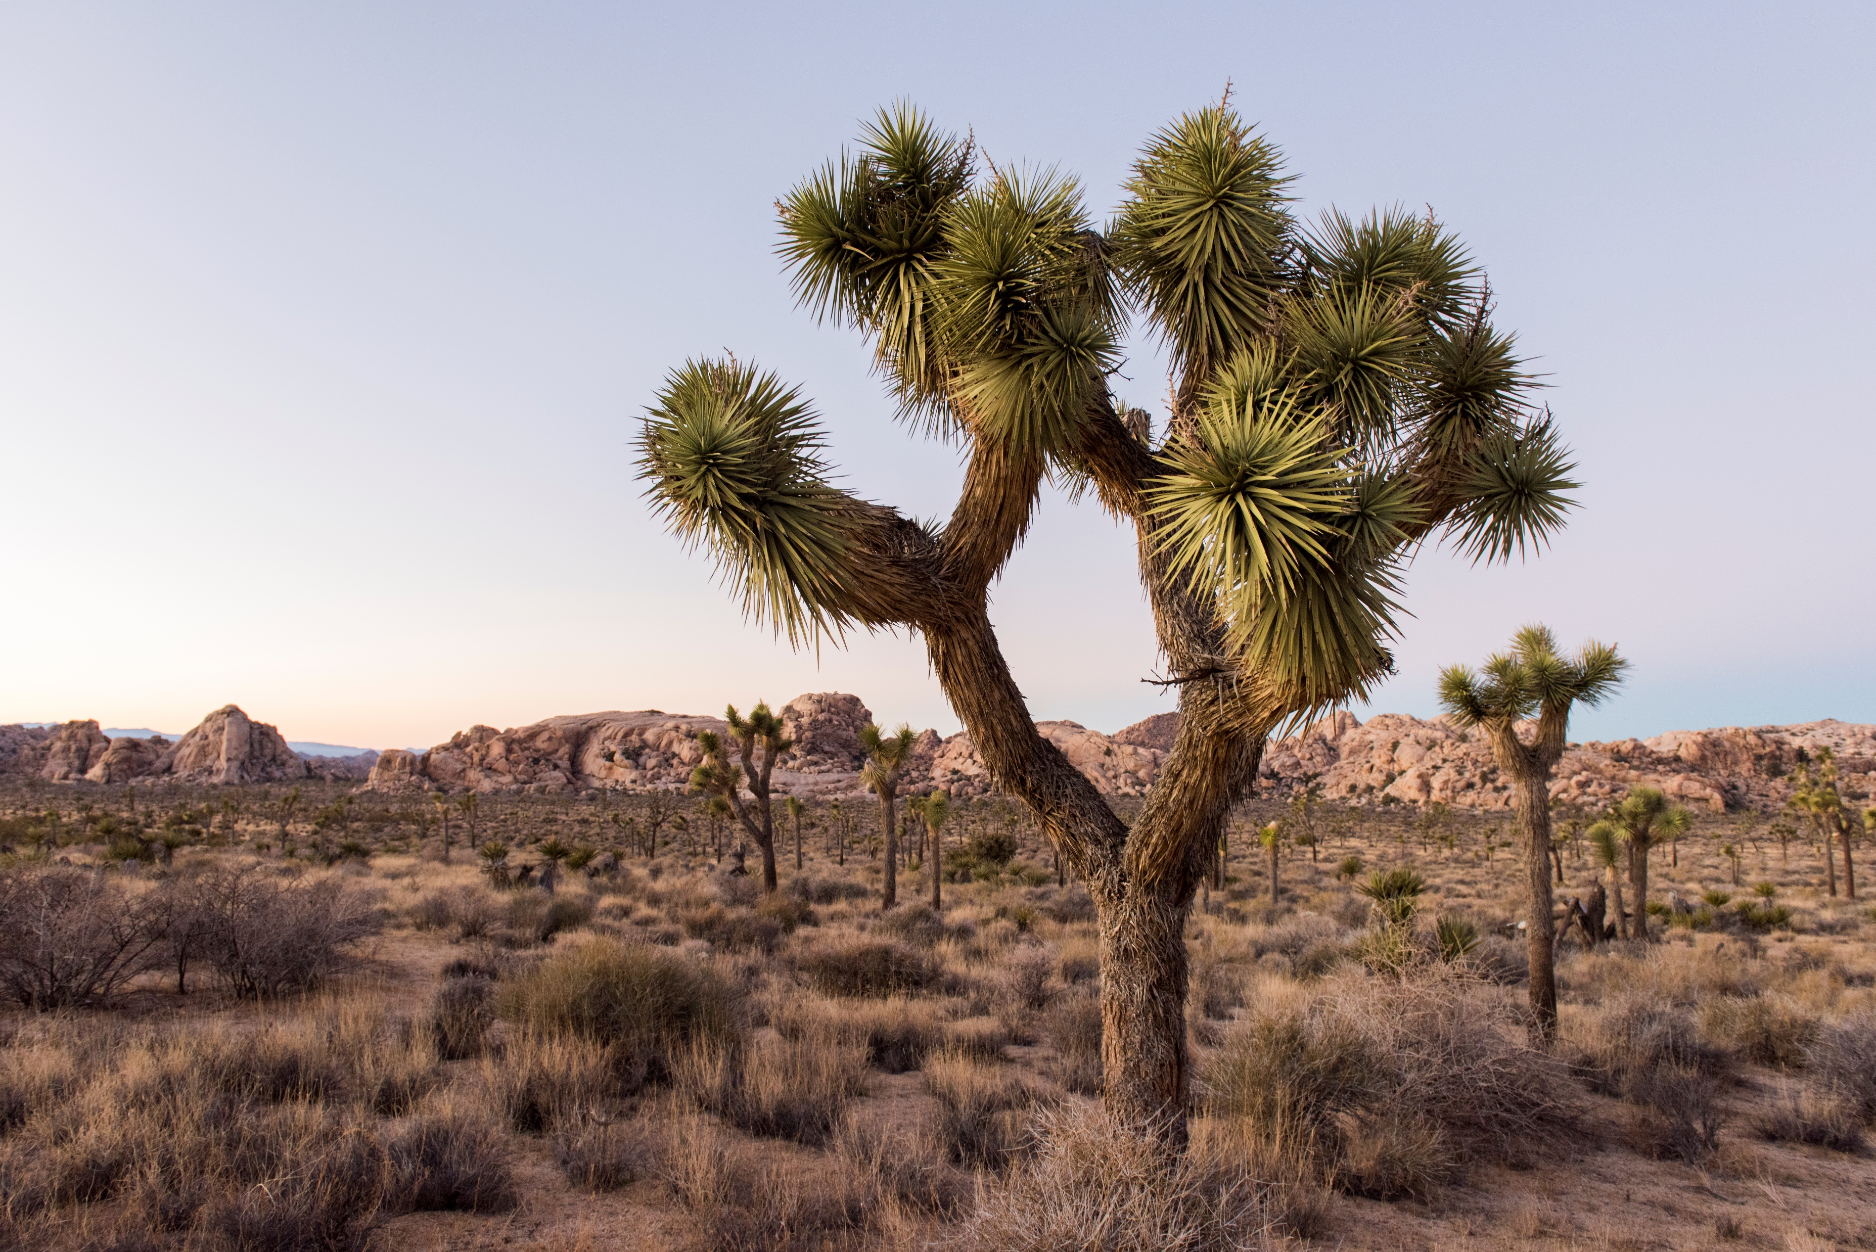
Joshua tree

Slide 3
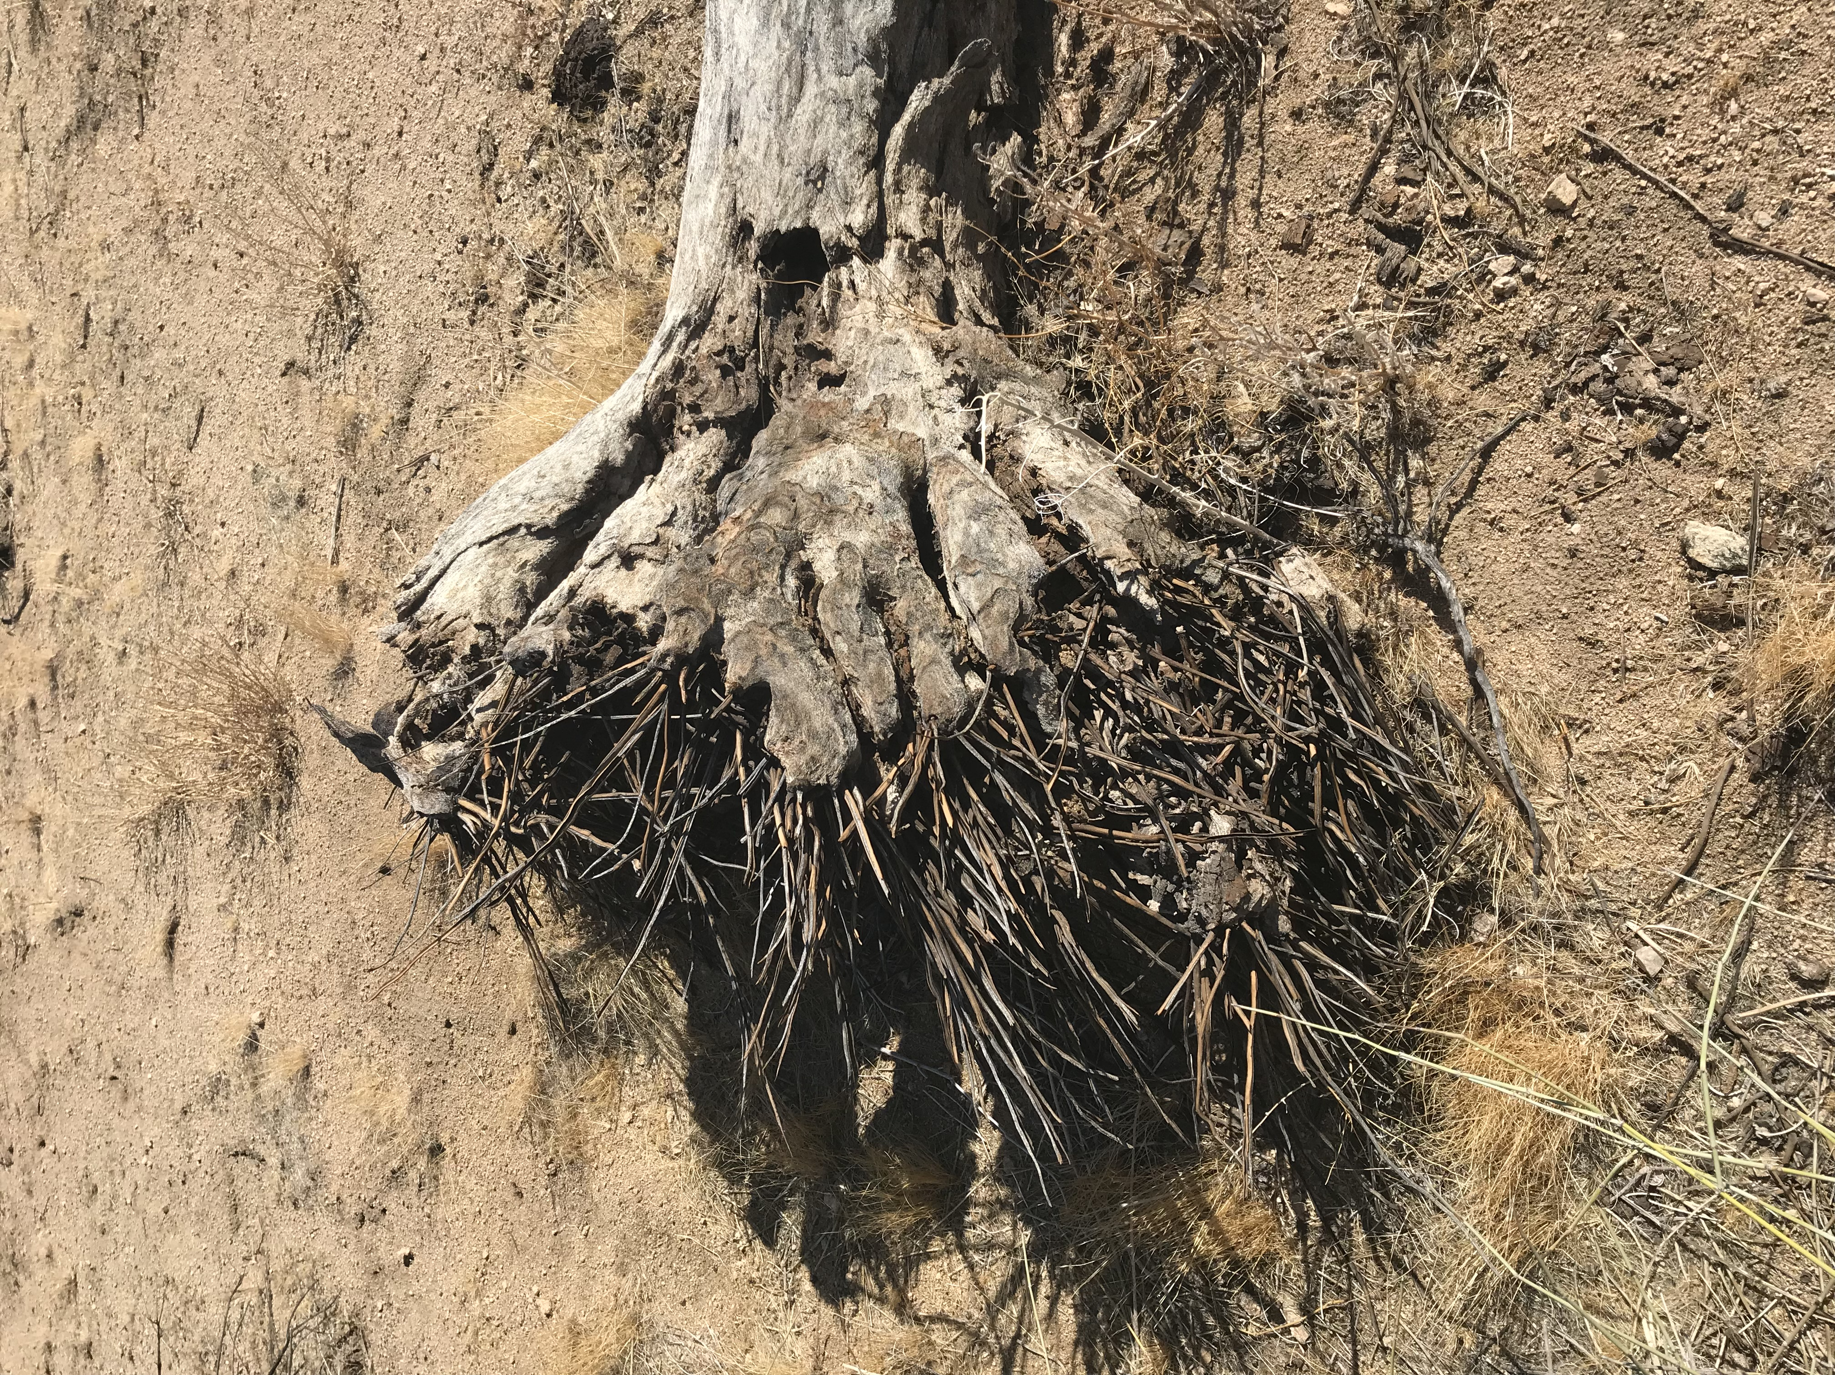
roots

Slide 4
Joshua tree flowers

Slide 5
Mojave yucca

Slide 6
jackrabbit

Slide 7
desert tortoise

Slide 8
quail

Slide 9
rattlesnake

Slide 10
Granite boulder mountains

Slide 11
Oasis of Mara with metamorphic
mountains in the background

