Slide 1
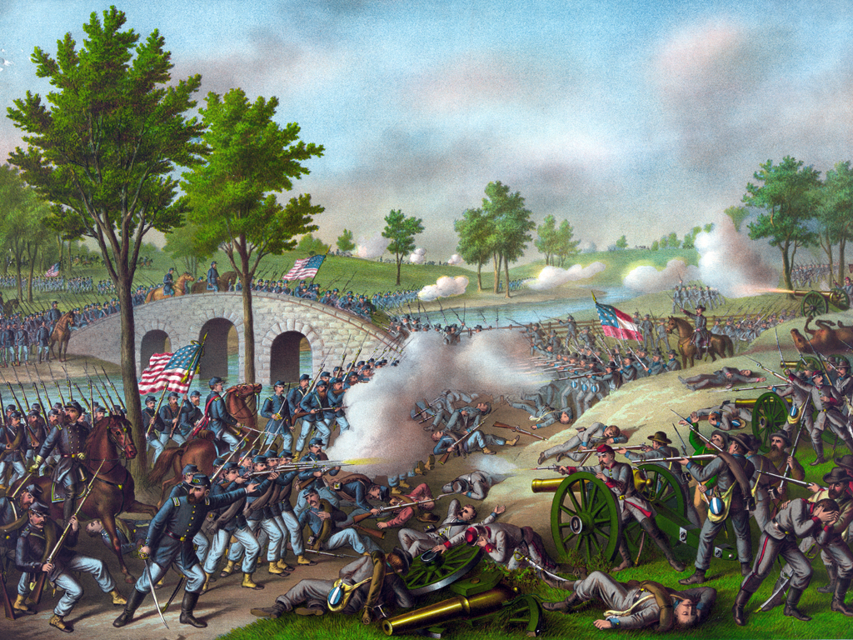
The Battle of Antietam September 17, 1862

Slide 2
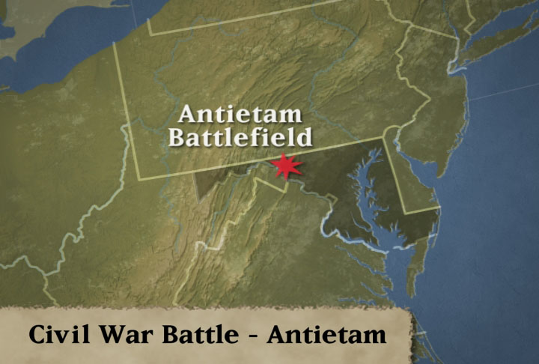

Slide 3
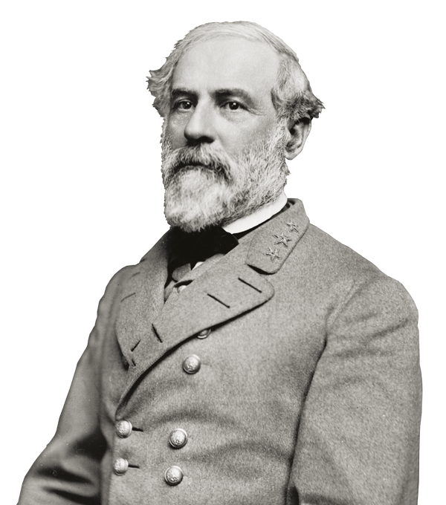
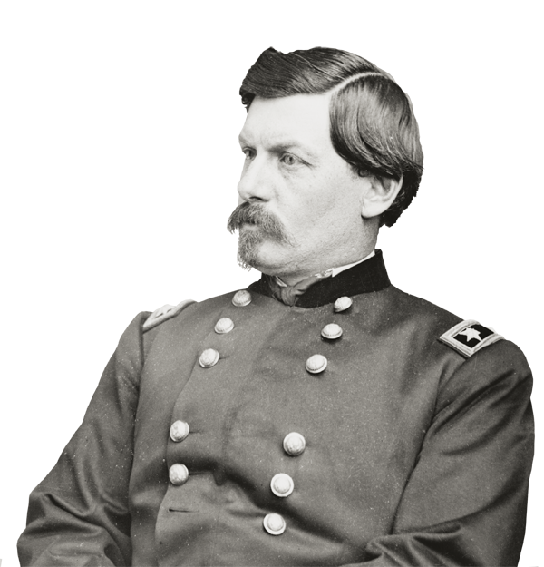
The Two Commanders
Robert E. Lee (CSA)
George B. McClellan (USA)

Slide 4
General Robert E. Lee’s reasons for invading Maryland
To gather supplies and troops from the slave-holding border state of Maryland.
To give the farmers in Virginia time to bring in their crops for the winter.
To get military or political support from France and Great Britain.
To damage Northern morale before the November elections.
To bring the war north and threaten Washington, DC and other Northern cities.
Defeat the Union army once and for all.

Slide 5
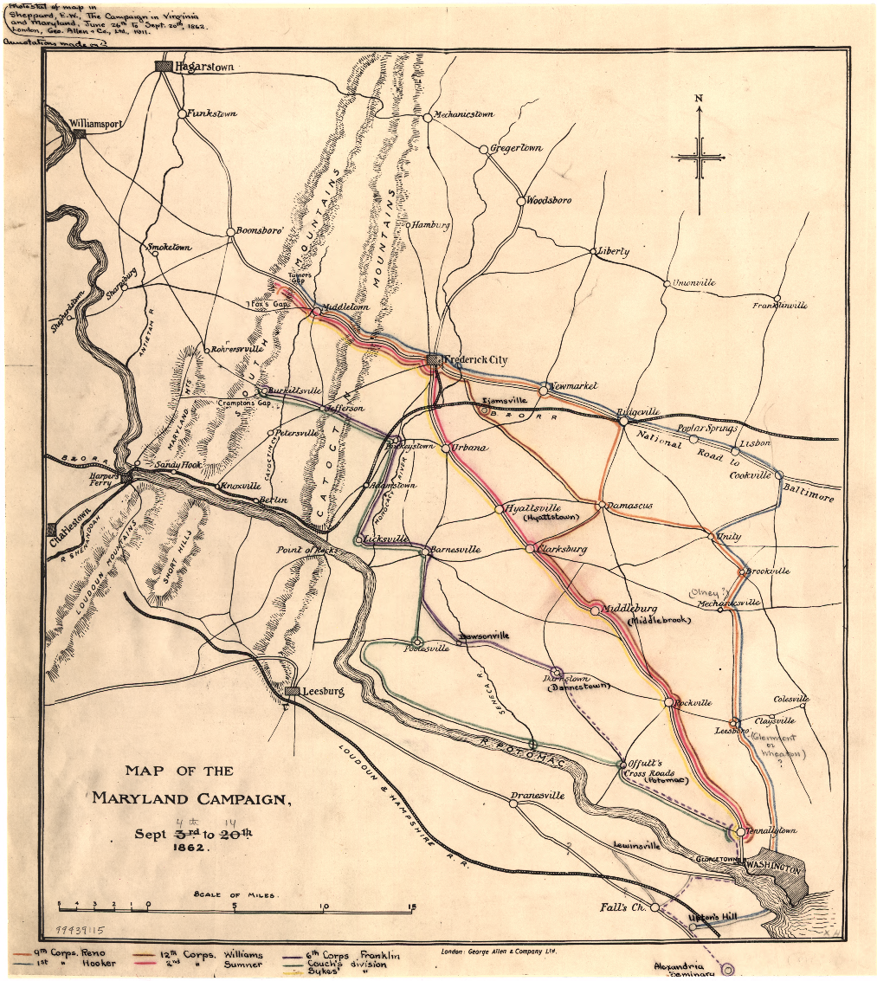

Slide 6
Battle Map

Slide 7
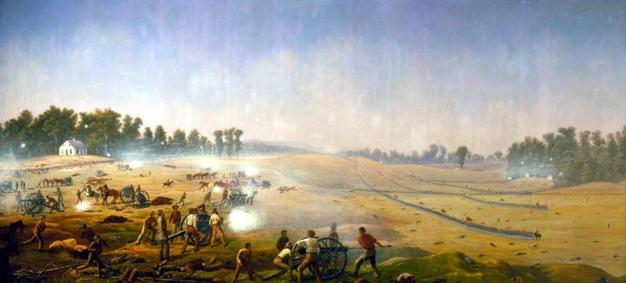
Death in the Cornfield
The Cornfield and Dunker Church area saw some of U.S. History’s most horrific fighting. For nearly three hours Union and Confederate forces battled each other and were cut to pieces.

Slide 8
Clara Barton brought medical supplies and helped the Union Doctors.
Clara Barton Monument at Antietam

Slide 9
Clara Barton at Antietam
"A ball has passed between my body and the right arm which supported him, cutting through his chest from shoulder to shoulder. There was no more to be done for him and I left him to his rest. I have never mended that hole in my sleeve. I wonder if a soldier ever does mend a bullet hole in his coat?" Clara Barton at Antietam

Slide 10
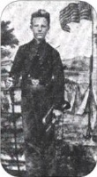
John Cook
He earned the Medal of Honor during the Battle while serving with Battery B, 4th United States Artillery. The medal was issued on June 30, 1894. "He had volunteered at the age of 15 to act as a cannoneer and as such served a gun under terrific fire of the enemy".

Slide 11
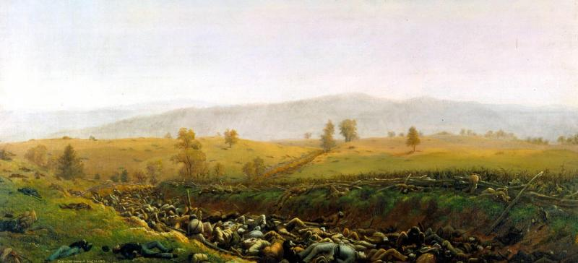
Bloody Lane
Outnumbered Confederates in the Sunken Road were able to withstand a Union frontal attack, but their line collapsed when flanked, resulting in tremendous casualties on both sides.

Slide 12
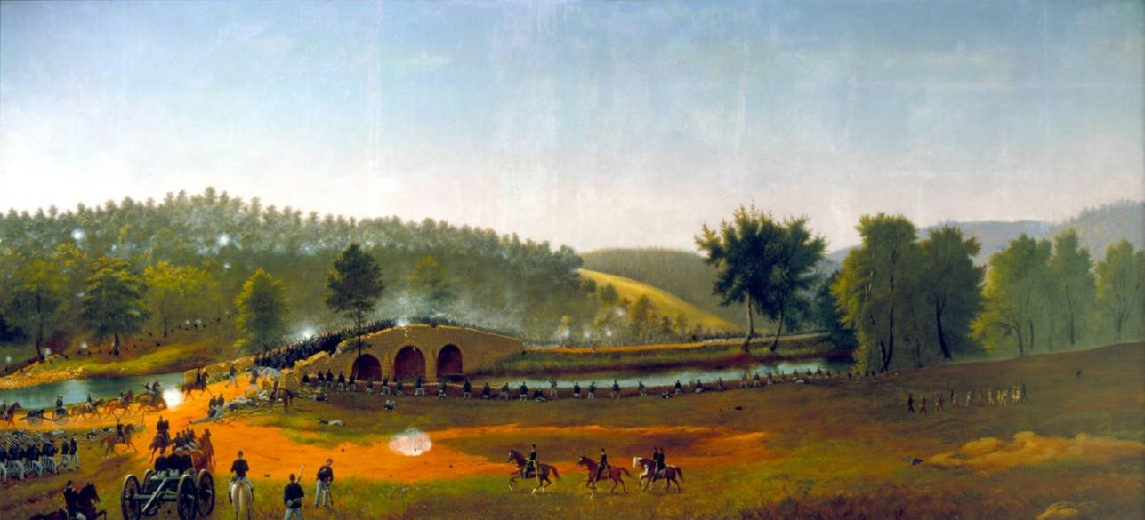
The Burnside Bridge
About 500 Confederates held this area overlooking the bridge for three hours until General Burnside’s men finally captured it and crossed Antietam Creek.

Slide 13
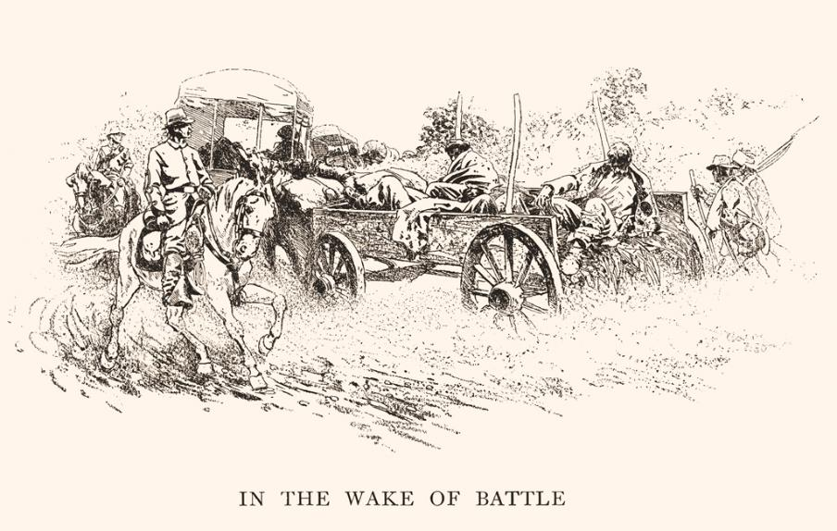
Results of the Battle
The Battle of Antietam ended Robert E. Lee and the Army of Northern Virginia’s first invasion into the North
The Confederate Army Retreats Back to Virginia

Slide 14
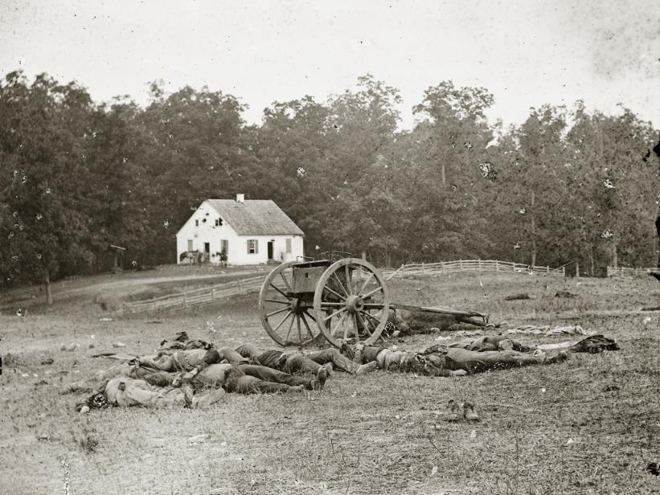
Aftermath
The Battle of Antietam was the bloodiest single day battle in American History. 23,000 soldiers were killed, wounded, or missing in a twelve-hour period.
Dead Confederate Soldiers in Front of Dunker Church

Slide 15
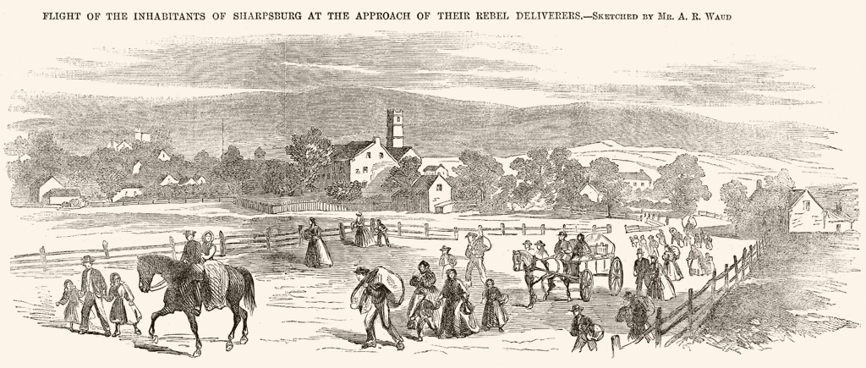
The Aftermath in Sharpsburg
Afterwards, the battlefield became a vast hospital and burial ground. Local residents returned to a scene of devastation.

Slide 16
Dr. A. Hurd, 14th Indiana Volunteers, attending to Confederate wounded after the Battle of Antietam, Alexander Gardner, 1862.

Slide 17
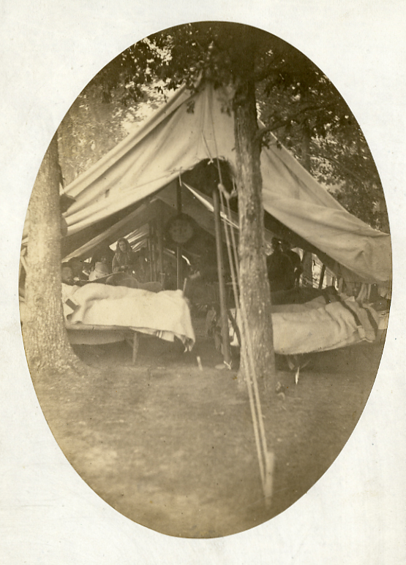
Antietam Hospital

Slide 18
Keedysville, Md., Smith's barn, used as a hospital after the battle of Antietam, Alexander Gardner

Slide 19
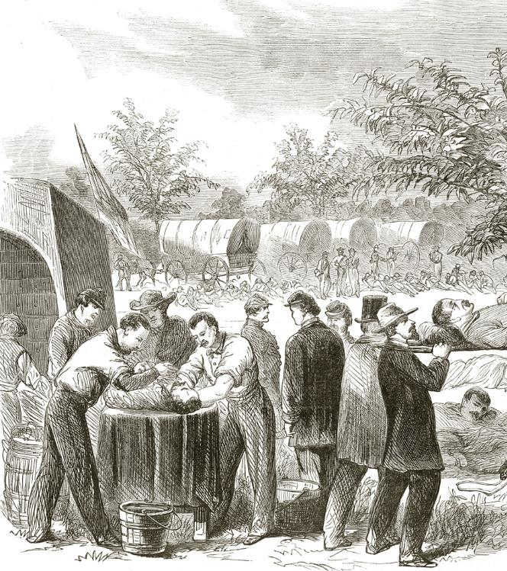
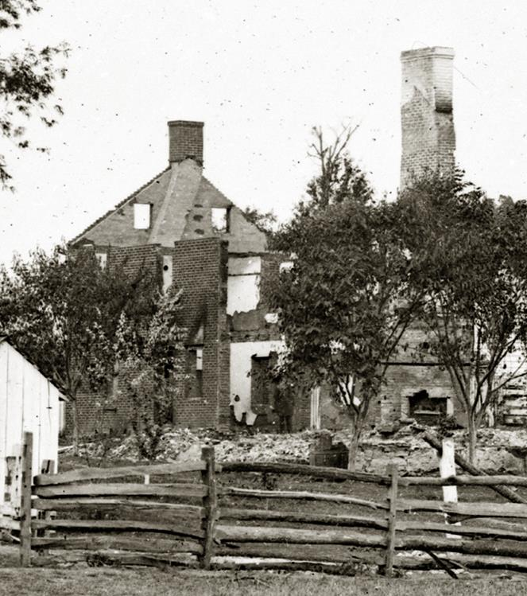
Surgeons try to care for the 19,000 wounded
The Mumma family farm was destroyed

Slide 20
Soldiers were buried in mass graves where they fell until they were reburied in area cemeteries several years later.

Slide 23
Emancipation Proclamation
Five days after the Battle of Antietam, Abraham Lincoln changed the war when he issued the Emancipation Proclamation.
The proclamation reflected Lincoln's new way of thinking about the conflict. Until this time, it was seen as a rebellion, a fight to preserve the Union without touching slavery. Now Lincoln was threatening to crush the Confederacy by destroying slavery, the basis of its economy and society. Now the North was waging a moral crusade to free the slaves.
Lincoln's preliminary proclamation, issued on September 22, 1862, declared that on New Year's Day, 1863, slaves in areas then "in rebellion against the United States shall be then, thenceforward, and forever free." For areas not deemed to be in rebellion (like Maryland), slavery would be unchanged.
Enslaved people in Maryland would not be freed until Nov. 1, 1864, only a few months before Congress would approve the 13th Amendment abolishing slavery.

Slide 24
Emancipation
After the proclamation, Union troops became an army of liberation as they advanced in the South. During the war, one out of every seven Confederate slaves (about 500,000) escaped to the Union army. The South was thus deprived of desperately needed labor to till fields, build forts and fix railroads.
The Emancipation Proclamation also paved the way for the enlistment of black Americans as soldiers.
About 186,000 African-Americans served in the Union army making up about nine percent of Union army forces.
District of Columbia. Company E, 4th U.S. Colored Infantry, at Fort Lincoln

Slide 25
Antietam Battlefield Today
Dunker Church

Slide 26
Antietam Battlefield Today
Bloody Lane

Slide 27
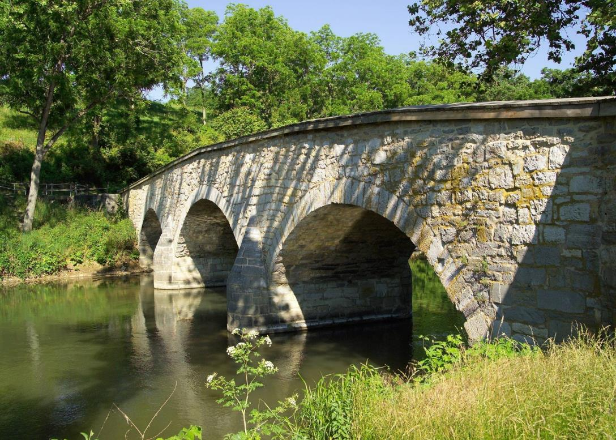
Antietam Battlefield Today
Burnside Bridge

Slide 28
Antietam Battlefield Today- National Cemetery

Slide 29
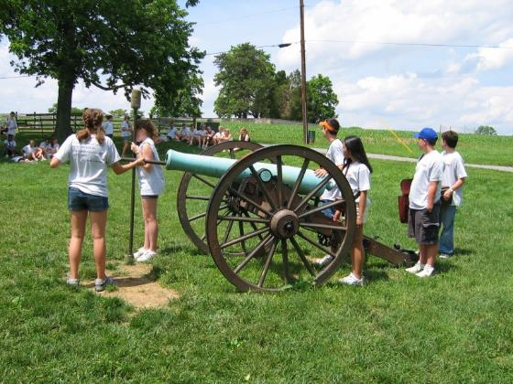
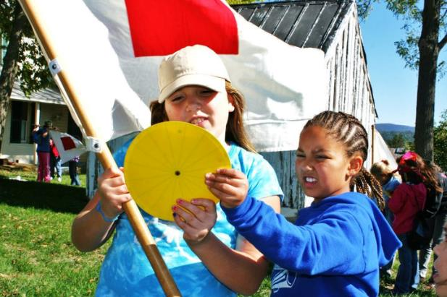
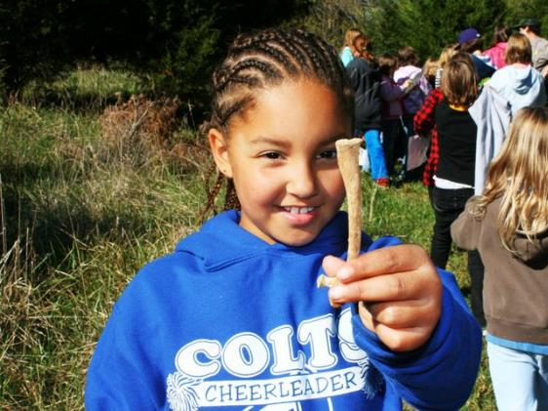
Antietam Battlefield Today- School Groups Visit

Slide 30
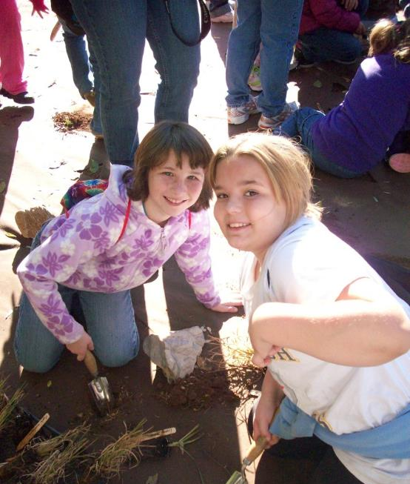
Antietam Battlefield Today- Volunteers Restore, Preserve, and Protect the Park

Slide 31
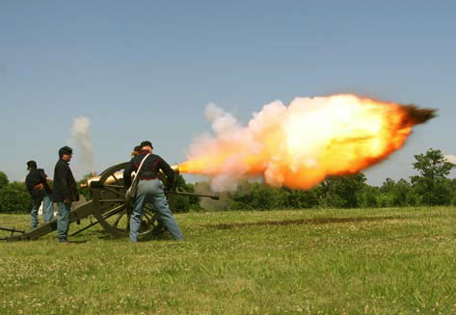
Antietam Battlefield Today- Volunteers Teach Visitors about the Battle

