Slide 1
The Restoration of the River
What Happens After the Dams Are Out?

Slide 2
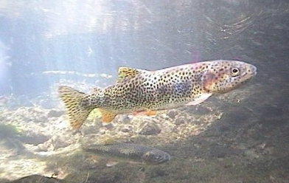
Natural Recolonization
The fish above the dams should not have any problems returning to anadromy.
These include;
Sockeye of Lake Sutherland
Coastal cutthroat trout
Bull trout
Dolly Varden
Notes:
The fish species that survived above the dams were species that have naturally flexible life histories that allow them to be either resident or anadromous. Thus, the sockeye (kokanee above the dams), coastal cutthroat trout, rainbow trout (steelhead when anadromous), bull trout, and Dolly Varden have survived, albeit in smaller populations than there were historically.
It is expected that with the removal of the dams these fish will work their way down river and many of them will return to an anadromous lifestyle. Thus, little if anything will need to be done to restore their populations.

Slide 3
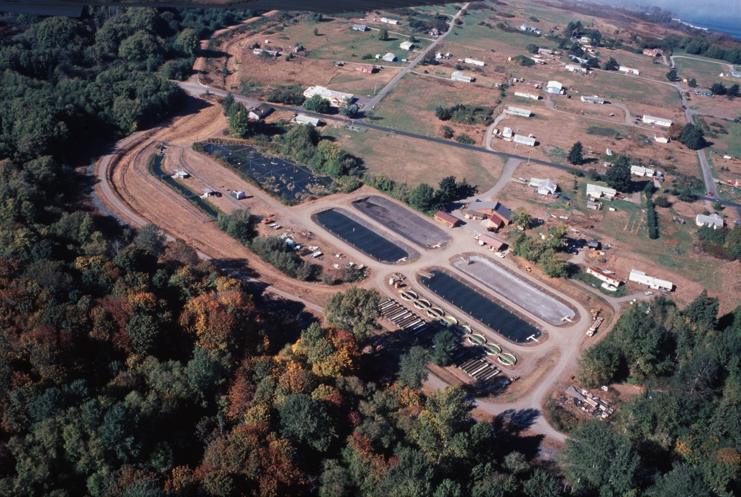
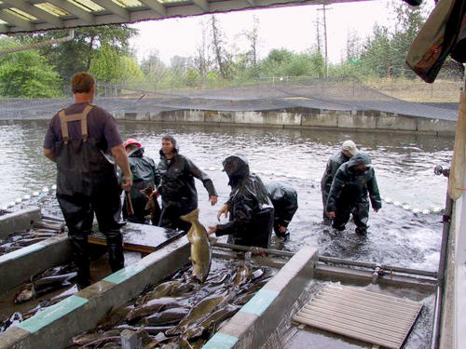
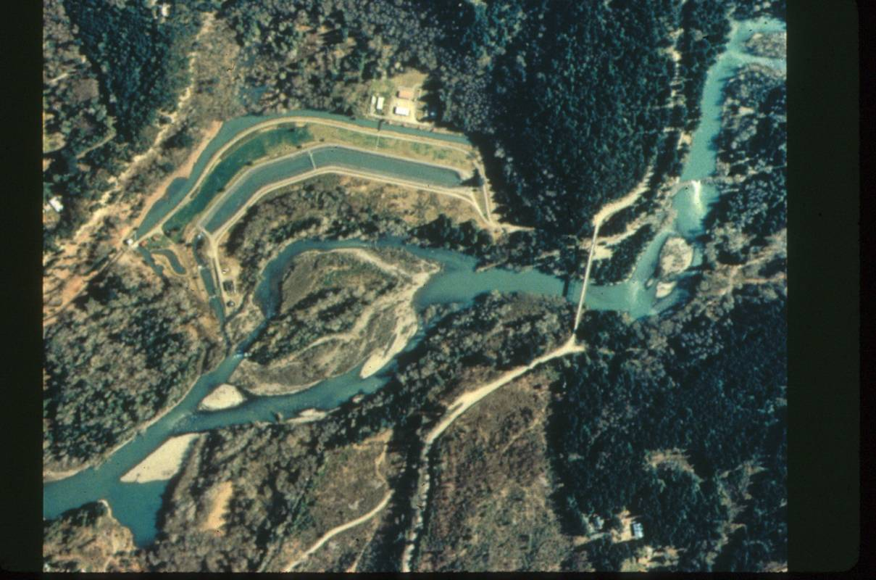
Hatchery Assisted Recovery
Coho, Chum, and Steelhead natural recolonization is assisted by hatcheries.
Notes:
For the small populations of anadromous coho, chum, and steelhead surviving below the dams, they will need assistance to survive the dam removal period, when silt and sediment will be moving downstream from behind the dams. This increased sediment which could damage their redds or suffocate juvenile salmon.
Two hatcheries (the state hatchery and the Elwha Klallam hatchery) will be used to remove eggs and fry from the river and to rear them through the dam removal process. In addition, these hatcheries will propagate larger populations than currently exist in the river. These fish will then have the opportunity to move upstream into the newly available habitat. In areas easily accessible by road, juvenile salmon will be planted into the river and lower tributaries.
It is expected, due to the natural straying tendencies that some salmon have, that they will, over time, move into the portions of the river upstream of the dam sites at some point in the future.

Slide 4
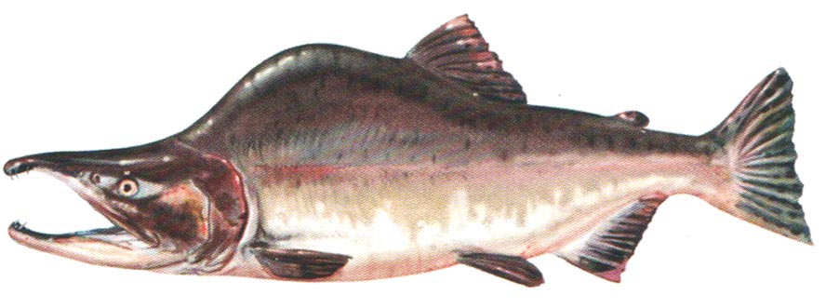
Pink Salmon Recovery
Pink salmon where historically the most numerous fish in the river at up to 200,000 returns in odd-years.
In 2010, they were the rarest of the salmon at only 50-200 adult returns!
Notes:
Pink salmon were historically the most important salmon species in the Elwha river at around 200,000 adult returns per run. However, their populations have been devastated by the dams to have a population today of only around 50-200 adult returns. The hatcheries will be critically important in saving and propagating the species through the dam removal process. Pink have among the highest stray rates of any salmon, so it is expected that they will quickly recolonize the river once the dams are removed.

Slide 5
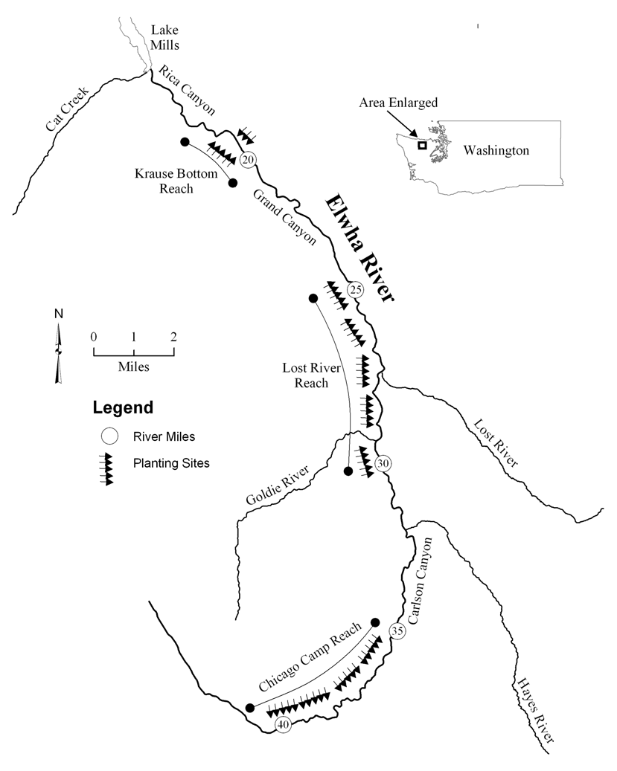
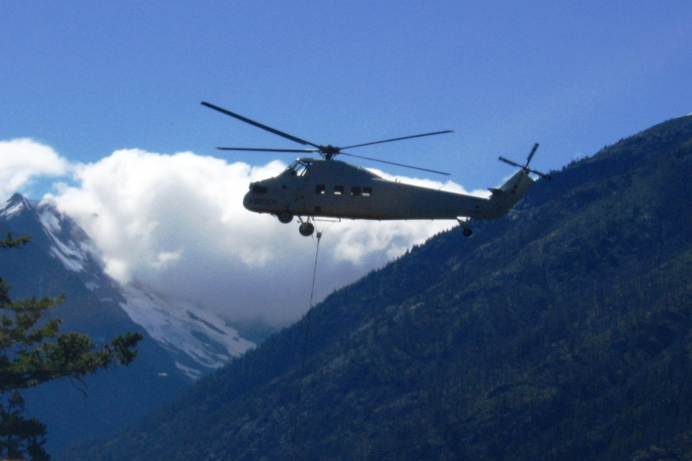
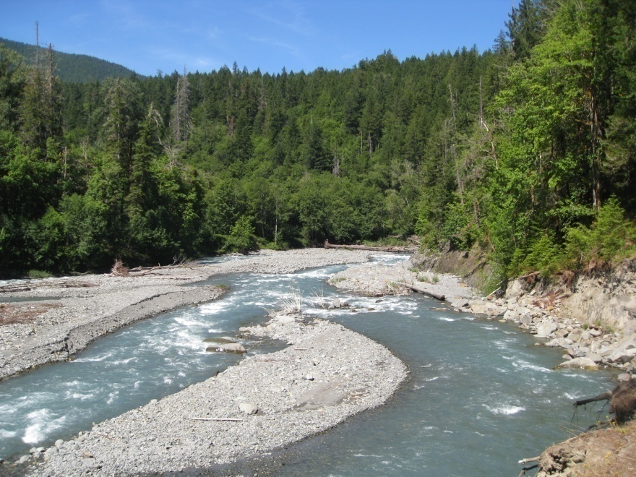
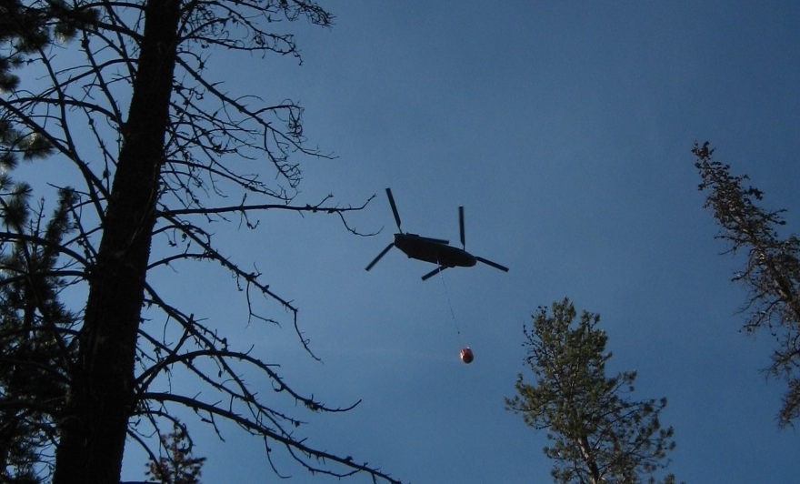
Chinook Salmon Recovery
Chinook have the lowest stray rate of the salmon species, so natural recolonization would take a very long time.
Chinook will be restored to the upper reaches with the use of helicopters and fire buckets.
Notes:
Chinook salmon have among the lowest straying rates of any Pacific salmon. This means that natural recolonization of the river might take a long time. In addition, the chinook in the Elwha river are a federally-listed endangered species. Thus, the Olympic National Park will help reestablish their population by flying them up the river with helicopters. Fire buckets holding thousands of fry will be deposited across the length of the mainstem of the river. They will do this for five consecutive years, since chinook generally spend five years at sea. This ensures a brood stock for every year.
It is expected that after five years at sea returning adults will return to the place where they were dropped by the helicopters to spawn.

Slide 6
Species | Current Escapement of wild populations | Lower Escapement Estimate | Upper Escapement Estimate | Harvest Rate
Chinook ^{e} | ~ 2,200 | 6,900 | 17,000 | 65%
Coho | ~ 450 Supplemented with hatchery stock | 12,100 | 34,500 | 65%
Chum | < 300 | 18,000 | 40,000 | 50%
Pink | < 200 | 96,000 | 250,000 | 65%
Sockeye | ~ 0 But, population lives in Lake Sutherland | 6,000 | N/A | N/A
Steelhead ^{e} | ~ 333 But, rainbow trout occur above the dams in significant numbers | 5,750 | 10,100 | 43%
Total Returns | ~ 3,500 wild anadromous returns | ~ 144,750 | ~ 357,500
e = federally listed endangered species
Notes:
This is a table showing the current population estimates for adult salmon returns (escapements). The lower and upper escapement estimates are based on several studies that attempted to determine based on modern river and oceanic conditions how many salmon may return to the river in the 20-30 year recovery period.
The harvest rate refers to how many salmon who enter the ocean on the North Olympic peninsula end up being harvested by commercial fisheries.

Slide 7
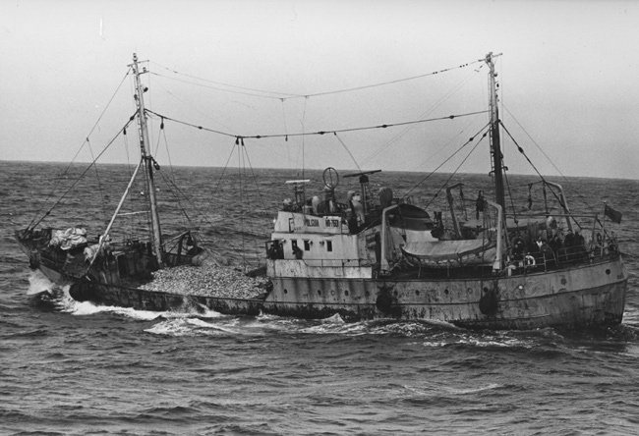
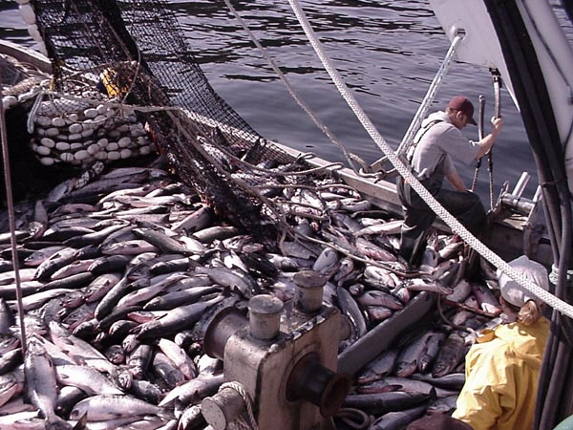
Escapement Rate and Harvests
The biggest threat to recovery is open ocean harvest.
Nearly 70% of salmon harvested are in Canadian waters.
10% are harvested in Alaskan waters, while only
8.5% are harvested commercially in Washington.
Notes:
The biggest threat to salmon once they enter the ocean is commercial fisheries, since between 40-65% of salmon who enter the ocean end up being caught by fishing vessels. Of those harvested, 70% are captured in Canadian waters. So, because of the international entanglements, not much can be done to help salmon once they enter the ocean.

Slide 8
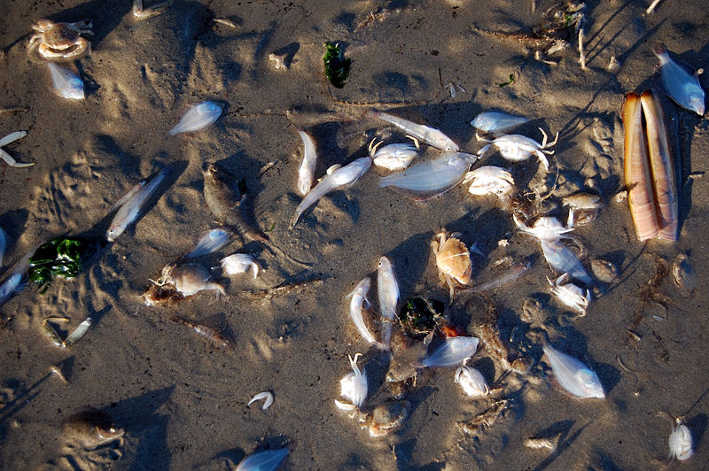
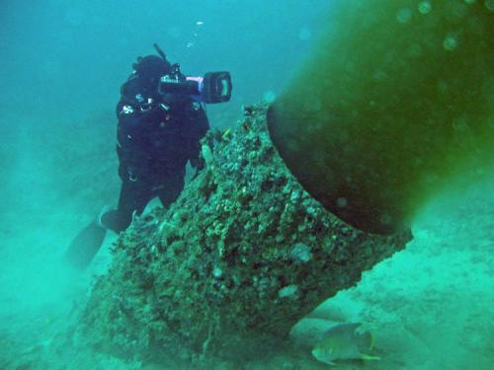
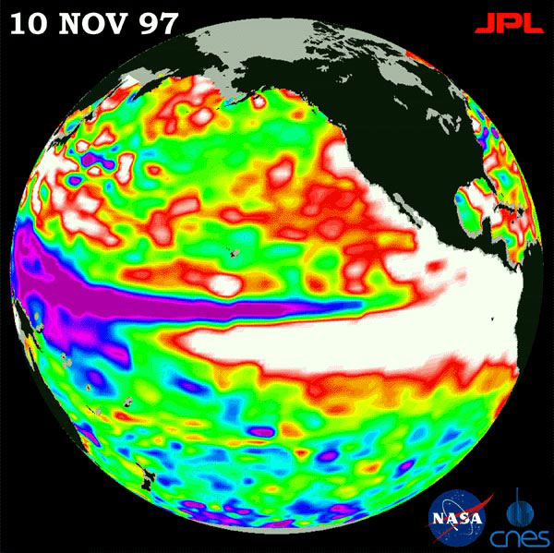
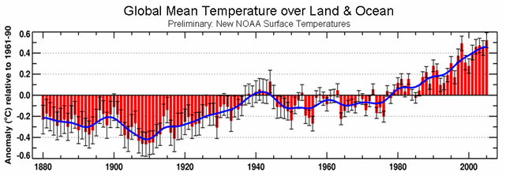
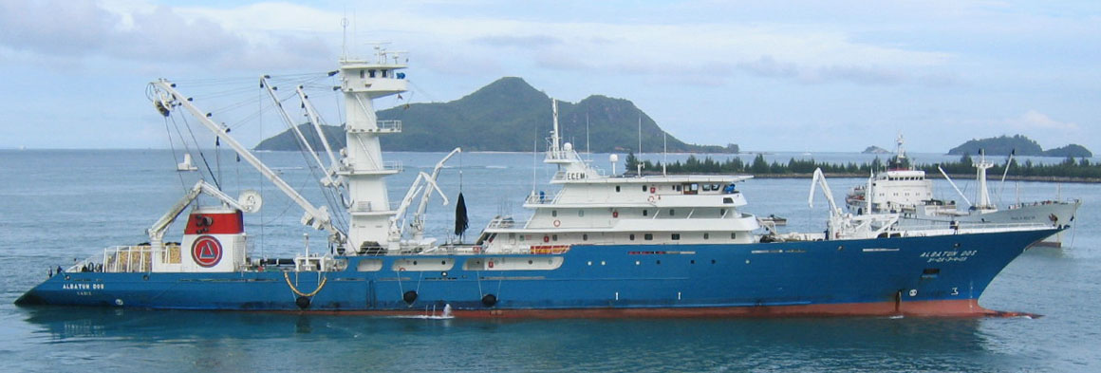
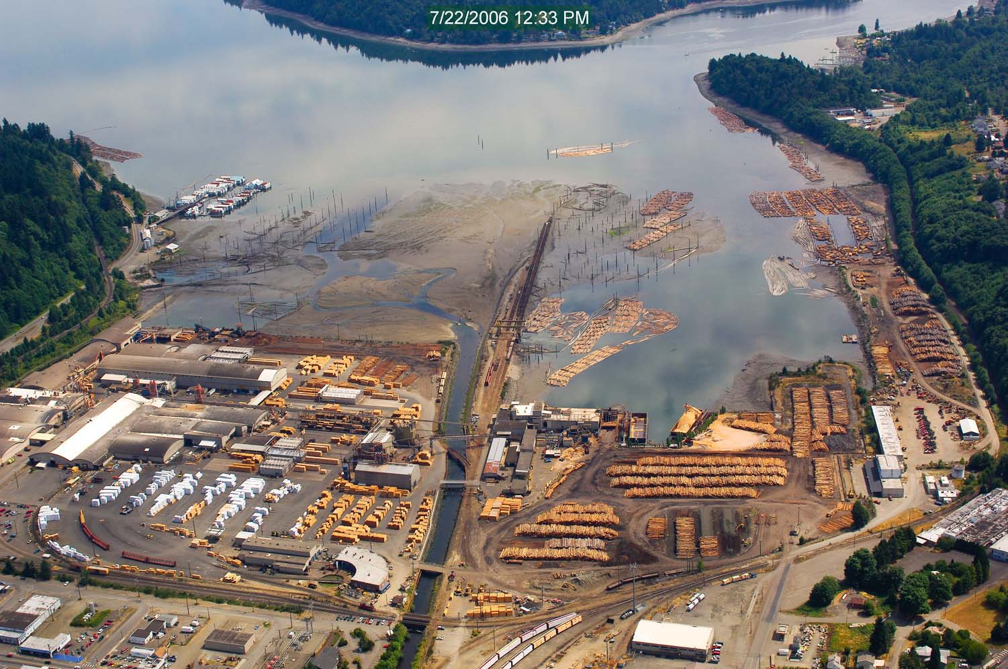
Other Threats in the Ocean
Global Warming
El Nino Events
Pollution
By-catch and
Factory Fishing
Notes:
Global warming threatens to change ocean current patterns, impact upwelling rates, raise water temperatures, and will cause the oceans to become more acidic as the ocean absorbs more carbon dioxide. All of this is likely to result in less plankton, which impacts forage fish and salmon food availability.
Increasing cyclical El Nino events result in higher ocean temperatures and the loss of nutrient-rich upwelling, which vastly reduces food supply for salmon and causes temporary crashes in fish populations. While El Nino events have been going on a long time, their impact combined with other factors could doom salmon to virtual extinction.
Pollution, sewage, and dangerous chemicals entering the ocean from urban centers along the Pacific coast threaten the entire food chain, as well as, salmon health specifically.
By-catch and factory-fishing catches many non-target fish that could be prey for salmon (or could be the salmon themselves), which hurts the overall population.

Slide 9
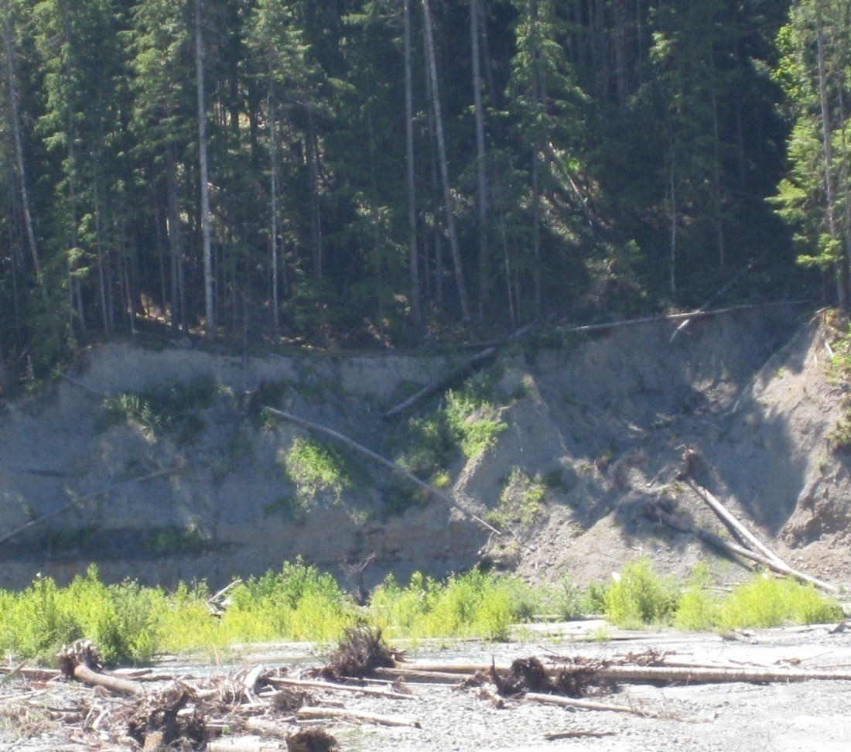
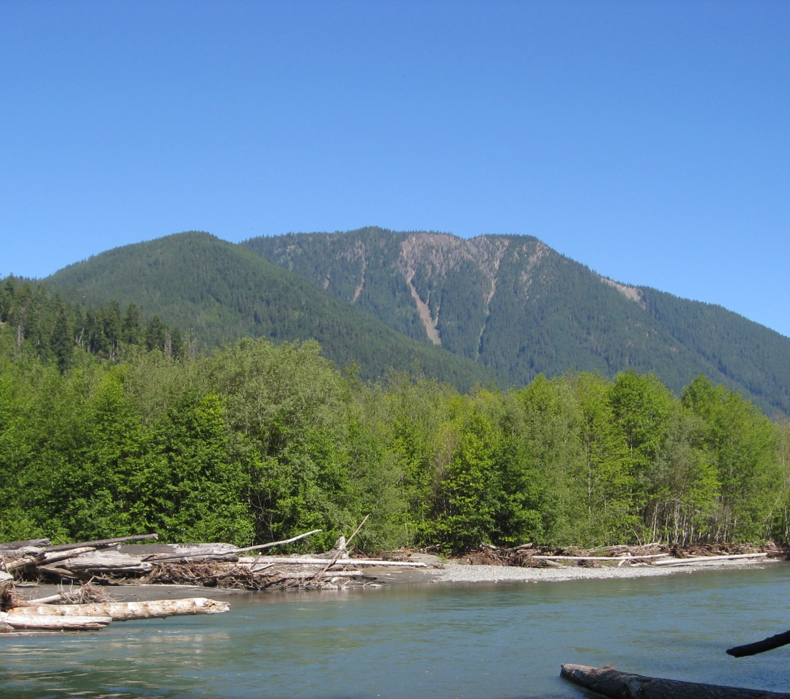
Once the Lakes are Drained
Revegetation projects will begin after dam removal to stabilize the newly exposed slopes and prevent erosion.
Notes:
Once the lake are drained, there will be a lot of exposed land that is at risk for erosion. The first plan is to revegetate the land, get roots in the ground, and stabilize the banks to prevent landslides, erosion, and slumping.

Slide 10
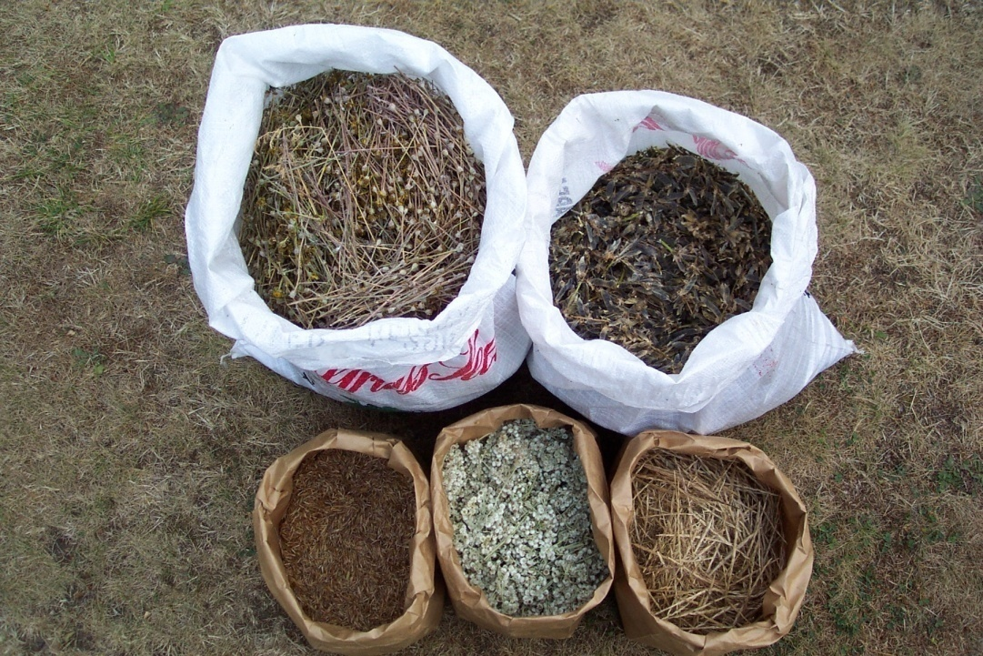
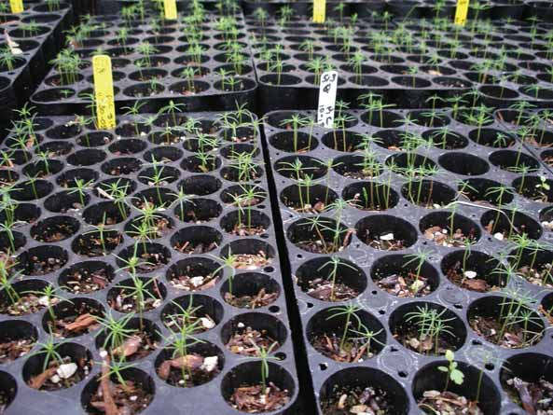
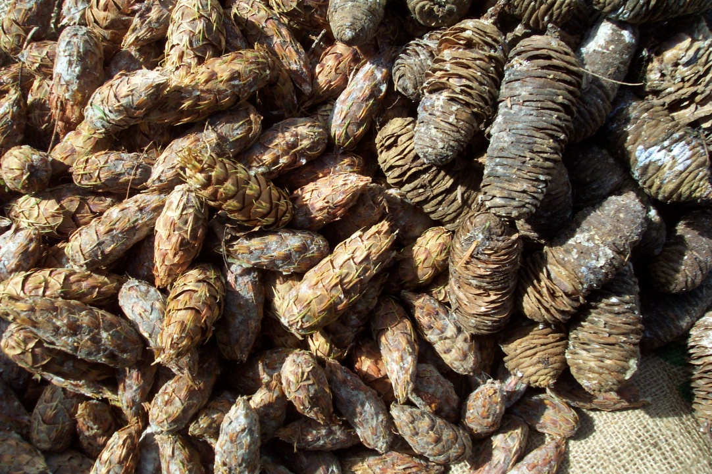
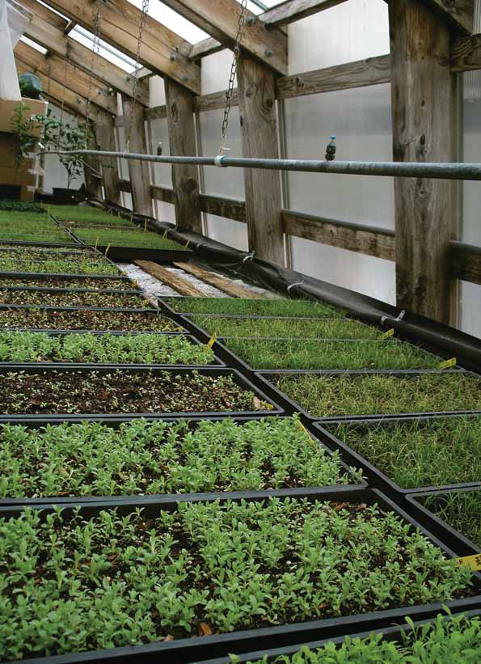
Revegetating the Drained Reservoirs
The park collected seeds and cones and propagated them in the greenhouse for out-planting
Notes:
The park is collecting seeds and cones from all of the native plant species that live along the Elwha river. They are growing these plants in greenhouses by the millions so that they will be ready to be out-planted once the lakes are drained. The purpose of this is to stabilize the exposed land, speed up ecological recovery, and prevent the invasion by exotic weedy plant species.

Slide 11
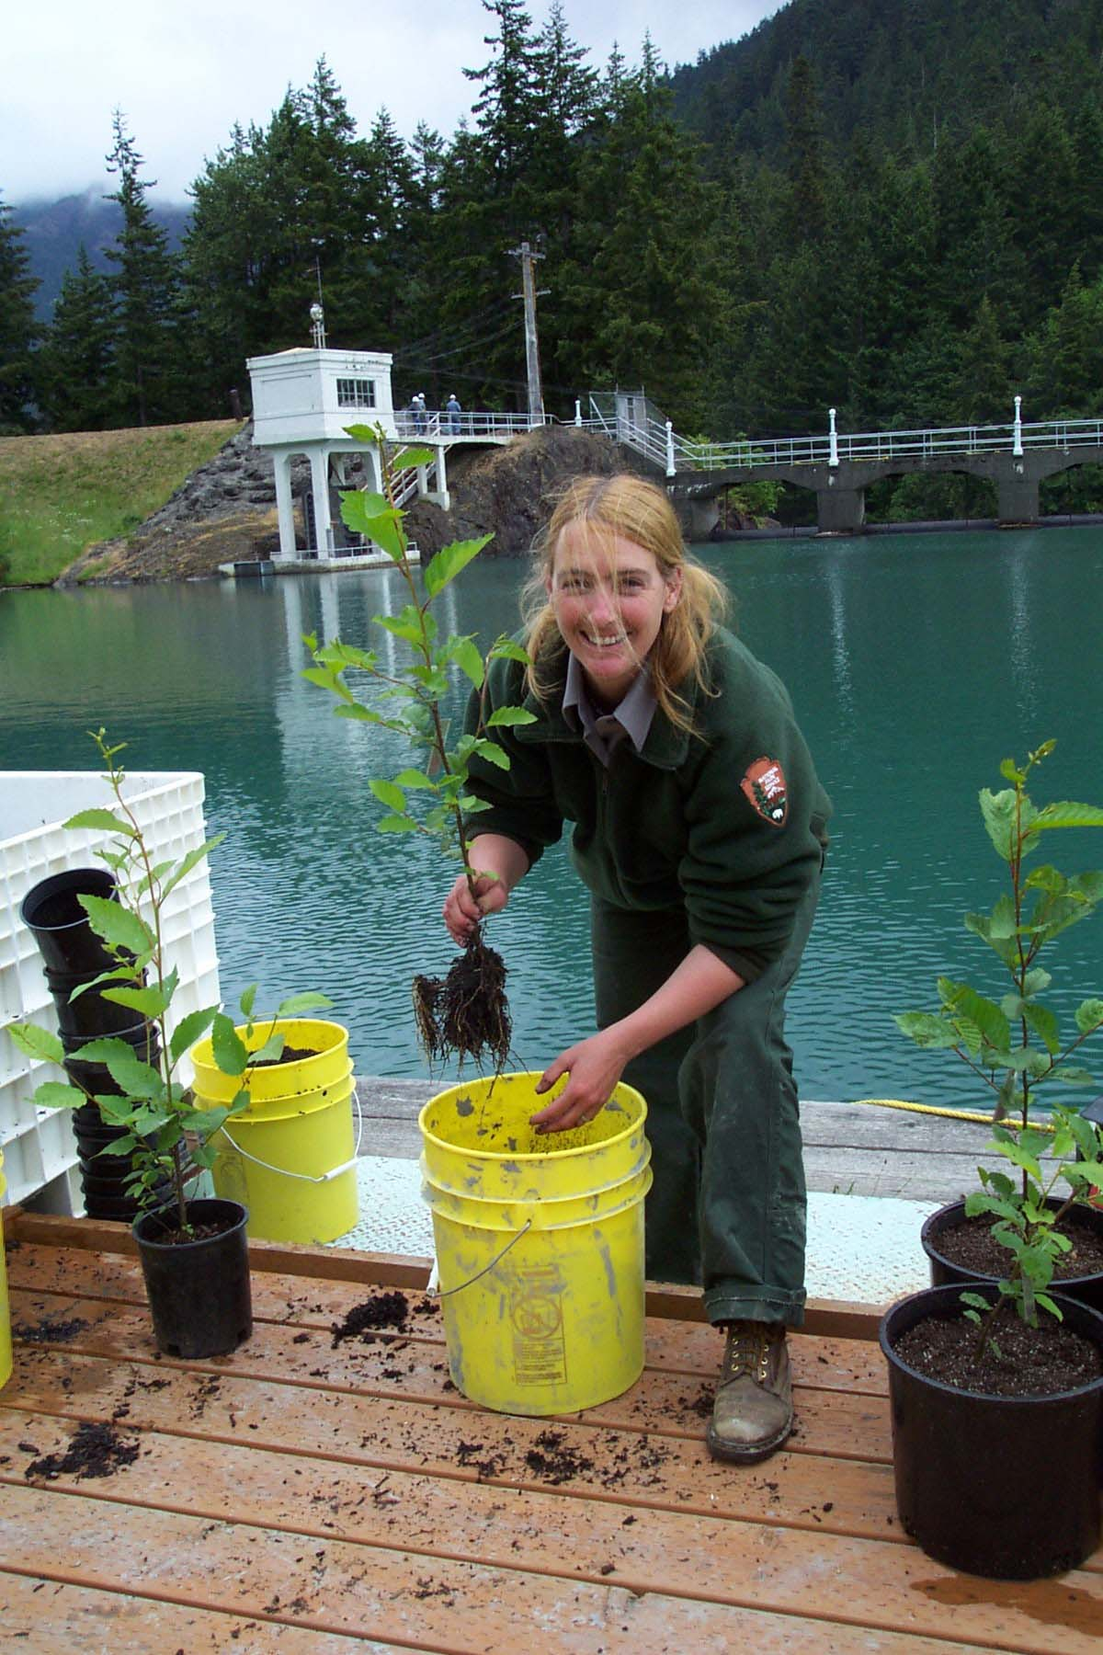
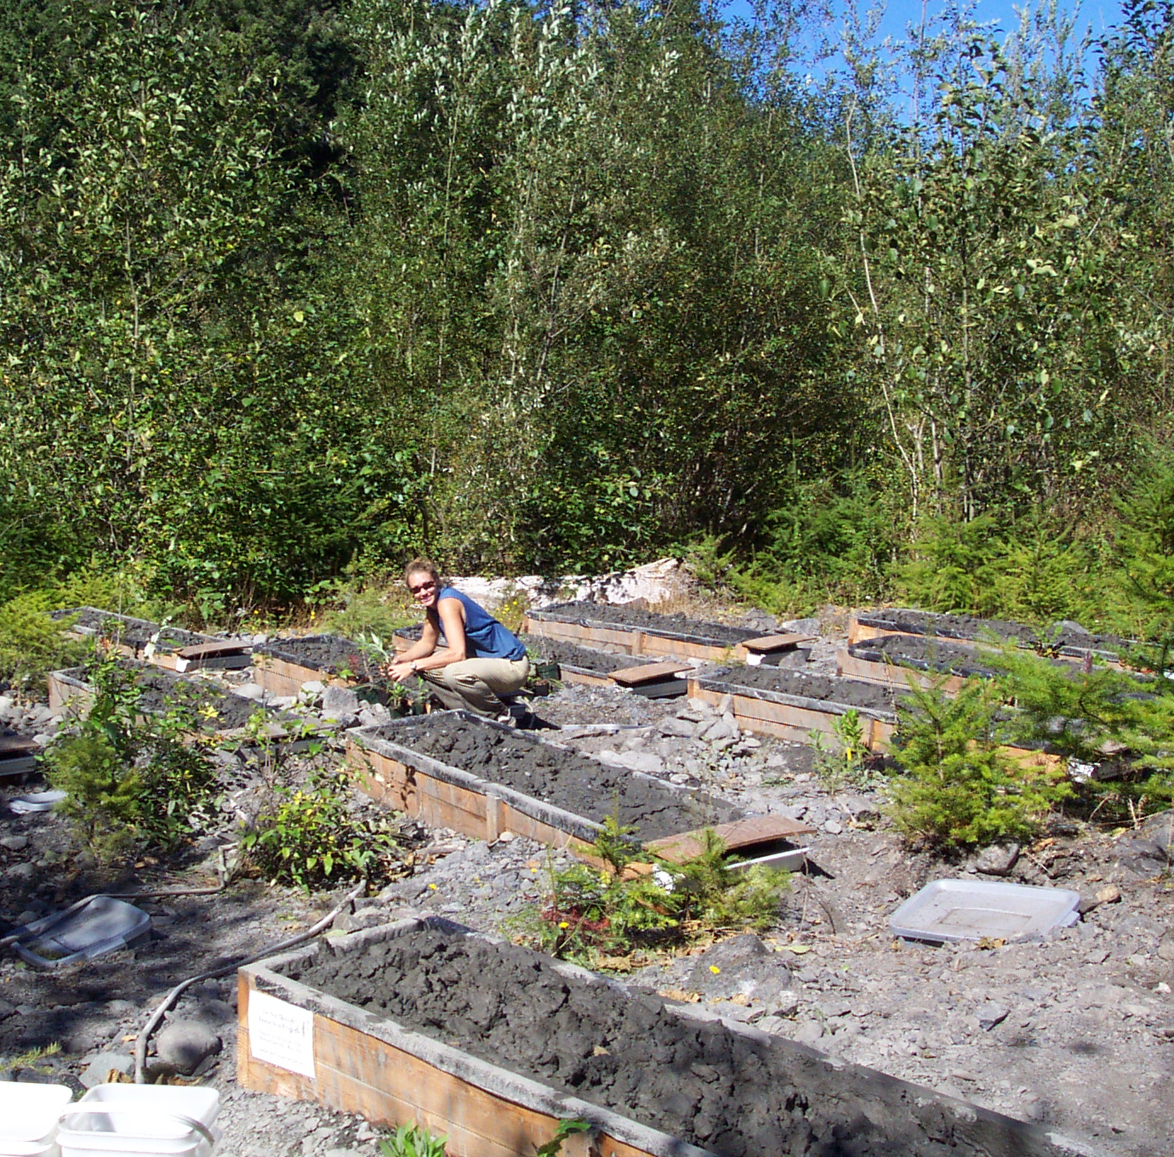
Testing Seedlings in Lake Silt
Notes:
The park has been conducting out-planting experiments to determine the best methods for revegetation. They’ve examined what species will grow best in the lake silts, sediments, and exposed soils that will be present once the lakes are drained. In addition, they are testing the seed bank (seeds that have naturally ended up in the lake by drifting or floating downstream or in the air) to see what will come up naturally.

Slide 12
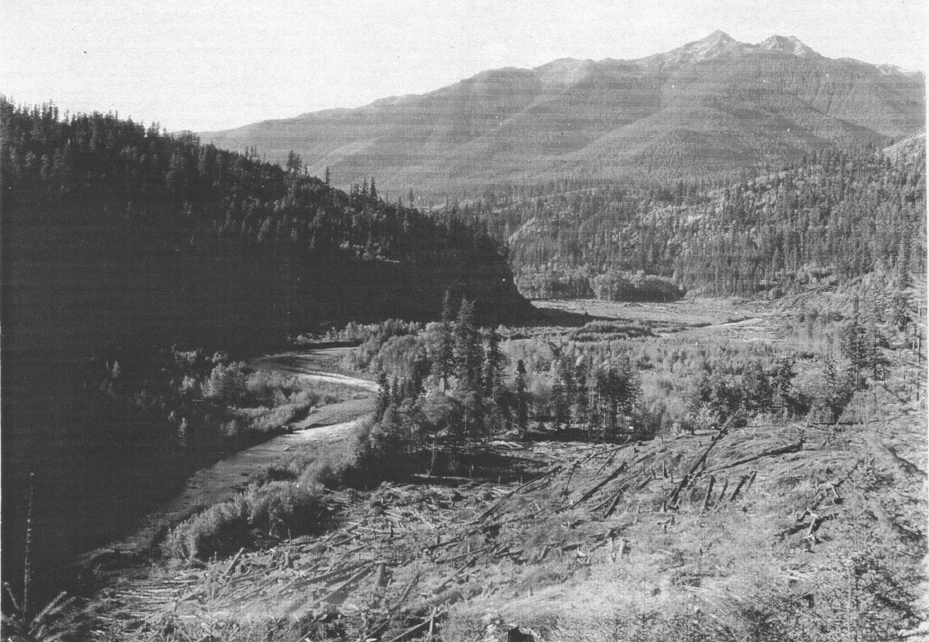
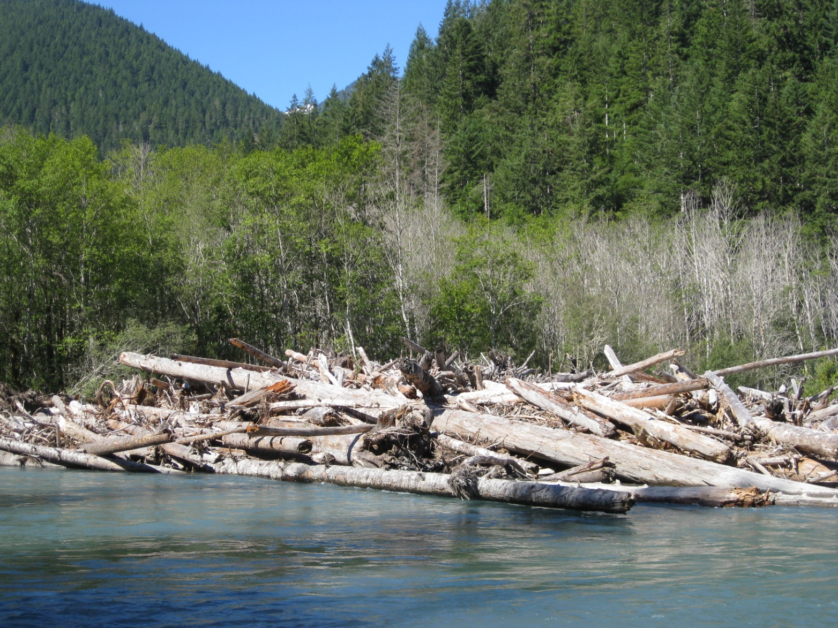
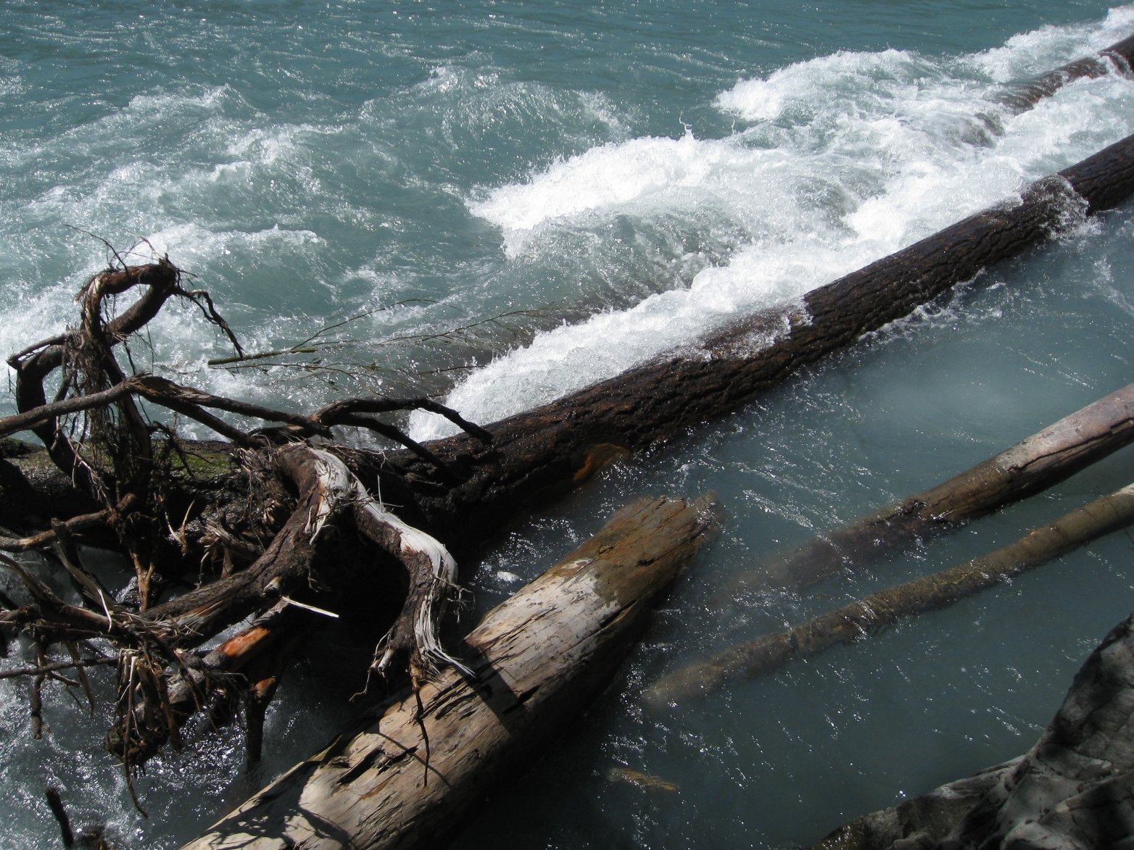
Course Woody Debris
Revegetation crews will place logs and branches on the slopes to stabilize the banks.
Wood in the river also give salmon resting places in strong currents.
Notes:
There is a lot of wood under Lake Mills right now. They will utilize a lot of that wood to stabilize the river banks, provide structure to the river, and assist in the revegetation project. Wood in the river not only protects banks from erosion, but slows the currents to give fish resting places during their migration either too or from the sea.

Slide 13
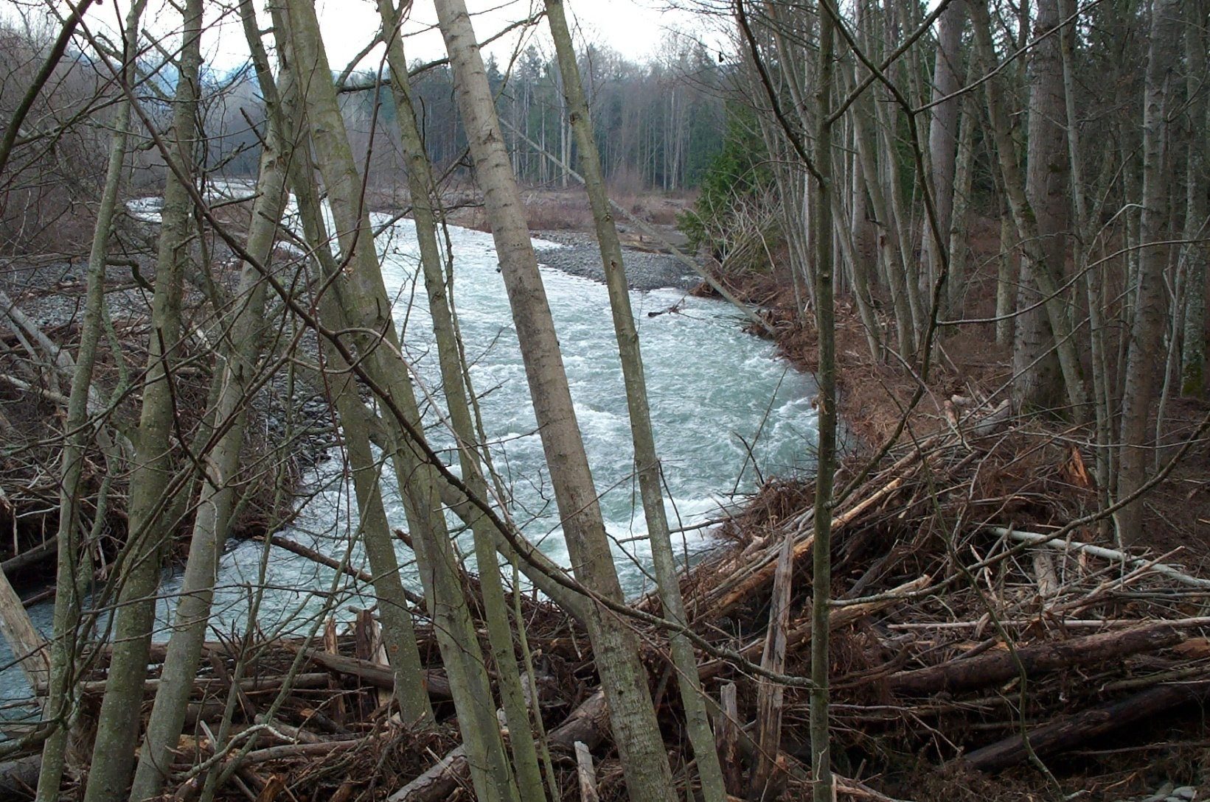
Engineered Log Jams
Notes:
An engineered log jam is a pile of logs put into place in the river for the purpose of deflecting river currents to prevent river erosion, control the scouring effects of floods, to provide fish habitat pools which are free from strong currents, and sediment retention for spawning beds.
Engineered logjams are embedded 20-feet deep into the substrate to make sure they are secure and can not be pried loose during flood events. They are among the most important river mitigation methods for restoring salmon runs. The Elwha Klallam tribe has already built dozens of logjams on the Elwha river, its tributaries, and other nearby creeks.

Slide 14
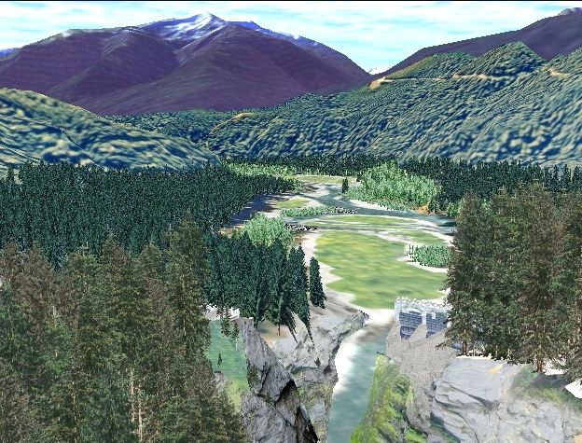
The Future
Computer modeling of forest recovery after dam removal
Notes:
This is a computer image of what the Lake Mills area may look like in 30 years after the draining of the lake and the revegetion is complete.

Slide 15
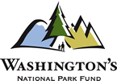
This project was made possible in part by a grant from
Washington’s National Park Fund.

