Slide 1
Functional Feeding Groups
Aquatic Insects and Macroinvertebrates

Slide 2
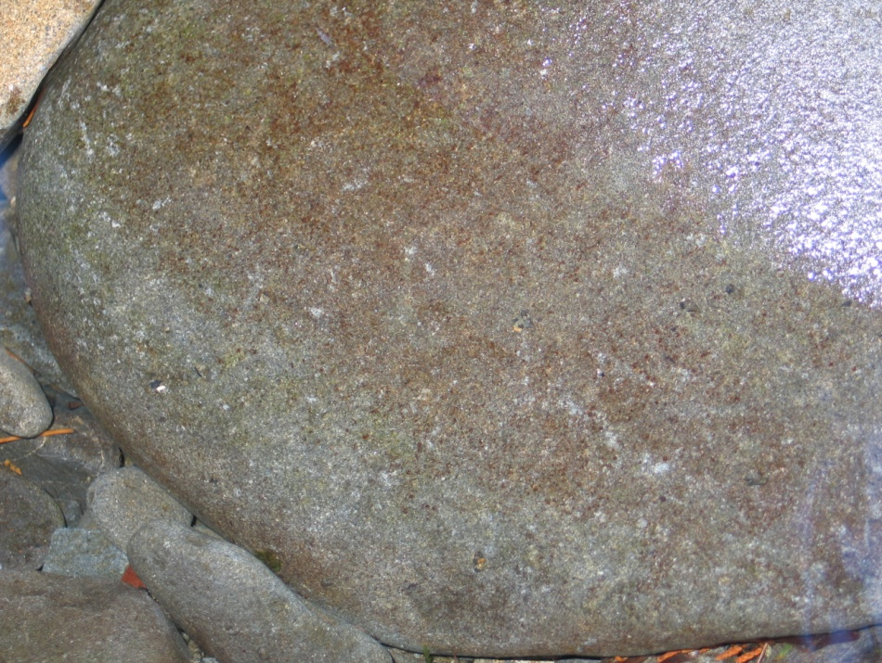
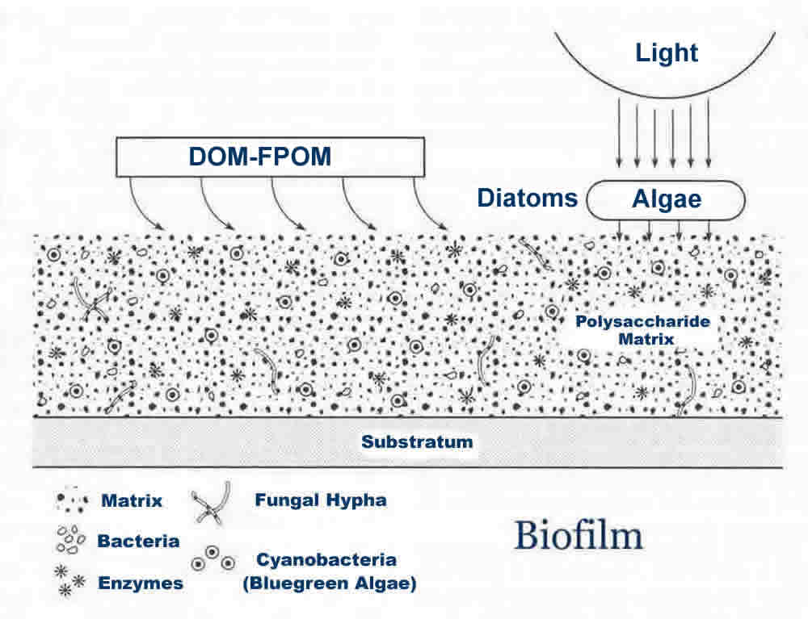
Biofilm
Notes:
Biofilm consists of a complex community of algae, bacteria, fungi, and protozoans living in a matrix of secretions that adhere to solid surfaces like rocks and aquatic vegetation. The algae (the reddish-brown substance on the rocks above) do photosynthesis. The algae secretes substances that are fed upon by bacteria, fungi, and single-celled organisms. In addition, an accumulation of detritus and other organic materials captured in the matrix provide other sources of food.

Slide 3
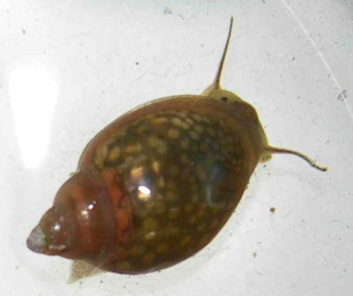
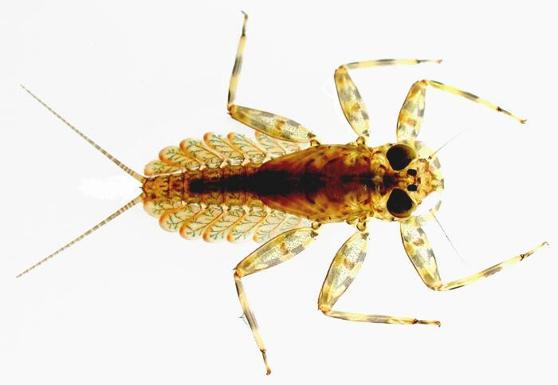
Grazers/Scrapers
Caddisfly larva
Freshwater snail
Mayfly larva
Notes:
Grazers and scapers are animals that specialize on feed on the biofilm layers. They use rasping mouthparts to scrape the biofilm and algae off of the rocks and vegetation. Caddisflies that live in rockty substrates make protective casings from small stones that are cemented together with silk and saliva.

Slide 4
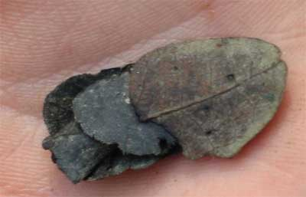
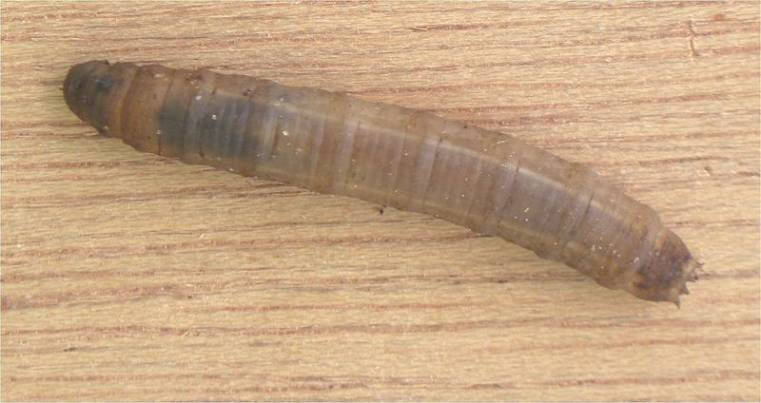
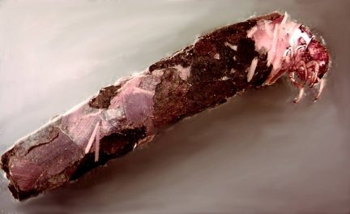
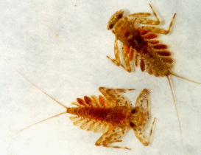
Shredders
Caddisfly larva
Cranefly larva
Caddisfly Larva
Mayfly Larva
Notes:
Shredders wander the stream bottom looking for vegetation that has fallen into the water. Using their tearing mouthparts, they rip and shred the leaves as they feed. Some, like the caddisfly larva, even use those shredded leaf pieces to make their protective casings.

Slide 5
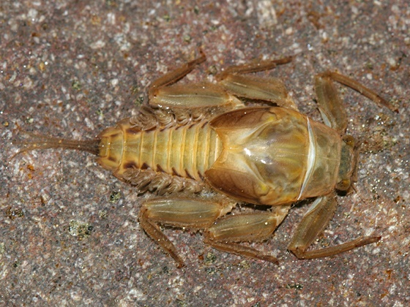
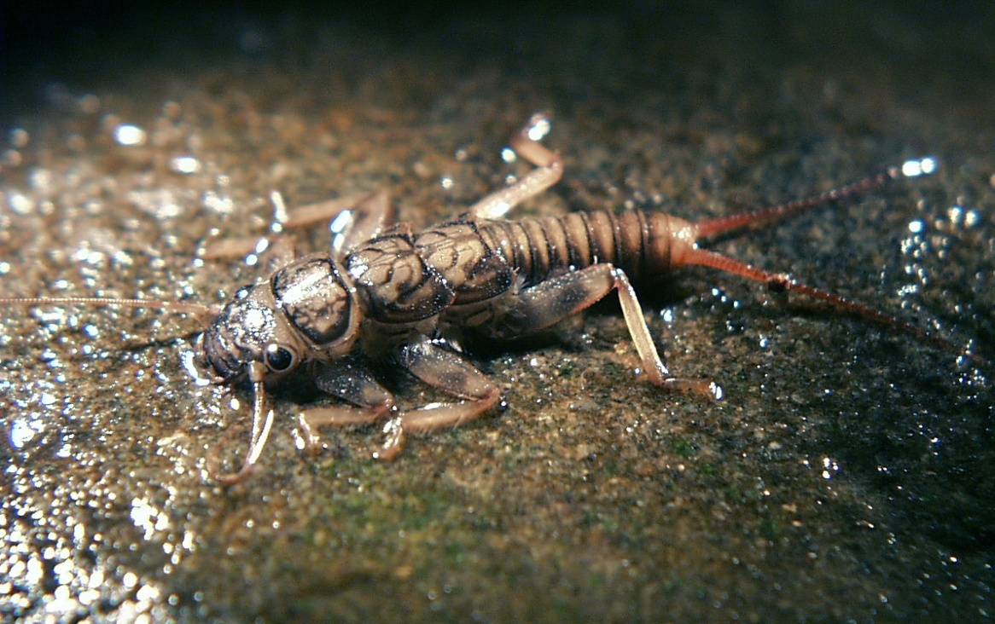
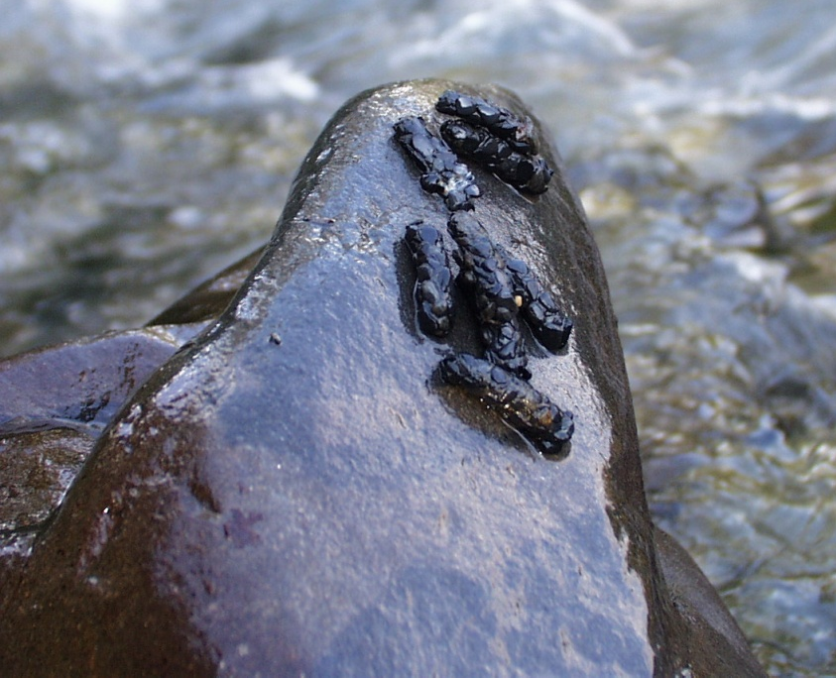
Collector/Gatherers
Drunella mayfly larva
Stonefly larva
Caddisfly larvae
Notes:
Another group of aquatic insects are the collector/gatherers. These insects primarily wander the stream bottom scavenging for dead organisms, detritus, or other food particles that get lodged between rocks or in deep pools.

Slide 6
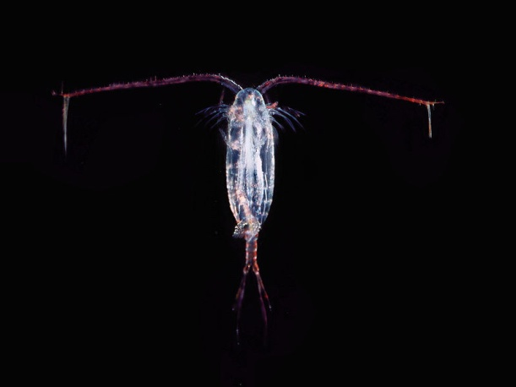
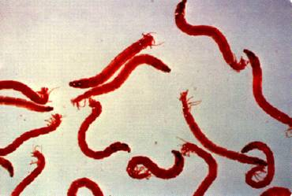
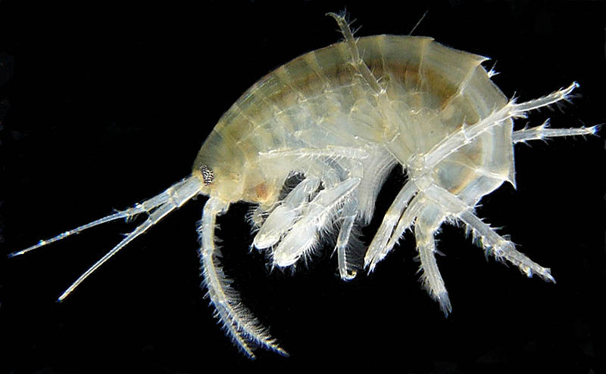
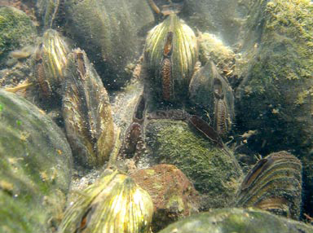
Filter-Feeders
Midge Larvae
Amphipod
Copepod
Freshwater Mussels
Freshwater Hydra
Notes:
Filter-feeders either swim through the water or sit sessile on the bottom filtering out particles that float by in the current. Often these are pieces of vegetation ripped up by shredders or tiny strips of biofilm dislodged by grazers, which are then sent downstream with the current. In addition, detritus from decaying plants and animals also provide a source of food.
Some filter-feeders, like hydra and amphipods are actually predatory, feeding on live organisms that happen to drift on by.

Slide 7
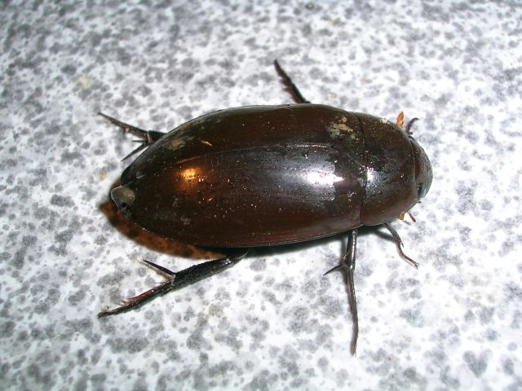
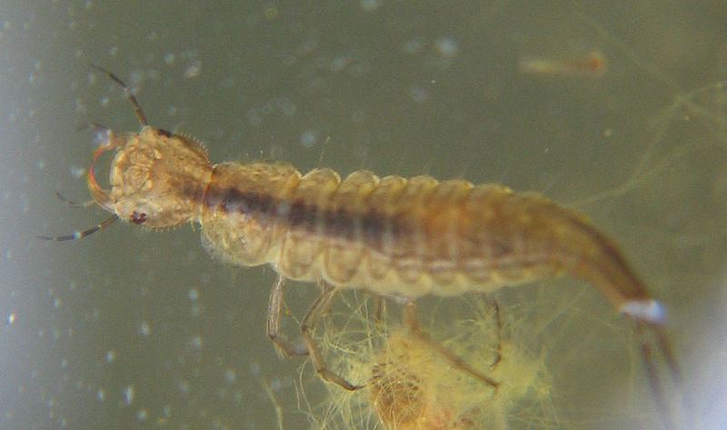
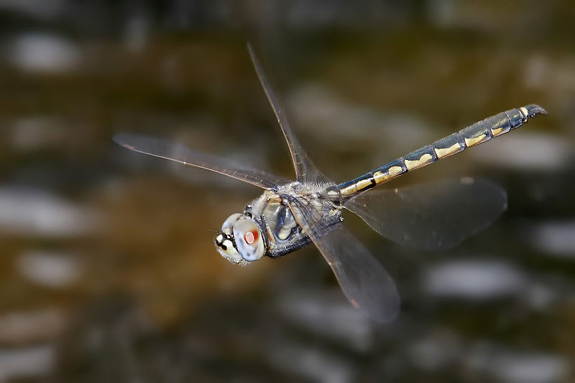
Predators
Dragonfly larva
Adult water beetle
Water beetle larva
Adult dragonfly
Notes:
Some species of invertebrates are predators in both the larval and adult stages of their life. The water beetle and dragonfly larva are vicious predators of other aquatic insects, tadpoles, and even small fish. As adults, they continue searching for prey either by swimming under water, as water beetles do, or flying directly above the surface as dragonflies do.

Slide 8
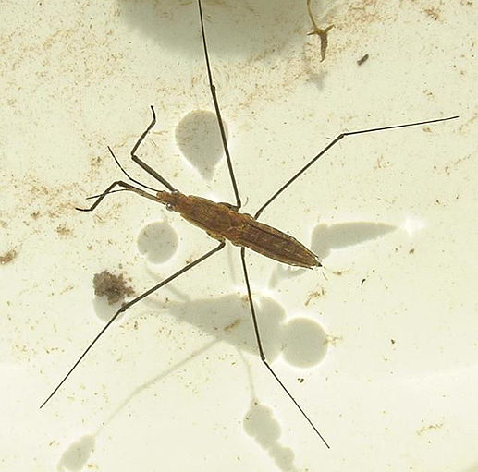
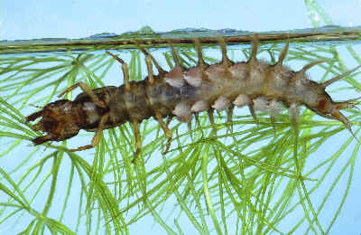
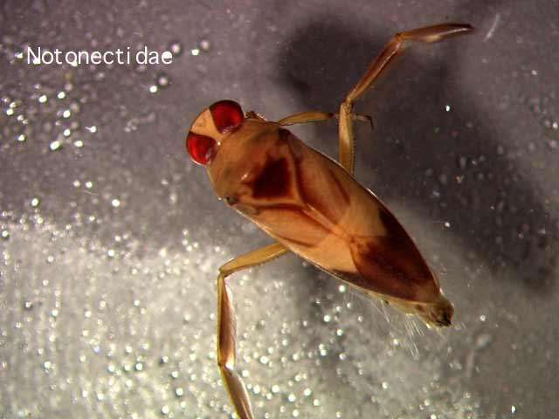
Predators
Water strider
Dobsonfly larva
Water boatman
Notes:
Other predators include the water strider, which searches for fallen insects on the surface of the water. Water boatmen are very similar to water beetles in swimming down and between the rocks looking for aquatic insects. However, water boatmen are actually true bugs, not beetles.
The dobsonfly larva is a large and voracious predator. It spends most of its life in the larval stage, only emerging as a huge adult with massive mandibles to breed for a few days before its death.

Slide 9
This project was made possible in part by a grant from
Washington’s National Park Fund.

