Slide 1
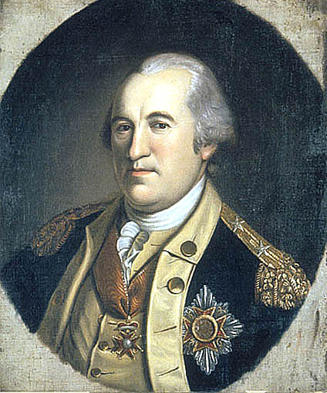
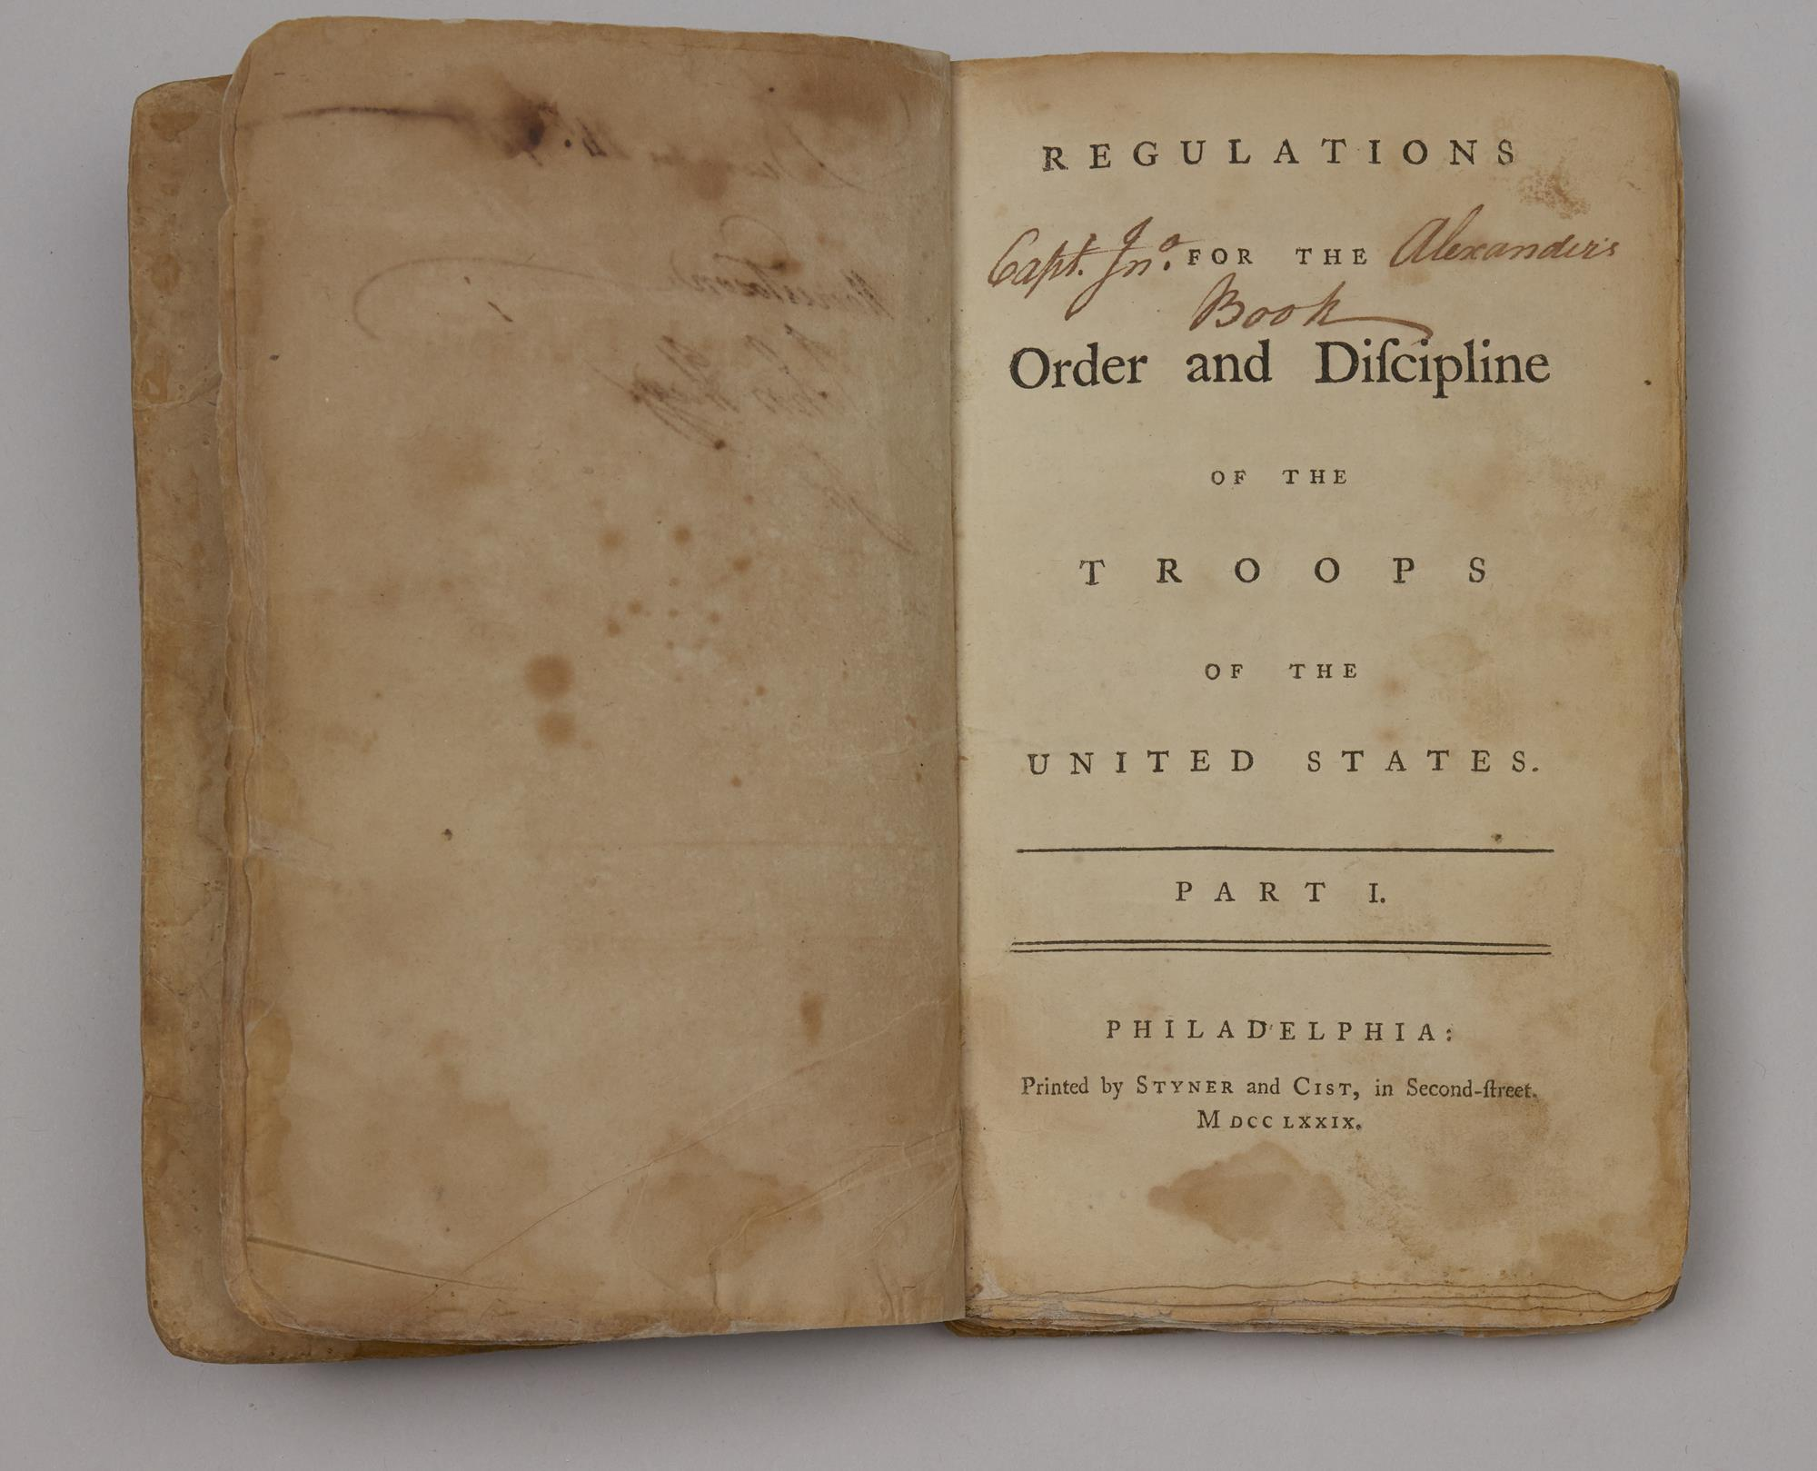
Von Steuben Makes an Army

Slide 2
Baron Friedrich Wilhelm Von Steuben
Born in Magdeburg, Prussia (Germany.) He joined the Prussian Army in 1747, when he was 17 years old.
He fought in the European Seven Years War in various capacities between 1756-1763.
  He was wounded twice and captured by the enemy on the Russian front.
He eventually became an aide-de-camp of King Frederick the Great (King of Prussia).
  He joined the King's personal class on the art of war, where young officers were trained in the complicated art of leadership.
In 1763, after the peace treaty was signed, he was discharged from the Prussian Army.
By, Charles Wilson Peale
1782-1784
Independence National Historic Park

Slide 3
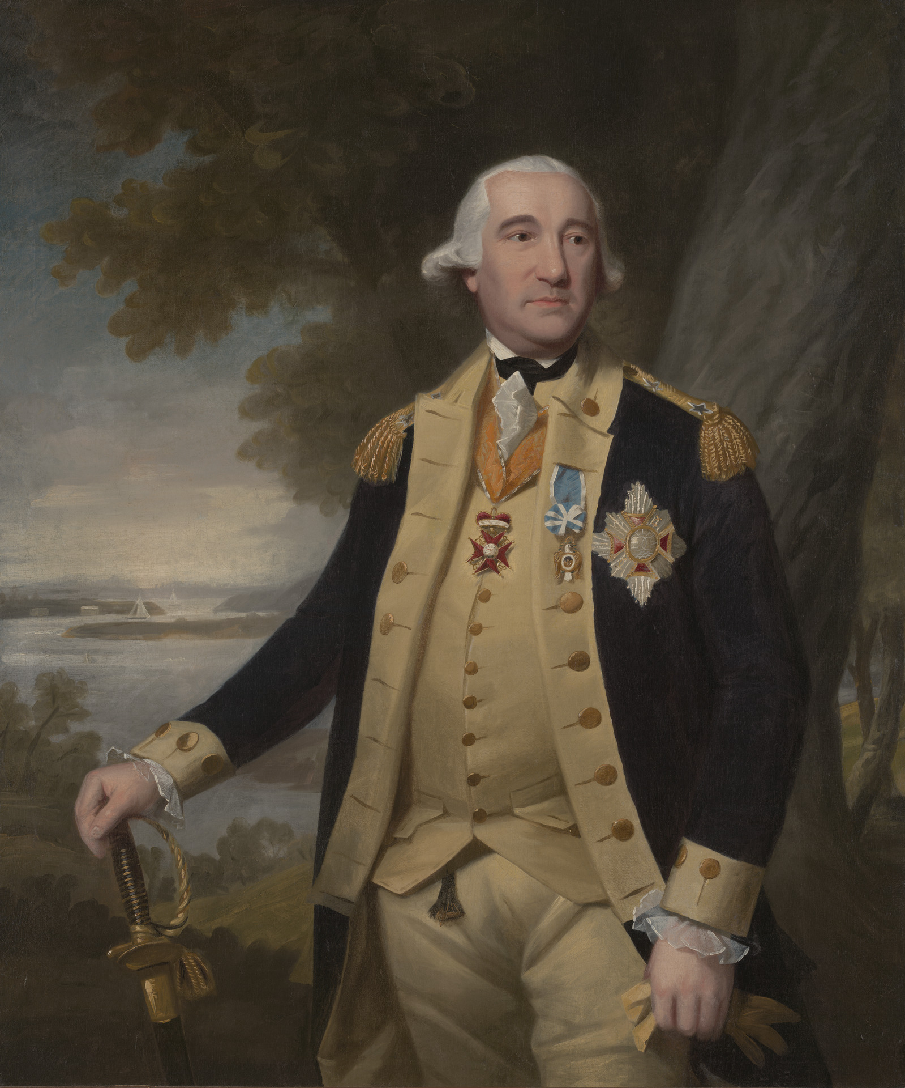
General Von Steuben
After being discharged from the army, Von Steuben was appointed chamberlain to the Prussian court of Hohenzollern Hechingen.
  For his service, he was given the title of “Baron.”
In 1777 eager to find military work, Von Steuben went to Paris to meet America's foreign commissioners, Benjamin Franklin and Silas Deane, and offer them his military services.
  Much to Von Steuben’s chagrin, the Continental Army had grown tired of employing expensive foreign mercenaries. If he was going to serve in the army, he would have to do so as a volunteer.
  Von Steuben, frustrated by these terms, returned to Prussia.
Again unable to find suitable employment, Von Steuben finally booked voyage to the colonies.
Major General Friedrich Wilhelm Augustus, Baron von Steuben. (1730-1794)
Yale University Art Gallery

Slide 4
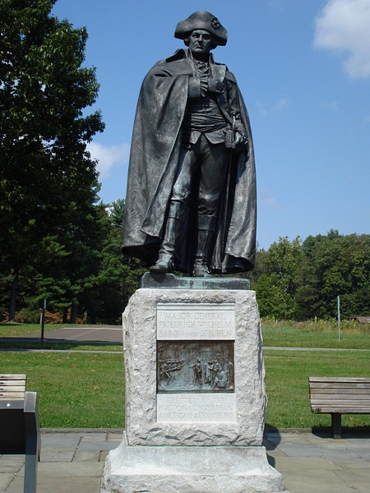
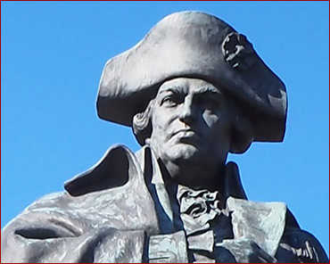
General Von Steuben
After arriving in York on February 8, 1778 with a letter of introduction from Benjamin Franklin, Von Steuben was presented to the Continental Congress.
  In the letter, Franklin referred to Von Steuben as “Lieutenant General” because of his French military title of "Lieutenant General Quarters Maitre.” In reality Von Steuben never achieved a rank higher than captain in the Prussian army.
  Through the mistranslation of Steuben's position, he was made a higher ranking officer in the American army – General Von Steuben.
Impressed with his title and military experience, arrangements were made for his salary to be paid following the successful completion of the war according to his contributions.
He was then sent to serve General Washington at Valley Forge and arrived there in late February of 1778.

Slide 5
Von Steuben at Camp
Steuben made a favorable enough impression upon Washington and was appointed temporary Inspector General.
  One soldier's first impression of the Baron was "of the ancient fabled God of War … he seemed to me a perfect personification of Mars. The trappings of his horse, the enormous holsters of his pistols, his large size, and his strikingly martial aspect, all seemed to favor the idea."
He went out into the camp to talk with the officers and men, inspect their huts, and scrutinize their equipment.
  What he found was an army short of everything, except spirit.
  He was quoted as saying "no European army could have held together in such circumstances.”

Slide 6
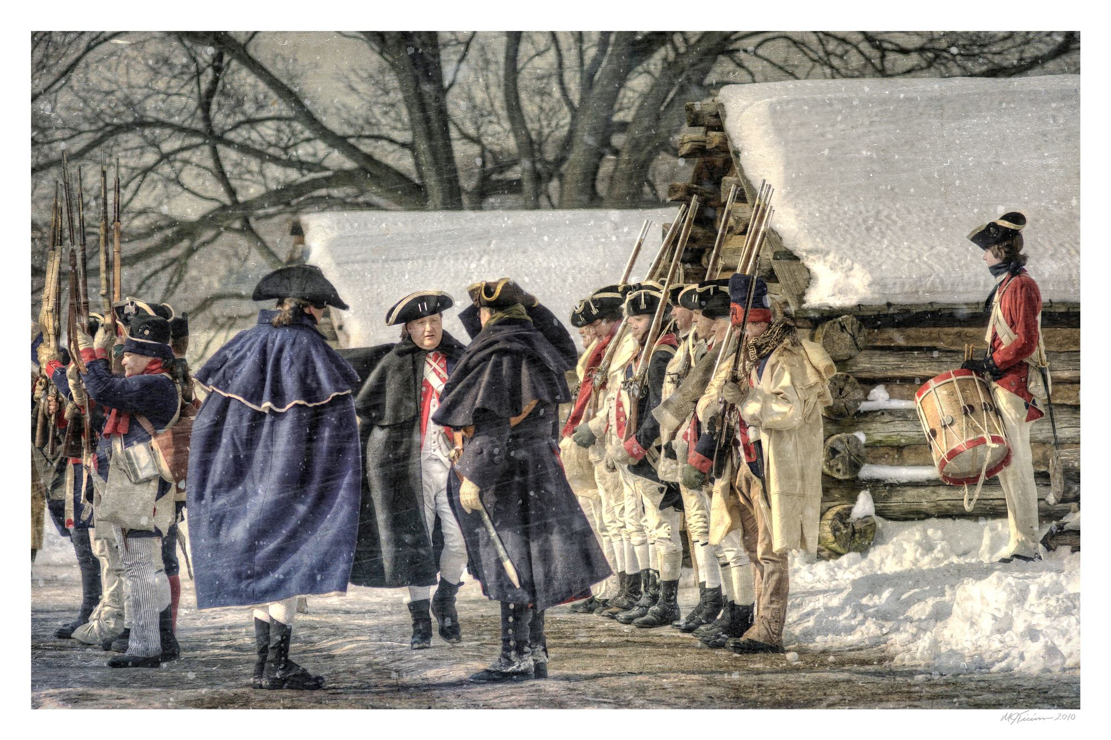
Courtesy of Valley Forge National Historic Park

Slide 7
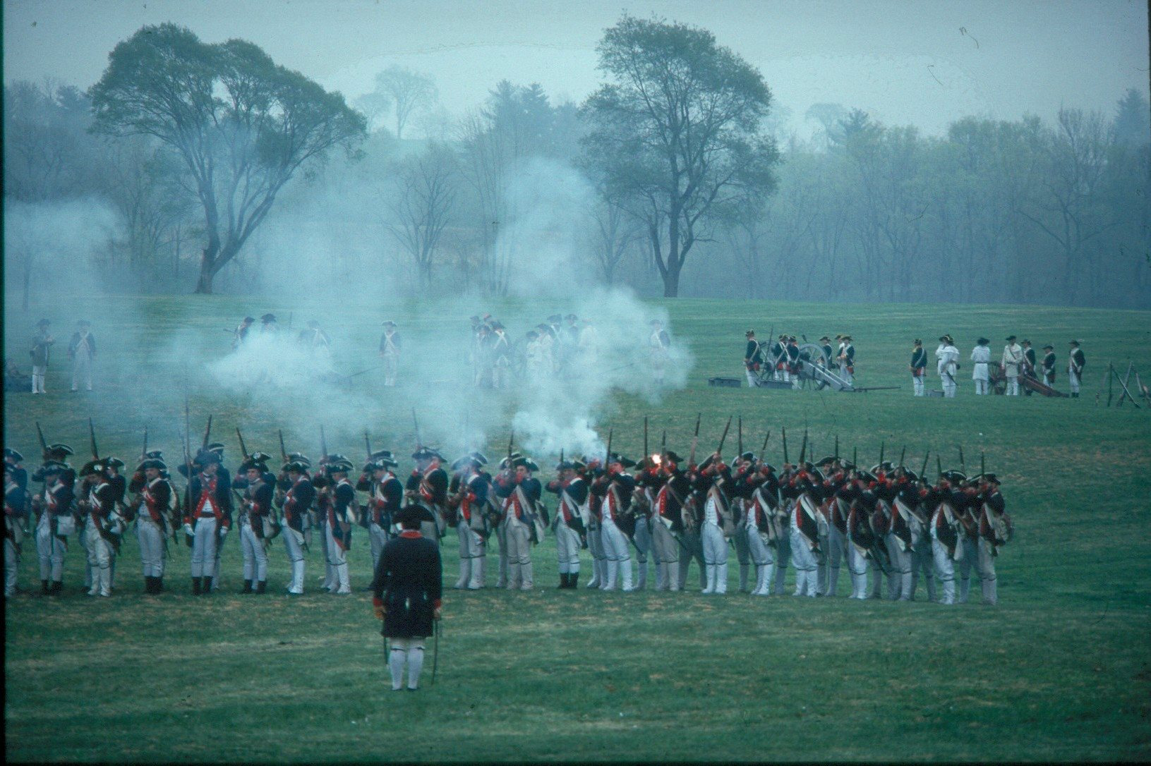
Training the Army
Von Steuben’s first step was to write the drills for the army.
  At this time, each state used different drills and maneuvers, patterned upon various European methods.
As Inspector General, Steuben's task was to create one standard method, thus coordinating the entire Continental Army.
  As he could not speak or write English, Steuben originally wrote the drills in French, the military language of Europe at the time.
  His secretary, Duponceau, translated the drills from French into English. Then John Laurens and Alexander Hamilton, two of Washington's aide-de-camps, rewrote them into military language.
They were then given to the brigade inspectors, who made copies of the next lesson in the orderly book for each respective brigade and regiment.
  Copies were taken from the orderly book to each company and then to each officer.
Firing Line
Courtesy of Valley Forge
National Historic Park

Slide 8
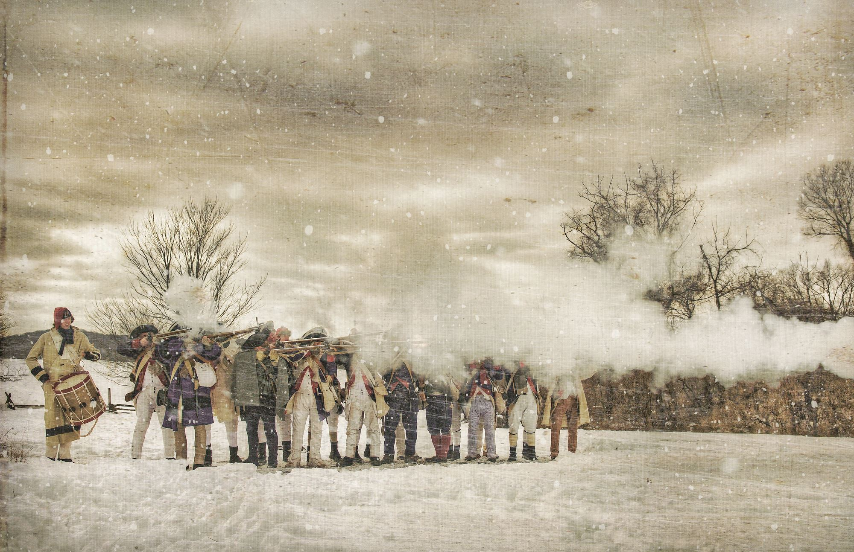
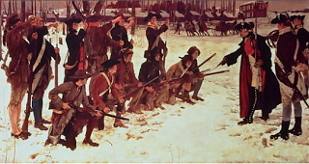
Courtesy of Valley Forge
National Historic Park
Baron von Steuben Drilling Troops at Valley Forge
By, E. A. Abbey (c.1904),
Courtesy of Pennsylvania State Capitol, Harrisburg.

Slide 9
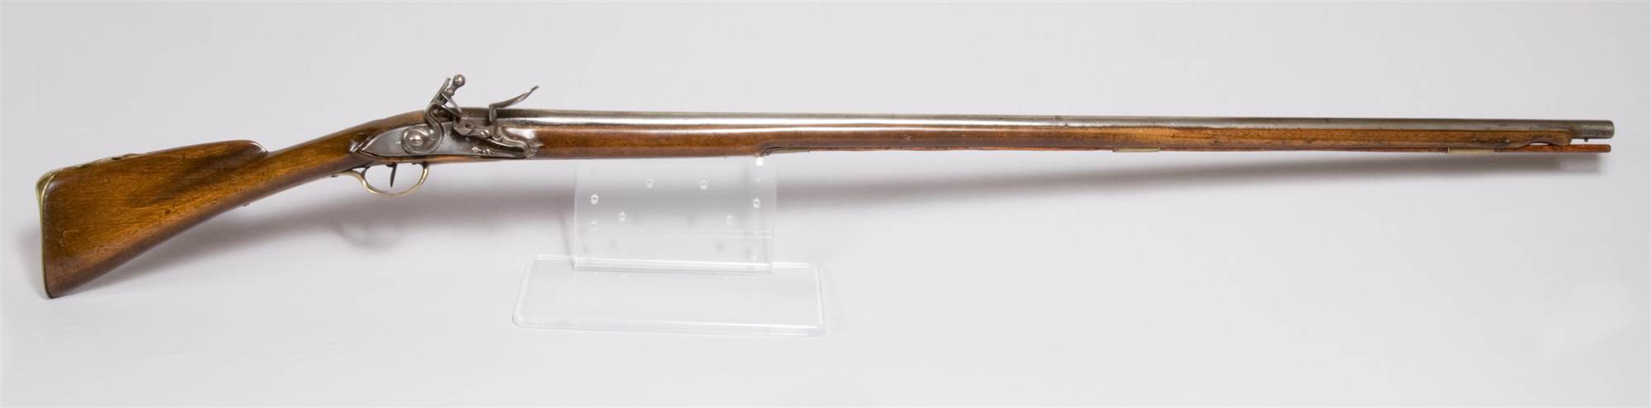
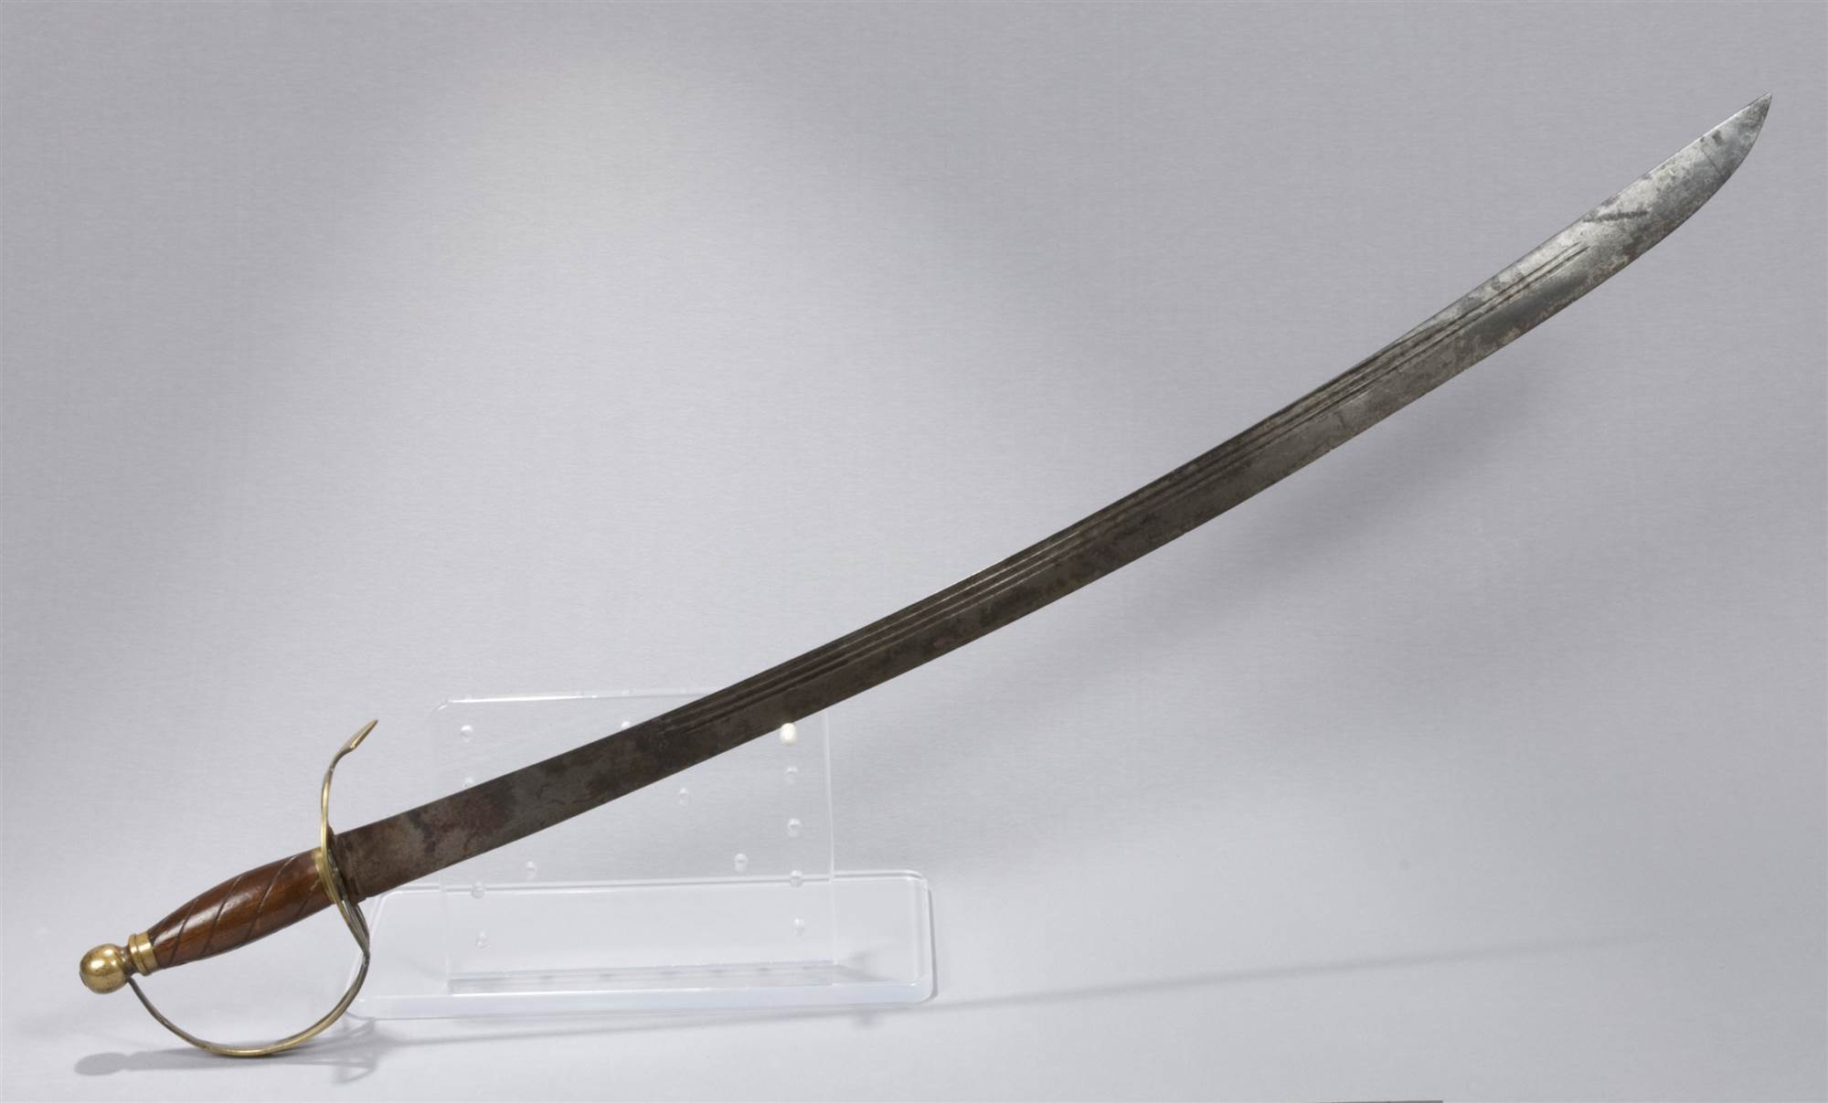
Training the Army
The Baron used the Commander-in-Chief's Guard and men from each state, about 120 men total, as a model company to demonstrate each new lesson.
Steuben would write the new drills at night, staying only several days ahead of the whole army.
He tried to fit his drills to the men he was teaching in the quickest possible time, by making them as simple as possible.
  In this way, uniform maneuvers and discipline was given to the army in a very rapid and orderly fashion.
Steuben set a precedent by working with the troops directly.
  Up to this time, the American officers had accepted the British practice of letting the sergeants drill the men, as it was thought to be ungentlemanly for officers to do so.
Flintlock Musket
Valley Forge National Historical Park, VAFO 142
Horseman Saber
Valley Forge National Historical Park
VAFO 498

Slide 10
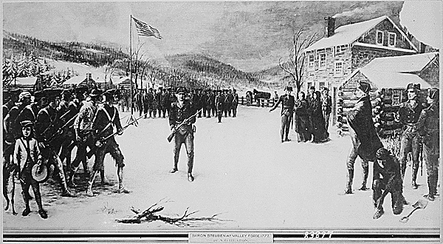
Courtesy of the Library of Congress

Slide 11
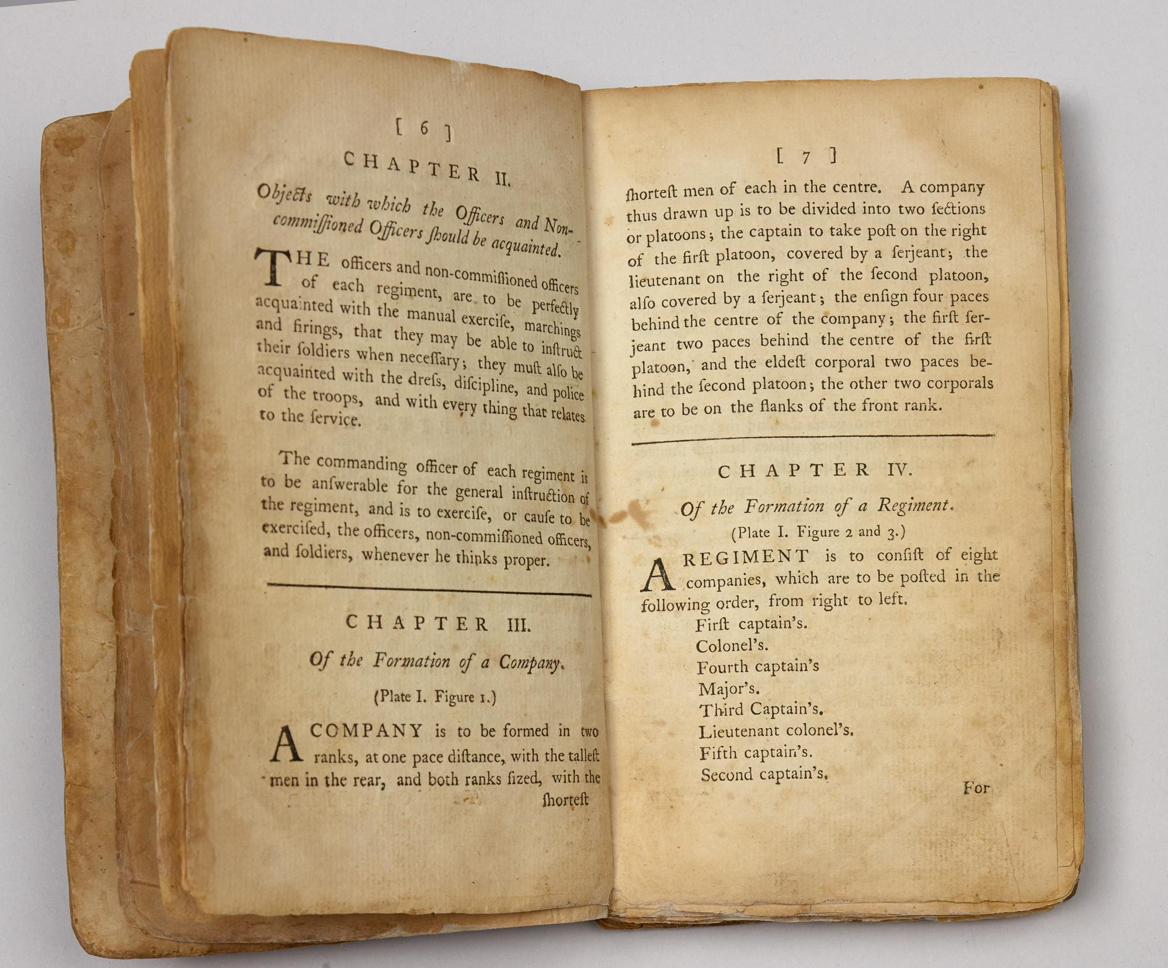
Order and Discipline
In the winter of 1778-1779, Gen. von Steuben went to Philadelphia to write his book of regulations.
  Lt Col. Francois de Fleury, a French volunteer serving in the Continental Army, assisted in writing the original French text. Duponceau and Capt. Benjamin Walker translated it into English.
  It was illustrated by Capt. Pierre Charles L'Enfant, the man who would design Washington D.C.
The Regulation for the Order and Discipline of the Troops of the United States was approved by Congress in March 1779. It became known as the "Blue Book," and it was used by the United States Army until 1814.
Gen. von Steuben rejoined the Continental Army on April 27, 1779, and he served throughout the remainder of the war.
  He was instructor and supply officer for Gen. Nathanael Greene's southern army, which fought the key battles that led to the British surrender at Yorktown in 1781.
  Steuben commanded of one of the three divisions in the Continental Army at Yorktown. In 1783, he helped demobilize the army, and resigned in 1784.

Slide 12
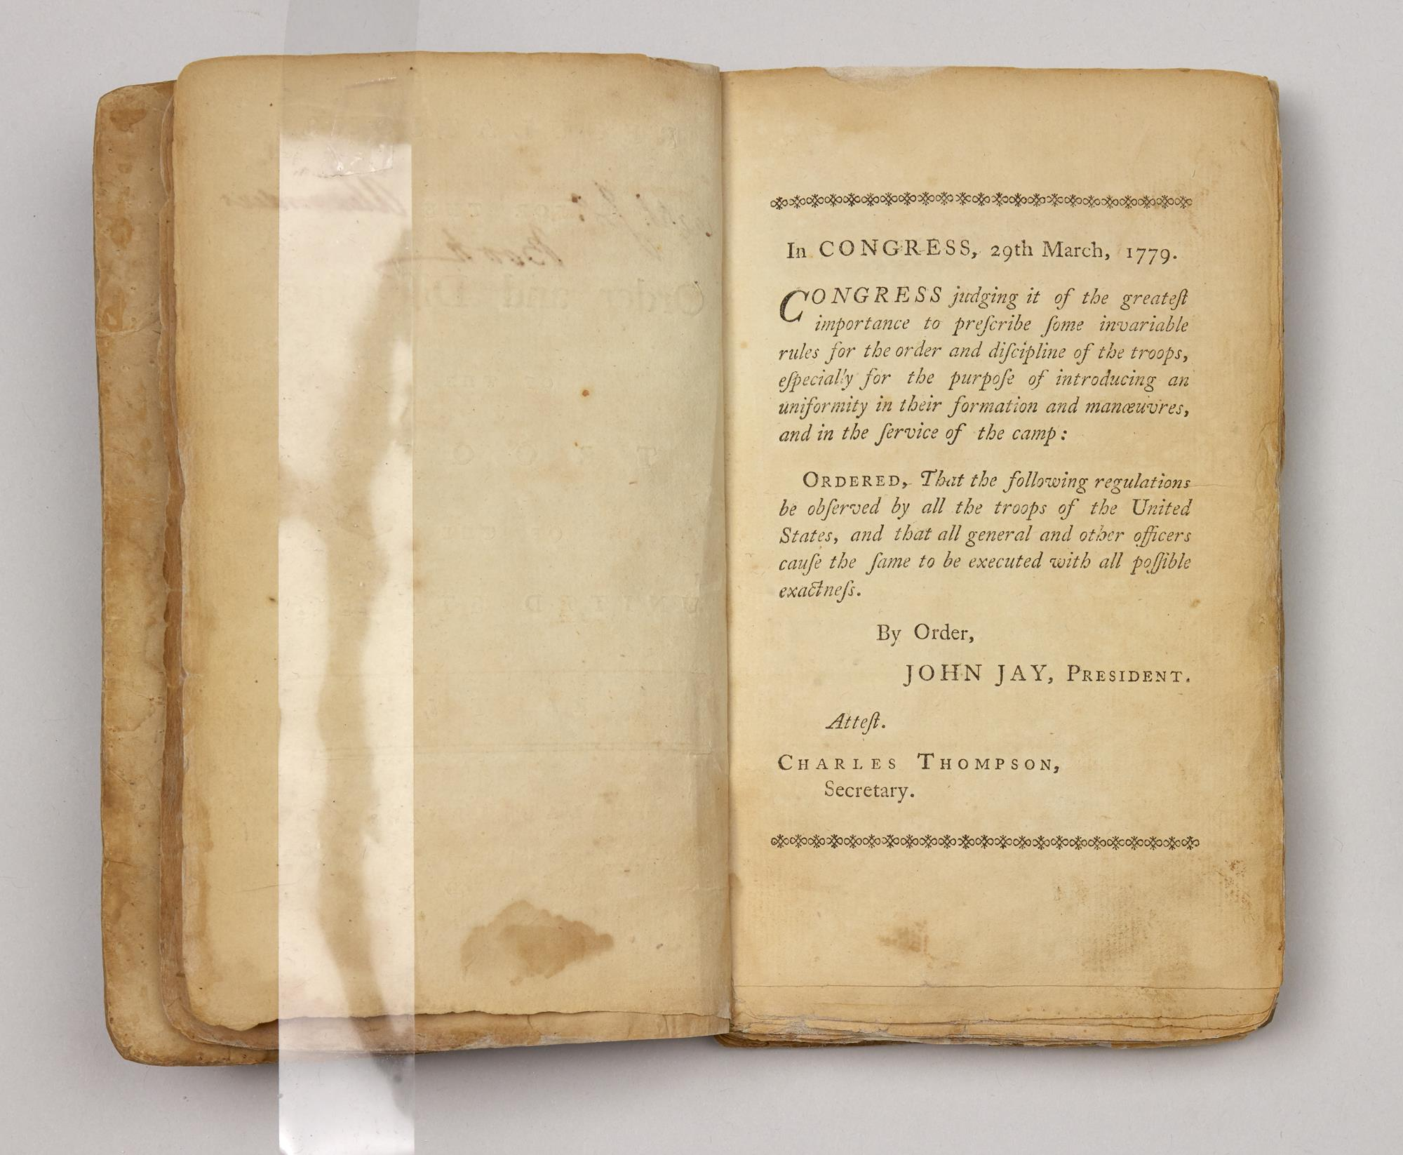
Courtesy of Valley Forge National Historic Park
VAFO 63977

Slide 13
After the War
During the war, Von Steuben had continually asked Congress for more money for his expenses.
After the war, he continued petitioning for compensation for his services. Congress did pay a portion of the amount Steuben expected, but not all.
New York, Pennsylvania, and Virginia granted him land, of which he sold portions, but these payments never quite offset his living expenses.
Consequently, he was forced to retire from New York City to his land holdings in order to live out the remainder of his life. Steuben never married, and he died on his 16,000 acre farm tract in the Mohawk Valley of New York, on November 28, 1794.
Although he never received the financial rewards he expected, Steuben will never be forgotten in the annals of American history. His administrative brilliance in organizing, training, and preparing the Continental Army for battle will ensure his legacy in the cause of American independence.

