Slide 1
Tips for a Good Proposal
National Park Service
Commercial Services Program
Updated July 1, 2021

Slide 2
Topics Covered
Due diligence
Notice of Intent to Propose
Content

Slide 3
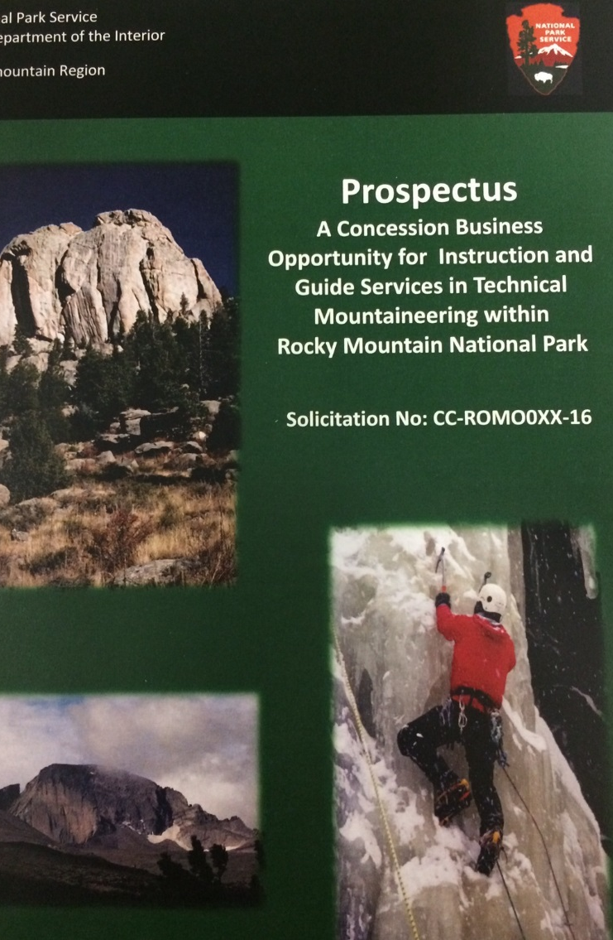
Due Diligence
Prospectus
  Business Opportunity
  Proposal Instructions
  Proposal Package
  Contract including exhibits
Site Visit
Q and A deadline
Notes:
Everyone interested in bidding for a concession contract should investigate the opportunity as thoroughly as possible. Our prospectuses contain a lot of information about the operations, and we expect bidders to take additional efforts to understand the operations and prepare a proposal.

Slide 4
Due Diligence – Prospectus
Review entire document
  Business opportunity
  Proposal instructions
  Proposal package
  Contract and exhibits
  Appendices
Notes:
We expect every offeror to review the entire prospectus, including appendices, early and thoroughly.
The business opportunity describes some conditions under which the concessioner will operate and some requirements of the draft contract including the minimum franchise fee, any required component renewal reserve, the length, operating seasons, and investment requirements.
Proposal Instructions
The instructions usually are the same from prospectus to prospectus but may have unique features. You should review them completely before preparing and submitting the proposal.
Proposal package
Proposal packages are unique for each prospectus.
Transmittal letter can vary from project to project. Review it and make sure you complete it. Failure to submit a signed transmittal letter usually results in a finding that the proposal is not responsive.
Contract and exhibits
These are not subject to negotiation or change after selection of the new concessioner other than to insert the terms of the best proposal. The description of the services in the contract and the operating and maintenance plans describe unique components of the operations. The land assignment and insurance exhibits describe expenses offerors must account for in their proposals.
Appendices
The appendices includes a Word version of the proposal package to assist offerors in completing proposals. They also include Excel workbooks the offerors MUST use to respond to PSF4 in the proposal package. Appendices usually include rates approved for concession operations, pertinent park planning documents, and links to other important information.

Slide 5
Due Diligence – Site Visit
RSVP if requested or required
Attend to learn logistics of operation
If none scheduled, arrange one as described in the Business Opportunity
Visit park website at nps.gov to understand more about the park and the opportunity
Notes:
Take advantage of scheduled site visits to learn more about the park and the operation.
Follow rules for the site visit, such as the following:
Pre-registration
Limited number of participants
Business employees and consultants
Disclosure of professional relationships
Be on time
Stay with the group
Park websites provide additional information that may help in preparing proposals.
We rarely host site visits for Category III contracts because most operations under those contracts do not have assigned park facilities and business operations to observe.

Slide 6
Due Diligence – Q and A
Know the deadline
What you do not understand in the prospectus
Cite the specific section of the prospectus
Email submittals
NPS may not answer all questions or reproduce them in their entirety
Notes:
Take advantage of the opportunity to submit written questions, but understand we answer questions about the prospectus and not about broader policy or legal issues.
Focus your questions on the opportunity in the prospectus and cite the specific section and page number.
We frequently combine similar questions and do not reproduce all questions submitted word for word.
The deadline for questions is early in the process to enable NPS time to provide responses at least 30 days prior to the proposal due date. We rarely extend the deadline for questions but may extend the due date for proposals to provide interested parties sufficient time to consider information in our responses when preparing proposals.

Slide 7
Notice of Intent to Propose
Know the deadline
Even if we extend the due date for proposals, we may keep this deadline
Failure to submit the notice timely will result in NPS not considering the proposal
Notes:
Knowing the number of proposals to expect helps NPS plan for evaluation panels.
This deadline always will be at least 60 days following the release date of the prospectus.
The time between this deadline and the proposal due date likely will vary from project to project.

Slide 8

Content of Your Proposal
Completeness
Clarity
Format
Notes:
Give us everything we seek – maybe a little more – nothing less.
Follow the organization of the subfactors – don’t make it a puzzle for us.

Slide 9
Content - Completeness
Respond to every Selection Factor and subfactor
Make your commitments clear
Clearly identify the Offeror and Offeror-Guarantors and have appropriate party/parties sign the transmittal letter
Use PSF 3 to explain
  Offeror
  Experience
  Violations
PSF 4 - Provide every document we request
  Use the Excel workbooks in the appendix
Notes:
We often have complex multipart requests. For many contracts, this is necessary to select the best company to operate in the park for the next 10 to 20 years. Even small operations present complex resource and safety issues necessitating complex requests.
Most selection factors contain two or more subfactors
Review this carefully to make sure you respond to every part
Avoid extraneous information
Focus on describing your commitments and avoid corporate philosophy
Not all proposals have Offeror Guarantors, but when they do, clearly explain that relationship.
PSF 3 can be tricky. First, in the unscored part, thoroughly explain the offeror and related entities that will provide financial or managerial support to the offeror. A clear explanation of these relationships may affect how we look at other responses primarily in PSF 3 and 4.
In PSF 3 we ask for experience in similar operations. If an offeror uses experience of related entities, clearly explain how that related entity will support the offeror’s operations. Merely describing what another company does in another location does not explain the experience of the offeror.
In PSF 3 we also ask about violations and other negative operating history. In responding, offerors should make sure to consider, disclose, and discuss information about all related entities relied upon in other parts of the proposal. As our instructions allow us to consider other information available to us, a failure to fully disclose readily available information could lead to a lower score.
We require specific documents and explanations in PSF 4. Make sure you provide the correct ones. Usually, this includes historical financial statements, bank statements, credit reports, and funding commitments
Cross check the content of PSF 4 to make sure you explain funding for commitments you make in other parts of the proposal.

Slide 10
Content - Clarity
Say it once – say it clearly
Break up the monotony of words
Illustrate if it adds to your commitment
Make it unique
Notes:
Prepare a proposal that is easy to follow, easy to read, and easy to understand.
Clearly state your commitments with sufficient detail for us to evaluate the difference among proposals.
Put the commitments first – don’t bury them in other narrative
Consider that we evaluate several proposals discussing the same topics. Make yours stand out.
Do not include information just to meet our page limits. If you can fully explain your ideas in two pages, don’t use three.

Slide 11
Content – Format Rules
Follow the format instructions
  Page size and limits
  Font size
  Margins
Beware of cross references
Use the forms provided
Notes:
Carefully read the format rules in the proposal instructions and proposal package.
Not all subfactors have page limits – we specifically note when they apply.
We check font size and margins.
Avoid cross references from one response to another if doing so will exceed page limits.
Use the forms provided for responses.
Consequences:
Exceeding page limits: We do not read, consider, even look at the extra information when evaluating proposals
Using smaller fonts: We convert proposals to the authorized size and do not consider information that exceeds page limits as a result of the conversion
Margins: We do allow identification of confidential information and page numbers in margins.

