Slide 1
panoramic map
an overhead, but tilted image usually composed by hand artistically to suggest a three dimensional view. These maps were used most often in the past to attract those moving West or prospective real estate investors.

Slide 2
birds-eye map
· an overhead, but tilted image usually composed by hand artistically to suggest a three dimensional view. These maps were used most often in the past to attract those moving West or prospective real estate investors.

Slide 3
contour map
an overhead image hand-drawn or composed by computer aided design tools used to illustrate elevation changes over a selected geographic space.

Slide 4
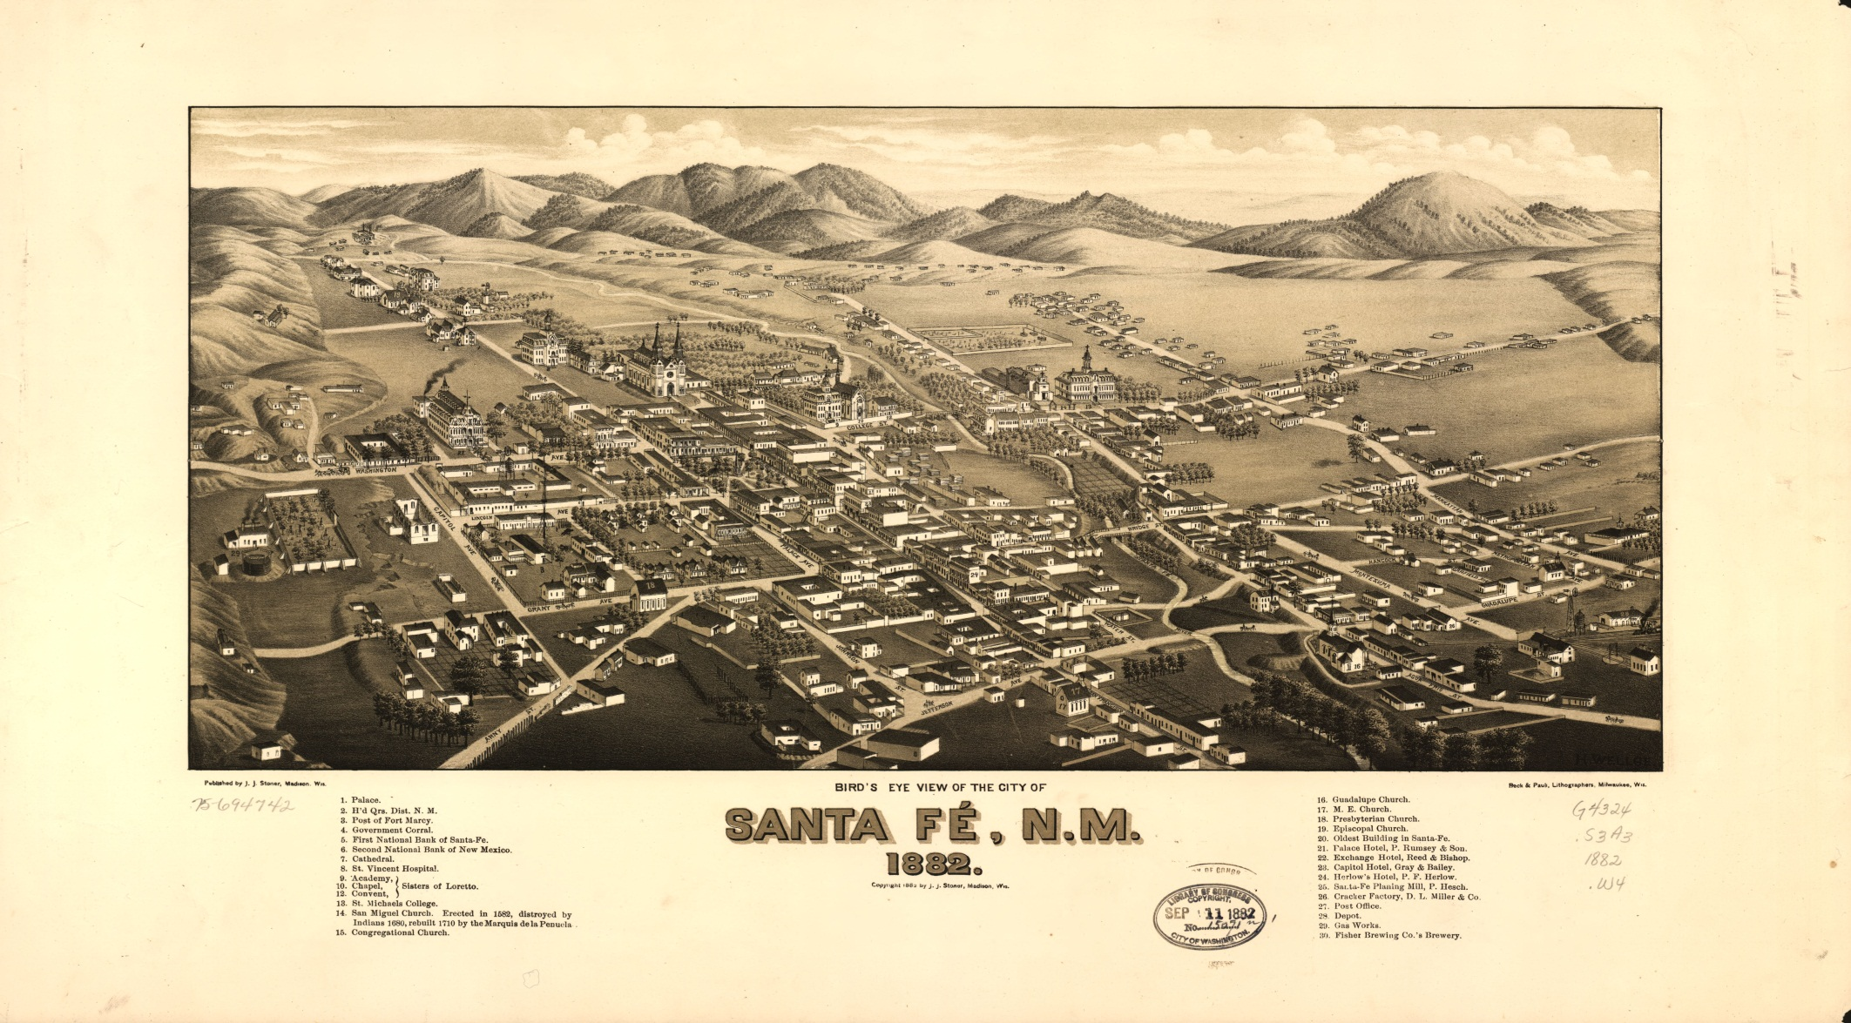
panoramic map...
an overhead, but tilted image usually composed by hand artistically to suggest a three dimensional view.

Slide 5
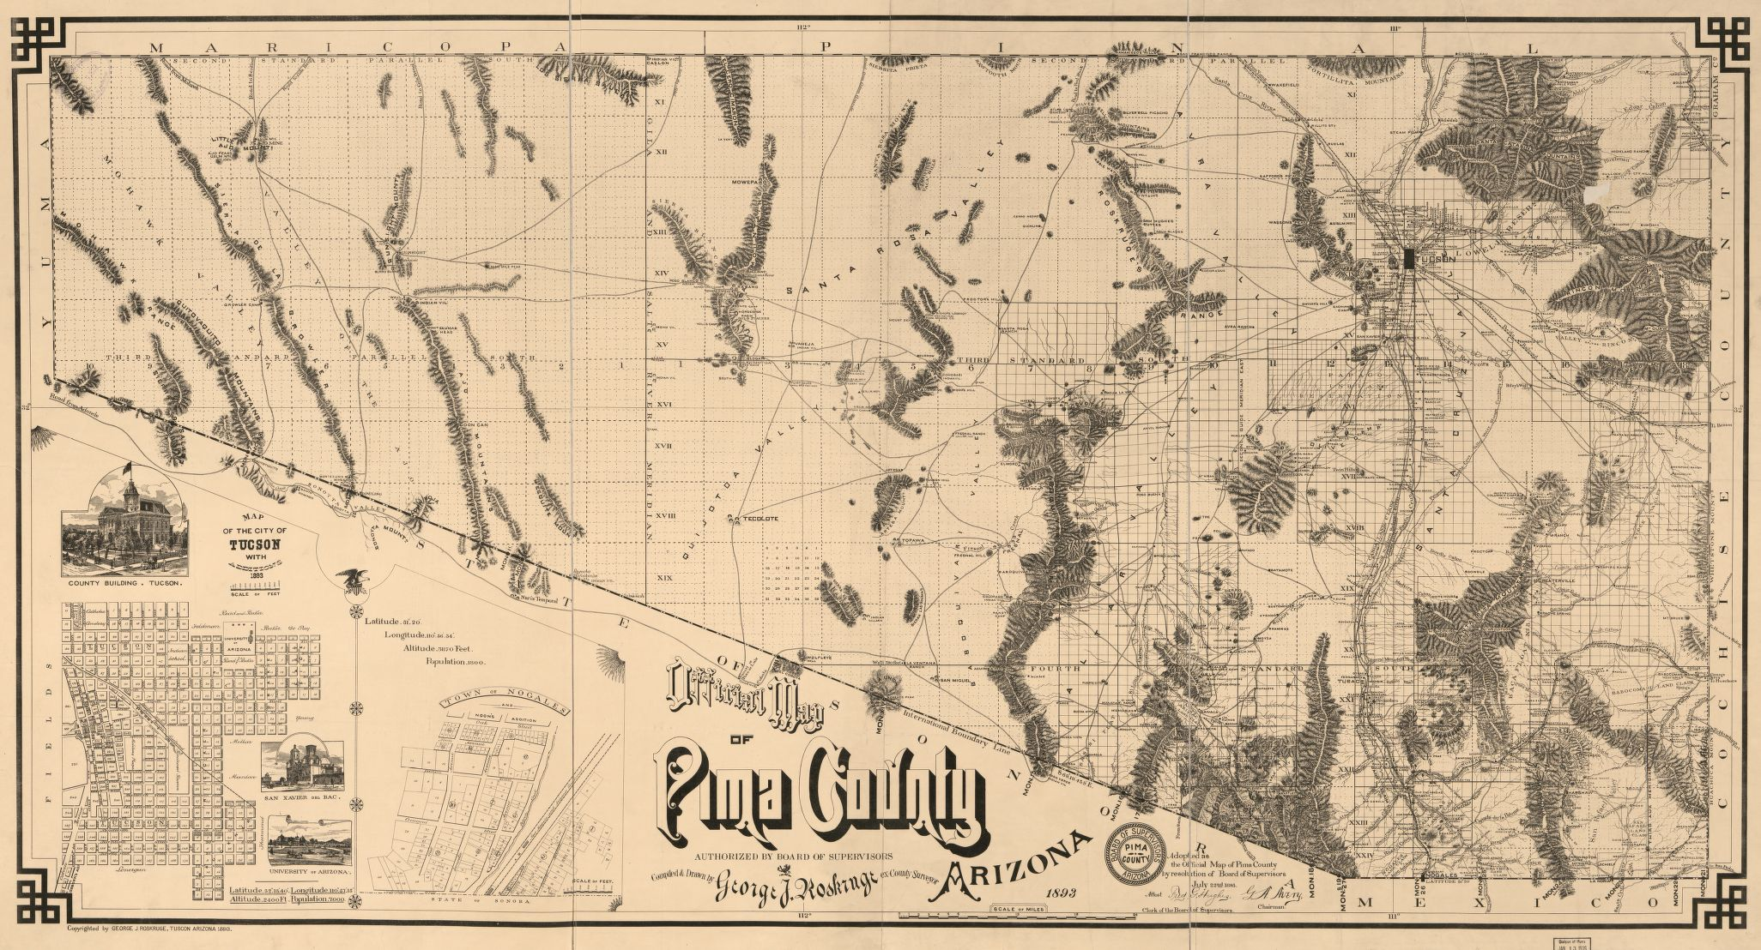
birds-eye map...
an overhead, two dimensional (2D)image, hand drawn or photographed.

Slide 6
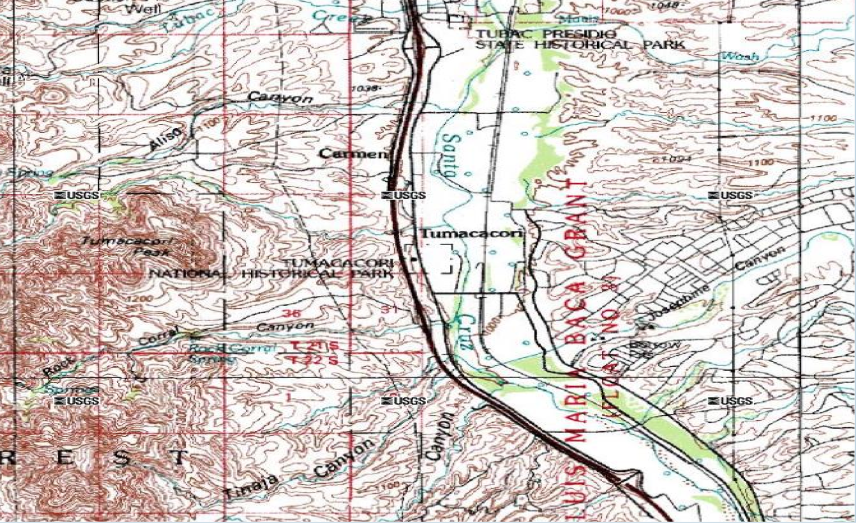
countour...
an overhead image used to illustrate elevation changes over a selected geographic space.

