Slide 1
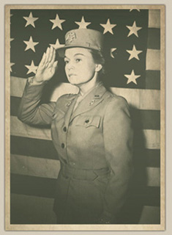
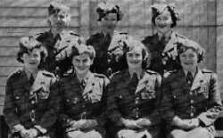
Women in World War 2:
The Political Battle Behind the WAAC
By Megan Blank

Slide 2
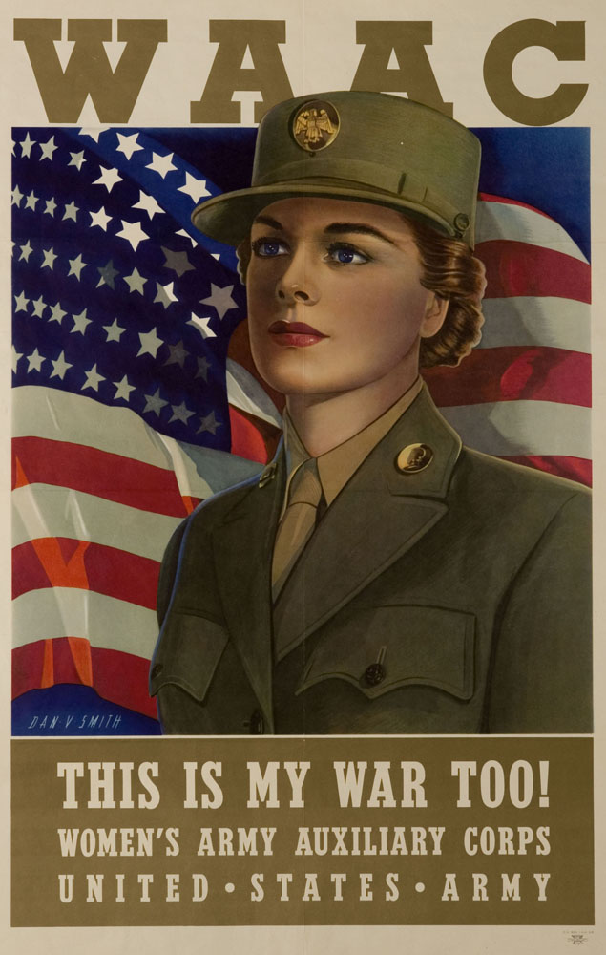
WAAC…What is it?
Women’s Army Auxiliary Corps
Two main goals for the legislation = equality & efficiency
The British Military included established women’s organizations, an example for the U.S.

Slide 3
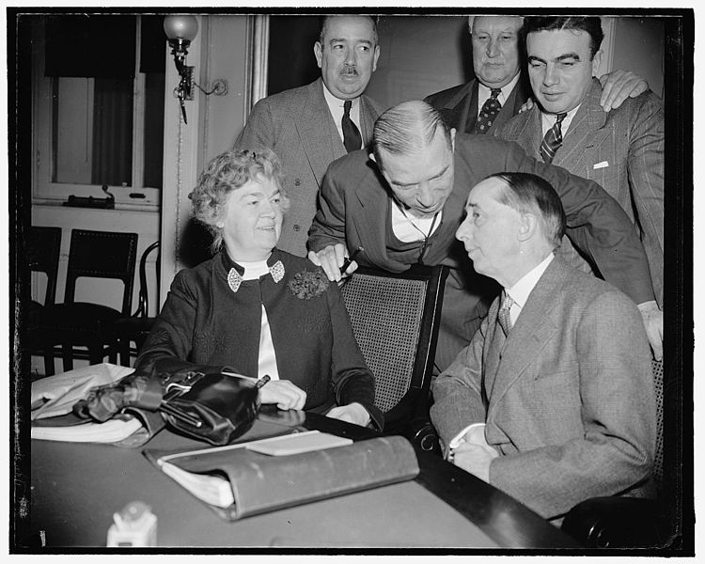
Congresswoman Edith rogers
-> Wanted greater provisions for women beyond what had been done for civilian employees in World War I
-> Introduced legislation regarding a women’s military unit

Slide 4
War Department
Existence of previous reports by the War Dept. from World War I were ignored regarding the necessity for similar rights, privileges, and benefits for female civilian employees and soldiers alike.
Support from the War Dept. was crucial to the passage of Rep. Rogers’ bill.
Although not fully convinced, the War Dept. began to make plans for a women’s unit, should the bill pass.

Slide 5
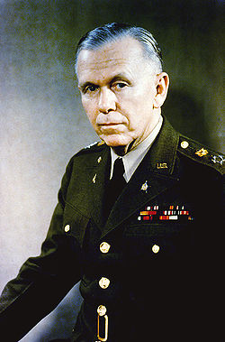
General George Marshall
-> War Department Chief of Staff
-> After Pearl Harbor, he wrote a letter of support/recommendation regarding the creation of the WAAC.

Slide 6
Legislation
Representative Rogers spent time meeting with leaders of the War Department, notifying them of her plans to introduce new legislation.
Representative Rogers introduced a bill that provided for the creation of a women’s military unit within the army to Congress in May 1941.

Slide 7
Pearl Harbor’s Effect
Before
~ Not much action on bill
~ Much opposition, low amounts of support
After
~ Pressure on Congress to pass the bill
~ More debate, more action taken on passage
~ Increasing amount of support

Slide 8
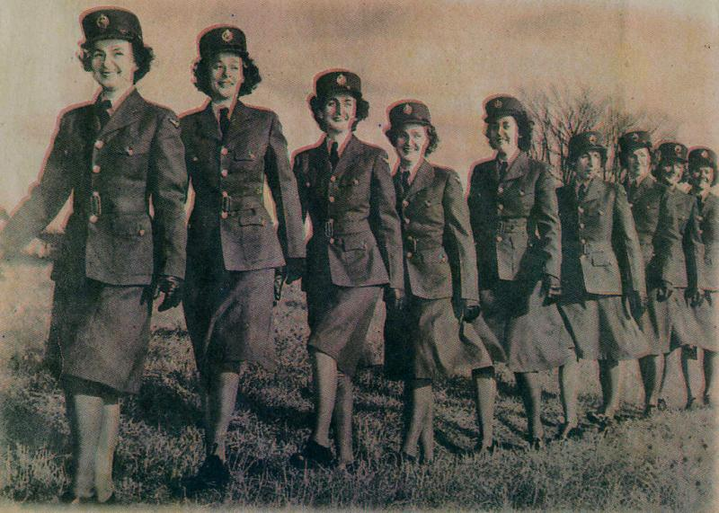
Action Taken
Three weeks post Pearl Harbor, the Secretary of War made minor changes to the bill and sent it on with his recommendations.
Hearings were completed in March 1942, and House Resolution 6293 was unanimously recommended by the House Committee on Military Affairs

Slide 9
Congressional Opposition
Most opposition to the bill was due to the major change it suggested to the traditional woman’s role in society.
Who will cook, mend, clean, and take care of the children?
How will women in the military affect the numbers of able-bodied men available to serve in possible future conflicts

Slide 10
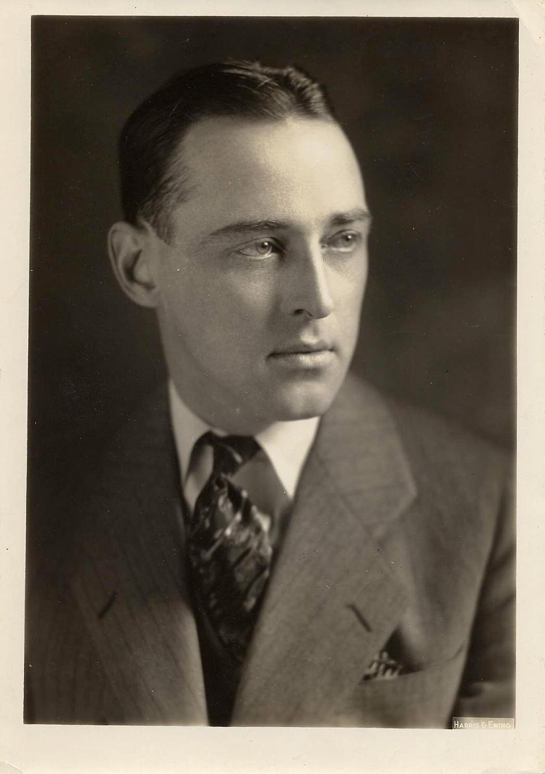
"…the silliest piece of legislation that has ever come before my notice in the years I have served here. A woman's army to defend the United States of America. Think of the humilitaion. What has become of the manhood of America, that we have to call on our women to do what has ever been the duty of men? The thing is so revolting to me, to my sense of decency, that I cannot discuss it."
~Congressman Andrew Somers, NY
More professional opinions in opposition were voiced within questions and details
Congress faced pressure to assist in war efforts by passing this legislation quickly

Slide 11
Public Opinion
Boyfriends and husbands were concerned for their significant others’ well-being
There were increasing amounts of public support for the bill. The public saw it as something being done to boost war efforts
Women recognized the opportunities they would gain if they could train and work in the army, and a number wanted to travel.

Slide 12
The Debate
Representative Rogers faced many questions and a long debate as Congress prepared to vote on the bill
Representative Rogers debated vs. Committee Chairman May and several colleagues
Significant support from Washington women and female organizations throughout the debate.

Slide 13
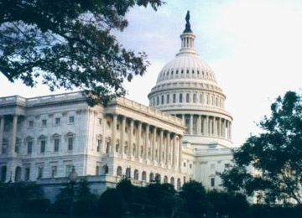
The House Votes…
-> Representative Rogers’ bill concerning the creation of a women’s division of the U.S. Military passed by a vote of 249-83 with 96 absent

Slide 14
…And On to the Senate
Representative Rogers’ bill reached the Senate floor and over the next two months it was debated and amended
Debate in the Senate was significantly shorter in comparison with the House. However opposition was higher in the Senate.
The bill passed the Senate with a final vote of 38-27, with almost one-third of senators not present.

Slide 15
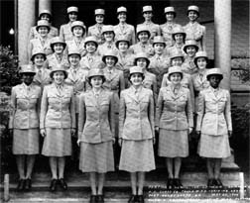
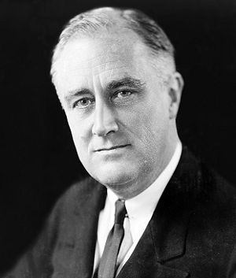
WAAC – The Women’s Army Auxiliary corps
-> President Franklin Roosevelt signed the bill into law on May 15, 1942. The War Department began working on the details of this new branch immediately.

Slide 16
Final Result
Sections of the original bill included those regarding overseas duty, bi-leadership, and racial discrimination in units.
The final bill was essentially a compromise – the WAAC was created for women to work with the army, with considerable details surrounding what women could/could not do.
Additionally, other pieces of legislation had passed the House concerning women’s units in the Navy and the Air Force

Slide 17
Bibliography
Dombrowski, Nicole Ann. Women and War in the Twentieth Century. New York: Garland Publishing, Inc., 1999.
Hinton, James. Women, Social Leadership, and the Second World War. Oxford: Oxford University Press, 2002.
Jordan, Jeanne. “Women’s Auxiliary Army Corps.” North Irish Roots, Vol. 12, No. 1 (2001), p. 23.
Pollard, Clarice. “WAAC’s in Texas during the Second World War.” The Southwestern Historical Quarterly, Vol. 93, No. 1 (Jul. 1989), pp. 60-74.
Poulos, Paula Nassen. A Woman’s War Too: U.S. Women in the Military in World War II. Washington, D.C.: National Archives Trust Fund Board, 1996.
Piehler, G. Kurt. “Women in the Army: World War II.” Daily Life Through History, (2011) : ABC-CLIO.
Taylor, Eric. Women Who Went to War. London: St. Edmundsbury Press Ltd., 1988.
Weatherford, Doris. American Women and World War II. New Jersey: Castle Books, 1990.
“WAVES, WAAC’s, SPARS, and Nurses.” The American Journal of Nursing, Vol. 43, No. 2. (Feb., 1943), pp. 134-137.
Bellafaire, Judith. “The Women’s Army Corps: Commemoration of World War II Service.” CMH Publication 72-15. 10 Sept. 2011. http://www.history.army.mil/brochures/WAC/WAC.HTM
Campell, D’Ann. Women at War With America. Cambridge, Mass: Harvard University Press, 1984.
This presentation may be published by Professor Harry Butowsky in connection with the National Park Service.

