Slide 1
Role of the LSTs (Landing Ship Tank) in WW II Amphibious Operations
by
Carlos Luna
Notes:
LST unloading in Sicily

Slide 2
Background
Planning for amphibious operations in the European and Pacific theaters identified the need for specialized ships and landing craft to load and unload military cargo on unprepared beaches
The British Navy developed initial designs for various types of amphibious craft
These plans were shared with the American Navy and it was agreed the Americans would take over development and production of the amphibious craft

Slide 3
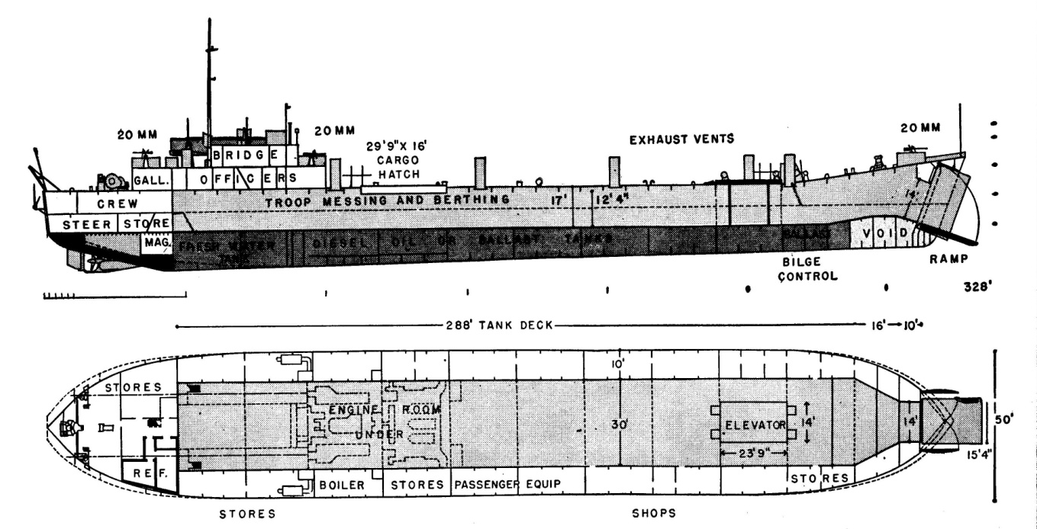
LST DESIGN
Initial designs that called for an amphibious landing craft were replaced by an ocean going ship that would carry 20 tanks and their crews directly on to the beach and then extract itself under its own power
The ship would be 328 feet long, 50 feet wide, displaced 3,880 tons with an endurance of 12,000 nm at 10kts
Notes:
LST ship plan; MacArthur’s Amphibious Navy, Appendix C pg 360
Displacement: 1,780 long tons (1,809 t) light 3,880 long tons (3,942 t) full load
Length: 327 ft 9 in (99.90 m)
Beam: 50 ft (15 m)
Draught: Unloaded : 3 ft 4 in (1.02 m) bow 7 ft 6 in (2.29 m) stern Loaded : 8 ft 2 in (2.49 m) bow 14 ft 1 in (4.29 m) stern
Propulsion: 2 × General Motors 12-567 diesel engines, two shafts, twin rudders
Speed: 12 knots (14 mph; 22 km/h)
Boats and landing craft carried: 2 to 6 LCVPs Troops: Approx. 140 officers and other ranks Complement: 8 to 10 officers, 100 to 115 enlisted Armament: • 1 × 3 in (76 mm) gun • 6 × 40 mm Bofors guns • 6 × 20 mm guns • 2 × .50 cal (12.7 mm) machine guns • 4 × .30 cal (7.62 mm) machine guns
Source: http://en.wikipedia.org/wiki/Tank_landing_ship

Slide 4
List of American Shipyards and Manufacturers that built LSTs
Builders:
American Bridge, Ambridge, PA- LST 137-141, 261-295, 653-681, 754-771, 829-849, 1081-1095
Bethlehem-Fairfield Co. Baltimore, MD- LST 401-430
Bethlehem-Hingham, Hingham, Mass- LST 906-979, 1060-1080
Bethlehem Steel, Quincy, MA- LST 361-382, 1004-1027
Boston Navy Yard -LST 301-310, 980-1003, 1028-1037
Charleston Navy Yard, Charleston, SC -LST 353-360
Chicago Bridge & Iron, Seneca, IL -LST 132-136, 197-231, 511-522, 600-652, 772-774, 850-860, 1115-1152
Dravo Corp., Pittsburgh, PA - LST 1-5, 7-15,17-20, 22-24, 26-60, 730-753, 775-796, 884-905, 1038-1059
Dravo Corp., Wilmington, DE -LST 6, 16, 21, 25
Jeffersonville Boat, Jeffersonville, IN -LST 61-84, 117-121, 181, 501-510, 523-530, 682-729,797-805, 861-873, 1096-1100
Kaiser, Inc. Vancouver, WA -LST 446-475
Kaiser, Inc. Richmond, CA -LST 476-490
Missouri Valley Bridge & Iron, Evansville, IN -LST 122-131, 157-180, 237-247, 491-500, 531-599, 806-828, 874-883, 1101-1114
Newport News Shipyard, Newport News, VA -LST 383-400
Norfolk Navy Yard, Norfolk, VA -LST 333-352
Philadelphia Navy Yard, Philadelphia, PA -LST 319-332
Notes:
Inside LST, http://www.insidelst.com/design.htm

Slide 5
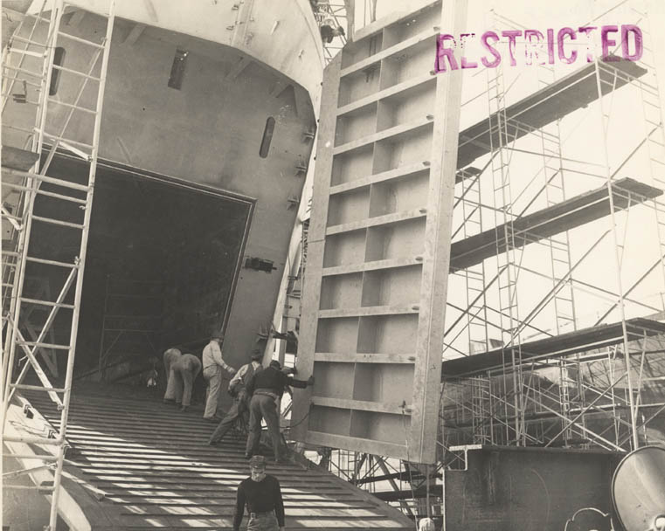
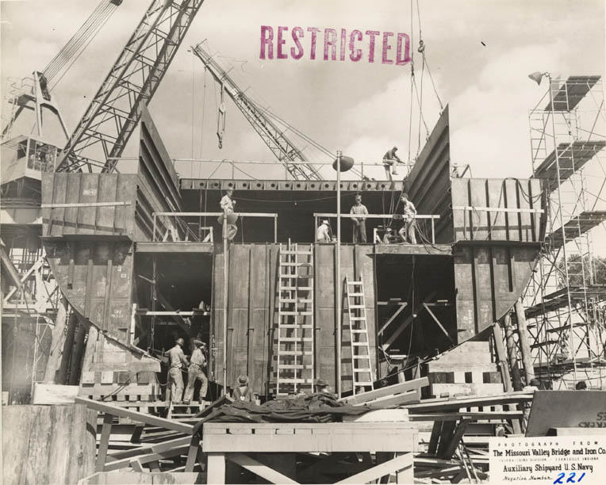
Construction activity at Evansville, Indiana plant
The largest producers of the LSTs were industrial facilities located in the Midwest along the inland water ways
Over 1050 ships were produced during the war
So many ships were produced, they were only assigned hull numbers, they were not assigned individual names
Notes:
More LSTs were constructed at Evansville than any other facility

Slide 6
European Amphibious Operations
Notes:
http://www.ibiblio.org/hyperwar/USA/USA-C-WWII/maps/USA-WWII-1.jpg

Slide 7
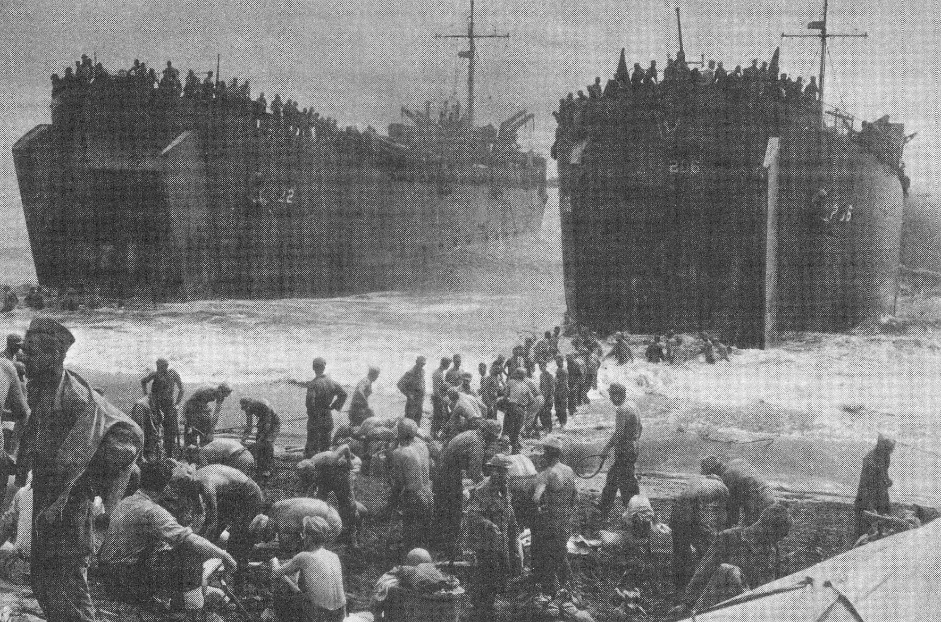
LSTs in European Landings
LSTs in the Normandy Invasion
Troops unloading supplies from beached LSTs

Slide 8
Pacific Amphibious Operations
Notes:
http://www.ibiblio.org/hyperwar/USA/USA-C-WWII/maps/USA-WWII-2.jpg

Slide 9
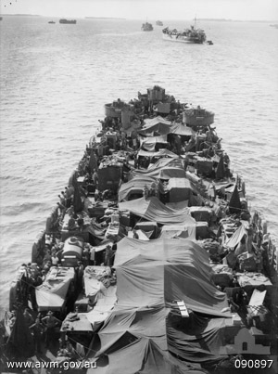
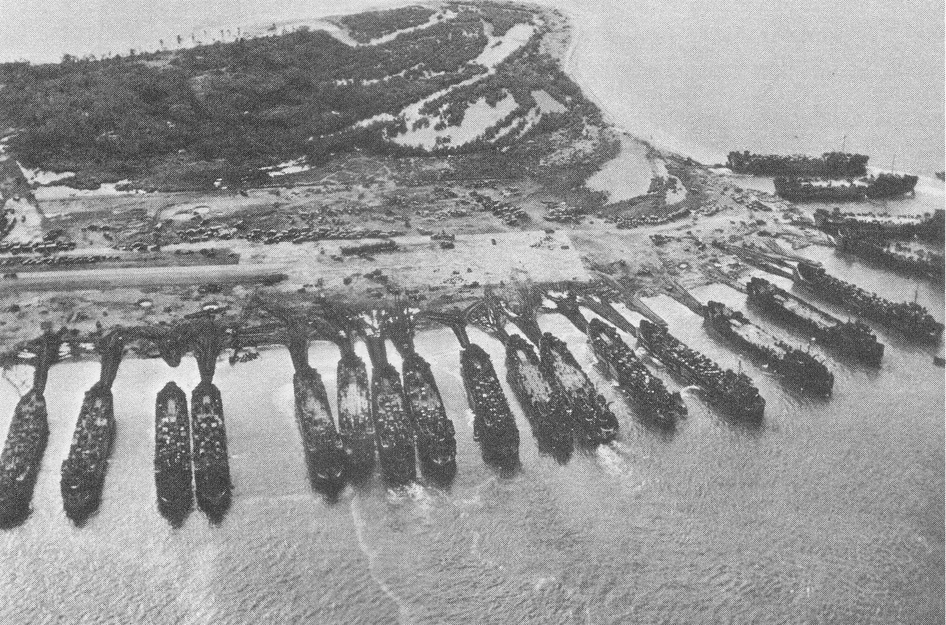
LSTs in Pacific Landings
20 LST’s in the Leyte Gulf Assault
Fully loaded LST on the way to Tarakan Island; 3 hours estimated time to unload

Slide 10
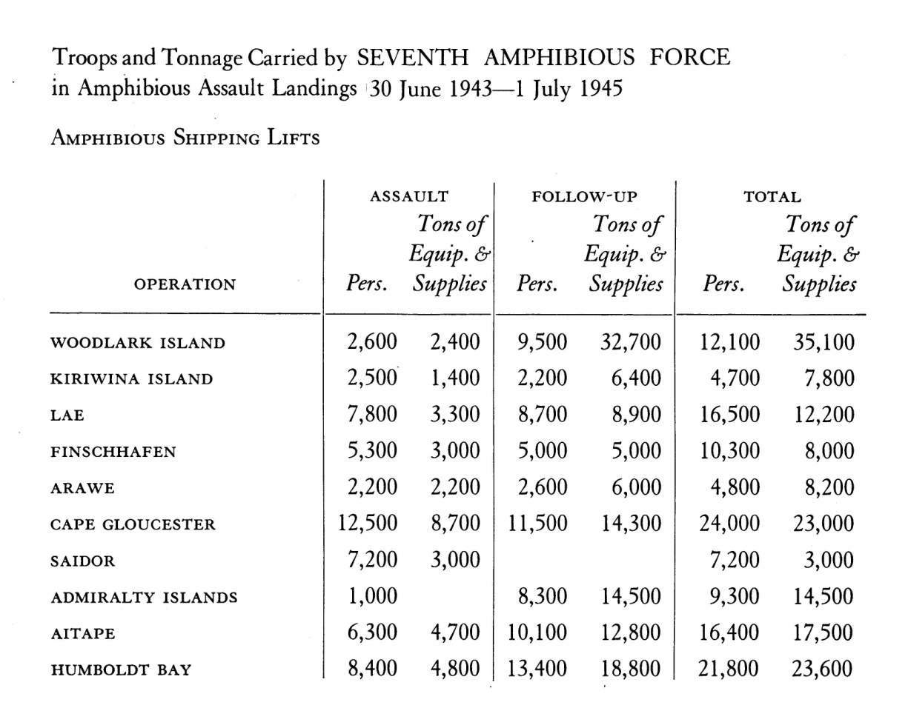
Almost a million troops and over a million tons of supplies are carried by Seventh Amphibious Force in support Gen McArthur
Almost a million troops and over a million tons of supplies were carried by the Seventh Amphibious Force in support of Gen MacArthur
Notes:
MacArthur's Amphibious Navy, Appendix B, pg 357-358.

Slide 11
Design Modifications
The LST design proved to be adaptable to the many needs of military operations
LSTs were converted into various types of repair ships and tenders, hospital ships and a scout plane carrier
The ship was provided with more boats and armament as it gained more operational experience

Slide 12
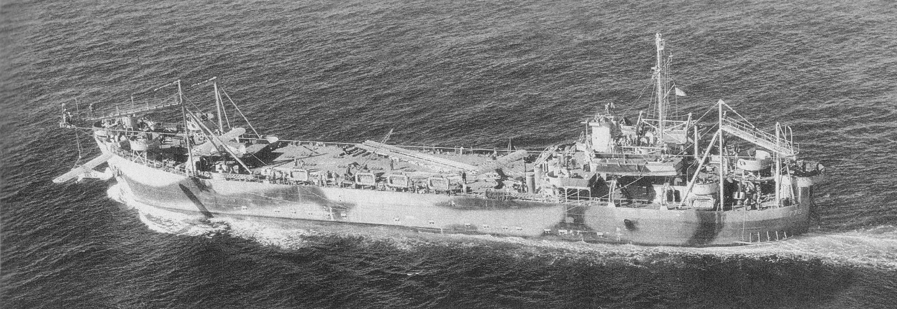
Aviation capable LSTs
LST 775 with Brodie launch and recovery system
LST 906 configured with a flight deck and aircraft stowage
Notes:
US Amphibious Ships and Craft; pg 125.

Slide 13
List of ship’s personnel and ratings
Ship Compliment
Officer Compliment:
Commanding Officer (Lieutenant)
Executive Officer (Lieutenant, Jr.Gr.)
First Lieutenant (Lieutenant, Jr.Gr.)
Engineering Officer (Ensign)
Ass’t First Lieutenant (Ensign)
Gunnery Officer (Ensign)
Communications Officer (Ensign)
TOTAL OFFICERS: 7
Enlisted Compliment:
Chief Boatswain’s Mate 1
Boatswain’s Mate 1st class 1
Boatswain’s Mate 2nd class 1
Coxswain 2
Chief Gunner's Mate 1
Gunner’s Mate 1st class 1
Gunner’s Mate 2nd class 2
Gunner’s Mate 3rd class 3
Chief Quartermaster 1
Quartermaster 1st class 1
Signal Man 2nd class 1
Signal Man 3rd class 1
Fire Controlman 2nd class 1
Seaman 1st class 20
Seaman 2nd class 22
Radioman 1st class 1
Radioman 2nd class 1
Radioman 3rd class 1
Radio Technician 1st class 1
Radarman 2nd class 1
Shipfitter 1st class 1
Shipfitter 2nd class 1
Chief Motor Machinist 2
Motor Machinist Mate 1st class 3
Motor Machinist Mate 2nd class 3
Motor Machinist Mate 3rd class 4
Electrician's Mate 1st class 1
Electrician's Mate 2nd class 1
Electrician's Mate 3rd class 1
Water Tender 2nd class 1
Water Tender 3rd class 1
Fireman 1st class 4
Fireman 2nd class 4
Yeoman 2nd class1
Storekeeper 1st class 1
Pharmacist's Mate 1st class 1
Pharmacist's Mate 2nd class 1
Chief Commissary Steward 1
Ship's Cook 1st class 1
Ship's Cook 2nd class 1
Ship's Cook 3rd class 1
Baker 2nd class 1
Cook 1st class 1
Steward's Mate 1st class 1
Steward's Mate 2nd class 2
TOTAL ENLISTED: 104
Notes:
Inside LST, http://www.insidelst.com/crew_compliment.htm.

Slide 14
Service aboard an LST
The rapid deployment of the newly built LST’s along with the expansion of Navy recruits created a situation where many officers and crew of the LSTs were inexperienced with little or no sea duty
As the ship and crews gained experience with amphibious landings, sailors referred to the LST as either “Large Slow Target” or “Large Stationary Target” to highlight the vulnerable situation they found themselves
While the LSTs were considered “expendable”, they turned in a tremendous service record and only 37 were lost during the war
Notes:
Web sites visited:
http://www.insidelst.com/
http://en.wikipedia.org/wiki/Tank_landing_ship
http://www.uslst.org/index.htm

Slide 15
Crew Berthing Space
Notes:
http://popartmachine.com/item/pop_art/LOC+1123912/%5BSAILORS-IN-BUNKS-IN-CREW-QUARTERS-OF-LANDING-SHIP-TANK-SHIP-BOUND...

Slide 16
“The destinies of two great empires … seemed to be tied by some god-dammed things called LSTs.”
Winston Churchill
Notes:
Quoted in :
Ninety and Nine; Brinkley, William
A novel about an LST in the Italian campaign
Image:
http://www.the-blueprints.com/blueprints/ships/ships-us/30154/view/usa_lst-1_type_landing_ship_tank/

Slide 17
Bibliography
Barbey, Daniel E. MacArthur’s Amphibious Navy; Seventh Amphibious Force Operations, 1943-1945. Annapolis: United States Naval Institute, 1969. Print.
Brinkley, William. The Ninety and Nine. Book Club Ed. Garden City, N. Y: Doubleday, 1966. Print.
Friedman, Norman. U.S. Amphibious Ships and Craft: An Illustrated Design History. Annapolis, Md: Naval Institute Press, 2002. Print.
“www.insidelst.com.” USS LST Ship Memorial, Inc. , 9 July, 2009. Web. 17 Oct. 2011. http://www.lstmemorial.org/default.htm.
“A Brief History of the US Army in World War II.” US Army Center for Military History, Web. 17 Oct. 2011. http://www.worldwariihistory.info/WWII/introduction.html.
“Welcome to United States L.S.T. Association.” United States LST Association, 17 Oct. 2011. Web. 17 Oct. 2011. http://www.uslst.org/index.htm.
“Landing Ship, Tank.” Wikipedia, 5 Sep, 2011. Web. 17 Oct. 2011. http://en.wikipedia.org/wiki/Landing_Ship,_Tank.
“Tank Landing Ship (LST).” Navsource Online, 2011. Web. 17 Oct. 2011. http://www.navsource.org/archives/10/16/16idx.htm.

