Slide 1
Aspect, Treeline, and Climate
Comparing the reasons why forests give way to Alpine-Tundra Meadows

Slide 2
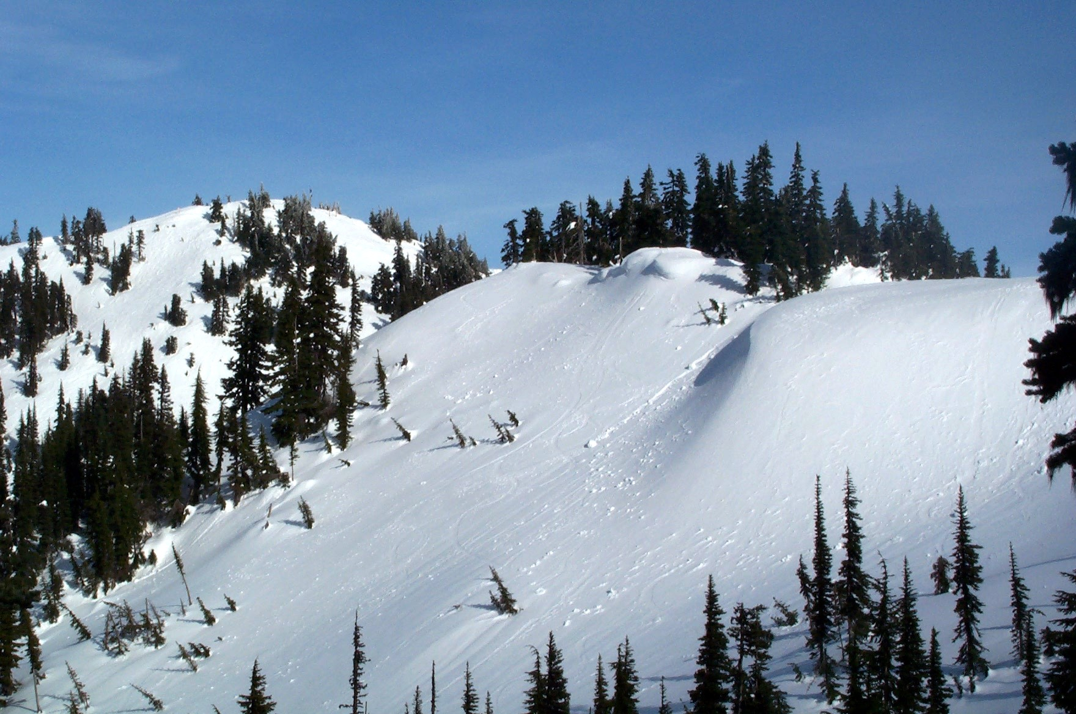
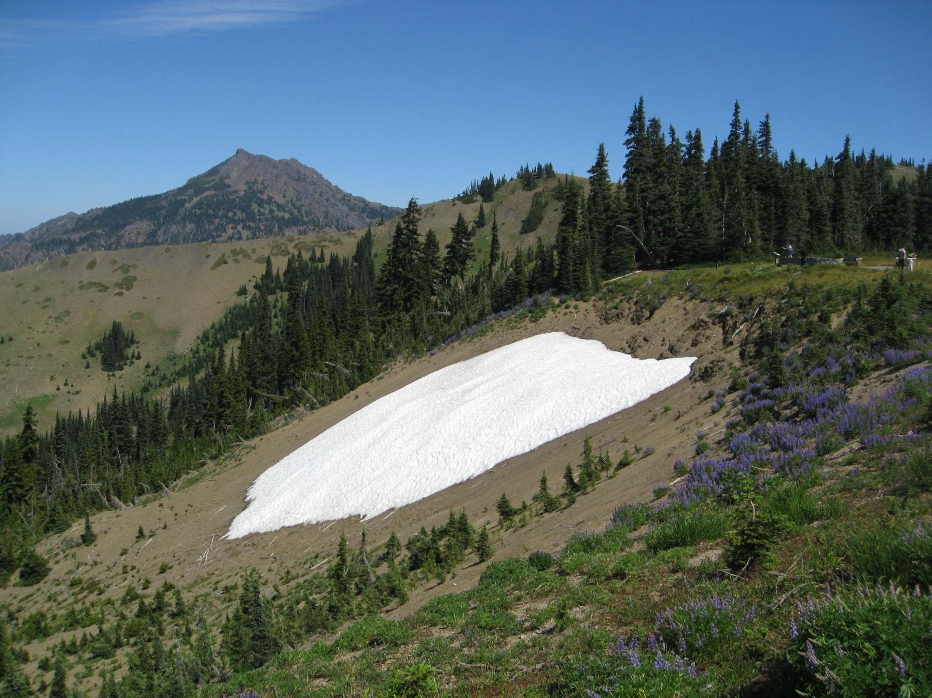
Treeline in the Coastal Mountains – Snowpack and Aspect
Notes:
Treelines in the Pacific Northwest are quite low for this latitude. The reason has to do with the deep snowpacks that form due to heavy precipitation. The temperatures are quite mild (20’s and 30’s F in winter), but the deep snow lingers well into summer, limiting the growing season for trees. North aspects maintain the snowpack longer into the summer due to the shadows that keep them cool most of the year.
The first image shows the snow that has piled up on the north-facing slope of Hurricane Ridge in March. The blowing drifts have accumulated up to 30 feet deep in places. These melt much more slowly than the south-facing slopes.
The second image shows that in August, there is still a patch of snow that has lingered on this north side because of the shadows that linger all year on this slope. That particular slope is extremely difficult for trees to become established on.

Slide 3
A Cross-Section of a Pacific Northwest Valley
Glacier
> 6500”
Rock/Ice
Alpine meadows
5000-6500 ft
Alpine meadows
Subalpine Forest
4000-5000 ft
subalpine fir/yellow cedar
Subalpine Forest
subalpine fir/yellow cedar
Montane Forests
2000 to 4000 ft
silver fir/mountain hemlock/Douglas fir
Montane Forests
silver fir/mountain hemlock/Douglas fir
Riparian Forest
maple/alder/willow
Lowland Forest
Sea Level to 2000 ft
Douglas fir/western hemlock/grand fir
western red cedar/Sitka spruce
Lowland Forest
Douglas fir/western hemlock/grand fir
western red cedar/Sitka spruce
Notes:
Looking at a cross-section of a typical river valley in the Pacific Northwest, there are changes in species composition and ecosystem processes based on elevation and aspect. Each species is best adapted to specific climatic conditions, but have a wide range of variability in which they can survive. So, while the dominate species types may change in an area, often there are a mixture of different species from each of the ecotones.
The lowland forests tend to be dominated by some of the largest tree species in the world, such as Douglas fir, western hemlock, grand fir, and western red cedar. The mild and wet conditions at low elevation, with uncommon freezing events, makes this an ideal environment for the trees to grow very large and live for a long time. Sitka spruce also becomes more dominate in coastal areas with salt spray and even wetter conditions.
At middle elevations, the temperatures are cooler, more of the precipitation falls as snow, and solar radiation in summer can be more intense. In these montane forests, silver fir and mountain hemlock begin to become more dominant, with Douglas fir, western hemlock, and western white pine also playing an important role.
At higher elevations near the edge of the ability for trees to live, deep snow packs, intense winter winds, and high summer solar radiation make life difficult for tree species. Only species adapted to these subalpine environments can thrive, such as subalpine fir and Alaska yellow cedar. Mountain hemlock, Douglas fir, whitebark and lodgepole pine can be found in some subalpine locations.
Above about 5,000 feet, the growing season becomes too short for trees to survive and the alpine meadows begin to dominate. However, above 6,000 feet the climatic conditions become too harsh, even for those hardy species. Above 6,500 feet the mountain become essentially bare rock and ice.

Slide 4
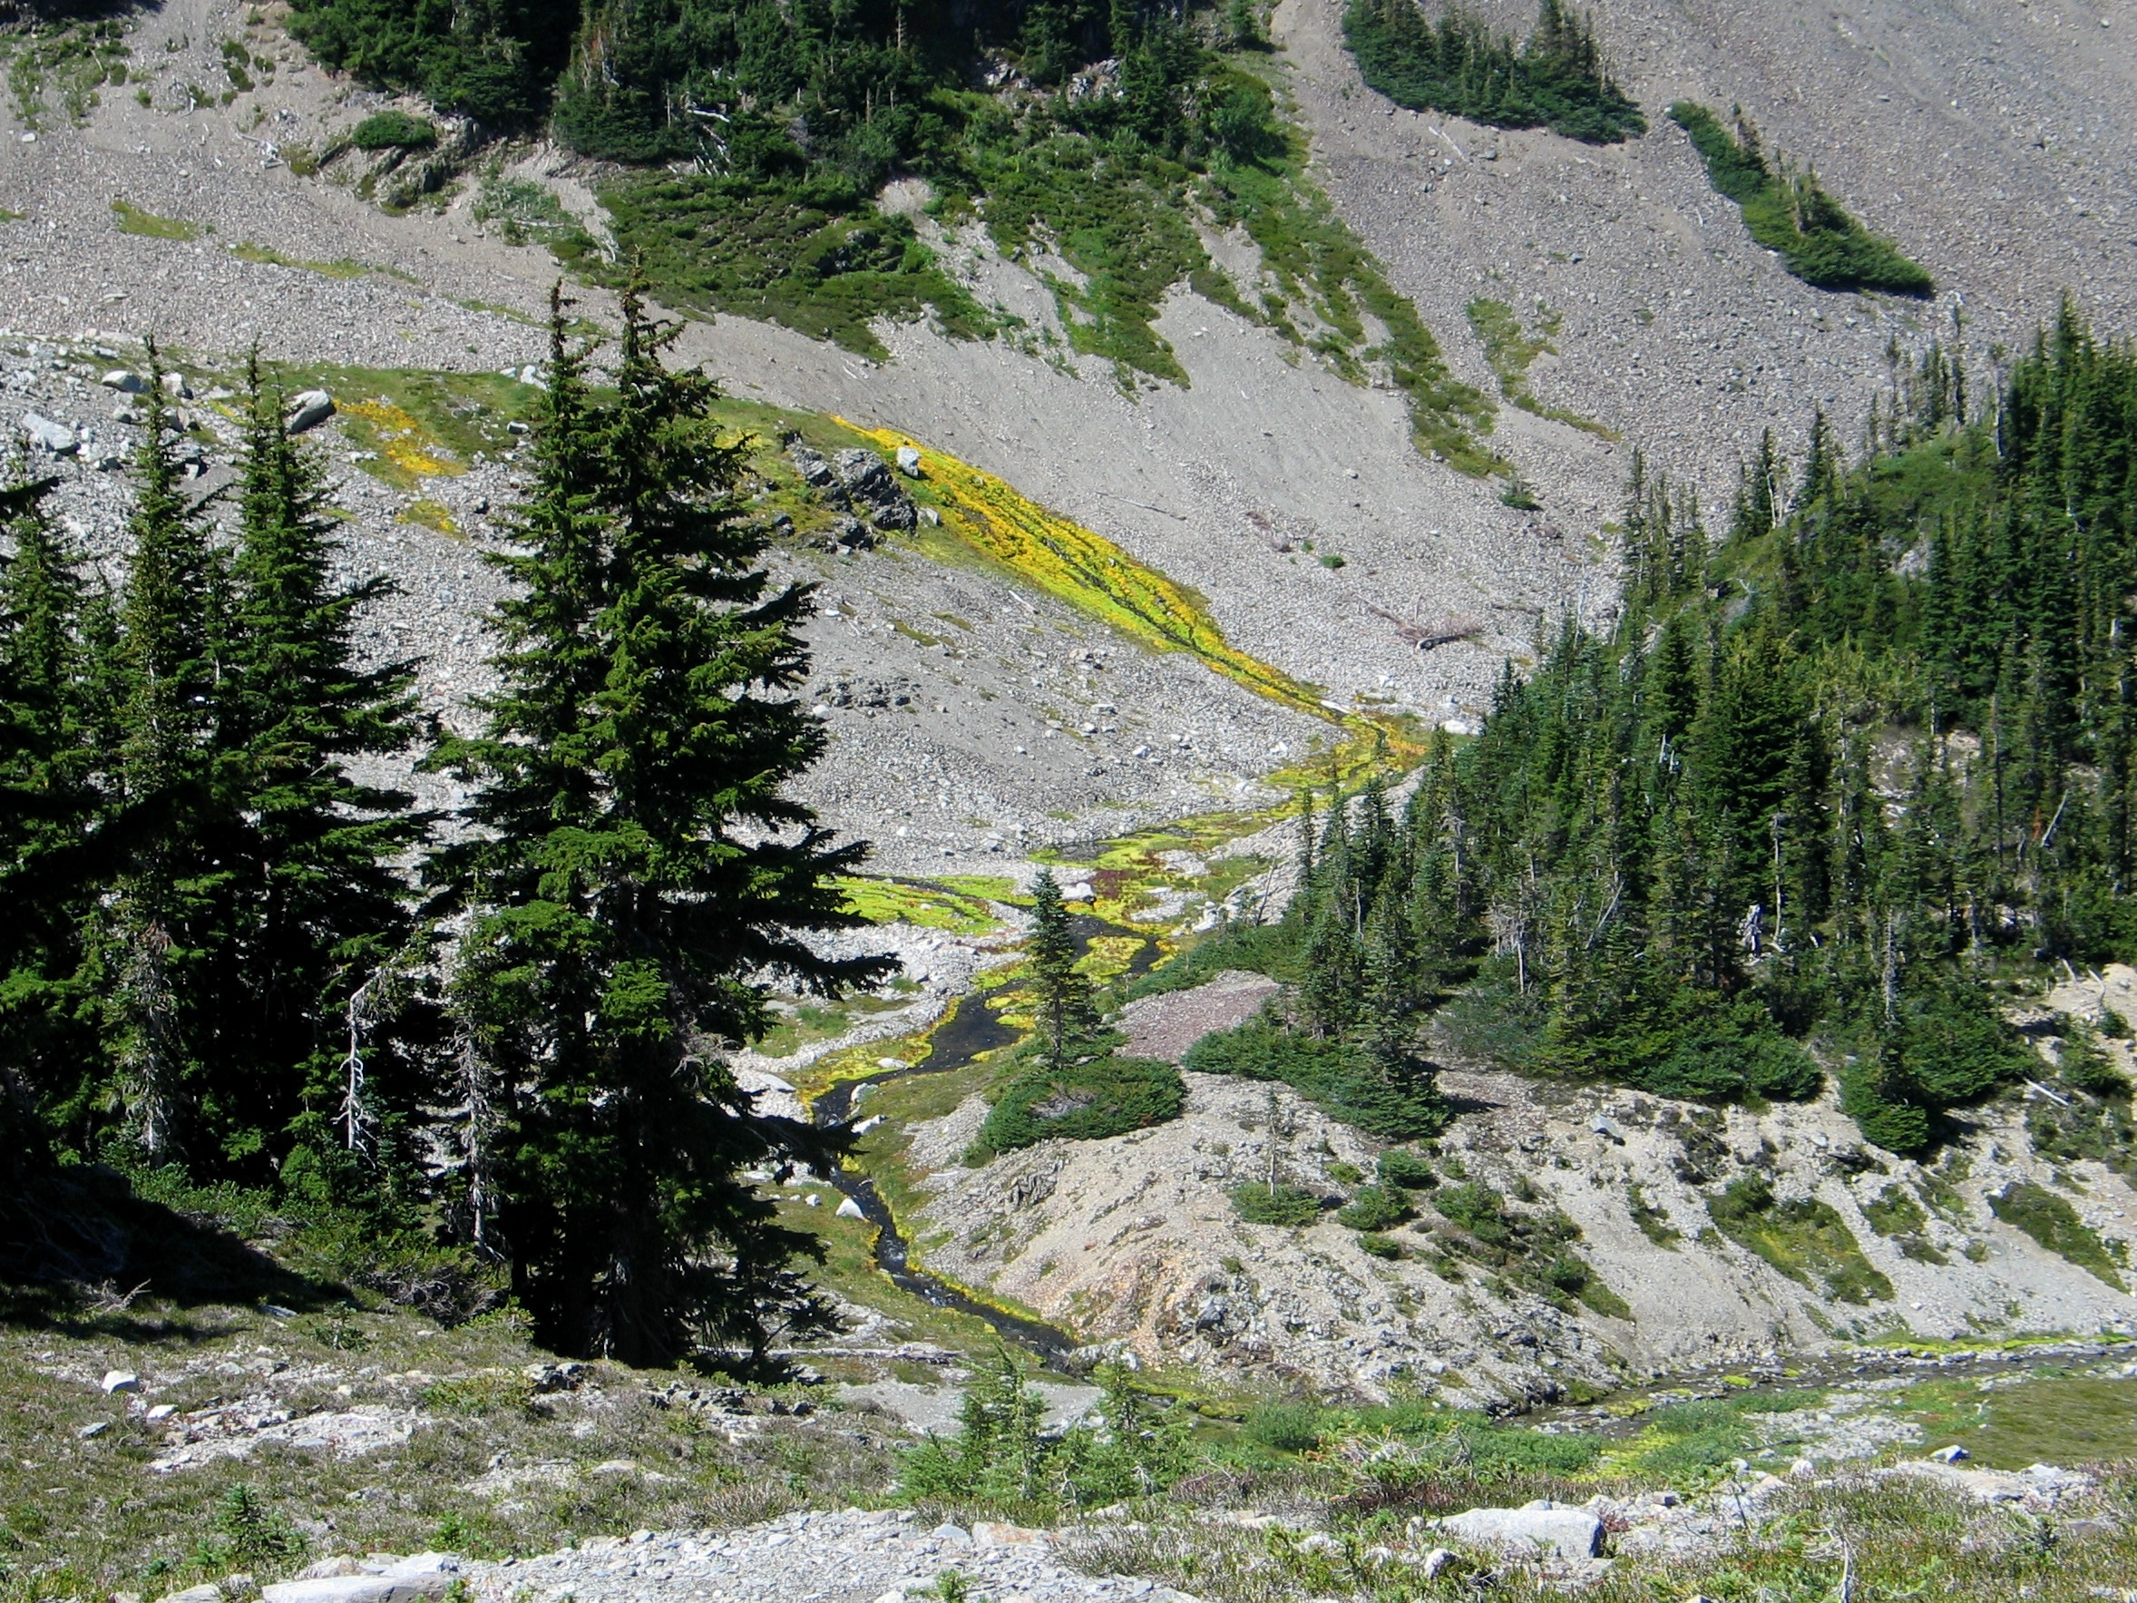
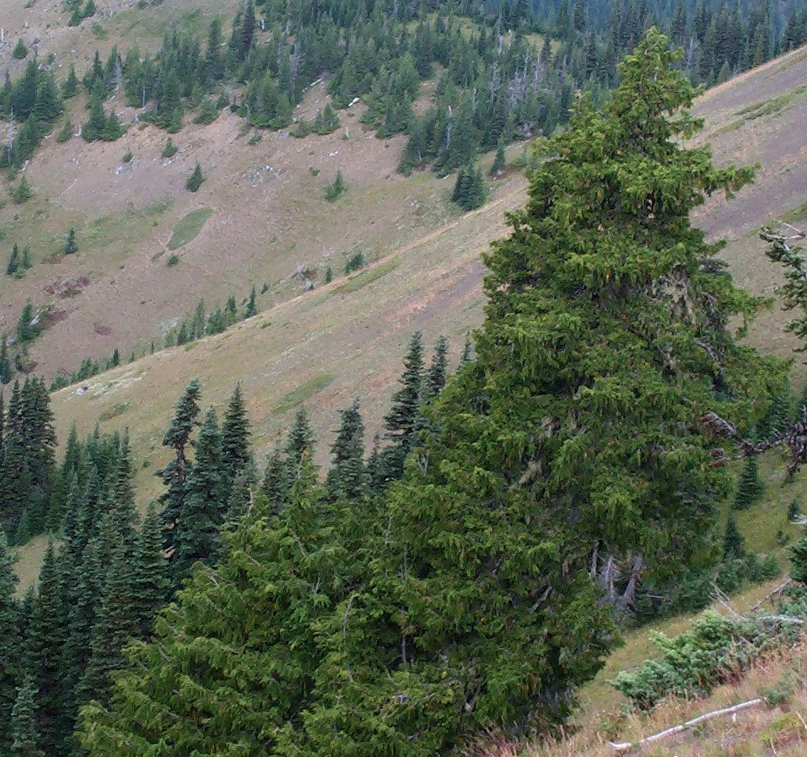
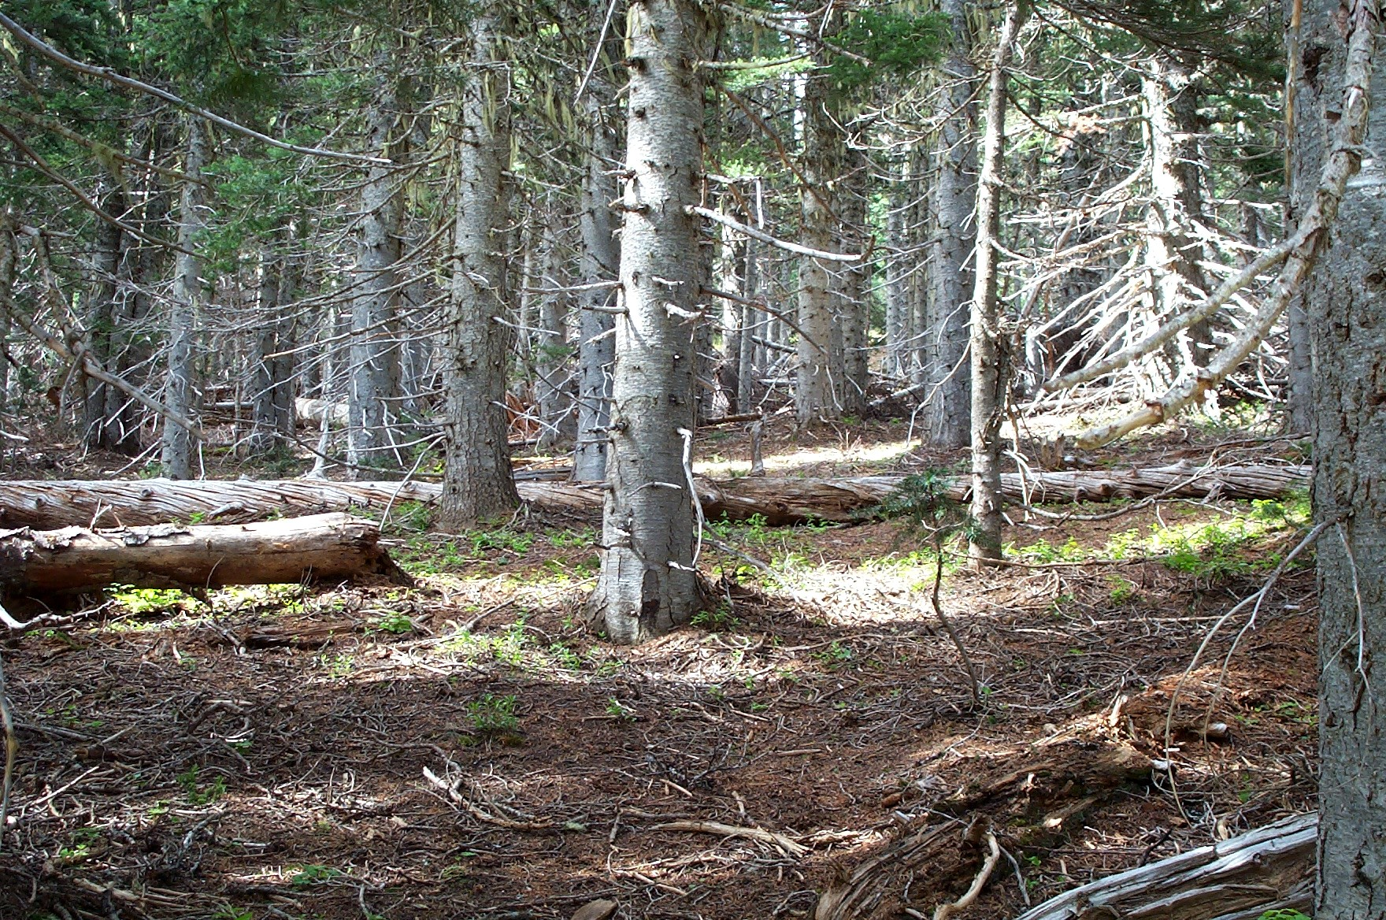
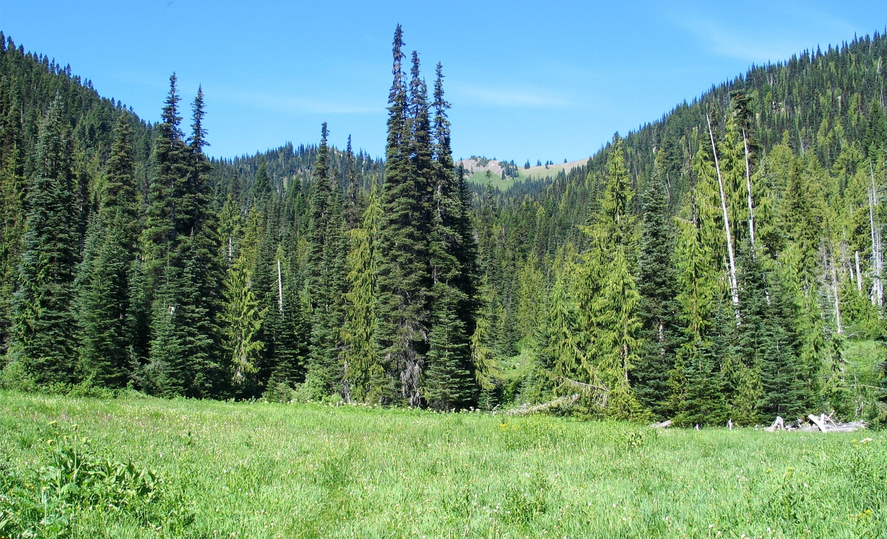
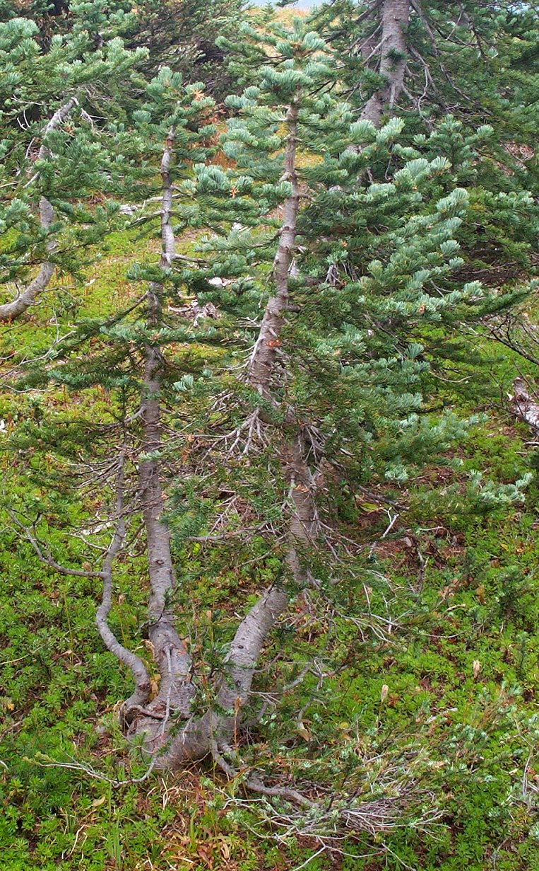
Life in the Subalpine Environment
Notes:
First image: In the montane forest, silver firs dominate. They grow together densely, providing each other protection from the winds and heavy snow. The understory tends to barren, due to heavy snow packs, dark shadows from the trees above, acidic soils formed by dropping fir needles, and the short growing season.
Second image: At the subalpine zone, subalpine fir and Alaska yellow cedar dominate. One strategy for survival in an area that can get 400” of snow each winter to go grow very straight and narrow, so that snow will slide off the branches, as opposed to accumulating and then snapping the branches off. Alaska yellow cedar on the other hand has very flexible branches and easily bend to release accumulated snow and then snap back up.
Third image: One a south-facing slope, dry meadows form where conditions are too dry to support trees or wet meadows, due to the intense summer sun. However, tree islands form on the ridge tops, where conditions are more moderate. The young subalpine fir to the right is twisted and bend from being buried all winter in 30 feet of snow. They have to be flexible to survive that kind of pressure. Subalpine firs grow very slowly in their first 30-50 years because of the short growing seasons. Once they are large enough to keep their limbs above the snow pack, their growing season is longer and their growth rate faster.
The fourth image shows a series of alpine meadows, rock fields, and tree islands. Notice the skirting at the base of the subalpine firs. This is another strategy for surviving deep snowpacks and intense solar radiation. These skirts protect the soil from solar radiation in summer, keeping the soil moist for the main stem of the tree. In winter, these skirts keep the snow off the ground and insulate the roots. Eventually small arms will head upwards from the skirts and once they reach high enough to be above the snowpack in the winter, it too can grow tall like its neighbors.

Slide 5
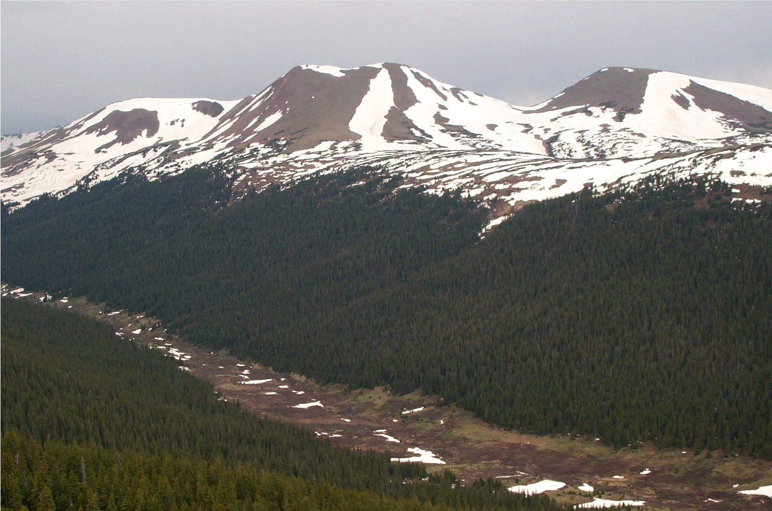
Treeline in the Rocky Mountains
Notes:
The treeline in the Rocky mountains has more to do with minimum winter temperatures than the depth of the snowpack. At the same latitude where treeline is 5,000 feet in the Olympics, the treeline is nearly 12,000 feet in the Rocky mountains. In this more arid region, caused by the rainshadow effect of the Cascades and Sierra Nevada mountains, sufficient rainfall for trees does not occur until about 6,000 feet elevation. Above that there are forests that climb the slopes until reaching a zone where winter temperatures sometimes drop to below -30°F. Those extremely cold temperatures freeze the sap inside the trees and the formation of ice crystals destroy their cells and trees die. This forms pretty distinct lines above which trees can not grow.
Unlike in the Pacific Northwest where the lines are not distinct and depend on the snow depth at any particular spot.
This is an image from Rocky Mountain National Park in Colorado. The meadows at the bottom of the valley are formed when very cold air in winter sinks into the valley, killing trees at the bottom, as well as, above the treeline.

Slide 6
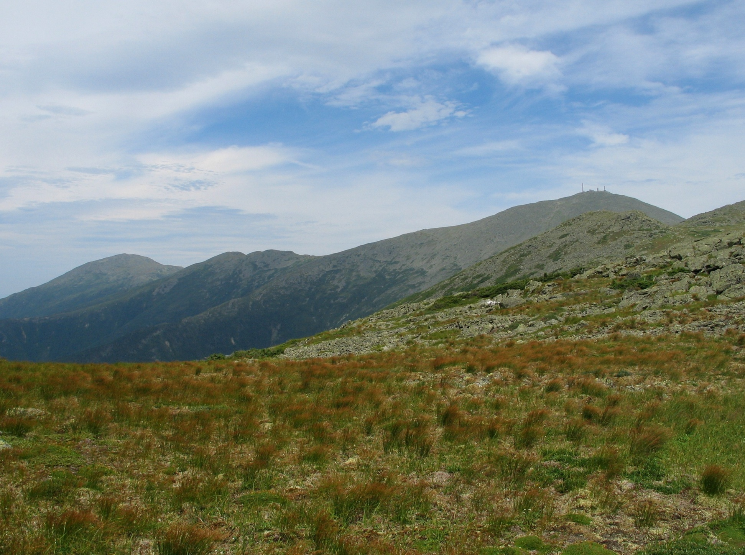
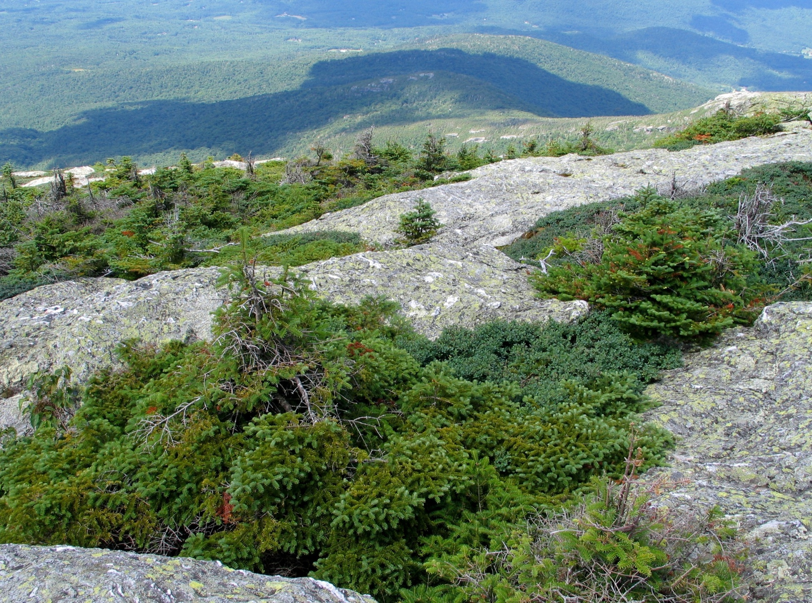
Treeline in the Northern Appalachians
Notes:
The treeline in the northern Appalachian mountains hovers around 4,000 feet, because like the Rocky mountains, extremely cold temperatures from the Arctic come down in winter and kill the trees. In the first image is a view at treeline on Mount Washington in New Hampshire. Mount Washington is famous for having the “worst weather in the world” with temperatures as low as -40°F and winds over 100 mph.
In the second image, spruces cling to sheltered locations on Mount Mansfield, Vermont above treeline at 4,000 feet. Only in these small sheltered creases can trees get some protection from fierce winds, sand paper like blowing ice, and arctic temperatures.

Slide 7
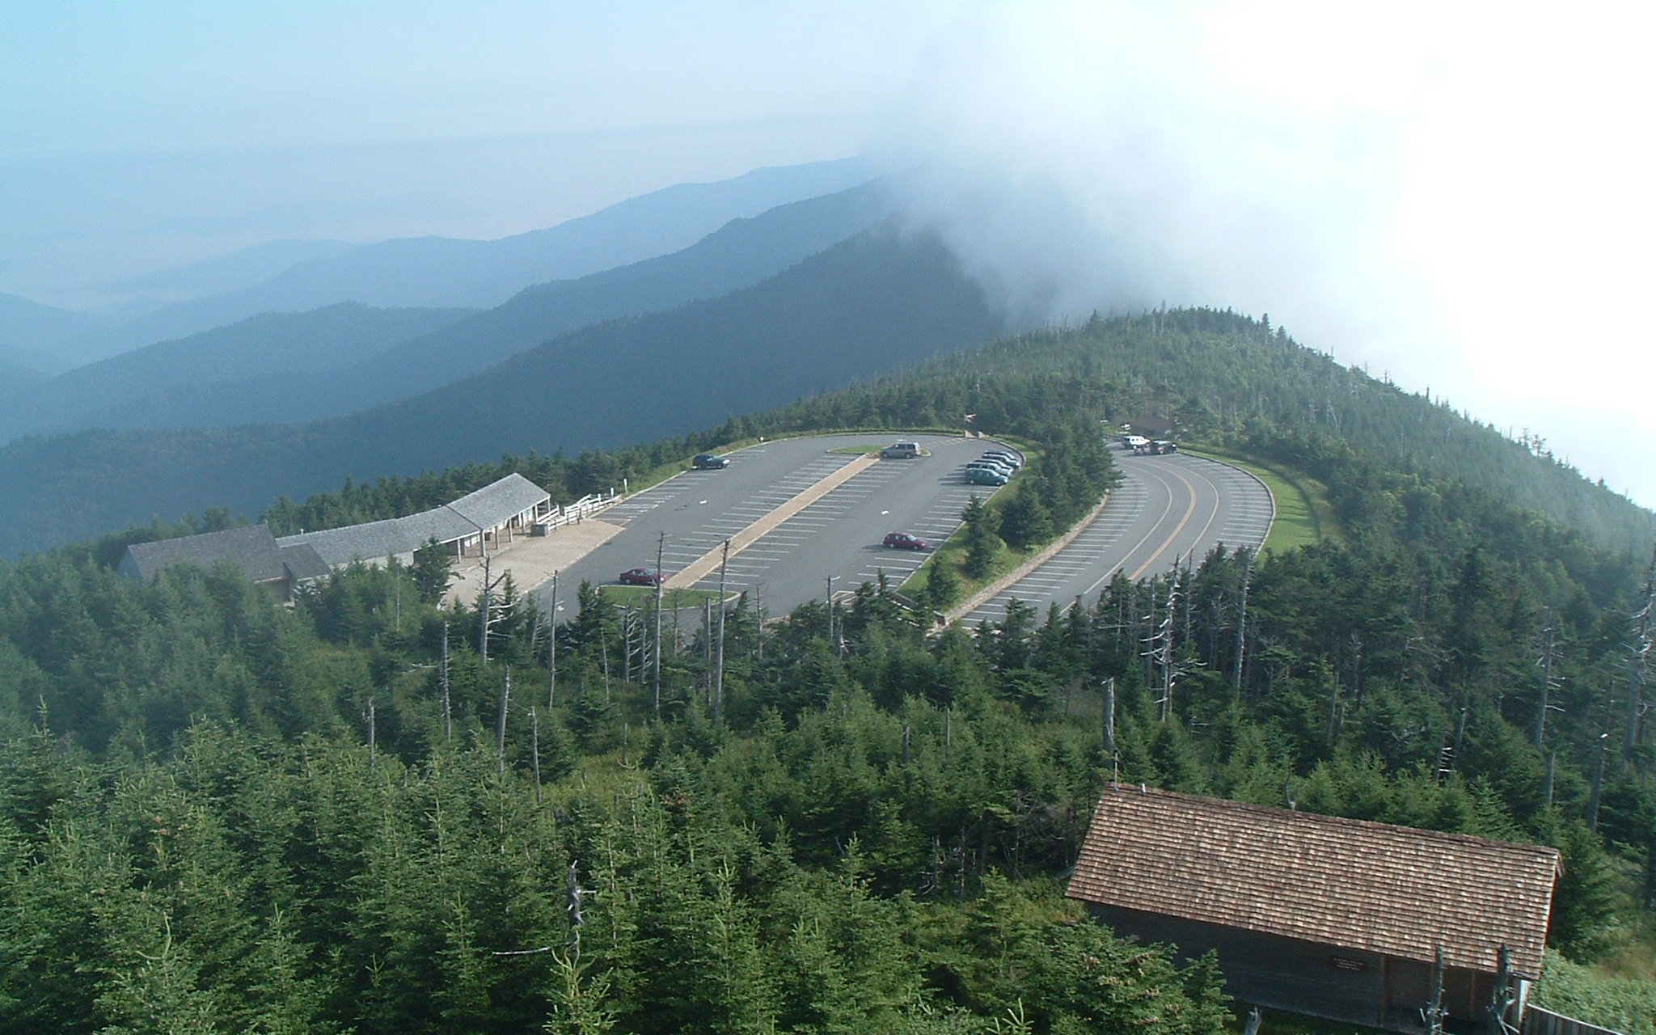
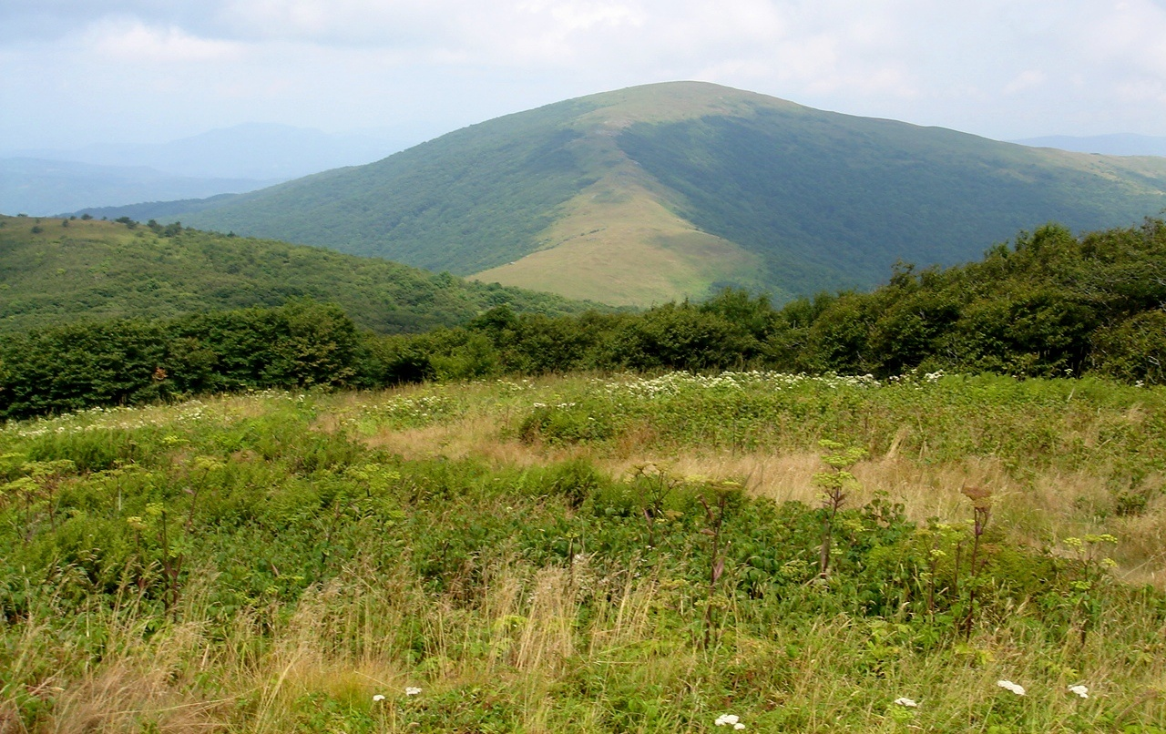
Treeline in the Southern Appalachians?
Notes:
In the southern Appalachian mountains, there is no true treeline, not even on 6,700 foot Mount Mitchell in North Carolina. Temperatures simply do not get cold enough in winter at that latitude. Image one shows the view from the summit of Mount Mitchell to the parking lot. Notice the spruce trees go all the way to the summit.
However, open meadow areas, called “balds”, can develop in places where fires or other phenomena eliminate trees and their recolonization is slow due to the harsher climate at these elevations. Image two shows the Roan Highlands at 5,800 feet in North Carolina.

Slide 8
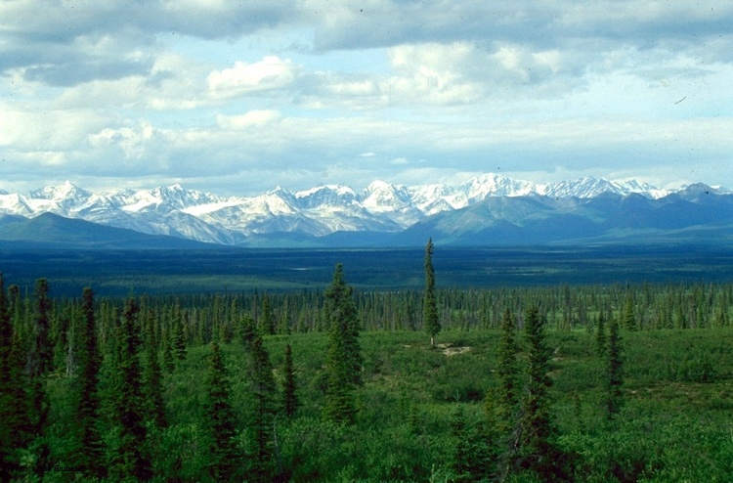
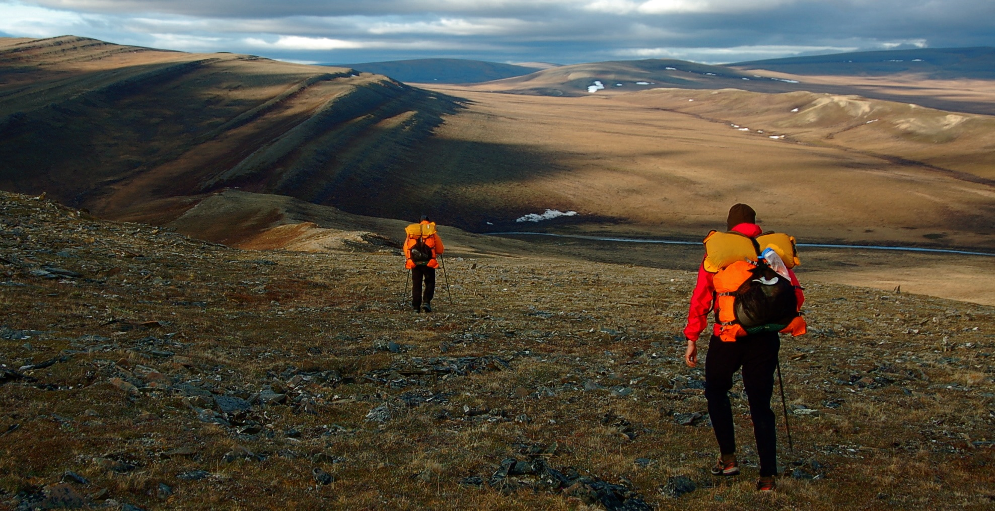
Treeline in the Arctic
Notes:
The treeline of the arctic is classified more on latitude than on elevation. It refers to the furthest north trees can grow. Like in the Rocky Mountains, it occurs where winter temperatures are low enough to freeze the sap in trees and kill them. In addition, permafrost plays a major role, as it solidifies the soil, making it impossible for trees to put stable roots into the ground. It usually occurs around 65-75 degrees North latitude. There is no Antarctic treeline in the southern hemisphere because of the lack of land. In general, the southern continents have trees and then there are none on the sub-Antarctic islands and Antarctica itself.
Image one shows the northern edge of the boreal forest in Alaska, with small and scattered white spruce.
Image two is located in Alaska’s north slope, well north of the arctic treeline.

Slide 9
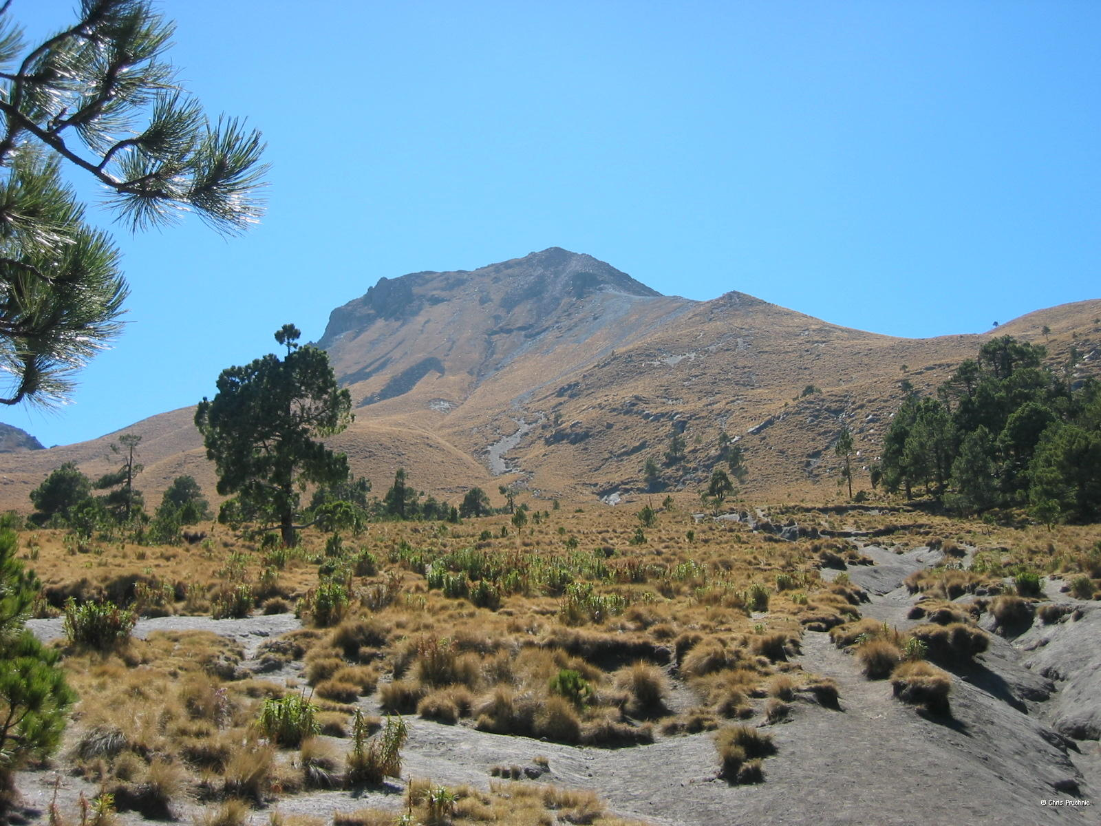
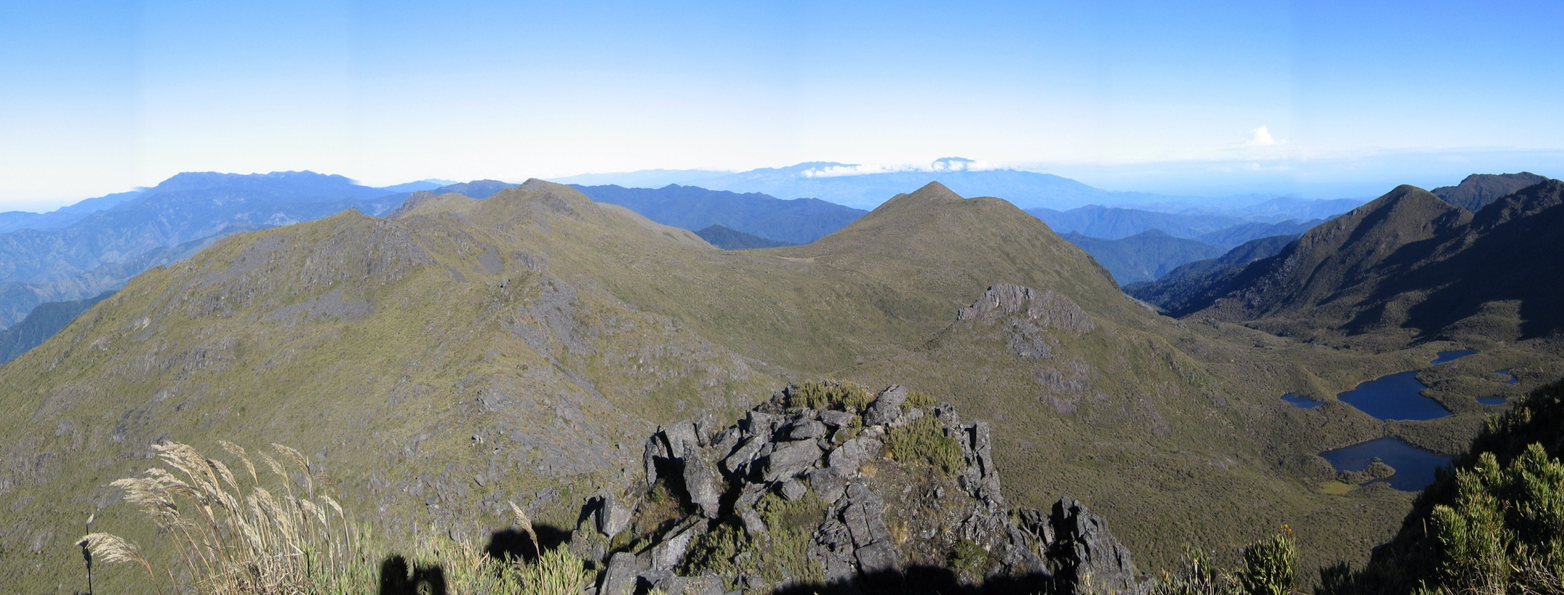
Treeline in the Tropics
Notes:
The Páramo of Central and South America and the Afromontane ecosystems of Africa are tropical alpine zones above the cloud forest treeline. These areas, while at elevations over 9,000 feet, are lower than one would expect based on a linear graph of treelines versus latitude in the northern hemisphere. In the tropics, there are multiple reasons for their lower elevations. For one, they are located above the dew point line for tropical moisture, making these areas much drier than the lower elevations. Secondly, as isolated islands of vegetation located thousands of miles from temperate zones, the species of the tropics are not well adapted to survival in cold temperatures. The first image is of the Páramo of Costa Rica from the summit of Cerro Chirripó at 12,200 feet.
In Mexico, the ecosystems are more closely related to and adapted to temperate climates from the north, due to the movement of ecosystems during the ice ages. These treeline areas are dominated by pines, firs, and oak forests. Thus, the plants are able to survive the cold and arid conditions more readily than tropical species and the treeline is significantly higher (around 13,000 feet). The fade in image is at the treeline on Matlalcueitl volcano in Mexico at about 13,000 feet.

Slide 10
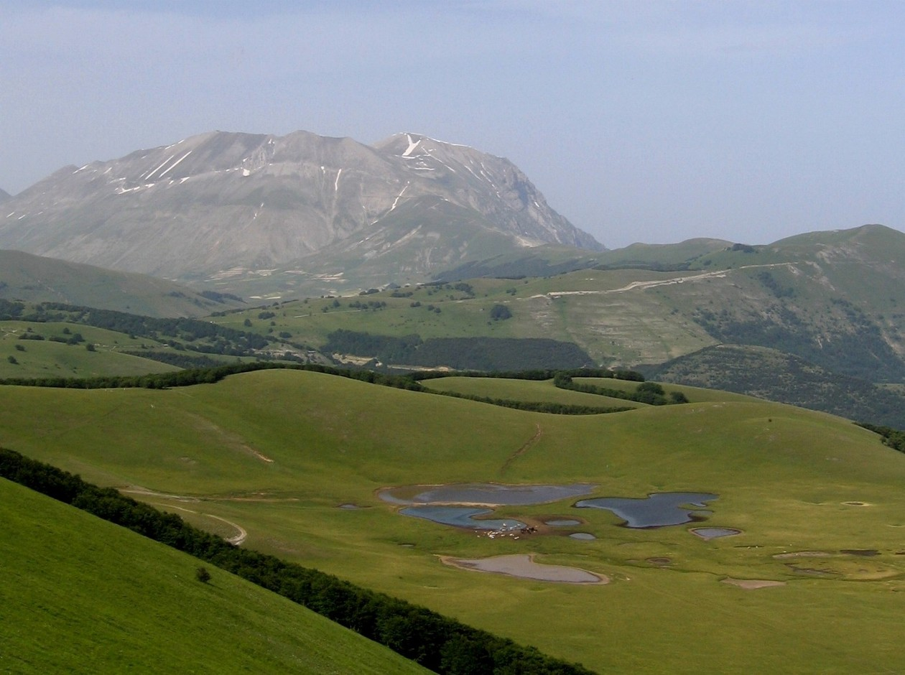
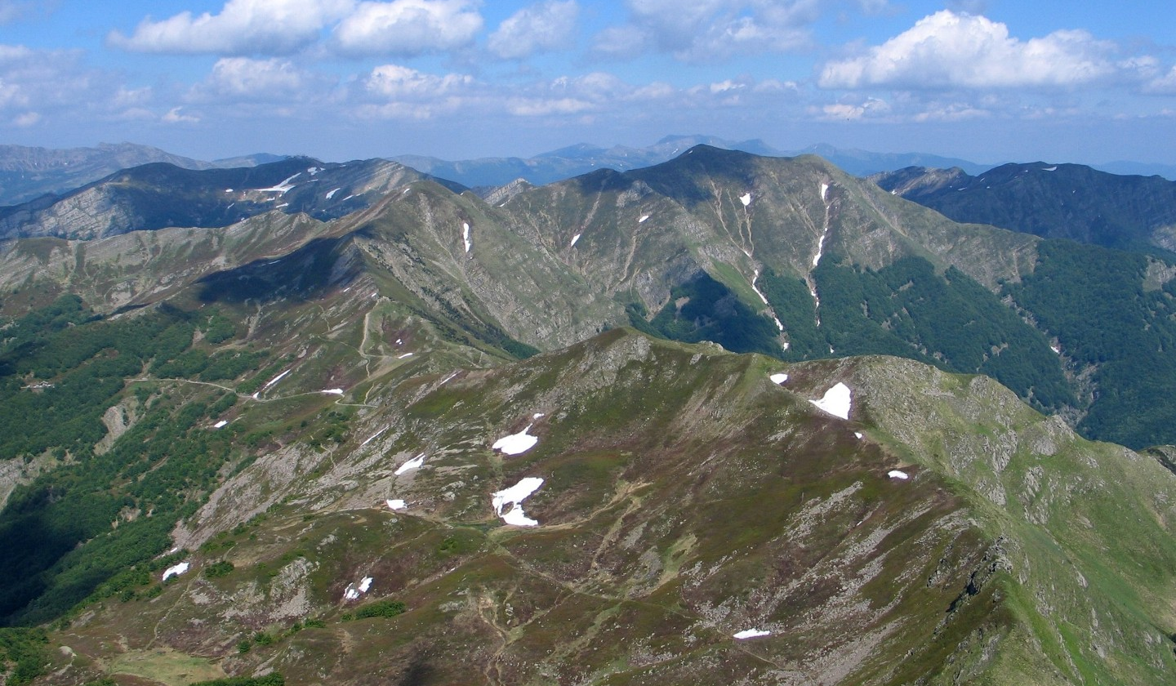
Other Impacts on Treeline
Grazing pressures at the treeline
Notes:
In Europe and across central Asia and the Middle East, heavy grazing pressures by sheep, goats, and cattle in more arid areas can cause treeline to be lower than it would be naturally, because these they munch on seedling trees near the edge of the subalpine meadows. In addition, the increased solar radiation and wind exposure makes it difficult for the forest to expand upward, even when grazing pressures are later reduced.
The first image is showing the treeline in the northern Apennines in Italy. The beech forests give way abruptly to alpine meadows. Even in national parks, sheep routinely graze in these meadows by small-scale traditional shepherds.
In the second image taken in the central Apennines in Italy, notice the cattle down by the small ponds. Their grazing prevents the forests from becoming established except for the steeper slopes. The high mountain in the distance rises high above the natural treeline at its summit of nearly 9,000 feet, even above the alpine meadows to bare rock.

Slide 11

Treeline Elevations in the Northern Hemisphere
Notes:
This is a plot of treeline elevations all across the northern hemisphere from the arctic treeline at 70°N (point where treeline is at sea level) down to the Equator. While there is some significant variation based on local temperature, moisture, and snowpack conditions, the overall trend is higher elevations and lower latitudes related to higher temperatures as you move towards the equator. There is a flattening of the curve closer to the equator, because climate patterns and moisture availability changes from temperature zones. In fact, treeline is often higher in sub-tropical arid zones than in truly tropical equatorial zones.

Slide 12
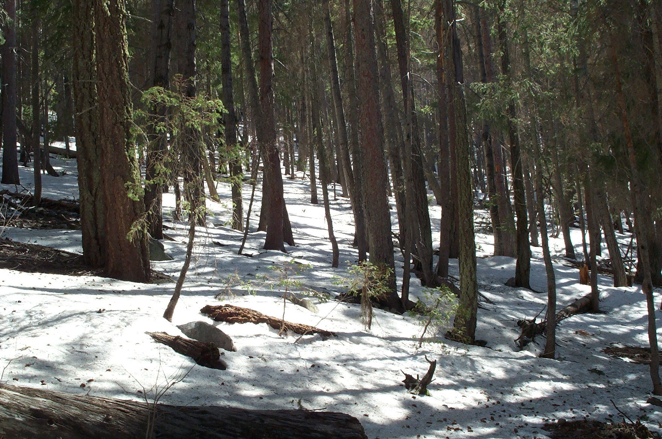
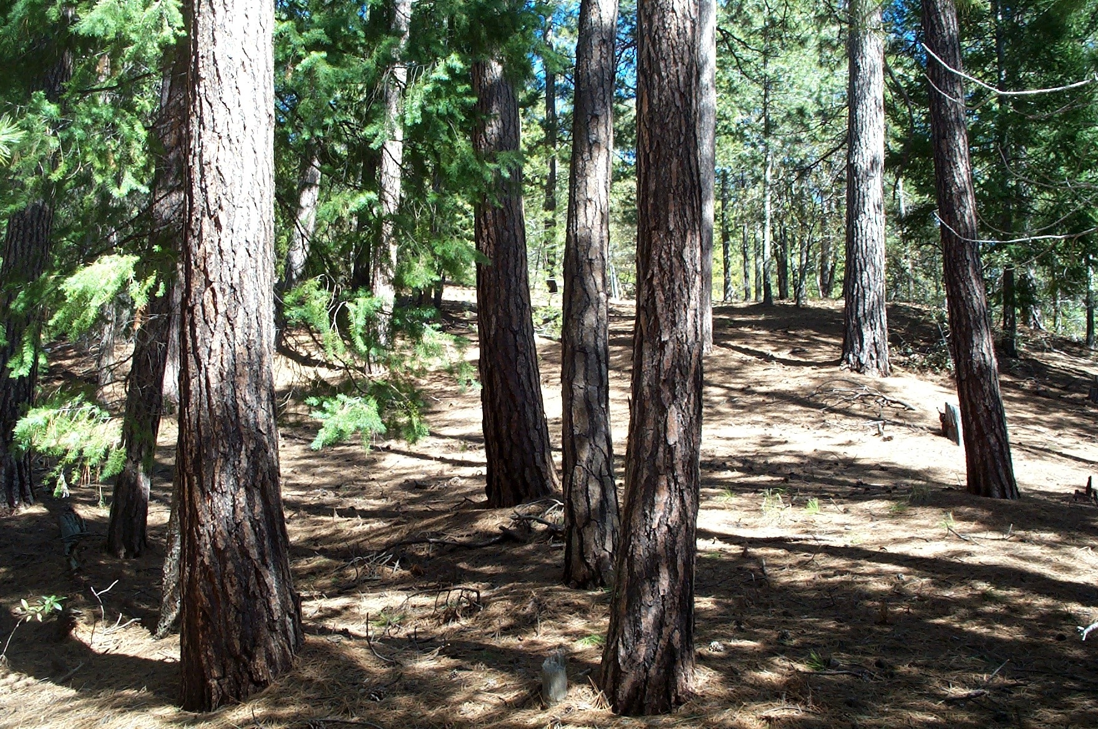
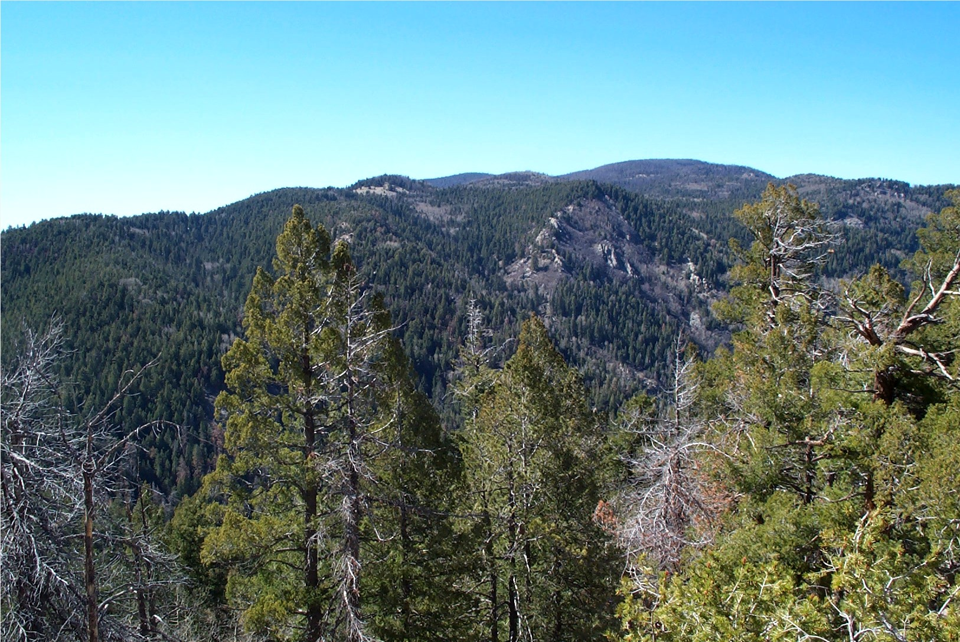
Aspect in the Desert Southwest
Notes:
While north-facing slopes tend to have lower treelines in the Pacific Northwest, they tend to have higher forested areas in the Desert Southwest. That is because, in this arid region, soil moisture is the limiting factor for trees. Thus, north-facing slopes maintain winter snowpack and soil moisture longer into the spring and summer, making it easier for trees to survive. The shade also keeps air temperatures lower.
Image one: At the summit of Mount Graham in Arizona at nearly 11,000 feet, the north slopes are covered in dense coniferous forests, while southern slopes are more open with scattered trees.
Image two shows a north-facing slope of Douglas firs on Mount Graham in early summer with some snow still on the ground. Image three shows the south-facing slope on Mount Graham on the same day. Notice the ground is bare and made up of more drought tolerate ponderosa pines.

Slide 13
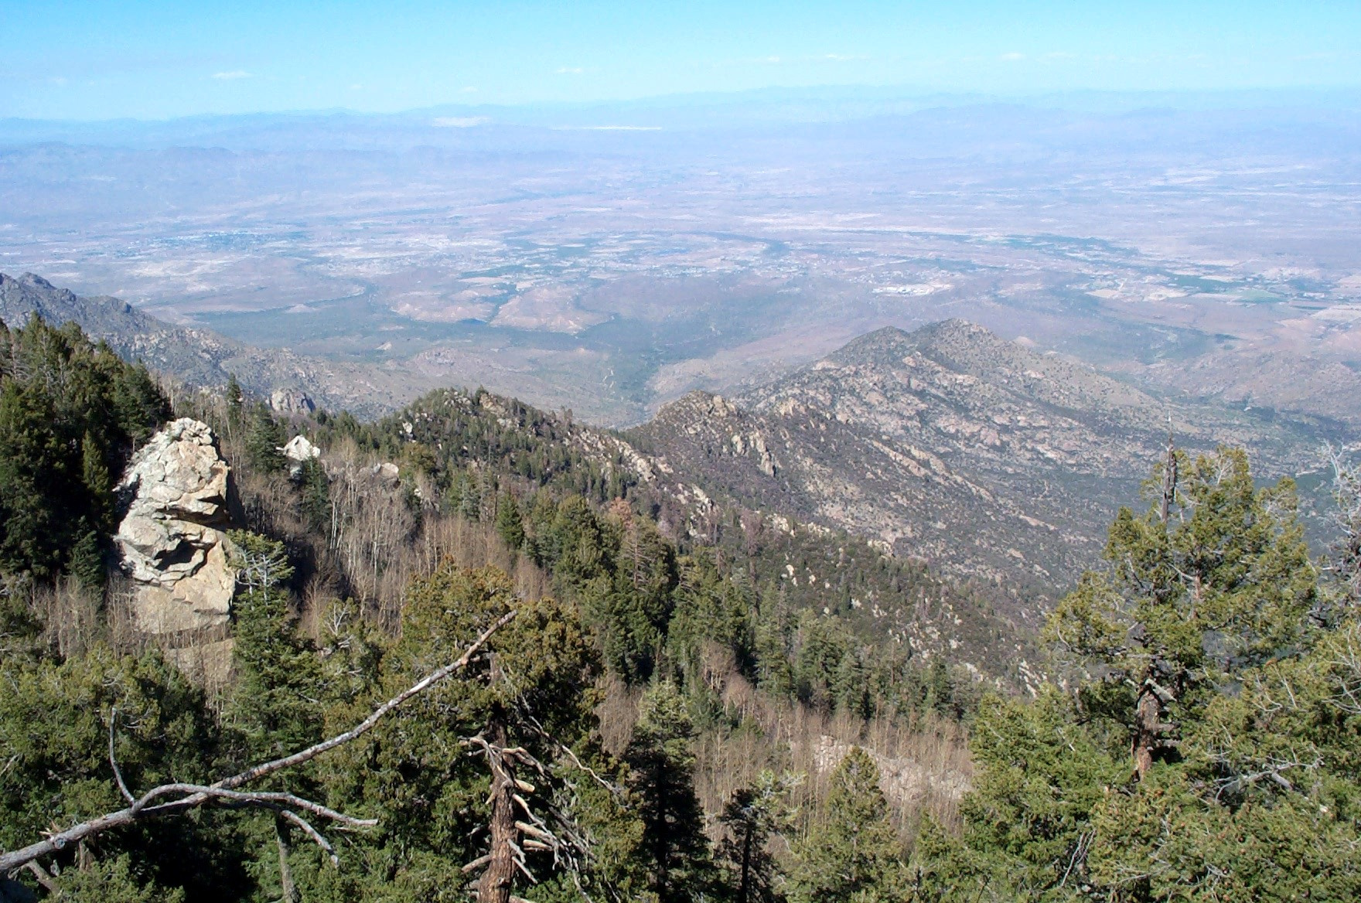
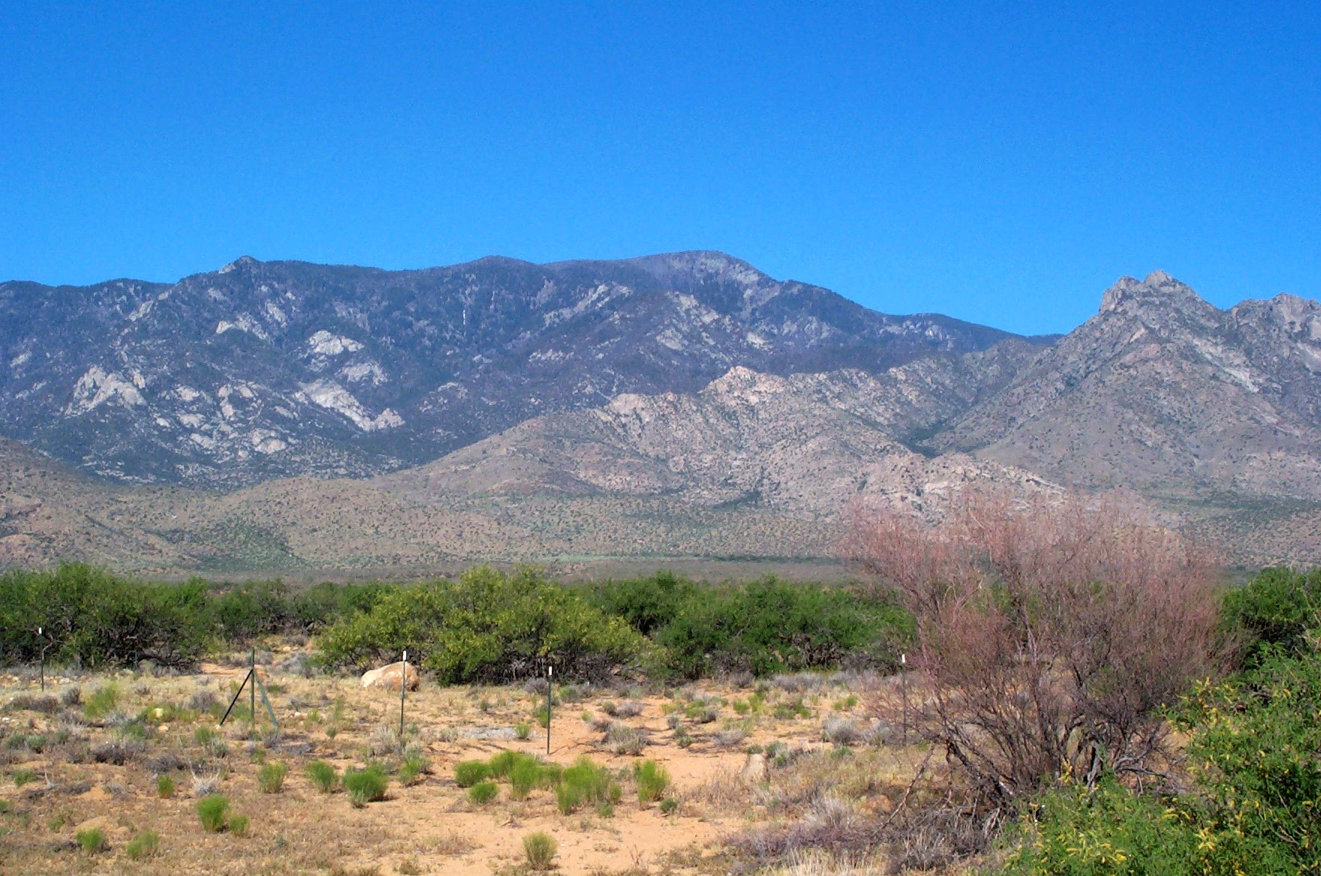
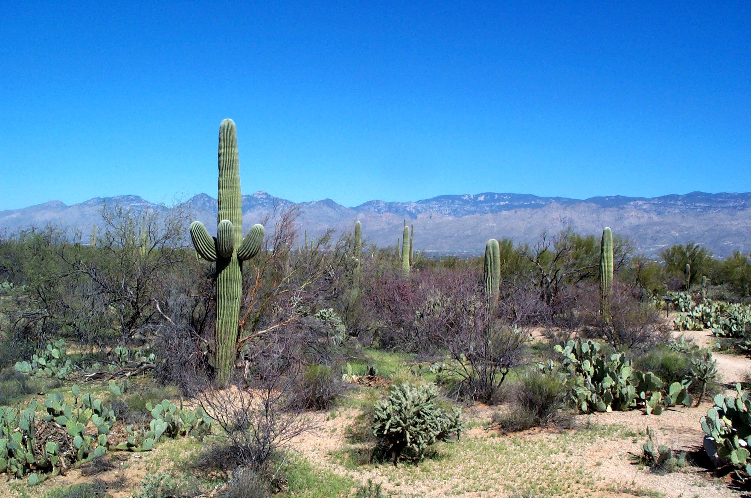
Desert Sky Islands
Notes:
The Sky Islands of the Desert Southwest are high elevation mountains that contain conifer forests above low deserts in the valleys. Image one shows Saguaro National Park in the Sonaran Desert with the Santa Catalina Mountains in the distance. At 9,000 feet the forests are dominated by pines and firs.
Image two shows Mount Graham, the highest of the Madrean Sky Islands at nearly 11,000 feet. From the desert flood, it rises through chaparral, juniper-pinyon stands, ponderosa pines, Douglas fir, and eventually a fir-spruce forest at the summit.
Image three shows the view from the summit of Mount Graham to the desert flood below.

Slide 14
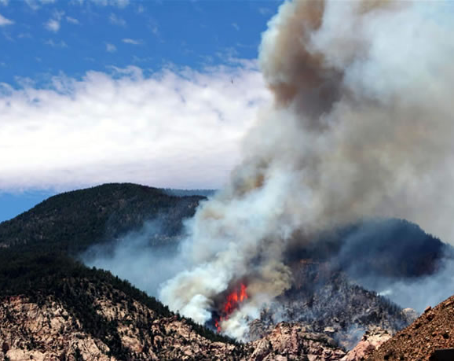
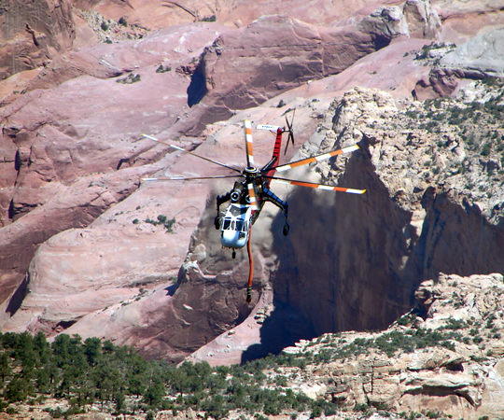
Fires and Forest Recovery
A Fire on a Sky Island and a Helicopter Fighting It
Notes:
In arid regions, forests help self-sustain themselves, because the canopy provides shade which keeps the ground temperature cooler. These cooler temperatures allow for the snowpack to last longer and keep soil moisture higher later into the summer. Thus, when events result in a loss of the forest canopy, this can have catastrophic effects on the forest ecosystems. The loss of the canopy will result in soils that dry out faster and prevent the regeneration of trees. Thus, once the forests are gone, they may never return.
One of the most common sources of canopy loss are catastrophic forest fires. In arid regions, fires were common and the tree species are adapted to their presence. A typical fire would have burned the needles and branches on the forest floor, without affecting the canopy or killing trees. However, human fire-suppression has caused fuel levels to rise and so when fires do get started they burn hotter and higher into the canopy. A canopy fire will kill the large shade-trees. These hotter fires can also destroy the soil and prevent the regeneration of seedlings.
Logging activities, insect outbreaks, and major wind storms can also result in the loss of the canopy. However, with global warming, the risk is that conditions will grow even drier and the impacts on montane forests of arid regions will be devastating. The sky islands may be that no more. This image shows a major fire on the 10,000 feet sky island of Navajo mountain in southern Utah. In this arid region, this forest may have a lot of difficulty growing back. The second image shows a helicopter that collected water from Lake Powell in the desert below to fight the fire.

Slide 15

Treeline
11500 ft
Montane Forest
Pine, Fir, and Spruce
8500 ft
7000 ft
Pinyon Pine – Juniper Zone
6000 ft
4500 ft
High Desert – Sagebrush Zone
3500 ft
2000 ft
Low Desert
Sea Level
North
South
Desert Southwest Sky Island
Notes:
This is a schematic of a Sky Island in the Desert Southwest. It still has climatic characteristics similar to mountains in the coastal regions, except that it is much warmer and drier, resulting in a lower treeline (desert). The desert tends to run higher on south-facing slopes than north-facing slopes, because the higher sun exposure means hotter and drier conditions for plants. Trees begin to appear at about 5,000-6,000 feet elevation (the point where enough moisture falls in winter and temperatures are cooler). Drought-tolerant pines and juniper give way to moisture-loving firs and spruces at about 8,000 feet. The treeline is about 11,500 feet, where winter temperatures and wind exposure conspire with exposure to intense summer sun to prevent the growth of trees.

Slide 16
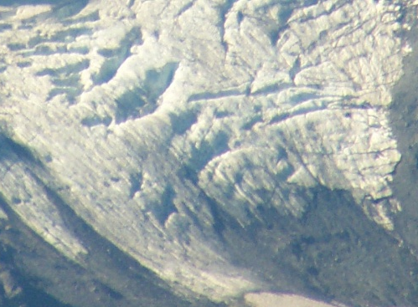
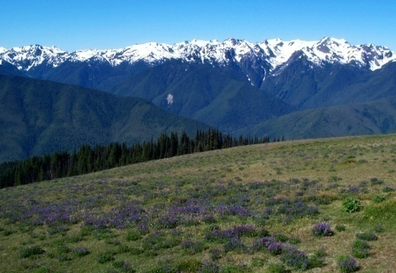
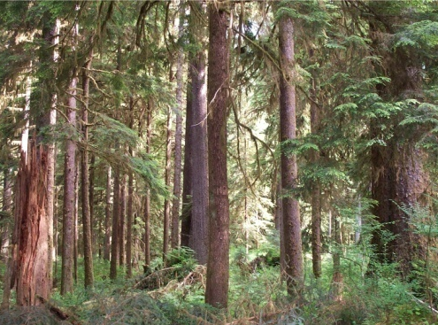
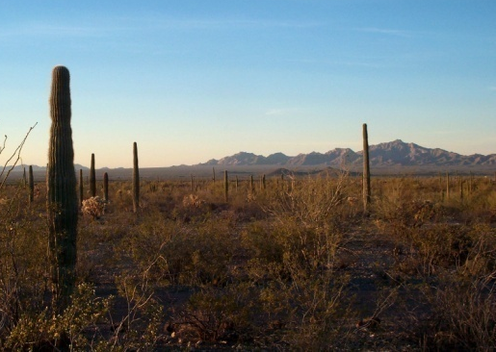
Biomes of Western North America based on Elevation
15
15
10
10
Glaciers and Ice
Alpine/Tundra
Forests
5
5
treeline
1
Deserts/semi-arid chaparral
1
Arctic
SE Alaska
Washington Oregon
Sierra Nevadas
Arizona
C. Mexico
Notes:
From a latitudinal basis, treeline elevation increases as you head south. As temperatures rise moving south, the elevations needed to accumulate enough snow or low enough temperature to hinder tree growth rises higher and higher. Once you reach the lower latitudes, forests also experience a “lower treeline” as arid conditions make surviving in lower elevations impossible.

Slide 17

This project was made possible in part by a grant from
Washington’s National Park Fund.

