Slide 1
Moisture Availability and Its Impact on Vegetation
Treelines and Forest Types

Slide 2
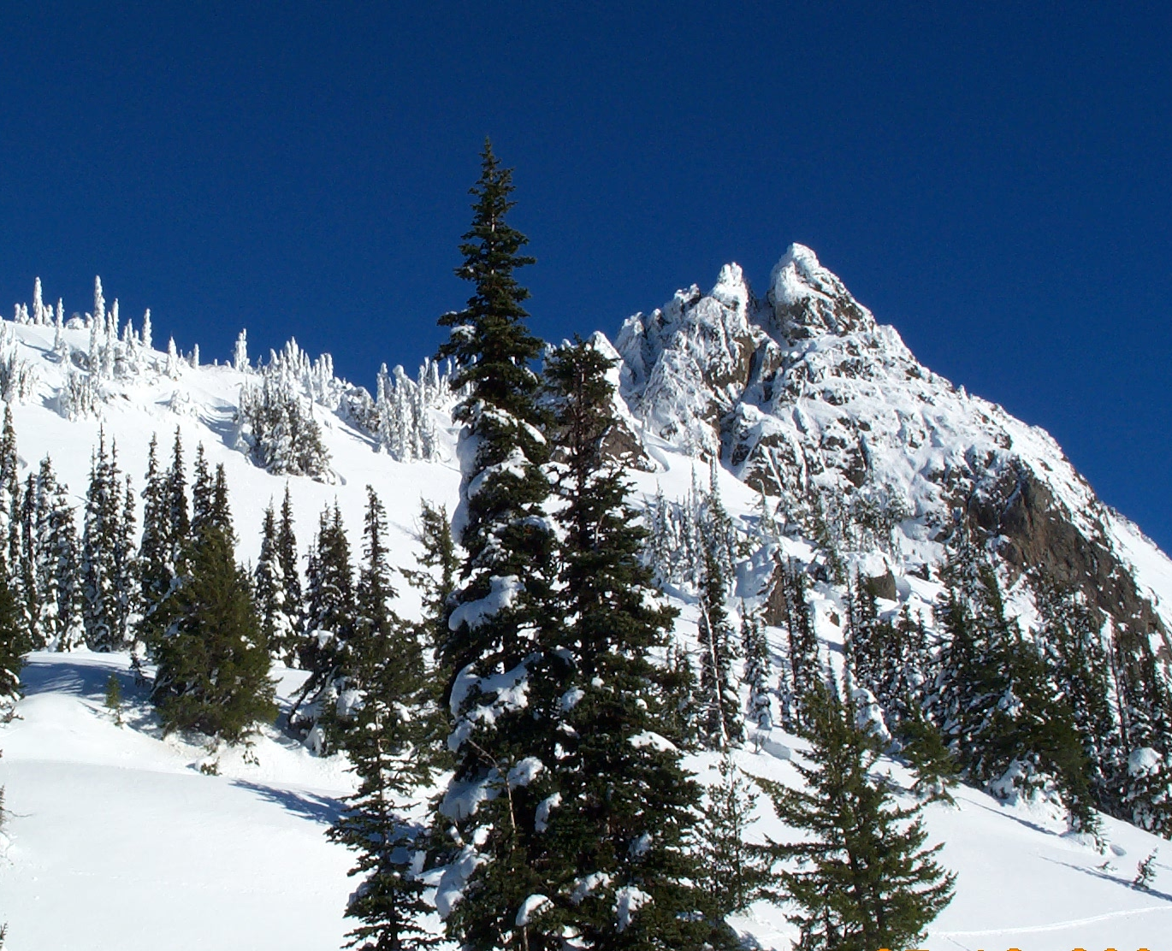
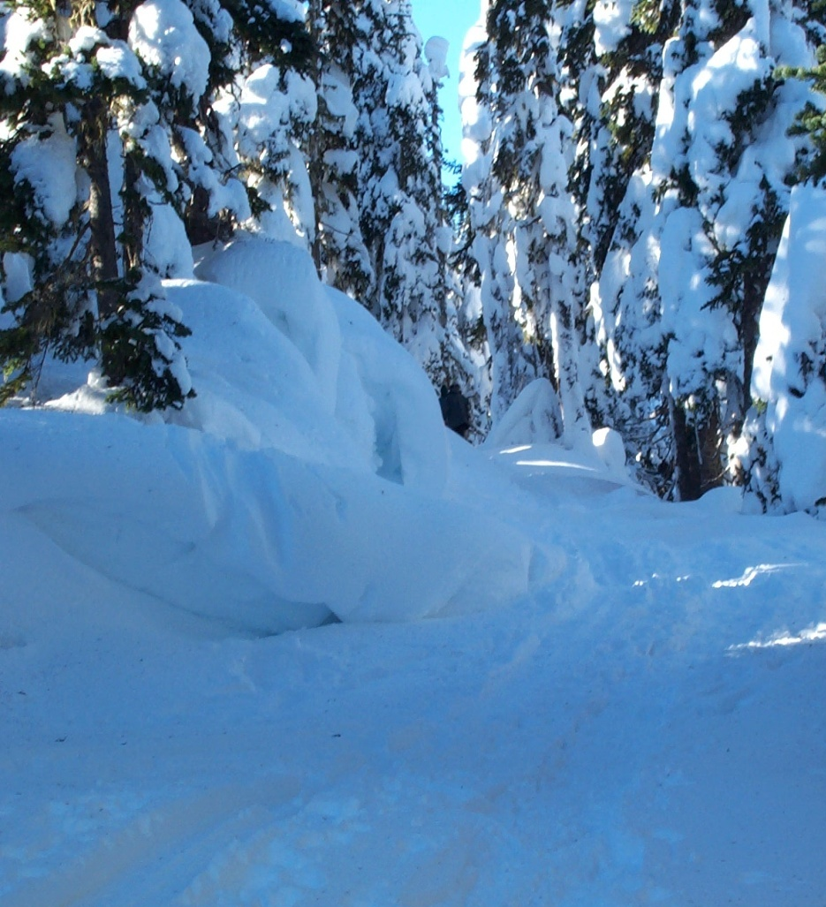
Aspect
The direction a slope faces.
North aspects are in the shadows all winter and thus stay colder than south aspects.
Notes:
Aspect refers to what direction a slope faces. Due to the angle of the sun in the sky, south-facing slopes get much more sun than north-facing slopes, particularly in winter. In winter, some north-facing slopes get absolutely no sun (in the shadows), while the south-facing slopes get all of the available sun. Even in summer, when the sun is the brightest and highest, the sun remains slightly in the south in the day, meaning north-facing slopes remain colder.
Notice in the left image that the south-sides of the trees have no snow on the branches, but the north-side branches still have snow. The image on the right shows that despite it being a bright sunny day, the long shadows results in darkness for anything north of an obstruction. Notice the large drift that is not melting off on the side? Both of these images were taken on the same day.

Slide 3
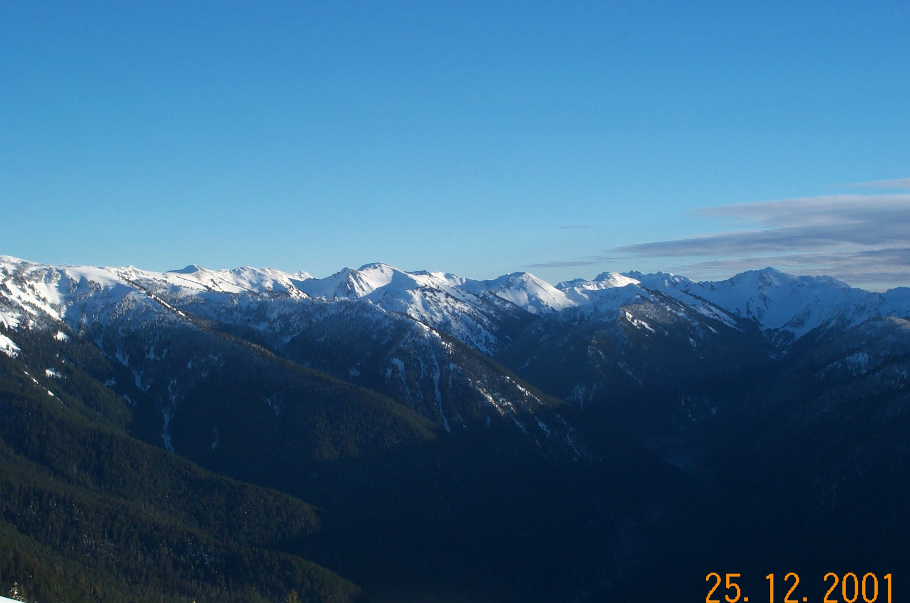
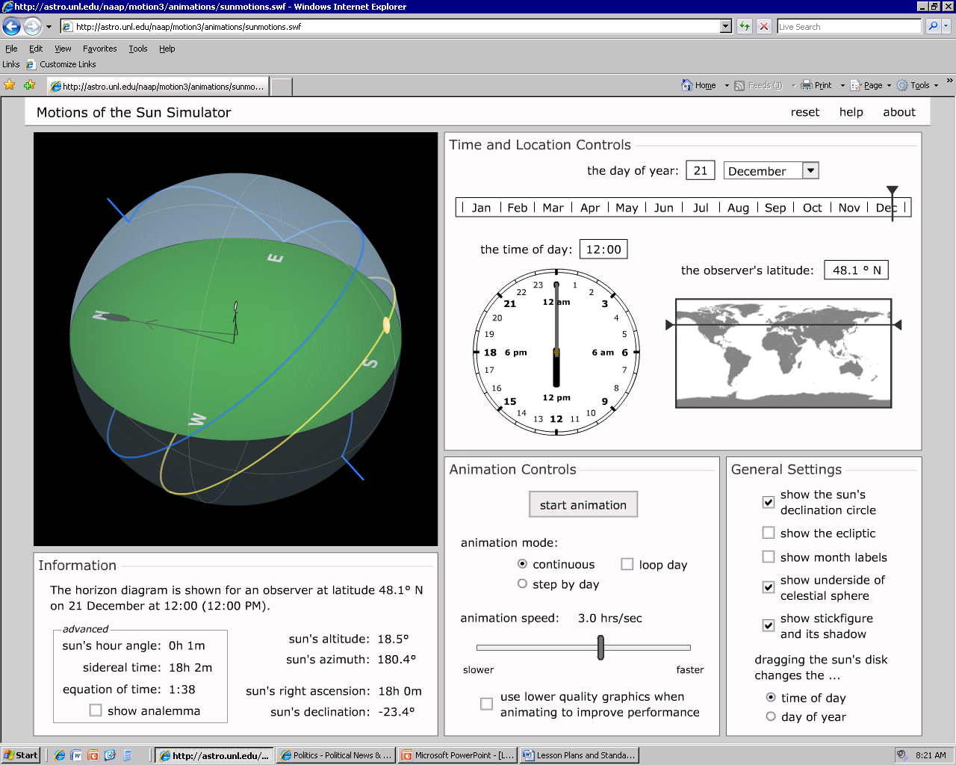
Winter Solstice
Notes:
On the winter solstice, notice that the sun rises in the southeast and sets in the southwest. Even at noon, the sun remains far to the south and casts long shadows. Ridges create shadows that keep the north-facing slopes in darkness all day long. Notice in the image how the shadows darken one side of the ridge.

Slide 4
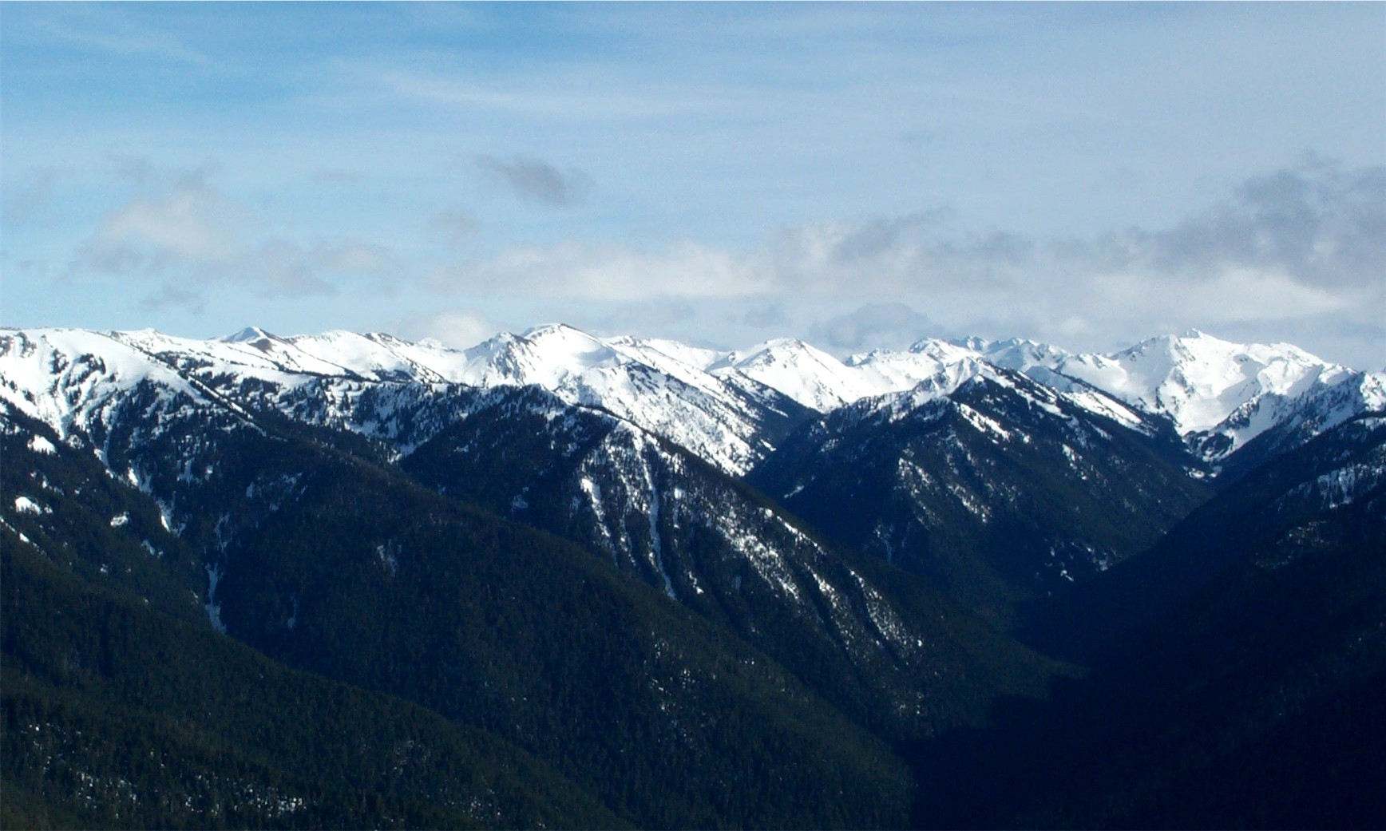
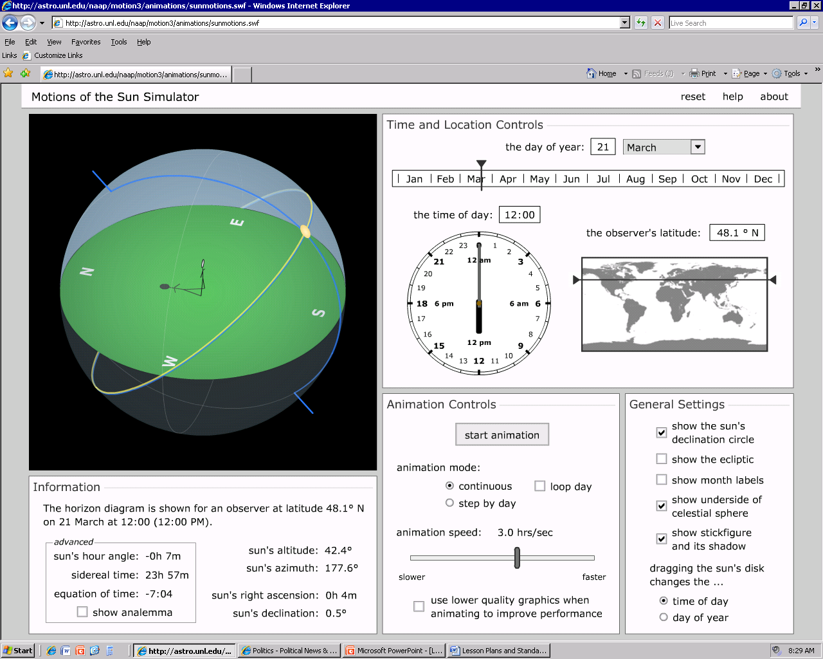
Spring Equinox
Notes:
On the spring equinox the sun rises due east and sets due west. However, all day long the sun remains to the south, casting shadows on the northern slopes. Notice on the image how the ridge still casts shadows on the north-aspect.

Slide 5
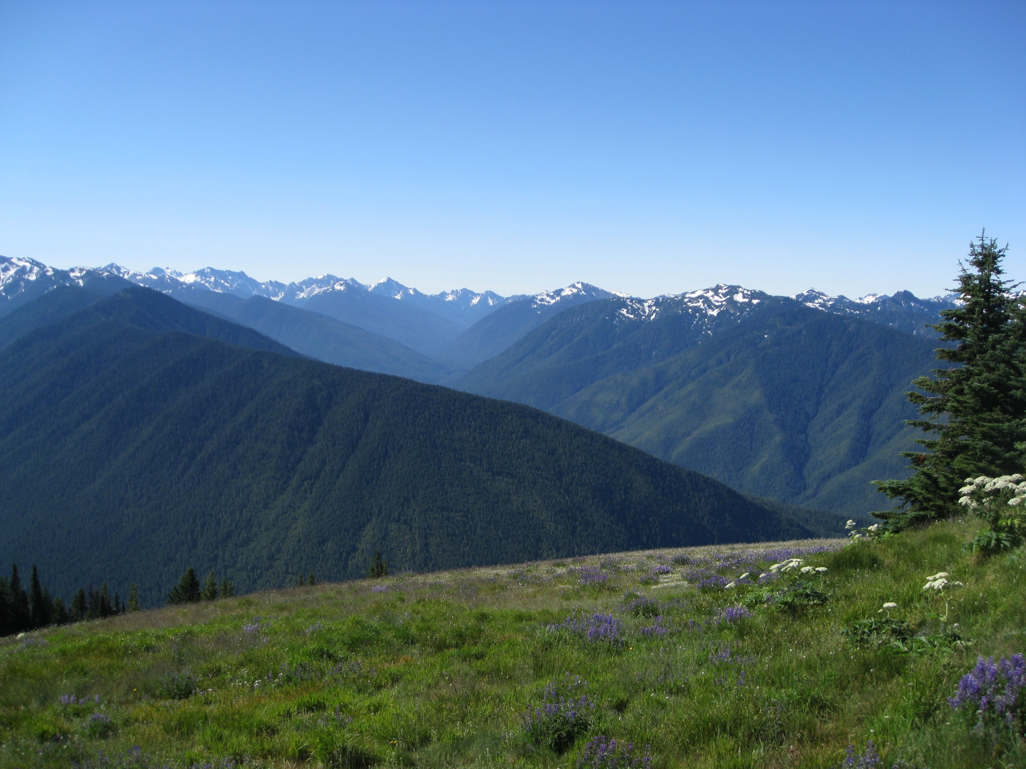

Summer Solstice
Notes:
During the summer solstice, the sun rises to the northeast and sets in the northwest. This is the only time of year that north-facing slopes receive significant sunlight. However, at noon the sun is back in the more southerly sky creating some shadows. Notice on the image above how most, but not all of the ridges are receiving sunlight.

Slide 6
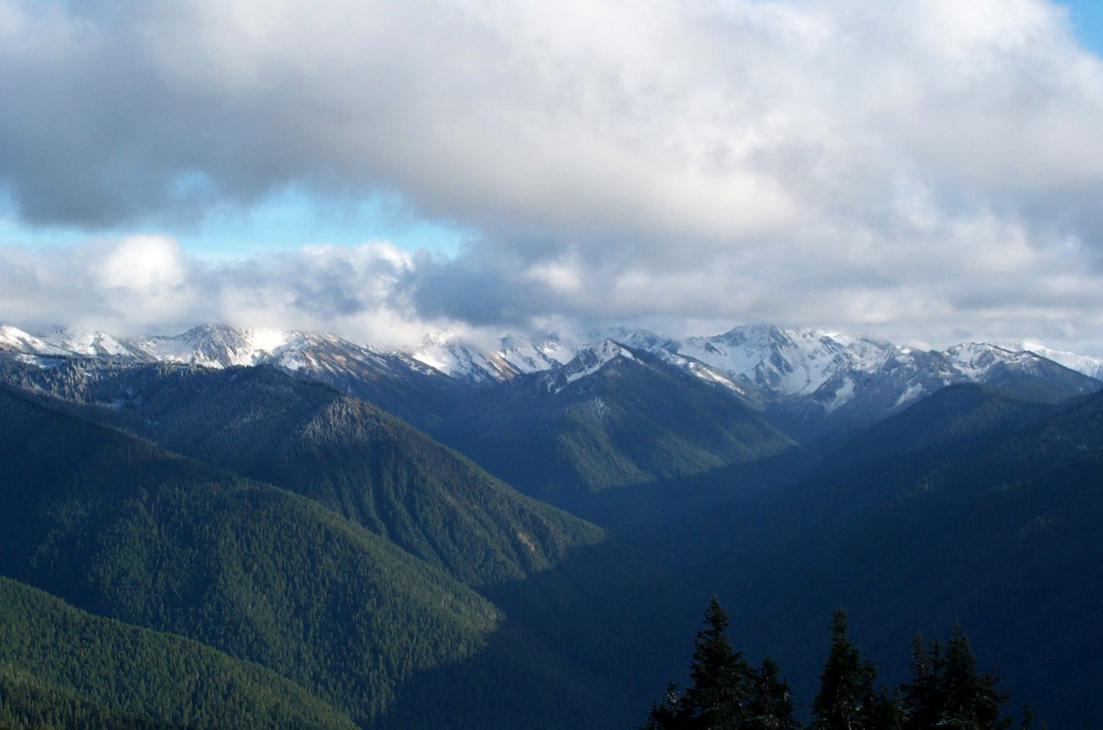

An Autumn Day
Notes:
In Autumn the sun returns to its normal southerly location and the long shadows are cast on the north-facing slopes once again.

Slide 7
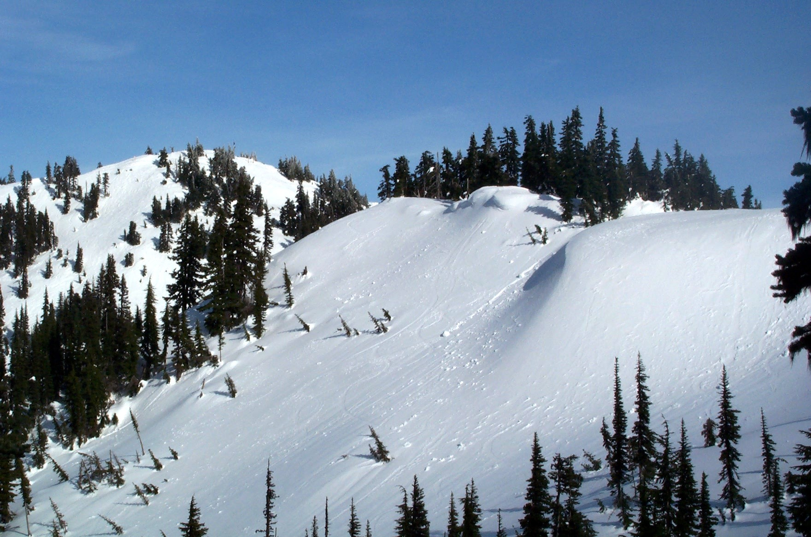
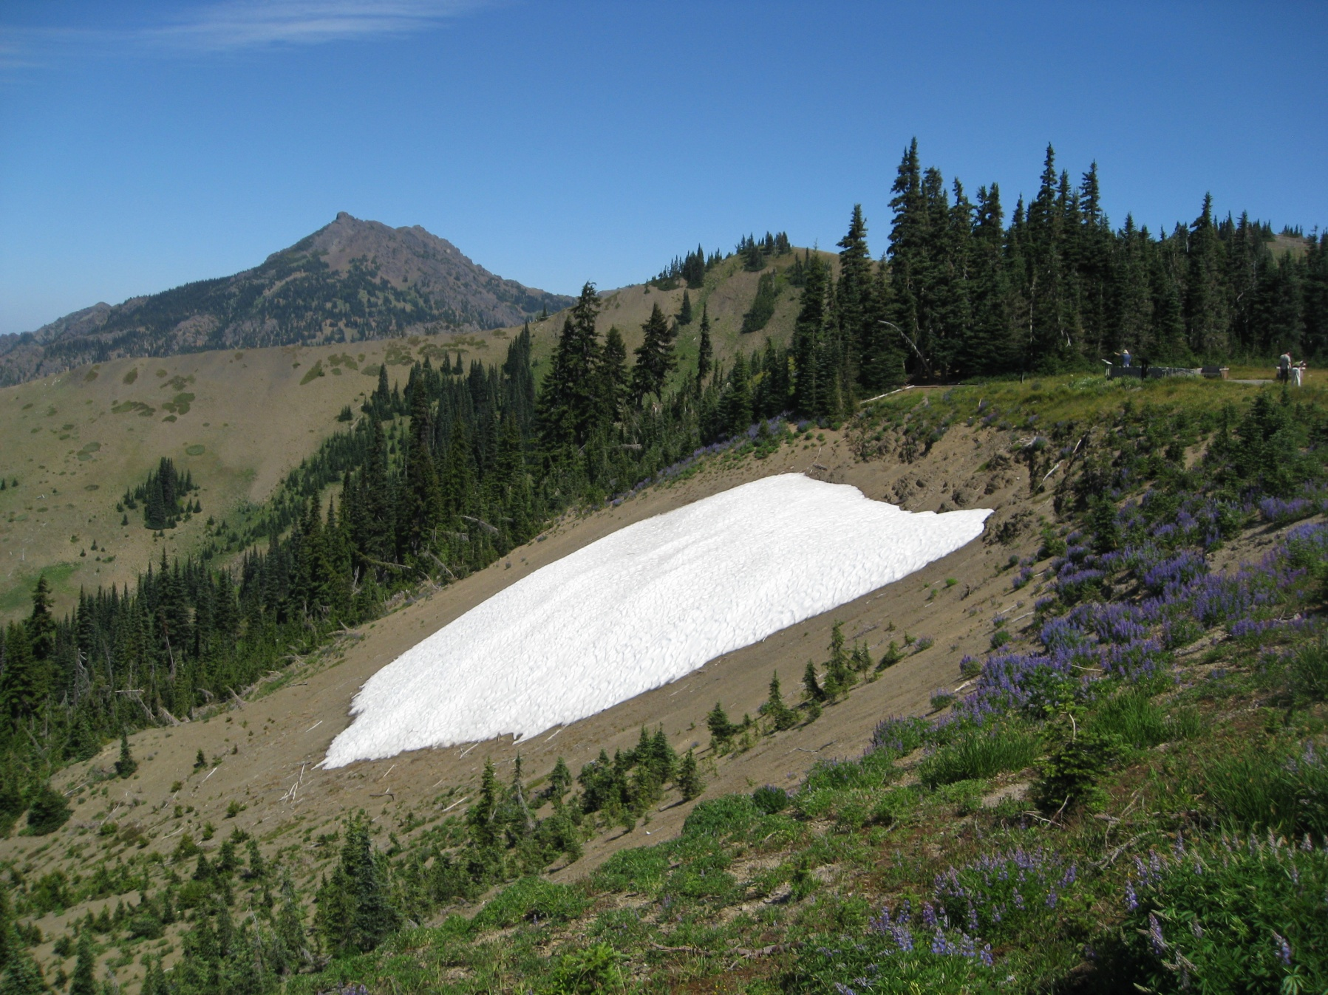
The Effects of Aspect
Notes:
The first image shows the snow that has piled up on the north-facing slope of Hurricane Ridge by late winter. The blowing drifts have accumulated up to 30 feet deep in places. These melt much more slowly than the south-facing slopes due to the long winter shadows.
The second image shows that in August, there is still a patch of snow that has lingered on this north-facing slope because of the shadows that linger all year on this slope. That particular slope is extremely difficult for trees to become established on due to the extremely short growing season.

Slide 8
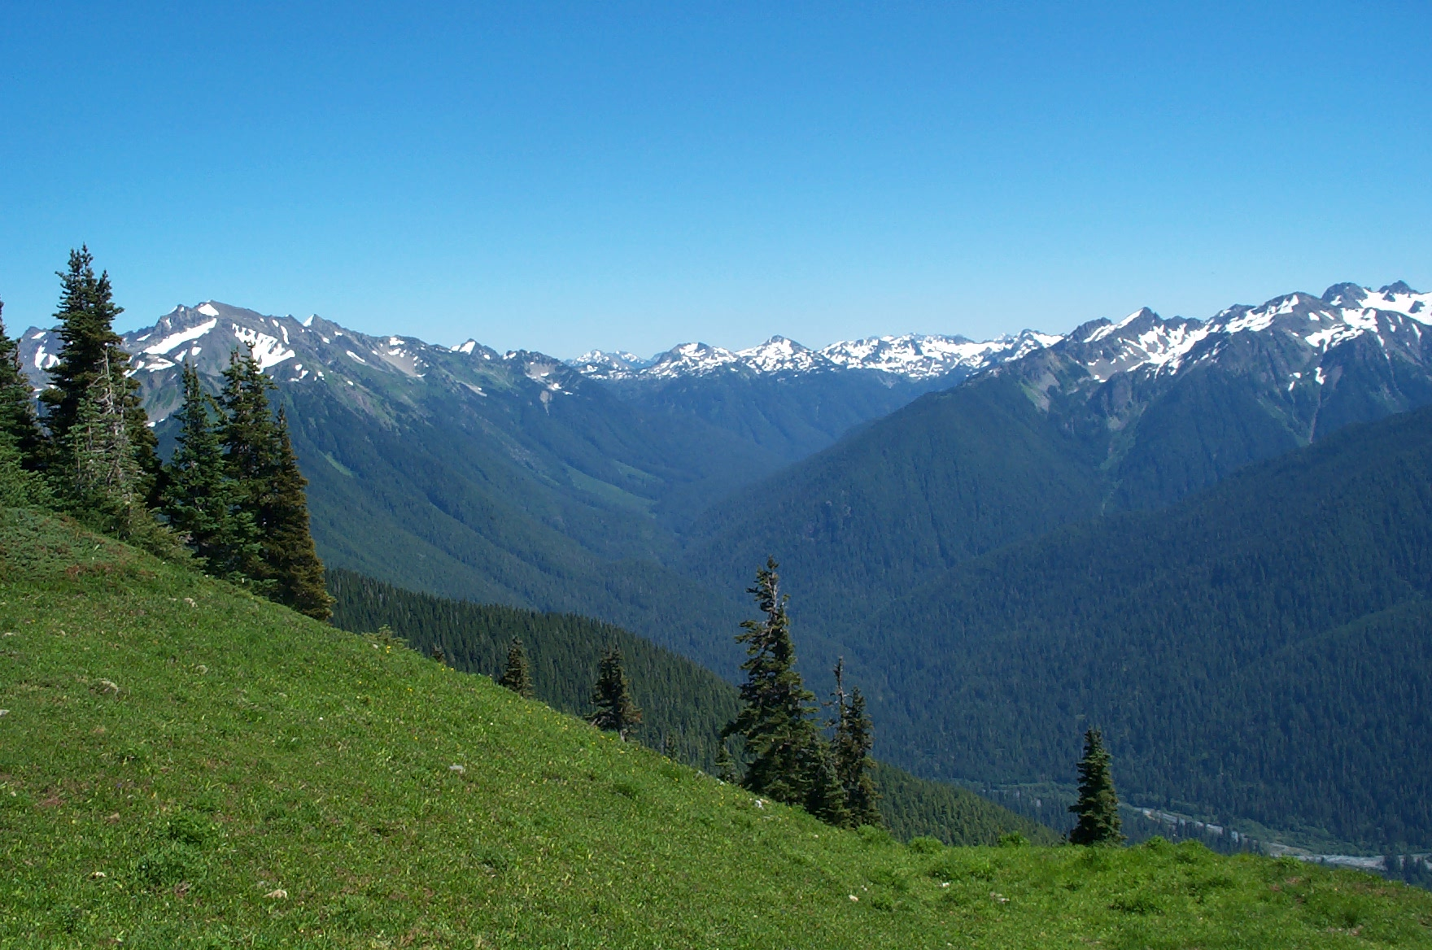
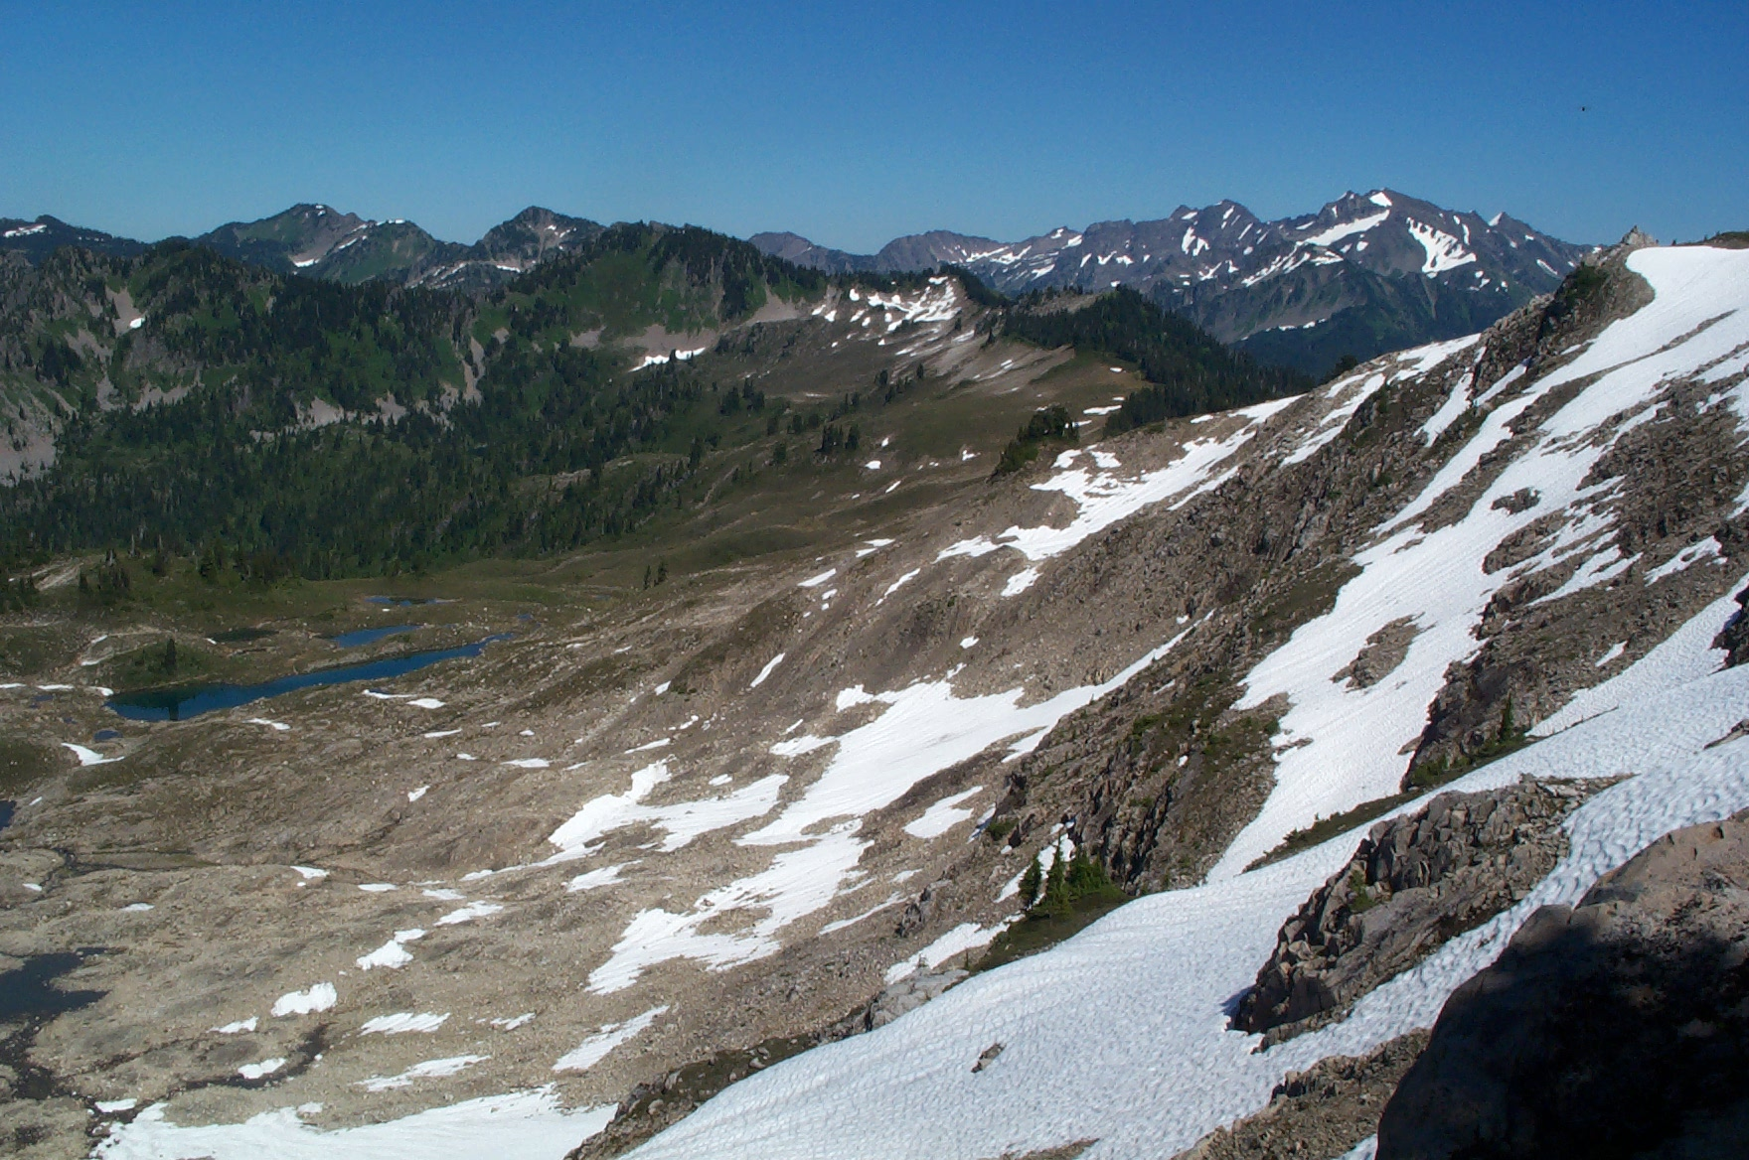
North Versus South Aspect
Bare on the north-slope
Forest growing on south-slope
Notes:
On the High Divide, the north-facing slopes still have snow in July and are devoid of trees. The south-facing slopes in the distance have long since shed their snow. In addition, there is more vegetation on those south-facing slopes.
The second image shows what it looks like immediately upon looking south from the ridgeline. Rather than barren slopes and snow, it contains green meadows and forests. That is because those slopes have a longer growing season because the trees are not buried by snow as long. Thus, treeline is further down the slope on the north side than on the south side.

Slide 9
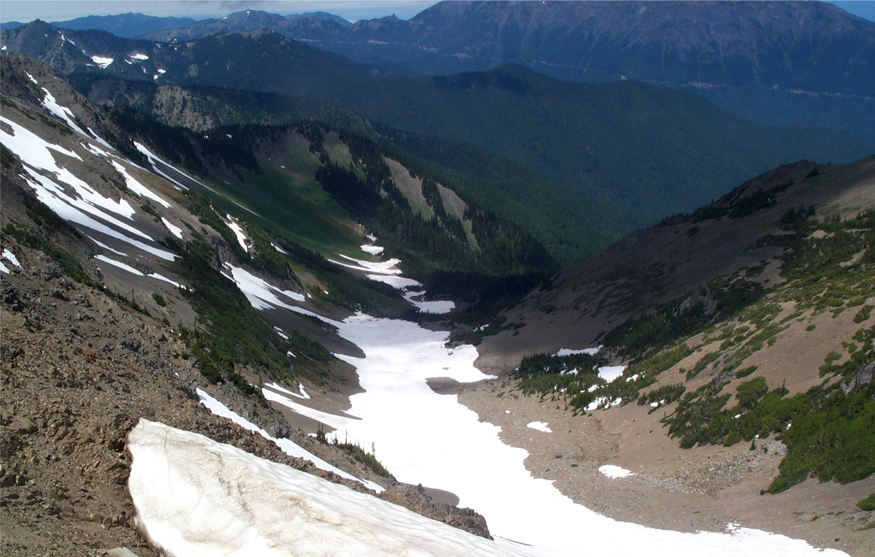
Another View of North Versus South
North-facing
South-facing
Notes:
Again, this image illustrates the difference between a north and south facing slope when it comes to melting snowpack. This image was taken in June when the sun is most directly overhead and the shadows are at their least. The shadows in this image are because of passing clouds.

Slide 10
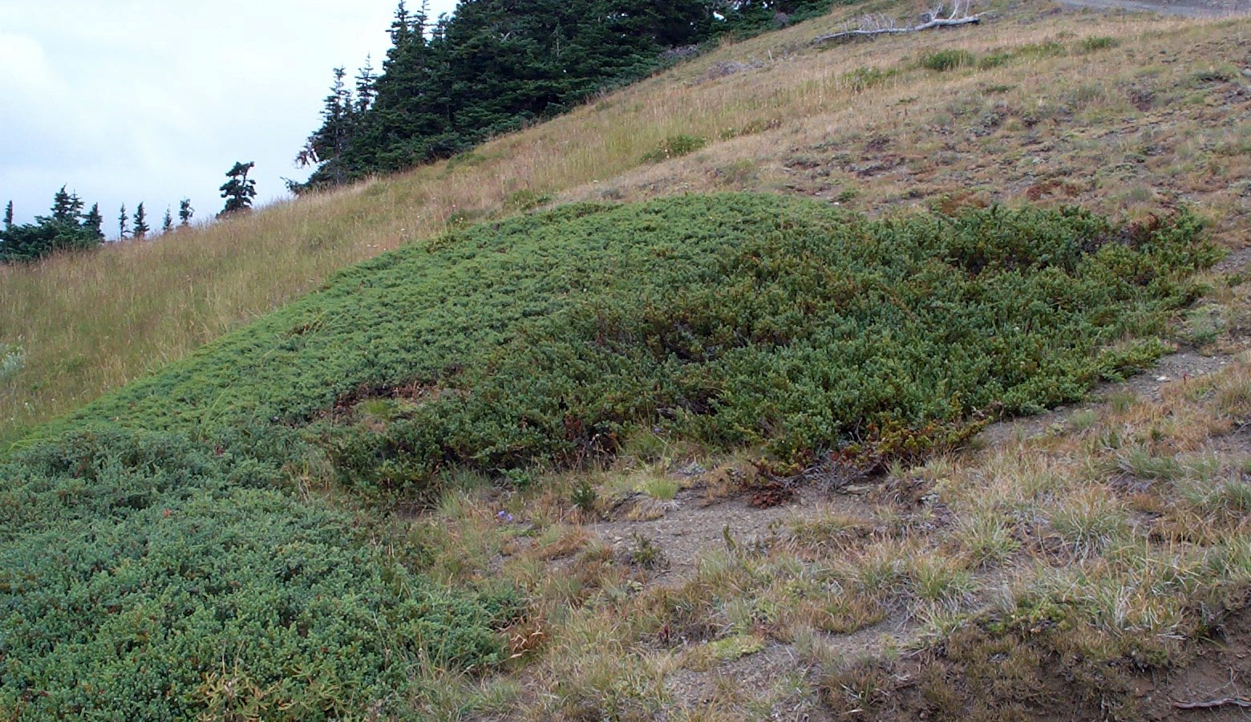
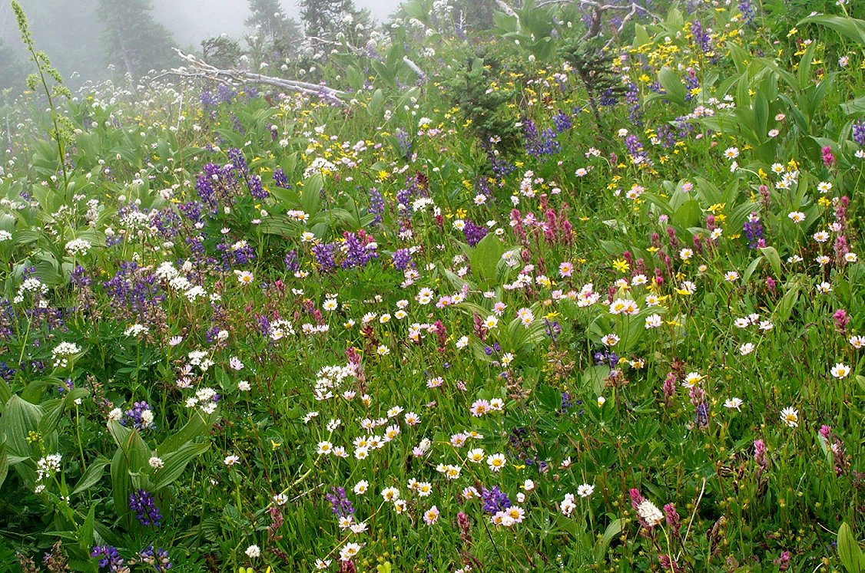
Dry Meadows and Wet Meadows
Notes:
Many factors can affect the types of alpine meadows which develop in an area, such as soil substrates and wind conditions. But, perhaps the most important factor is the intensity of the sunlight on a meadow. South-facing meadows are often very dry (First image), since the sun melts the snowpack sooner and evaporates the soil moisture quicker. These dry meadows tend to turn brown pretty rapidly and are dominated by low grasses and hardy plants adapted to arid conditions.
Wet meadows (second image) can often form on north-facing slopes, where shade keeps soil moisture high for a longer period into the summer. These meadows tend to grow taller, are more lush, and last longer into the summer.

Slide 11
The Effect of Aspect on Treeline
Tree Island
Snowbank
Dry Meadows
Wet Meadows
Treeline
5500 feet
4500 feet
Sea Level
North
South
Pacific Northwest
Notes:
While there are exceptions to this rule based on many factors, such as slope steepness, soil type, wind conditions, and latitude, the general trend is that treelines are lower on north-facing slopes than south-facing slopes because of the longer time it takes for the winter snowpack to melt off.
The treeline in the Pacific Northwest averages around 5,000 feet elevation, but can vary by up to 1,000 feet in either direction based on local conditions.
Often there are also tree islands, particularly on the tops of ridges, where the snowpack and soil moisture neither melt and then dry out too fast nor linger too long into the summer. Notice the trees are taller and larger, the further down the slope you go. Warmer temperatures and less snowpack provide longer growing seasons for these trees, regardless of the impact of shadows.

Slide 12
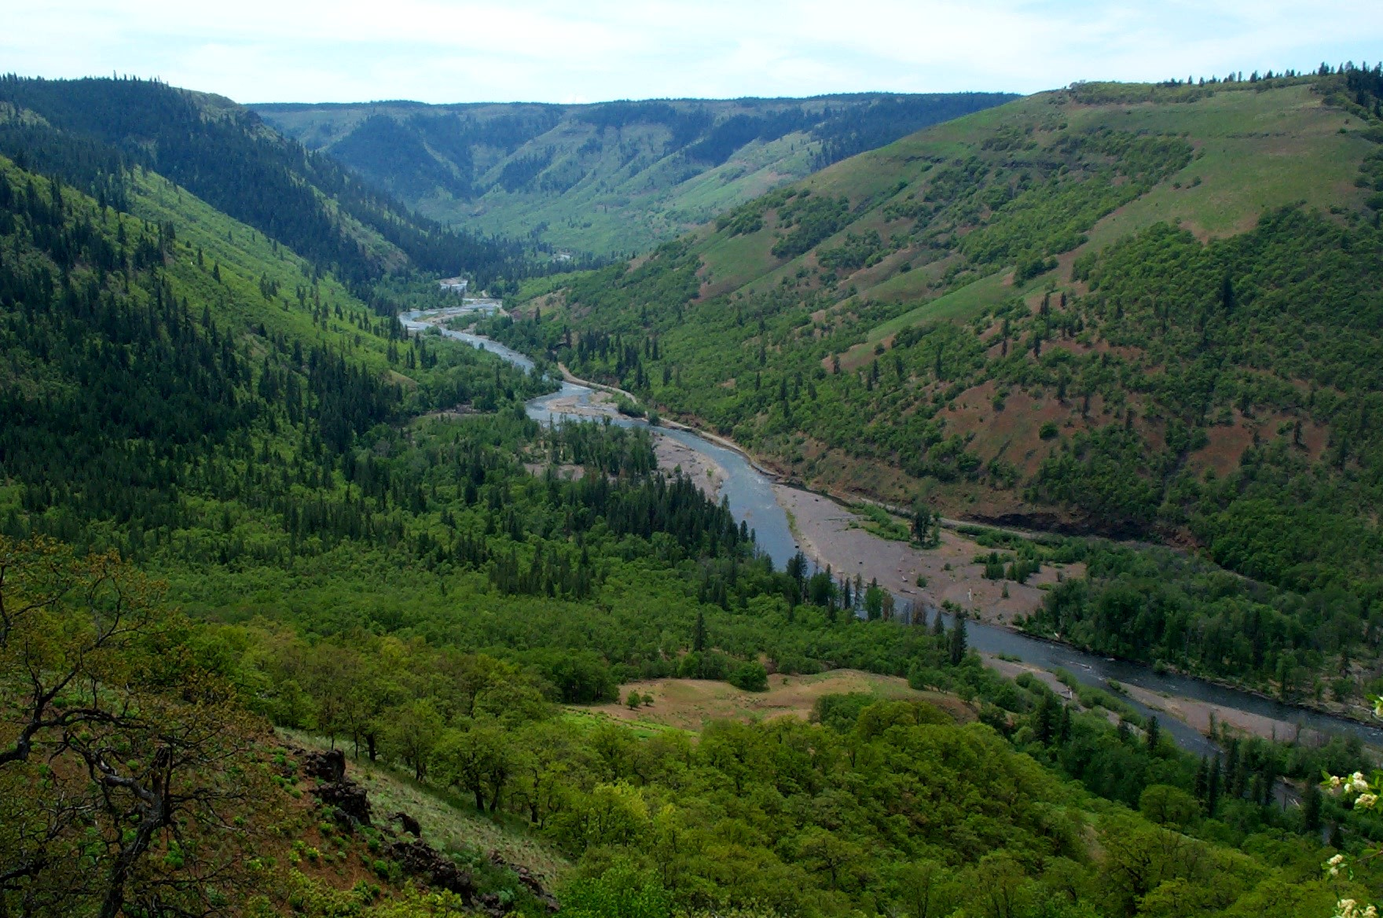
Aspect: The Difference Between Forest and Grassland
Notes:
This is the Klickitat Canyon in the transition zone between the moist Cascade mountains and the arid Columbia Basin. In this zone, aspect is very important. The south-facing side of the canyon has few trees and contains mostly grassy slopes. The north-facing slopes contain pines, Douglas fir, and dense oak forests. The additional shade keeps soils from drying out as quickly, which helps the forests survive in this transition zone toward desert.

Slide 13

This project was made possible in part by a grant from
Washington’s National Park Fund.

