Slide 1
What is a Watershed?
From Precipitation to the River

Slide 2
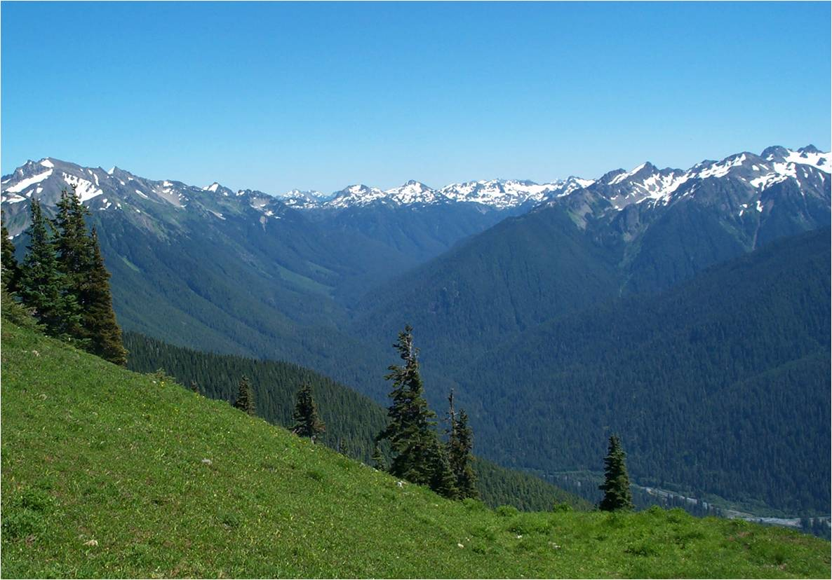
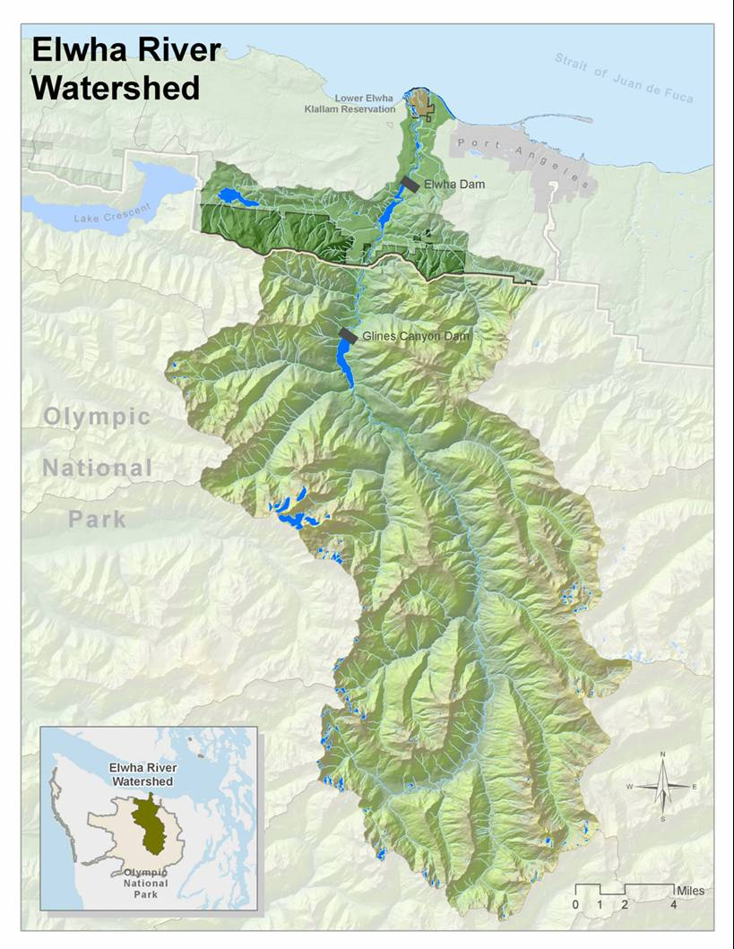
What is a Watershed?
All the area where precipitation that falls funnels down into a river that flows to the sea.
Notes:
Any water falling onto the mountain tops (whether it be rain or melting snow) will flow over the surface via streams, or in the groundwater into one river that heads to the sea. The watershed in the image is the Hoh river.
A basin is a collection area that gathers water from upper areas of the watershed and delivers it to the watershed drainage river.
A watershed can have many tributaries which feed into the main river. Each of these tributaries could be considered their own watershed, but all of them together make up the larger tributary.

Slide 3
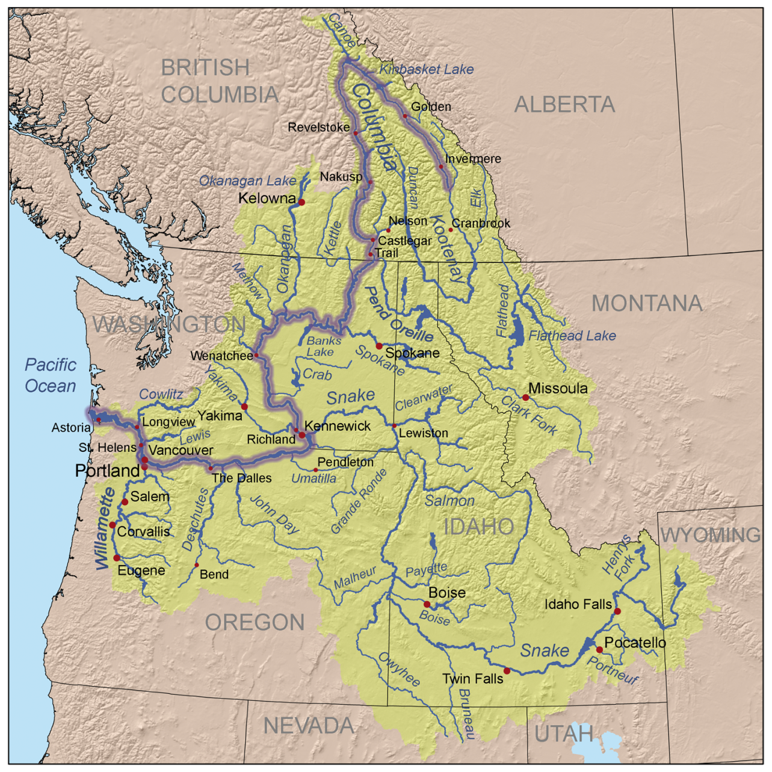
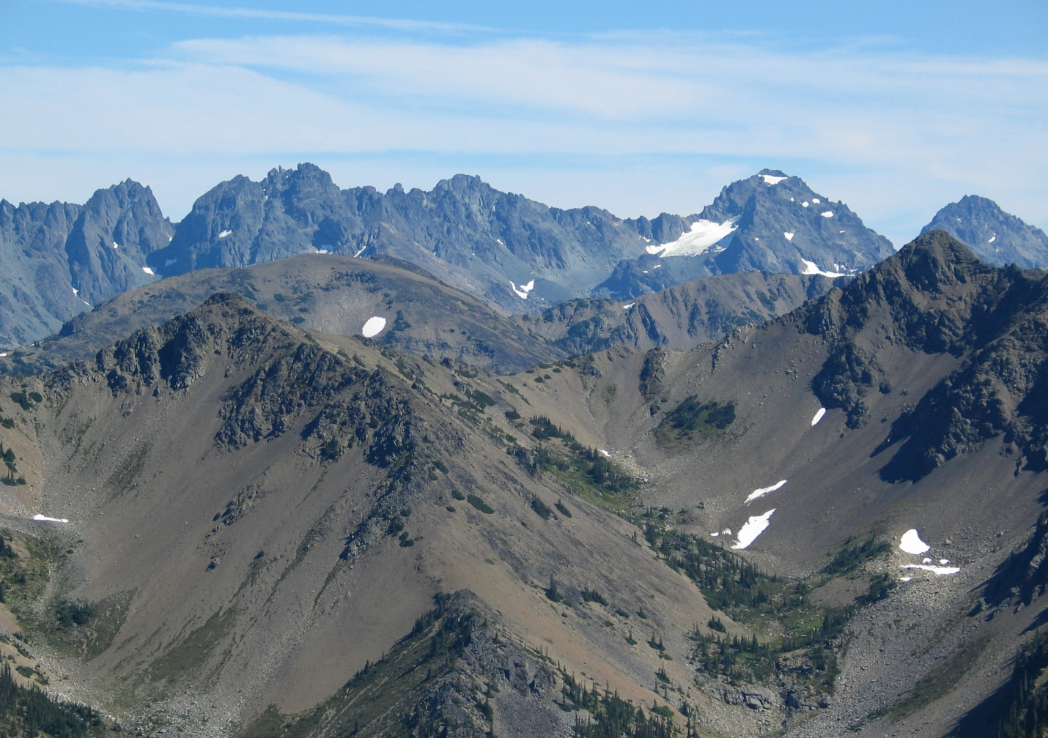
Watersheds Can Vary Widely in Scale
Columbia Basin
Basins are depressions surrounded by higher terrain that collect water
Notes:
Watersheds can vary widely in scale and have to be defined by the specific outlet river or stream that is being referred to. The Columbia river watershed is huge, occupying more than half of Washington and Oregon, nearly all of Idaho, and parts of Montana, British Columbia, and Nevada. Within the Columbia watershed are many large tributary watersheds such as the Snake, Willamette, Spokane, Salmon, Yakima, and Kootenay rivers. Within those tributary watersheds are countless smaller rivers and creeks, each which could be considered their own watershed if that is the focus. So, there are many layers to watersheds, but the main definition remains the same; it is the area where all of the precipitation that falls drains into a river that flows to the sea.
Another term often used for watersheds, especially in higher mountainous areas, is basin. A basin is simply a depression that water flows into from higher slopes. Sometimes basins contain lakes. But, basins can simply be small mountain valleys, such as the ones in this images in the highest elevations of the Elwha river watershed.
Sometimes basins can be quite large, such as the whole region of of south-central Washington, called the Columbia Basin. This area is referred to as a basin because so many rivers feed into the Columbia river in this area and it is surrounded by mountains on all sides.

Slide 4
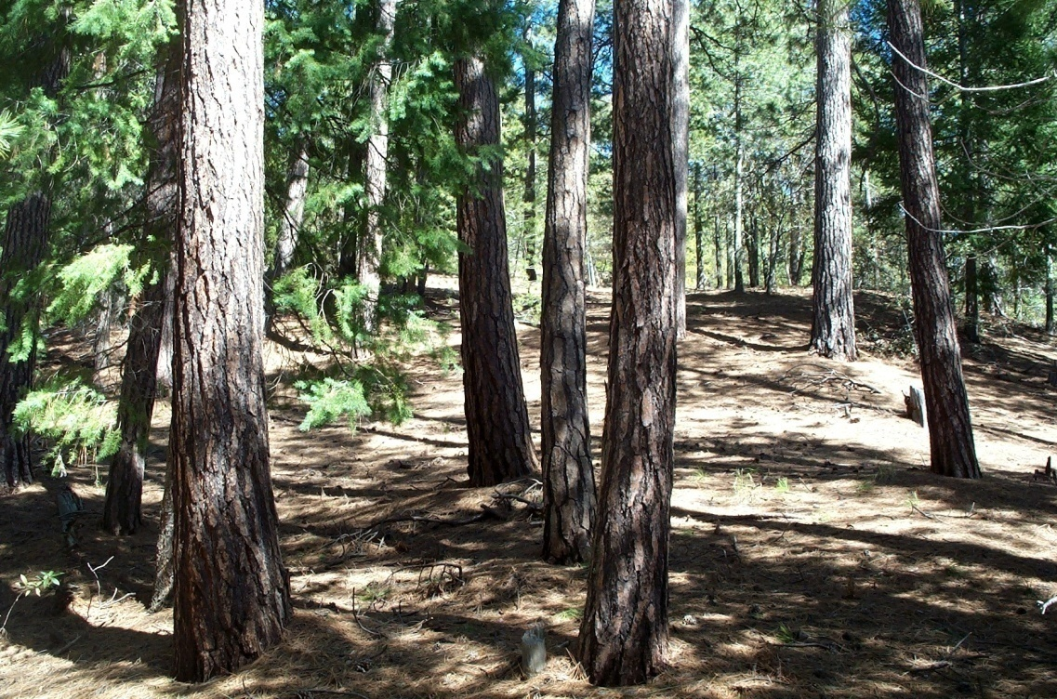
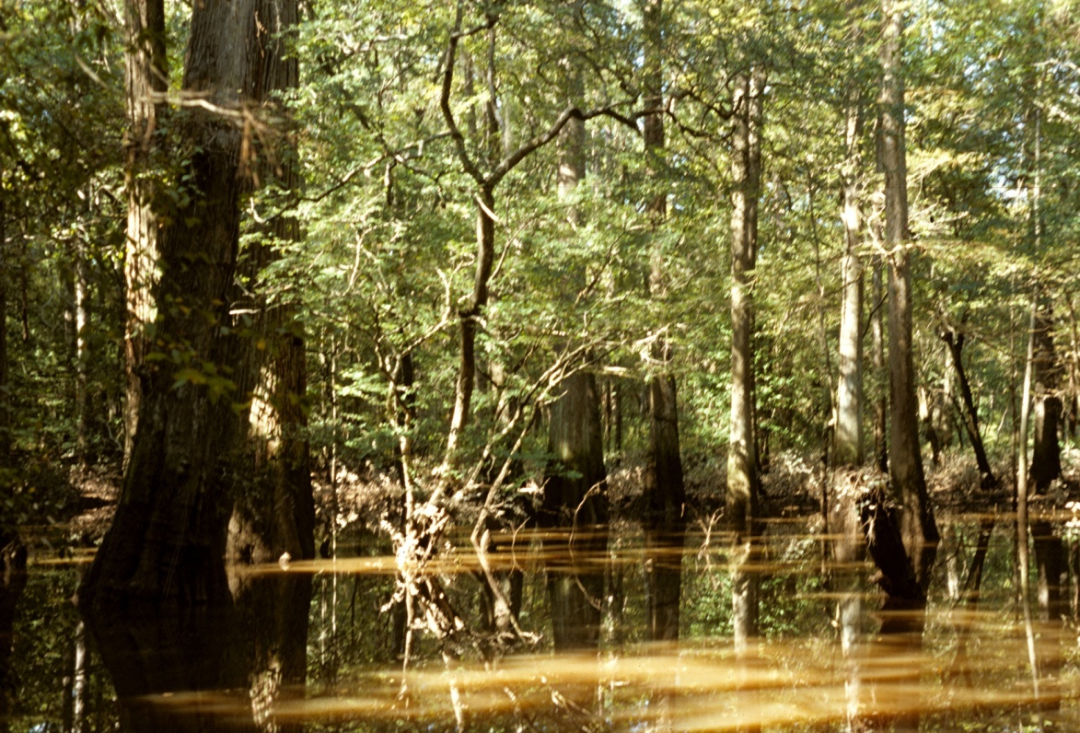
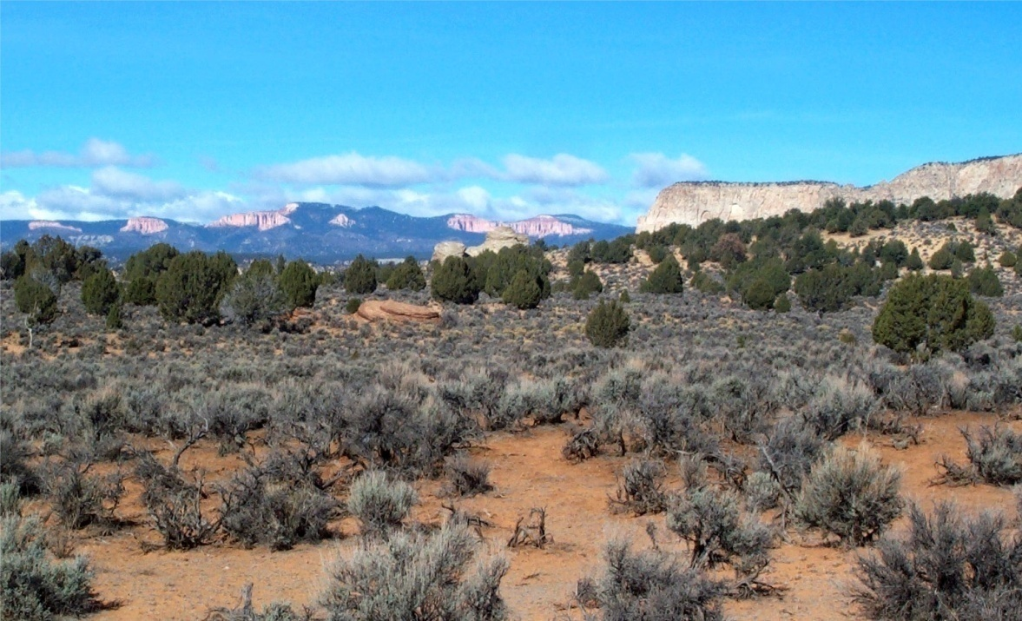
Infiltration: Surface Runoff or Infiltration
Notes:
Once precipitation hits the ground, it can either drain into the soil to become groundwater or it can flow over the surface. Whether it will drain or flow depends a lot on what types of soils are present. If the soil is sandy or porous, the water will easily infiltrate into the ground and become groundwater. However, if the surface is impermeable, such as dense clay or solid rock, water will run over the surface.
Clockwise from top-left: Volcanic cinders are very porous, allowing virtually all precipitation to drain through rapidly. For plants, it is almost as if they live in a desert. Top-right: However, where the soils are less porous, dense pine forests grow. Lower-left: These sandy soils in Utah have difficulty supporting plants because the little precipitation that falls drains through easily. Lower-right: Dense clay soils in this east Texas swamp results in standing water and swamp trees of bald cypress and gum.

Slide 5
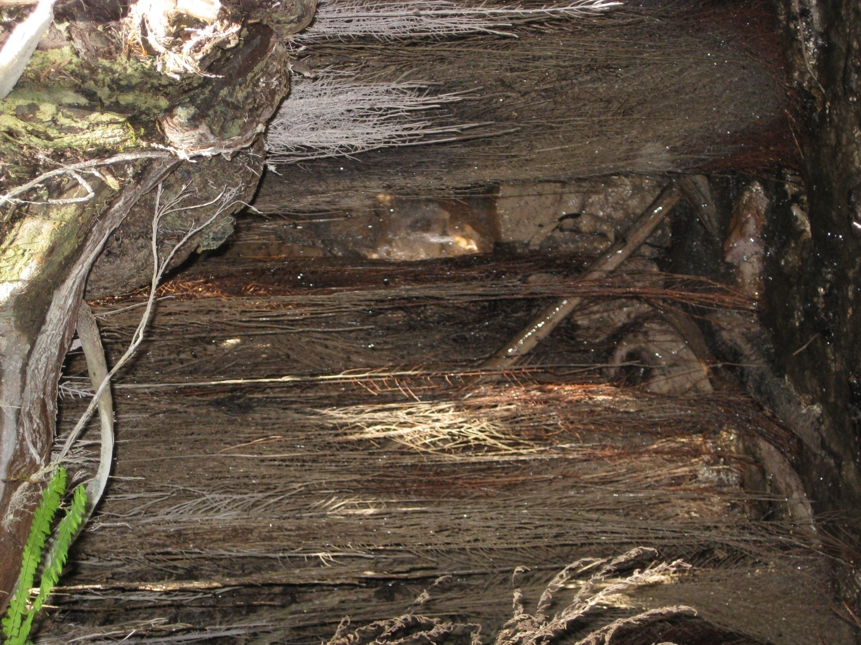
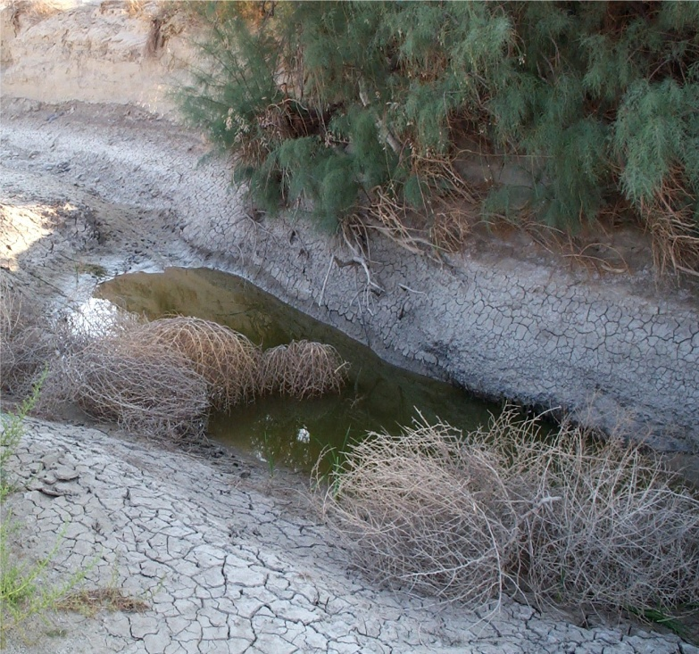
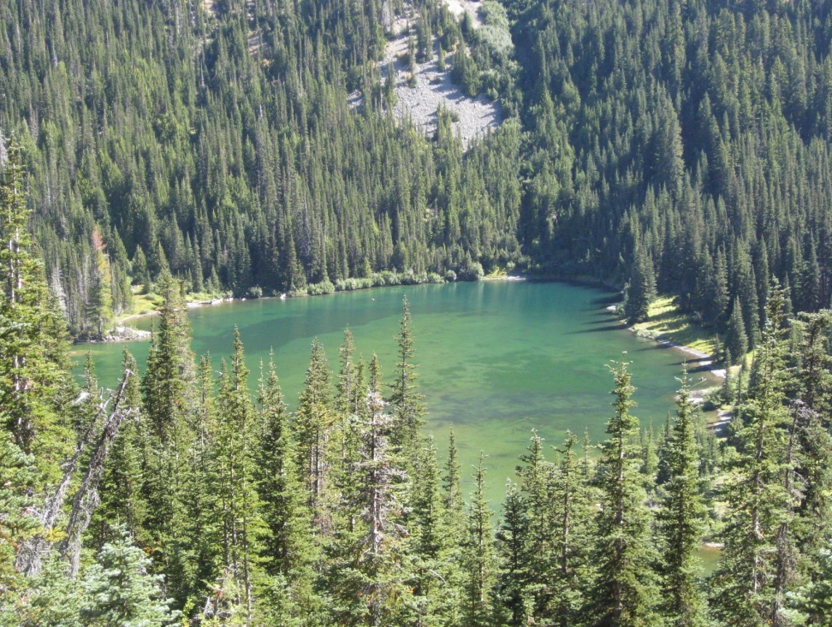
Aquifer and the Water Table
Pond
Water Table
Permeable Rock
Unsaturated Zone
Spring
Aquifer
Impermeable Bed Rock
River
Permeable Rock
Notes:
An aquifer is an underground supply of water that results from water that infiltrated through the soil, but collected when it hit an impermeable layer of rock or clay below. This water is not in a “cave” per say, but contained within the porous spaces between the soil particles. It tends to flow downward due to gravity, much as surface water does, but following the contours of the impermeable rock, not necessarily the topography of the surface. In addition, because of the friction within the rock material, the rate of water flow is much slower. It may take months to years, or even thousands of years, for the underground water to travel the same distance as surface water could travel in a few days.
The uppermost level of the aquifer is the water table. Where the surface dips below the level of the water table, this water reemerges on the surface as a pond, lake, or if the topography dips downward as a spring that feeds a surface stream.
The image at left shows a spring in the desert where a dip in the surface drops below the water table. The cracked mud indicates that the water table was higher earlier in the season when winter rains recharged the aquifer. But, as the dry season continues and less water enters the aquifer, the water table will drop.
The middle image shows a spring in the Sol Duc valley, where the surface slopes intersects the water table. This is the source of a stream that runs on the surface. The image at right is Grand Lake in the Olympic Mountains, which is at the bottom of a basin and shows where the water table is located. There is an outlet stream that flows down into the Dungeness River.

Slide 6
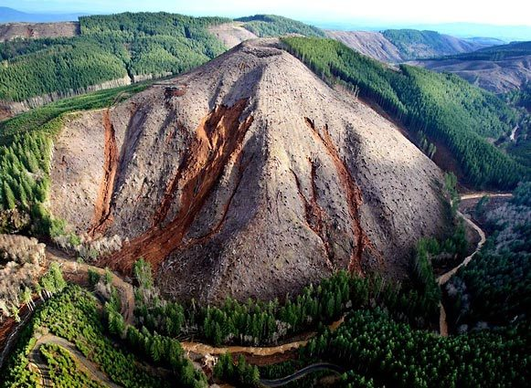
Effects of Surface Materials on Infiltration and Surface Runoff
Why did the soils in the areas that were clear-cut have landslides and river flooding, while the areas that still had trees suffer few problems?
Photos courtesy of Seattle Times
Notes:
Have students look at these photos and ask them, why did the clear-cut areas have mudslides and increased flood, while the forested areas did not? Vegetation captures moisture in the canopy and slows the momentum of water heading to the surface. High velocity raindrops hit the branches and run down the trees slowly, rather than striking the surface soil with their full force. When rain hits the surface directly, it’s momentum can break up the soil and free it to run over the surface. Some of the rain is also held in the canopy and evaporates rather reaching the ground.
Often when normally permeable soils are exposed to direct sunlight, they dry and cake to form into impermeable surfaces. When heavy rains come, instead of infiltrating normally, the water runs over the surface, resulting in increased surface flow and flooding into the rivers. Also, without a canopy to capture moisture and few roots holding the soil in place, the hillsides are more susceptible to mass wasting and mudslides. When there are clear-cuts, dead tree roots rot underground and weaken, thus losing their ability to hold the soil together.

Slide 7
This project was made possible in part by a grant from
Washington’s National Park Fund.

