Slide 1
Salmon Nutrient Cycling
Accessing the Terrestrial Ecosystems

Slide 2
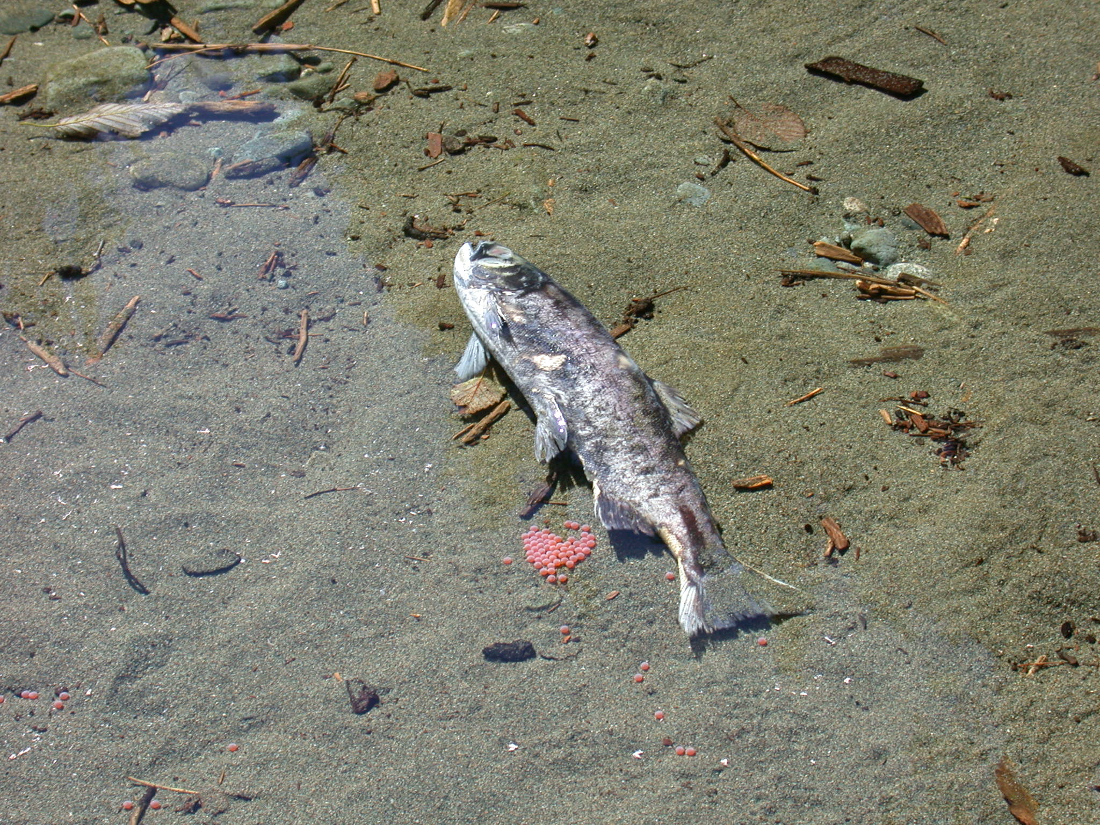
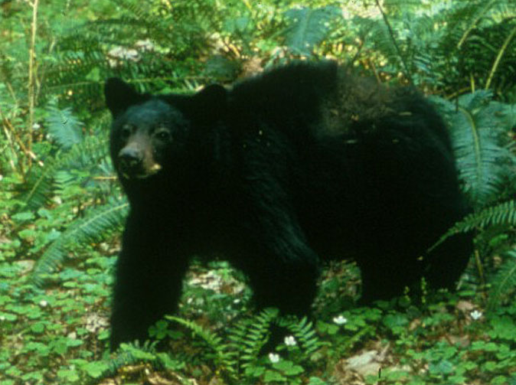
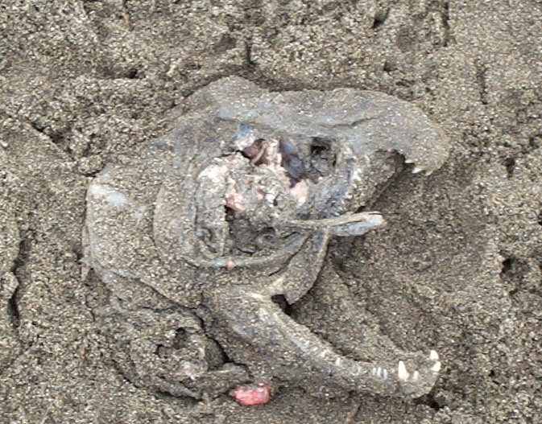
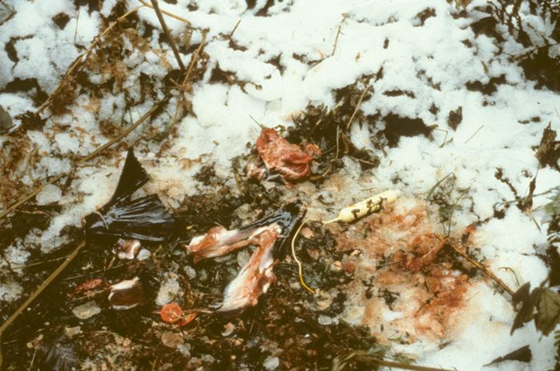
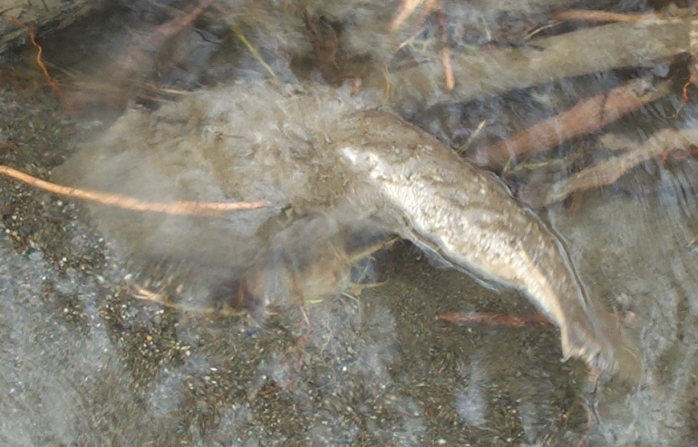

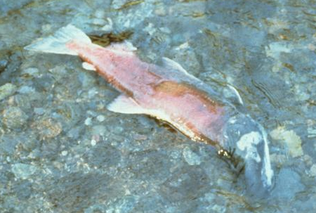
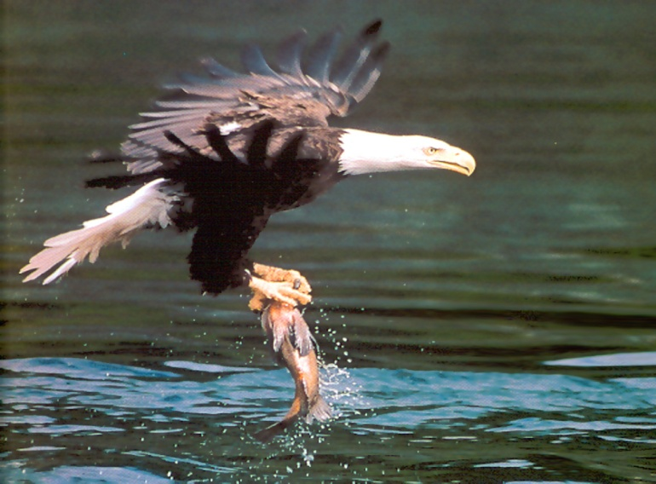
Notes:
Salmon carcasses bring critical marine-derived nutrients that are not ordinarily available in freshwater and terrestrial ecosystems. The arrival of the salmon brings a mass migration of animals to the river to scavenge on the carcasses. Bear, raccoons, skunk, eagles, flies, and dozens of other animals feed on the carcasses. The fall salmon runs are particularly important because they provide critical food that animals use to build up their fat supplies to survive the long winter ahead.

Slide 3
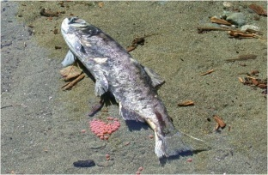

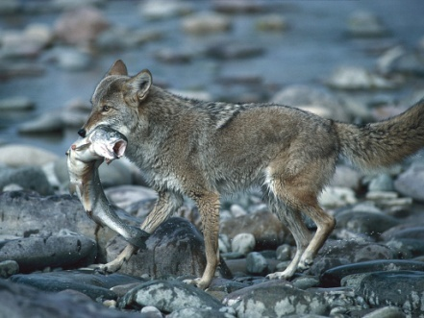
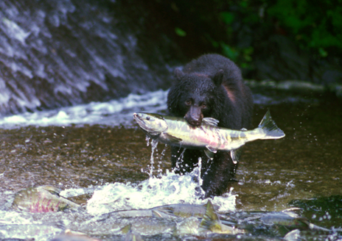
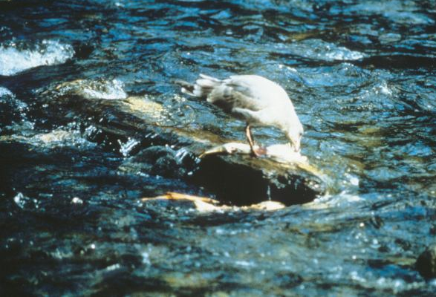
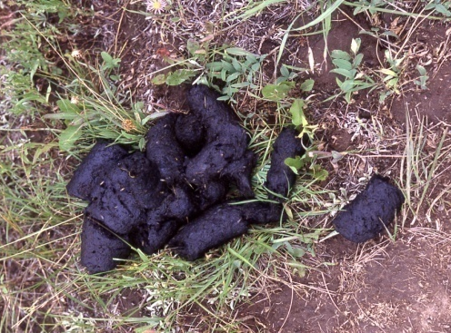
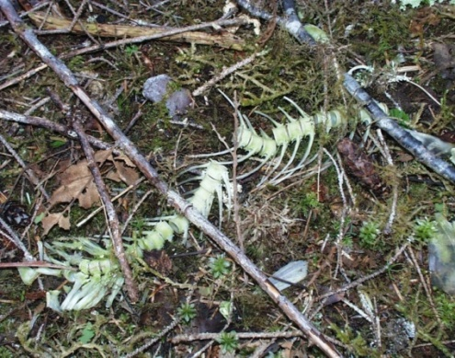
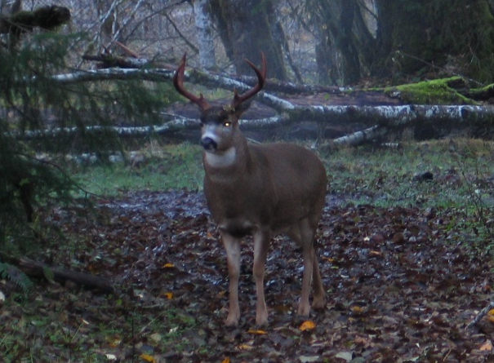
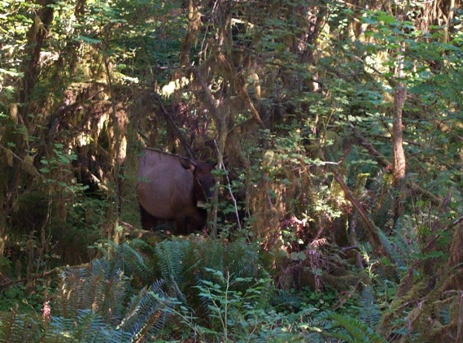
Movement of Marine-Derived Nutrients
Salmon Carcass
Scavengers feed on carcass
Scavenger feces deposited in forest
Scavenger hauls carcass into forest
Marine-derived nutrients enter soil
Nutrients taken up
by vegetation through roots
Herbivores feed on vegetation
Notes:
In addition, the marine-derived nutrients find their way into terrestrial environments. Scavengers, such as bear, coyote, skunks, and birds feed on carcasses and often drag them into the forest. Their waste, whether it be uneaten portions of the carcasses or their feces are then deposited on the forest floor. Those nutrients enter the soil and are eventually taken up vegetation and trees through their roots. Most plants need to acquire specific minerals and nitrogen from the soil to build plant tissues. These nutrients are then eaten by herbivores such as deer, elk, caterpillars, and a myriad of other species that eat plant tissues such as leaves, flowers, fruit, and seeds.

Slide 4
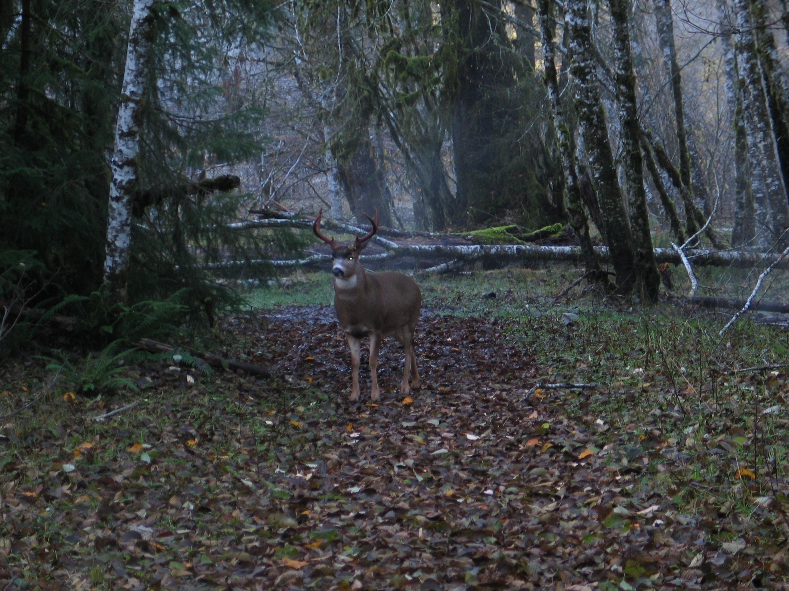
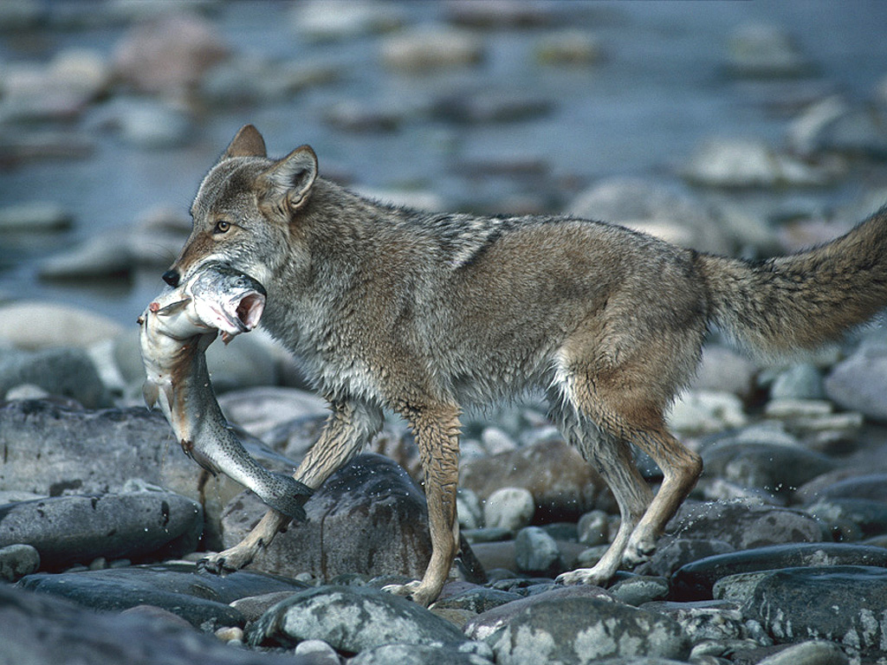
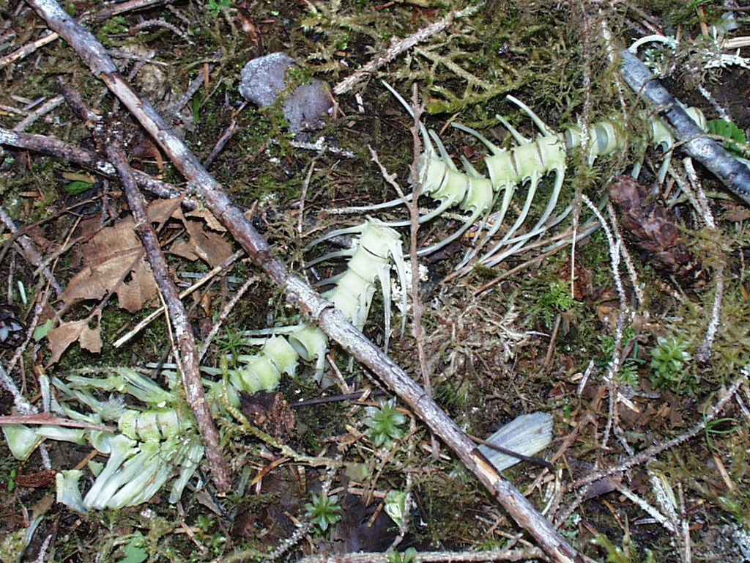
How a Coyote Helps a Deer
Coyote with a coastal cutthroat trout
Notes:
A coyote takes an anadromous fish from the river, drags the carcass into the forest, and feeds on the meat. The leftover portions of the carcass are decomposed by bacteria, which release the nutrients into the soil. The nutrients are taken up by plants. The deer then eats the plant leaves and absorbs these marine-derived nutrients.
“A predator becomes a friend”

Slide 5
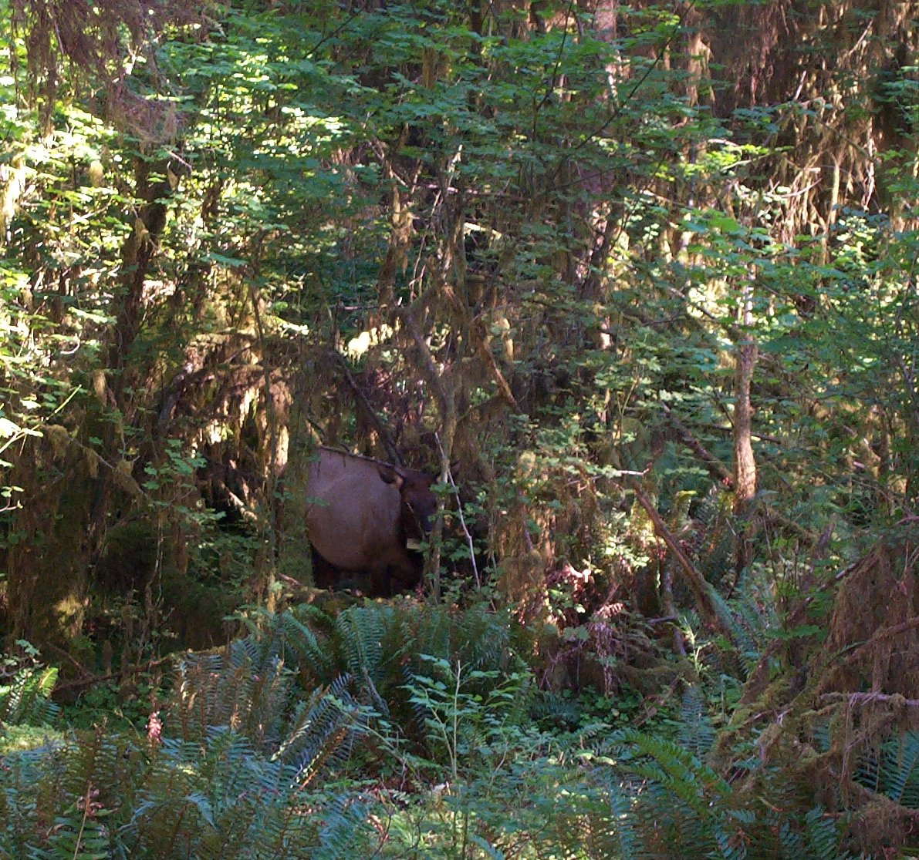
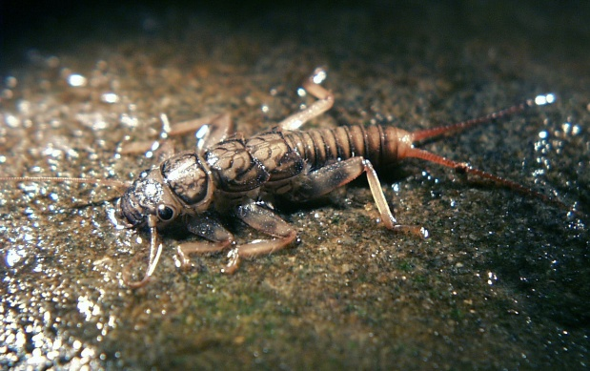
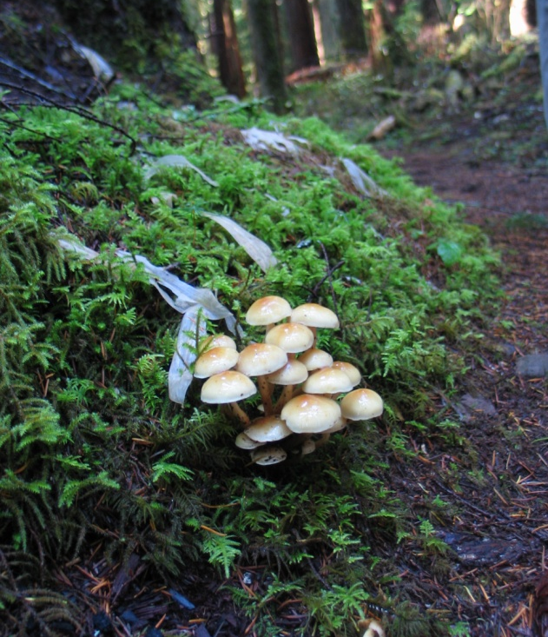
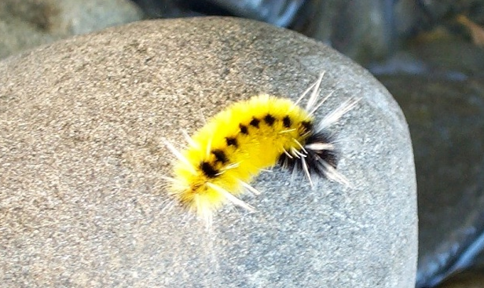
Using Markers to Determine Nutrient Origins
The stable isotope N¹⁵ occurs at a higher rate in marine organisms than in freshwater.
Salmon biomagnify N¹⁵ through the trophic levels
Elevated N¹⁵ levels in freshwater environments is a sign of it originating in marine environments.
Notes:
The stable isotope N¹⁵ occurs in marine environments at a higher concentration than in freshwater or terrestrial ecosystems.
Salmon have elevated N¹⁵ isotope levels because these isotopes biomagnify into their tissues through the trophic levels. Scientists can track how the nutrients salmon acquire in the ocean travel in the freshwater and terrestrial environments after the salmon carcasses are consumed by scavengers and detritivores. What has been discovered is that salmon nutrients permeate into virtually every aspect and trophic level of the ecosystems in areas where salmon spawn.
Examining aquatic insects, terrestrial vegetation, fungi, and herbivores have all shown elevated N¹⁵ over areas where salmon are not found.
Every living organism and the decaying biomass in these photos has some quantity of marine-derived N¹⁵ higher than in river systems that lack spawning salmon. These extra nutrients help support healthier and more productive ecosystems up to 7-miles from salmon-bearing rivers.

Slide 6
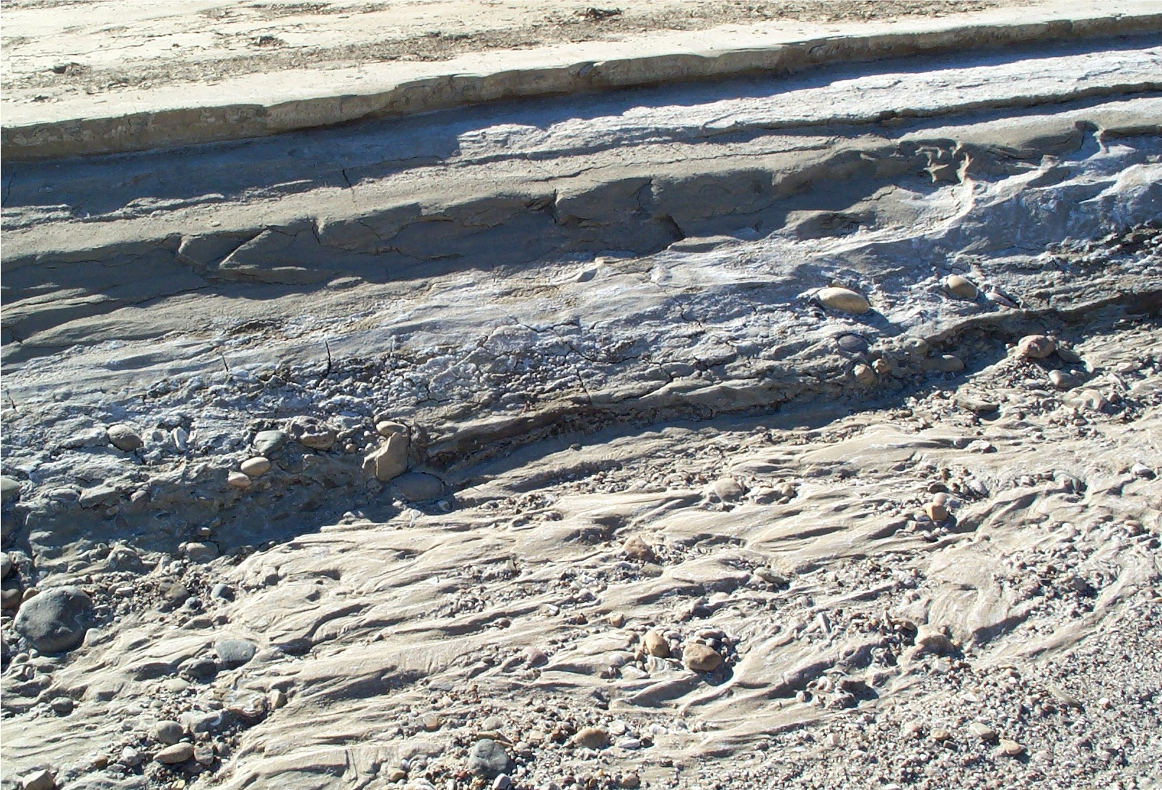
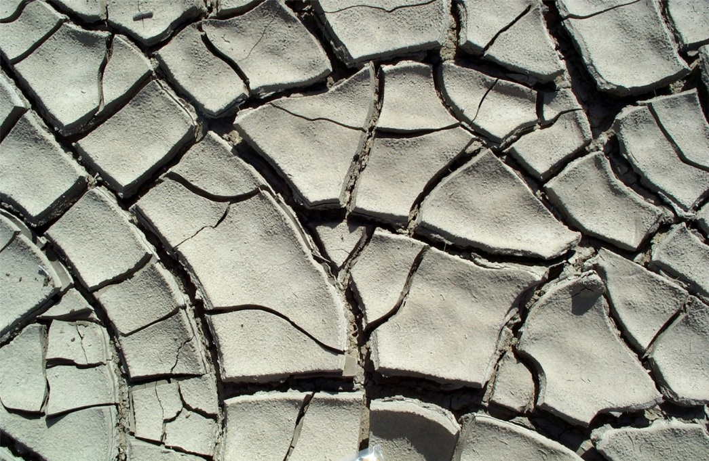
Using N¹⁵ to Trace the Past
By examining the N¹⁵ levels in lake sediments, scientists can even estimate the salmon densities of the ancient past
Notes:
Scientists examine past and even ancient salmon run densities, by looking at the amount of N¹⁵ in lake silts that have been deposited for thousands of years. In river systems with lakes, as salmon die and their carcasses are washed down stream, they would accumulate at the bottom of these lakes and then would be buried in the lake muds. By examining the lake sediments for N¹⁵ levels, they can tell how dense the salmon runs were at the time each layer of sediment was deposited. Using carbon-14 analysis or volcanic ash deposits as markers, they can determine when those layers were laid down.
These tell-tale signs of marine-derived nutrients help scientists reconstruct past salmon runs and thus help in models of ancient climate history and ecological health cycles.

Slide 7

This project was made possible in part by a grant from
Washington’s National Park Fund.

