Slide 1
Pacific Salmon
Anadromous Lifestyles

Slide 2
Define Anadromous
A fish that is born in freshwater, spends its adult life in the ocean, and then returns to freshwater to spawn.
Many, but not all, anadromous fish die shortly after spawning.
Notes:
Anadromous means a fish that is born in freshwater, heads to the ocean to spend its adult life, and then returns to freshwater to spawn. All five species of Pacific salmon die after spawning, but about 1 in 4 steelhead and cutthroat trout adults can return to the ocean for another year or two before returning to spawn again.

Slide 3
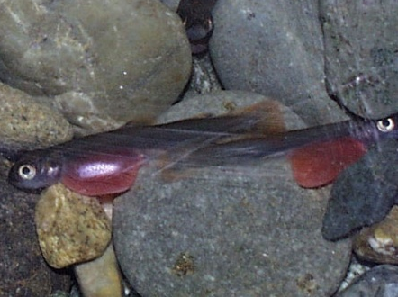
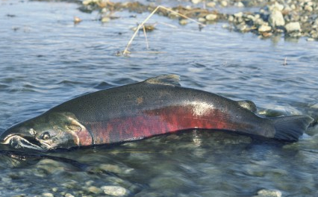
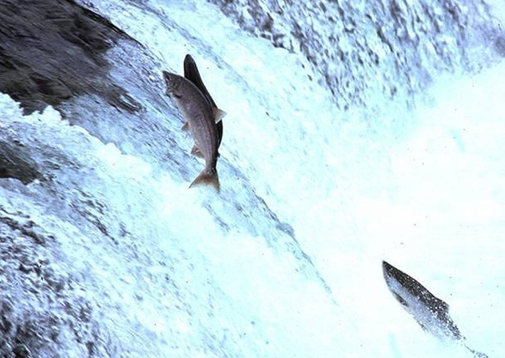
Salmon Life Histories
Eggs hatch
Head to sea
Fry will spend up to 1 year in freshwater
Alevin feed off yolk sack
Spawning in gravel
Jumping waterfalls
After spending 2-6 years at sea, salmon return to their native river
After spawning,
they die
Notes:
The generalized lifecycle of a Pacific salmon:
Salmon lay their eggs in gravel nests called redds. They then deposit sand and gravel on top of these eggs to protect them from predators and currents. The eggs hatch into tiny juvenile fish called alevin (pronounced Al-vin). These tiny fish stay in the redd and amongst the gravel, feeding on their yolk sac until they are large enough to swim efficiently and to search for their own food. Once fish are large enough to hunt for food, they become fry. While Chum and Pink fry head directly to the ocean within a few days or weeks, most other salmon fry stay in the river for up to 1-2 years, feeding on aquatic insects and invertebrates.
Once they head to sea they are called smolts, they remain in the estuary areas making the transition to salt water, then hang out in the shallows, especially eel grass beds, feeding until they are large enough to go out into the open ocean.
After 2-6 years at sea, where they feed on krill and small forage fish, they return to their native river much large than they left. Some chinook salmon can be 4 feet long and over 100 pounds.
They migrate back to the areas where they hatched and spawn.

Slide 4
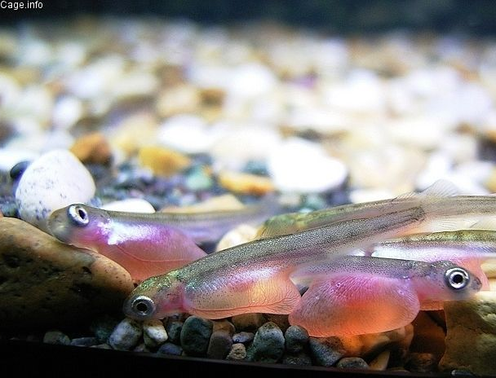
Alevin
An alevin feeds completely off the yolk sac attached to its body.
They hide under the gravel and around vegetation trying to avoid predators. They are poor swimmers, as this photo shows.
Notes:
Pronounced Al-vin, these tiny juvenile fish feed off their yolk sac which is attached to their bodies.
They hide under the gravel and around vegetation trying to avoid predators. They are poor swimmers, as this photo shows.

Slide 5
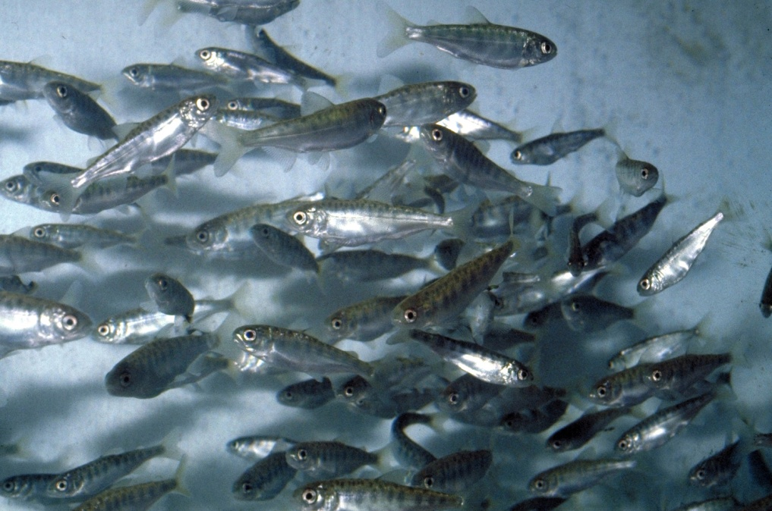
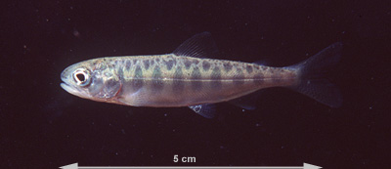
Fry
Fry are juvenile fish that are free swimmers and able to begin feeding on their own.
They eat primarily aquatic insects and zooplankton.
Depending on the species, they either head to sea immediately (Chum and Pink) or spend 1-2 years in the river.
Fry also tend to be victim to predation by larger fish such as resident trout and birds such as herons and ducks.
Notes:
Fry are juvenile fish that are free swimmers and able to begin feeding on their own.
They eat primarily aquatic insects and zooplankton.
Depending on the species, they either head to sea immediately (Chum and Pink) or spend 1-2 years in the river.
Fry also tend to be victim to predation by larger fish such as resident trout and birds such as herons and ducks.

Slide 6
Smolt
A smolt is a juvenile salmon that is preparing for the journey into salt water.
Often smolt spend some time in the estuary to physiologically adjust to salt water.
Estuaries also tend to rich in food, while providing cover from predators.
Notes:
A smolt is a juvenile salmon that is preparing for the journey into salt water.
Often smolt spend some time in the estuary to physiologically adjust to salt water.
Estuaries also tend to rich in food, while providing cover from predators.

Slide 7
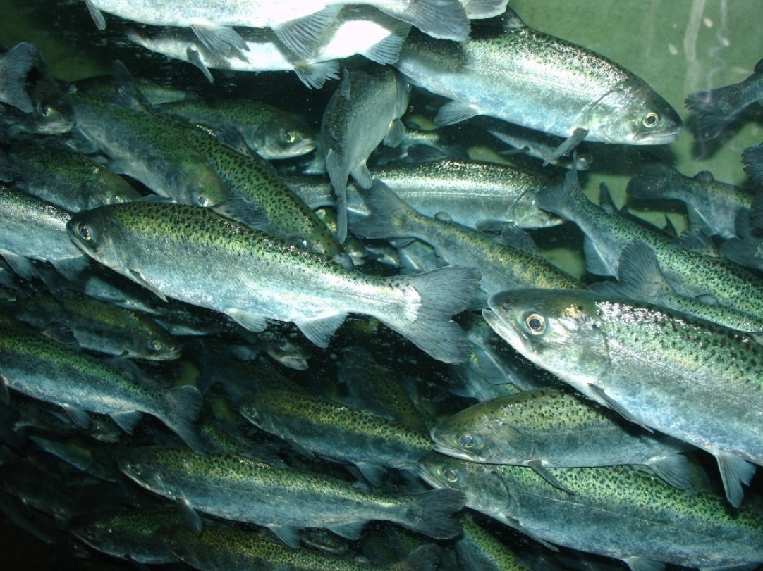
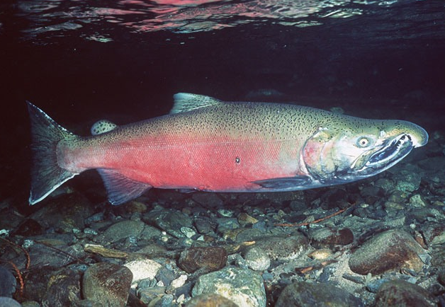
Adult Stage
Adult salmon spend 2-5 years at sea.
Depending on the species, they may head thousands of miles into the ocean or may remain within a few miles of the estuary.
They eat primarily krill and small forage fish.
Adults then return to the river where they emerged to spawn.
Notes:
Adult salmon spend 2-6 years at sea.
Depending on the species, they may head thousands of miles into the ocean or may remain within a few miles of the estuary.
Adults then return to the river where they emerged to spawn.

Slide 8
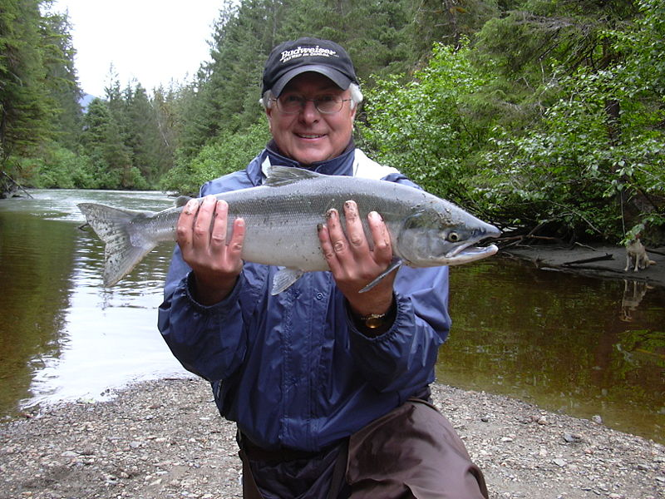
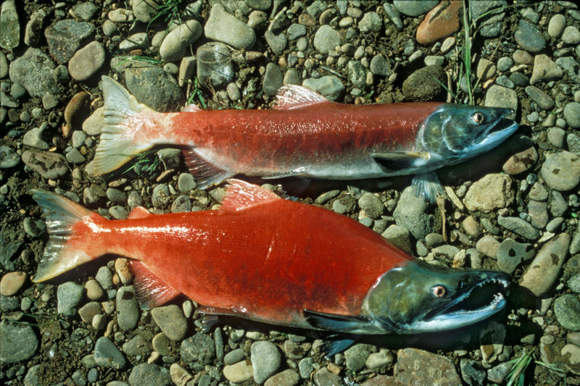
Returning Adults
These sockeye have changed to the spawning red form
Here a sockeye salmon is still in its ocean-going silver form
Notes:
When adults return to the river, they need to wait in the estuary for their bodies to physiologically adjust to freshwater again.
Because they are limited to a small area, they are susceptible to large predators such as seals and salmon sharks.
As their bodies adjust to freshwater and reproductively prepare for spawning, their bodies change shape and color. Most salmon develop large hooked beaks for territorial fighting.
The first image shows a sockeye salmon in the lower river still in its ocean-going silver form. As its body changes, it will turn a bright red color, its head turns green, and its beak hooks.

Slide 9
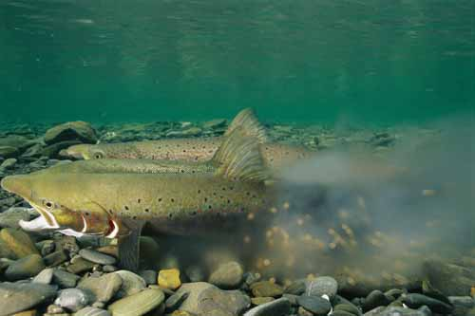
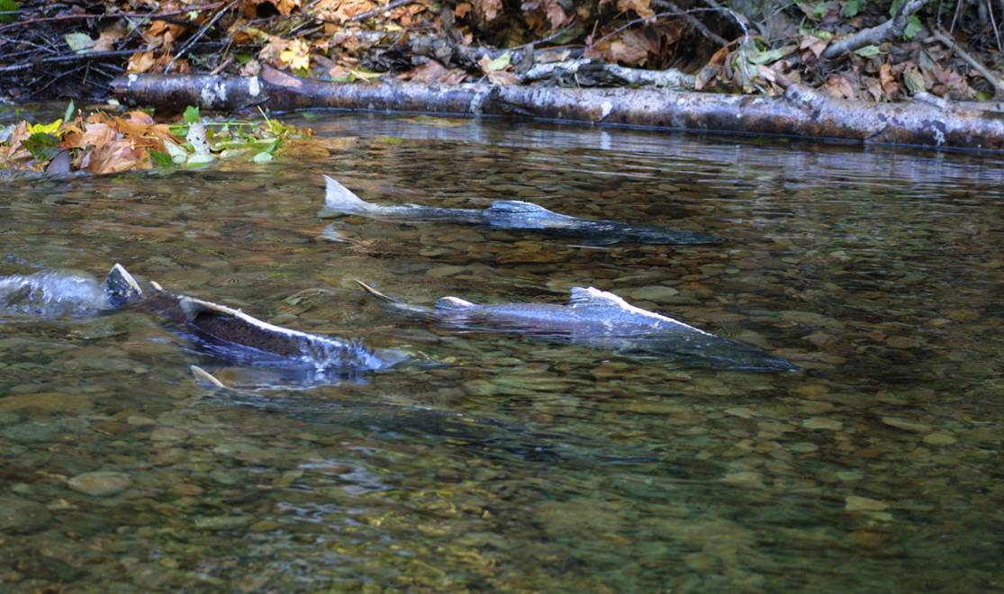
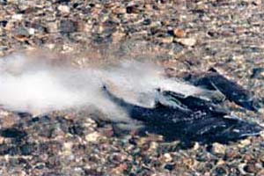
Spawning Salmon
Most salmon return to the stream where they were born.
Females dig a depression in the gravel with their tails
A male and female line up together to release sperm and eggs into the nest.
The female covers the redd with gravel using her tail.
Notes:
Most salmon return to the stream where they were born. But, some salmon stray to other tributaries or even other rivers.
Once they find the proper spawning area, the female will prepare a redd by digging in the gravel with her tail.
A male salmon will move up beside the female and as she releases her eggs, he releases his sperm.
Once the eggs are laid, the female uses her tail to cover the redd with gravel.
Sometimes other males will move in on a spawning couple to try and sneakily fertilize the eggs the female is laying. This can result in fights between males for the rights to a redd.
While most salmon may stay at sea for 3-5 years, sometimes tiny little adult males called jacks will return after just one year at sea. These fast little jacks use their small size to hide and then sneak in during the spawning of redds to fertilize the eggs themselves.
Lower panel: The image on left is a spawning chinook salmon in shallow water. The middle image and right images show spawning sockeye salmon.
Fade-in image: Although not a true salmon, Atlantic salmon have a similar anadromous life history. Here are a pair spawning.

Slide 10
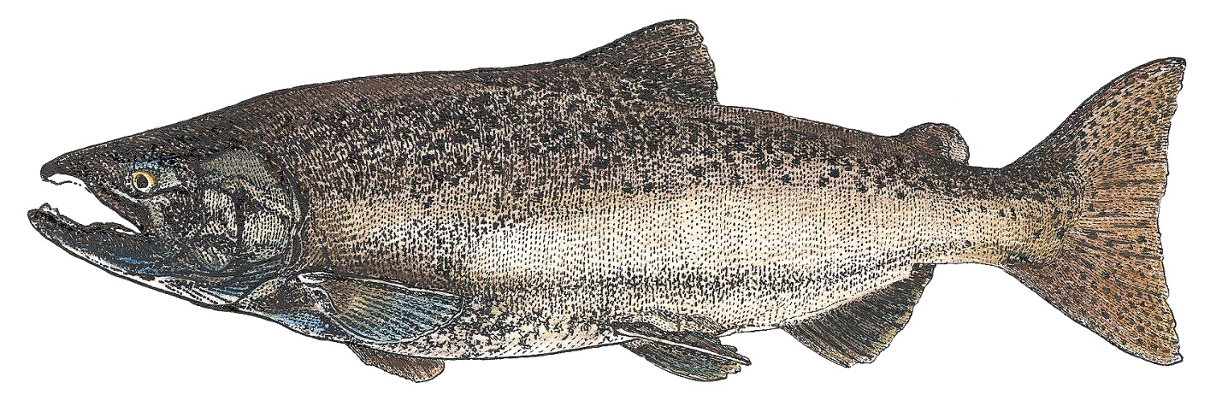
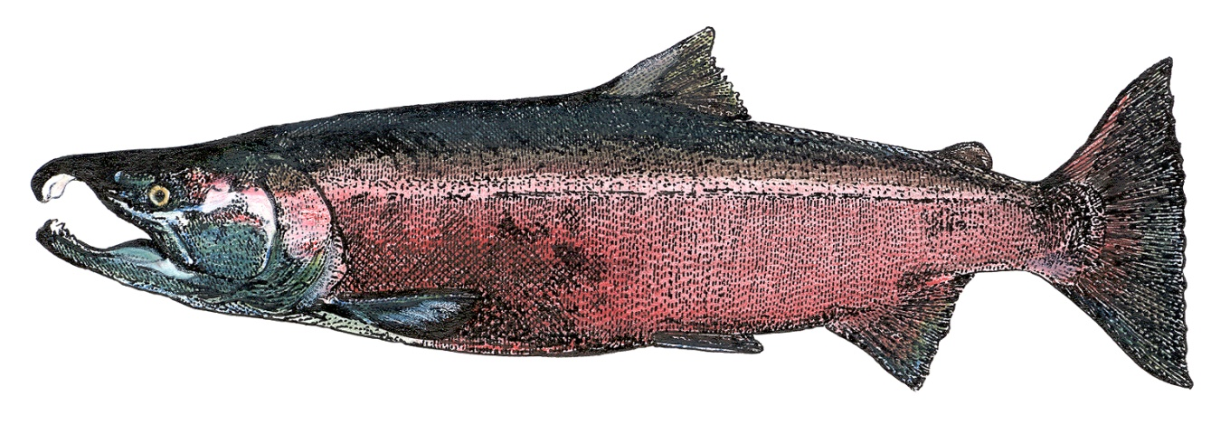
Pacific Salmon Species
Chinook
O. tsawytscha
Coho
O. kisutch

Slide 11
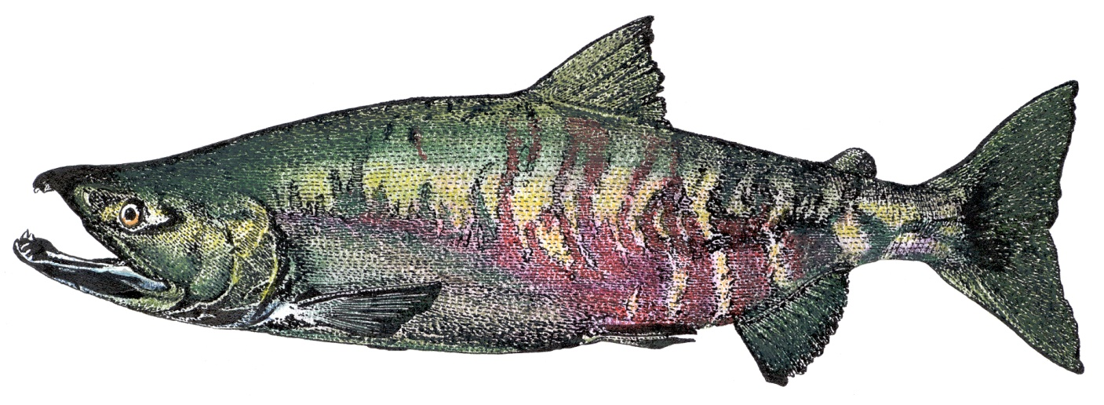
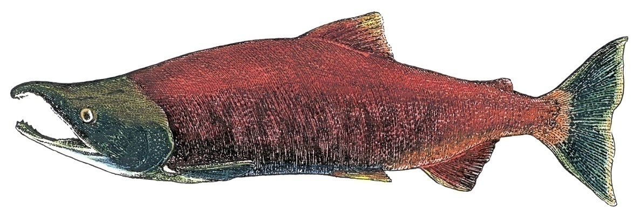
Pacific Salmon Species
Pink
O. gorbuscha
Chum
O. keta
Sockeye
O. nerka

Slide 12
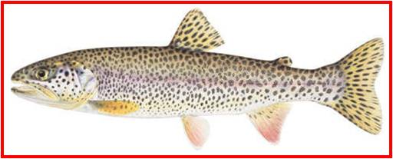
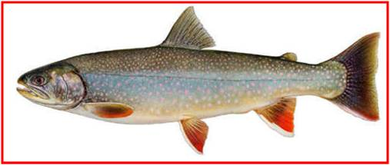
Anadromous Trout Species
Steelhead O. mykiss
Coastal Cutthroat O. clarki
Dolly Varden Salvelinus malma
Bull Trout Salvelinus confluentus

Slide 13
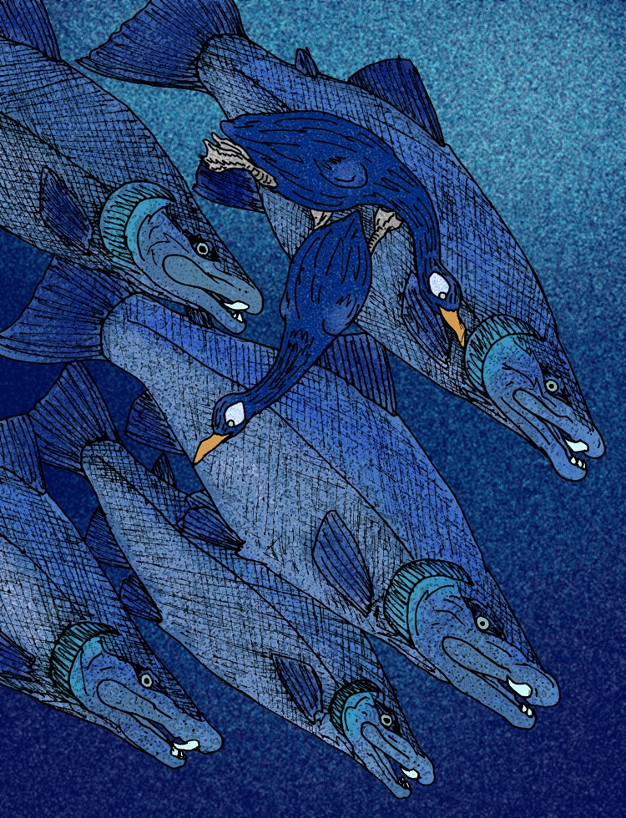
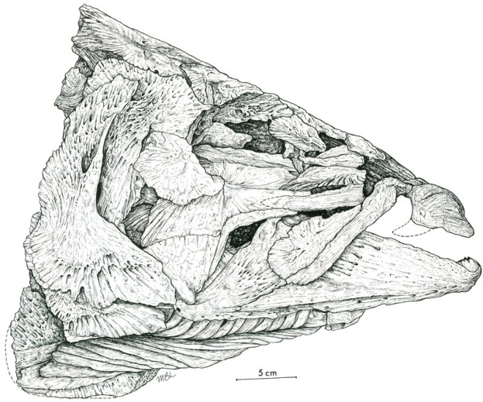
One Other Salmon…
The sabre-toothed salmon (Oncorhynchus rastrosus) lived around 6-8 million years ago, and grew over 9 feet long. As scary as they sound, they actually were filter-feeders, feeding on plankton.
Their fossils are found in an ancient Idaho lake, indicating that they were also anadromous.
Notes:
The sabre-toothed salmon (Oncorhynchus rastrosus) lived around 6-8 million years ago, and grew over 9 feet long. As scary as they sound, they actually were filter-feeders, feeding on plankton.
Their fossils are found in an ancient Idaho lake, indicating that they were also anadromous.

Slide 14
This project was made possible in part by a grant from
Washington’s National Park Fund.

