Slide 1
Salmon Farming
Great Potential
But, Not Currently the Ideal Solution

Slide 2
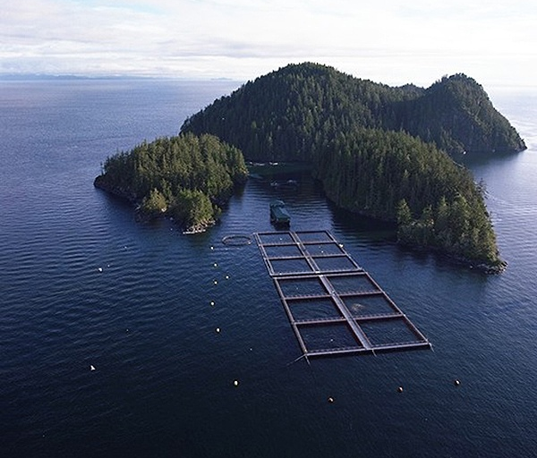
Salmon Farming
Courtesy of the BC Salmon Farmers Association
Notes:
Salmon farms are places where juvenile salmon raised in hatcheries are placed as adults into pens in marine environments for the purpose of growing them for food. Each pen can contain thousands of adult salmon, up to 25,000 per acre. They are fed fish pellets, which contain ground up forage fish, and they live in the pens until they are harvestable size.

Slide 3
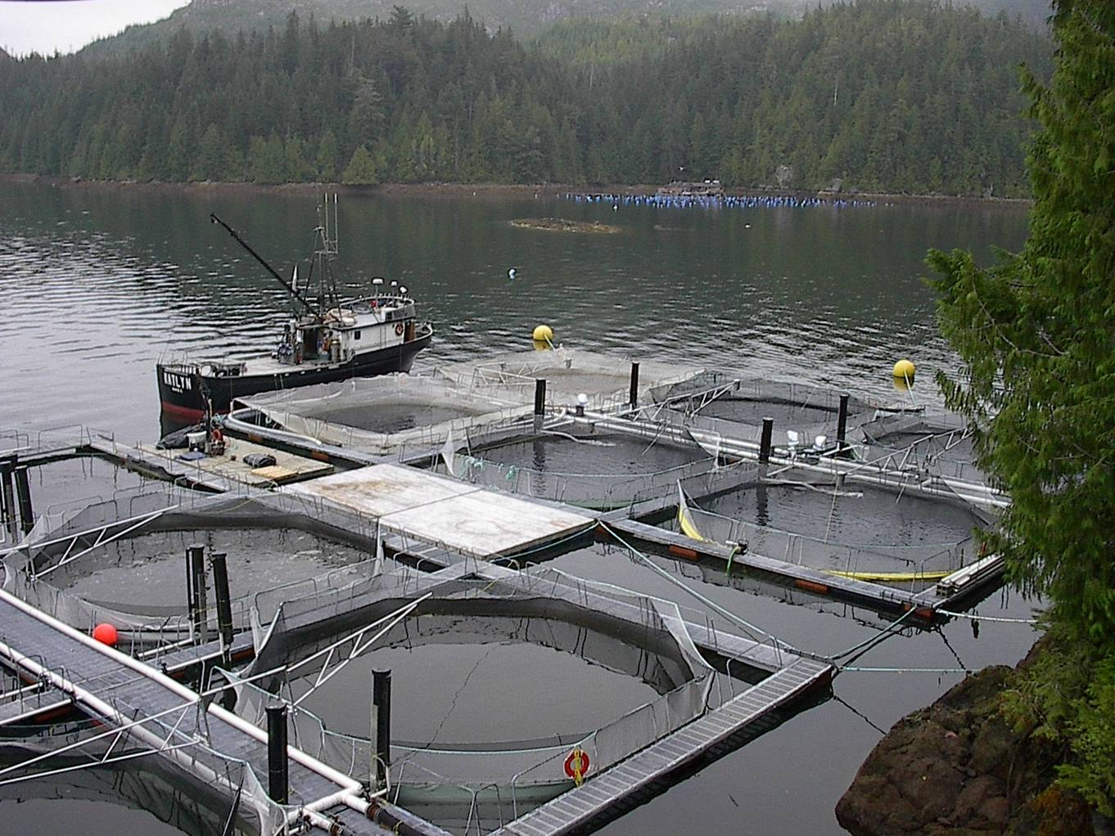
Purposes of Fish Farms
Courtesy of the BC Salmon Farmers Association
Notes:
Salmon are among the world’s most popular food fish. With the collapse of the salmon fisheries in the Pacific Northwest, New England, and much of northern Europe, there simply are not enough salmon left to supply world demand.
One advantage of farming fish (aquaculture) is that it is easy to mass produce a commodity fish. In addition, certain characteristics of those fish can be carefully controlled through selective breeding and diet. Farmed salmon tend to be larger, fattier, and taste better to some people.
With wild fisheries collapsing, but worldwide fish demand growing, the use of fish farming to supply those demand has grown dramatically. In fact, in 1980 only 9% of the world’s fish consumption was farmed, in 2006 it was 43%! In the United States, 66% of salmon consumed come from fish farms. Thus, salmon farming is one potential solution to world wide over fishing.

Slide 4
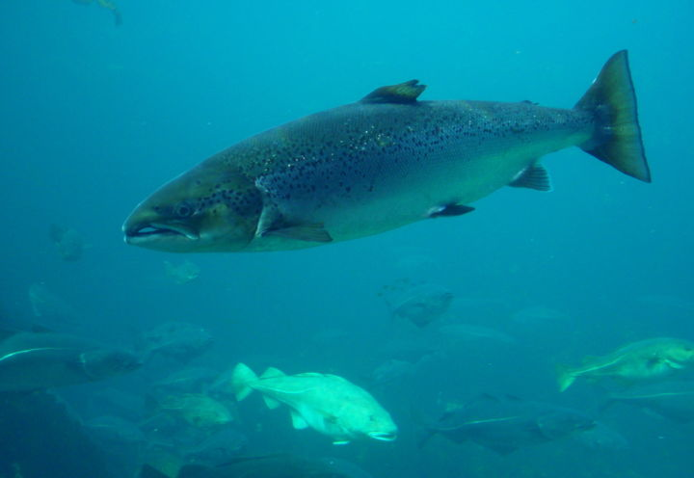
Which Species to Use?
Atlantic Salmon instead of Pacific Salmon
Notes:
Usually salmon farms use Atlantic salmon instead of Pacific salmon, even in fish farms on the Pacific coast. Atlantic salmon tend to grow faster and behaviorally are more suitable for an aquaculture operation than Pacific salmon. An Atlantic salmon in a pen is ready for harvest after 2 years, as opposed to up to 5 years for wild chinook salmon.
There are advantages and disadvantages to using Atlantic salmon on the Pacific coast over Pacific species. The advantage of using Atlantic salmon, is that they do not interbreed with Pacific species, due to being in a different genus. Thus, they are not a threat to interbreed with wild Pacific salmon and interfering with their genetics.
The disadvantages are that Atlantic salmon that escape the farms will compete with Pacific salmon for food once in the ocean and will potentially migrate up rivers and compete for spawning grounds. The establishment of naturalized populations of Atlantic salmon in west coast rivers potentially threatens the rivers ability to support wild Pacific salmon runs. There is some evidence that naturalize populations have begun to establish themselves in some British Columbia rivers.
There are several ways which farmed salmon can escape their pens. They can jump out, winter storms can damage the pens and allow them to escape, or large predators such as seals and sharks can damage the nets trying to get at the trapped prey items. A single ruptured or overturned pen can release 5,000-30,000 fish into the ocean! That is often equivalent to the entire adult run of the nearby rivers of many wild salmon species. Thus, the risks for over-competition for food resources is high.

Slide 5
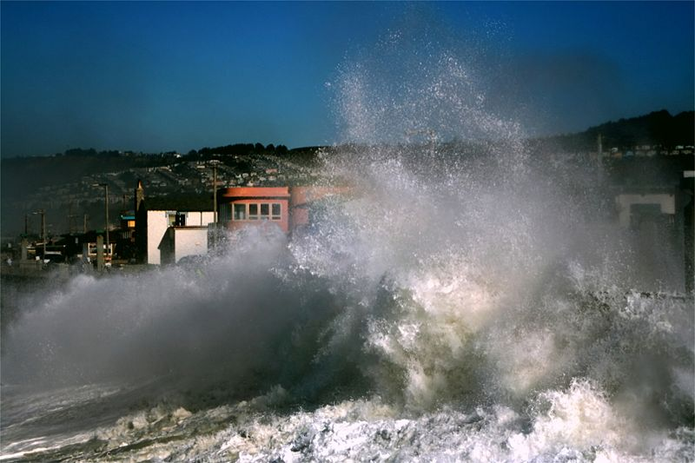
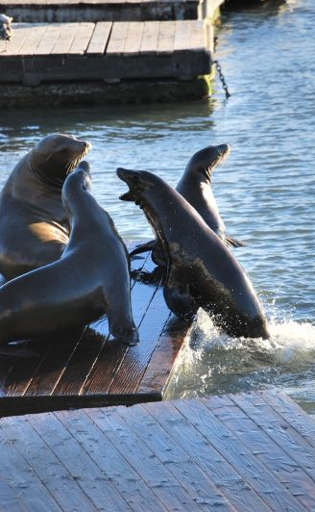
How Farmed Salmon Escape
Notes:
There are several ways which farmed salmon can escape their pens. The simplest way is that they can jump out without proper netting and control mechanisms on the pen.
However, to get large numbers of escapees, winter storms are the biggest threat because they can damage the pens or even capsize them, allowing thousands of fish to escape at once.
In addition, with so many fish in tight quarters, it is very tempting for large predators such as seals and sharks to attack the pens to get at the fish. They can damage the nets trying to get at the trapped prey items and a single ruptured or overturned pen can release between 5,000-30,000 fish into the ocean! That can often be the equivalent of an entire adult run of wild salmon into the nearby rivers. Thus, the risks for over-competition for food resources can be high for a certain area.

Slide 6
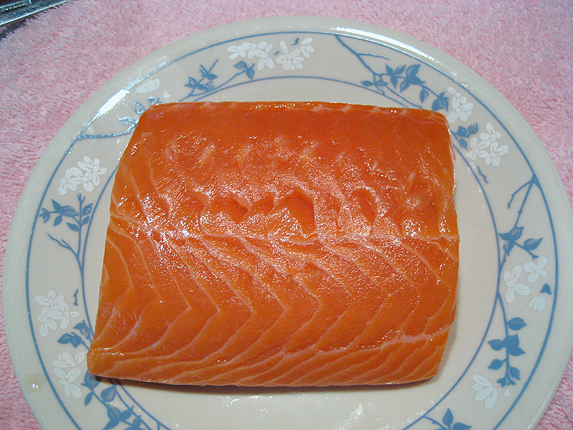
Chemical Accumulation in Farmed Salmon
By the way, wild salmon meat is pink due to the krill they eat.
Farmed salmon have grey meat.
It has to be dyed to make it marketable.
Notes:
While salmon farming potentially solves the problem of over-harvesting wild salmon populations to feed society’s demand for fish, there are several serious problems with salmon farming for human health.
Farm-raised salmon are fed concentrated pellets of fish oil meal. As higher level predators, all salmon bioaccumulate chemicals from the environment into their bodies. But, because the fish pellets that are fed to farmed salmon are so concentrated with oily forage fish and contain less quantities of lower trophic krill, and their rate of growth is so much faster than wild salmon, they have elevated levels of many chemicals in their flesh, such as PCB’s, dioxins, and DDT. PCB’s are a particular concern because of its ability to be accumulated in fish oils.
Those chemicals can also accumulate in the bay where their pens are located, as uneaten pellets, feces, and dead salmon parts drop to the bottom of the bay. This accumulation of material can lead the entire bay to have higher levels of toxins which can enter the natural food web via decomposers and scavengers and thus can even result in elevated levels of those chemicals in wild salmon which feed nearby.
Because of the health risks of these cancer-causing chemicals, it has been recommended that Americans eat farmed salmon no more than once every two months. Since wild salmon tend to have lower concentrations of dangerous chemicals, the recommended consumption rate is higher at once every 2 weeks to a month.
As for the meat color, wild salmon have pink meat, because they absorb the natural flavinoids from the krill they eat. Since farmed salmon eat pellets made of oily forage fish, they do not get those flavinoids and their meat is naturally grey. Since that makes them less marketable, their meat is dyed with special tints to look more natural (sometimes darker than natural!).

Slide 7
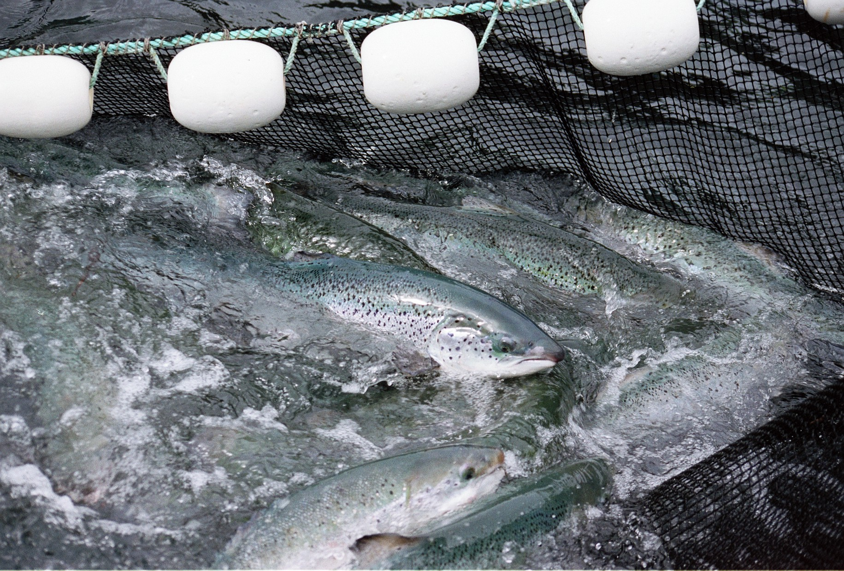
Overcrowding and Disease
Courtesy of the BC Salmon Farmers Association
Notes:
Farmed salmon are crammed into densely packed cages of up to 25,000 fish per acre. This unnatural situation allows for the perfect opportunity to spread diseases. These densely packed fish constantly bump, scrape, and bite into each other, causing sores and injuries that allow for disease spread.
There are several bacteria and viruses that affect farmed salmon. Some are natural diseases that occur in salmonids on the Pacific coast and some are introduced diseases from the North Atlantic. In order to combat the outbreak of epidemics, fish farmers will vaccinate the salmon against common diseases, but they are often forced to use antibiotics or chemical treatments to help the salmon survive the outbreaks.
It is unclear how these treatments affect the humans that eat these fish or the rest of the marine environment in which they are dumped. However, this is an area of great concern and increasing research.

Slide 8
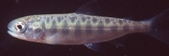

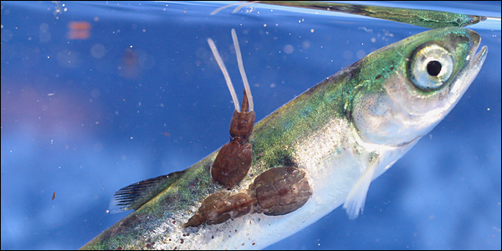
Parasites Devastate Wild Salmon
Notes:
Whenever you have animals packed into dense cages, the risk of diseases and parasite epidemics increases dramatically. A parasite called sea lice (actually a copepod) has caused major problems for fish farms. While adult salmon can tolerate quite a few sea lice attached to them, juvenile salmon can be killed by just one or two being attached.
Thus, when salmon farms are built right at the mouths of rivers, tiny juvenile wild salmon must “run the gauntlet” to get from the river to the open ocean, by navigating around the fish pens. Rather than just a few sea lice floating around looking for a host, in areas near fish-farms the sea is literally filled with thousands or millions of sea lice. The chances of a juvenile pink salmon will escape the area without a parasite is virtually zero. It is estimated that some 98% of juvenile pink salmon are killed by sea lice in some of the rivers near fish farms!

Slide 9
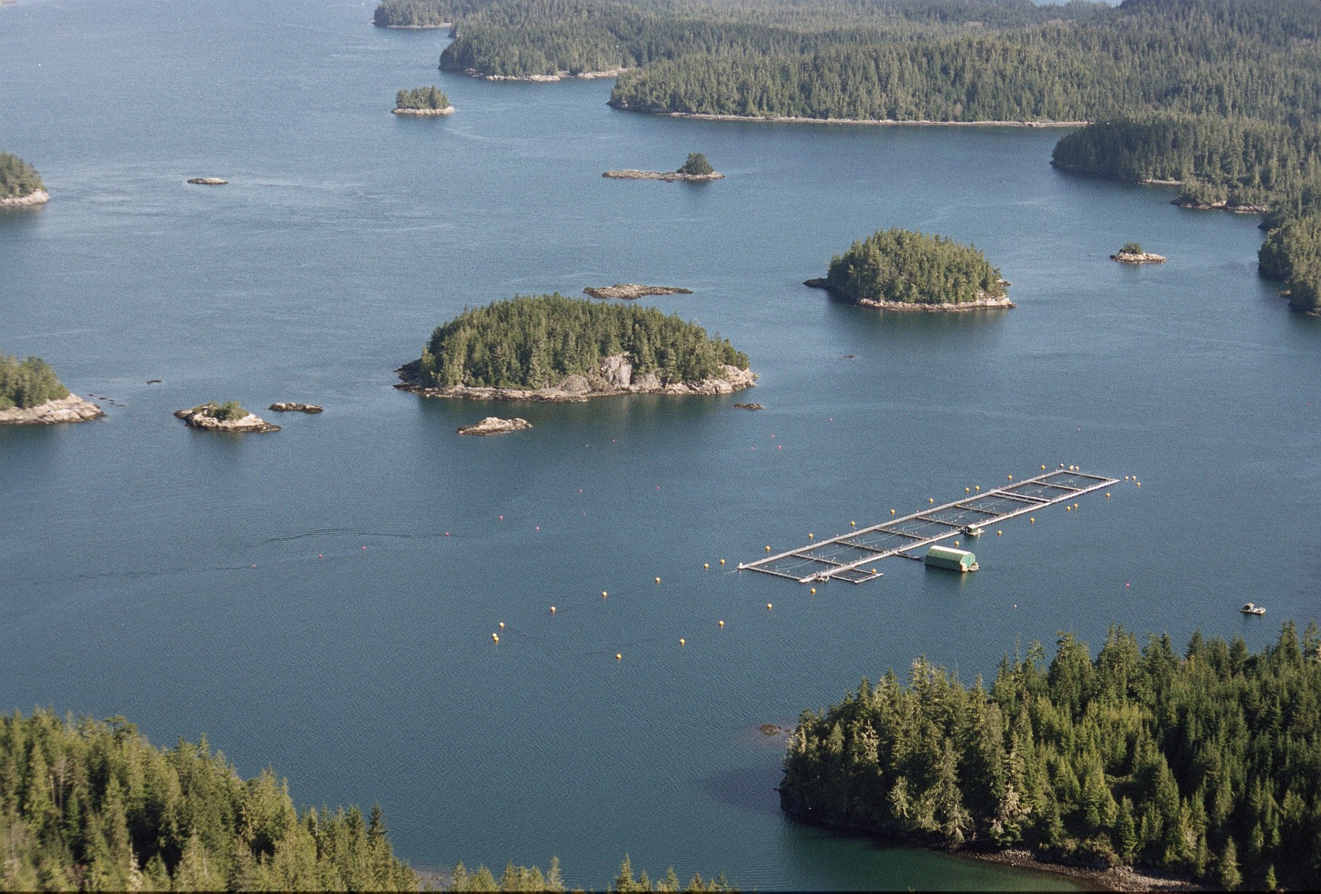
Typical Fish Farm Location
Courtesy of the BC Salmon Farmers Association
Notes:
The vast majority of salmon farms on the west coast of North America are in British Columbia (currently 121 farms). British Columbia has an extensive sheltered coastline, with few people or urban centers. This is ideal for salmon farming because the islands, inlets, and coves protect the pens from stormy seas. But, these are the same features that juvenile salmon seek before they are large enough to enter the open ocean.
There are a few salmon farms in Washington (only 9), but because of the odor they produce due to tons of rotting food, they are not well liked in the more densely population Puget Sound. There are no salmon farms in Oregon or California, mostly due to the open-ocean coastline of those states and thus the risks of storm damage.
Salmon farms are common in the Martime provinces of Canada, in Scotland, Iceland, Norway, and Chile.

Slide 10
Alaska Bans Fish Farms
Escapees compete for food with native salmon
Atlantic salmon in-river competition for spawning ground and risks of them developing self-sustaining populations.
Farming lowers salmon prices, hurting Alaska fishermen.
Lower salmon prices, means higher wild catches to make the same income, which threatens wild salmon runs.
Notes:
Alaska has a law banning salmon farms because they are worried about the risks of these farms to their still abundant and economically important wild salmon runs. The reasons though, go beyond just the threats of escaped Atlantic salmon competing with wild runs. In fact, given the size of the Alaska runs (who’s populations have not been decimated to the degree that the Washington, Oregon, and California populations have due to urbanization, dams, and agriculture), it is unlikely that Atlantic salmon could successful compete.
One of the biggest reasons Alaska bans fish farms is that mass production of farmed salmon lowers overall salmon prices worldwide, due to the increased supply to meet demand. Lower salmon prices means less income for Alaskan fishermen and it requires them to catch more wild salmon to make a living. Thus, either fishermen suffer economically or wild salmon runs have to be depleted further by overharvesting.
The risk is that salmon farming, rather than helping wild salmon runs, may actually lead to their overfishing and collapse is because lower prices means high catch totals to make the same income.
A study conducted by the World Wildlife Fund and the Atlantic Salmon Federation examined the salmon farming practices of several countries and found that Canada ranked last out of the countries they examined (Norway, Iceland, Scotland, Ireland and the United States) in terms of salmon farming practices and regulations.

Slide 11
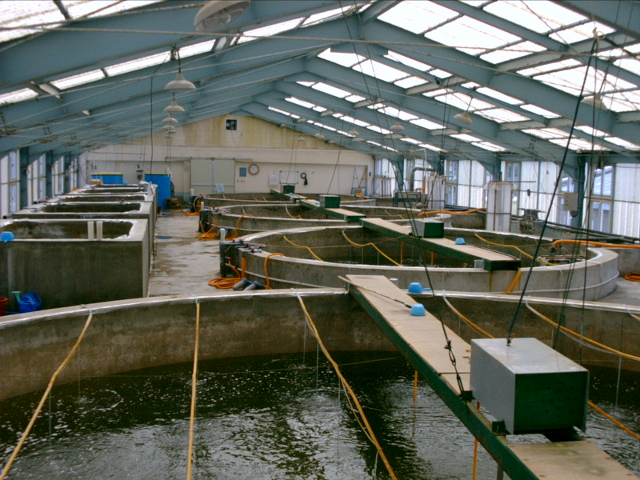
Potential Solutions?
Closed-Tank Fish Farms
Notes:
A self-contained fish farm seems like a potential solution to some of these problems. If, rather than having floating pens with open tops, that release their waste and chemicals into the ocean, and can release thousands of non-native fish into the sea with a bad storm or a torn net, why not have everything done on land in a controlled environment.
While more expensive to set up, this solution is done with other fish species, particularly catfish, tilapia, and trout. Self-contained farms would not risk fish escapements to the ocean. The sewage and waste from the operation would not drop to the bottom of the bay and affect the ecosystem, but rather it would be gathered and disposed up in a controlled manner. In some cases, with more limited chemical contamination, it could be used for composting or fertilizer on land.
Disease outbreaks would be easier to control, since fish could be isolated in smaller tanks. There is also no risk of the fish getting diseases or parasites from the outside ocean environment. It also eliminates the risk of predator losses by seals, sharks, and sea birds.
Water can also be filtered and recirculated within the system, eliminating the need to build site-specific facilities based on ocean currents and sheltered coves. But, if built near the sea, the source of cold salt water would be easily obtained.
Some experiments are being done with closed-tanks that are suspended in the marine waters to allow for natural temperature control.
The major disadvantages of the closed-tank farms in addition to initial equipment costs is that they are more expensive to operate, particularly to run the pumps and filtration systems necessary to keep water quality and waste disposal at acceptable levels.
But, self-contained fish farms have the potential to greatly relieve the pressure on wild fisheries stocks and to allow the collapsed stocks to return, while still meeting the growing worldwide demand for fish products.

Slide 12

This project was made possible in part by a grant from
Washington’s National Park Fund.

